Slide 1
LOGIN
ABOUT
produswap.org
Swap homegrown produce with your neighbors.
ENTER ZIP CODE HERE
SUBMIT

Slide 2
produswap.org
WELCOME ANDREW
HOME
ABOUT
MY PROFILE
new post
my posts
my messages
posts for 93010:
username post date summary
agonzalez27 10/25/2016 I will swap oranges for view post
avocados, tomatoes,
or squash.
Kwood28 10/25/2016 I will swap strawberries view post
for avocados, tomatoes,
or oranges.
mwong50 10/24/2016 I will swap strawberries view post
for avocados, tomatoes,
or oranges.

Slide 3
LOGIN
produswap.org
WELCOME
ABOUT
USERNAME
Showing results for 93010:
PASSWORD
username user rating summary
SUBMIT
agonzalez27 4.5/5 Stars/5 swaps I will swap oranges for view post
avocados, tomatoes,
or squash.
Forgot password?
Kwood28 5/5 Stars/20 swaps I will swap strawberries view post
for avocados, tomatoes,
or oranges.
REGISTER
USERNAME
mwong50 4.5/5 Stars/100 swaps I will swap strawberries view post
for avocados, tomatoes,
or oranges.
EMAIL
PASSWORD
PASSWORD CONFIRMATION
SUBMIT

Slide 4
RULES OF PRODUSWAPPING
produswap.org
WELCOME
ABOUT
Showing results for 93010:
I will only swap produce I grew myself.
I will not use any potentially harmful chemicals on my produce.
I will only swap high quality produce.
I will be kind in my messages and during swaps.
I will be honest and fair in my user & produce reviews.
I will schedule swaps at well lit and open spaces (shopping centers, malls, etc..)
I will not exchange currency for produce. I will only barter like for like.
username user rating summary
agonzalez27 4.5/5 Stars/5 swaps I will swap oranges for view post
avocados, tomatoes,
or squash.
Kwood28 5/5 Stars/20 swaps I will swap strawberries view post
for avocados, tomatoes,
or oranges.
mwong50 4.5/5 Stars/100 swaps I will swap strawberries view post
for avocados, tomatoes,
or oranges.
Click on the box if you agree to abide by the rules
SUBMIT

Slide 5
Post by agonzalez27:
10/25/2016
I will swap 10 oranges for 4 avocados, 3 tomatoes, or 2 squash. I’m usually available to swap after 5:00pm and my preferred location is the old Albertsons parking lot off las Posas in front of SBUX. Message me if your’re interested!
Message User

Slide 6
Post by agonzalez27:
10/25/2016
5:00pm
I will swap 10 oranges for 4 avocados, 3 tomatoes, or 2 squash. I’m usually available to swap after 5:00pm and my preferred location is the old Albertsons parking lot off las Posas in front of SBUX. Message me if your’re interested!
Message by kwood28 10/25/2016 5:05pm:
I’ve got 4 avocados! Can we meet tonight at 5pm?
Thanks!
Submit

Slide 7
produswap.org
WELCOME ANDREW
HOME
ABOUT
MY PROFILE
new post
posts for 93010
my messages
my posts:
username post date summary
agonzalez27 10/25/2016 I will swap oranges for view post
avocados, tomatoes,
or squash.
agonzalez27 10/10/2016 I will swap oranges for view post
tomatoes!
agonzalez27 10/1/2016 I will swap oranges for view post
pumpkins.

Slide 8
produswap.org
WELCOME ANDREW
HOME
ABOUT
MY PROFILE
new post
posts for 93010
my posts
my messages:
message date message time message to message from
10/25/2016 5:01pm kwood28 view message
10/24/2016 5:08pm kwood28 view message
10/23/2016 5:10pm mwong50 view message

Slide 9
Rate Swap
True False
Swapper was on time.
Swapper was kind.
Produce was high quality.
I had an overall great experience with swapper

Slide 10
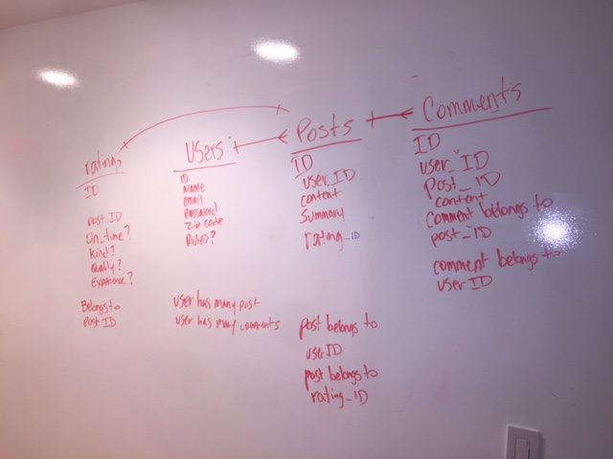

Slide 11
Users
ID
first_name
last_name
Email
Password
Zip Code
Rules?
username
has_many :posts
has_many :replies
has_many :messages
Posts
ID
User_ID
Content
Summary
has_many :messages
belongs_to :user
Messages
ID
User_ID
Post_ID
Content
Recipient_ID:int
belongs_to :post
belongs_to :user
has_many :replies
Replies
ID
User_ID
Message_ID
Content
belongs_to :message
Belongs_to :user

Slide 12
Routes
resources :users do
resources :posts do
resources :messages
end
end
end

