Slide 1
Need-finding
Mixed Reality

Slide 2
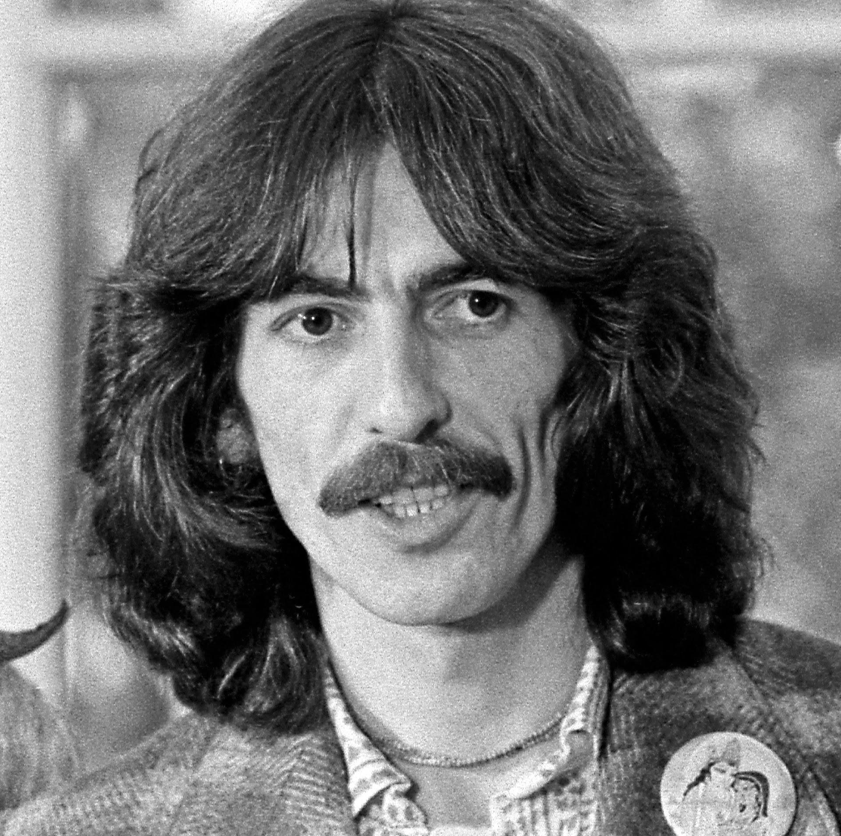

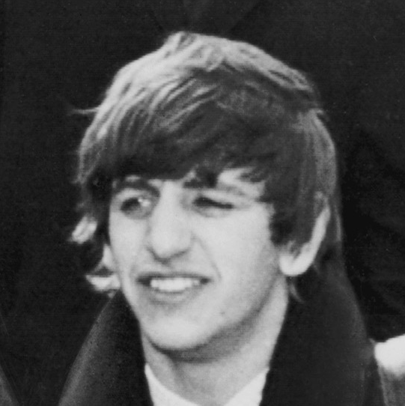
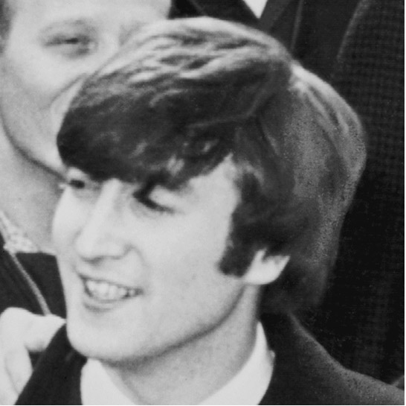
Team members
Exclusive photos from the team’s archive
Abdallah Abuhashem
Ammar Alqatari
Alejandrina Gonzalez Reyes
Ahmed Shuaibi

Slide 3
Problem
Education + Accessibility
Notes:
Started out as education but then shifted to accessibility as we interviewed more people, after realizing how the digital space and technology can really help the differently abled both in the classroom and in their social lives.

Slide 4
Need-Finding Methodology
Users | Non-Users
Professors Differently-abled Students | Educational experts Student peers Industry experts
Notes:
We made sure to pick a diverse range of interviewees and picking both users and non-users

Slide 5
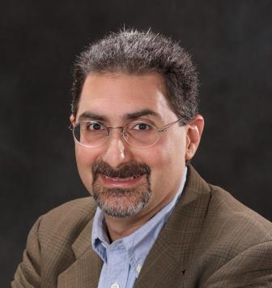
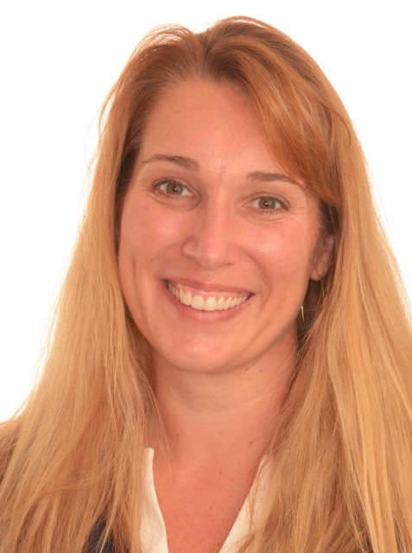
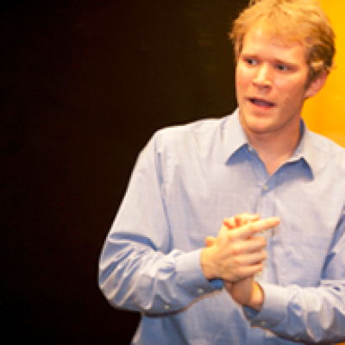
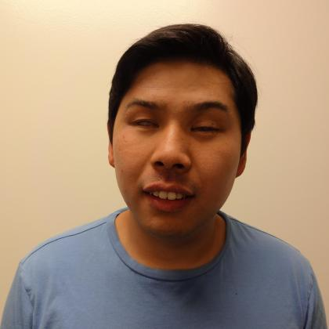
Who To Interview?
Education Experts - Professors
Industry Experts
Mehran Sahami
Computer Science Professor at Stanford
Christopher Proctor
Previous High School and Middle School Teacher.
Current PhD student in Learning Sciences Technology and Design
Sarah Herrlinger
Senior Manager, Global Accessibility Policy & Initiatives, Apple
Michael Chang
Computer Science Lecturer at Stanford and a previous Stanford student

Slide 6
Who To Interview?
Zina Jawadi - A Stanford student with pre-lingual hearing loss and a leader of accessibility organizations on- and off-campus
Mohannad Silwadi - Pursuing a bachelor’s in Biology at San Jose State
Ayman Ibrahim - Pursuing a Masters in Mathematics at UC Berkeley

Slide 7
Some of the Questions Asked
How do you study/learn outside of the classroom?
What is the hardest part of studying?
Tell me a story of one of the worst experiences you have had preparing for an exam.
(With disability) What is the most difficult aspect of studying for you personally?
What is the most boring thing about studying? Could you tell me a story about the most cumbersome/annoying time you had reviewing/preparing for an exam?
Was the learning part in class or outside the class harder? Why?

Slide 8

Interview Results

Slide 9
Tensions
“I like hearing people’s sounds and laughter -- and you can’t do that with the FM system” - Zina “Captions don’t have note or connotations” - Zina “Professors don’t understand how to deal with disabled students” - Zina “I didn’t want to take my laptop to class… which meant not taking notes” - Michael “[Charter schools graduates] ends up in college, and they look around, they don’t see anybody anywhere who’s ever been in a neighbourhood like the one they grew up in” -Chris

Slide 10

Surprises
“Education is not only about delivering facts, it’s also about the social and cultural side and we should focus on that” - Christopher Proctor
“I couldn’t for the life of my time find an accessible PDF viewer” -Michael

Slide 11
Contradictions
Is the problem about making delivery easier, or a positive digital atmosphere?
“You should focus on solving the issue for a specific need” said Mehran, but later he said “What you might come up with probably will help people beyond these with disability”
Michael mentioned that he didn’t like “Formal Processing” through OAE, but contacting professors directly wasn’t good for other students also
Notes:
Which is tougher for a student with disability, learning in the classroom or taking part in the social and cultural sphere of the school outside of class

Slide 12

Analysis

Slide 13
Empathy Map
Say Condensing notes to study Whispering professors Inside class is a bigger problem Searching the web was a pain Private schools have bad accessibility Can’t hear people laughing Note taking Social struggle I had to teach the teachers teach me | Think Note taking is cumbersome Too much effort to get available resources Teachers has an important role Technology indeed has a potential Needing a hacky way to do things normally
Do Made unsure gestures/ annoyed looking faces Fluent Hinching Pausing constantly to think Hesitation Checking phone | Feel Felt annoyed Awkward Interested Uncomfortable Disadvantaged Adapted Embarrased

Slide 14
Needs
The need for those with disabilities to develop a comfortable social sphere.
The need for those with physical disabilities to feel less embarrassed
The need for those without these disabilities to understand and empathize with those who do
Insights
Many felt dissatisfied at the state of accessibility in education for the disabled and clearly displayed their frustration.
Many thought that technology will play a role in solving big part of the issue
Questions
There are a variety of ways to approach our issue; Should we tackle it in the manner of bettering the social sphere of the disabled, or focus on the remaining non-disabled community and find ways allow them to empathize with the disabled.

Slide 15
Summary
Accessibility of education to those with disabilities is available, yet lacking.
Making it accessible is a challenge for the disabled and difficult for professors to do.
For those with physical disabilities, learning and developing a social sphere are unnaturally difficult.

