Slide 1
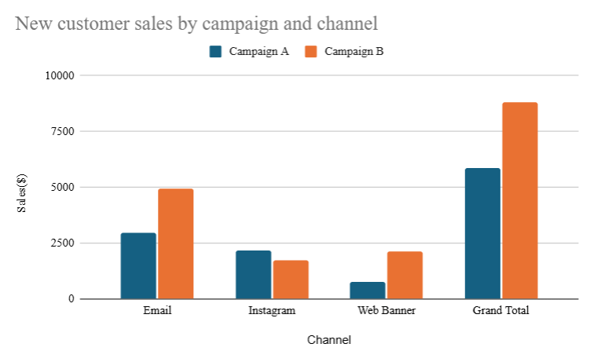
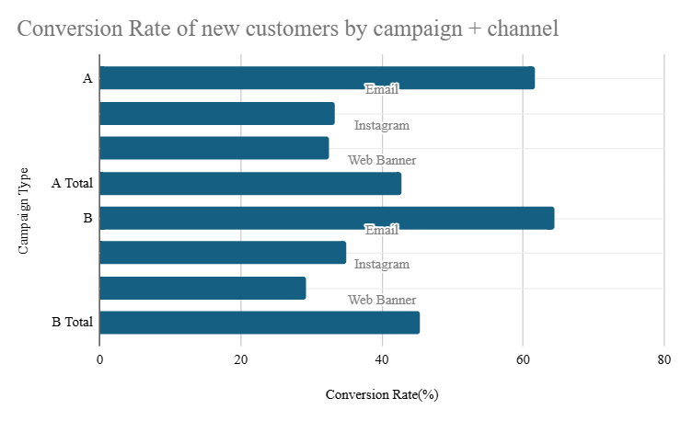
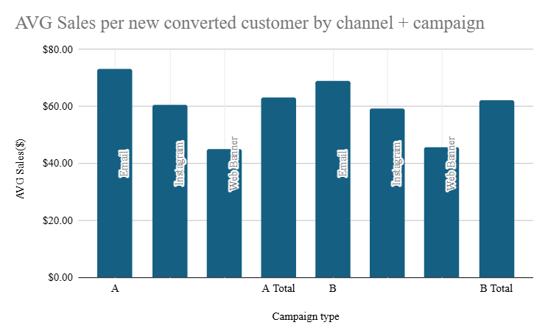
Campaign & Channel Performance Analysis Findings
Conversion Rate of new customers by campaign + channel
AVG Sales per new converted customer by channel + campaign
New customer sales by campaign and channel
Recommendation:
Double down on Email across both campaigns — it delivers the strongest combination of new‑customer volume, conversion efficiency, and revenue per conversion.
• The highest conversion rates (50-60%)
• Strong average sales per converted new customer

