Slide 1
COMP 2930 – AJAX-NodeJS

Slide 2
Outline
Review
AJAX

Slide 3
Ajax (Asynchronous JavaScript and XML)

Slide 4
AJAX
JavaScript runs in user’s browser, thus can handle clicks on buttons, event listening and other dynamic operations on HTML Dynamic Object Models (DOM) but has no access to server’s database.
NodeJS runs in server and thus cannot handle user clicks on buttons etc but can perform database operations. With NodeJS we can Create Read, Update or even Delete (CRUD) data from database.

Slide 5
 | JS |  | Node
Browser Operations | User’s clicks on buttons, playing animations, moving a button to random locations |  | Cannot do those
Database operations | JS Cannot do those |  | Create, Read, Update, Delete database. Modify server files. Encryption etc
PHP:
How to communicate?

Slide 6
One way of establishing communication between JavaScript on the browser and PHP/Node on the server is via sending AJAX requests

Slide 7
But because processing our requests by server can take time, we usually make our AJAX requests asynchronously!

Slide 8
Asynchronous AJAX requests means:
The bowers sends an AJAX call to server and does not wait for response.
It just moves on with executing the rest of JavaScript code
(before sending the request) browser specifies a callback function to handle the response once arrived

Slide 9
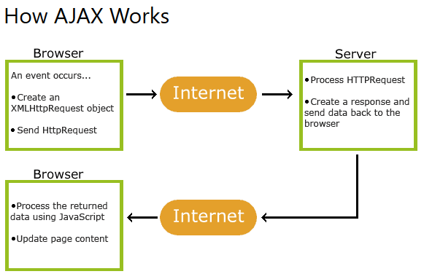
AJAX allows sending request to server
https://www.w3schools.com/xml/ajax_xmlhttprequest_create.asp

Slide 10
Here is how we do it :
1- Create an XMLHttpRequest Object:
( just like the way we created Date object)
let xhttp = new XMLHttpRequest();
2- Open AJAX request
xhttp.open(method, url, Async or sync);
Method type could be GET or POST etc
url is the url of the file we want to handle our request

Slide 11
Here is how we do it :
3- specify the function that handles response :
xhttp.onreadystatechange = function () {
if (this.readyState == 4 && this.status == 200) {
document.getElementById("demo").innerHTML =
this.responseText;
}
};
status of the XMLHttpRequest:
0: request not initialized 1: server connection established 2: request received 3: processing request 4: request finished and response is ready
http response type:
200: "OK" 403: "Forbidden" 404: "Not Found“ etc

Slide 12
So what else is left?
Everything is in place! We just send it and carry on …
xhttp.send();

Slide 13
Demo 1 sending AJAX call without any arguments ! (files uploaded onto D2L)

Slide 14
Demo 2 sending AJAX call with passing arguments ! (files uploaded onto D2L)

Slide 15
Using url built-in module to pars parameters
let url = require('url');
let adr = 'http://localhost:8888/default.htm?name=John&age=23';
let q = url.parse(adr, true);
console.log(q.host); //returns 'localhost:8888'
console.log(q.pathname); //returns '/default.htm'
console.log(q.search); //returns '?name=John&age=23'
let qdata = q.query; //returns an object: { name: John, age: 23 }
console.log(qdata.name); //returns 'John'

Slide 16
POST vs GET

Slide 17
More on Ajax calls… GET or post?
Q: Why do we need AJAX calls?
GET:
Query string (name/value pairs) is sent in the URL of a GET request:
/test/..?name1=value1&name2=value2
POST:
Query string (name/value pairs) is sent in the HTTP message body of a POST request:
POST /test/… HTTP/1.1 Host: myWebsite.com name1=value1&name2=value2

Slide 18
GET vs POST
GET requests remain in the browser history
GET requests can be bookmarked (Q: why?)
GET requests should never be used when dealing with sensitive data(Q:why?)
GET requests have length restrictions
GET requests “should” be used only to retrieve data
POST requests are never cached (Q: what does “cached” mean?)
POST requests do not remain in the browser history
POST requests cannot be bookmarked
POST requests have no restrictions on data length

Slide 19
How to host your project!
HTML, JavaScript, CSS
PHP, Node files
databases

Slide 20
Choosing the right hosting plan!
Domain Name Registrars:
Gdaddy, Name.com, Register.com, networksolutions.com, …
Hosting:
Godaddy, Gear.host, ixwebhosting.com, ipower.com, 1and1.ca, somee.com, hostgator.com, digitalocean (good for VPS), GlowHost, Heroku: Cloud Application Platform, Microsoft Azure (free for student ), Digital Ocean
Comparing shared Linux hosting plans (for PHP and MySQL ) on few of Canadian data centres
As of Oct 10th | hostpapa | glowhost | canadianwebhosting
money‑back guarantee | 30 days | 91 days | 60 days
Free SSL (for facebook login) | Only on business pro | Free provide SSL | only on enhanced
Customer service
Uptime
Price |  | Search net for (50% off) coupon
CPanel

Slide 21
DB

Slide 22
DB
With our AJAX calls JavaScript can communicate with server-side scripts like PHP or Node.
Now we might want to fetch data from DB to display contents on the user’s browser.
Remember the browser only understands JavaScript and JavaScript runs in the browser of the user. Thus has no access to DB of the DB server. Only server-side languages like PHP or Node can directly talk to DB.
Steps
1- JavaScript asks nodeJS to connect DB and fetch some data
2- PHP/NodeJS fetches data from DB and returns it to JS.
JS receives data and displays it

