Slide 1
Exchange Simulator
Financial Service Computing

Slide 2
Content
Use Case
Structure
Matching Algorithm
Requirements

Slide 3
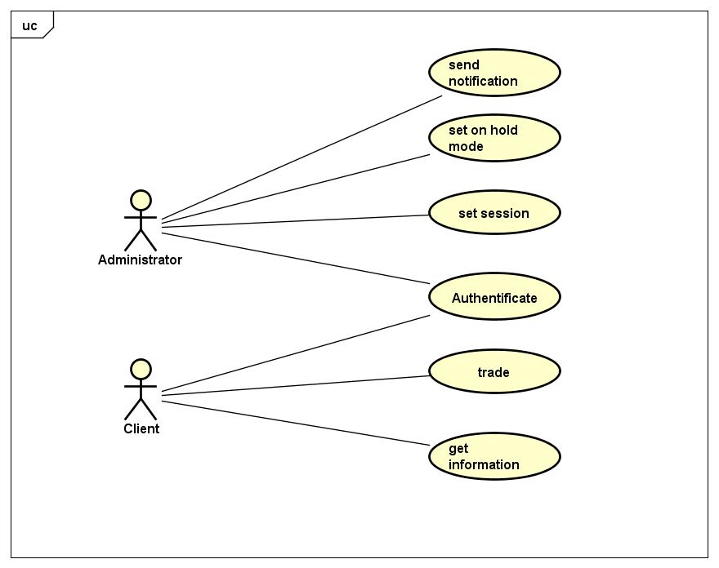
Use Case

Slide 4
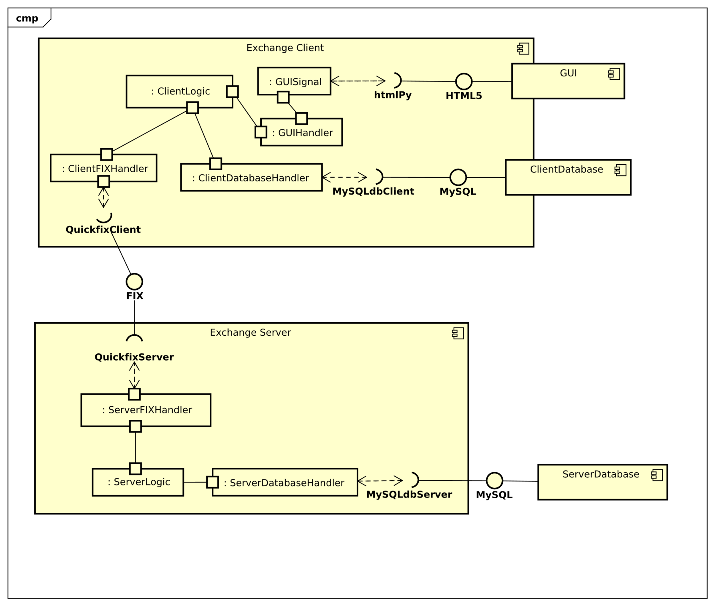
Structure

Slide 5
Matching Algorithm
Pro Rata Algorithm
Considers the percentage one holds of the total amount of shares
Weighted according to time

Slide 6
Matching Algorithm
Input: two lists; buyer and seller
Outputs a matrix buyer x seller
Contains the shares which are traded

Slide 7
Functional Requirements
Order
Execution
Stock universe
Lot size
Tick size
Trading schedule
Matching mechanisms
Stock data publishing
Order and execution reporting
Exchange members

Slide 8
Functional Requirements
Preload a universe of well defined stocks
Publish tradable stock list to members
System must have rules to ensure that orders will not be over executed, should be within price range of the original order.
All transaction records must be kept for future query.
Calculate open price accurately.
Has knowledge of the price of stock got executed last time, last trading day’s close price of each stock

Slide 9
Functional Requirements
Accept orders with price in proper range, which means 10% away from last price. Reject the rest orders with reason
Accept orders with notional value in proper range, which means within 20% of total tradable value of the target stock
Accept orders during auction, normal trading session. Reject orders after close, before open.
All communications should based on FIX4.2
Trading schedule should be configurable. For example, auction could start from 11:00am when required

Slide 10
Non-functional Requirements
Scalability: have multiple instances of the system running, sharing each other’s work load
System must have authentication and authorization mechanism, administrator and operator have different permission to view the order books.
When system goes down un-expectantly (process crash, machine failure, lose of power), after restart it needs to remember current order book details.
Has GUI tool could switch stocks to “on hold” mode , means not tradable, publish “on hold” message to exchange members, and switch back to normal trading mode. This function should limited to “administrator”.
Provide “stop execution” function.
Provide “special auction” function for specific stocks when buy or sell pressure is unbalanced, with breach of price limit.
Provide pre-defined stock universe data publish based on request

Slide 11
Do you have any questions???
Thank you for listening

