Slide 1
Exchange Simulator
Financial Service Computing

Slide 2
Content
Use Case
Structure
Communication
GUI
Matching Algorithm

Slide 3
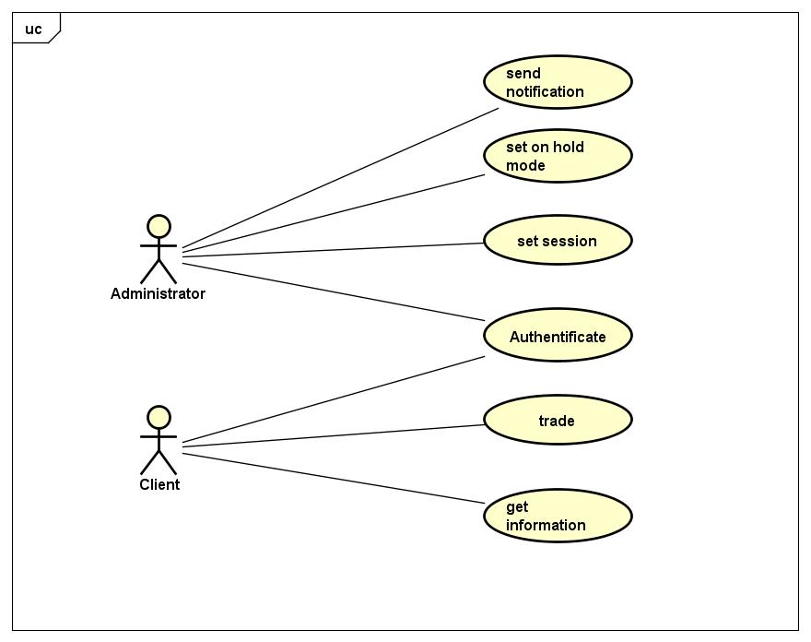
Use Case

Slide 4
Matching Algorithm
Pro Rata Algorithm
Considers the percentage one holds of the total amount of shares
Weighted according to time

Slide 5
Matching Algorithm
Input: two lists; buyer and seller
Outputs a matrix buyer x seller
Contains the shares which are traded

