Slide 1
Exchange Simulator
Financial Service Computing

Slide 2
Content
Use Case
Structure
Communication
GUI
Matching Algorithm

Slide 3
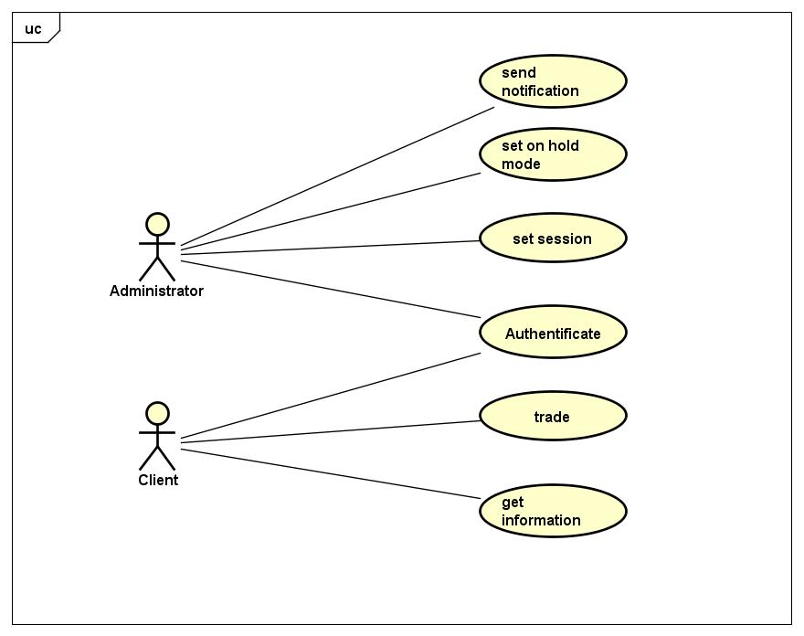
Use Case

