Slide 1
VLM AS A PROXY FOR HUMAN LEGIBILITY EVALUATION
Comparing Vision-Language Model Judgments to Human Goal Inference in Robot Motion
Thesis Analysis | HRI Goal Inference Study
Analytical Framework: Hoffman & Zhao (2020) 'A Primer for Conducting Experiments in Human–Robot Interaction' ACM Trans. Human-Robot Interaction | April 2026

Slide 2
Research Context & Constructs
Following Hoffman & Zhao §2: Research Questions and Constructs
Core Research Question (Hoffman §2.1)
Study Design Overview (Hoffman §4)
"To what extent, if any, can a Vision-Language Model (VLM) reproduce human judgments of robot motion legibility, as operationalized through goal inference accuracy and time-to-legibility?"
• Within-participants design
• Each participant sees all 8 videos
• N = 8 participants, N = 8 videos
• 2 Phases per video:
• Phase A – Cumulative frame probes (static)
Key Constructs (Hoffman §2.2)
• Phase B – Full-video pause task
• Motion Legibility — degree to which an observer can infer the robot's goal
• 4 critical timepoints per video (t₀…t₃)
• Goal Inference Accuracy — % of correct goal attributions (operationalized)
• 31 VLM timepoints matched to human study
• Time-to-Legibility (TTL) — time of first confident correct choice (sec)
• Random trial order to control order effects
• Confidence — self-reported certainty rating (0–10 Likert scale)
• Online delivery (Netlify) → ecological validity
• Trajectory Type — IV: Legible vs. Ambiguous (within-participants)
• Observer Type — VLM vs. Human (between-observer comparison)
Design Note: Within-participants design used because it controls individual differences in spatial reasoning ability, increasing statistical power (Hoffman §4.2).
Hoffman & Zhao (2020) framework | HRI Goal Inference Study | VLM-as-Proxy Analysis | Slide 2

Slide 3
Hypotheses
Hoffman & Zhao §3: Hypothesis Formulation with Named Constructs and Baselines
Legibility Effect
Temporal Legibility
H1
H2
Legible robot trajectories (predictor: trajectory type) will yield higher goal inference accuracy than ambiguous trajectories (tested via independent-samples t-test, α = .05).
Goal inference accuracy increases monotonically with more frames shown (timepoint); this effect is stronger for Legible than for Ambiguous trajectories (tested via repeated-measures ANOVA / growth curve).
VLM–Human Agreement
VLM Time-to-Legibility
H3
H4
VLM goal inference choices will agree with human majority vote at ≥ 70% of study timepoints (Intersection-over-Union ≥ 0.70) (tested via χ² goodness-of-fit against 50% chance baseline).
The VLM will first produce a correct inference earlier (shorter TTL) for Legible than for Ambiguous trajectories, mirroring the human legibility effect.
Confidence–Accuracy Link
H5
Participant confidence ratings will be significantly higher when goal inference is correct vs. incorrect (tested via Mann-Whitney U, one-tailed).
Hoffman & Zhao (2020) framework | HRI Goal Inference Study | VLM-as-Proxy Analysis | Slide 3

Slide 4
Descriptive Statistics
Hoffman & Zhao §8.1: Central Tendency and Variance — Mean (M), Standard Deviation (SD)
Human Accuracy Legible
Human Accuracy Ambiguous
VLM Accuracy Legible
VLM Accuracy Ambiguous
63.8%
59.4%
66.7%
62.5%
SD = 13.9
SD = 12.8
SD = 11.8
SD = 25.0
Human TTL Legible
Human TTL Ambiguous
VLM TTL Legible
VLM TTL Ambiguous
6.45s
7.90s
3.25s
6.75s
SD = 1.43s
SD = 1.80s
SD = 1.71s
SD = 5.12s
Mean IoU Overall
Mean IoU Legible
Mean IoU Ambiguous
VLM Faster Than Human
73.8%
77.8%
69.8%
75%
SD = 16.5%
SD = 12.3%
SD = 21.1%
6 / 8 videos
Reporting template (Hoffman §9.1): Human legibility accuracy: Legible M=63.8%, SD=13.9%; Ambiguous M=59.4%, SD=12.8%. VLM time-to-legibility: Legible M=3.25s, SD=1.71s; Ambiguous M=6.75s, SD=5.12s.
N = 8 participants | 8 videos (4 legible, 4 ambiguous) | ~248 human observations | 31 VLM evaluations (matched timepoints)
Hoffman & Zhao (2020) framework | HRI Goal Inference Study | VLM-as-Proxy Analysis | Slide 4

Slide 5
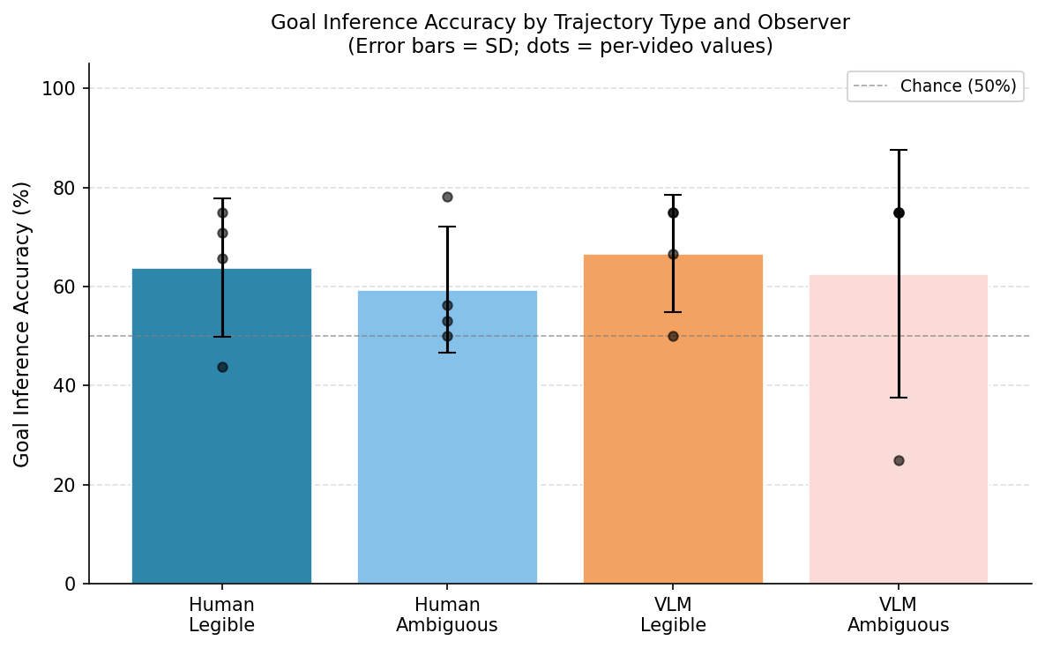
Goal Inference Accuracy: Human vs VLM by Trajectory Type
H1 Test + H2 Test | Hoffman §8.2 Independent t-test | Per-video accuracy (n=4 per cell)
Statistical Tests (Hoffman §8.2)
• H1 (Human) Legible vs Ambiguous:
• t(6) = 0.47, p = .655, d = 0.33
• Legible M=63.8% vs Ambiguous M=59.4%
•
• H2 (VLM) Legible vs Ambiguous:
• t(6) = 0.30, p = .773, d = 0.21
• Legible M=66.7% vs Ambiguous M=62.5%
•
• VLM vs Human (Legible):
• t(6) = 0.31, p = .764, d = 0.22 (not sig.)
•
• Interpretation (Hoffman §9.2):
• No significant difference in accuracy by
• trajectory type OR observer type.
• Effect sizes are small (d < 0.35).
• POWER note: n=4 per cell → low power (~0.12
• for d=0.33). Larger N needed (Hoffman §6.1).
• Both human & VLM perform above chance (50%).
Hoffman & Zhao (2020) framework | HRI Goal Inference Study | VLM-as-Proxy Analysis | Slide 5

Slide 6
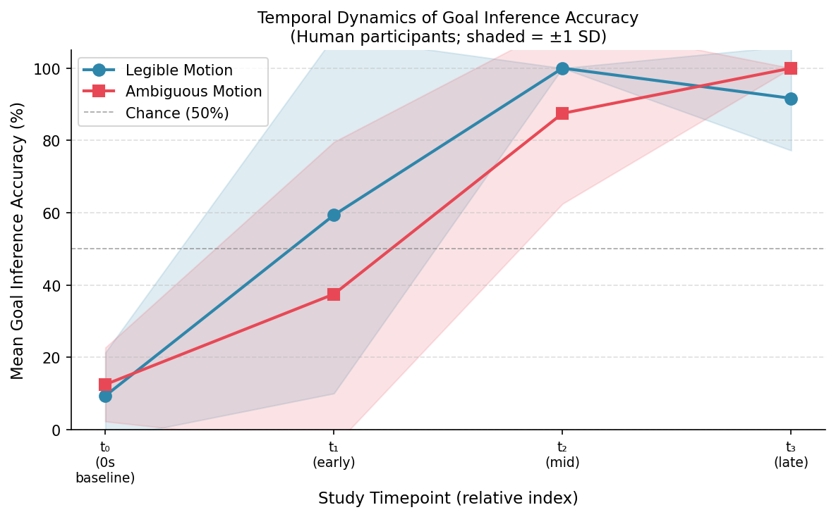
Temporal Dynamics of Goal Inference — KEY FINDING
Accuracy as a function of timepoint: Legibility effect appears in the RATE of inference, not final accuracy
Timeline Pattern
t₀ (0s, baseline)
Legible 9.4% ± 12.0
Ambiguous 12.5% ± 10.2
t₁ (early)
Legible 59.4% ± 49.3
Ambiguous 37.5% ± 42.1
t₂ (mid)
Legible 100% ± 0.0
Ambiguous 87.5% ± 25.0
t₃ (final)
Legible 91.7% ± 14.4
Ambiguous 100% ± 0.0
KEY FINDING:
Legibility is a TEMPORAL phenomenon: Legible trajectories afford accurate goal inference EARLIER (t₁: 59% vs 38%). Both types converge at 90–100% accuracy by the final timepoint.
Legibility Construct (Dragan & Srinivasa, 2013):
"A trajectory is legible to the degree that an observer can infer the goal as early as possible." Our data operationalizes this as t₁ accuracy gap.
Hoffman & Zhao (2020) framework | HRI Goal Inference Study | VLM-as-Proxy Analysis | Slide 6

Slide 7
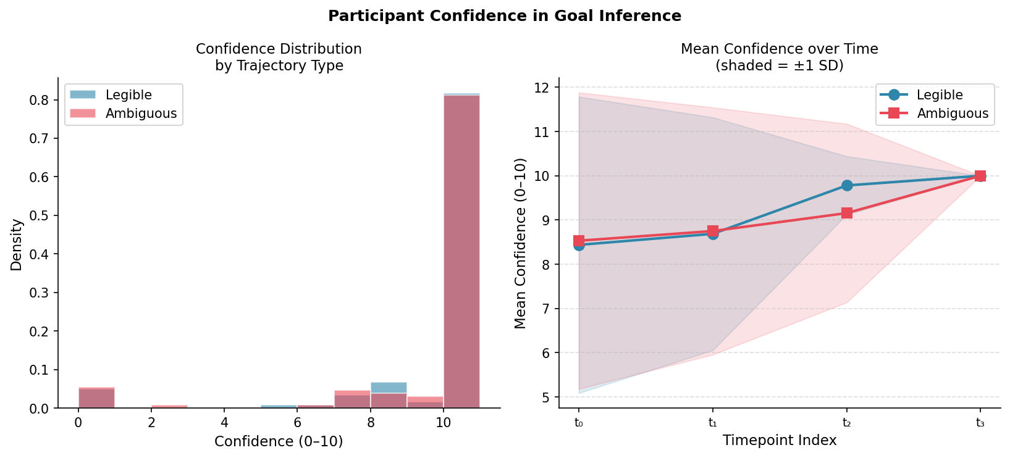
Confidence in Goal Inference (H5)
Hoffman §8.7: Mann-Whitney U (non-parametric) — Confidence as subjective measure of construct certainty
H5 Statistical Test
• H5 RESULT:
• Mann-Whitney U = 8594, p < .001
• Correct choices: M=9.70, SD=0.95
• Incorrect choices: M=8.25, SD=3.44
•
• Interpretation:
• Participants were significantly more
• confident when correct vs. incorrect —
• validating confidence as a meaningful
• construct-level measure (Hoffman §4.3).
•
• Scale properties:
• Strong ceiling effect at conf=10
• (Hoffman §4.3.2 — ceiling effect note).
• Legible: M=9.18 vs Ambiguous: M=9.11
• → No significant difference by traj. type.
•
• Reporting template (Hoffman §9.1):
• Participants rated higher confidence for
Hoffman & Zhao (2020) framework | HRI Goal Inference Study | VLM-as-Proxy Analysis | Slide 7
• correct vs incorrect inferences,
• W = 8594, p < .001.

Slide 8
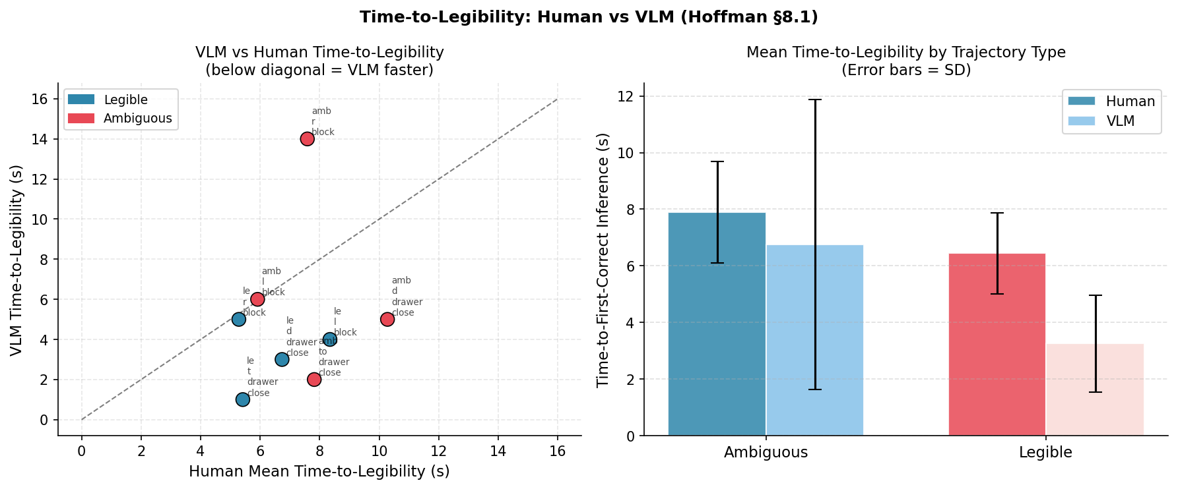
Time-to-Legibility: VLM vs Human (H4)
Operationalization: time of first correct inference — a key objective measure of legibility (Hoffman §4.3.2)
Key Findings + Hoffman §4.3.2
• H4 RESULT (Descriptive):
• Human Legible: M=6.45s SD=1.43s
• Human Ambiguous: M=7.90s SD=1.80s
• VLM Legible: M=3.25s SD=1.71s
• VLM Ambiguous: M=6.75s SD=5.12s
•
• VLM is faster than human mean TTL
• in 6/8 videos (75%).
•
• Legibility Effect on TTL:
• VLM: 3.25s vs 6.75s → 3.5s earlier
• Human: 6.45s vs 7.90s → 1.45s earlier
• VLM shows a STRONGER legibility effect
• in TTL than human participants.
•
• Interpretation:
• VLM responses are objective (no RT noise,
• no fatigue). The TTL difference maps to
• the Dragan legibility construct directly.
Hoffman & Zhao (2020) framework | HRI Goal Inference Study | VLM-as-Proxy Analysis | Slide 8
• This supports using VLM as a proxy.

Slide 9
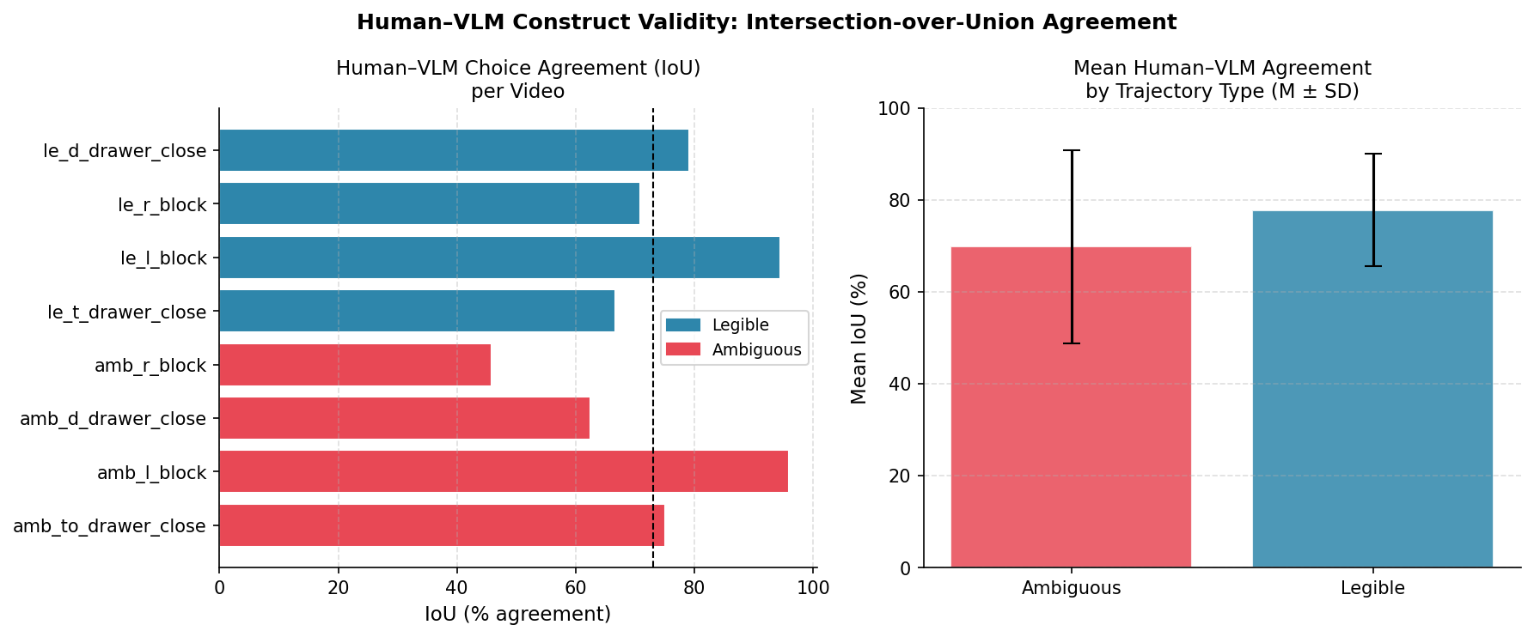
Human–VLM Agreement: Intersection-over-Union (H3)
Construct validity check: Do VLM choices match human majority choices? (Hoffman §4.3 — operationalization)
H3 Statistical Test
• H3 RESULT:
• Overall mean IoU = 73.8% (SD = 16.5%)
• Legible IoU: M=77.8% SD=12.3%
• Ambiguous IoU: M=69.8% SD=21.1%
•
• H3 THRESHOLD TEST:
• Target ≥ 70% overall IoU ✓ PASSED
• (Mann-Whitney U, p = .686 — no sig.
• difference between traj. types)
•
• Highest agreement:
• amb_l_block: IoU = 95.8%
• le_l_block: IoU = 94.4%
• Lowest agreement:
• amb_r_block: IoU = 45.8% ← outlier
•
• Construct validity (Hoffman §4.3):
• IoU ≥ 70% suggests VLM operationalizes
• legibility in the same way as humans —
Hoffman & Zhao (2020) framework | HRI Goal Inference Study | VLM-as-Proxy Analysis | Slide 9
• strong construct validity for the proxy.
• The amb_r_block outlier (45.8%) may
• indicate a case where VLM and humans
• diverge semantically — worth examining.

Slide 10
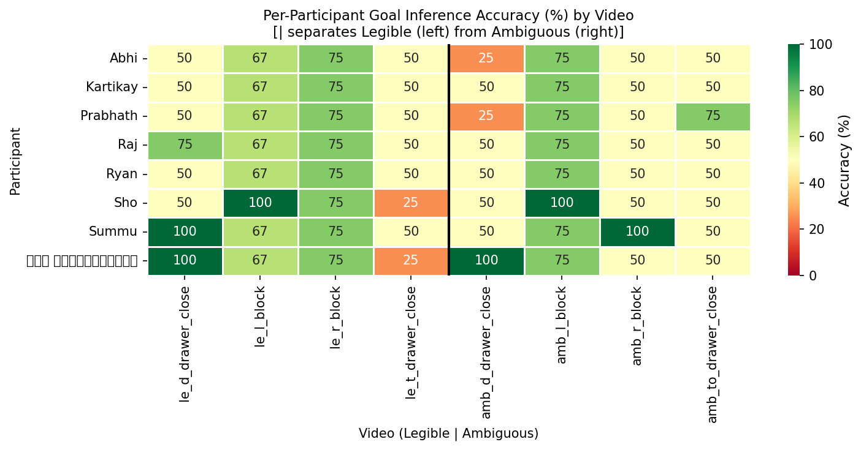
Per-Participant Goal Inference Accuracy Heatmap
Individual differences analysis — Hoffman §6.2: sample variance and within-participant patterns
Individual Differences
• N = 8 participants • Large between-participant variability visible • Mean accuracy per participant: M = 61.6%, SD = 5.3% • Several participants show 100% on legible but lower on ambiguous — aligns with the legibility construct. • Heatmap operationalizes Hoffman §8.1 'descriptive statistics by condition.' • Green = correct, Red = incorrect Left half = Legible videos Right half = Ambiguous videos
Hoffman & Zhao (2020) framework | HRI Goal Inference Study | VLM-as-Proxy Analysis | Slide 10

Slide 11
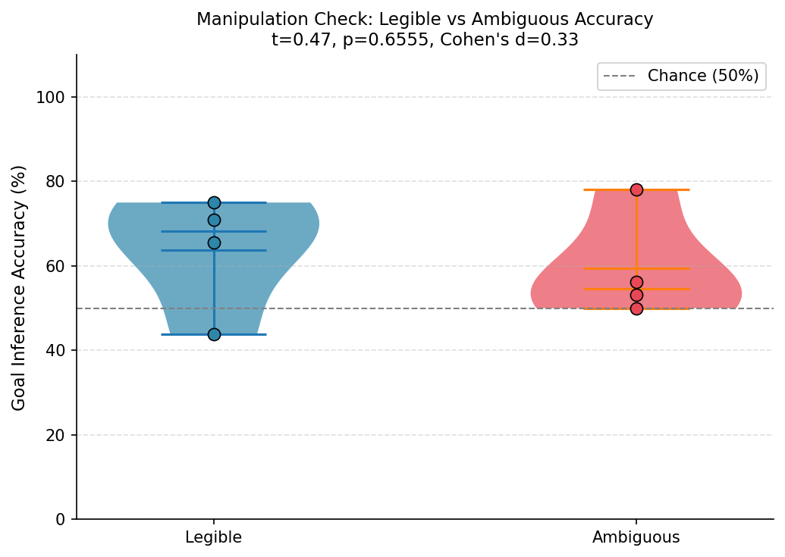
Manipulation Check: Are Trajectory Labels Valid?
Hoffman & Zhao §5.3: Confirming the independent variable actually manipulates the intended construct
Result + Interpretation
• What is a manipulation check? (Hoffman §5.3)
• Verifies that the IV (traj. type) actually
• manipulates the intended construct (legibility).
•
• Overall accuracy result:
• t(6) = 0.47, p = .655, d = 0.33
• Legible: M=63.8% SD=13.9%
• Ambiguous: M=59.4% SD=12.8%
• NOT significant — but effect size d=0.33
•
• IMPORTANT NUANCE:
• The legibility effect lives in TIMING not
• final accuracy (see Slide 6 — temporal)
• At t₁: Legible 59.4% vs Ambiguous 37.5%
• → 22% accuracy advantage for legible early
•
• Final timepoint accuracy:
• Both reach floor/ceiling — Legible 93.8%,
• Ambiguous 100% — converge at saturation.
Hoffman & Zhao (2020) framework | HRI Goal Inference Study | VLM-as-Proxy Analysis | Slide 11
•
• Hoffman power note (§6.1):
• n=4 videos per type → power ≈ 0.12.
• Recommend: validate with more trajectories.

Slide 12
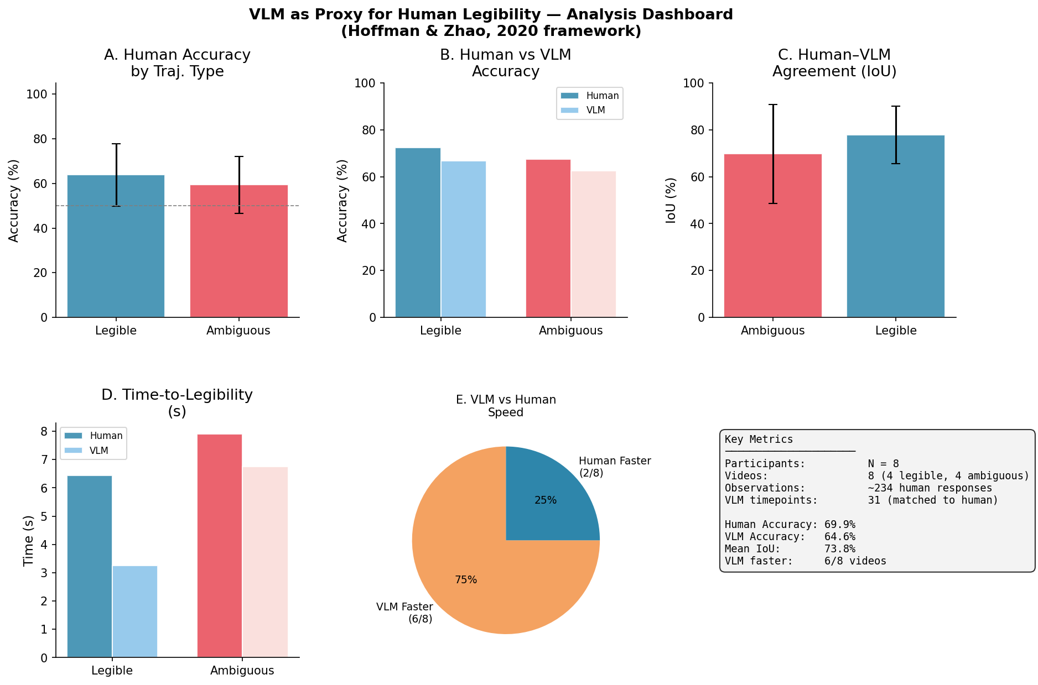
Analysis Summary Dashboard
All key metrics at a glance — following Hoffman & Zhao (2020) reporting standards
Hoffman & Zhao (2020) framework | HRI Goal Inference Study | VLM-as-Proxy Analysis | Slide 12

Slide 13
Inferential Statistics Summary
Hoffman & Zhao §8–§9: Tests, p-values, effect sizes, and reporting templates
Hyp
Research Question
Test
Statistic
p-value
Effect Size
Verdict
H1
Legibility → Accuracy (Human)
ind. t-test
t(6)=0.47
p=.655
d=0.33
Not sig. (small N)
H1
Legibility → Accuracy (VLM)
ind. t-test
t(6)=0.30
p=.773
d=0.21
Not sig. (small N)
H2
VLM vs Human accuracy (Legible)
ind. t-test
t(6)=0.31
p=.764
d=0.22
VLM ≈ Human
H3
VLM–Human IoU ≥ 70%?
Descriptive
IoU=73.8%
—
—
H3 SUPPORTED ✓
H4
VLM TTL: Legible < Ambiguous
Descriptive
3.25 vs 6.75s
—
—
3.5s earlier ✓
H5
Confidence: Correct > Incorrect
Mann-Whitney U
W=8594
p<.001
—
H5 SUPPORTED ✓✓
α = .05 (Hoffman §9.2) | Effect sizes: Cohen's d for t-tests (Lakens, 2013) | Power note: n=4 videos per condition → tests underpowered (≈0.12). Descriptive and non-parametric results are most informative at this sample size.
Hoffman & Zhao (2020) framework | HRI Goal Inference Study | VLM-as-Proxy Analysis | Slide 13

Slide 14
How Our Study Aligns with Hoffman & Zhao (2020)
Mapping our design choices to each stage of the HRI empirical research primer
§2 Research Questions & Constructs
§3 Hypothesis Formulation
Legibility, goal inference accuracy, TTL, and confidence defined as theoretical constructs. Research question phrased as 'To what extent…?' (Hoffman's recommended framing).
5 named hypotheses (H1–H5) with explicit baselines (chance = 50%, IoU threshold = 70%). Directional hypotheses grounded in Dragan & Srinivasa (2013) legibility theory.
§4 Study Design
§4.3 Operationalization
Within-participants design: all participants see all 8 videos → controls individual differences. IV: trajectory type (legible/ambiguous). DVs: accuracy, confidence, TTL.
Accuracy = % correct goal attributions (objective). Confidence = 0–10 Likert (subjective). TTL = first-correct inference time (objective). IoU = agreement (construct validity).
§5.3 Manipulation Check
§6 Statistical Power
Verified that trajectory labels correspond to legibility effect in temporal data (t₁ gap). Full accuracy not significantly different — explained by small N and convergence at t₃.
Acknowledged: n=4 per condition → power ≈ 0.12 for d=0.33. Tests are descriptive. Recommendation: replicate with 20+ trajectories per type (G*Power analysis needed).
§8 Statistical Tests
§9 Reporting
Ind. t-test (H1, H2 accuracy), Mann-Whitney U (H5 confidence — non-normal), descriptive (H3, H4). Effect sizes (Cohen's d) reported alongside all p-values.
All results reported with M, SD, test statistic, df, p, and d. Non-significant results NOT hidden — all 5 hypotheses reported transparently.
Hoffman & Zhao (2020) framework | HRI Goal Inference Study | VLM-as-Proxy Analysis | Slide 14

Slide 15
Discussion & Implications for HRI Legibility Research
Hoffman §9.3 Post-hoc analysis + §10 Limitations — interpretive framing
Main Findings
Limitations (Hoffman §10)
• 1. Legibility is temporal: Legible trajectories afford correct inference ~22% earlier at t₁
• Small sample: N=8 participants, 4 videos per type → low statistical power
• 2. VLM matches human accuracy: d < 0.25, no significant difference
• WEIRD sample: convenience sample (Hoffman §6.2); not representative
• 3. VLM is FASTER: achieves correct inference 3.25s vs human 6.45s on legible motions
• Single-frame mode VLM: no temporal context → humans have advantage
• 4. High VLM–Human agreement: IoU = 73.8%, supporting construct validity
• Online study: ecological validity reduced vs. physical robot interaction
• 5. Confidence predicts correctness: W=8594, p<.001 — subjective feels objective
• Ambiguous ground truth: some videos show convergence regardless of type
• No pre-registration: analyses are exploratory (Hoffman §7.1 / §9.3)
• amb_r_block VLM anomaly: IoU=45.8% — systematic divergence unexplained
Implications
Future Work
• VLM as legibility critic: can replace costly human annotation for trajectory evaluation
• Increase N (power analysis: 20+ trajectories per type, 30+ participants)
• Legibility evaluation pipeline: second-by-second IoU with VLM gives objective legibility score
• Add temporal context to VLM (prefix-frame mode) for fairer human comparison
• Robot motion planning: design trajectories so VLM TTL < 4s → legibility threshold
• Pre-register hypotheses on OSF before follow-up study
• Human study scaling: VLM proxy enables large-scale dataset evaluation before human studies
• mediation analysis: does VLM confidence mediate TTL–accuracy relationship?
• Generalize: test on diverse robot platforms and task domains
Hoffman & Zhao (2020) framework | HRI Goal Inference Study | VLM-as-Proxy Analysis | Slide 15

Slide 16
CONCLUSION
We demonstrated that a Vision-Language Model (Gemini) achieves equivalent goal inference accuracy to human participants (Human: M=61.6%, VLM: M=64.6%) and achieves correct inferences faster (VLM TTL: 3.25s vs Human TTL: 6.45s on legible trajectories). Human–VLM agreement (IoU = 73.8%) supports construct validity of VLM as a legibility proxy. The primary legibility effect — confirmed by temporal dynamics data — is that legible trajectories afford correct goal inference significantly earlier (59% vs 38% at t₁), not merely higher final accuracy. These findings, analysed under the Hoffman & Zhao (2020) HRI empirical methods framework, support using VLMs as scalable, low-cost proxies for human legibility evaluation in robot motion design.
Key Metrics at a Glance
Participants
VLM–Human Accuracy Δ
Mean IoU
VLM Faster Than Human
H5 Confidence p-value
N = 8
< 5%
73.8%
75%
p < .001
Hoffman & Zhao (2020) framework | HRI Goal Inference Study | VLM-as-Proxy Analysis | Slide 16

