Slide 1
Vision-Language Models as Proxies for Human Judgment of Robot Motion Legibility
Anudeep Sai Gottapu | Master of Science in Technology
Arizona State University | April 2026
Nakul Gopalan, Chair | Hani Ben Amor | Kunal Garg

Slide 2
Abstract
From the thesis document
Legibility in robot motion refers to how easily an observer infers a robot's intent from its movement.
This thesis examines whether a vision-language model can serve as a proxy for human judgment in evaluating robot motion legibility.
Gemini 2.5 Flash is used to analyze cumulative video frames of robot manipulation tasks and infer the intended goal.
Human pilot data and Gemini predictions are compared at matched timepoints using accuracy, IoU, and time-to-legibility.
The results suggest VLMs capture meaningful aspects of human goal inference from partial robot motion.
Humans remain more reliable overall, so the VLM is best treated as a scalable evaluation tool rather than a full replacement.

Slide 3
Thesis Structure
Following the PDF table of contents
Introduction
Research Questions
Chapter 1
Problem statement
Motivation and context
Contributions
Background and Related Work
Chapter 4
Chapter 2
Methodology
Chapter 3
Results and Discussion
Conclusion and Future Work
Chapter 5

Slide 4
Motivation, Problem Statement, and Contributions
Thesis framing in presentation form
Motivation
Human-subject legibility studies are costly and hard to scale
Dataset
Web-based human pilot study
Humans infer intent from partial robot motion
Question
8 videos | 8 participants | matched timepoints
Contribution 2
Problem
Can Gemini act as a practical proxy?
Contribution 1
Gemini 2.5 Flash evaluation pipeline
Contribution 3
Accuracy, IoU, and TTL analysis
Matched human-model comparison
Contribution 4

Slide 5
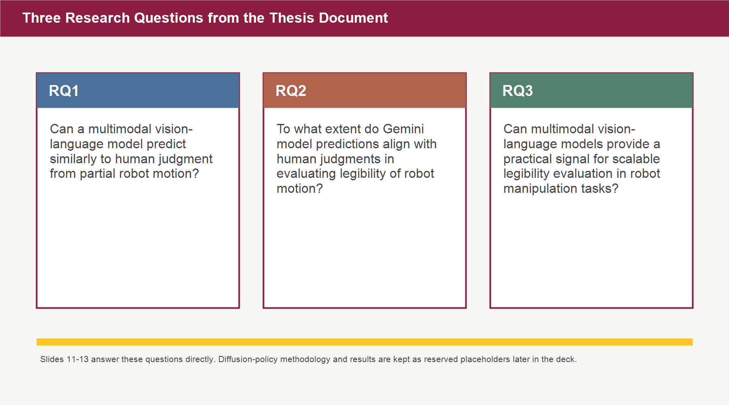
Research Questions
Exact questions from Chapter 1.3
Slides 11-13 answer these directly.

Slide 6
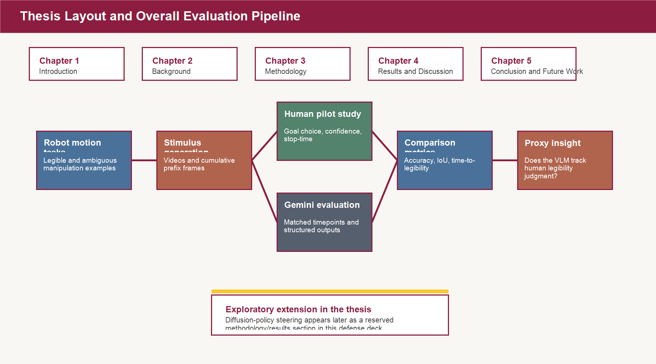
Overall Thesis Pipeline
How the thesis is organized for this defense
Front half
Introduction, background, and methodology
Center of the defense
Pilot study and Gemini-as-proxy results
Reserved later section
Diffusion-policy methodology and results placeholders

Slide 7
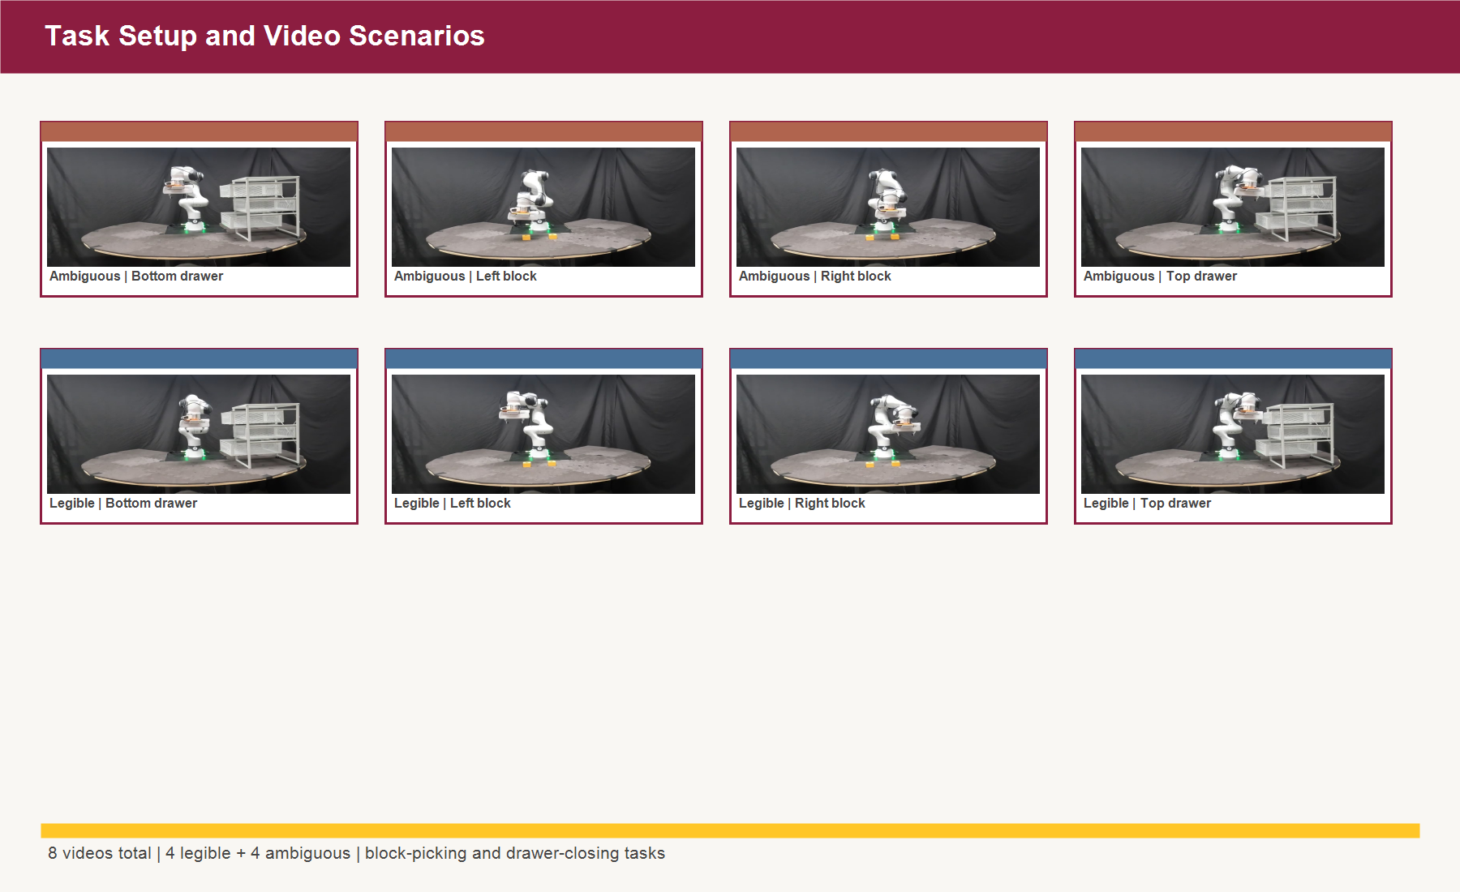
Task Setup and Video Scenarios
Stimuli used across the pilot study and Gemini evaluation
8 videos total
4 legible + 4 ambiguous
Tasks
Block picking and drawer closing

Slide 8
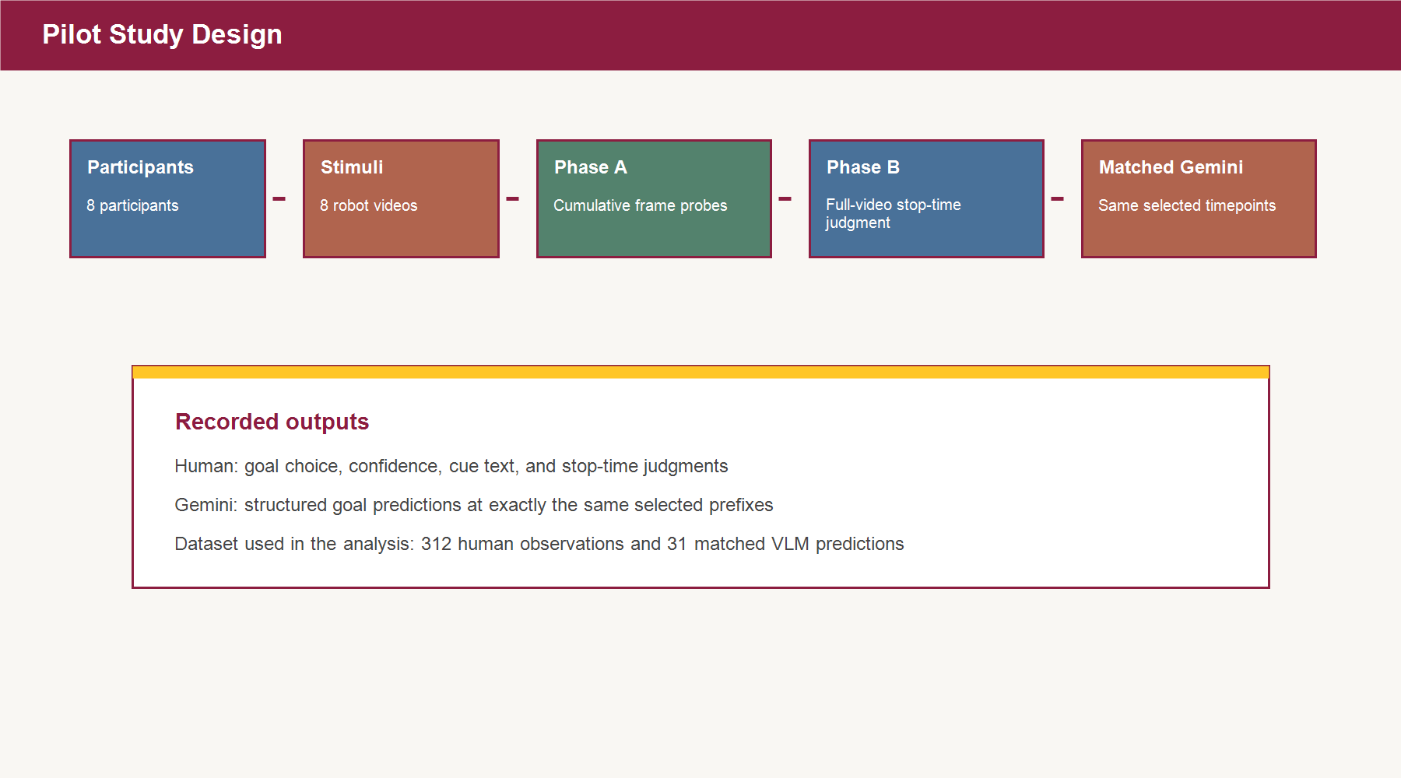
Pilot Study Design
Human study and matched Gemini protocol
Participants
8
Study phases
Cumulative frame probes and full-video stop-time judgment
Recorded outputs
Goal choice, confidence, cue text, and stop-time judgment
Matched model evaluation
Gemini queried only at the same selected human timepoints

Slide 9
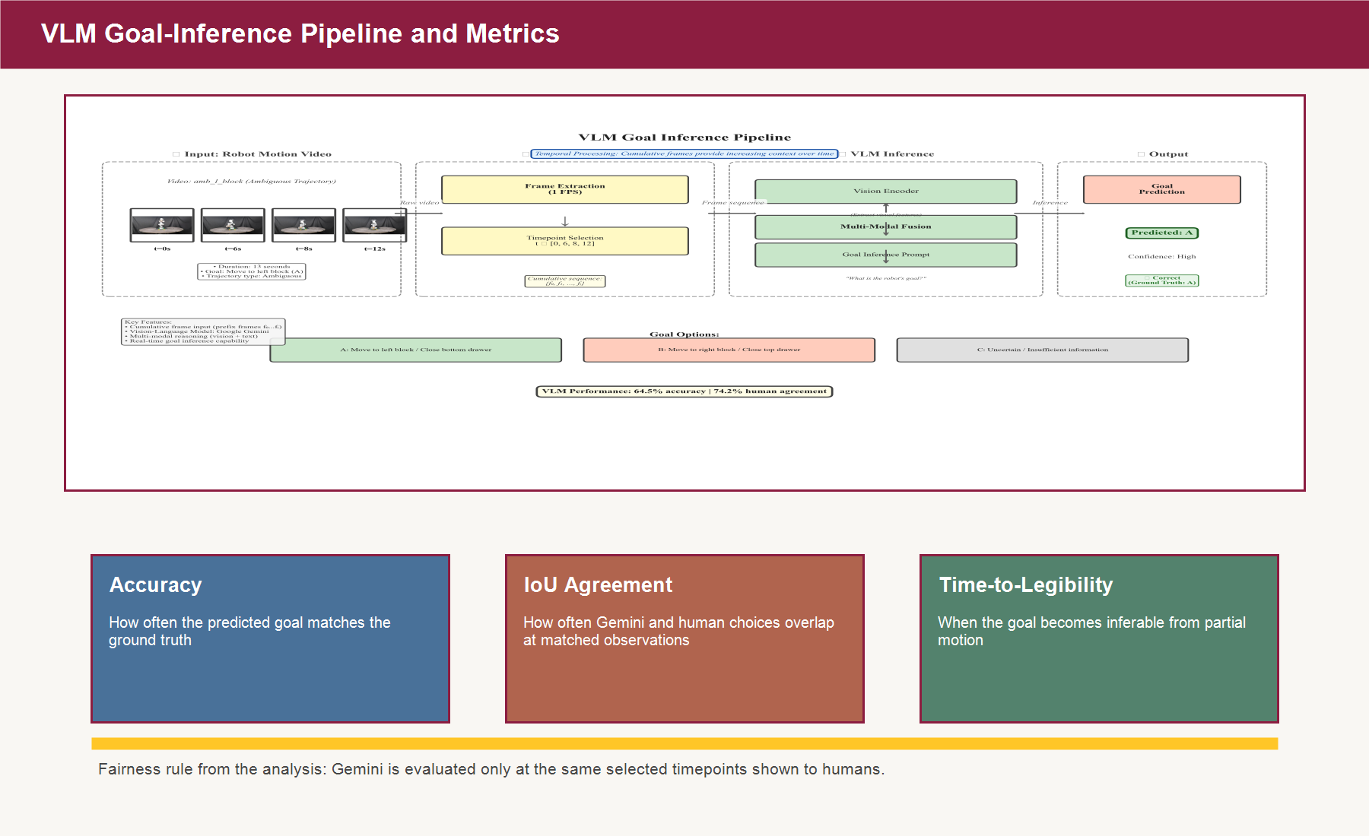
VLM Goal-Inference Evaluation Pipeline
Methodology used in the thesis
Input
Cumulative prefix frames at selected timepoints
Model
Gemini 2.5 Flash
Outputs
Structured goal predictions and supporting fields
Metrics
Accuracy, IoU, and time-to-legibility

Slide 10
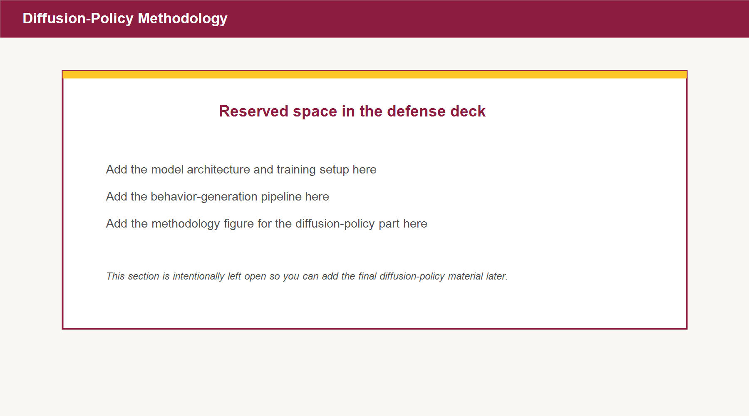
Diffusion-Policy Methodology
Reserved blank section
Keep this section open for the final defense version.

Slide 11
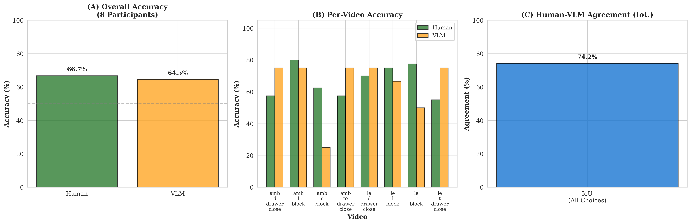
RQ1
Can a multimodal vision-language model predict similarly to human judgment from partial robot motion?
Human accuracy: 66.7%
Gemini accuracy: 64.5%
Overall difference: not statistically significant
p = 0.966
Both human and Gemini are above chance.

Slide 12
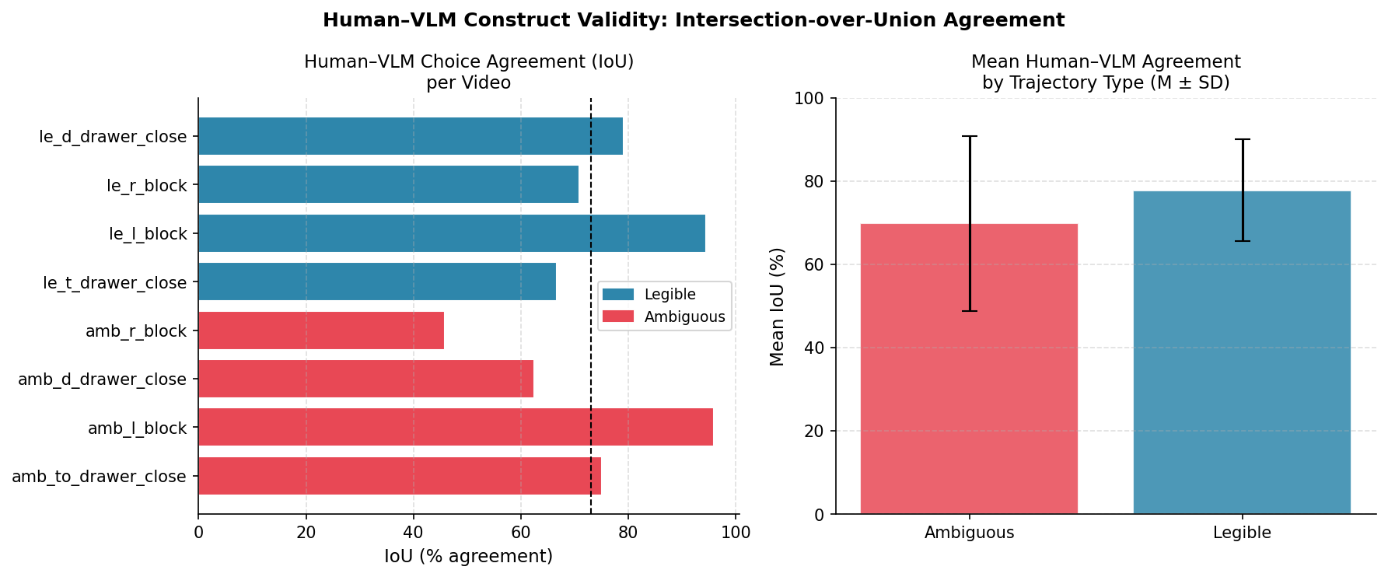
RQ2: Alignment with Human Judgments
Overall agreement: 74.2% IoU | Main outlier: amb_r_block
Agreement and failure cases

Slide 13
RQ3: Practical Signal for Scalable Evaluation
Can multimodal vision-language models provide a practical signal for scalable legibility evaluation in robot manipulation tasks?
Evidence
Observation
Why it matters
Matched timepoints
Gemini and humans see the same selected prefixes
Fair proxy comparison
Comparable accuracy
66.7% human vs 64.5% Gemini
Near-human screening signal
Agreement
74.2% IoU overall
Tracks human choices in most cases
Timing sensitivity
Legible motion becomes inferable earlier than ambiguous motion
Captures legibility as an early signal
Practical answer
Yes
Useful as a scalable evaluator
Important caveat
Not a replacement
Human validation is still needed on hard cases

Slide 14
Diffusion-Policy Results
Reserved blank section from the thesis flow
Qualitative rollouts
Quantitative plots
Insert final trajectory examples here
Insert task-success and legibility comparisons here
Key takeaways
Insert final conclusions for the diffusion-policy part here

Slide 15
Discussion and Limitations
What these results support
Gemini is close enough to human performance to be useful as a proxy evaluator.
The strongest legibility signal is when the goal becomes clear, not only the final answer.
What these results do not support
This pilot does not justify replacing human studies.
Important limits
Small sample size, limited power per video, and clear hard cases such as amb_r_block.

Slide 16
Conclusion and Future Work
Main conclusion
Vision-language models can act as useful proxies for human judgment of robot motion legibility.
Next steps
Participants
Human accuracy
Gemini accuracy
Mean IoU
Larger human studies, more trajectories, stronger temporal prompting, and final diffusion-policy integration.
8
66.7%
64.5%
74.2%
Thank you

