Slide 1
Vision-Language Models as Proxies for Human Judgment of Robot Motion Legibility
by
Anudeep Sai Gottapu
A Thesis
Presented in Partial Fulfillment
of the Requirements for the Degree
Master of Science
Approved April 2026 by the
Graduate Supervisory Committee
Nakul Gopalan, Chair
Hani ben Amor
Kunal Garg

Slide 2
Abstract
2
Legibility in robot motion refers to how easily an observer infers a robot’s intent from its movement. Evaluating robot's motion legibility often requires human-subject studies, which are time-consuming and resource-intensive. To address this limitation, this work examines whether a vision-language model can serve as a proxy for human judgment in evaluating robot motion legibility. Gemini 2.5 Flash is used to analyze video frames of a robot performing a task and infer the robot’s intended goal. Human evaluation pilot data and Gemini-based predictions on videos of robot manipulation tasks with cumulative frame observations at selected timepoints are compared.For each timepoint, cumulative (prefix) frames are provided, starting from a single initial frame and progressively increasing to include more of the trajectory, allowing both human participants and the model to infer the robot’s intended goal. The resulting predictions are analyzed using human and vlm agreement based metrics and per task metrics, including accuracy, intersection-over-union, and time-to-legibility. The results suggest that multimodal vision-language models can capture meaningful aspects of human goal inference from partial robot motion, although human observers remain more reliable overall.
Notes:
Legibility refers to how easily an observer can infer a robot's intent from its motion. In this thesis, the challenge is not only whether the robot succeeds, but when the goal becomes readable. Human-subject studies are the standard way to evaluate this, but they are slow and resource intensive when we want to test many candidate policies. So the core question is whether a vision-language model can approximate human judgment well enough to serve as a scalable evaluator.

Slide 3
Abstract
3
These findings indicate that vision-language models can serve as scalable proxies for evaluating robot motion legibility, reducing reliance on costly human-subject studies.This work highlights the potential of integrating such models into robot learning pipelines and motivates future approaches for generating more legible robot motion. The study also explores how VLM-based goal inference can be incorporated into a diffusion-policy framework trained on demonstrations to guide the selection of more legible robot trajectories. Together, these results support the use of multimodal language-vision models as practical tools for evaluating robot motion and motivate future methods for generating more interpretable, human-aligned behavior.
Notes:
We compare humans and Gemini 2.5 Flash on the same robot videos. Instead of showing the full trajectory at once, we reveal cumulative prefix frames at selected timepoints. Both the human observer and the model infer the intended goal from that partial evidence. This setup lets us study not only what goal is predicted, but how early the goal becomes legible.

Slide 4
What We Measure And What We Found
4
The goal is human alignment over time, not only final-goal prediction
Accuracy
Agreement (IoU)
Time-to-legibility
How often the predicted goal matches the true goal at each timepoint.
How closely human and model judgments overlap on matched evidence.
How early the intended goal becomes readable from partial motion.
Abstract takeaway
- Gemini tracks meaningful parts of human goal inference from partial robot motion.
- Human observers are still more reliable overall.
- VLMs can scale evaluation and later help select more legible trajectories.
This defense focuses on validating the evaluator before using it inside a policy-improvement loop.
Notes:
We evaluate the proxy using accuracy, agreement, and time-to-legibility. The results show that Gemini captures meaningful aspects of human goal inference from partial robot motion, although human observers remain more reliable overall. That means VLMs are not a full replacement for people, but they are promising scalable proxies for legibility evaluation. This also motivates using VLM-based judgments later in the pipeline to help select more legible trajectories.

Slide 5
Motivation And Context
5
In shared workspaces, robot motion is also a communication signal
Core idea
People do not wait for the robot to finish. They watch partial motion and infer the intended goal early.
Shared workspaces
Legibility
Why this thesis
Humans and robots act close to one another, so intent must be easy to read during execution.
A motion is legible when an observer can infer the goal from the trajectory, not just the final outcome.
If we can evaluate legibility faster, we can study more trajectories and improve robot behavior at scale.
The key HRI question is whether intent becomes readable early enough for coordination.
Notes:
Robots are increasingly being deployed in shared workspaces where they operate close to humans. In these settings, collaboration depends not only on successful task completion, but also on how clearly the robot's motion communicates its intended goal during execution. Humans observe partial motion and infer intent before the action is complete, so motion itself becomes a communication channel. This is the motivation for studying legibility in human-robot interaction.

Slide 6
Problem Statement
6
Human evaluation is valuable, but it is hard to scale across many robot motions
Current bottleneck
Legibility is usually evaluated with human-subject studies on partial motion, but those studies are costly, slow, and hard to repeat.
What we need
What this thesis tests
Working expectation
A practical way to estimate human goal inference across tasks, trajectories, and model variants.
Whether Gemini 2.5 Flash can act as a proxy for human judgment when both see the same cumulative frames.
The model may capture meaningful human-like signals, even if it does not fully replace human evaluation.
Thesis stance
This thesis treats VLMs as scalable evaluators to validate against humans first, then use inside future motion-generation pipelines.
Notes:
Although legibility is important in human-robot interaction, evaluating it in practice remains difficult. Existing approaches often rely on human-subject studies to determine whether the intended goal can be inferred from partial motion, but such studies are costly, time-consuming, and difficult to scale across many trajectories and task settings. This thesis examines whether a multimodal vision-language model, specifically Gemini 2.5 Flash, can serve as a practical proxy for human judgment when both humans and the model are given the same cumulative visual evidence.

Slide 7
Research Questions
7
The thesis moves from model capability to alignment with humans to practical usefulness
1
Can a multimodal vision-language model infer robot goals from partial motion similarly to humans?
2
How closely do Gemini predictions align with human judgments of robot motion legibility?
3
Can VLM judgments provide a practical, scalable signal for legibility evaluation in robot manipulation?
These questions ask whether the model is capable, aligned, and useful.
Notes:
The thesis is guided by three research questions. First, can a multimodal vision-language model predict robot intent from partial motion in a way that is similar to human judgment? Second, to what extent do Gemini predictions align with human judgments when evaluating motion legibility? Third, can such multimodal models provide a practical signal for scalable legibility evaluation in robot manipulation tasks?

Slide 8
Thesis Contributions
8
The work contributes a study design, an evaluator pipeline, a comparison framework, and evidence
C1
Built a web-based human study for goal inference from frame-based and video-based robot observations.
C2
Implemented a Gemini 2.5 Flash pipeline using cumulative frame sequences at selected timepoints.
C3
Created a matched human-model evaluation setup where both receive corresponding visual evidence.
C4
Analyzed performance with accuracy, agreement, intersection-over-union, and time-to-legibility.
C5
Showed that VLMs can be useful evaluation proxies while also revealing their current limits.
Together, these contributions connect human-subject evaluation, VLM assessment, and future legible-motion generation.
Notes:
This thesis makes five main contributions. It develops a web-based human-subject study for goal inference from both selected image frames and full videos. It implements a Gemini 2.5 Flash evaluation pipeline over cumulative frame sequences. It establishes a matched human-model comparison setup using corresponding visual evidence. It analyzes performance with metrics such as accuracy, agreement, intersection-over-union, and time-to-legibility. Finally, it provides evidence that multimodal vision-language models can serve as useful proxies for human judgment in robot motion legibility evaluation, while also identifying their limits.

Slide 9
Legibility In Robot Motion
9
Prior HRI work frames robot motion as a signal that reveals intent to an observer
Legibility
Predictability
The observer infers the correct goal from ongoing motion, ideally early and confidently.
different
but related
The motion looks expected once the robot's goal is already known.
What prior work established
- Dragan and collaborators made early goal inference central to observer-aware motion design.
- A trajectory can be efficient yet still fail to communicate intent clearly.
Key prior work: Dragan and Srinivasa (RSS 2013); Dragan, Lee, and Srinivasa (HRI 2013).
Notes:
Prior work in human-robot interaction defines legible motion as motion that enables an observer to infer the correct goal quickly and confidently from a partial trajectory. A key contribution from Dragan and collaborators is the distinction between legibility and predictability. Predictable motion matches what an observer expects when the goal is already known, while legible motion helps reveal the goal from the motion itself. This observer-centered view is the foundation for this thesis.

Slide 10
Human Goal Inference And Human Studies
10
People infer robot intent from partial motion, so human studies became the standard evaluation tool
Partial observation
Timing matters
Why human studies
Observers do not wait for task completion. They update beliefs as the trajectory unfolds.
A motion is more useful for collaboration when the goal becomes clear earlier, not later.
They directly measure how accurately and how early people identify the intended goal.
Limitation of prior evaluation
Human-subject studies are informative and grounded in actual perception, but they are time-consuming and hard to repeat across many trajectories and task settings.
Key prior work: Dragan et al. (RSS 2013, HRI 2013, HRI 2015).
Notes:
Human goal inference is central to legibility because people continuously observe robot motion and form judgments about the robot's intended action. This inference happens from partial motion, not only after completion, so timing matters. For that reason, prior work often evaluates legibility through human-subject studies that measure how accurately and how early observers identify the intended goal. These studies are valuable, but they are difficult to scale across many motions and conditions.

Slide 11
Vision-Language Models For Video And Reasoning
11
Recent multimodal models make structured visual reasoning possible, but their judgments still need validation
Why VLMs are promising
Why they fit this thesis
Recent multimodal models support strong visual understanding, long-context processing, and structured reasoning over visual evidence.
The model does not need open-ended video understanding. It only needs to infer the goal from cumulative frames as evidence grows over time.
Important caution from prior work
A VLM is not treated as a replacement for human reasoning. Its outputs depend on prompting, representation choices, and model-specific biases, so direct human comparison is necessary.
Key prior work: Gemini Team (2025) and recent multimodal video-language reasoning literature.
Notes:
Vision-language models combine visual and textual information and have recently shown strong capabilities in reasoning over images and visual sequences. In this thesis, the question is not full open-ended video understanding, but whether a VLM can support goal inference from visual evidence of robot motion. The model is given cumulative frames over time, which matches the observer-centered view of legibility. At the same time, the thesis treats the VLM as a candidate proxy, not as a direct replacement for people.

Slide 12
Diffusion Policies, Steering, And The Gap
12
Generative robot policies can support legible motion, but the evaluation signal still needs validation
Diffusion policies
Inference-time steering
Recent intent work
They model multiple valid action trajectories from demonstrations instead of a single deterministic action.
Sampling can be biased toward desired properties without retraining the policy from scratch.
New diffusion-based methods suggest that robot motion can be shaped to better express intent.
Open gap that motivates this thesis
Prior work does not yet show whether a VLM aligns well enough with human goal inference from partial robot motion to serve as a scalable legibility evaluator. This thesis studies that alignment first.
Key prior work: Chi et al. (2023); Ho and Salimans (2022); Bronars et al. (2024); Shi et al. (2025).
Notes:
Diffusion policies are promising for robot learning because they model distributions over possible actions and can represent multiple valid ways to solve a task. Inference-time steering lets us bias sampling toward desired properties without retraining. Recent work has begun to explore intent-expressive and legible motion with diffusion models. The gap addressed by this thesis is different: before using an evaluator inside such a policy loop, we first need to know whether a vision-language model aligns with human goal inference well enough to be trusted as a scalable evaluation signal.

Slide 13
Overall Thesis Pipeline
13
One shared video source feeds both the Gemini evaluator and the pilot study, then the outputs are compared
Robot task videos
Cumulative frames at selected timepoints
->
Eight robot manipulation videos with two possible goals per task.
Same growing visual evidence is used for both branches.
Gemini evaluation pipeline
Pilot study
Prefix frames go into Gemini and return structured goal predictions over time.
Participants infer the robot's goal from corresponding partial observations.
Output of the methodology
Human and model judgments are compared with shared evidence, matched timepoints, and legibility metrics.
Notes:
The methodology has two linked parts. The same robot task videos are converted into cumulative visual observations at selected timepoints. One branch sends those observations into the Gemini evaluation pipeline to obtain structured goal predictions over time. The other branch runs a pilot study in which human participants infer the robot's goal from corresponding partial observations. By comparing the two outputs, the thesis evaluates how closely the model aligns with human goal inference.

Slide 14
Task Setup And Video Scenarios
14
Two task families, two candidate goals per task, and both legible and ambiguous motion
Robot platform
Task families
Video set
A Franka robot arm acts in a tabletop scene observed through recorded task videos.
Block pick: left vs right target block. Drawer task: upper vs lower drawer.
Legible and ambiguous trajectories are included, giving 8 videos across the 2 tasks.
Evaluation structure
Each video is analyzed at selected timepoints using cumulative frames from the start of the motion up to that point. The same time-based structure is used for both the VLM and the human study.
These scenarios are useful for legibility because early movement cues can either reveal or hide the intended goal.
Notes:
The task setup uses robot manipulation scenarios where the goal must be inferred from motion because more than one goal is plausible. The two task families are block picking and drawer closing in a tabletop setup with a Franka robot arm. For block picking, the robot targets either the left or right block. For the drawer task, it targets the upper or lower drawer. Both legible and ambiguous trajectories are included, for a total of eight videos. Each video is evaluated at selected timepoints using cumulative frames.

Slide 15
Pilot Study Design
15
Human observations provide the reference point for judging whether the VLM behaves like an observer
Participants
Frame-based mode
Video-based mode
Recorded outputs
8 participants produced 312 total observation points across the 8 videos.
Participants saw cumulative frames at selected timepoints and chose the intended goal.
Participants watched the motion unfold and marked when the goal became identifiable.
Goal choice, confidence, and supporting visual cues from the participant.
Role in the thesis
The pilot study is the human reference. It lets us test not only whether the goal is identified correctly, but also how early and how consistently motion communicates that goal.
Pilot study website: https://6976add6d5f1ae5921bd14f7--astonishing-macaron-b778b2.netlify.app/
Notes:
The pilot study was designed to compare human goal inference with model-based goal predictions on the same robot motions. Across the study, 312 total observation points were collected from eight participants on eight videos. Participants interacted with two input formats: a frame-based setting using cumulative frames at selected timepoints, and a video-based setting where they watched the motion unfold and reported when the goal became identifiable. In addition to goal choice, they provided confidence and cue information.

Slide 16
VLM Goal-Inference Evaluation Pipeline
16
Gemini receives progressively larger motion prefixes and returns structured goal judgments over time
1. Video to frames
2. Prefix frames
3. Gemini prompt
4. Structured output
Each robot video is converted into an ordered frame sequence.
->
Cumulative frame sequences are built at selected timepoints.
->
The model scores candidate goals from the visible motion evidence.
->
Predicted goal and confidence are extracted for analysis.
Timepoint design
Four timepoints are selected per video: the start of the trajectory, the first high-confidence correct VLM prediction, the point where the predicted goal changes when applicable, and the end of the trajectory. This mirrors the observer-centered view of legibility.
Notes:
The Gemini evaluation pipeline uses the same videos as the pilot study. Each video is converted into ordered frames, and cumulative frame sequences are created at selected timepoints so that the model sees progressively more of the trajectory over time. At each timepoint, Gemini receives a structured prompt asking it to evaluate candidate goals and return structured outputs. Those outputs are processed into predicted goal and confidence values for comparison with human responses. Four timepoints are used to capture how goal inference changes as more motion becomes visible.

Slide 17
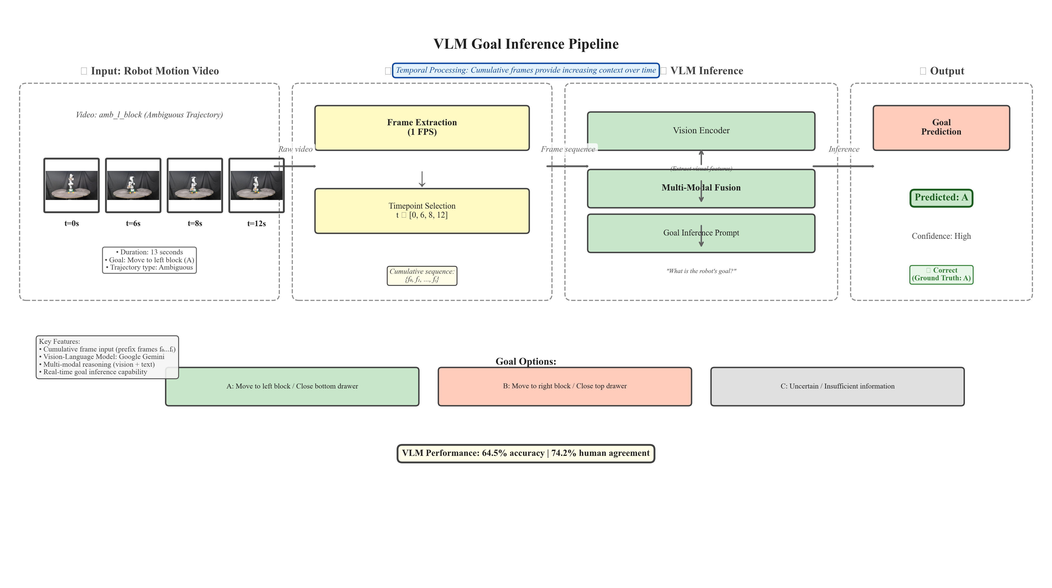
VLM Pipeline With Frames
17
Notes:
This figure shows the full VLM evaluation pipeline with the actual cumulative frame input. A robot video is sampled at selected timepoints, frames are accumulated from the start up to the current time, and Gemini uses that growing visual evidence to make a goal prediction.

Slide 18
Prefix-Frame Prompting Strategy
18
Exact prompt logic from prompt.py; the shared body stays fixed and the opening context changes by mode
Exact mode-specific context block
if mode == "prefix_frames": context_text = f""" You are evaluating LEGIBILITY of a robot arm trajectory: how early a typical human observer can infer the robot's intended goal from its path shape. You are given MULTIPLE images showing frames from t=0 to t={t_sec} seconds from video_id = "{video_id}". Frames are ordered from earliest to latest; you have observed the motion up to time t={t_sec}s. Use ALL frames provided to analyze the robot arm's APPROACH PATH.""" else: # single_frame (default) context_text = f""" You are evaluating LEGIBILITY of a robot arm trajectory: how early a typical human observer can infer the robot's intended goal from its path shape. You are given ONLY ONE image: a single video frame captured at time t = {t_sec} seconds from video_id = "{video_id}". Use ONLY this frame. Do NOT assume you saw earlier or later frames."""
Shared exact prompt body sent with the image input
There are exactly two candidate goals: Goal A: {goal_A} Goal B: {goal_B} TASK-SPECIFIC CONTEXT: In this robot pick task, the robot approaches its target block by curving its arm path laterally. A robot committed to the LEFT goal will show a path that curves LEFT of center during the approach. A robot committed to the RIGHT goal will show a path that curves RIGHT of center. The key signal is the LATERAL BIAS of the arm's trajectory arc, NOT just the final gripper position. Look at the arm's PATH SHAPE across the frames (if multiple frames are provided): does the arm's trajectory bow LEFT, bow RIGHT, or remain straight/ambiguous? Use this lateral path curvature as evidence for the goal. Based on the arm's path shape and any other available evidence, assign probabilities: - pA = P(Goal A | observed frames) [a strong left-curving path supports Goal A if Goal A is the left target] - pB = P(Goal B | observed frames) Constraints: - 0 <= pA, pB <= 1 - pA + pB = 1 (within rounding) YOU MUST MAKE A DECISIVE CALL. If you observe any lateral bias in the arm path, commit to it. Only output pA=0.5 if there is truly NO directional signal whatsoever (e.g. arm is stationary at center at t=0). Provide EXACTLY ONE short visual cue describing the arm's PATH SHAPE (e.g. "arm bows left of center", "arm tracks directly right", "arm at home position - no path visible yet"). Also output legibility: - "legible_now" if the path shape is clear enough that a human could confidently infer the goal NOW - "not_legible_yet" if the motion is still ambiguous Output ONLY valid JSON with keys: pA, pB, cue, legible. No markdown. No extra text. No code fences. Example format: {"pA": 0.78, "pB": 0.22, "cue": "arm arc bows distinctly leftward during approach", "legible": "legible_now"}
Source: C:\\Users\\anude\\OneDrive\\Documents\\gemini_vlm_eval\\src\\gemini_vlm_eval\\prompt.py
Notes:
This slide shows the exact prompt logic used in the Gemini evaluation code. The opening context depends on the evaluation mode: single_frame uses only the current frame, while prefix_frames tells the model that it is seeing an ordered sequence from time zero up to the current time. The rest of the prompt stays fixed and forces structured output in JSON.

Slide 19
Manifest And Prompt Flow
19
The manifest tells the pipeline which video, goal pair, and labels to use before the prompt is assembled and sent
1. load_manifest()
2. extract frames
3. build prompt
4. Gemini call
Reads manifest.jsonl and builds one ManifestEntry per video.
->
extract_and_cache_frames() creates timestamped frames and chooses single or prefix input.
->
get_instruction_prompt(...) uses goal_A, goal_B, t_sec, video_id, and mode.
->
GeminiClient.evaluate_frame() sends prompt plus images and parses JSON output.
Example manifest row
Why the manifest is used
{"video_id":"amb_l_block","video_path":"videos/amb l block.mp4", "goal_gt":"A","goal_A":"pick the left block","goal_B":"pick the right block", "scene_id":"block_scene","task_family":"block_pick","traj_type":"ambiguous"}
- Each video has a different goal pair and ground-truth label.
- The same code can evaluate all videos without hardcoding prompt text per case.
- It preserves task_family, traj_type, scene_id, and notes for later analysis and reproducibility.
Flow source: scripts/eval_dataset.py -> src/gemini_vlm_eval/client.py -> src/gemini_vlm_eval/prompt.py -> data/manifest.jsonl
Notes:
The manifest is the dataset-level control file for the evaluation pipeline. Each row tells the pipeline which video to open, what the two candidate goals are, what the ground-truth goal is, and which task family and trajectory type the video belongs to. In the code, eval_dataset.py loads each row into a ManifestEntry, extracts frames, and passes the entry into GeminiClient.evaluate_frame. That client then calls get_instruction_prompt using goal_A, goal_B, t_sec, video_id, and mode. The manifest matters because each video has different goals, so the prompt cannot be hardcoded once for the whole dataset.

Slide 20
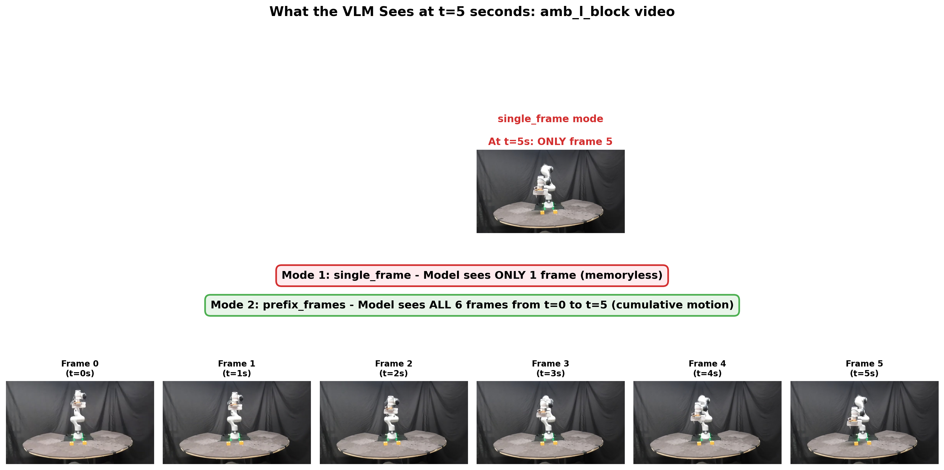
Input Comparision
20
Notes:
This slide compares the two Gemini input modes used in the evaluation. In the single-frame mode, the model only sees the current frame at that timepoint. In the prefix-frames mode, the model sees all frames from the start up to that timepoint, which better matches cumulative human observation of motion.

Slide 21
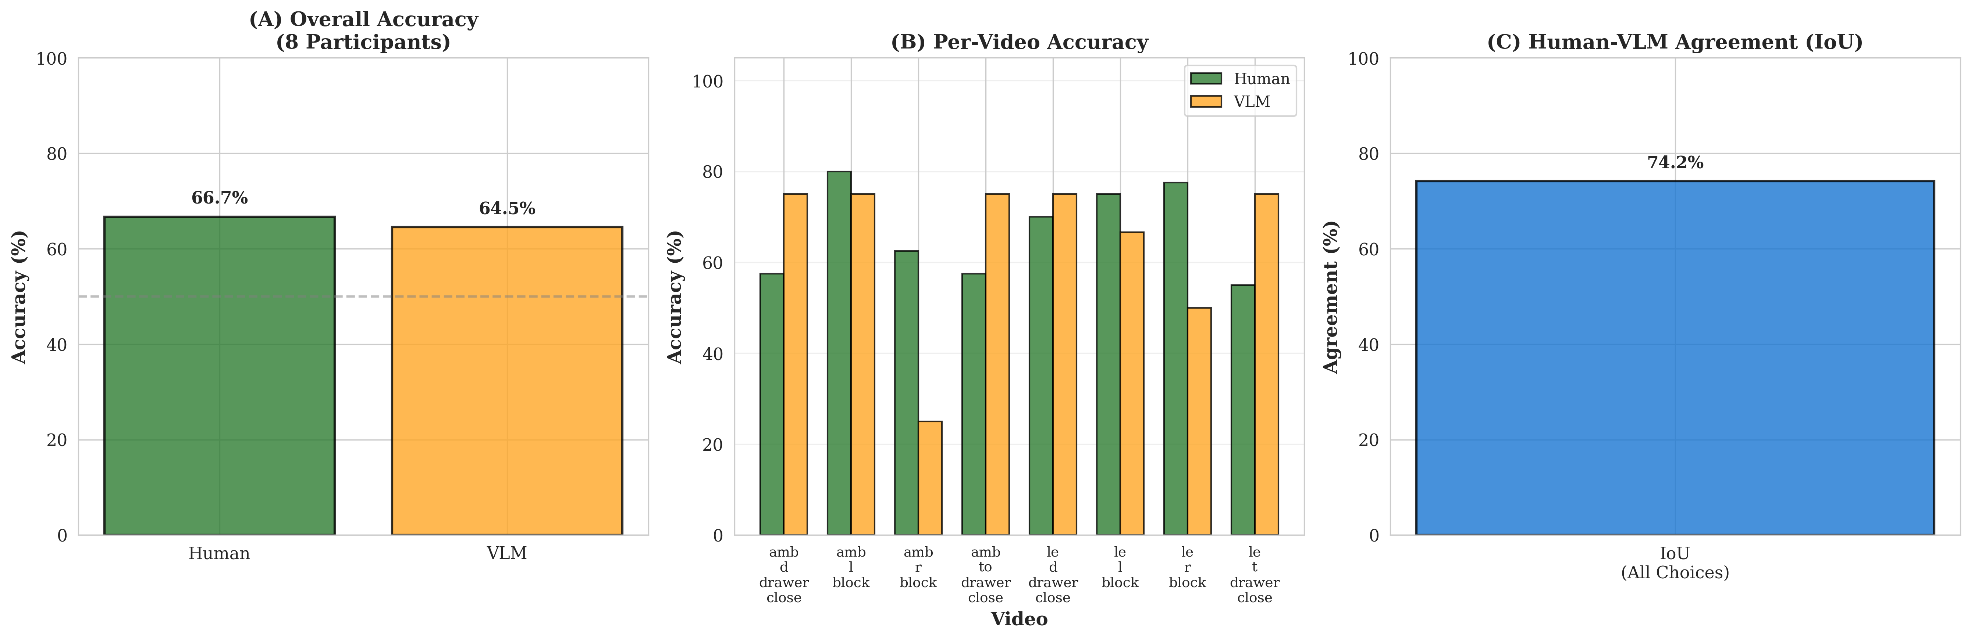
Metrics: Accuracy, IoU, Time-to-Legibility
21
Notes:
This slide summarizes the main quantitative comparison. It shows overall accuracy, per-video accuracy, and overall human-VLM agreement measured with intersection-over-union.

Slide 22
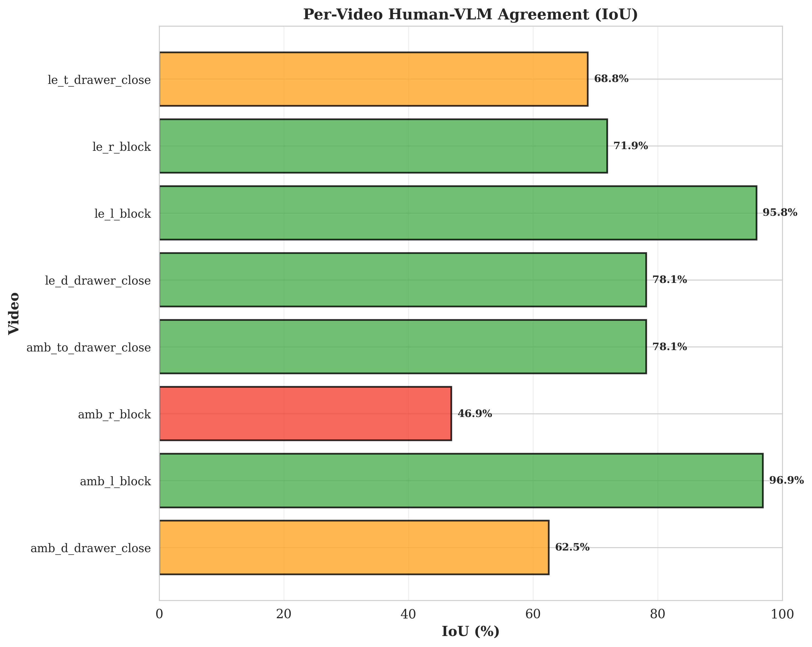
Per-Video Human-VLM Agreement (IoU)
22
Notes:
This slide breaks the agreement down by video, showing which motion trajectories aligned strongly with human judgment and which cases were harder for the VLM.

Slide 23
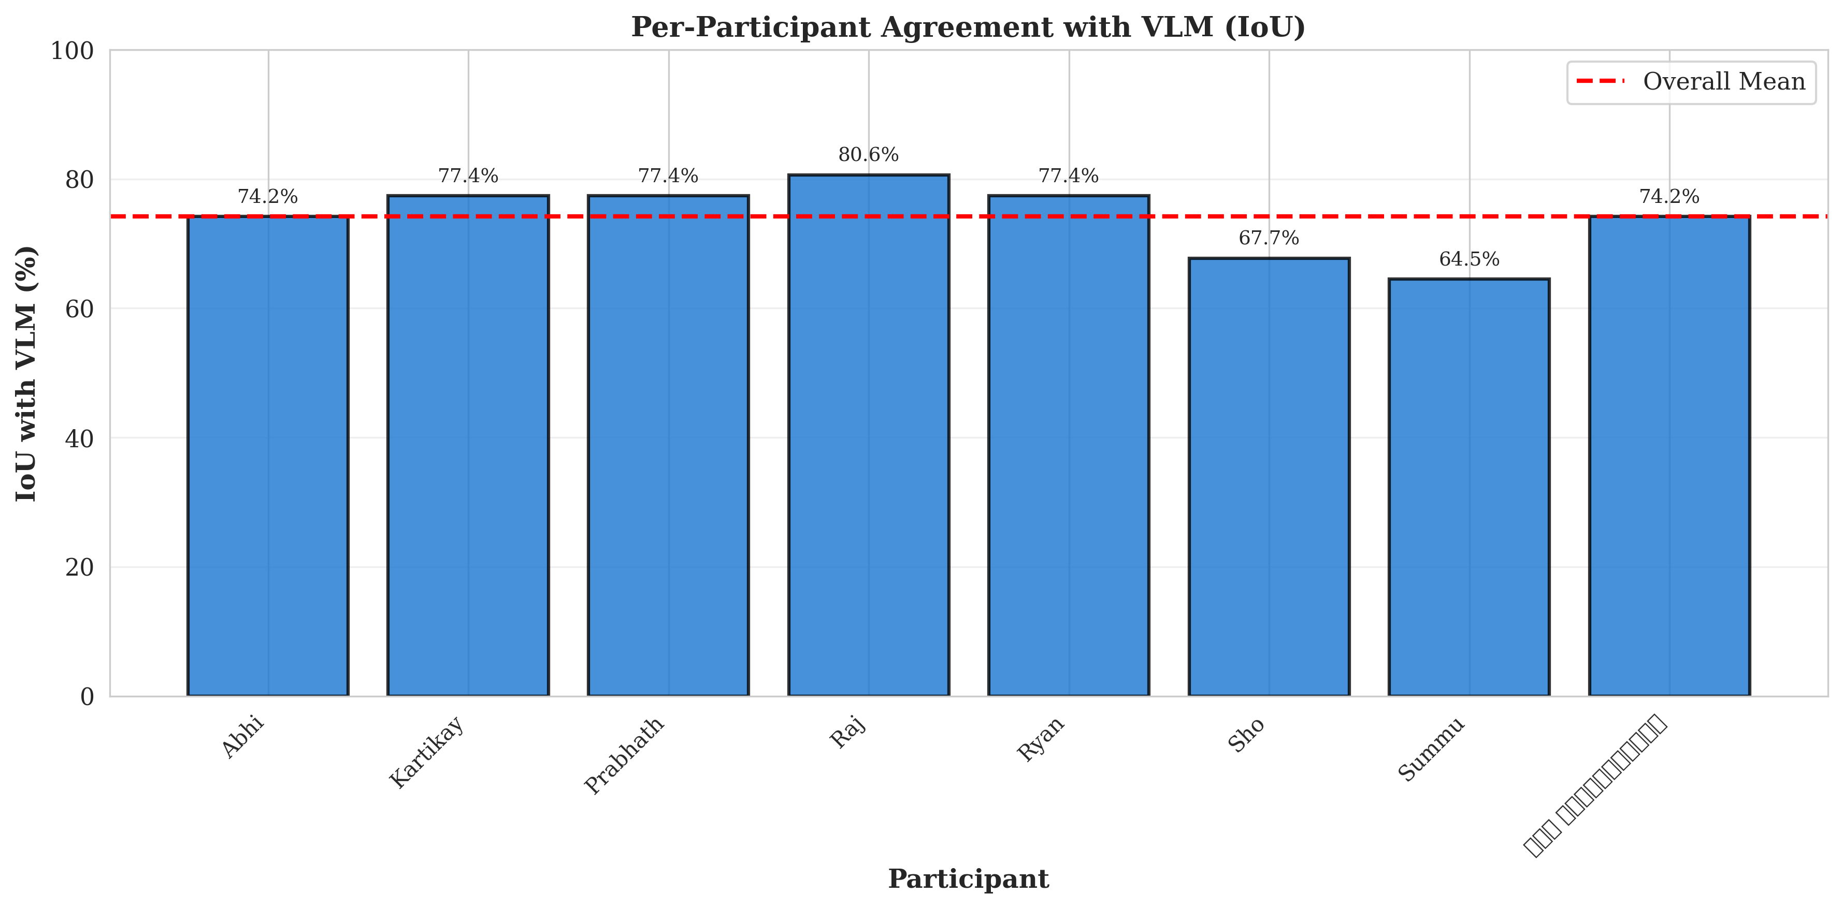
Per-Participant Agreement with VLM (IoU)
23
Notes:
This slide shows agreement between each participant and the VLM, which helps us see whether the model tracks only an average trend or aligns reasonably across multiple individual observers.

Slide 24
Diffusion-Policy Steering Framework
24
Layer 0: the TwoBlockPickEnv environment defines the action interface, physics rollout, and observation returned to every collector and policy
Action API
Observation
Physics
Position Scale
5-D
22-D
20
0.05 m
[dx, dy, dz, dyaw, grip] in [-1, 1]
EE pose, gripper, left block, right block
PyBullet substeps per env step
Default delta position scale per step
Observation layout
Action in
Scale
IK control
Physics
ee_pos(3) + ee_quat(4) + grip(1) left_cube_pos(3) + left_cube_quat(4) right_cube_pos(3) + right_cube_quat(4) The base env returns raw state only; V2 later appends context and behavior mode.
dx dy dz dyaw grip
0.05 m on xyz 15 deg on yaw then clip targets
inverse kinematics for Panda arm plus gripper cmd
20 PyBullet substeps then success check
What step() returns
StepResult(obs, reward, done, info) reward = 1 only when a cube is lifted above the success threshold. info carries success_left, success_right, picked_left, picked_right, and step count.
Codeflow note
Base env default = 200 steps. All demo collectors override it to 400.
Notes:
This slide is the bottom layer of the steering stack. The environment takes a 5-D normalized action, scales the position deltas by 5 centimeters and yaw by 15 degrees, solves inverse kinematics for the Franka arm, runs 20 PyBullet substeps, and returns a 22-D raw state observation. One subtle implementation detail is that the base environment defaults to 200 steps, but all three collection scripts override it to 400-step episodes for slower, more legible trajectories.

Slide 25
Layer 1 Data Collection: demos.npz
25
collect_demos_twoblockpick.py builds the base two-goal dataset with legible quadratic Bezier approaches
Dataset size
Targets
Episode length
400
200 / 200
400
10 configs x 20 arcs x 2 targets
Balanced left-pick and right-pick episodes
Collector buffers full length, then stores true stop time
Trajectory design
What gets saved
10 scene configs keep the block layout varied but symmetric. 20 quadratic Bezier arc variations sweep toward the chosen side. Control-point lateral sweep ranges from 5 cm to 28 cm.
obs (N, 400, 22) observations per timestep actions (N, 400, 5) delta actions per timestep episode_lengths (N,) actual stop time per episode labels (N,) target block: left or right config_ids (N,) which of the 10 block layouts ran metadata_json string collection settings and counts
Collection loop
build config + arc schedule -> choose target side -> roll out ScriptedExpert in the env -> retry until a successful pick -> save arrays and the demo video
Notes:
This is the simplest collection layer. The script builds 10 block-position configurations, pairs every arc variation with both left and right goals, rolls out a waypoint-based scripted expert, retries until the pick succeeds, and stores full observation and action tensors. The saved file is demos.npz, and a matching demo video is exported for every episode.

Slide 26
Layer 1 Data Collection: demos_combined.npz
26
collect_demos_combined.py mixes legible, neutral, and deceptive motion styles for training and steering experiments
Legible
Neutral
Deceptive
200
100
100
Quadratic Bezier arc toward the target side
Quadratic Bezier with cp_y fixed at 0
Cubic Bezier feint wrong side, then commit
Style logic
What gets saved
legible : lateral control point points toward the true goal neutral : no lateral bias before descent deceptive : early motion suggests the wrong goal, then recovers to the right cube
obs (N, 400, 22) actions (N, 400, 5) episode_lengths (N,) labels (N,) target side style_labels (N,) 0=legible, 1=neutral, 2=deceptive style_names (N,) string label for the style arc_idxs (N,) variation index within the style bucket config_ids (N,) block layout id metadata_json string
Collector detail
Environment settings changed from demos.npz
Checkpoint and resume is built in: the script writes a _ckpt.pkl snapshot every 20 demos.
cube_half = 0.015 m, cube_mass = 0.08 kg, cube_lateral_friction = 2.5 for more stable grasping during mixed-style collection.
Notes:
This dataset is where steering starts to matter. Instead of only legible arcs, the collector mixes three motion styles: legible, neutral, and deceptive. It saves both the target label and the style label, which makes it useful for evaluating whether a learned model can preserve task success while changing how early the motion communicates intent.

Slide 27
Layer 1 Data Collection: demos_v2.npz
27
collect_demos_v2.py extends the observation with context and behavior mode so the policy can condition on more than raw robot state
Observation
Planned demos
Saved labels
26-D
500
5 types
22-D base obs + context_xyz + behavior_mode
200 legible, 100 predictable, 100 grounding, 100 safety split
legible, predictable, safety_legible, safety_predictable, grounding
Observation extension
What gets saved
22-D env state + context_xyz(3) + behavior_mode(1) behavior_mode: +1 legible, -1 predictable, 0 grounding
obs (N, 400, 26) actions (N, 400, 5) episode_lengths (N,) types (N,) behavior label string targets (N,) left or right block behavior_modes (N,) +1.0, -1.0, or 0.0 metadata_json string
Behavior schedule
200 legible 100 predictable 50 safety_legible 50 safety_predictable 100 grounding Safety adds obstacle context. Grounding adds waypoint context.
Collector detail
Only the first few videos per type are exported for preview. Episodes that still fail after 10 retries are skipped, so the final saved N can be below the planned 500.
Notes:
The V2 collector is the conditioning-ready version of the dataset. It appends a context vector and behavior mode to the original 22-D observation, then mixes legible, predictable, safety, and grounding scenarios. One important correction from the copied summary is that the saved file uses five type labels, and the final count can be slightly below 500 because the script skips episodes that still fail after repeated retries.

Slide 28
Data Distribution & Diversity: demos.npz
28
The first dataset varies scene geometry and arc size, but keeps motion style fixed to legible trajectories only
Total
Targets
Arc family
Behavior modes
400
200 / 200
20 / side
1
10 configs x 40 episodes per config
Balanced left and right picks
All are quadratic Bezier and legible
Single behavior only: no safety, grounding, or predictable mode
Axes of variation
Target side 200 left + 200 right (balanced) Block configs 10 configs x 40 episodes per config Type A (4) both blocks shifted symmetrically; dx in {-5, 0, +5} mm; one dy = +/-4 mm Type B (3) only left block shifted: (-5,0), (+5,0), (0,+4) mm Type C (3) only right block shifted: same offset set as Type B Arc variations / side 20 quadratic Bezier arcs, all legible and curved toward target Control-point sweep cp_y_mag: 5 cm to 28 cm Control-point height cp_z: 0.56 m to 0.68 m Control-point depth cp_x: 0.38 m to 0.28 m Approach height randomized per episode: 6 cm to 12 cm Behavior label none; this dataset stores target only
Takeaway
This is a purely legible arc dataset. Diversity comes from left/right goals, block placement, and arc magnitude, not from multiple behavior types.
Notes:
This slide shows that demos.npz is diverse in geometry and trajectory size, but not in behavior type. The collector changes block layout and arc magnitude, yet every path is still a legible trajectory that curves toward the correct goal. So this dataset is best thought of as a clean legibility-only base set.

Slide 29
Data Distribution & Diversity: demos_combined.npz
29
The second dataset keeps the same scene structure but adds style diversity: legible, neutral, and deceptive motion
Total
Style split
Targets
Key addition
400
200 / 100 / 100
200 / 200
Style
Same 10 config x 40 episode recipe
Legible, neutral, deceptive
Balanced left and right picks
This is where intent expression becomes a dataset variable
Axes of variation
Style split 200 legible (50%) + 100 neutral (25%) + 100 deceptive (25%) Target side 200 left + 200 right (balanced) Block configs 10 configs x 40 episodes per config Legible arcs 10 per side; quadratic Bezier; cp_y_mag 5 cm to 28 cm toward target Neutral arcs 5 per side; quadratic Bezier; cp_y fixed at 0 for no lateral bias Deceptive arcs 5 per side; cubic Bezier; P1 feints wrong side, P2 commits correct side Feint timing wrong-side cue around t~0.3, most ambiguous around t~0.5, committed by t~0.7 Cube physics cube_half = 1.5 cm, cube_mass = 0.08 kg, friction = 2.5 Saved labels target side + style label + style name + arc index + config id
Takeaway
Compared with demos.npz, the main gain is style diversity. The dataset now includes ambiguous and actively misleading trajectories, not just more or less curved legible ones.
Notes:
This dataset adds the key dimension missing from demos.npz: motion style. It still spans left/right targets and block configurations, but now the same task can be expressed as legible, neutral, or deceptive. That makes it much more useful for steering and style-aware evaluation.

Slide 30
Data Distribution & Diversity: demos_v2.npz
30
The third dataset adds conditioning context and behavior-mode signals on top of scene and trajectory diversity
Planned total
Observation
Behavior types
Mode values
~500
26-D
5
+1 / -1 / 0
May be slightly lower because failed episodes can be skipped
22 base + 3 context_xyz + 1 behavior_mode
legible, predictable, safety_legible, safety_predictable, grounding
Legible, predictable, grounding
Axes of variation
Behavior split 200 legible + 100 predictable + 50 safety_legible + 50 safety_predictable + 100 grounding Target side balanced left/right within each behavior family Block configs same 10 block-position configs as earlier datasets Legible vars 10 vars; quadratic Bezier toward target; cp_y_mag 8 cm to 28 cm Predictable vars 5 vars; quasi-straight quadratic path via midpoint upward bulge; approach_h 6 cm to 12 cm Safety-legible obstacle placed on straight path at x=0.46, y~+/-2 cm; wider arcs 12 cm to 28 cm Safety-predictable obstacle placed on curved path at x=0.38, y~+/-11 cm Obstacle cyan cylinder, radius 3.5 cm, height 18 cm, visual-only; xyz goes into context Grounding 5 waypoints x 2 sides; home -> hover waypoint -> rise -> transit -> pick Context signal [0,0,0] for legible/predictable; obstacle xyz for safety; waypoint xyz for grounding
Takeaway
This dataset adds both richer behavior diversity and explicit context conditioning, making it the most suitable set for CFG-style conditioning and behavior steering experiments.
Notes:
The V2 set is the most expressive one. It keeps the task diversity from the earlier datasets, but now adds predictable, safety-reactive, and grounding behaviors, plus a context vector and behavior-mode value inside the observation itself. That makes it the strongest candidate for conditioning-aware diffusion policy experiments.

Slide 31
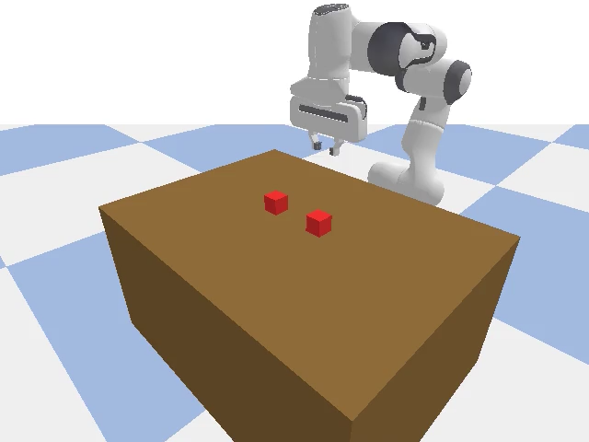

Video Examples: Legible Arc Magnitude
31
Same goal and scene from demos.npz, but different arc sizes show different levels of early lateral commitment
cfg00_left_arc00.mp4 | smaller legible arc
cfg00_left_arc15.mp4 | larger legible arc
What to say
Both trajectories reach the same left target. The difference is path shape: the larger arc communicates commitment earlier because the lateral sweep away from center is more obvious.

Slide 32


Video Examples: Neutral Vs Deceptive
32
Qualitative examples from the mixed-style dataset show the difference between ambiguous motion and actively misleading motion
preview_neutral_left_var04.mp4 | neutral
preview_deceptive_left_var04.mp4 | deceptive
What to say
The neutral motion hides directional information until late in the trajectory. The deceptive motion is stronger: it first suggests the wrong side, then later commits back to the true target.

Slide 33

Video Example: Grounding Behavior
33
A V2 grounding example where the policy-relevant context is a waypoint, not only the final pick target
grounding_left_cfg05_v00.mp4
What to say
This behavior first hovers over the waypoint context, then transitions toward the left pick. It is useful because the context signal changes the motion plan before the final grasp.

Slide 34

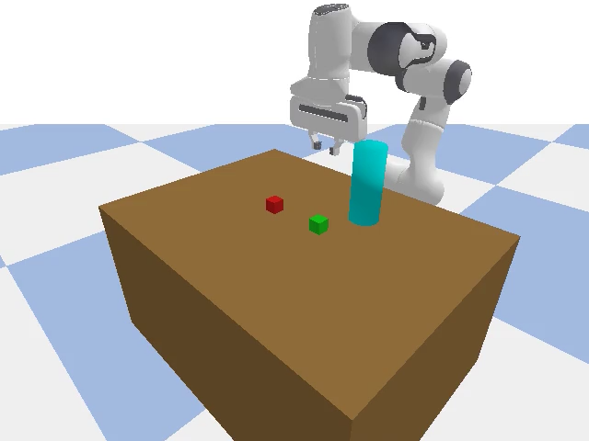
Video Examples: Safety-Legible Vs Safety-Predictable
34
Both behaviors are obstacle-aware, but they express intent differently depending on where the obstacle is placed
safety_legible_left_cfg03_v01.mp4 | obstacle on straight path -> take curve
safety_predictable_left_cfg04_v04.mp4 | obstacle on curved path -> go straighter
What to say
In safety-legible motion, the straight path is blocked so the robot uses a wider curved approach. In safety-predictable motion, the obstacle sits on the curved side, so the robot takes the more direct path instead.

Slide 35
Training Data And Learning Setup
35
train.py turns demonstration episodes into observation-conditioned action chunks, then normalizes them before diffusion training
Input file
Training sample
Chunk stride
Batching
.npz demos
obs_t + plan_H
H / 2
64
obs, actions, and episode_lengths from the collected datasets
One current observation plus one future horizon-length action sequence
Overlapping chunks are extracted every horizon/2 steps
DataLoader shuffles normalized chunks during training
What DemoDataset does
Normalization used in train.py
1. Load obs, actions, and episode_lengths. 2. Cut each episode into horizon-sized action chunks. 3. Pair each chunk with the observation at its start time. 4. Compute global mean and std over all valid timesteps. 5. Return normalized tensors for training.
obs_norm = (obs - mu_obs) / sigma_obs action_norm = (action - mu_act) / sigma_act The script stores these statistics in the checkpoint so evaluation uses the same scale.
Simple thesis explanation
Instead of predicting one action at a time, the model learns a short future action plan. Each training example says: given the robot state now, what should the next horizon of actions look like? Diffusion training then learns this plan as a denoising problem.
Useful note
train.py is GPU-only and saves checkpoints at epochs 50, 100, and the final epoch.
Notes:
This slide should make the training data story feel simple. The training script does not use whole episodes directly. It converts them into overlapping horizon-length action chunks, pairs each chunk with the observation at the chunk start, and z-score normalizes both observations and actions. Those normalization statistics are saved in the checkpoint and reused during evaluation.

Slide 36
Diffusion Policy Architecture And Objective
36
The model takes a noisy action sequence, a diffusion timestep, and the current observation, then predicts the noise that should be removed
Input 1
Input 2
Input 3
Output
noisy actions
timestep t
current obs
eps_hat
A horizon-length action sequence with Gaussian noise added
Sinusoidal time embedding tells the model how noisy the sample is
Observation embedding is broadcast across the whole horizon
The model predicts noise, not bounded actions
Forward process
Conditioning
U-Net policy
Training target
clean action plan + Gaussian noise -> x_t
time embedding + observation embedding
encoder bottleneck decoder + skips
predict epsilon then compare to true noise
Core formulas to present
What train.py does each batch
xₜ = √(ᾱₜ) x₀ + √(1 − ᾱₜ) ε L = ‖ ε_θ(xₜ, t, obs) − ε ‖²₂
1. Sample a random diffusion timestep. 2. Draw Gaussian noise. 3. Corrupt the clean action chunk. 4. Predict the noise with the policy. 5. Minimize MSE loss. 6. Update the EMA copy for stable evaluation checkpoints.
Notes:
This is the core diffusion slide. The clean way to explain it is: we corrupt a future action plan with Gaussian noise, and the policy learns to predict the noise that was added. The observation and timestep tell the network what state the robot is in and how far along the noising process this sample is. The script also maintains an EMA model, and that EMA version is what gets saved for evaluation.

Slide 37
Sampling Actions At Test Time
37
eval_with_videos.py reverses the diffusion process with DDIM, denormalizes the action plan, and executes it through the environment
Checkpoint
Sampler
Planner output
Execution
EMA model
DDIM
action horizon
queue + replan
The evaluation script loads the EMA weights from training
Uses 10 reverse denoising steps by default
The script samples a whole action sequence, not a single action
Actions are popped from a queue and resampled when empty
1. Normalize obs
2. Start from noise
3. DDIM reverse steps
4. Denormalize
5. Execute
use mu_obs and sigma_obs from checkpoint
x_T ~ N(0, I) for the full action horizon
denoise x_t -> x_0 using the policy prediction
action = action_norm * sigma_act + mu_act
push to queue step env
Simple sampling formulas
Simple thesis explanation
x̂₀ = (xₜ − √(1 − ᾱₜ) ε̂) / √(ᾱₜ) xₜ₋₁ = √(ᾱₜ₋₁) x̂₀ + √(1 − ᾱₜ₋₁) ε̂
At test time, the policy works like a planner. It starts from random noise, gradually denoises a future action sequence conditioned on the current observation, and then the robot executes that sequence. When the queue is empty, the script samples a fresh plan from the latest state.
Notes:
This slide is the easiest way to explain test-time inference. The checkpoint provides both the EMA weights and the normalization statistics. The evaluator normalizes the current observation, samples a full action horizon from Gaussian noise using DDIM, denormalizes the actions back to the robot's action scale, and executes them from a queue. When the queue runs out, it replans from the latest observation.

Slide 38
Evaluation With Videos
38
The evaluation script rolls out the learned policy in TwoBlockPickEnv, records all episodes, and saves both quantitative and qualitative outputs
Environment
Video policy
Folders
Saved metadata
400-step eval
record all
2 video dirs
results.json
TwoBlockPickEnv with episode_length = 400 and cube_jitter = 0.0
Both successful and failed episodes are saved as videos
Videos are separated into videos_success and videos_failure
Per-episode success, picked_side, steps, and video_path
Episode loop in eval_with_videos.py
Metrics computed at the end
1. Reset environment. 2. Start video recording after reset. 3. Sample actions when the queue is empty. 4. Step the environment until done or 400 steps. 5. Stop video before closing env. 6. Move the video into the success or failure folder.
Success Rate = (1/N) Σᵢ 1[successᵢ] Mean Length = (1/N) Σᵢ Tᵢ The script also counts successful and failed episodes explicitly.
Why this script matters in the thesis
This script gives both quantitative and qualitative evaluation. Quantitatively, it reports success rate and average rollout length. Qualitatively, it preserves every rollout as a video, so we can inspect whether the learned behavior is smooth, legible, unstable, or failure-prone in ways that a single scalar score would miss.
Good one-line explanation
train.py learns the policy from demonstrations; eval_with_videos.py tests it in the simulator and records what actually happens.
Notes:
This final slide should connect the script back to the thesis goal. The evaluation script is valuable because it does not only compute summary numbers. It records every rollout, including failures, and stores episode-level metadata. That makes it possible to compare not only task success but also visible motion quality and failure modes.

Slide 39
Implementation Details
39
Notes:
Placeholder slide reserved for final implementation details.

Slide 40
Pilot Study Results
40

Slide 41
Gemini vs Human Comparison
41

Slide 42
Agreement and Failure Cases
42

Slide 43
Exploratory VLM-Based Steering Results
43

Slide 44
Summary of Findings
44
Vision-language models as proxies for human judgment of robot motion legibility
Near-human VLM performance
Temporal stability improves with model strength
Prefix frames help every model
Gemini-3-pro-preview and Gemini-3.1-pro-preview reached 95.45% accuracy, only 2.8% below human accuracy at 98.25%.
The Gemini 3 Pro models showed only 1 choice flip across all 8 videos, compared with 6 for Flash.
Cumulative temporal context consistently improved accuracy over single-frame prompting for every model tested.
Primary failure mode is spatial disambiguation
Model generation matters more than minor version
The hardest cases were left-right block confusion and top-bottom drawer confusion. All models failed on the amb_to_drawer_close video.
Gemini-2.5-pro achieved 76.5%, far below Gemini-3-pro-preview at 95.45%, while the 3.0 to 3.1 change produced no measurable gain.
Overall conclusion
Modern VLMs can plausibly act as scalable legibility critics, but their weakest point is still geometric and spatial reasoning in ambiguous scenes.

Slide 45
Summary of Findings: Multimodal Policy
45
Main takeaways from the diffusion-policy steering and reranking experiments
CFG enables multi-behavior steering without retraining
A single 8.8M-parameter policy with lambda = 2.0 achieved roughly 90 to 100% success across all four behaviors at inference time.
VLM reranking gives the strongest gain for legibility
Gemini 3 Pro Best-of-4 improved legibility from 40% to 100%, with a discrimination gap of +0.629.
Behavior-specific unconditional masking is critical
Legibility and predictability need only the behavior-mode channel zeroed, while safety and grounding also require the context position to be zeroed.
Practical takeaway
A single policy can express multiple behaviors, but the strongest legibility improvement came from selection and reranking rather than from the base sampler alone.

Slide 46
Limitations
46
Constraints of the VLM-as-proxy evaluation study
Very small evaluation set
Binary goal space
Sparse time sampling
Only 8 videos, split into 4 legible and 4 ambiguous cases, which limits statistical power and generalization.
The setup is strictly A-versus-B, while real HRI often involves continuous or multi-goal action spaces.
Models were queried at only about four human-study timepoints per video, so intermediate motion dynamics were not analyzed.
Commercial API dependency
No unseen-domain validation
Results rely on proprietary, versioned Gemini endpoints that may change, be deprecated, or update silently over time.
All videos share the same robot platform, scene layout, and two-goal structure, so transfer to other robots and viewpoints is untested.
Takeaway
The current study is a strong pilot, but not yet a broad benchmark for VLM-based legibility judgment.

Slide 47
Future Work
47
Next steps for both the VLM legibility critic and the multimodal policy direction
Closed-loop VLM steering
Sim-to-real transfer
Replace open-loop Best-of-K reranking with online, step-level guidance from real camera observations.
Deploy the method on a physical Franka Panda and test whether the learned behaviors remain stable outside PyBullet.
Human-subject validation
Broader task coverage
Run observer studies to validate whether L_early and VLM-based improvements correspond to real human judgments.
Extend the framework to more robots, more viewpoints, and more than two competing goals per task.
Longer-term goal
Build a practical observer-aware learning loop where VLM critics, policy sampling, and human validation reinforce each other.

Slide 48
Limitations: Multimodal Policy
48
Current limitations of the steering and reranking experiments
Single simulated environment
All results come from TwoBlockPick in PyBullet, so generalization to real robots and other task families is still untested.
Execution non-determinism reduces VLM gains
Re-executing sampled trajectories from scratch introduces stochasticity, which helps explain why VLM-guided gains were weaker for safety and grounding.
No human-subject validation for policy legibility
L_early is currently a Bayesian legibility metric; it has not yet been validated against actual human observer studies for these policy outputs.
Takeaway
The policy results are promising, but they should be treated as an initial steering study rather than a final human-centered validation.

Slide 49
49
Thank You
Questions?
Vision-Language Models as Proxies for Human Judgment of Robot Motion Legibility
Anudeep Sai Gottapu | April 2026

