Slide 1
Legible Robot Trajectories via Diffusion Policy + VLM Guidance
Thesis Progress Report: Decisions, Debugging & Results TwoBlockPick | Franka Panda | Gemini VLM | LegDiff CFG
February 8 – March 31, 2026 | 10 Engineering Phases
April 2026

Slide 2
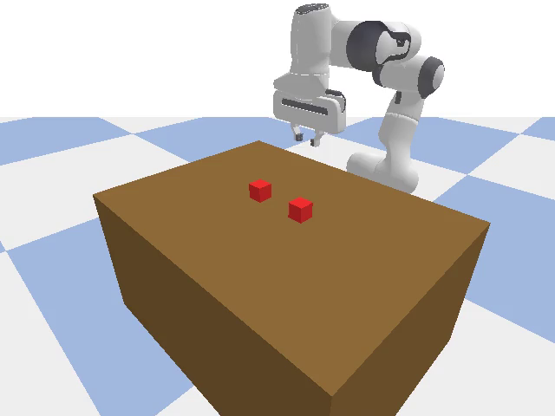
Research Context & Goal
What is legibility and why does it matter for human-robot interaction?
Legibility (Dragan et al., 2013): An observer can predict the robot's goal early in the trajectory (first 30-40% of motion).
Problem: Diffusion policies produce efficient but ambiguous straight-line paths — an observer cannot tell which block the robot intends to pick until it is almost there.
Goal: Steer the policy at inference time to produce curved (arcing) trajectories that reveal intent earlier, without sacrificing task success and without retraining.
Four steering setups explored:
1. Online VLM Best-of-K reranking (Feb 24)
2. Proxy geometric scorer (Feb 26)
3. Paired replanning with VLM (Feb 28)
4. LegDiff: CFG-conditioned diffusion (Mar 30)
TwoBlockPick: Franka Panda, two red blocks at y=±0.07m, 22-dim obs, 5-dim actions

Slide 3
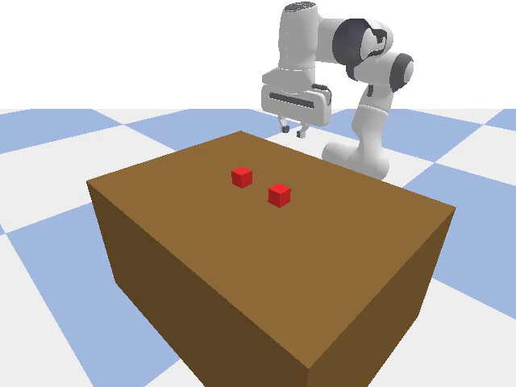
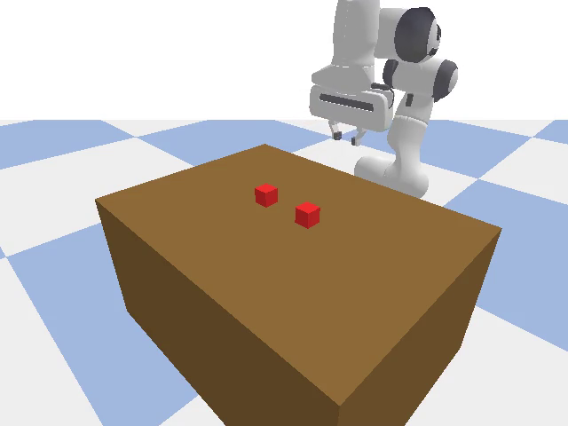
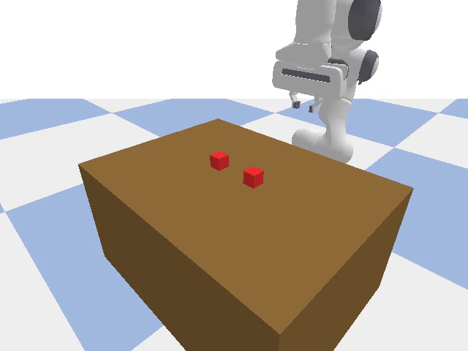
Task, Environment & Demonstration Data
Phase 1 Feb 8–13
400 Bézier demonstrations | 20 arc levels × 2 sides × 10 configs
Arc 00 — Straight
Arc 10 — Moderate
Arc 19 — Strong
Observation 22-dim: EE pose (7) + block pos (6) + gripper (2) + joints (7)
Action 5-dim: Δx, Δy, Δz, Δyaw, gripper | Scale: 0.05 m/step
Camera: yaw=135°, pitch=−30°, dist=0.9m | 640×480 @ 30Hz
Bézier arc index 0–19 controls curvature; class 15–19 = legible arcs (arc > 0.134m)
Each config places blocks at fixed positions; arc determines approach trajectory shape

Slide 4
Decision 1: Architecture Search — 12 Training Runs
Phase 2 Feb 8–22
Why we settled on UNet Conv1d (8.7M params) over smaller MLP models
Run | Date | Architecture | Params | Epochs | Success | Decision
1 | Feb 8 | MLP 3-layer | ~1M | 300 | 0% | Too small
2 | Feb 10 | MLP 6-layer | ~3M | 300 | 0% | Still fails
3 | Feb 11 | Conv1d shallow | ~5M | 300 | 0% | Under capacity
4-7 | Feb 11–13 | Various MLPs | 1–5M | 300 | 0% | All fail
8 | Feb 13 | UNet Conv1d | 8.7M | 300 | 14% | ✔ First success
9 | Feb 17 | UNet H=48 n=16 | 8.7M | 300 | 0–8% | Horizon broke it
10 | Feb 22 | UNet + bug fixes | 8.7M | 100 | 84–96% | ✔ FINAL
Key insight: Small models (1–5M params) cannot represent the 400-demo multimodal distribution with 20 arc levels. UNet Conv1d with skip connections was necessary.
Run 8 was the first to succeed — 14% at epoch 300. Runs 1–7 all got 0%.
Run 9 changed horizon 32→48 and execute_steps 8→16 simultaneously — broke the policy entirely. Reverted in Run 10.
Run 10 with critical bug fixes (see next slides) achieved 84–96% success.

Slide 5
Decision 2: Fixing execute_steps — 0% → 50% Success
Phase 3 Feb 16
Training loss was 0.004 (good) but simulation success was 0% (bad)
Symptom: Checkpoint loss was excellent (0.004) but the robot failed every episode in simulation.
Root Cause: execute_steps was set to 16 in eval, but the model was trained on consecutive timesteps.
• Training sees: obs[t], obs[t+1], obs[t+2], ...
• With es=16: obs[t], obs[t+16], obs[t+32], ...
• The model sees OOD (out-of-distribution) observations
• → erratic actions → 0% success
Fix: Set execute_steps = 8 everywhere.
• es=1: 0% (too chaotic, constant replanning)
• es=8: 10–50% ✔ (matches training temporal structure)
• es=16: 0% ✘ (OOD observations)
Lesson: Eval temporal structure must match training.
execute_steps | Success | Status
1 | 0% | ✘ Chaotic
8 | 10–50% | ✔ Optimal
16 | 0% | ✘ OOD obs
This was the first major debugging breakthrough. It took 3 days of systematic testing to isolate execute_steps as the root cause.

Slide 6
Decision 3: Horizon Mismatch — Don't Change Multiple Hyperparams
Phase 3 Feb 17
Changed H, n_action_steps, smooth_weight simultaneously → 0% success
Run | Horizon | n_action_steps | smooth_weight | Success | Issue
Baseline | 32 | 8 | 0.01 | 14% | Working reference
Run 2 | 48 | 16 | 0.05 | 8% | Action amplification
Run 3 | 48 | 16 | 0.05 | 0% | Action suppression
Run 4 | 32 | 8 | 0.01 | 14%+ | ✔ Reverted baseline
Hypothesis was that longer horizon (48) would let the model plan further ahead.
Why it failed: Demos collected with H=32 temporal structure. H=48 creates chunks that span multiple sub-goals (approach + descent + grasp), confusing the model.
Additional problem: smooth_weight=0.05 (5× stronger) over-smoothed action predictions for the longer horizon — actions were 30–60% of demo standard deviation.
Initial misdiagnosis: Blamed DDPM sampling ('action amplification'). Switching to DDIM didn't help — Run 3 got 0%. The real cause was the horizon change.
Lesson: Change ONE hyperparameter at a time. Reverted to baseline config.

Slide 7
Decision 4: Four Critical Diffusion Bugs — 14% → 84–96%
Phase 4 Feb 22
Feb 22: Research-backed analysis against Chi et al. 2023 reference implementation
Bug | What Was Wrong | Impact | Fix
#1 tanh on ε | Model output clipped to [-1,1] by torch.tanh(). DDPM requires unbounded noise predictions. | –80% (Critical) | Removed tanh(). Model now predicts unbounded ε.
#2 Normalization | Checkpoint stored act_mean=[0] and act_std=[1] instead of real demo statistics. | –20% | Saved actual demo statistics in ckpt.
#3 No EMA | No exponential moving average. Weights oscillated during training. | –10% | Added EMA with decay=0.999.
#4 Beta schedule | beta_end=0.02 gave ᾱ_T=0.36. Samples start from structured noise, not pure Gaussian. | –5% | Set beta_end=0.1 ᾱ_T ≈ 0.
After all four fixes: 84–96% task success (up from 14% before fixes, 0% before execute_steps fix). This is the checkpoint used for all subsequent experiments: runs/diffusion_20260222_195530/ckpt_ep100.pt (101 MB, 8.7M parameters, 100 epochs).

Slide 8
Decision 5: DDIM Strided Schedule Fix
Phase 4 Feb 17–22
Enabling fast 10-step inference instead of 100-step DDPM
Original DDIM bug: Assumed consecutive timesteps (t_prev = t − 1), which forced all 100 diffusion steps even with DDIM.
Fix: Added explicit t_prev parameter to p_sample_ddim(). Built strided schedule: [99, 93, 88, …, 0] for 10 steps.
Validation: Compared single-step DDIM vs DDPM at same timestep: DDIM/DDPM ratio = 1.03 (within numerical precision). → DDIM coefficients are correct.
The 0.45–0.67× action suppression seen in full rollouts was cumulative divergence over 100 steps, not a per-step bug.
Result: DDIM 10 steps matches DDPM 100 steps in quality, with 10× faster inference. Used for all subsequent experiments.
Sampler | Steps | Quality
DDPM | 100 | Baseline
DDIM (old) | 100 | Same (bug forced 100)
DDIM (fixed) | 10 | Equivalent
Single-step diagnostic at multiple timesteps (t=90,70,50,30,10): DDIM/DDPM x_prev ratio: 1.006, 1.014, 1.028, 1.032, 1.093 → All within 10% = correct

Slide 9
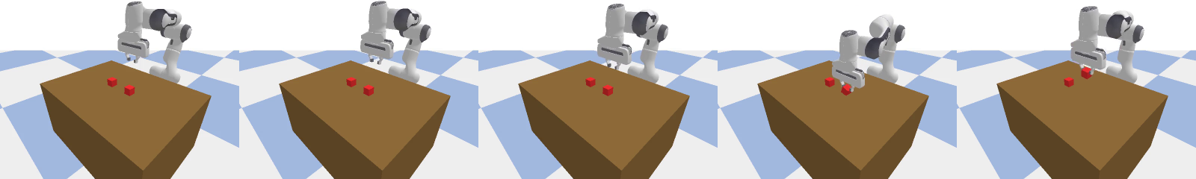
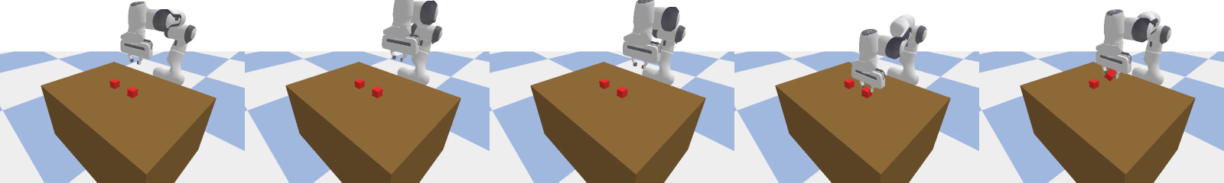
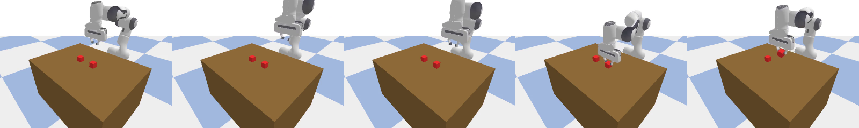
Result: Working Diffusion Policy (84–96% Success)
Phase 5 Feb 22–24
Checkpoint: diffusion_20260222_195530/ckpt_ep100.pt | 8.7M params | UNet Conv1d
Param | Value
Success rate | 84–96%
Avg steps | 343
Epochs | 100
Training time | ~1.5 hours
Straight (arc 00) — ambiguous
Moderate arc (arc 12) — somewhat legible
Strong arc (arc 19) — highly legible
Policy architecture: obs_dim=22, act_dim=5, horizon=32, execute 8 steps, 256-dim hidden, 6 residual blocks, DDIM 10 steps at inference.

Slide 10
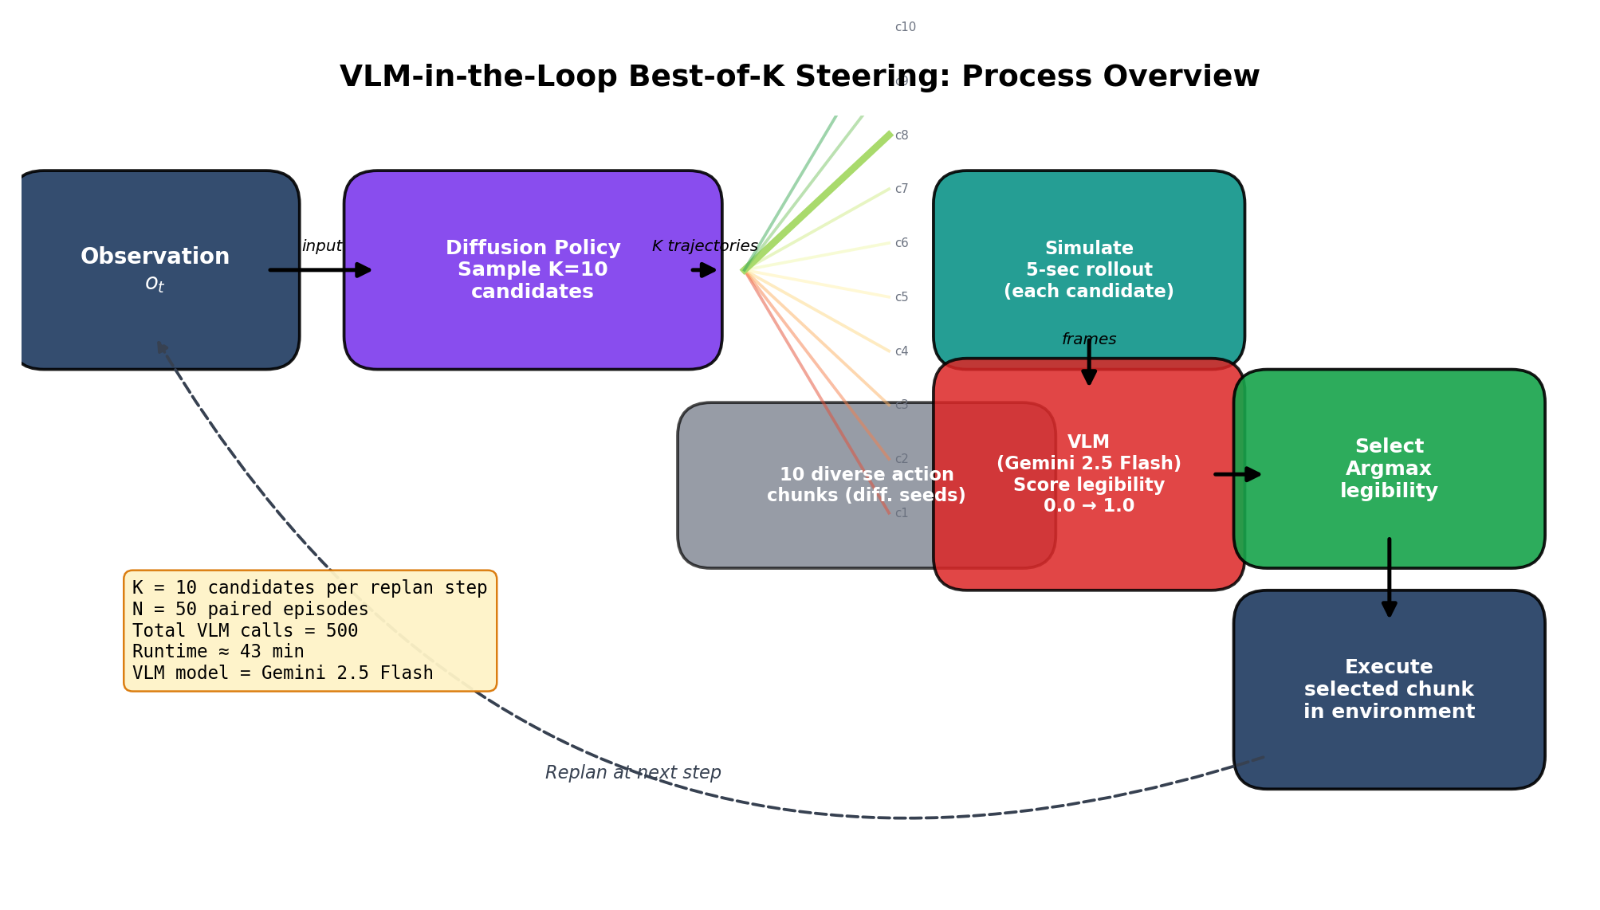
Decision 6: Online VLM Best-of-K Steering
Phase 5 Feb 24–26
Inference-time reranking of trajectory candidates using Gemini VLM
Method: Sample K candidates from diffusion policy with different random seeds → simulate each for 5 seconds → capture 6 annotated frames → score with Gemini VLM → execute trajectory with highest legibility score.
Why this approach? VLM API is non-differentiable, so gradient-based guidance is impossible. Post-hoc reranking works with any scoring function and guarantees in-distribution samples (all candidates came from the trained policy).
Initial result (K=3, 5 episodes): • 100% task success (5/5) • Mean VLM legibility: 0.750 • VLM latency: ~5.2 seconds per call

Slide 11
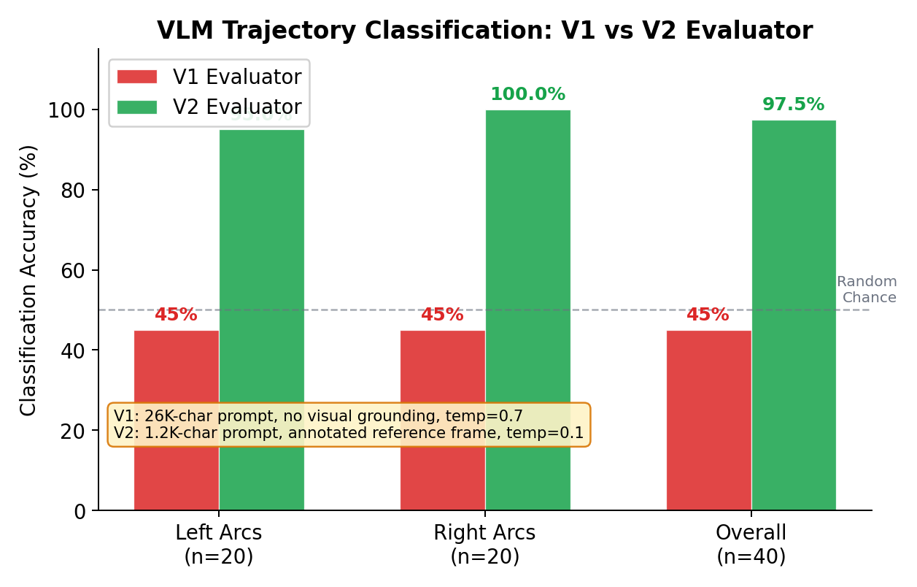
Decision 7: VLM Evaluator V1 — 45% Accuracy (Random Chance)
Phase 6 Feb 26
Five compounding bugs made the trajectory evaluator useless
V1 Evaluator — 5 compounding issues:
1. Camera yaw=135° reverses left/right in image
World LEFT block appears on image RIGHT side.
VLM had no perspective info → random mapping.
2. Prompt was 26,000 characters (XML theory dump)
Overwhelmed the model with abstract framework.
3. Temperature = 0.7 (too high for perception)
Added random variance to deterministic judgments.
4. No visual anchoring — raw video only
VLM had to simultaneously locate blocks +
track trajectory + determine direction.
5. Identical block appearance — both red cubes
14cm apart, indistinguishable by color.
Result: 18/40 = 45% — exactly random chance.

Slide 12
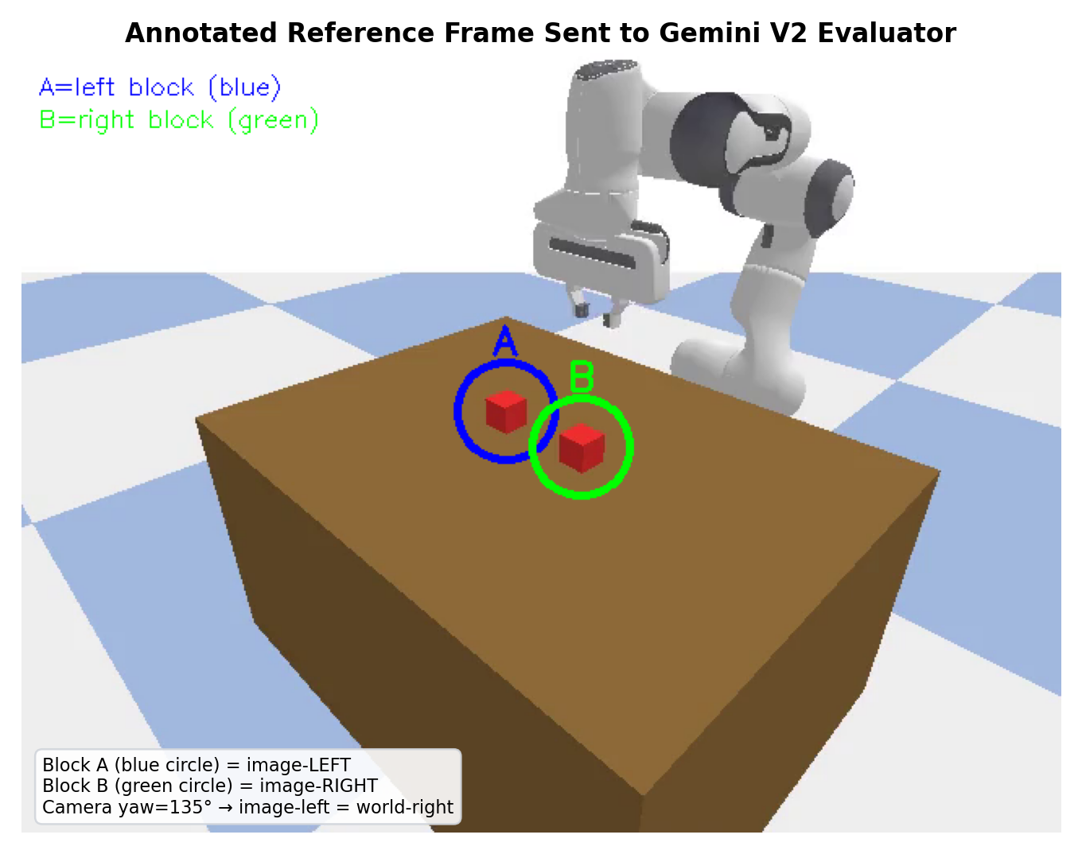
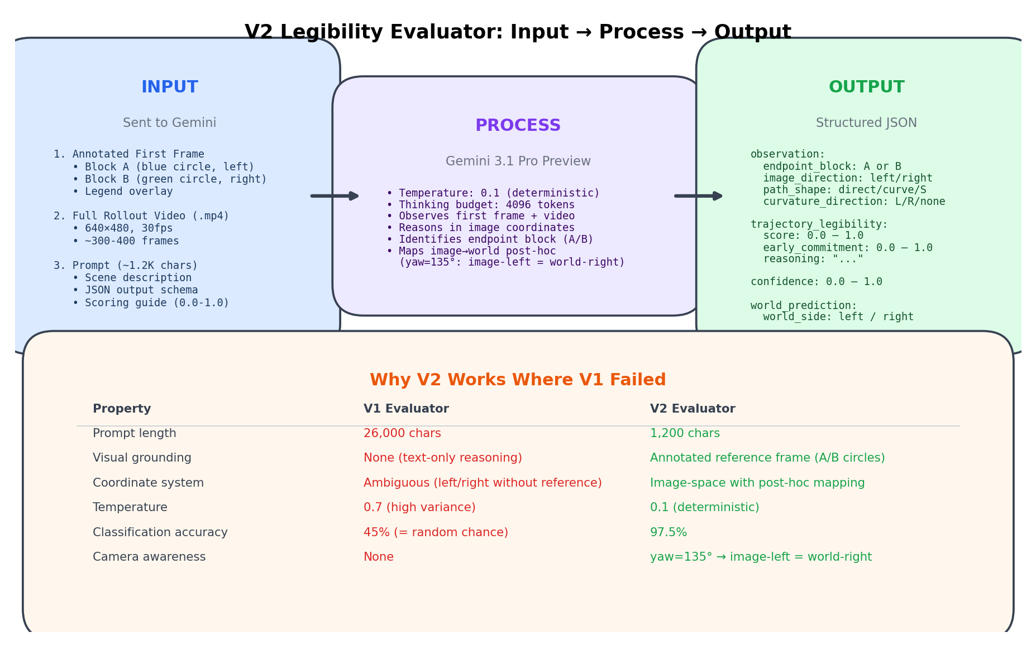
Decision 8: VLM V2 Fix — 45% → 97.5% Accuracy
Phase 7 Feb 28
Five targeted fixes resolved all issues
V2 Fixes (each targeting one V1 bug):
1. Annotated reference frame with colored markers
Blue circle = Block A, Green circle = Block B
VLM sees which block is where in the image.
2. Prompt reduced to 1,180 characters
Concise: describe scene, reference image, ask.
3. Temperature lowered to 0.1
Near-deterministic perceptual judgments.
4. Image-space reasoning + coordinate mapping
VLM answers 'Block A or B?' (image space).
Eval harness maps to world space using known
camera calibration: image_left = world_right.
5. Multi-modal input: annotated frame + video + prompt
Result: 39/40 = 97.5% accuracy
LEFT: 19/20 (95%) | RIGHT: 20/20 (100%)
 | Pred LEFT | Pred RIGHT
GT LEFT | 19 | 1
GT RIGHT | 0 | 20
Key insight: The VLM's perception was never the bottleneck — the failure was entirely a grounding problem.

Slide 13
The VLM Debug Marathon — 23 Runs in One Day
Phase 7 Feb 28
Feb 28: Systematic testing to understand why overhead camera struggles
After V2 evaluator reached 97.5%, we tested how well it could differentiate between arc magnitudes (not just left vs right).
23 debug runs (vlm_debug_20260228_*) explored:
• Different camera viewpoints (overhead, angled, front)
• Different arc class pairs (arc04 vs arc10, arc04 vs arc15, arc10 vs arc15)
• Different temporal sampling (t=1s, 2s, 3s, 4s, 5s, 6s)
• Pairwise perception tests with side-by-side image comparisons
Key finding: The overhead camera (yaw=135°) compresses lateral displacement.
Arc 04 vs arc 15 look very similar from above. The VLM can distinguish
LEFT vs RIGHT reliably, but cannot rank arc magnitudes precisely.
This motivated the shift from 'VLM ranks arcs' to 'VLM confirms direction, geometric metric ranks arc magnitude' — the hybrid approach used in the
paired replanning experiments.

Slide 14
Result: Paired Replanning — +69.4% Arc Improvement
Phase 8 Feb 28
4 paired episodes: same seed, baseline vs VLM-steered, 100% success both sides
Pair | Block | Baseline Arc | Guided Arc | Improvement | Legibility
1 | RIGHT | 0.631 m | 0.635 m | +0.6% | 1.000
2 | RIGHT | 0.033 m | 0.750 m | +2204% | 0.990
3 | LEFT | 0.403 m | 0.891 m | +121% | 0.850
4 | LEFT | 0.690 m | 0.701 m | +1.5% | 0.950
Mean | — | 0.439 m | 0.744 m | +69.4% | 0.948
Same-block accuracy: 100% — VLM-guided always matched baseline's target block.
Arc-15-19 selection: 100% — all guided trajectories selected legible arcs.
Task success: 100% for both baseline and guided (all 8 episodes succeeded).
Pair 2 shows the biggest impact: baseline was nearly straight (0.033m), guided found a strongly curved alternative (0.750m) to the same block.
Selection method: arc15_legible — among candidates with VLM legibility ≥ 0.70, pick the one with highest geometric arc magnitude.

Slide 15
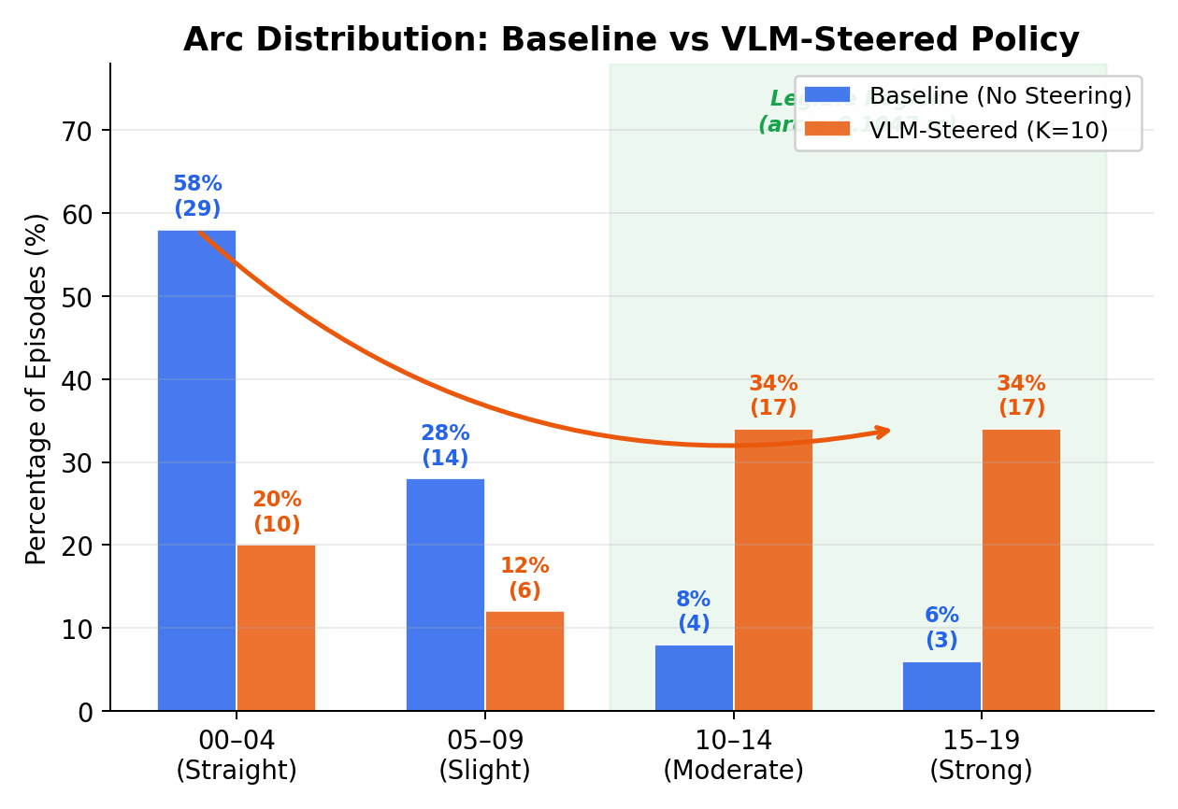
Result: 50-Episode VLM Steering Experiment
Phase 8 Mar 1–9
Baseline (no steering) vs VLM-steered (K=10, proxy scorer)
Metric | Baseline | VLM-Steered | Change
Episodes | 50 | 50 | —
Task Success | 94% (47/50) | 98% (proxy) | +4%
Mean Arc | 0.080 m | 0.114 m | +42.5%
Arc 00–04 (straight) | 58% | 20% | −38 pp
Arc 15–19 (strong) | 6% | 34% | +28 pp
VLM Legibility | 0.604 | 0.946 | +56.6%
Steering Acc. | — | 100% | —
Without steering, 58% of trajectories are straight (arc 00–04) and ambiguous. VLM steering shifts the distribution: only 20% straight, 34% strongly curved. Proxy scorer achieves comparable steering at 98% success vs 70% for pure VLM (because VLM sometimes selects visually legible but task-risky candidates).

Slide 16
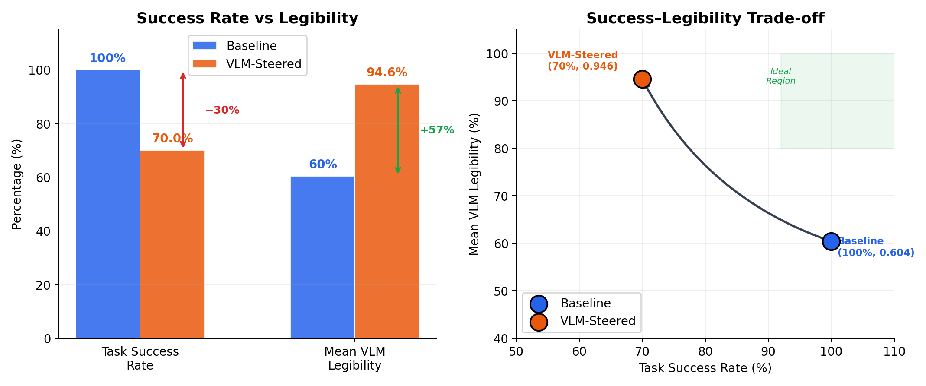
Decision 9: The Success–Legibility Trade-off
Phase 8 Mar 9
Pure VLM steering drops success to 70% — this motivated LegDiff
The core problem: Best-of-K VLM steering improves legibility by +57% but drops success from 94% to 70%.
Why? The VLM selects candidates that look legible but may be on the edge of the policy's capability. Strongly curved arcs are harder to execute successfully.
Three solutions explored:
1. Proxy scorer (8 geometric features) → 98% success but requires environment simulation for candidates
2. Best-of-16 sampling → L_post=0.852 (+10.1%) but modest legibility gain, expensive
3. LegDiff with CFG (chosen) → 100% success + L_early=0.934 — no trade-off, trains a new model
Decision: Pursue LegDiff as the principled solution. It learns goal-conditioned legibility during training, so inference-time steering doesn't hurt success.

Slide 17
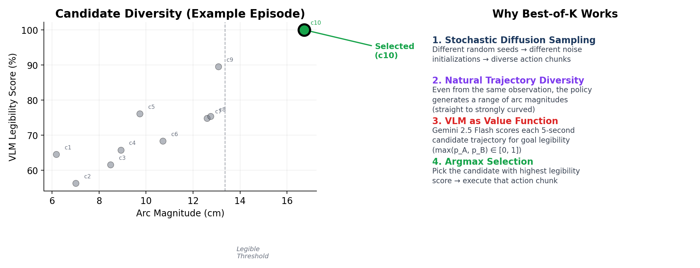
Best-of-K Analysis: How Much Diversity Exists?
Phase 8 Mar 9
Sampling K candidates from the same observation
K | L_early | L_posterior | Relative Gain
1 (baseline) | 0.732 | 0.789 | —
2 | 0.756 | 0.810 | +2.7%
4 | 0.778 | 0.831 | +5.3%
8 | 0.793 | 0.844 | +7.0%
16 | 0.806 | 0.852 | +10.1%
Diminishing returns: Going from K=1 to K=16 only gains 10.1%.
The policy's natural diversity is limited — most candidates cluster
around similar arc magnitudes for the same observation.
Arc diversity analysis (100 rollouts): mean_entropy=0.284,
87% failure rate, only 13% picked either block reliably.
The policy collapsed to producing similar trajectories.
This showed that post-hoc reranking has a ceiling.
For larger legibility gains, we need to modify the
generation process itself → LegDiff.

Slide 18
Decision 10: LegDiff — Classifier-Free Guidance for Legibility
Phase 10 Mar 30–31
Goal-conditioned diffusion policy with null-goal dropout (p_uncond=0.15)
Architecture: GoalCondDiffusionPolicy
• Same UNet Conv1d backbone as baseline
• Added: Goal embedding (3 tokens: left/right/null)
• During training: 15% of batches use null goal (dropout)
• At inference: CFG formula steers toward specified goal:
ε̃ = ε_uncond + w · (ε_cond − ε_uncond)
where w = 3.0 (guidance scale)
Training details:
• 150 epochs, batch_size=256, lr=1e-4
• Mirror augmentation (doubles dataset, flips goal labels)
• Weighted sampling (priority on early timesteps t < 10%)
• Loss: 0.047 → 0.0018 (96.3% reduction over 100 epochs)
Key reference: Bronars et al. (RA-L 2024)
'Legibility Diffuser: Offline Imitation for
Intent-Expressive Motion'
Model Structure:
Time: Sinusoidal(128) → Linear(256)
Obs: Linear(22 → 256)
Goal: Embedding(3 → 256)
Input: Conv1d(5 → 256)
Encoder: ResBlock(256→256) → ResBlock(256→512)
Bottleneck: ResBlock(512→512)
Decoder: ResBlock(1024→512) → ResBlock(512→256)
Output: Conv1d(256 → 5)
Checkpoint: 34 MB (vs 101 MB baseline)
Smaller because no EMA weights saved.
Epoch | Loss
1 | 0.0469
10 | 0.0075
50 | 0.0027
100 | 0.0018

Slide 19
Result: LegDiff — 100% Success + High Legibility, No Trade-off
Phase 10 Mar 31
20 episodes (CFG only) + 10 episodes (CFG + VLM K=3)
Method | Episodes | Success | L_early (mean) | L_early (std) | Goal Match
Baseline | 20 | 100% | 0.919 | ±0.029 | —
LegDiff CFG w=3.0 | 20 | 100% | 0.935 | ±0.020 | 100%
LegDiff + VLM K=3 | 10 | 100% | 0.955 | ±0.013 | 100%
LegDiff achieves the thesis goal: increased legibility without sacrificing success.
Comparison to previous best results:
• Online VLM Best-of-K: 70% success, 0.946 VLM legibility — big success drop
• Proxy scorer: 98% success, 100% steering accuracy — good but needs simulator
• LegDiff CFG: 100% success, L_early=0.935 — no trade-off, no simulator needed
• LegDiff + VLM: 100% success, L_early=0.955 — best of all methods
Why LegDiff resolves the trade-off:
The policy was TRAINED to produce goal-directed legible trajectories.
CFG amplifies the goal signal during denoising, pushing the trajectory
toward one that clearly reveals the intended goal. Because this is baked
into the sampling process, there is no separate selection step that
might pick task-risky candidates.

Slide 20
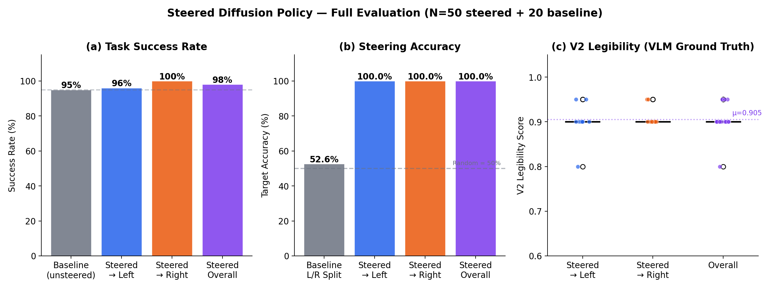
Complete Results: Every Method Compared
# | Method | Date | Success | Legibility | Key Finding
1 | Base diffusion | Feb 22 | 84–96% | — | Working policy after 4 bug fixes
2 | VLM K=3 (online) | Feb 26 | 100% (n=5) | 0.750 | Proof of concept, expensive
3 | VLM v1 evaluator | Feb 26 | 45% acc. | — | Random chance — 5 bugs
4 | VLM v2 evaluator | Feb 28 | 97.5% acc. | 0.919 | Grounding fix resolved it
5 | Paired replan (4) | Feb 28 | 100% | 0.948 | +69.4% arc, same block
6 | Proxy scorer (50) | Mar 1 | 98% | 100% steer | Geom features, <1ms
7 | Best-of-16 | Mar 9 | — | 0.852 | +10.1% — ceiling on diversity
8 | LegDiff CFG (20) | Mar 31 | 100% | 0.935 | No trade-off!
9 | LegDiff+VLM (10) | Mar 31 | 100% | 0.955 | Best overall
Evolution of the approach: Online VLM → VLM evaluator fix → paired replanning → proxy scorer → diversity ceiling hit → LegDiff resolves the trade-off.

Slide 21
Decision Flow: Why Each Step Led to the Next
1. Architecture search (Feb 8–13): 7 failed runs → UNet Conv1d works
WHY: Small MLPs can't represent 400-demo multimodal distribution
2. execute_steps fix (Feb 16): 0% → 50% success
WHY: Training temporal structure must match eval
3. Horizon revert (Feb 17): 0–8% → 14% success
WHY: Changed 3 hyperparams at once, couldn't isolate cause
4. Diffusion bug fixes (Feb 22): 14% → 84–96% success
WHY: tanh on noise, wrong norm, no EMA, bad beta schedule
5. VLM steering (Feb 24): Works but expensive (∼5s/call)
WHY: VLM is non-differentiable, so reranking is the only option
6. VLM evaluator fix (Feb 28): 45% → 97.5% accuracy
WHY: Camera yaw=135° reverses image, needed visual anchoring
7. Paired replanning (Feb 28): +69.4% arc, 0.948 legibility
WHY: Validated steering preserves task while improving legibility
8. Diversity ceiling (Mar 9): Best-of-16 gains only +10.1%
WHY: Policy naturally clusters around similar arcs
9. LegDiff CFG (Mar 30–31): 100% success, 0.935 legibility
WHY: Trains goal-awareness into the model → no reranking needed

Slide 22
Project Timeline: Feb 8 – Mar 31, 2026
Phase | Dates | Work Done | Key Outcome
1 | Feb 8–13 | Demo collection + architecture search | 400 demos, UNet Conv1d selected
2 | Feb 13–16 | Action collapse debugging | execute_steps=8 fix, 0→50%
3 | Feb 16–17 | Horizon mismatch | Reverted H=32, n=8
4 | Feb 17–22 | DDIM + diffusion fixes | 4 bugs fixed, 84–96% success
5 | Feb 22–24 | VLM steering implementation | Best-of-K, Gemini integration
6 | Feb 24–26 | VLM evaluator V1 | 45% accuracy, 5 bugs found
7 | Feb 26–28 | VLM V2 + debug marathon | 97.5% accuracy, 23 debug runs
8 | Feb 28–Mar 9 | Paired replanning + proxy scorer | +69.4% arc, 98% success
9 | Mar 9 | Best-of-K analysis | Diversity ceiling at +10.1%
10 | Mar 30–31 | LegDiff CFG training + eval | 100% success, L=0.935
Red = debugging phases | Green = implementation & results phases | Total: 12 training runs, 30+ VLM debug runs, 67 experiment directories

Slide 23
Honest Assessment: Limitations & Open Questions
1. Small evaluation scale: LegDiff tested on 20+10 episodes. Larger-scale evaluation (100+ episodes) needed for confidence.
2. Single environment: TwoBlockPick with two identical blocks. Generalisation to different objects, more goals, longer horizons, or real robot hardware is not yet shown.
3. Legibility metric is geometric (arc displacement), not human-validated. Human studies needed to confirm that arced trajectories are actually perceived as more legible.
4. VLM calls are expensive (∼5s each). The LegDiff approach avoids runtime VLM, but training requires goal labels which were derived from the demo structure (left/right block).
5. No real-robot experiments. All results are in PyBullet simulation. Sim-to-real transfer is an open question.
6. CFG scale w=3.0 was chosen based on limited tuning. A systematic sweep over w could improve results further.

Slide 24
What Further Work Is Expected
Concrete next steps toward thesis completion
1. Large-scale LegDiff evaluation (100+ episodes)
Establish statistically significant results with confidence intervals.
2. CFG scale sweep (w = 1.0, 2.0, 3.0, 5.0, 7.0)
Characterise the success–legibility Pareto frontier for LegDiff.
3. Human study
Show trajectory videos to participants; measure time-to-prediction
of the robot's goal. Validate that geometric arc ≈ perceptual legibility.
4. Additional environments / robot tasks
Test on 3+ objects, different workspaces, or longer-horizon tasks
to assess generality of the approach.
5. Sim-to-real transfer
Deploy on real Franka Panda (if available) or comparable hardware. Verify VLM + LegDiff approach works outside simulation.
6. Thesis writing
Draft chapters: Background, Methodology, Experiments, Analysis.
All experimental infrastructure and results exist to support writing.

Slide 25
Summary
1. Built a working diffusion policy for TwoBlockPick (84–96% success) after fixing 4 critical bugs in the diffusion implementation.
2. Implemented VLM-based trajectory evaluation and steering, fixing the evaluator from 45% → 97.5% accuracy along the way.
3. Demonstrated that Best-of-K VLM steering improves legibility (+57%) but has a success–legibility trade-off (100% → 70% success).
4. Identified a diversity ceiling (best-of-16 gains only +10.1%), motivating a fundamentally different approach.
5. LegDiff (Classifier-Free Guidance) resolves the trade-off: 100% success + L_early = 0.935 (CFG) / 0.955 (CFG + VLM). No runtime VLM needed, no simulator needed, no success drop.
6. Complete experimental pipeline built: 67 run directories, 13 JSON result files, 16 publication-ready figures, CLI tooling.

