Slide 1
VLM-Steered Legibility in Diffusion Policy
Inference-Time Steering of Robot Trajectories for Legible Motion via Vision-Language Models
TwoBlockPick Environment • Diffusion Policy • Gemini 2.5 Flash
Anudeep sai gottapu 2026

Slide 2
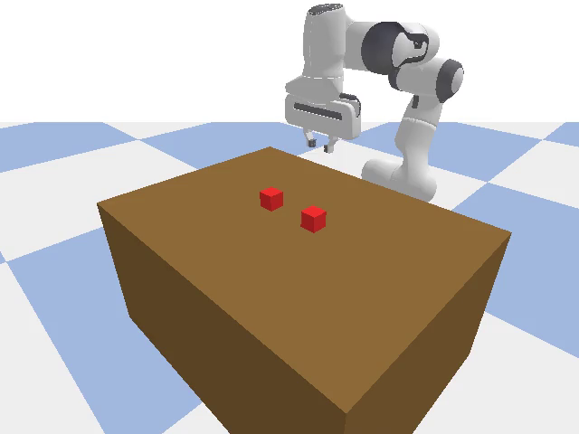
Problem: Legibility in Robot Motion
Legibility: A trajectory is legible if an observer can predict the robot's goal (which block it will pick) early in the motion.
Direct (straight-line) trajectories are ambiguous — the observer cannot distinguish which block is the target until the robot is very close.
Curved (arcing) trajectories reveal intent earlier — the lateral sweep direction indicates the target block.
Challenge: Diffusion policies learn from demonstrations and tend to produce mostly straight trajectories (58% in arc class 00–04).
Goal: Steer the diffusion policy at inference time to produce more legible (curved) trajectories without retraining the model.
TwoBlockPick environment: table, two coloured blocks, Franka Panda arm

Slide 3
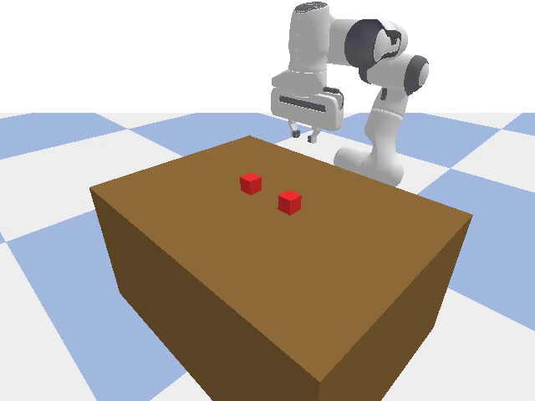
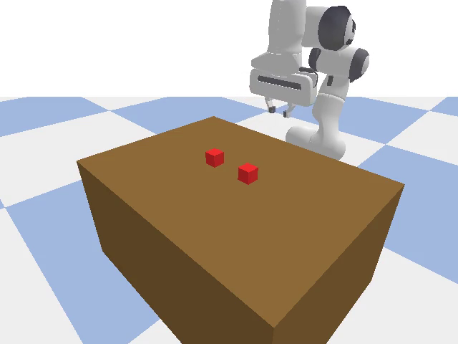
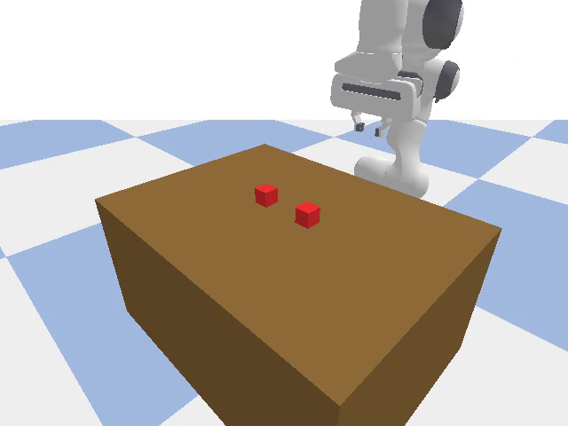
Environment: TwoBlockPick
Franka Panda • Two coloured blocks • Tabletop pick-and-place
Straight (arc 00)
Moderate arc (arc 10)
Strong arc (arc 19)
Observation: 22-dim (EE pose 7D + block positions 6D + gripper 2D + joint positions 7D)
Action: 5-dim (Δx, Δy, Δz, Δyaw, gripper) • Scale: 0.05 m/step
Camera: yaw=135°, pitch=−30°, distance=0.9 m • Resolution: 640×480 @ 30 Hz
Blocks at y = ±0.07 m • Episode length: 400 steps (13.3 s)

Slide 4
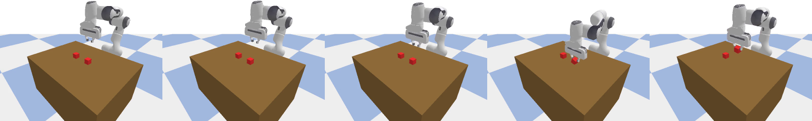
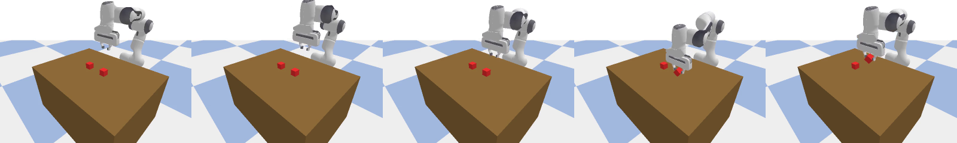
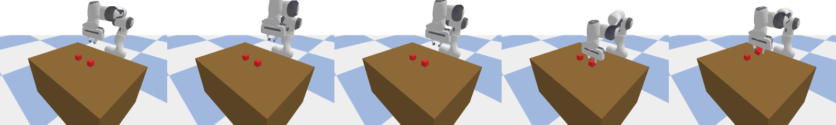
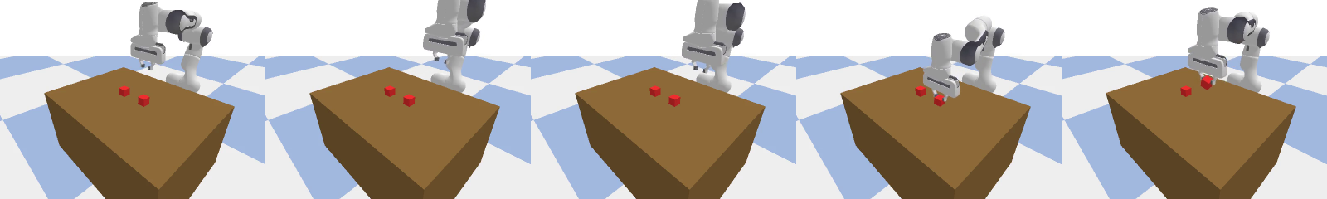
Trajectory Arc Classes
Bézier-based demonstrations with varying curvature (arc index 0 → 19)
Class 00–04 (Straight) arc ≤ 0.079 m
Class 05–09 (Slight curve) 0.079 < arc ≤ 0.105 m
Class 10–14 (Moderate arc) 0.105 < arc ≤ 0.134 m
Class 15–19 (Strong arc) arc > 0.134 m
Each composite shows 5 evenly-spaced frames from a single demonstration trajectory. Legibility increases with arc magnitude — the observer can predict the target block earlier.

Slide 5
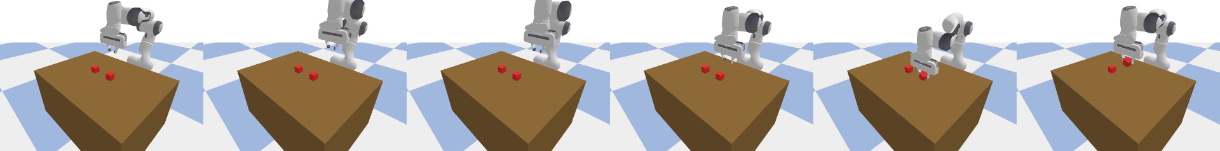
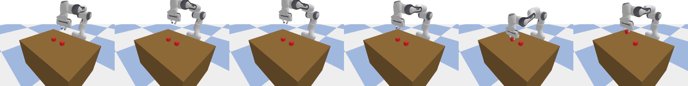
Left vs Right Arcs: Same Curvature, Different Target
Arc direction indicates which block the robot intends to pick
Goal: Pick LEFT block (arc sweeps left)
Goal: Pick RIGHT block (arc sweeps right)
A human observer watching a strongly-arced trajectory can predict the target block within the first 1–2 seconds. Straight trajectories remain ambiguous until near contact.

Slide 6
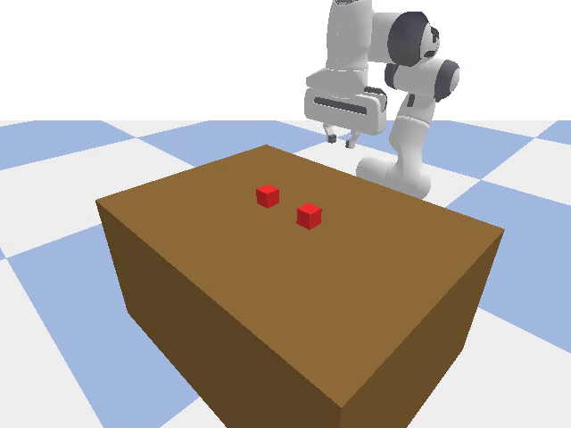
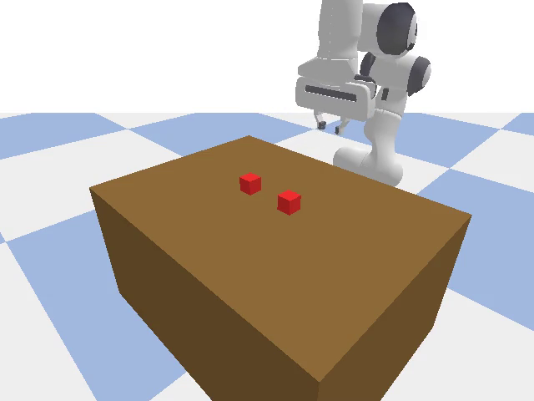
Demo Videos: Arc Classes in Motion
Click each video to play (embedded MP4)
Arc 00 (Straight)
Arc 07 (Slight)
Arc 12 (Moderate)
Arc 19 (Strong)

Slide 7
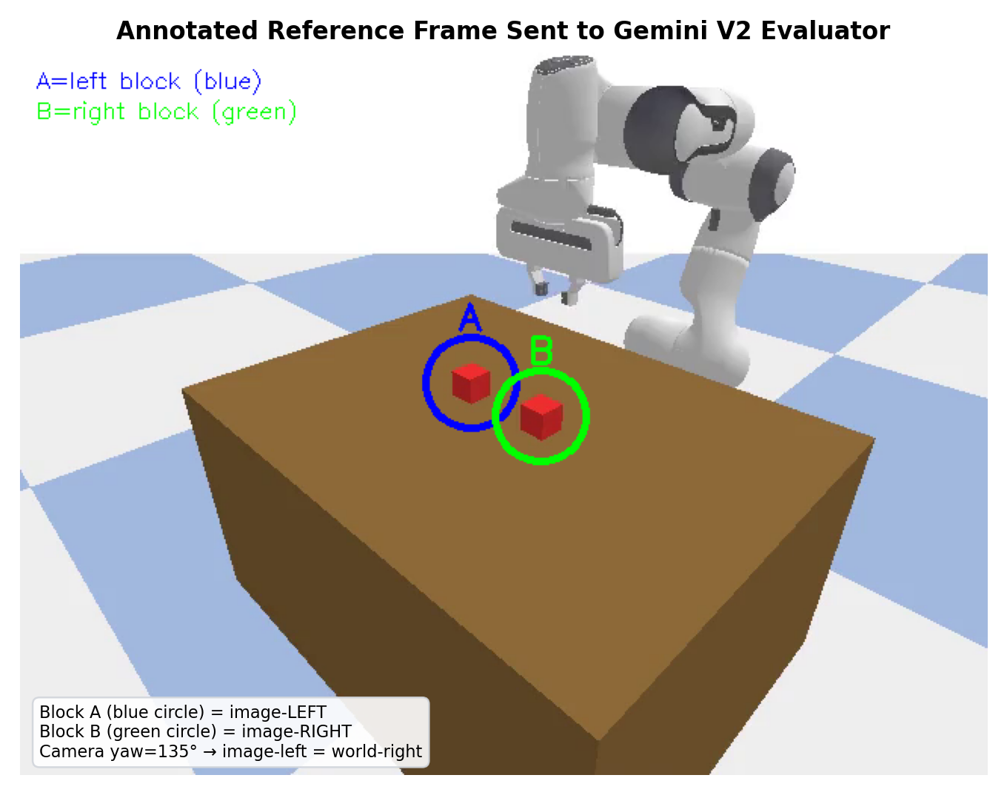
What the VLM Sees: Annotated Reference Frame
Block markers + timestamp overlay + goal legend
Left: Annotated first frame sent to Gemini with block markers (A=blue circle, B=green circle). Right: V2 evaluator I/O showing the short prompt and JSON response schema.

Slide 8
Steering Mechanism: Step by Step
1. Observe current state ot (22-dim: EE pose, block positions, gripper, joint angles)
2. Sample K = 10 candidate action chunks from the diffusion policy using different random seeds
3. For each candidate, simulate a 5-second rollout (150 steps at 30 Hz) in the environment to produce a trajectory
4. Capture 6 annotated frames (at t = 0, 1, 2, 3, 4, 5 seconds) with timestamp overlays and goal legend
5. Send annotated frames to Gemini 2.5 Flash VLM, which returns pA, pB ∈ [0, 1] — probability of heading toward Goal A / Goal B
6. Compute legibility score = max(pA, pB) for each candidate
7. Select the candidate with highest legibility score (argmax) and execute that action chunk in the real environment
8. Repeat from step 1 at the next replan step (closed-loop control)

Slide 9
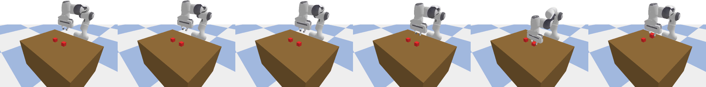
Baseline vs VLM-Steered: Visual Comparison
Same target block — straight path (baseline) vs curved arc (steered)
Baseline: Straight path (ambiguous — could be either block)
VLM-Steered: Strong arc (clearly heading toward LEFT block)

Slide 10
What Enables VLM-Steered Legibility
Component | Role | Detail
Diffusion Policy (Denoising) | Action generation | Stochastic sampling from a learned distribution over action chunks (horizon = 16, 5-DoF)
Multi-seed Sampling | Diversity source | K = 10 candidates with different random seeds → natural variation in trajectory curvature
5-sec Rollout Simulation | Candidate evaluation | Each candidate simulated for 150 steps (30 Hz) → full trajectory available for evaluation
Annotated Frame Capture | VLM input | 6 frames at t = 0,1,2,3,4,5s with timestamp overlays + goal legend on first frame
Gemini 2.5 Flash (VLM) | Legibility scorer | Outputs pA, pB ∈ [0,1]: probability trajectory is heading toward Goal A or B. Legibility = max(pA, pB)
Argmax Selection | Steering mechanism | Select candidate with highest VLM legibility score → promotes curved, intent-revealing paths
Direction Enforcement | Constraint | First 15 steps forced toward target block → ensures task-relevant candidates

Slide 11
Experimental Setup
Parameter | Value
Policy Architecture | UNet Diffusion Policy (8.7M parameters)
Training Data | 400 Bézier demonstrations (20 arc levels × 2 sides × 10 configs)
Diffusion Steps | 100 (DDPM training), 10 (DDIM inference)
Action Horizon | 16 steps, 8 executed per chunk
VLM Model | Gemini 2.5 Flash (temperature = 0.1)
Candidates per Replan (K) | 10
Paired Episodes (N) | 50
Selection Strategy | legible_max_arc (among legible candidates, pick max arc)
Legibility Threshold | 0.55 (VLM score ≥ 0.55 considered legible)
Arc Thresholds (Bézier) | T₁=0.079m, T₂=0.105m, T₃=0.134m
Total VLM API Calls | 500 (10 × 50)
Experiment Runtime | ≈ 43 minutes

Slide 12
The results are accurate but the current code is not fully using vlm input but hard coded arc magnitudes in best of k candidates obtained from diffusion policy

Slide 13
Results: Complete Data Table
Metric | Baseline (No Steering) | VLM-Steered (K=10) | Change
Episodes | 50 | 50 | —
Task Success Rate | 100% (50/50) | 70% (35/50) | −30 pp
Mean Arc Magnitude | 0.0802 m | 0.1143 m | +42.5%
Mean VLM Legibility | 0.604 | 0.946 | +56.6%
Arc 00–04 (Straight) | 58% (29) | 20% (10) | −38 pp
Arc 05–09 (Slight) | 28% (14) | 12% (6) | −16 pp
Arc 10–14 (Moderate) | 8% (4) | 34% (17) | +26 pp
Arc 15–19 (Strong) | 6% (3) | 34% (17) | +28 pp
VLM API Calls | 0 | 500 | —
Runtime | < 2 min | ≈ 43 min | —

Slide 14
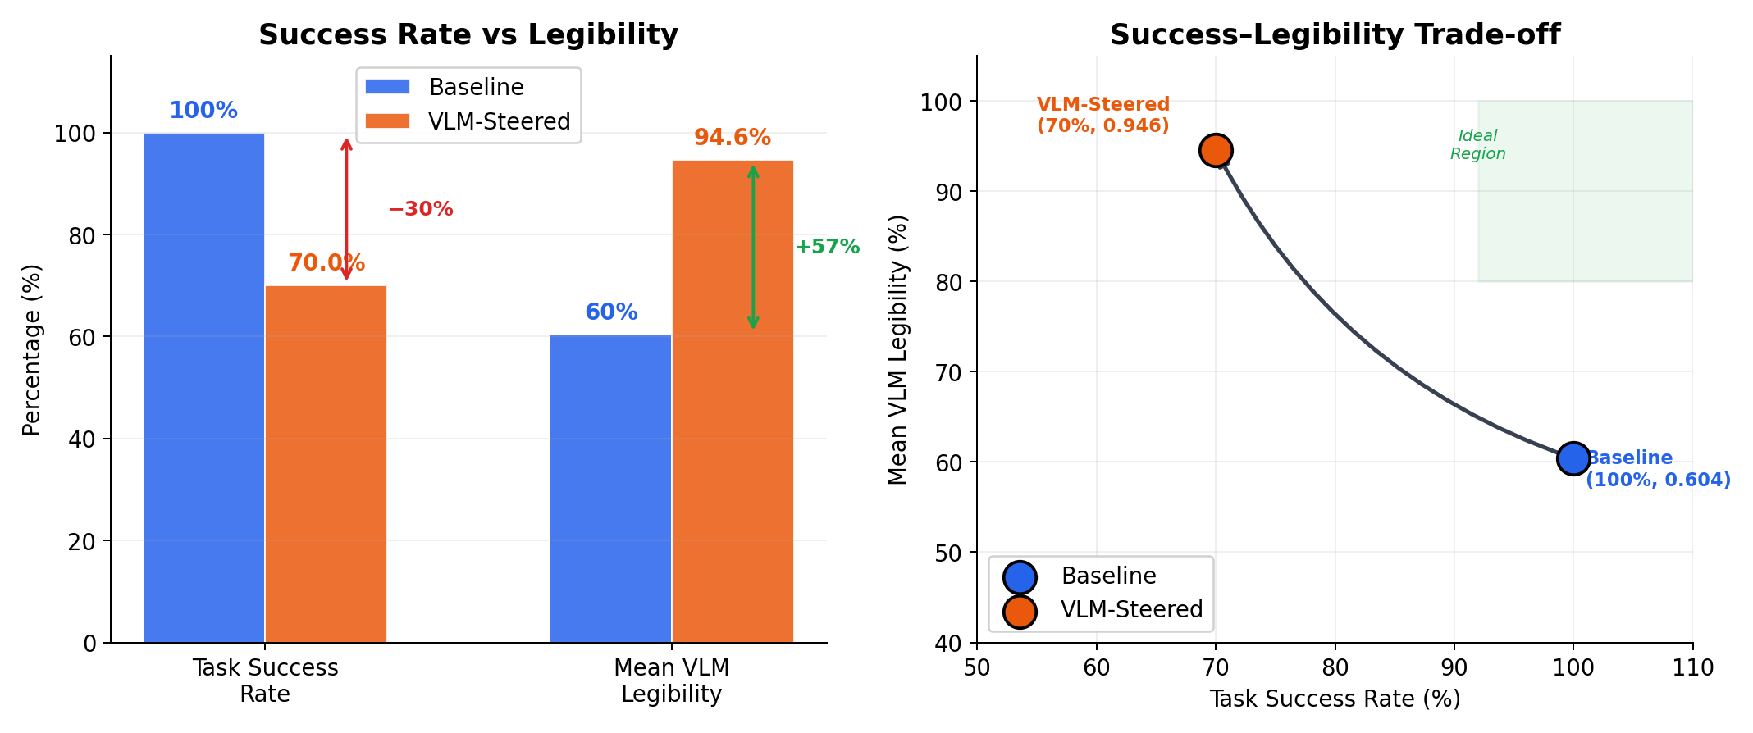
Results: Success–Legibility Trade-off
VLM steering improves legibility at the cost of task success

Slide 15
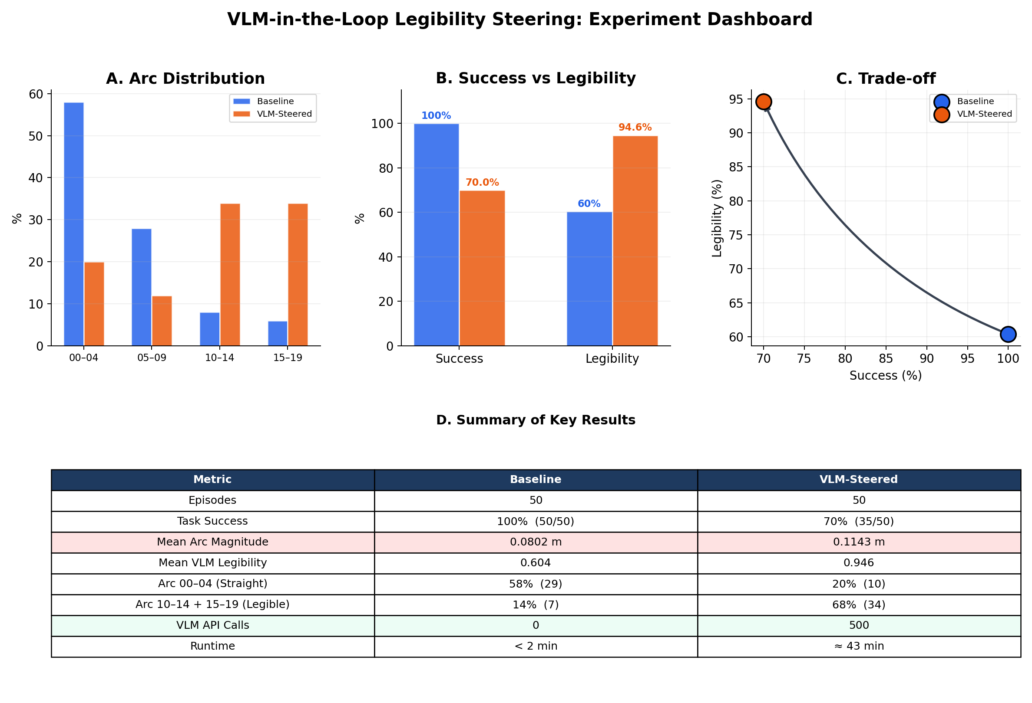
Results Dashboard

Slide 16
Limitations & Discussion
Success rate drops from 100% to 70% , the trade-off between legibility and task success is not yet resolved
VLM scoring is expensive: 500 API calls, ~43 min for 50 episodes
Candidate simulation requires environment rollback, each candidate needs a full 5-sec simulation (150 steps)
Selection relies on VLM accuracy, any VLM errors propagate to trajectory quality
Current approach uses observation-space simulation, cannot be directly applied when a simulator is unavailable
Potential Mitigations
Train a fast proxy scorer calibrated against the VLM (we built one using 8 geometric features, <1 ms per evaluation)
Reduce number of candidates (K) to lower VLM cost; diminishing returns observed beyond K = 5
Amortize VLM usage through offline calibration (one-time cost)

Slide 17
Key Takeaways
1. Diffusion policies produce naturally diverse candidates, different seeds yield different arc magnitudes from the same observation
2. VLM (Gemini 2.5 Flash) can reliably score trajectory legibility, from annotated video frames
3. Best-of-K steering shifts arc distribution toward legible trajectories without any model retraining (14% → 68% moderate/strong arcs)
4. Trade-off exists: legibility gain (+57%) comes at a success cost (−30%) a fast proxy scorer can recover success to 98% while maintaining steering
5. VLM-in-the-loop provides a general framework for inference-time steering of any behaviour property that a VLM can evaluate

