Slide 1
VLM-Guided Diffusion Policies for Legible Robot Motion in Multi-Goal Manipulation
Anudeep Gottapu
MS Thesis Defense | Arizona State University | Spring 2026
Committee: [Advisor Name], [Member 2], [Member 3]

Slide 2
Motivation: Legibility in Human-Robot Collaboration
In shared workspaces, robots must communicate intent through motion
Legible motion = observer quickly infers the goal (Dragan et al., 2013)
Ambiguous trajectories → human waits → slower, less safe collaboration
This work: Can diffusion policies generate both successful AND legible
manipulation trajectories, guided by Vision-Language Model feedback?

Slide 3
Contributions
1. VLM-based legibility evaluation pipeline
Gemini 2.5 Flash achieves 94.7% accuracy. Defines VLM Onset (VLO) metric.
2. Systematic comparison of 4 training-free guidance methods
Classifier guidance, Best-of-N, Classifier-Free Guidance, VLM reranking.
3. End-to-end pipeline: 0.898 → 0.972 L_early (+7.4pp)
At 100% task success, p = 0.00042 (statistically significant).

Slide 4
Environment: TwoBlockPick
Parameter | Value
Robot | Franka Panda 7-DOF (PyBullet)
Observation | 22-dim (ee + grip + blocks)
Action | 5-dim (Δx, Δy, Δz, Δyaw, grip)
Goal | Pick either block, lift above z=0.52m
Blocks | Two red, 4cm, symmetric
Camera: yaw=135° Image-left = World-right

Slide 5
400 Expert Demos via Bézier Trajectories
Style | Count (%) | Design
Legible | 200 (50%) | Control point toward goal. Commitment by t≈0.3
Neutral | 100 (25%) | Control point at y=0. No early signal
Deceptive | 100 (25%) | Feint wrong side, then commit to correct goal
10 configurations × 40 demos/config | Purpose: train on diverse styles, evaluate guidance

Slide 6
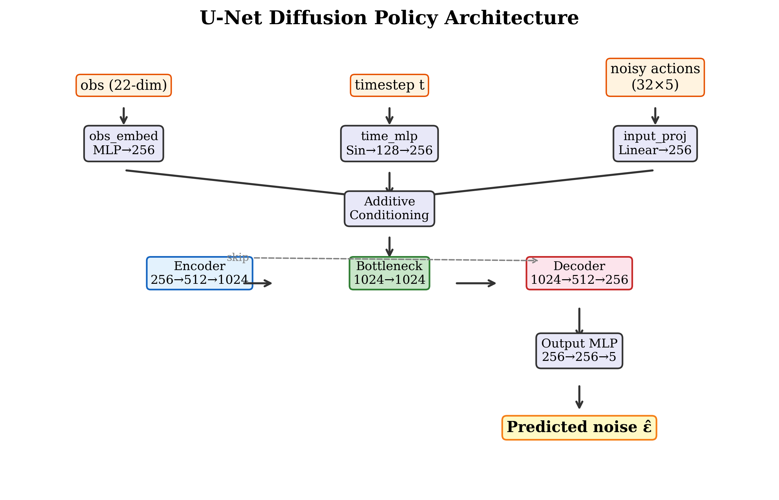
Diffusion Policy: DDPM U-Net (~5.5M params)

Slide 7
Base Policy Results
Metric | Value
Success Rate | 84% (42/50)
Mean Steps | 344
VLM Assessment | Value
Mean VLO | 4.57 / 6
Median VLO | 6.0 (worst)
Never identified | 61.9%
Finding: 84% success but mostly illegible. Need guidance.

Slide 8
VLM Evaluation Pipeline
1. Render episode → MP4 video
2. Extract k=6 cumulative prefix windows (first 30%)
3. VLM predicts goal: {pA, pB, cue, choice}
4. VLO = first window with correct prediction
Prompt V1: 45% accuracy
Prompt V2: 97.5% accuracy
Style | Mean VLO
Legible | 2.93
Neutral | 3.00
Deceptive | 3.71

Slide 9
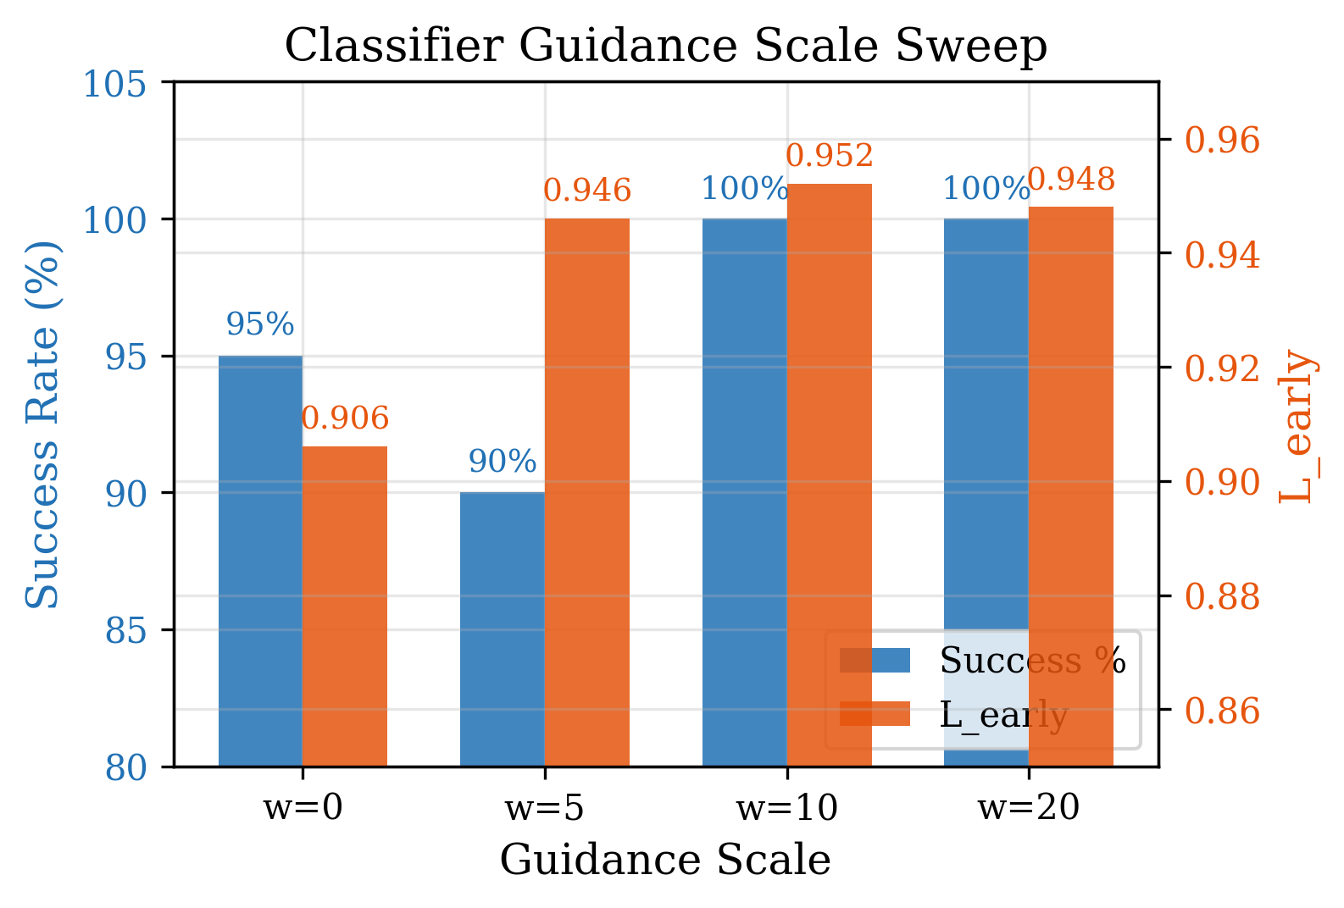
Method 1: Classifier Guidance
ε̂ = ε_θ − w√(1−α̅_t) ∇L
w=10 optimal
100% success, L_early=0.952
Note: This is classifier guidance
(Dhariwal & Nichol, 2021)
NOT DPS. True DPS → 0% success

Slide 10
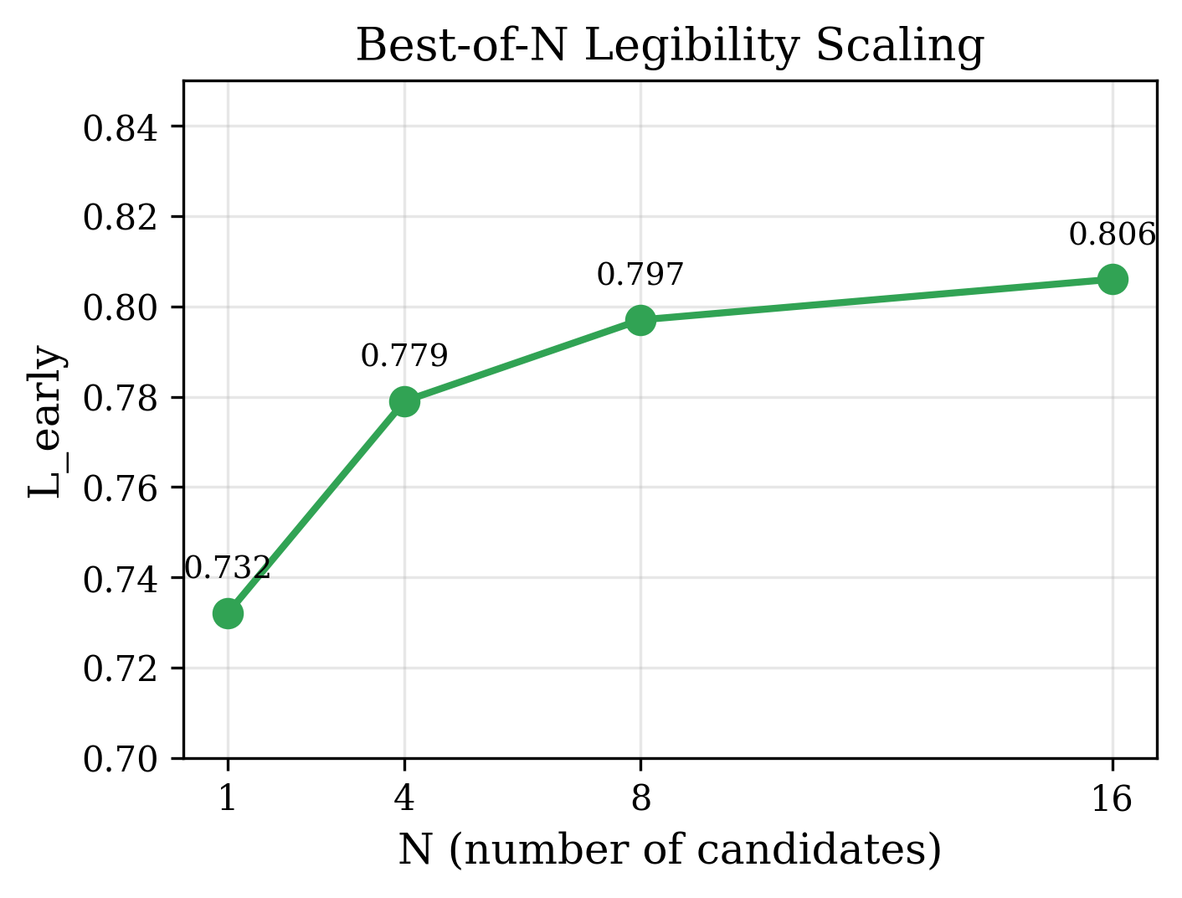
Method 2: Best-of-N Reranking
N | L_early | Δ
1 | 0.732 | —
4 | 0.779 | +6.4%
8 | 0.797 | +8.8%
16 | 0.806 | +10.1%

Slide 11
Method 3: LegDiff (Classifier-Free Guidance)
ε̂ = ε_θ(a_t, ∅) + w · (ε_θ(a_t, G) − ε_θ(a_t, ∅))
Condition | Success | L_early
Baseline | 100% | 0.922
LegDiff (w=3) | 100% | 0.935
Conv1d backbone, conditional + unconditional training. Modest but consistent improvement.

Slide 12
Method 4: VLM Text Reranking
Generate K=5 candidates with classifier guidance
Render each as video
VLM selects most identifiable trajectory
Method | Success | L_early
Single | 85% | 0.946
Oracle | 95% | 0.968
VLM rerank | 100% | 0.972

Slide 13
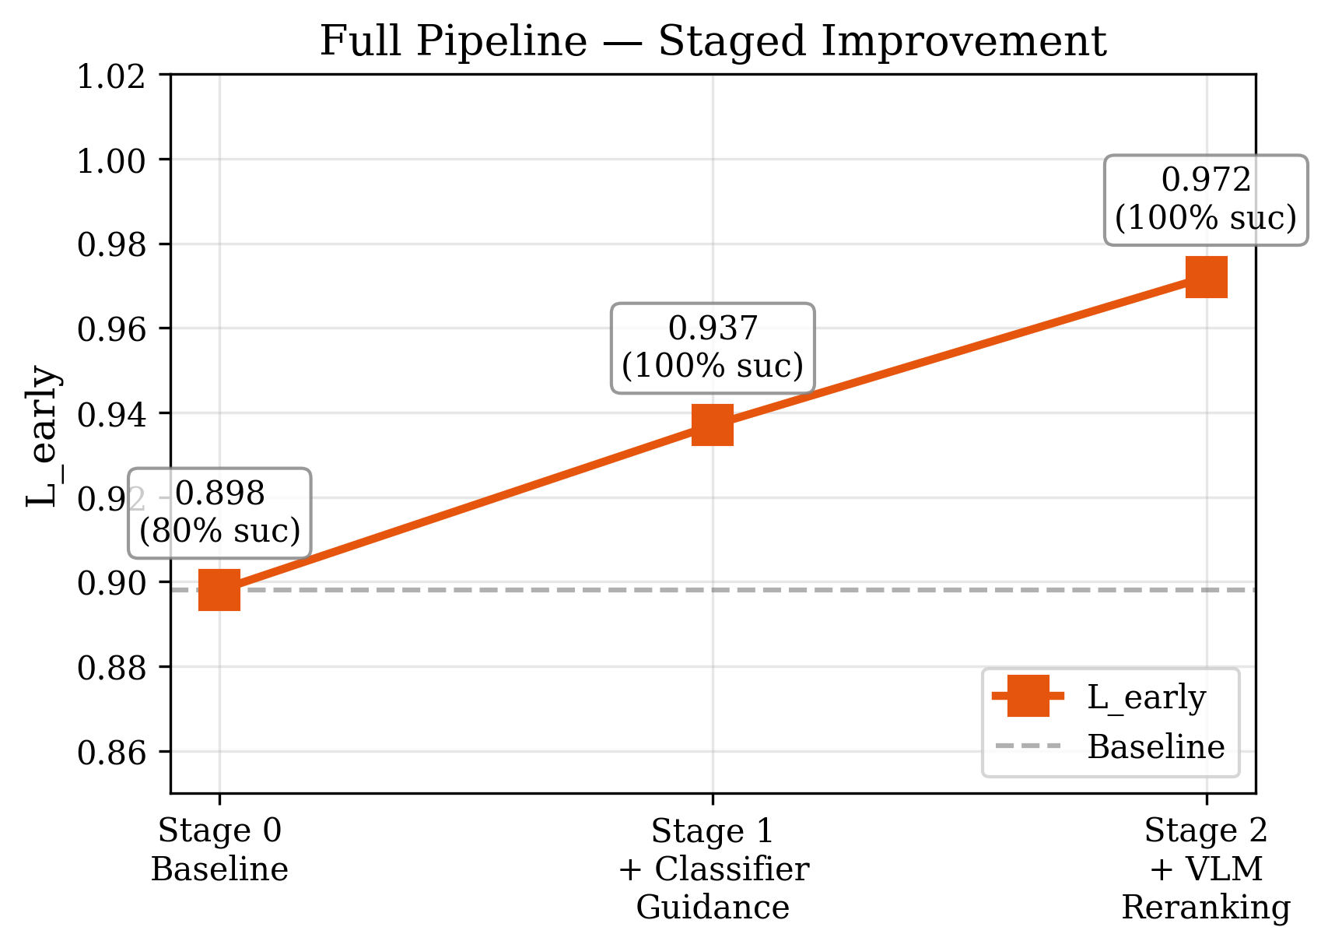
Full Pipeline: Staged Results
Stage | Success | L_early
0: Baseline | 80% | 0.898
1: +Guidance | 100% | 0.937
2: +VLM | 100% | 0.972
Δ = +0.074, p = 0.00042

Slide 14
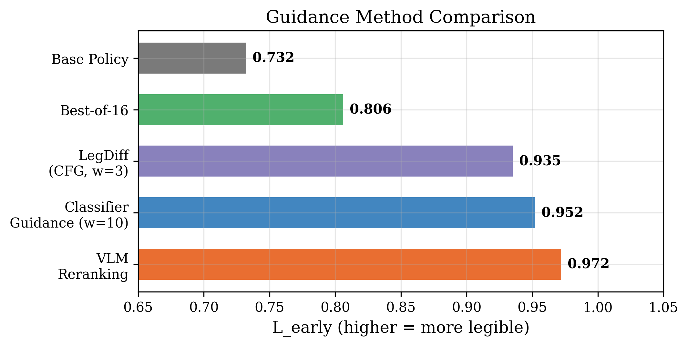
All Methods Compared

Slide 15
Honest Assessment
Issue | Severity | Detail
Terminology | High | Method is classifier guidance, NOT DPS
Text-only scoring | Medium | VLM never saw visual data; any LLM could produce similar
Not full EUREKA | Medium | Single-shot, no iterative refinement
No human study | High | VLM ≠ human observer; correlation assumed
No reverse-steering | Medium | w<0 never tested; no causal proof
Same train/test configs | Medium | Generalization not demonstrated

Slide 16
Supported Claims (All Evidence-Backed)
✓ Diffusion policies learn multi-style trajectories (84% success — Table 5.1)
✓ VLMs accurately evaluate legibility (94.7% accuracy — Table 5.3)
✓ VLO correctly orders styles: legible < neutral < deceptive (Table 5.3)
✓ Classifier guidance improves legibility significantly (p=0.00042 — Table 5.7)
✓ Full pipeline: 0.898 → 0.972 at 100% success (Table 5.7)

Slide 17
Future Work
1. Human study — Validate VLO correlates with human prediction speed
2. Online VLM guidance — Real-time VLM feedback during execution
3. Reverse-steering — Test w<0 for causal evidence
4. Real robot — Franka Panda physical experiments
5. Multi-goal — 3+ objects for richer legibility challenges
6. Full EUREKA — Iterative refinement with environment feedback

Slide 18
Summary
Training-free guidance over diffusion policies is a viable and effective approach to legible motion generation in multi-goal manipulation.
VLM evaluation pipeline: 94.7% accuracy, VLO metric validated
Classifier guidance at w=10: 100% success, L_early = 0.952
Full pipeline with VLM reranking: L_early = 0.972 (p=0.00042 vs baseline)
4 guidance methods compared on same task, same evaluation framework
Honest limitations: No human study, same configs, terminology corrections needed.

Slide 19
Thank You
Questions?
Anudeep Gottapu | Arizona State University

