Slide 1
Week 2: Diffusion Policy Architecture & Training
DDPM-based Action Chunk Prediction
Anudeep Gottapu | Arizona State University | Spring 2026

Slide 2
Why Diffusion Policy?
Multimodal distribution modeling — Captures legible/neutral/deceptive in one model
Training-free controllability — Iterative denoising allows gradient-based steering
Chunk-based prediction — 32-step chunks provide temporal coherence
State-of-the-art — Chi et al. (2023): DDPM policies outperform explicit classes
Key insight: By learning a distribution over trajectories, we can later steer toward legibility.

Slide 3
DDPM Training Formulation
Forward: q(x_t | x_0) = N(x_t; √α̅_t x_0, (1-α̅_t)I)
Objective: L = E[‖ε − ε_θ(x_t, t)‖²] (predict noise)
Reverse: x_{t-1} = (1/√α_t)(x_t − β_t/√(1-α̅_t) ε_θ) + σ_t z
Linear noise schedule: β_start=0.0001, β_end=0.1, T=100
ε-prediction (no tanh on output — predicts unbounded noise)

Slide 4
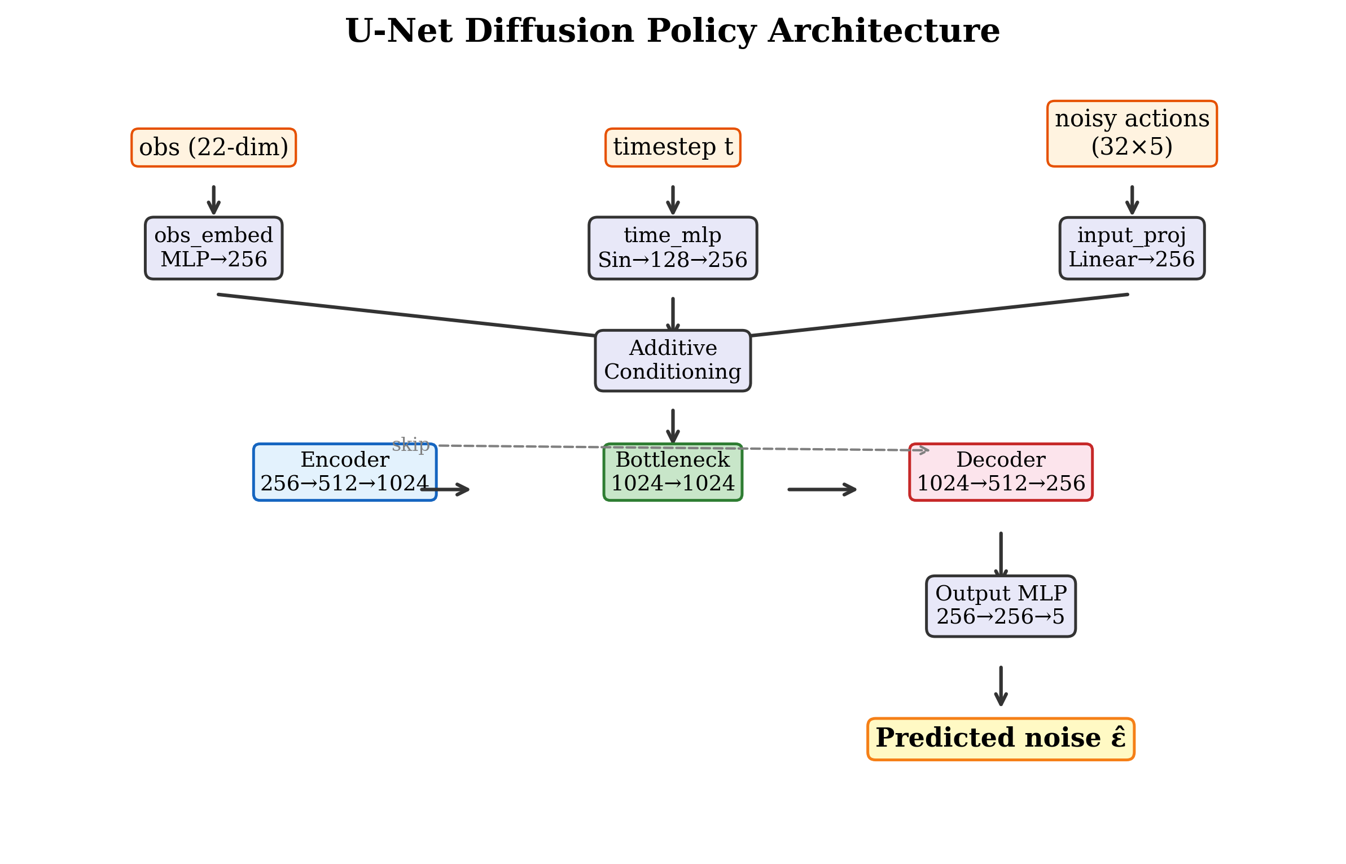
U-Net Architecture (~5.5M params)

Slide 5
Training Configuration
Parameter | Combined Model | Original Model
Demo data | 400 (combined) | 200 (left/right)
Hidden dim | 256 | 256
Encoder blocks | 3 | 6
Batch size | 64 | 256
Learning rate | 2e-4 | 1e-4
EMA decay | 0.999 | 0.999
Epochs | 100 | 500

Slide 6
DDIM Inference (10-Step)
100-step training → 10-step DDIM inference (10× speedup)
η = 0.3 (partial stochasticity for diversity)
Temporal ensemble: weighted blend of overlapping predictions
Execution: Predict 32-step chunk, execute first 8 steps, re-predict
Provides both planning horizon (32) and responsiveness (replan every 8 steps)

Slide 7
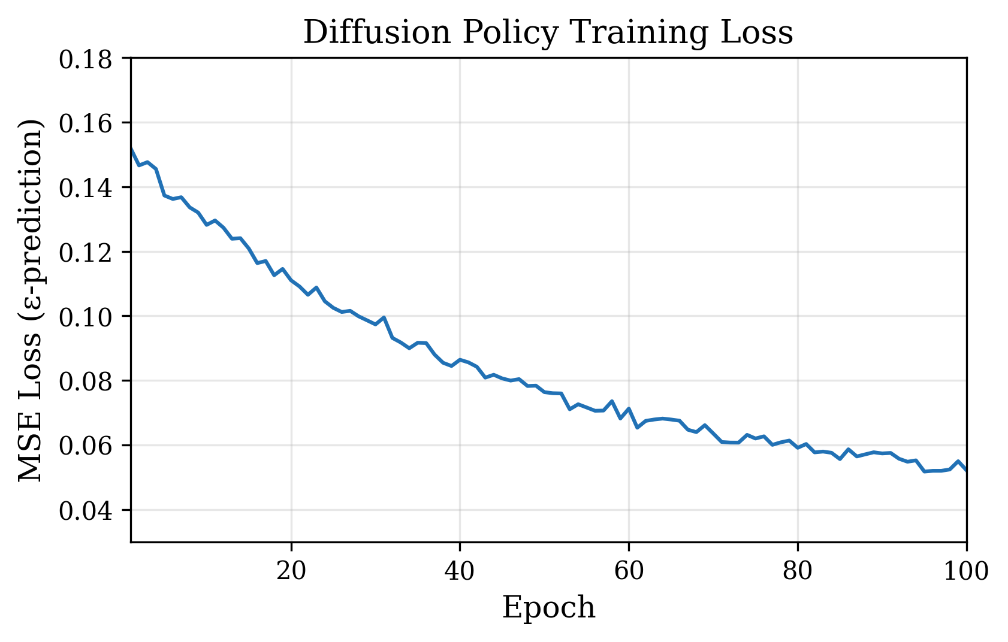
Training Results
6,920 chunks from 400 demos
horizon=32, stride=2
Loss: 0.154 → 0.045

Slide 8
Base Policy Evaluation (50 Episodes)
Metric | Value
Success Rate | 84% (42/50)
Mean Episode Length | 344 steps
Picked Left | 31/42 (73.8%)
Picked Right | 11/42 (26.2%)
Left-side bias reflects demo distribution
16% failure rate — some episodes fail to lift block
Policy learns multi-style distribution but doesn’t distinguish at inference

Slide 9
Debugging Journey
Problem | Outcome | Root Cause
Initial eval | 13% success | Checkpoint saved normalized stats (mean=0, std=1)
Seed eval | 87% failure | Modal collapse in some seeds
Early architecture | 25% success | Needed architecture refinements
Key lesson: Normalization statistics must match inference conditions exactly

Slide 10
Key Takeaways
DDPM successfully learns multi-style trajectory distribution from mixed demos
84% task success demonstrates viable base policy
But base policy is largely illegible (VLO assessment in Week 3)
Training-free steering is the key advantage — modify behavior without retraining
Architecture is simple — 1D U-Net with ResBlocks, not transformer-based

