Slide 1
Week 3: VLM-Based Legibility Evaluation
Using Gemini 2.5 Flash as a Legibility Judge
Anudeep Gottapu | Arizona State University | Spring 2026

Slide 2
The Evaluation Problem
Human studies are gold standard but expensive and slow
Analytical metrics (L_early) assume a specific Bayesian observer model
Proposal: Use a Vision-Language Model (VLM) as a proxy human observer
VLMs can watch trajectory videos and predict intent — just like a human
VLM Onset (VLO): First timestep where VLM correctly predicts the robot’s goal.
Lower VLO = more legible.

Slide 3
VLM Evaluation Pipeline
1. Render policy rollout → MP4 video
2. Extract cumulative prefix frames: k=6 windows over first 30% of episode
3. For each window, send frames to Gemini 2.5 Flash with goal prompt
4. VLM returns: {pA, pB, cue, choice} as structured JSON
5. VLO = first k where choice matches true goal
Cumulative windows (not independent) — VLM sees progressively more context

Slide 4
Prompt Engineering: V1 → V2
Version | Accuracy | Key Issue
V1 | 45% | World-coordinate confusion, long prompt, high temp
V2 | 97.5% | Annotated reference frames, image-space reasoning, temp=0.1
Annotated reference frame with block position markers (visual grounding)
Image-space reasoning (“LEFT/RIGHT in image”) instead of world coordinates
Short, direct prompt — removed verbose instructions
Temperature lowered from default to 0.1

Slide 5
Expert Demo Evaluation (Ground Truth)
Metric | Value
Non-C accuracy | 94.7% (36/38)
C-rate (uncertain) | 84.2% of windows
Left arc accuracy | 95.0%
Right arc accuracy | 100.0%
Style | Mean VLO
Legible | 2.93
Neutral | 3.00
Deceptive | 3.71
VLO ordering: legible (2.93) < neutral (3.00) < deceptive (3.71) ✓

Slide 6
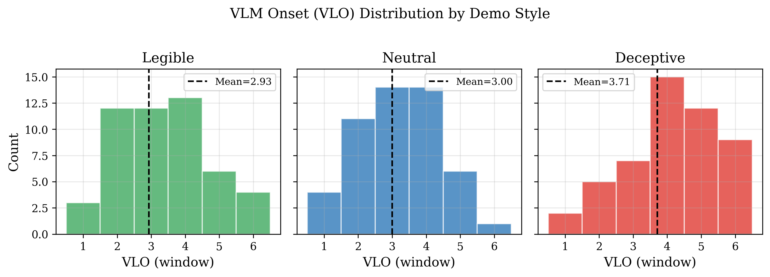
VLO Distribution by Demo Style

Slide 7
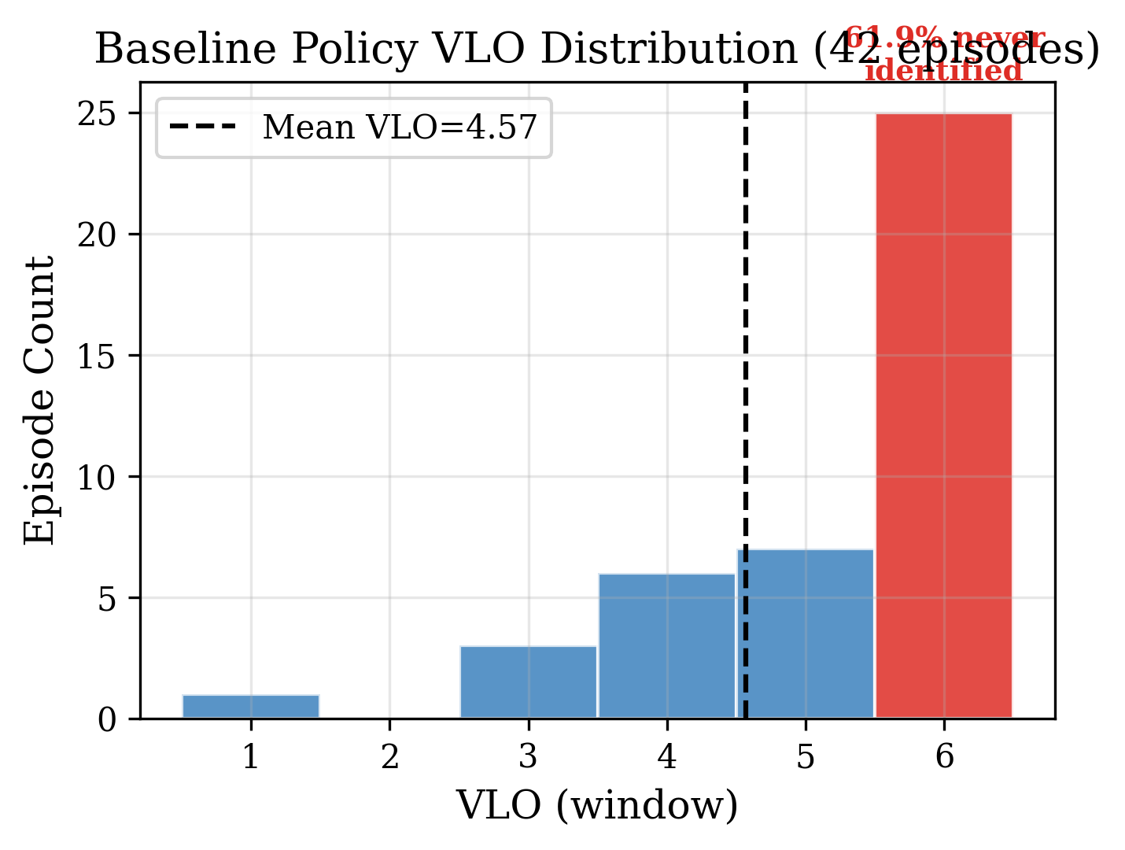
Base Policy VLM Assessment (42 Episodes)
Metric | Value
Mean VLO | 4.57 / 6
Median VLO | 6.0 (worst)
Never identified | 61.9%
Legible at k=1 | 9.5%

Slide 8
Key Insight
The base policy achieves 84% task success but produces largely illegible trajectories.
Mixed training data averages out trajectory styles
Diffusion policy doesn’t prefer legible modes without explicit steering
We need training-free guidance to push toward legible distribution region

Slide 9
What VLM Evaluation Does and Does NOT Show
Supported:
✓ VLMs accurately predict goals (94.7%)
✓ VLO correctly orders styles
✓ Base policy is mostly illegible
Limitations:
✗ VLM ≠ human observer
✗ Post-hoc evaluation, not real-time
✗ Only 10 block configs tested
✗ VLO is a proxy metric

