Slide 1
Week 4: Guidance Methods for Legible Diffusion
Training-Free Steering of Trajectory Distribution
Anudeep Gottapu | Arizona State University | Spring 2026

Slide 2
The Guidance Idea
Diffusion models generate via iterative denoising
At each step, add gradient info to steer toward desired properties — no retraining
# | Method | Type
1 | Classifier Guidance | Gradient-based, training-free
2 | Best-of-N Reranking | Sample + select, training-free
3 | LegDiff (CFG) | Conditional training required
4 | VLM Text Reranking | VLM as judge, training-free

Slide 3
Method 1: Classifier Guidance
ε̂ = ε_θ − w√(1−α̅_t) ∇ L_score(a_t)
Criterion | Weight | Description
P_prox | 0.35 | Gaussian proximity to goal
P_dir | 0.30 | Velocity alignment toward goal
P_lat | 0.25 | Lateral separation from non-goal
P_speed | 0.10 | Speed commitment
Scoring function generated by Gemini from text prompt. Correlation with hand-crafted: r = 0.992

Slide 4
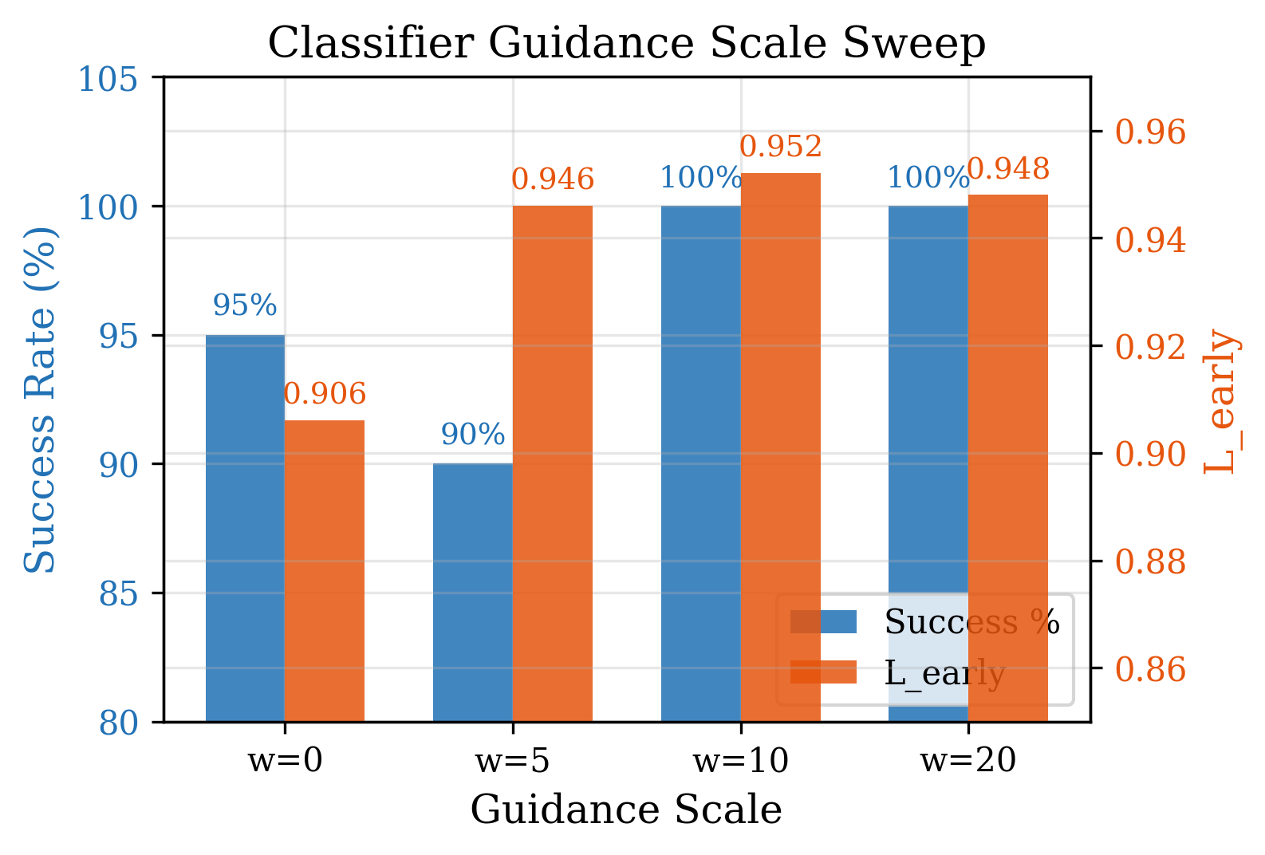
Classifier Guidance: Scale Sweep
Scale w | Success | L_early
0 | 95% | 0.906
5 | 90% | 0.946
10 * | 100% | 0.952
20 | 100% | 0.948
* w=10 optimal

Slide 5
Terminology Correction: NOT DPS
 | Classifier Guidance (Ours) | True DPS (Chung 2023)
Gradient applied to | Noise prediction ε_θ | Denoised sample x_{t-1}
Our result | 100% success | 0% success
Step divergence | 0% | 38%
All reported results use classifier guidance (Dhariwal & Nichol, 2021), NOT DPS.

Slide 6
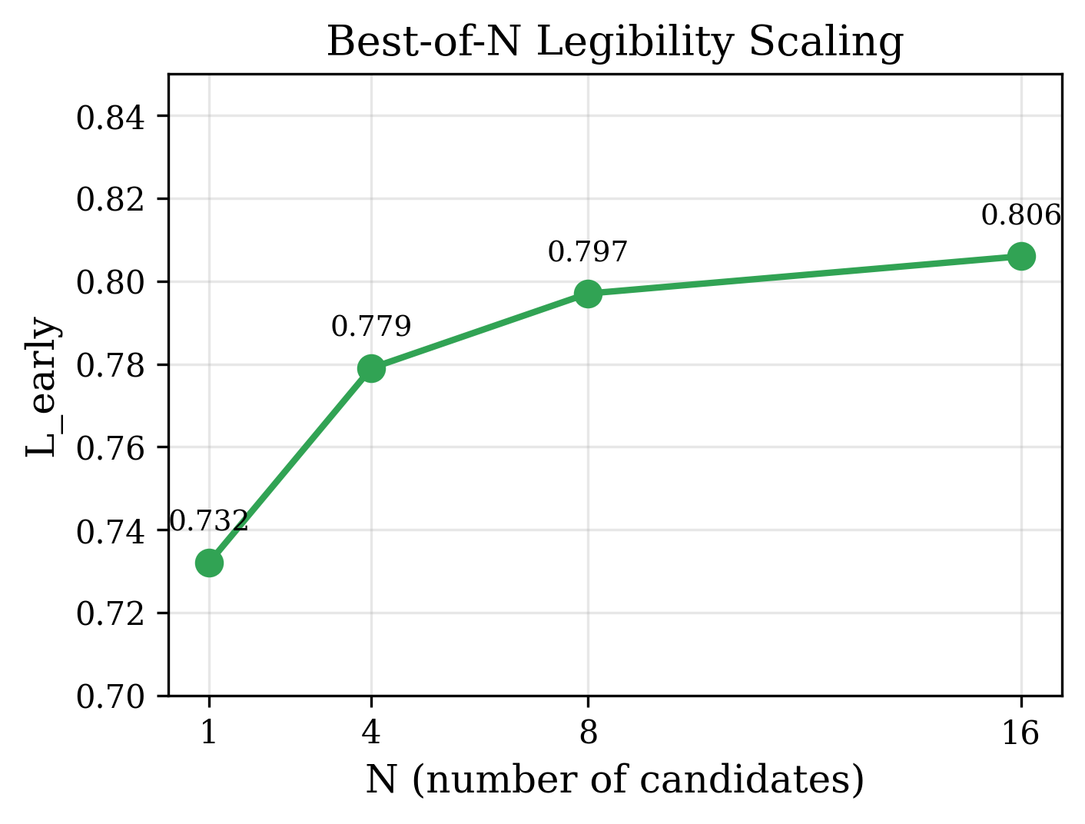
Method 2: Best-of-N Reranking
N | L_early | Δ vs N=1
1 | 0.732 | —
4 | 0.779 | +6.4%
8 | 0.797 | +8.8%
16 | 0.806 | +10.1%
Simple, gradient-free, diminishing returns above N=16

Slide 7
Method 3: LegDiff (Classifier-Free Guidance)
ε̂ = ε_θ(a_t, ∅) + w · (ε_θ(a_t, G) − ε_θ(a_t, ∅))
Trains both conditional (goal-aware) and unconditional models
Conv1d backbone with temporal convolutions (kernel=5), w=3
Condition | Success | L_early
Baseline | 100% | 0.922
LegDiff (w=3) | 100% | 0.935

Slide 8
Method 4: VLM Text-Based Reranking
1. Generate K=5 candidates using classifier guidance
2. Render each as video → VLM scores for goal identifiability
3. Execute the trajectory VLM most confidently identifies
Condition | Success | L_early
Single candidate | 85% | 0.946
Oracle rerank | 95% | 0.968
VLM rerank | 100% | 0.972

Slide 9
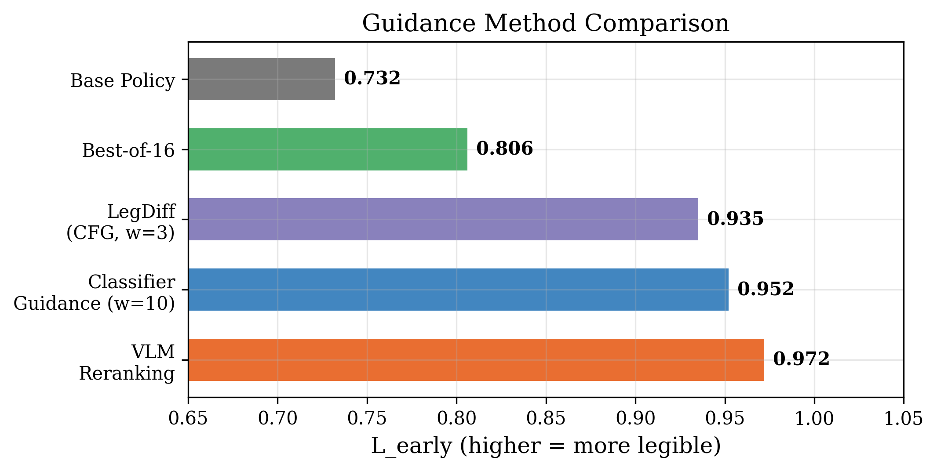
All Methods Compared

Slide 10
Honest: VLM-Generated Scoring Function
Generated by Gemini from text-only prompt (no visual data)
Single-shot, no iterative refinement (not full EUREKA protocol)
Achieves r=0.992 correlation with hand-crafted 4-criteria function
Any capable text LLM could produce equivalent output
Claimed as: valid use of LLM code generation, NOT a visual contribution

