Slide 1
Week 5: Full Pipeline Integration & Lessons Learned
From Training to VLM-Guided Legible Diffusion
Anudeep Gottapu | Arizona State University | Spring 2026

Slide 2
The Complete Pipeline
1. Demo Collection (400 Bézier trajectories, 3 styles)
2. Diffusion Policy Training (DDPM, 100 epochs, 5.5M params)
3. Base Policy: 84% success, VLO=4.57 — illegible
4. Classifier Guidance (w=10): L_early=0.952, 100% success
5. VLM Reranking (K=5): L_early=0.972, 100% success
6. VLM Evaluation (VLO metric, Gemini 2.5 Flash)

Slide 3
What Worked
Component | Result | Why It Worked
Mixed-style demos | 84% success | Bézier gives precise control; 400 demos sufficient
DDPM U-Net | Learns distribution | Suitable for multimodal action data
Classifier guidance | +5.2% L_early | Gradient signal meaningful; w=10 balances task/legibility
VLM evaluation | 94.7% accuracy | Prompt engineering (v1→v2) was critical
VLM reranking | Best L_early | VLM as judge catches what metrics miss

Slide 4
What Didn't Work
Attempt | Outcome | Root Cause
True DPS | 0% success | Gradient to x_{t-1} causes divergence
Initial eval | 13% success | Checkpoint bug: wrong normalized stats
VLM v1 prompt | 45% accuracy | World-coordinate confusion
Seed eval (10 seeds) | 87% failure | Modal collapse in some seeds

Slide 5
Engineering Lessons
Video saving bug — reset() cleared _video_frames; fix: guard with flag
Video recording order — record_video() before reset() erased initial frame
Camera convention — Image-left ≠ world-left caused systematic VLM errors
Normalization stats — Wrong stats in checkpoint → wildly wrong predictions

Slide 6
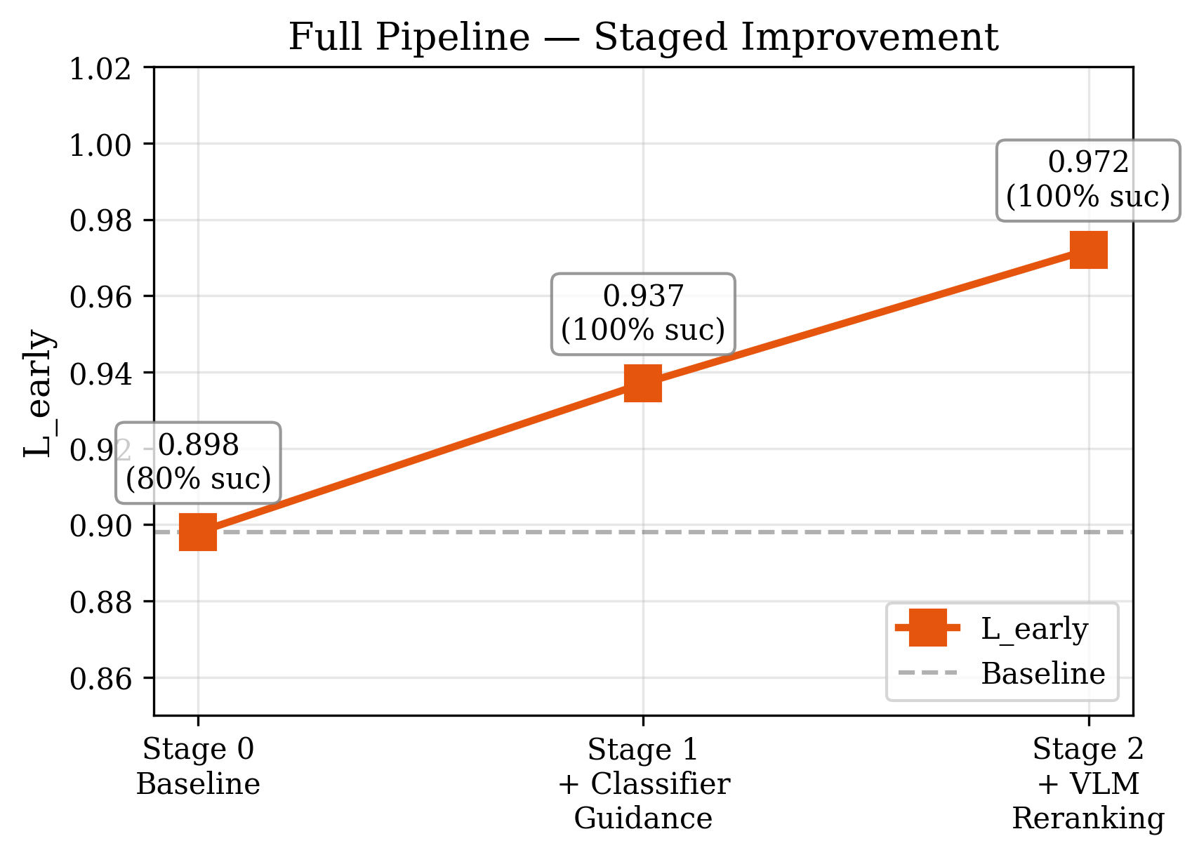
Full Pipeline: Staged Improvement
Stage | L_early
0: Baseline | 0.898
1: +Guidance | 0.937
2: +VLM | 0.972
p = 0.00042

Slide 7
Honest Assessment (6 Issues)
# | Issue | Severity
1 | Method is classifier guidance, NOT DPS | High
2 | VLM scoring from text only (not visual) | Medium
3 | Single-shot, not full EUREKA | Medium
4 | No human study to validate VLM | High
5 | No reverse-steering (w<0) test | Medium
6 | Same configs for train and eval | Medium

Slide 8
Supported vs. Unsupported Claims
CAN Claim (with evidence):
✓ Multi-style learning: 84% success
✓ VLM accuracy: 94.7%
✓ VLO orders styles correctly
✓ Guidance significant: p=0.00042
✓ Pipeline: 0.898 → 0.972
CANNOT Claim:
✗ More legible to humans
✗ VLM scoring > hand-crafted
✗ Generalizes to real robots
✗ DPS inherently unsuitable
✗ Visual contribution from VLM

Slide 9
Future Directions
1. Human validation study — Does VLO correspond to faster human prediction?
2. Online VLM guidance — Real-time VLM feedback during execution
3. Reverse-steering — Test w < 0 for causal evidence
4. Real robot transfer — Franka Panda physical experiments
5. Multi-goal settings — 3+ objects for richer legibility challenges
6. Full EUREKA loop — Iterative refinement with environment feedback

Slide 10
Thank You
Questions?

