Slide 1

SMART INDIA HACKATHON 2026
TITLE PAGE
Problem Statement ID – PS-04
Problem Statement Title – Space Debris Tracking & Satellite Collision Risk Prediction Dashboard
Theme – Space Technology
PS Category – Software
Team ID – <TEAM ID>
Team Name (Registered on portal) – <TEAM NAME>
THE IDEA
KESSLER
A conjunction screening console that ranks which close approaches are worth acting on — and says what would have to be true for each one to stop mattering.
859 OBJECTS · 3,032 EVENTS / 72 h · NO BACKEND

Slide 2
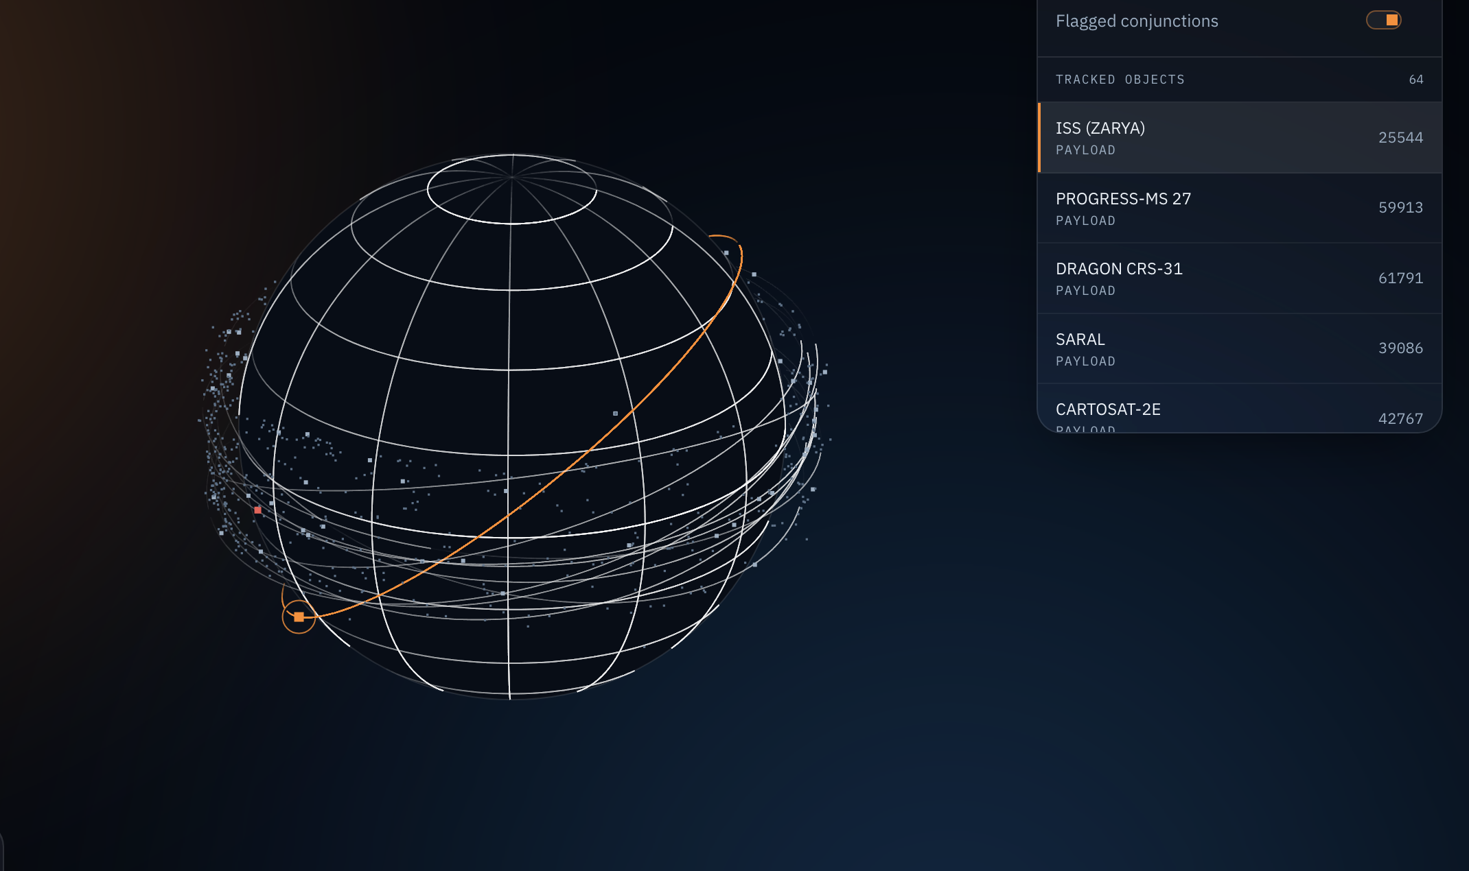
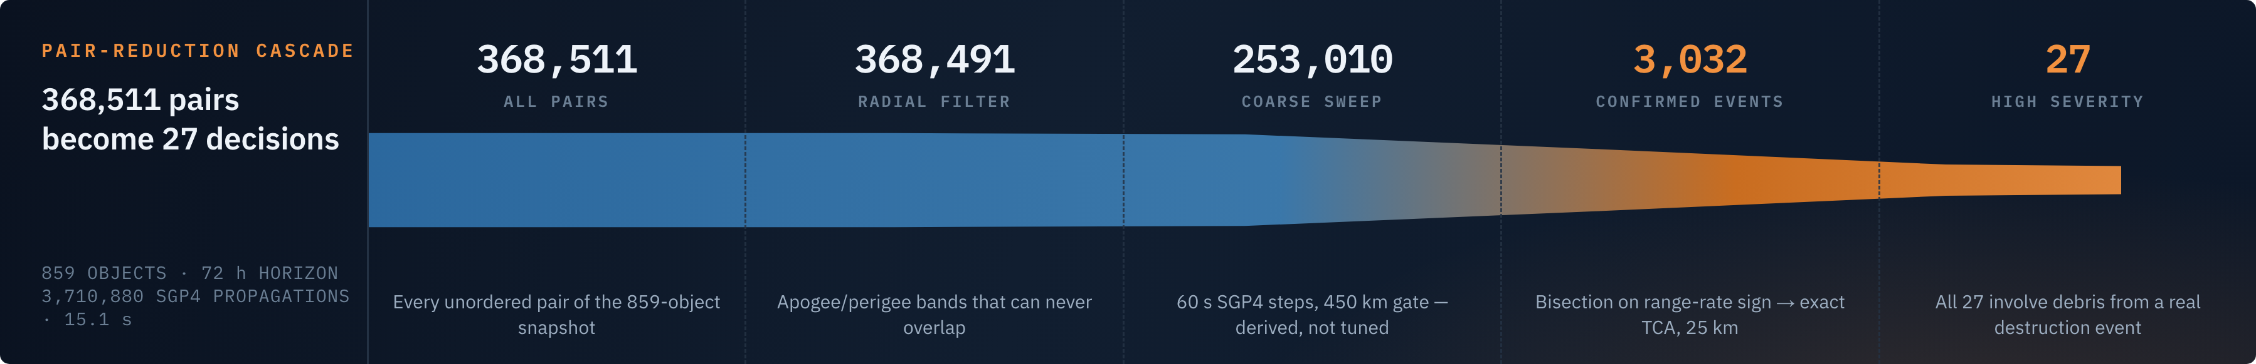
KESSLER
Conjunction screening console for Low Earth Orbit
<TEAM NAME>
PROPOSED SOLUTION · DESCRIBE YOUR IDEA / SOLUTION / PROTOTYPE
859
3,032
15.1 s
An operations console for Low Earth Orbit: it finds every close approach in the catalogue, ranks them, and defends the ranking.
OBJECTS
EVENTS / 72 H
FULL RUN
DETAILED EXPLANATION OF THE PROPOSED SOLUTION
HOW IT ADDRESSES THE PROBLEM
INNOVATION AND UNIQUENESS OF THE SOLUTION
Screen, rank, explain
Triage, not detection
An interface that cannot overstate itself
▪ Public CelesTrak TLEs → SGP4 propagation → exact time of closest approach → a 0–100 risk score.
▪ A cascade takes 368,511 pairs to 3,032 events in 15 s — in the browser.
▪ Every figure is measured; the one assumed input, σ, is shown where it is used.
▪ Nobody needs help finding conjunctions — 53,000 arrive unbidden. Judgement is scarce.
▪ Each event carries a triage verdict: what would have to change for it to stop mattering.
▪ CARTOSAT-2C would need to miss by 3.16 km, not 1.911 — that one is measurable.
▪ One registry declares every capability live / partial / not built — the UI renders from it.
▪ It continues past the conjunction: breakup, decay, re-entry survival, cascade rate.
▪ Exports CCSDS CDMs — output enters an operator’s existing pipeline.
2D ORBITAL VIEWER · FLAGGED-CONJUNCTION LAYER · REAL ELEMENT SETS

Slide 3
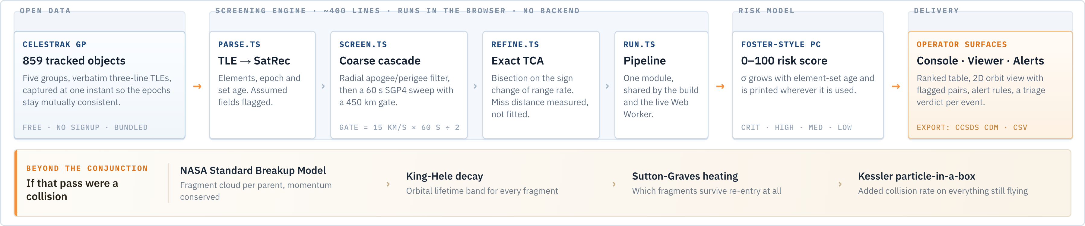
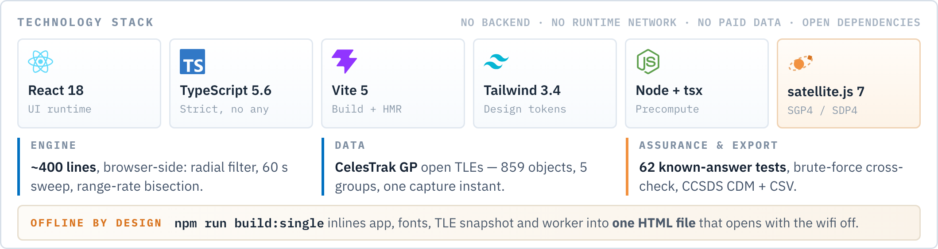
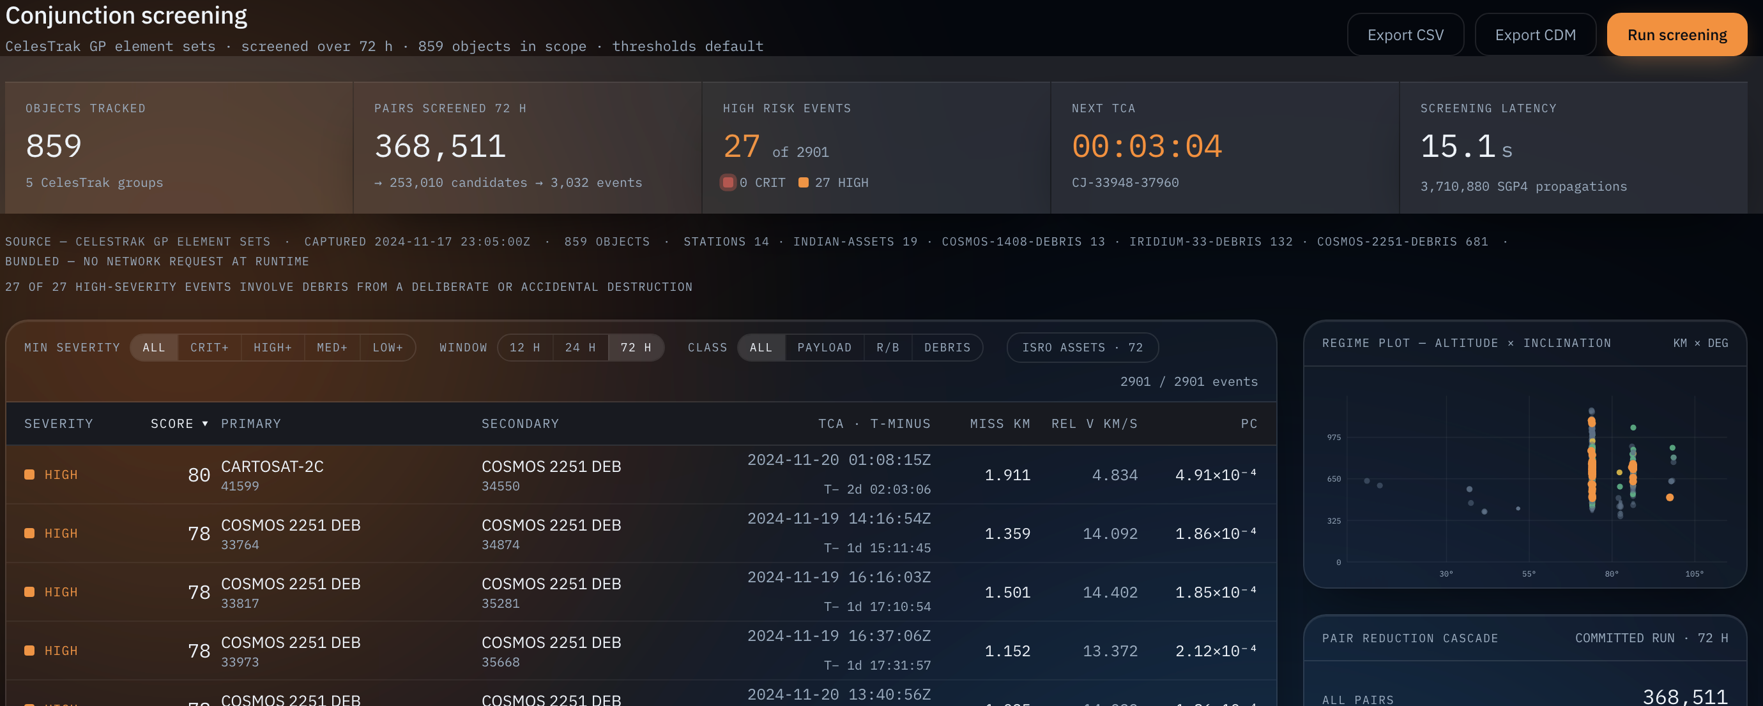
TECHNICAL APPROACH
<TEAM NAME>
TECHNOLOGIES TO BE USED · METHODOLOGY AND PROCESS FOR IMPLEMENTATION
~400
3.7 M
62/62
Four stages, each one derived rather than tuned — the same cascade ISRO’s CLAPS uses, reached from the physics and then found to match.
LINES OF ENGINE
SGP4 CALLS / RUN
CHECKS PASS
WORKING PROTOTYPE

Slide 4
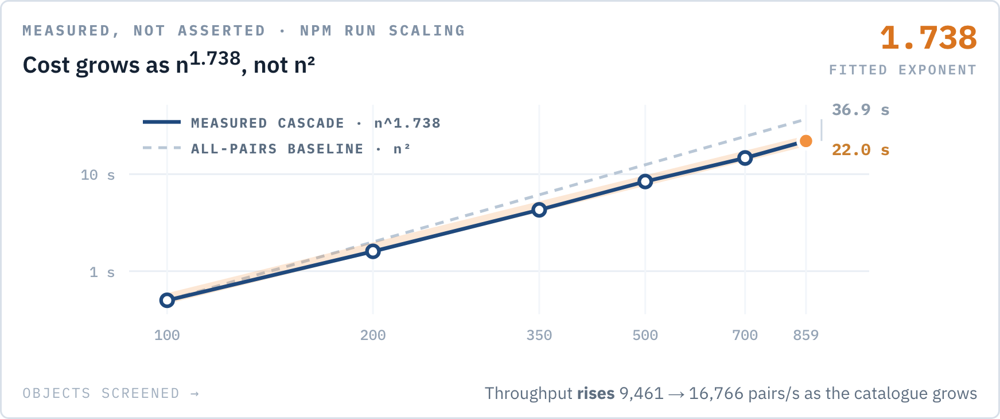
FEASIBILITY AND VIABILITY
<TEAM NAME>
ANALYSIS OF FEASIBILITY · POTENTIAL CHALLENGES AND RISKS · STRATEGIES TO OVERCOME
₹0
0
It is already built and already measured — the full pipeline runs offline, on free data, from a fresh clone.
DATA LICENCE
NETWORK CALLS
WHY WE KNOW IT WORKS · NPM RUN VALIDATE
62 of 62 known-answer checks pass from a fresh clone
▪ Cascade vs brute force — 505 candidates both ways, 0 missed, 0 extra; minimum distances agree to 1.14 × 10⁻¹³ km.
▪ Breakup model vs three real events — Cosmos 1408 0.80×, Iridium/Cosmos 0.53×, Fengyun-1C 0.33×. The disagreement prints on every test run rather than being tuned away.
▪ Burn advisor — re-propagated displacement agrees with the closed form to 3.9%.
▪ Deterministic — re-running the screen reproduces all 3,032 events byte for byte.
RISK 01 · DATA
RISK 02 · MODEL
RISK 03 · SCALE
RISK 04 · INPUTS
TLEs are not precision ephemerides
A TLE carries no covariance
The real catalogue is 30,000 objects
Masses and cross-sections are assumed
SGP4 along-track error is kilometre-scale and grows with element-set age — the same size as the miss distances reported.
Pc rests on an assumed σ — the weakest link in the ranking, and the easiest one to hide.
All-pairs is O(n²): 30,000 objects is roughly 450 million pairs, not 368,511.
Fragment count scales as mass⁰·⁷⁵, and a TLE carries neither mass nor geometry.
MITIGATION
MITIGATION
MITIGATION
MITIGATION
σ = 0.9 km + 0.055·age feeds every score, and a max-age threshold withholds stale predictions rather than showing them.
Every CDM declares COVARIANCE_METHOD = DEFAULT; σ is a live control that re-bands the whole board on screen.
Measured, not asserted — exponent 1.738 over six catalogue sizes. Next step is spatial binning per time step.
Every such assumption is a slider, not a constant — sweep it and watch the answer move.

Slide 5
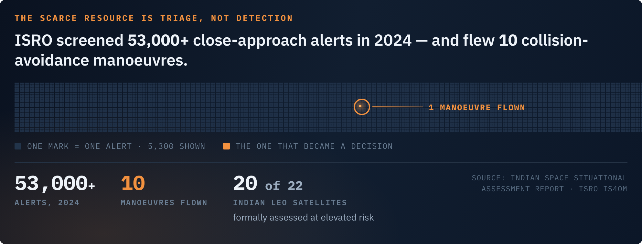
IMPACT AND BENEFITS
<TEAM NAME>
POTENTIAL IMPACT ON THE TARGET AUDIENCE · BENEFITS OF THE SOLUTION
5,300 : 1
₹0
The operators who most need conjunction screening are exactly the ones who cannot buy it.
ALERTS PER DECISION
LICENCE + DATA
SPACE AGENCIES & NATIONAL OPERATORS
A triage layer over public data that says which pair to escalate for a real CDM. 72 of the 3,032 events in the demo run involve an ISRO-operated asset.
UNIVERSITIES, CUBESAT TEAMS, STARTUPS
The entry cost of commercial CA is the licence plus the analyst. This needs neither — one cubesat gets the same pipeline as four hundred satellites.
STRATEGIC AUTONOMY
Asking a foreign vendor “is my satellite about to be hit” is a dependency that is not commercially negotiable in a crisis.
SOCIAL
ECONOMIC
ENVIRONMENTAL
OPERATIONAL
Not a procurement decision
Zero licence, zero data cost
Orbit is a shared resource
Fits the pipeline that exists
▪ Open engine, open data, every assumption stated where it is used.
▪ No licence to negotiate, and nothing you are contractually barred from inspecting.
▪ Commercial CA is priced for constellation operators — the entry cost is the licence plus the analyst.
▪ One avoided collision protects an asset worth hundreds of crores.
▪ Low Earth Orbit has no traffic control, and 20 of India’s 22 active LEO satellites already face elevated risk.
▪ Ranking which passes matter is how the Kessler cascade stays hypothetical.
▪ CCSDS CDM export drops straight into an operator’s flight-dynamics workflow.
▪ Runs offline from a single file — a demo that never depends on the venue’s wifi.

Slide 6
RESEARCH AND REFERENCES
<TEAM NAME>
DETAILS / LINKS OF THE REFERENCE AND RESEARCH WORK
10
62
Every model here is a published one applied to real data, and every claim the console makes has a test behind it.
MODELS & STANDARDS
TESTS PASSING
MODELS AND STANDARDS IMPLEMENTED — NOT CITED, IMPLEMENTED
DATA SOURCES AND PRIOR ART
01 Vallado & Crawford — Revisiting Spacetrack Report #3 (SGP4) AIAA 2006-6753
02 Foster & Estes — Parametric analysis of orbital debris collision probability NASA JSC-25898, 1992
03 Johnson et al. — NASA’s New Breakup Model of EVOLVE 4.0 Adv. Space Res. 28(9), 2001
04 Kessler & Cour-Palais — Collision frequency of artificial satellites JGR 83(A6), 1978
05 King-Hele — Satellite Orbits in an Atmosphere: Theory and Applications 1987
06 Sutton & Graves — General stagnation-point convective-heating equation NASA TR R-376, 1971
07 Allen & Eggers — Motion and aerodynamic heating of ballistic entry NACA TR-1381, 1958
08 CCSDS 508.0-B-1 — Conjunction Data Message Blue Book, 2013
09 Flohrer et al. — Categorisation of TLE orbit errors for the SSN catalogue AMOS 2008
10 Anilkumar et al. — CLAPS, ISRO close-approach prediction software MCF Hassan / IS4OM
▪ CelesTrak GP element sets — celestrak.org. Free, no signup, five groups, 859 objects, captured 2024-11-17T23:05Z.
▪ ISRO Indian Space Situational Assessment Report — IS4OM. Source of the 53,000 alerts and 10 manoeuvres.
▪ CelesTrak SOCRATES — the closest public prior art. Upstream truth we would happily consume; what we add is interrogability and the consequence chain.
▪ ESA Spacecraft Collision Avoidance Challenge — 13,154 real CDMs, 97 teams. The evidence behind the panel below.
▪ 18th / 19th Space Defense Squadron — issuer of the operational CDMs with a real covariance. This tool tells a small operator which pair to go and ask about.
Each of these is implemented in src/data/engine/, not merely cited — and every one is exercised by the validation suite.
WHY THERE IS NO MACHINE-LEARNING MODEL
REPRODUCE EVERY NUMBER IN THIS DECK
ESA ran exactly this experiment: 13,154 real conjunction events as CDMs, 97 registered teams. The naive baseline — predict the risk stated in the most recent CDM — beat almost every model submitted, and a later systematic benchmark found roughly one model in five thousand beat it on both training and test sets, by 1.4%.
So a model here would be decoration we could not validate, inside a project whose entire argument is that every claim has a test behind it. We spent that effort on successive TLE differencing instead — the published method for measuring positional uncertainty from public element sets alone, tested against a known injected perturbation, which it recovers to 1.00×.
github.com/agpriyanshu07/SIH-Internal-NITR-2
npm run validate → 62/62 known-answer checks
npm run screen → reproduces all 3,032 events
npm run scaling → the measured 1.738 curve
npm run build:single → one offline HTML file

