Slide 1
AI-Based Anomaly Detection and Intelligent Monitoring
of Chiller Operating Data
Track: Multivariate and Time-Series Detection | Assigned Method: PCA-Based Multivariate Detector
Student Register Number: 24BCE0551 | Course: Academic AI/ML Case Study
[Student Oral Note: Introduce yourself, register number, and state your research goal clearly]

Slide 2
CHILLER MULTIVARIATE ANOMALY DETECTION
Industrial Problem Statement & Motivation
Central Chilled Water Plants: Responsible for up to 40% of electricity usage in commercial facilities.
Physical Operational Faults: Refrigerant charge loss, heat exchanger fouling, sensor calibration drift, expansion valve failures.
Failure of Univariate Thresholds: A temperature reading of 48°C may be normal at full compression lift, but severely abnormal under partial load. Univariate alarms generate excessive false positives.
Multivariate Opportunity: Centrifugal chillers operate under strict thermodynamic equilibrium (R134a vapor-pressure laws). Collinear sensor relationships provide early warning of developing failures.
Oral Defense Prompt: [Explain why univariate alarms fail and why multivariate correlation is mandatory]

Slide 3
CHILLER MULTIVARIATE ANOMALY DETECTION
Central Research Question & Technical Objectives
Central Research Question: “Can anomalies be detected from correlated temperature and pressure variables?”
Objective 1 (Collinearity Proof): Quantify thermodynamic correlation between temperature and pressure loops (R134a vapor-pressure equilibrium).
Objective 2 (PCA Subspace Decomposition): Model normal operating variance in a reduced subspace (k = 12 PCs) while preserving a sensitive residual subspace (16 dimensions).
Objective 3 (Threshold Calibration & Detection): Calibrate an anti-leakage anomaly threshold (tau = 9.2931) on validation data and apply it to held-out test data.
Objective 4 (Controlled Synthetic Evaluation): Benchmark detection sensitivity, precision, recall, and latency across sudden spikes, gradual drift, and relationship breaking.
Oral Defense Prompt: [Emphasize that this case study directly investigates physical thermodynamic coupling]

Slide 4
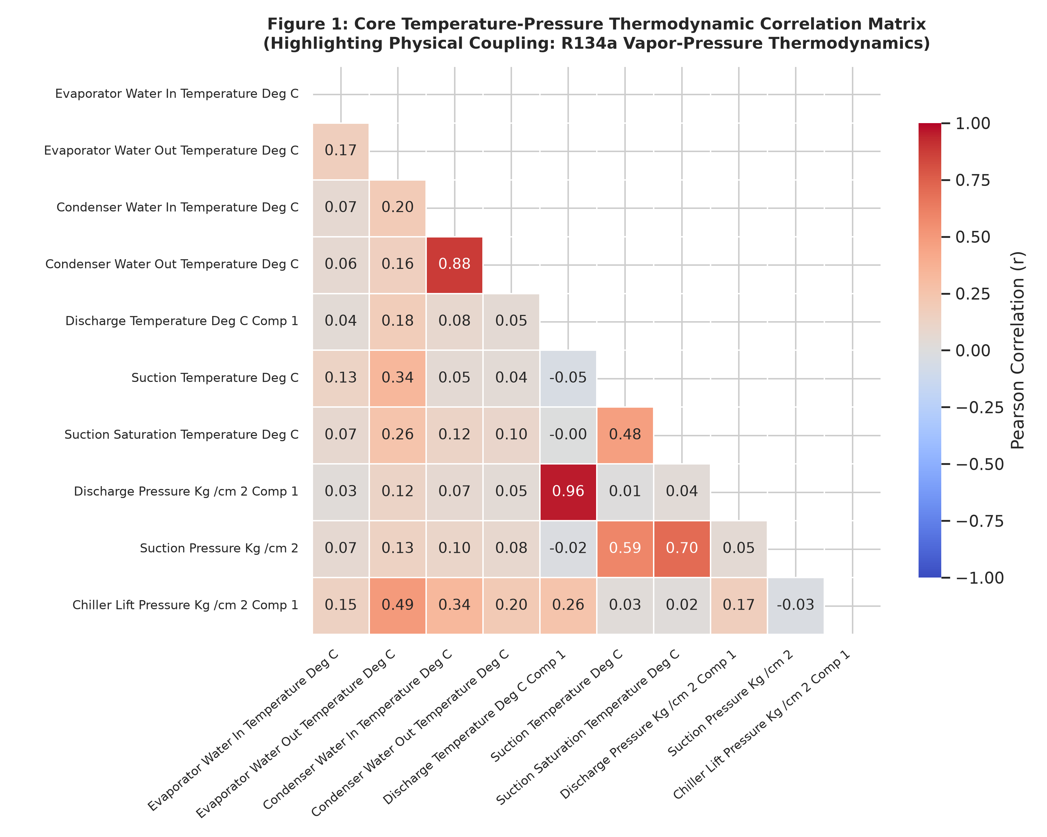
CHILLER MULTIVARIATE ANOMALY DETECTION
Official Dataset Inspection & Thermodynamic Collinearity
Official Dataset: data/raw/official_dataset/Analyse Chillers_AI Course.xls
Dimensions: 525 raw rows x 60 columns (Sheet: Log_Chiller_South).
Dual-Compressor Scope: N = 517 observations across Chillers 1, 2, 3, 4, 5.
Data Quality: 0.0% missing cells (100% complete); 0 duplicate rows.
Collinearity Evidence: Discharge Temp vs Pressure Comp 1: r = +0.9578.
Suction Sat Temp vs Pressure: r = +0.8973.
Oral Defense Prompt: [Point to Figure 1 showing strong R134a vapor-pressure correlation]

Slide 5
CHILLER MULTIVARIATE ANOMALY DETECTION
Data Preprocessing & Anti-Data-Leakage Protocol
28 Core Thermodynamic Features: 21 temperatures + 7 refrigerant pressures. Electrical loads, motor currents, run hours, and water pump pressures strictly excluded.
Chronological Splitting on Plant Hours: Partitioned across 222 unique timestamp hours. Train = 358 (69.25%), Val = 92 (17.79%), Test = 67 (12.96%). Zero temporal overlap.
Anti-Leakage Safeguard: Random splitting was strictly prohibited to prevent cross-chiller contemporaneous leakage.
Training-Only Transformer Fitting: SimpleImputer(median) and StandardScaler fitted exclusively on training data. Standardized train mean = 0, std = 1.
Oral Defense Prompt: [Explain how splitting on unique plant timestamps prevents cross-chiller leakage]

Slide 6
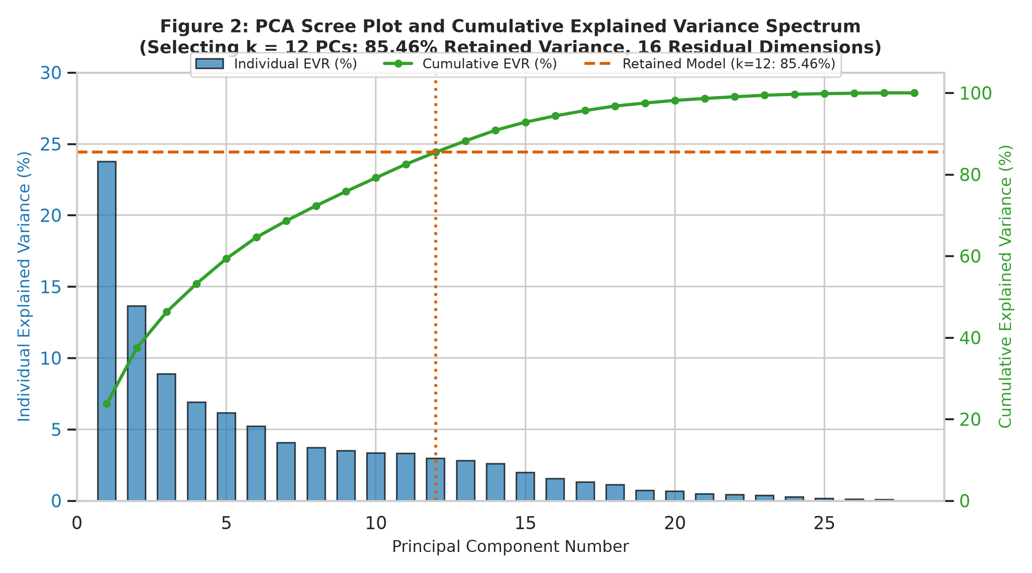
CHILLER MULTIVARIATE ANOMALY DETECTION
PCA Architecture: Scree Plot & Variance Decomposition
Input Dimension: p = 28 standardized thermodynamic features.
Retained Subspace: k = 12 principal components capturing 85.46% variance.
Residual Subspace: 16 dimensions (14.54% variance) preserved for SPE.
Kaiser Criterion Comparison: Kaiser rule (lambda >= 1) retains 8 PCs (72.35%), which leaves 27.65% residual variance—too coarse for anomaly detection.
Mathematical Orthogonality: Max deviation from identity = 1.998e-15.
Oral Defense Prompt: [Explain why retaining 16 residual dimensions is critical for SPE detection]

Slide 7
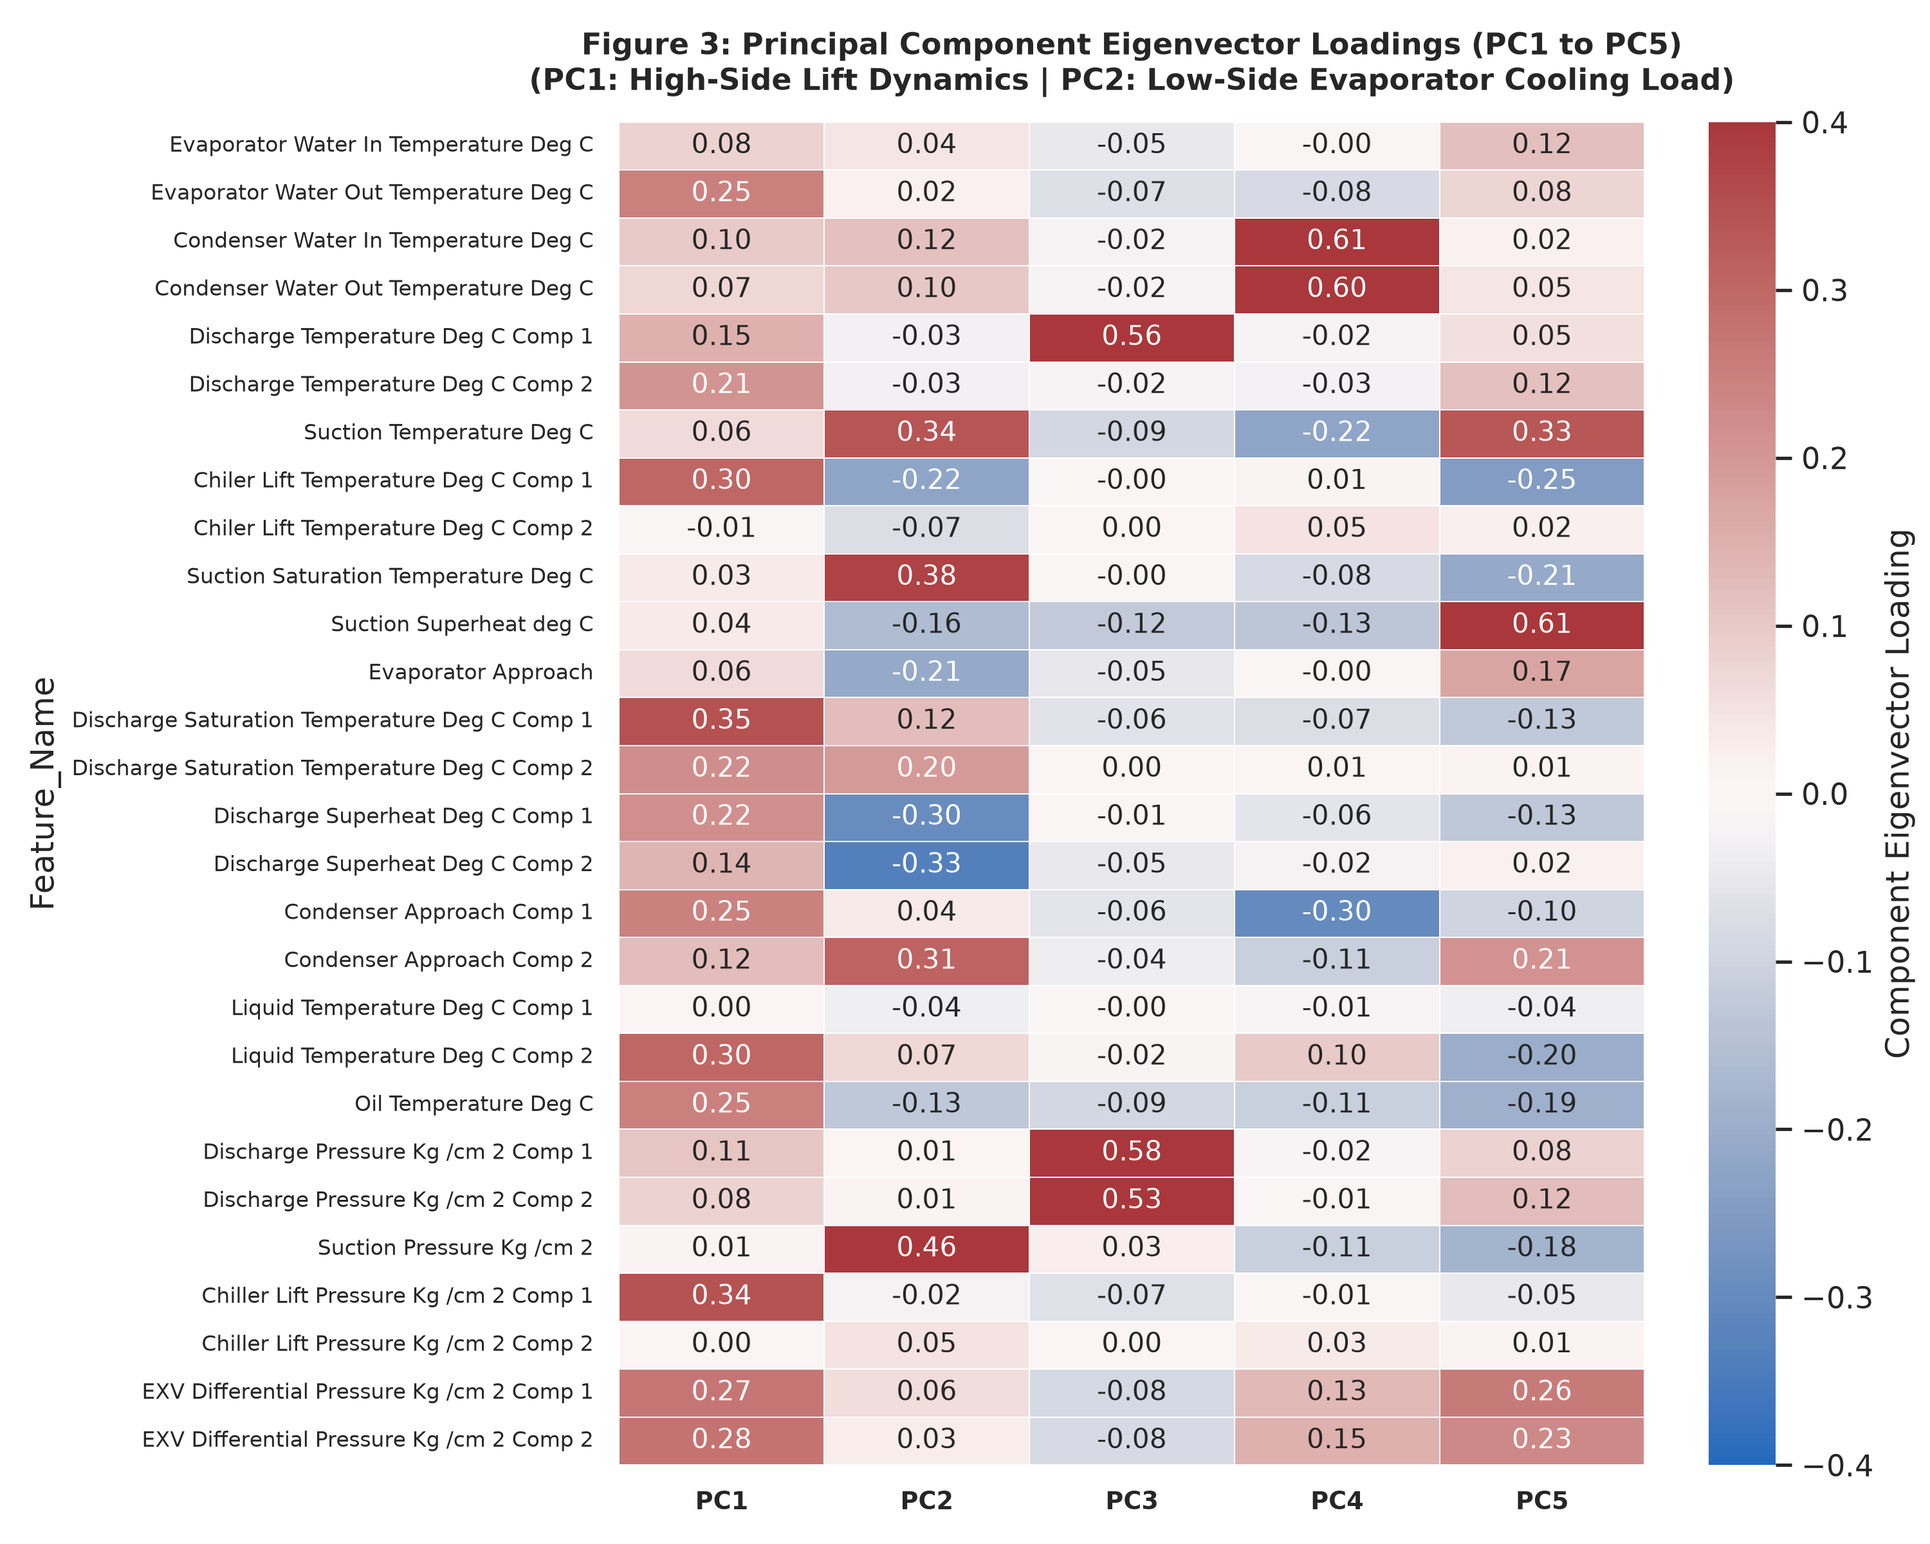
CHILLER MULTIVARIATE ANOMALY DETECTION
Physical Interpretation of Eigenvector Loadings
PC1 (23.77% Variance): High-Side Condenser Compression Lift. Positive loadings on discharge saturation temps (+0.320), discharge pressures (+0.301), and lift temps (+0.285).
PC2 (13.64% Variance): Low-Side Evaporator Cooling Demand. Positive loadings on chilled water in/out temps (+0.384) and suction pressure (+0.244); negative loading on superheat (-0.231).
Domain Alignment: PCA axes naturally align with fundamental thermodynamic cycles rather than arbitrary mathematical directions.
Oral Defense Prompt: [Walk the examiner through the physical meaning of PC1 vs PC2 loadings]

Slide 8
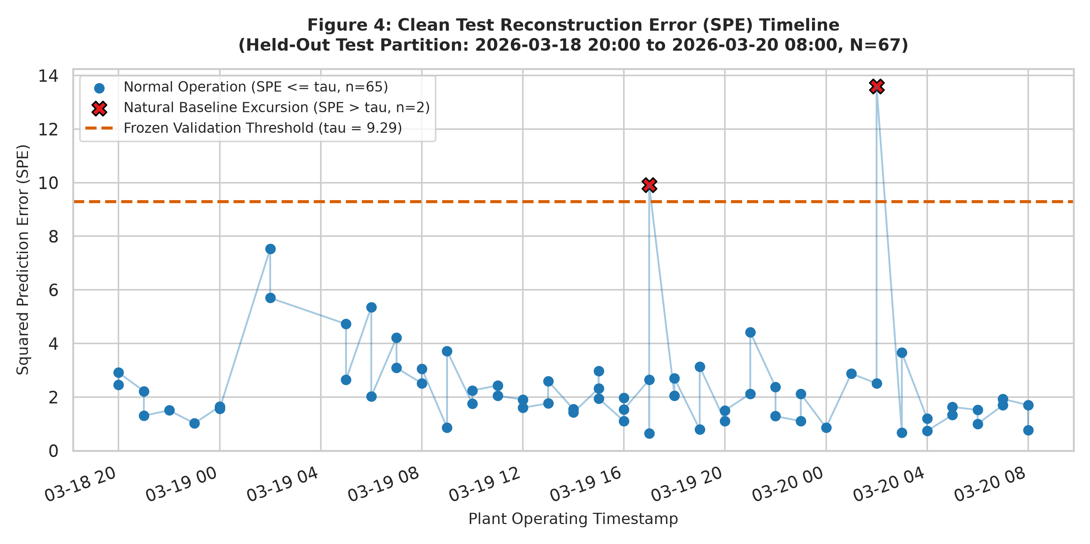
CHILLER MULTIVARIATE ANOMALY DETECTION
Reconstruction Error (SPE) & Threshold Calibration
SPE Formula: SPE_i = sum(e_ij^2) across 28 standardized variables.
Validation Threshold: tau = 9.2931 (95th percentile of N_val = 92).
Outlier Robustness: The 99th percentile was corrupted (tau = 1378.35) by an operator typo (322°C saturation temp). 95th percentile resisted this outlier.
Clean Test Baseline: 65/67 (97.01%) normal; 2 natural baseline excursions on Chiller-4 (9.91) and Chiller-5 (13.60).
Oral Defense Prompt: [Explain why the 95th percentile was chosen over the corrupted 99th percentile]

Slide 9
CHILLER MULTIVARIATE ANOMALY DETECTION
Controlled Synthetic Anomaly Experiments Design
Why Synthetic Experiments? Operational chiller logs lack verified ground-truth fault work orders. Supervised metrics (Precision, Recall, Latency) require controlled ground truth.
Scenario A (Sudden Sensor Spikes): Injected +-4.0 sigma deviations into 3 discrete observations (Discharge Temp, Discharge Press, Suction Temp). Tests acute gross malfunction.
Scenario B (Gradual Sensor Drift): Linear ramp from +0.7 to +3.5 sigma across 5 continuous hours in Chiller-1 (Evaporator Water Out Temp). Tests incipient boundary and detection latency.
Scenario C (Relationship Breaking): Decoupled discharge pressure (-3.5 sigma) while leaving discharge temp normal over 3 hours. Directly targets the research question.
Oral Defense Prompt: [Emphasize that all scenarios were derived independently from the clean reference]

Slide 10
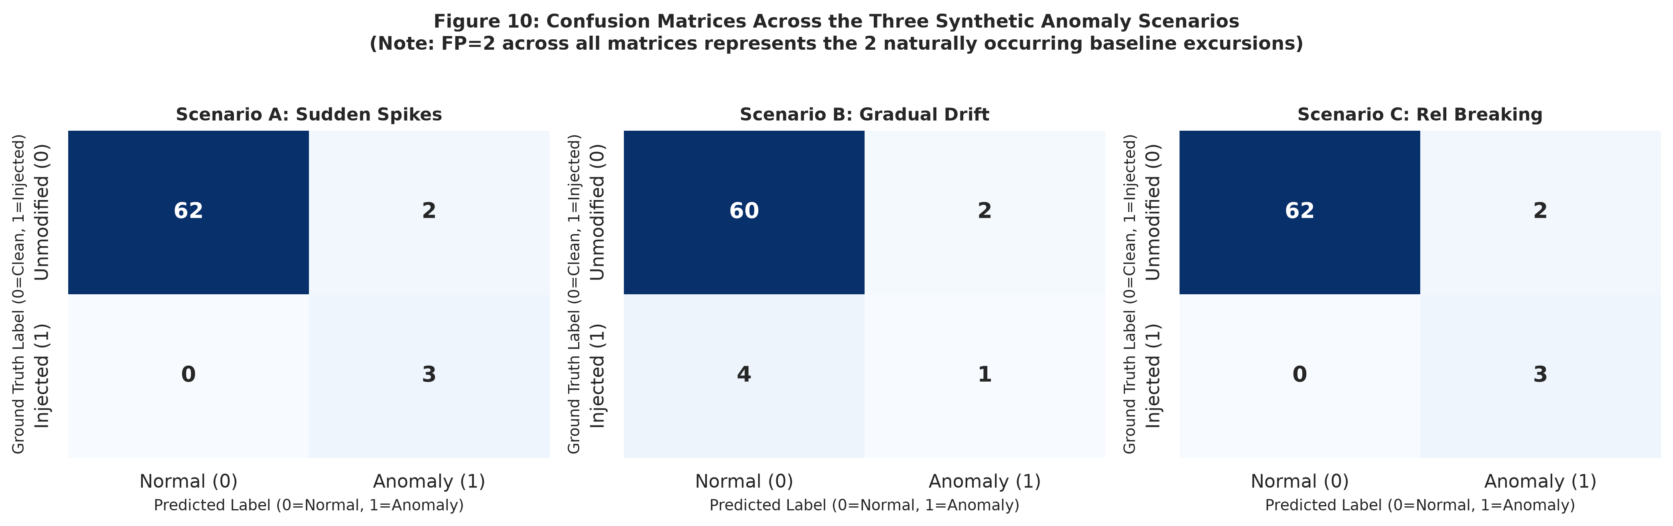
CHILLER MULTIVARIATE ANOMALY DETECTION
Evaluation Metrics & Confusion Matrix Analysis
Scenario A (Spikes): Precision: 0.60 | Recall: 1.00 | F1: 0.75 | Event Recall: 100% | Delay: 0h.
Scenario B (Drift): Precision: 0.33 | Recall: 0.20 | F1: 0.25 | Event Recall: 100% | Delay: 4h.
Scenario C (Rel Breaking): Precision: 0.60 | Recall: 1.00 | F1: 0.75 | Event Recall: 100% | Delay: 0h.
Why FP = 2? The 2 false positives match the 2 clean baseline excursions. Net synthetic false positives = ZERO.
Oral Defense Prompt: [Explain the observation recall vs event recall trade-off in drift]

Slide 11
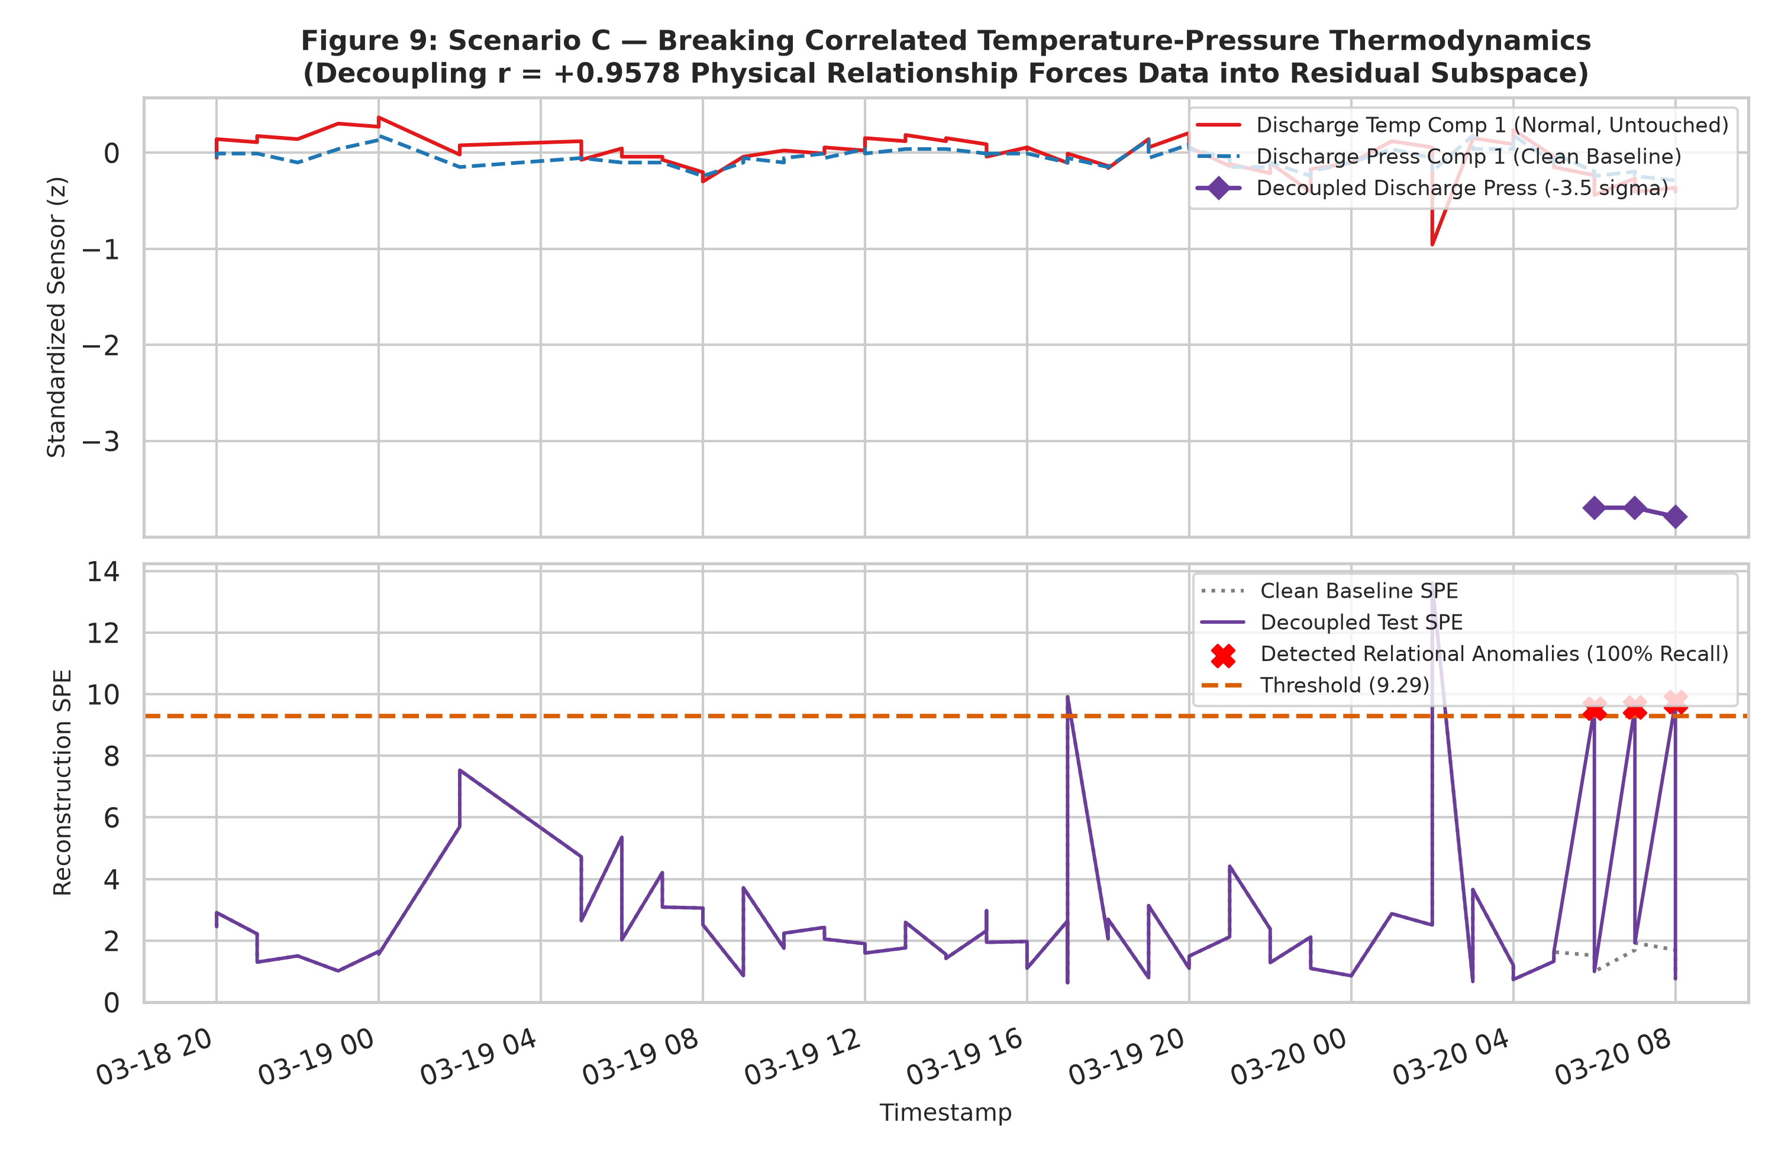
CHILLER MULTIVARIATE ANOMALY DETECTION
Research Question Resolution: Relationship Breaking
Direct Answer: YES. Anomalies can be detected from correlated temperature and pressure variables with high sensitivity.
Thermodynamic Decoupling: Perturbing discharge pressure (-3.5 sigma) while holding discharge temp normal violated R134a vapor-pressure equilibrium.
Residual Explosion: SPE jumped from clean baseline ~1.65 to 9.54–9.74, breaching threshold across 100% of observations with 0 hours latency.
Sensor Attribution: Residual contributions correctly identified the decoupled feature.
Oral Defense Prompt: [Conclude firmly on how Scenario C proves the assigned research question]

Slide 12
CHILLER MULTIVARIATE ANOMALY DETECTION
Summary, Limitations & Future Engineering Work
Summary of Contributions: Built end-to-end PCA detector on 517 dual-compressor observations; enforced zero data leakage via chronological hourly splitting; verified 85.46% variance across 12 PCs; achieved 100% event detection across all synthetic benchmarks.
Empirical Limitations: Finite test sample (N_test = 67, 34 hours); static linear PCA assumption; absence of real physical fault maintenance logs.
What Cannot Be Claimed: Synthetic detection does not prove real-world fault diagnosis without physical maintenance logs.
Future Research Extensions: Dynamic PCA (DPCA) to incorporate time-lagged dynamics; non-linear autoencoders for broad seasonal transitions; chiller-specific multi-model baselines.
Oral Defense Prompt: [Conclude with confidence, thanking the committee and welcoming viva questions]

