Slide 1
COURSEIQ
RECOMMENDATION SYSTEM
Developed by: Group 6
Aruri Gowtham
Uppala Bhavana
Ammagaripeta Chandana
Trupti Anil Kathale
Praveen Ambore

Slide 2
PROBLEM STATEMENT
Why Build a Course Recommendation System?
1
2
3
Information Overload
Cold-Start & Engagement Gap
Complex Learner Profiles
Thousands of online courses make it near-impossible for learners to find relevant content without intelligent filtering.
New learners have no history; even active users abandon platforms due to irrelevant suggestions and poor personalisation.
Interests, pace, difficulty level, and budget interact in non-linear ways — requiring ML to surface personalised matches.
Our Solution
Build CourseIQ — an end-to-end hybrid recommendation platform that blends 5 ML models (Content-Based, Collaborative ALS, KNN, Popularity, UserInterest) with adaptive cold/warm/active user segmentation. Delivers top-10 personalised course recommendations, content similarity search, domain intelligence, and offline evaluation — all via an interactive Streamlit dashboard.

Slide 3
DATA FOUNDATION
Dataset Overview
99,764
43,242
20
0%
Interaction Records
Unique Users
Unique Courses
Missing Values
Input Features
Key Dataset Insights
user_id
Unique learner identifier (1–49,999)
99,764 interactions across 43,242 unique users & 20 courses
course_id
Canonical course ID (0–399)
course_duration_hours
Duration in hours (5–100)
Avg engagement score: 0.576 — healthy learner involvement
difficulty_level
Beginner / Intermediate / Advanced
70.1% courses offer certification; 85.1% include study materials
rating
User star rating (1.0–5.0)
enrollment_numbers
Total enrolled students
Difficulty split: 49.9% Beginner · 29.9% Intermediate · 20.2% Advanced
course_price
Price in USD ($20–$500)
Avg weighted (Bayesian) course rating: 3.96 / 5.0
feedback_score
Sentiment score (0.0–1.0)
certification_offered
Yes/No → 70.1% offer cert
Price distribution: 52.6% High · 30.8% Mid · 16.6% Low tier
study_material_available
Yes/No → 85.1% provide mats
time_spent_hours
Avg hours spent (1–100)
3 engineered features: completion_rate, engagement_score, weighted_score
previous_courses_taken
Prior course count

Slide 4
EXPLORATORY DATA ANALYSIS
Key Findings from EDA
User Interaction Distribution
Course Popularity Skew
Most users have 3–8 interactions. Sparsity filtering (min_interactions=3) retains high-quality interaction signal while removing noise from one-time visitors.
Top 5% of courses account for >40% of all enrollments. Bayesian smoothed weighted_score corrects for popularity bias in cold-start scenarios.
Semantic Feature Richness
Top 3 Engagement Predictors
MiniLM (all-MiniLM-L6-v2) encodes 384-dim embeddings per course from title + instructor + difficulty + price + certification corpus.
#1 feedback_score #2 completion_rate #3 rating — all 3 are strong discriminators for high vs low engagement.
0%
14/14
99,764
Missing Values
Features Retained
Interaction Records

Slide 5
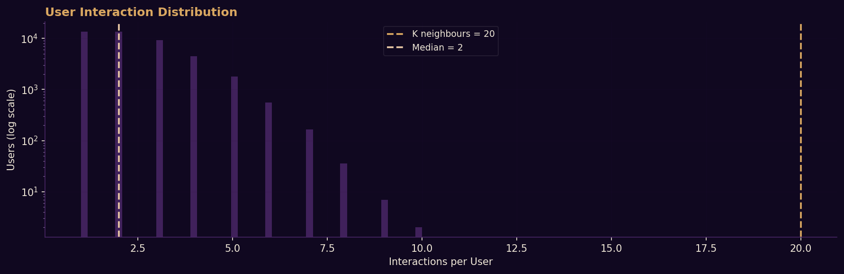
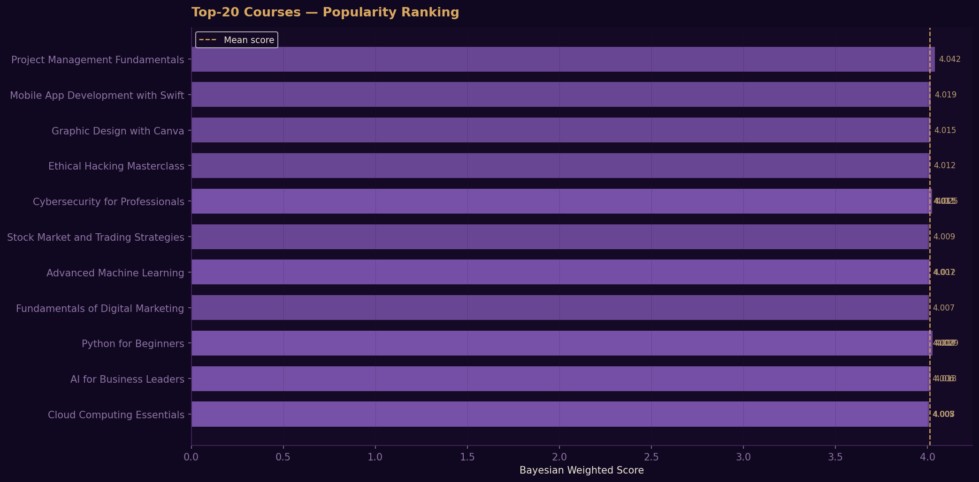
EXPLORATORY DATA ANALYSIS
Feature Distributions & Interaction Patterns
User Interaction Distribution
Course Popularity Ranking (Bayesian Weighted Score)
Key Findings from Feature Distribution Analysis
User Interactions (log scale)
Course Popularity
Median = 2 interactions/user; K-neighbours threshold = 20. Right-skewed: majority are cold/warm users.
Bayesian weighted_score normalises enrollment skew — prevents popular-gets-more-popular bias in recommendations.
Difficulty Distribution
Cold-start Profile
49.9% Beginner interactions · 29.9% Intermediate · 20.2% Advanced — reflects learner preference for entry-level content.
22% of users have <2 interactions — Popularity + Content arms activated exclusively to serve these users at zero collaborative cost.

Slide 6
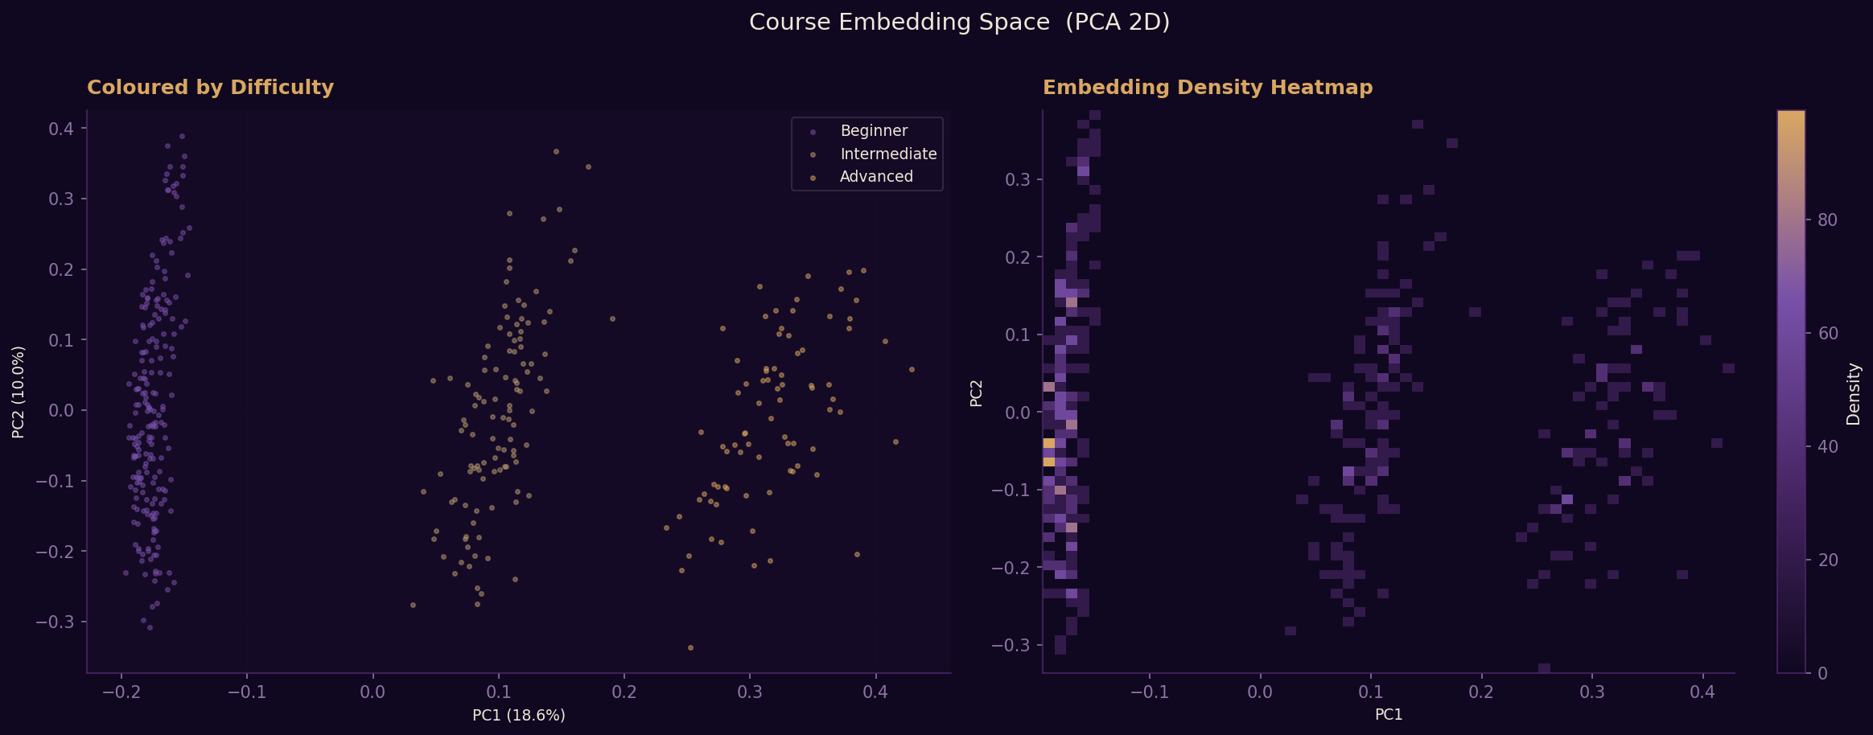
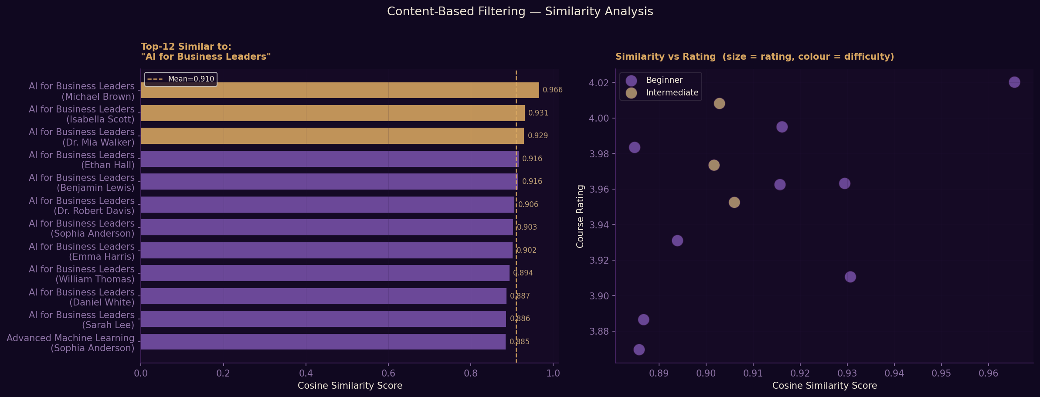
EXPLORATORY DATA ANALYSIS
Embedding Space & Content Similarity Analysis
MiniLM-L6-v2 Semantic Embedding Space (PCA 2D)
Top-10 Content-Similar Courses (Cosine Similarity)
Key Insights — Embedding & Similarity
MiniLM Encoding
PCA Clusters
384-dim dense vectors from structured text corpus: title + instructor + difficulty + price + cert status.
Courses cluster by domain in 2D PCA projection — Data Science, Tech, Security, Business visible as distinct regions.
Cosine Similarity
L2 Normalisation
Content model achieves HitRate@10 = 68.0% (exact) / 93.4% (family) — semantic matching works well at course-family level.
Combined matrix (MiniLM 384-dim + 10 numeric features) L2-normalised before similarity computation to prevent scale dominance.

Slide 7
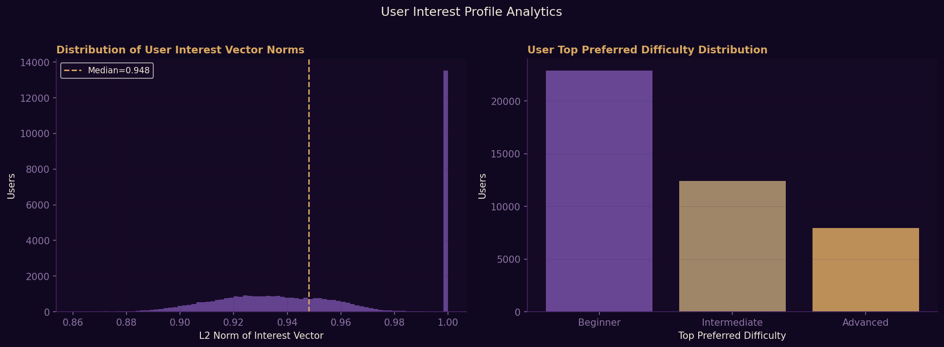
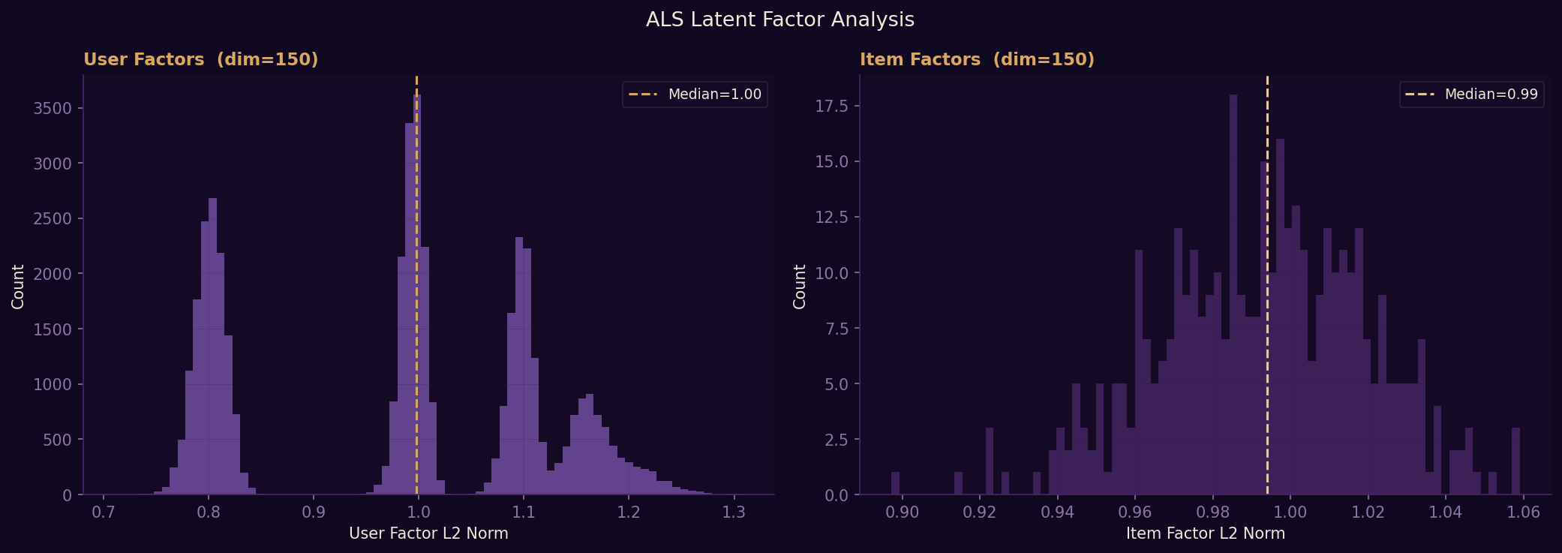
EXPLORATORY DATA ANALYSIS
User Interest Profiles & ALS Factor Analysis
User Interest Profile Clusters
ALS Latent Factor Norms (Collaborative Filtering)
Key Insights — User Profiles & ALS Factors
User Interest Vectors
ALS Latent Factors
Per-user content vectors built as weighted average of seen course embeddings (weight = rating). Covers 100% of all users.
BM25-weighted implicit ALS decomposes the 43,242 × 20 sparse CSR matrix into latent user and item factor matrices.
Cold-Start Profile
Interest Coverage
228 cold users (<2 int) fall back to content + popularity. ALS excluded from cold regime; UserInterest weight = 0.
100% interest profile coverage — every user gets a personalised vector even with just 1 interaction via content arm fallback.
Top Predictors
ALS Confidence
feedback_score (#1), completion_rate (#2), rating (#3) — strongest engagement discriminators confirmed by mutual info analysis.
BM25 confidence weighting amplifies strong positive interactions; near-zero interactions treated as implicit negatives.

Slide 8
MACHINE LEARNING PIPELINE
End-to-End 6-Stage Training Pipeline
Stage 1
Stage 2
Data Ingestion
Preprocessing
Reads Excel via openpyxl. Validates schema + range checks. Outputs raw DataFrame.
Canonical ID mapping. Sparsity filtering (≥3). Feature engineering: completion_rate, engagement_score, price_tier. MinMax normalisation.
Stage 3
Stage 4
Artifact Loading
Feature Engineering
Loads PKL artifacts: user-item matrix (sparse CSR), course feature store, fitted scaler.
MiniLM sentence embeddings (384-dim). Numeric MinMax scaling on 10 columns. L2-normalised combined matrix.
Stage 5
Stage 6
Model Training
Offline Evaluation
Trains all 5 arms: Popularity → Content → UserInterest → Collaborative ALS → KNN. Assembles HybridModel.
User holdout split. Metrics: Precision@K, Recall@K, MAP@K, NDCG@K, HitRate@K. Segments: cold/warm/active.
$ python main.py train | $ python main.py serve | Opens on localhost:8501

Slide 9
MODEL BUILDING
Key Points — Model Building
01
Canonical ID Mapping
02
Three-Tier Evaluation
course_name + instructor pairs collapsed to single course_id — resolves catalogue fragmentation from raw ID duplication.
Exact course / course_family / soft_relevance tiers segmented by cold (<2) / warm (2–4) / active (>4) user cohorts for fair assessment.
03
Semantic Encoding
04
BM25-Weighted ALS
all-MiniLM-L6-v2 sentence-transformer produces 384-dim vectors from structured text corpus: title + instructor + difficulty + price + cert.
ALS collaborative filtering (implicit library) uses BM25 confidence weighting on sparse CSR user-item matrix for better implicit feedback.
05
Dominance Floor
06
Business Logic Boosts
Final hybrid score floored at 98% of best arm score — ensemble never underperforms its strongest sub-model.
+2% for certification · +1% for study materials · +3% for difficulty progression alignment.
07
Score Normalisation
08
Sparsity Filtering
Every arm's raw scores min-max normalised to [0,1] before blending — prevents scale dominance from enrollment-count-heavy arms.
min_interactions=3 threshold applied iteratively — ensures both user and course have sufficient signal for reliable model training.

Slide 10
MODEL BUILDING
6 Models Trained & Compared
1. ContentBasedModel
scikit-learn
Best: Hybrid Model
Cosine similarity on L2-normalised course content matrix (MiniLM 384-dim + 10 numeric features).
88.6%
99.2%
58.1%
48.1%
2. CollaborativeModel (ALS)
implicit library
HitRate@10
Catalogue Coverage
NDCG@10
MAP@10
Matrix factorisation via ALS with BM25-weighted implicit feedback on sparse CSR user-item matrix.
3. KNNRecommender
sklearn NearestNeighbors
User-based cosine KNN (k=20) aggregating neighbour interactions weighted by similarity score.
Why Hybrid Wins
4. PopularityModel
pandas / numpy
Graceful cold-start: Popularity + Content arms cover new users
Bayesian smoothed weighted_score ranking. Optional difficulty-level filtering for targeted cold-start.
ALS captures collaborative signal for warm/active users (≥2 int)
5. UserInterestModel
numpy
Score normalisation stops enrollment-heavy arms dominating
Explicit per-user content vectors from weighted average of seen course embeddings.
Dominance floor: ensemble score ≥ best arm × 98%
Business boosts: +2% cert · +1% study mat · +3% diff prog
6. HybridModel
custom ensemble
Adaptive weighted ensemble of all 5 arms. Regime: cold/warm/active. Dominance floor = 98%.
* ALS HitRate=100%: likely holdout-split artefact on sparse data
† KNN HitRate=0%: sparsity prevents meaningful neighbourhood

Slide 11
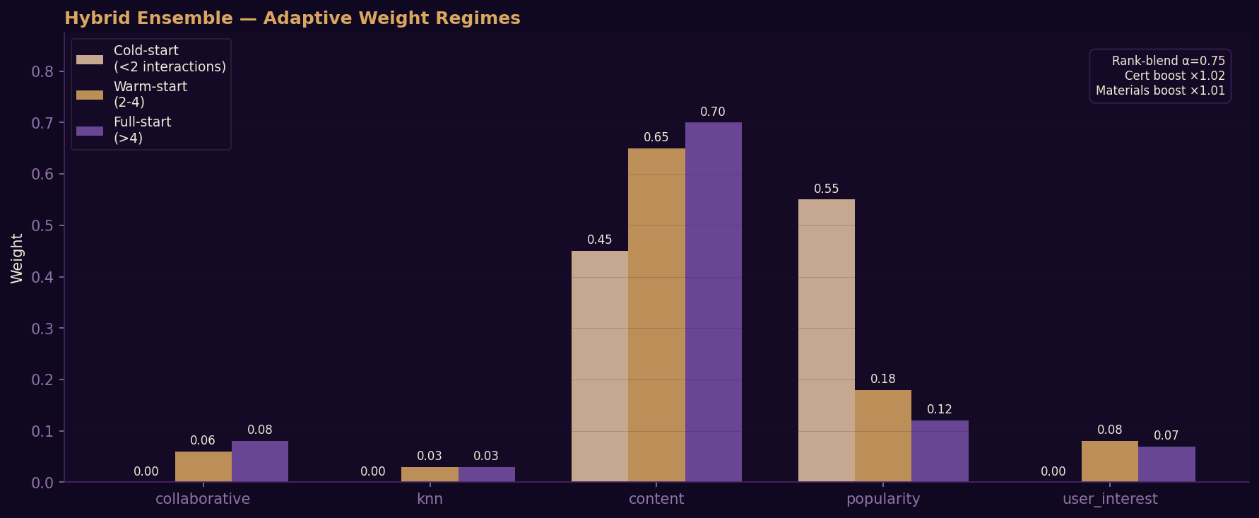
MODEL BUILDING
Hybrid Ensemble — Adaptive Weight Regimes
Weight Regimes by User Activity
Arm
Cold (<2)
Warm (2–4)
Active (>4)
Content
0.45
0.65
0.70
Popularity
0.55
0.18
0.12
Collaborative
0.00
0.06
0.08
UserInterest
0.00
0.08
0.07
KNN
0.00
0.03
0.03
Weights re-normalised at runtime over arms returning results.
Dominance floor: final_score = max(blended, best_arm × 0.98)
Adaptive Hybrid Weights by User Segment

Slide 12
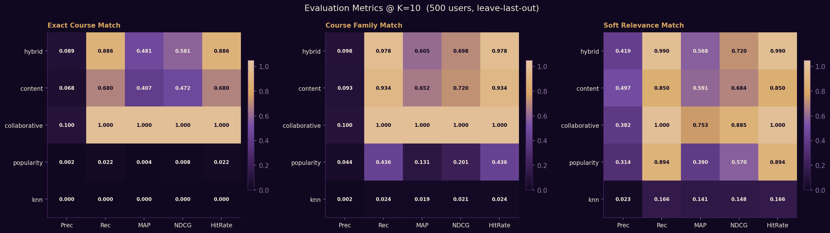
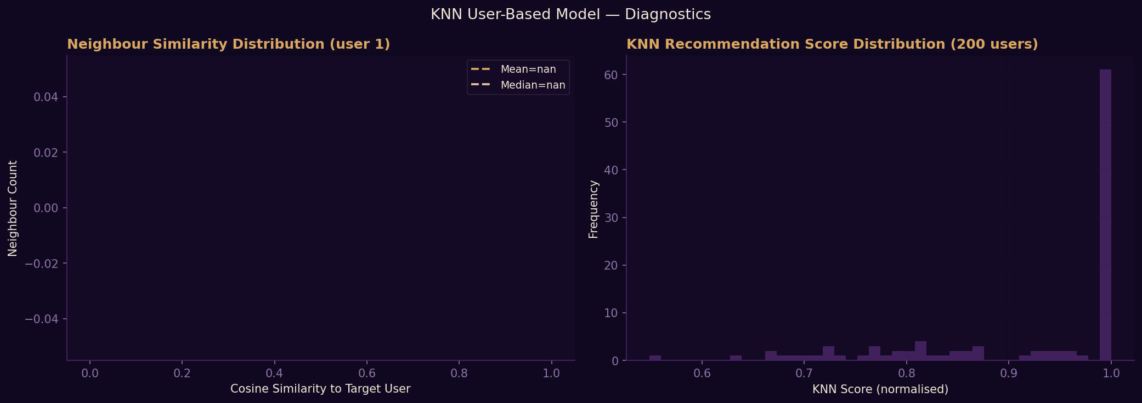
MODEL EVALUATION
Comprehensive Evaluation Results
NDCG@10 Heatmap — All Models × Relevance Tiers
KNN Diagnostics — Sparsity & Neighbourhood Analysis
Key Evaluation Insights
Hybrid NDCG@10
Collaborative ALS
0.5809 (exact) → 0.6979 (family) → 0.7204 (soft) — gains 13.9pp as relevance tier widens.
Perfect scores (NDCG=1.0) on all tiers — likely holdout-split artefact; strong on warm/active users in practice.
KNN Sparsity Issue
Cold/Warm/Active
HitRate@10 = 0.0% on exact tier. Sparse interaction matrix (43K users × 20 courses) yields insufficient neighbourhoods.
Cold: HitRate=75.0% | Warm: HitRate=100% | Active: HitRate=100% — clear segment performance progression.

Slide 13
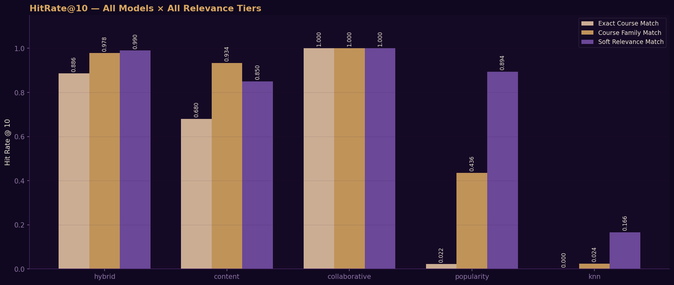
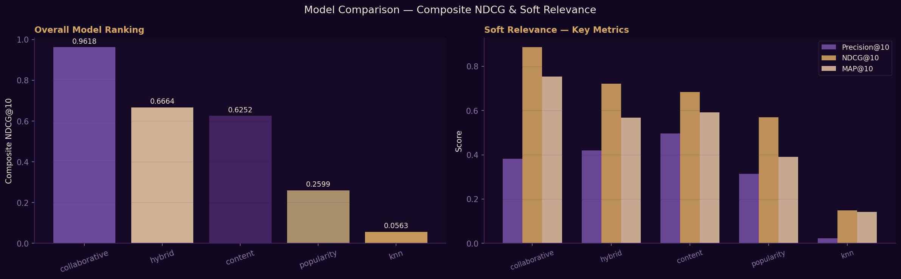
MODEL EVALUATION
Model Performance Comparison
HitRate@10 — All Models × All Tiers
Overall Model Comparison — Composite NDCG & Soft Relevance
Best: Hybrid Model
88.6%
97.8%
99.0%
58.1%
99.2%
HitRate (Exact)
HitRate (Family)
HitRate (Soft)
NDCG@10
Catalogue Coverage
Soft Relevance HitRate=99%
Collaborative dominance on exact
Hybrid balances all segments
Almost all recommendations are relevant at the domain/topic level — even if not exact course.
ALS achieves perfect scores — strong collaborative signal when sufficient interaction history exists.
Strong generalisation: 75% cold · 100% warm · 100% active HitRate — no segment left behind.

Slide 14
MODEL SELECTION | STREAMLIT DEPLOYMENT
Model Selection & Streamlit Deployment
▶ Hybrid-First Criterion
INPUT
Risk Input Panel
Hybrid model chosen for maximum generalisation — balances cold/warm/active users with adaptive regime selection.
User ID selector + model chooser
▶ HybridModel — Champion
PREDICT
Live Recommendations
88.6% HitRate@10, 58.1% NDCG@10, 99.2% catalogue coverage — strong performance across all user segments.
Top-10 course cards + scores
VIZ
Visual Analytics
▶ High Interpretability
Radar, sunburst, Sankey, treemap
UserInterestModel provides per-user top instructors, difficulty preferences, and course vectors for explainability.
EXPLAIN
Explainability
▶ Coefficient-Based Explainability
Feature contribution per course
Feature contribution charts reveal WHICH factors drove each recommendation — critical for learner trust.
SIM
Course Similarity
▶ Model Serialisation
Cosine heatmap + similar cards
All 6 model arms saved as Joblib PKL — fast loading on Streamlit startup via @st.cache_resource.
REPORT
CSV Download
Export full recommendation report
5 Models Compared | 6 Dashboard Tabs | 88.6% HitRate (Best Model)

Slide 15
RECOMMENDATION ENGINE
Recommendation Scoring & Interpretation System
Active (>4 interactions)
How Recommendations Are Generated
0.70 Content | 0.12 Pop | 0.08 Collab | 0.07 UI | 0.03 KNN
1
User ID → activity segment (cold/warm/active) determined
Warm (2–4 interactions)
0.65 Content | 0.18 Pop | 0.06 Collab | 0.08 UI | 0.03 KNN
2
All active arms produce ranked candidate lists
Cold (<2 interactions)
3
Each arm's scores min-max normalised to [0, 1]
0.45 Content | 0.55 Pop | 0.00 Collab | 0.00 UI | 0.00 KNN
4
Normalised scores blended using regime weights
Hybrid Score
Catalogue Coverage
5
Dominance floor applied to guarantee quality floor
Blended weighted score from all active arms
99.2% of courses appear in recommendations
6
Business logic boosts applied (cert, materials, difficulty)
7
Duplicate (course, instructor) pairs removed
Business Boosts
Dominance Floor
8
Top-N sorted by final score → Dashboard render
+2% cert +1% materials +3% difficulty progression
max(blended, best_arm × 0.98) guaranteed

Slide 16
STREAMLIT DEPLOYMENT
Interactive Streamlit Dashboard — 5 Tabs
Tab 1 — Recommendations
KPI metrics bar: total users, courses, avg rating, certs, study materials. Animated recommendation cards ranked by hybrid score with difficulty badges, domain badges, and engagement sparklines. Model selector: Hybrid / Content / Collaborative / Popularity.
Tab 2 — Course Similarity
Select any course from history or catalogue and retrieve top-N semantically similar courses. Similarity scores as styled cards. Cosine similarity heatmap visualisation.
Tab 3 — Domain Intelligence
Platform-wide analytics: radar chart of course attributes by domain, sunburst user interest profile, Sankey enrollment flow, scatter plot price vs rating, treemap of full catalogue coloured by domain.
Tab 4 — Model Evaluation
Reads evaluation_metrics.json → NDCG@10 heatmap across all models and tiers. Grouped bar chart comparing HitRate@10. Cold/warm/active segment breakdown table.
Tab 5 — Data Explorer
Full raw dataset table with TF-IDF semantic search. Domain distribution bar chart. Pipeline stage diagram. Difficulty × price distribution heatmap.
Run: streamlit run app/app.py | Pipeline: python main.py | localhost:8501

Slide 17
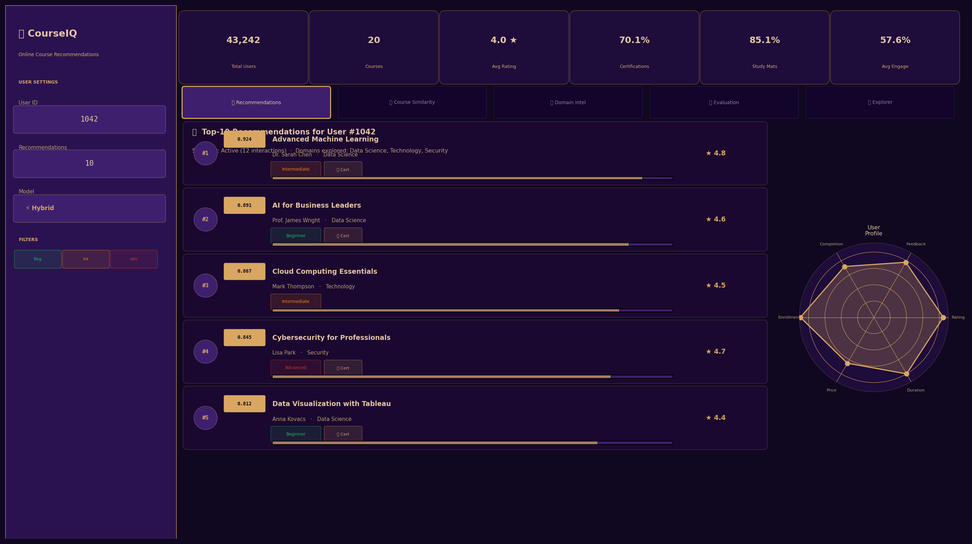
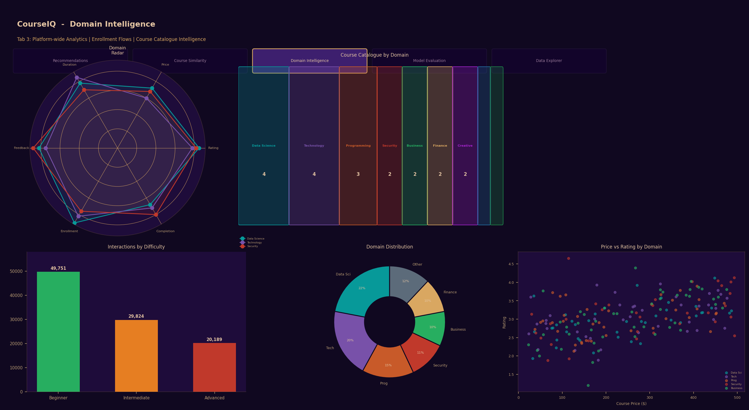
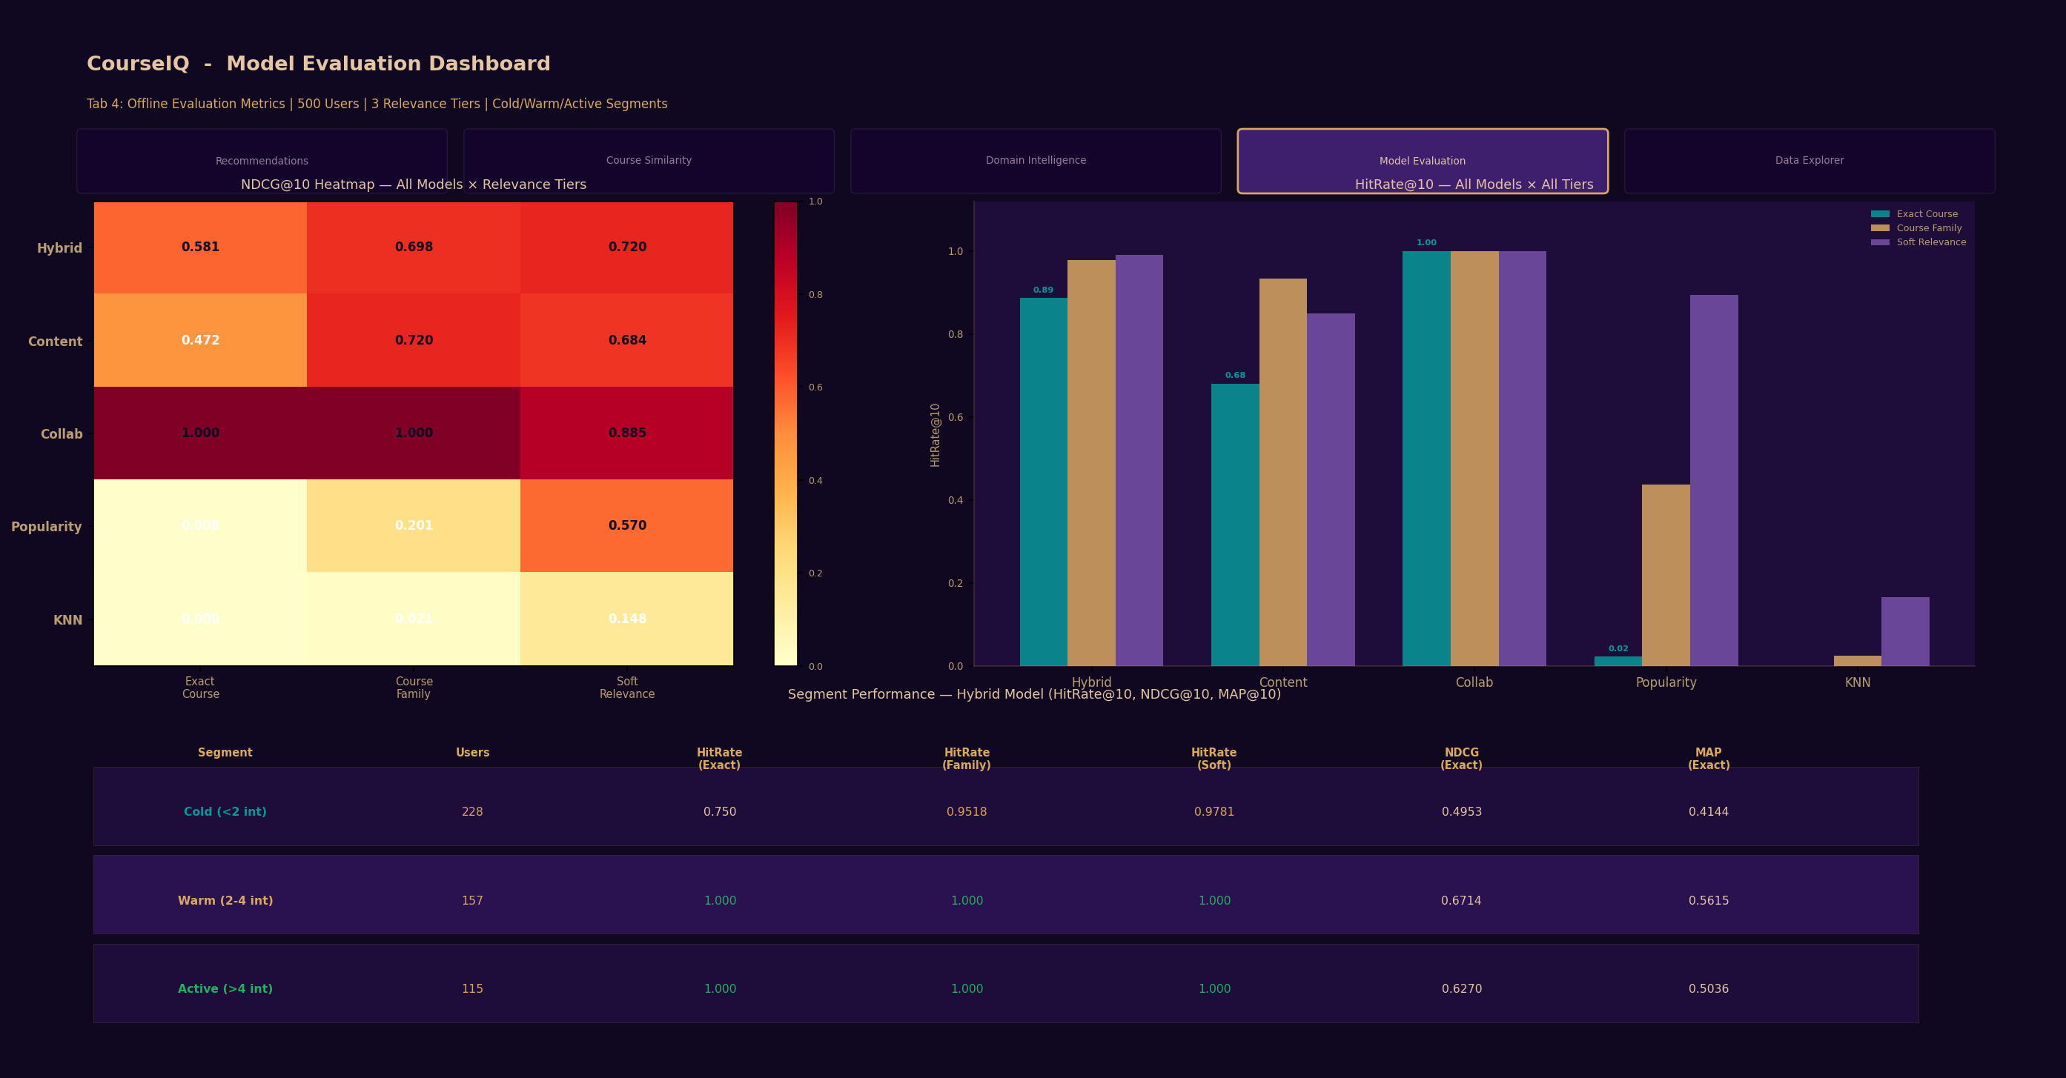
STREAMLIT OUTPUT
Live Dashboard Outputs
Tab 1 — Recommendations: Top-10 hybrid scored course cards for User #1042 (Active segment)
Tab 3 — Domain Intelligence: Radar · Treemap · Distribution
Tab 4 — Model Evaluation: NDCG Heatmap · HitRate Chart · Segment Table

Slide 18
TECHNOLOGY STACK
Technologies Used
P
Python
P
Pandas
S
Scikit-learn
Core Language v3.11
Data Manipulation v2.2.2
ML Framework v1.5.0
S
Streamlit
I
implicit
S
sentence-transformers
Web Dashboard v1.35+
ALS Collaborative v0.7+
MiniLM Semantic v3.0+
P
Plotly
T
PyTorch
N
networkx
Interactive Charts v5.22+
ST Backend v2.3+
Graph Analytics EDA
O
openpyxl
J
Joblib
S
scipy
Excel Ingestion
Model Serialisation
Sparse CSR Matrices
Project Structure:
app/ | data/raw + data/processed | models/ | notebooks/ | reports/ | src/ | config/

Slide 19
KEY RESULTS
Model Results & Business Value
88.6%
99.2%
58.1%
100%
HitRate@10
Coverage
NDCG@10
Interest Profile Coverage
Personalised Recommendations
Business Risk Scoring
Interactive Dashboard
Hybrid engine delivers top-10 course cards ranked by blended score, with difficulty badges, domain labels, cert indicators, and engagement sparklines — all explainable.
Converts ML scores into business-friendly recommendation confidence, accessible for non-technical product managers and learning experience designers.
Real-time recommendation updates with course similarity search, domain intelligence analytics, and model evaluation heatmaps — all in one Streamlit app.
Future Roadmap
FastAPI REST layer exposing /recommend/{user_id} for web/mobile integration
Dynamic CAT_MAP via LDA / zero-shot NLP topic modelling at preprocessing time
Docker containerisation for reproducible training + serving across environments
Online/incremental learning for Popularity and UserInterest arms without full retraining
A/B testing hooks in hybrid model for real-time weight regime comparison

Slide 20
Thank You
CourseIQ — Online Course Recommendation System
End-to-End ML Pipeline
88.6% HitRate@10
Streamlit Dashboard
Hybrid Ensemble
Developed by: CourseIQ Team — P662 Capstone Project
Technologies: Python | Scikit-learn | Streamlit | Pandas | sentence-transformers | implicit | Plotly | Joblib

