Slide 1

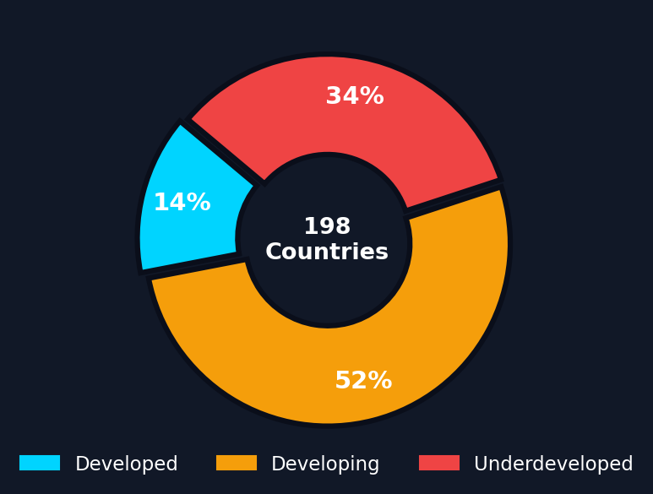
MACHINE LEARNING · UNSUPERVISED CLUSTERING · GLOBAL ANALYTICS
WORLD DEVELOPMENT
Cluster Distribution
CLUSTERING
Classifying 198 Countries via KMeans, GMM, Hierarchical,
Spectral & BIRCH Clustering on 22 Socioeconomic Indicators
198
22
5
3
Countries
Features
Models
Clusters

Slide 2


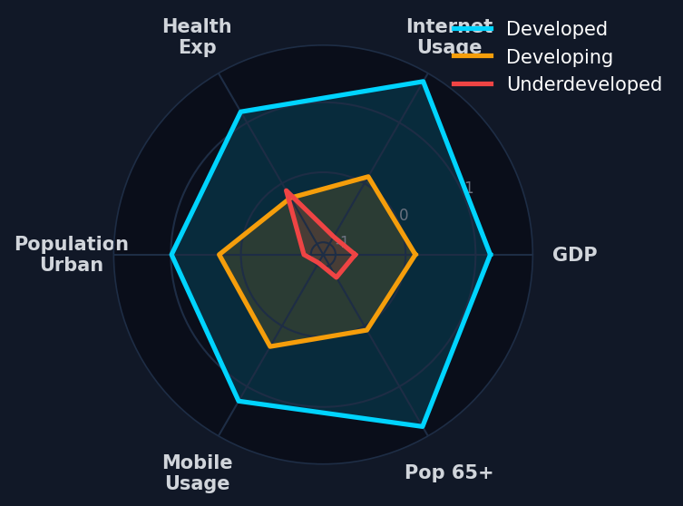



02
PROJECT OVERVIEW
Objective, Data & Pipeline Architecture
Objective
Data Snapshot
Group 198 world nations into meaningful development clusters using unsupervised machine learning — enabling data-driven policy targeting, resource allocation, and comparative analysis without predefined labels.
Source:
World Bank — World Development Measurement
Records:
198 Countries × Multi-year panel
Features:
22 socioeconomic indicators
1. Data Ingestion
Raw Excel → 198 countries, 22 features
Target:
Unsupervised (no ground truth)
Algorithms:
5 clustering models, ensemble labeling
2. Preprocessing
KNN impute, IQR cap, log1p, power-transform
Output:
3 development tiers per country
3. Feature Engineering
Trend slopes, PCA (90% var), correlation drop
4. Clustering × 5
KMeans, GMM, Hierarchical, Spectral, BIRCH
5. Validation
Silhouette, balance ratio, ensemble voting

Slide 3


03
CLUSTER PROFILES
Development Tier Characteristics & Representative Nations
DEVELOPED
DEVELOPING
UNDERDEVELOPED
28 Countries · 14% of World
103 Countries · 52% of World
67 Countries · 34% of World
+1.21
+1.68
+0.14
+0.11
−0.72
−0.88
Avg GDP (z)
Internet Usage
Avg GDP (z)
Internet Usage
Avg GDP (z)
Internet Usage
+1.18
+1.66
−0.24
+0.07
−0.12
−0.80
Health Exp
Pop 65+ (z)
Health Exp
Pop 65+ (z)
Health Exp
Pop 65+ (z)
−0.98
−0.98
−0.48
−0.46
+1.14
+1.12
Birth Rate
Infant Mortality
Birth Rate
Infant Mortality
Birth Rate
Infant Mortality
SAMPLE NATIONS
SAMPLE NATIONS
SAMPLE NATIONS
Australia, Austria, Belgium, Canada, Denmark, Finland, France, Germany, Japan, USA
Algeria, Argentina, Brazil, China, India, Indonesia, Mexico, South Africa, Turkey, Vietnam
Afghanistan, Angola, Burkina Faso, Burundi, Cambodia, Chad, DR Congo, Ethiopia, Mali, Yemen
High-income economies with advanced healthcare, digital infrastructure, aging populations, and strong industrial output.
Emerging economies with moderate infrastructure growth, transitioning demographics, and rising digital adoption.
Low-income nations facing high birth rates, infant mortality, low internet access and limited healthcare investment.

Slide 4
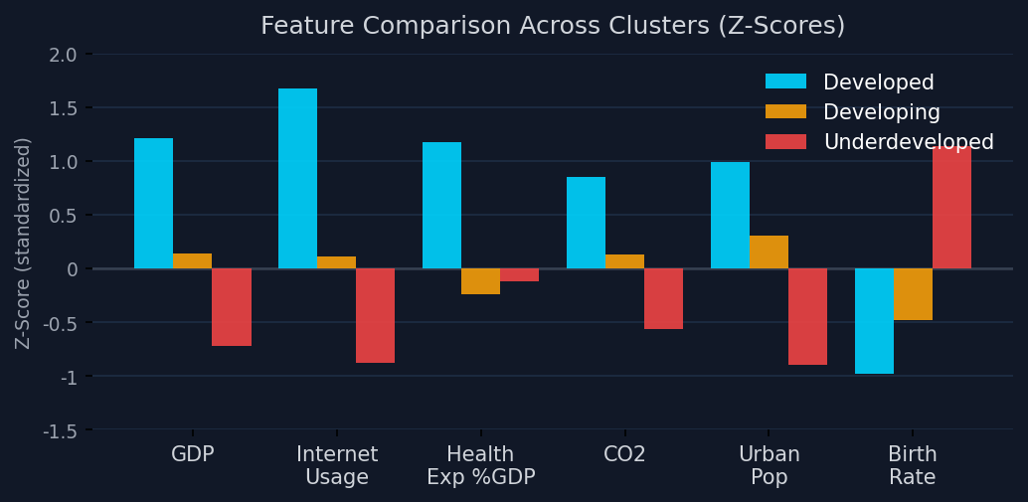
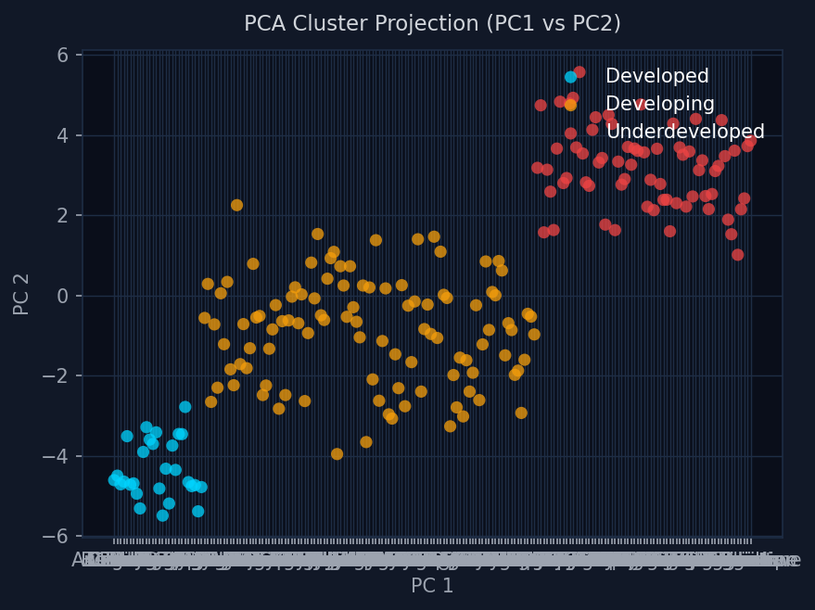
04
FEATURE ANALYSIS
Key Feature Insights
GDP
Strongest differentiator; Developed nations ~2σ above underdeveloped
Internet Usage
Digital divide is stark — 2.5σ gap between tiers
Birth Rate
Inverse proxy — high in fragile states, low in developed nations
Health Exp/Capita
PCA Cluster Separation
PCA Insights
Developed spend 3× more per capita on healthcare
PCA reduces 15 features to 2 principal components for 2D visualization while preserving ≥90% variance.
PC1 represents the primary development axis — separating high-GDP, high-internet economies from fragile states.
PC2 captures orthogonal variance such as population structure differences and regional energy patterns.
Developed cluster shows tight grouping (high homogeneity); Underdeveloped has wider spread, reflecting diverse fragility factors.

Slide 5
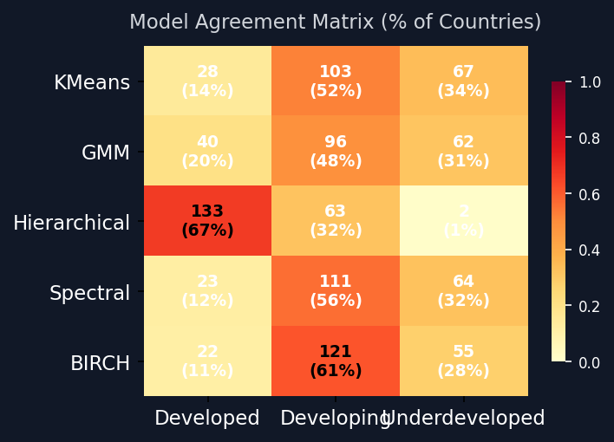

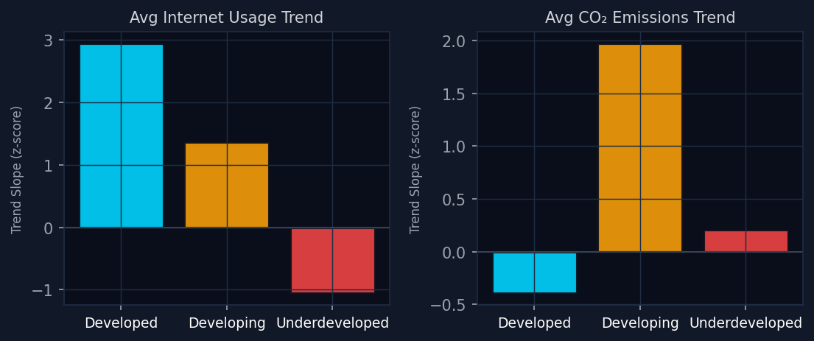
05
MODEL COMPARISON
5-Algorithm Ensemble Clustering Analysis
K-Means
Spectral
k=4, k-means++, n_init=10
rbf affinity, n_init=10, kmeans assign
Dev: 28
Dev: 23
Dvpg: 103
Dvpg: 111
Undev: 67
Undev: 64
Primary model. Best balance ratio, strong silhouette score.
Graph-based. Stricter developed boundary, slight underdeveloped shift.
GMM
BIRCH
4 components, full cov, n_init=10
threshold=0.5, branching=50
Dev: 40
Dev: 22
Dvpg: 96
Dvpg: 121
Undev: 62
Undev: 55
Probabilistic model. Identifies more borderline developed countries.
Scalable tree method. Compresses developing; fewer underdeveloped.
⚠ Hierarchical (Ward, k=4):
Assigned 133/198 countries as Developed — indicating over-merge at k=4; excluded from ensemble vote for Developed cluster.

Slide 6

06
STREAMLIT APP ARCHITECTURE
7-Layer Multi-Page Dashboard System
Hero Dashboard
Cluster Atlas
L0
layer_0_hero.py
L4
layer_4_cluster_atlas.py
Landing KPIs, cluster summary, global snapshot
Deep cluster drill-down, PCA 2D/3D scatter
Command Center
Country Lens
L1
layer_1_command.py
L5
layer_5_country_lens.py
Control panel, model selector, data upload
Per-country profile, feature radar, ranking
Intelligence
Model Arena
L2
layer_2_intelligence.py
L6
layer_6_model_arena.py
Trend analytics, correlation matrix, insights
Side-by-side model comparison, silhouette plots
World Map
Feature Vault
L3
layer_3_world_map.py
L7
layer_7_feature_vault.py
Choropleth globe, cluster geographic view
Raw feature explorer, distribution charts

Slide 7

07
KEY INSIGHTS & TRENDS
52%
34%
of Countries Developing
Underdeveloped Nations
14%
90%
of Countries Developed
PCA Variance Retained
Digital Divide
CO₂ Paradox
Health Investment
Demographic Shift
2.5 z-score gap in Internet Usage between Developed & Underdeveloped nations — widening with Developing countries accelerating internet adoption fastest.
Developing cluster shows fastest CO₂ growth trend (+1.97 z/year) as industrialization accelerates, surpassing Developed nations' historical footprint velocity.
Developed nations spend 1.18 z-scores above mean on Health % GDP. Underdeveloped nations remain close to average despite far worse health outcomes.
Strong aging signal in Developed cluster (Pop 65+: +1.66 z). Youth bulge in Underdeveloped (Birth Rate: +1.14) signals future labor force dynamics.

Slide 8
THANK YOU
Built With
› Python 3.11
World Development Clustering — Analytical Summary
› Scikit-learn
› Pandas / NumPy
5 clustering algorithms evaluated with ensemble majority voting for robust labeling
› Matplotlib / Plotly
198 countries stratified into Developed (14%), Developing (52%), Underdeveloped (34%)
› Streamlit
› KNN Imputer
KMeans emerged as primary model; GMM provides probabilistic confidence scores
› PCA
22 features reduced via PCA (90% variance) — GDP and Internet Usage most discriminating
› PptxGenJS
Trend analysis reveals diverging CO₂ trajectories and rapid digital convergence patterns
Interactive 7-layer Streamlit dashboard enables drill-down analysis per country or cluster

