Slide 1
PD-QSM radiomics
01/30/2023

Slide 2
Outline
Use 10 QSM datasets to train model for UPDRS prediction
Extract features from QSMs using pyradiomics
Use ROI-level features in original image
Build prediction model using sklearn
Feature standardization
Dimensionality reduction using Ward clustering
Distinctive feature weighting using Lasso
UPDRS estimation using multi-class SVM

Slide 3
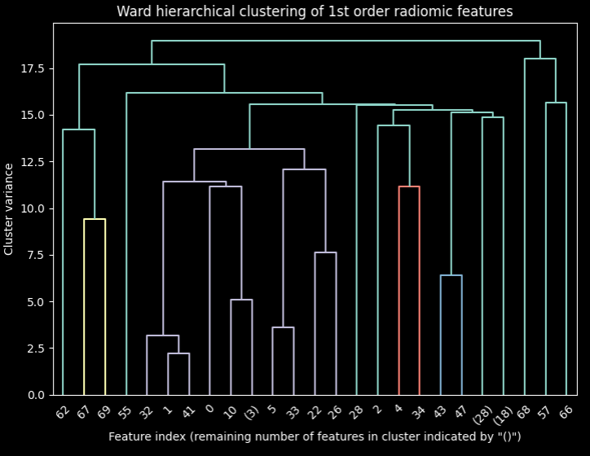
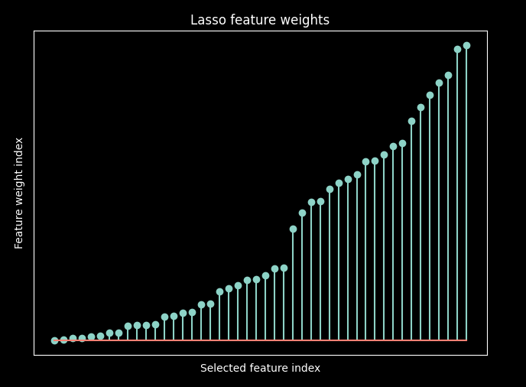
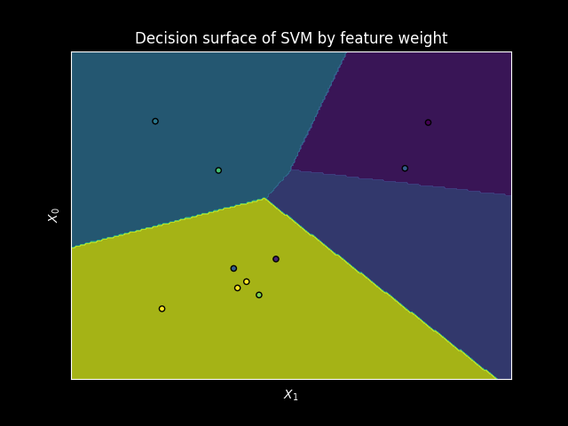
Model pipeline
Cross-validation
Input QSM
Feature extraction
Dimensionality reduction
Feature selection
Prediction

Slide 4
Model pipeline
Outer loop cross-validation
Inner loop cross-validation
Input QSM
Feature extraction
Feature selection
Prediction

Slide 5
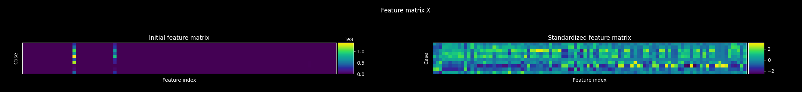

UPDRS prediction
Recover the UPDRS for a single case
Use 10 IRONMAN cases with substantia nigra and red nucleus segmentations
Calculated 1,688 features per ROI
Standardize features to $X\sim 𝓝(0,1)$

Slide 6
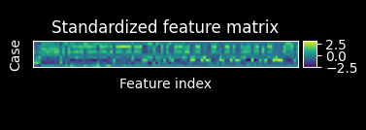
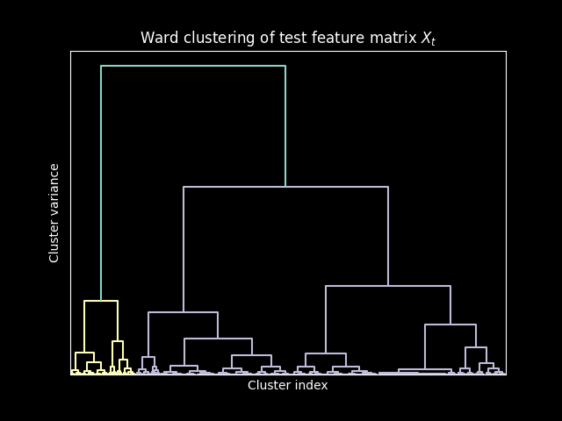
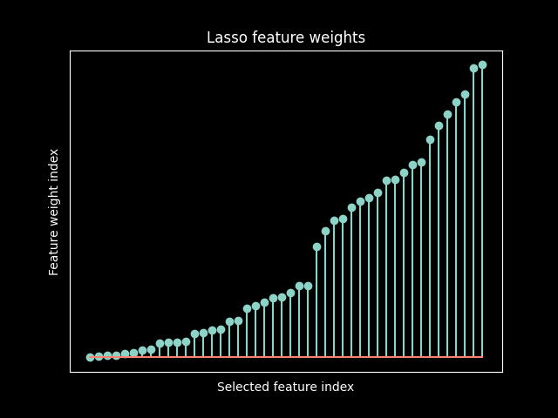

UPDRS prediction
$$X∈R^{10×6752}$$
$$X∈R^{10×1000}$$
$$X\backslash 0∈R^{10×72}$$
Recover the UPDRS for a single case
Apply Ward clustering to group redundant features
Select and weight features with Lasso
Predict label for each score using multiclass SVM

Slide 7
Model performance
Model | UPDRS | Mean relative error
Ground truth | [2 13 30 6] | 0.0
Sample mean | [ 1 6 23 2] | 0.48
Ward + Lasso + MLP | [0 10 24 4] | 0.44
Ward + Lasso | [1 8 40 3] | 0.43
Ward + Lasso + SVM* | [3 10 26 8] | 0.3

Slide 8

UPDRS prediction
Lasso weights features from clustered matrix $X$
Classifier is trained for each possible value of each index of the UPDRS score
Classifier with highest confidence on test case is selected for each index of UPDRS score
$u_{t}=$ $\underset{k∈\{1,…,K\}}{argmax}{f_{k}\left(X_{t}\right)}{=}\underset{k∈\{1,…,K\}}{argmax}{{\left(β^{∗}\right)}^{T}X_{t}w^{∗}−}β_{0}^{∗}$

Slide 9
Appendix

Slide 10

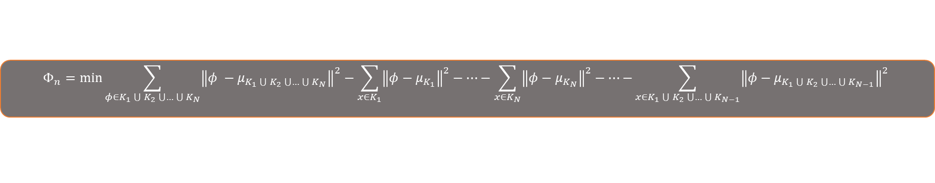




Model pipeline details
Cross-validation
$$Φ_{n}=\min{\sum_{φ∈K_{1}\bigcup{K_{2}}\bigcup{…\bigcup{K_{N}}}}{{\left\|φ −μ_{K_{1}\bigcup{K_{2}}\bigcup{…\bigcup{K_{N}}}}\right\|}^{2}−\sum_{x∈K_{1}}{{\left\|φ−μ_{K_{1}}\right\|}^{2}}−…−\sum_{x∈K_{N}}{{\left\|φ−μ_{K_{N}}\right\|}^{2}−…−}}\sum_{x∈K_{1}\bigcup{K_{2}}\bigcup{…\bigcup{K_{N−1}}}}{{\left\|φ−μ_{K_{1}\bigcup{K_{2}}\bigcup{…\bigcup{K_{N−1}}}}\right\|}^{2}}}$$
Reduce $N$ features to $n$ feature clusters $K$ using Ward’s method
$X=[Φ_{1},…,Φ_{m}$]
$$w^{∗}=\operatorname{argmin}{\frac{1}{2N}{\left\|X_{m×n}w_{n×1}−y_{m×1}\right\|}^{2}+α{\left\|w\right\|}_{1}}$$
Feature matrix for $m$ patients
Weight distinctive features using LASSO
$$β^{∗}= argmin y−({\left(β\right)}^{T}Xw^{∗}−β_{0})$$
Apply SVM on weighted feature matrix test case
Predict new patient $t$ response
$$y_{t}=\underset{k∈\{1,…,K\}}{argmax}{{\left(β_{k}^{∗}\right)}^{T}X_{t}w^{∗}−}β_{0,k}^{∗}$$

