Slide 1
OPERATIONS RESEARCH PROJECT
Identification of High-Risk Zones
in a National Highway Project
Methodology: Monte Carlo Simulation of Weather & Terrain Data
Optimization: 0-1 Knapsack Mixed Integer Linear Programming (MILP)
CASE STUDY
SIMULATIONS
COURSE
200 km Mountain Highway Corridor
10,000 Monte Carlo Trials
Operations Research | CSN13402(L)

Slide 2
01 | Problem Statement
The Real-World Crisis
A 200 km national highway cuts through steep mountain terrain
Every monsoon season: landslides, rockfalls, and flash floods
Roads blocked for 3–7 days → freight halted, lives at risk
Annual repair & disruption cost: Crores of rupees
The Core Question
"Given a limited budget of Rs. 60 Cr,
which specific highway segments
are most likely to collapse,
and where should we invest first?"
The Engineering Constraint
Reinforcing 1 km costs Rs. 15–25 Crores
Total annual budget: only Rs. 60 Crores
Cannot protect all 200 km — must prioritise
Traditional methods use averages → miss extreme events
OR Solution
Monte Carlo Simulation quantifies failure
probabilities for each segment.
0-1 Knapsack MILP allocates the budget
to maximise total risk reduction.

Slide 3
02 | Why Operations Research?
Deterministic Approach
(Traditional)
Probabilistic OR Approach
(Our Model)
Uses average rainfall, slope, soil strength
Gives one fixed risk estimate
Ignores rare catastrophic 1-in-50 year storms
Misses how multiple bad factors combine
Cannot quantify probability or uncertainty
Models full range of rainfall, slope, soil
Runs 10,000 simulated storm seasons
Captures extreme tail-event cloudbursts
Evaluates all 4 factors simultaneously
Outputs failure probability & Value-at-Risk
Central Limit: Disasters happen during extreme tails, not on average days.

Slide 4
03 | The 4 Hazard Factors & Their Distributions
Rainfall Intensity
Cut-Slope Angle
R
Distribution: Log-Normal (μ, σ)
θ
Distribution: Triangular (min, mode, max)
Cannot be negative. Extreme cloudbursts create a heavy right tail. High-altitude zones receive orographic rainfall.
Survey gives min/most-likely/max degrees. Bounded by physical terrain limits. Steeper = higher gravitational shear force.
Soil & Rock Quality
Drainage Deficit
G
Distribution: Beta (α, β) → [0, 1]
D
Distribution: Uniform (0, 0.4) choke rate
Naturally bounded between 0 (loose mud) and 1 (solid granite). Fractured shale zones have α < 2, β > 5 — peak near 0.2.
Culverts randomly choked by storm debris. Effective drainage = base capacity minus random blockage. Deficit = 1 − effective.

Slide 5
04 | Monte Carlo Simulation Methodology
Define Corridor
AHP Weights
Draw Random Values
1
20 segments × 10 km each
Terrain & weather parameters
2
Pairwise comparison matrix
Eigenvector → w_R, w_S, w_G, w_D
3
Sample Rain, Slope,
Soil, Drainage from distributions
Compute CRI
Check Threshold
Repeat × 10,000
4
CRI = Σ wᵢ × normalised factor
Range: 0 (safe) to 1 (extreme)
5
If CRI > 0.65 → Failure
Record closure days & loss
6
Tally: P(Failure), VaR-95
Expected Annual Loss
CRI = 0.394·R̃ + 0.285·θ̃ + 0.205·(1−G̃) + 0.116·(1−D̃) Failure when CRI > 0.65

Slide 6
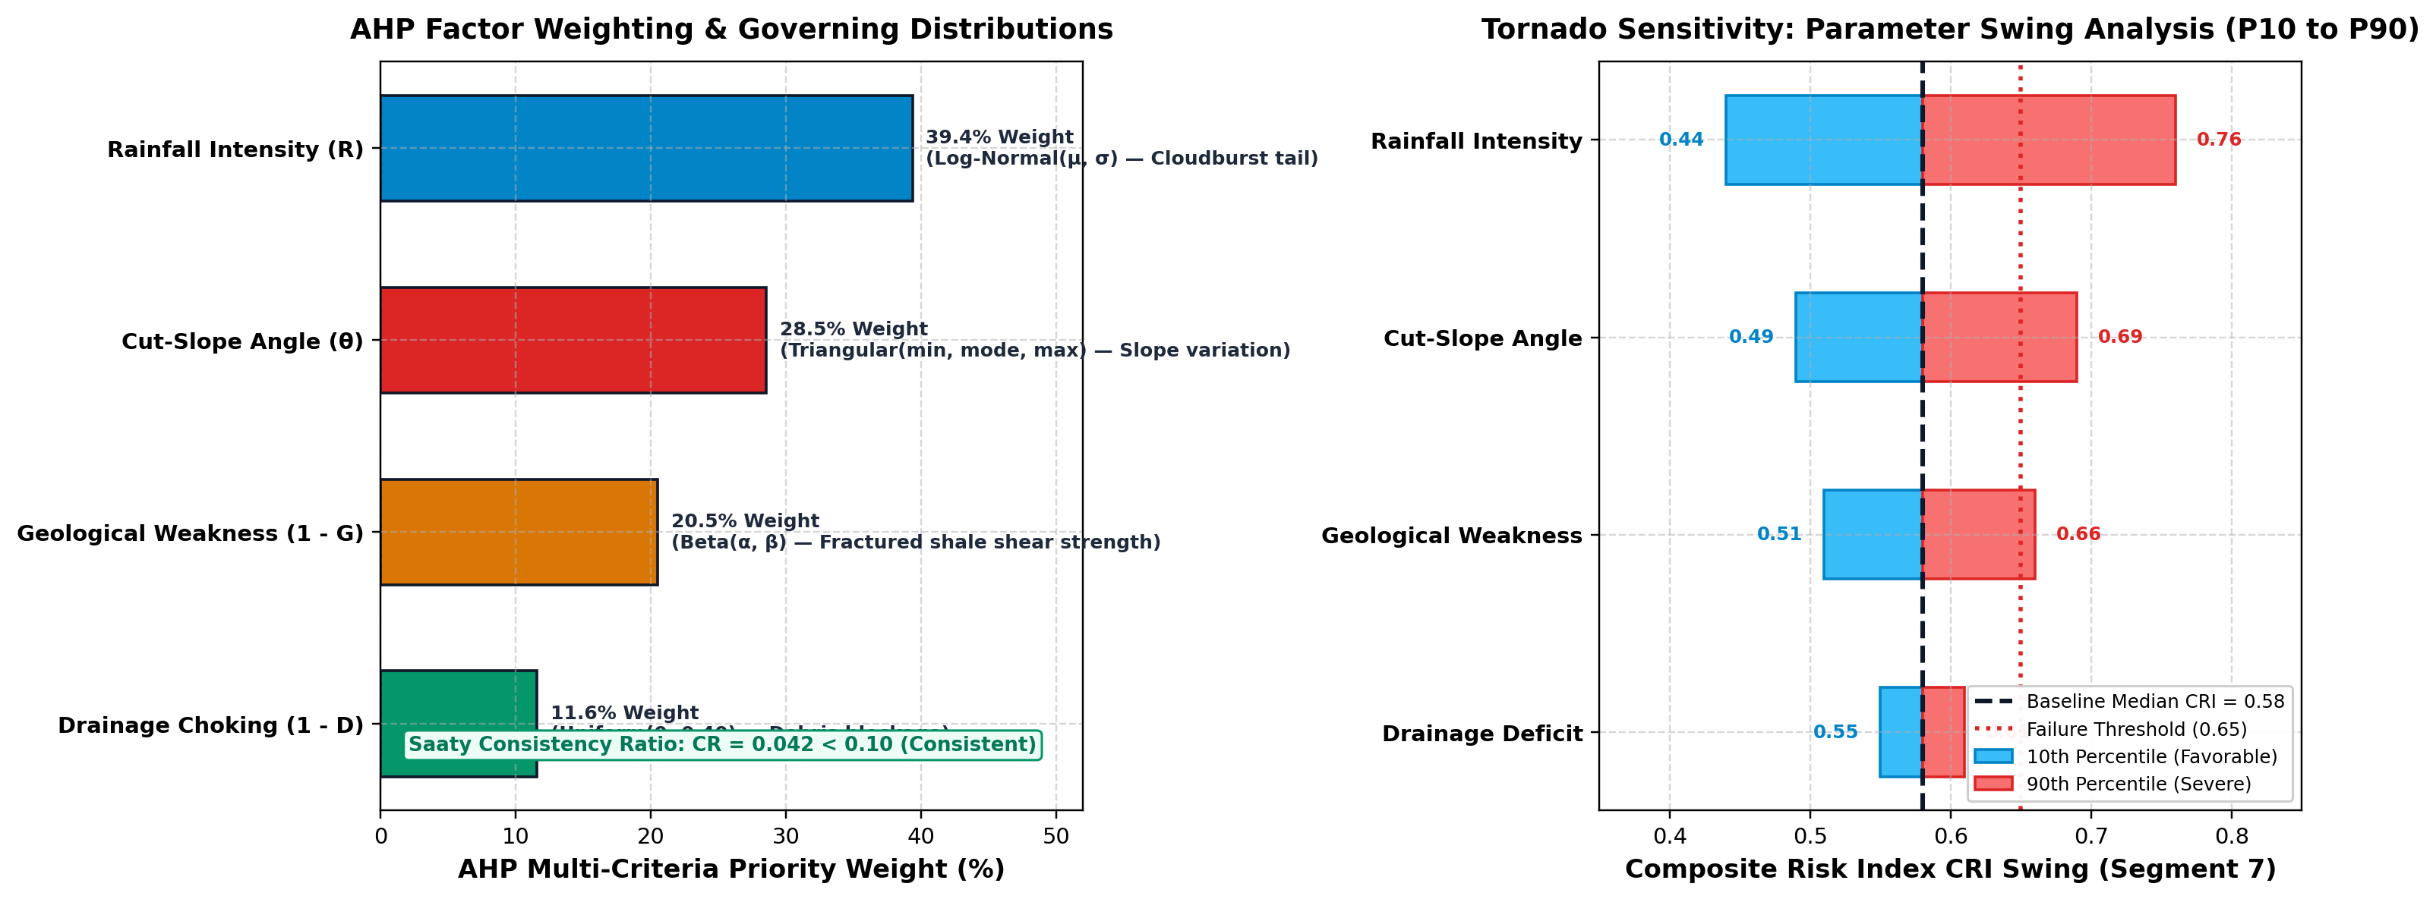
05 | AHP Multi-Criteria Weighting
Pairwise Comparison Matrix (Saaty 1–9 Scale):
Derived Criteria Weights:
Criterion
Rainfall
Slope
Soil
Drainage
Weight
Rainfall
39.4%
Rainfall
1.0
1.5
2.0
3.0
39.4%
Slope
0.67
1.0
1.5
2.5
28.5%
Slope
28.5%
Soil
0.50
0.67
1.0
2.0
20.5%
Soil
20.5%
Drainage
0.33
0.40
0.50
1.0
11.6%
Drainage
11.6%
Weights computed using the principal eigenvector of the pairwise matrix.
Consistency verified via Saaty's Consistency Ratio (CR < 0.10).

Slide 7
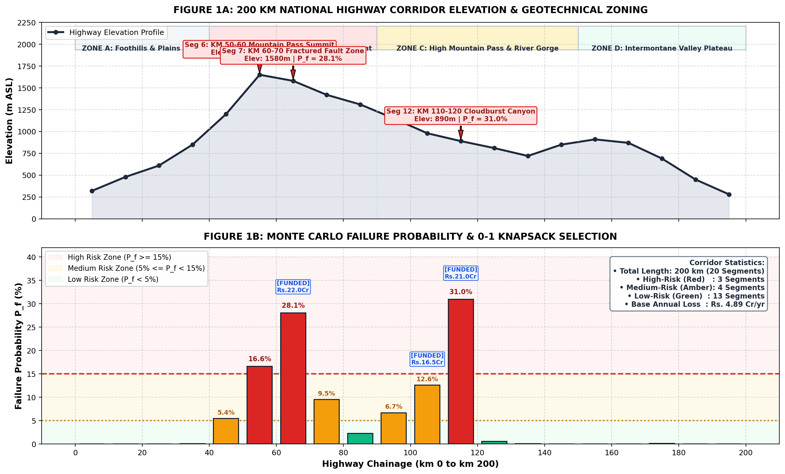
06 | Simulation Results — Corridor Risk Profile
3
High-Risk Segments
4
Medium-Risk Segments
13
Low-Risk Segments
Critical Segments
• Seg 12 — Cloudburst Canyon (P = 31.0%)
• Seg 7 — Fractured Fault Zone (P = 28.1%)
• Seg 6 — Mountain Pass Summit (P = 16.6%)

Slide 8
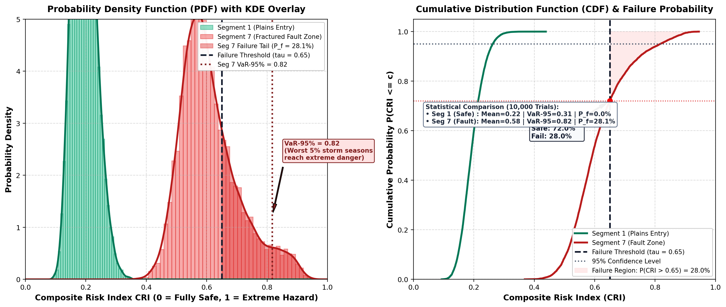
07 | Monte Carlo Distributions & Value-at-Risk
Key Insights
PDF: Segment 1 (green) safely below threshold
Segment 7 (red) has a fat tail beyond τ = 0.65
VaR-95 = 0.82 for Seg 7: worst 5% of storms cause catastrophic damage
CDF shaded region = 28.1% failure probability
10,000 trials capture rare 1-in-50-yr cloudburst events

Slide 9
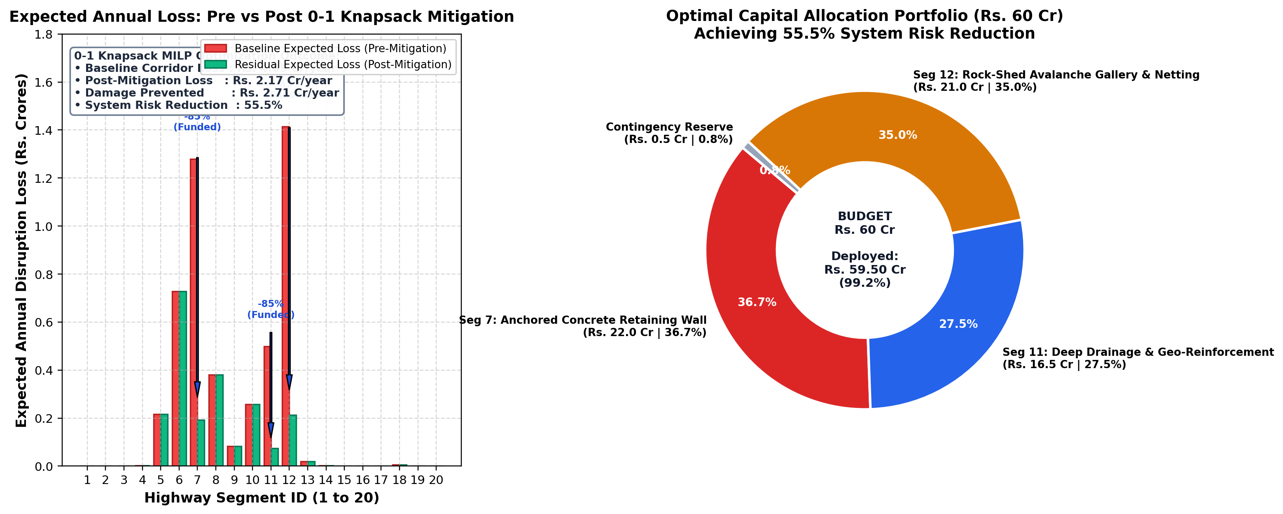
08 | 0-1 Knapsack MILP — Budget Optimization
Optimization Details
Maximize total risk reduction subject to Rs. 60 Cr budget constraint
xᵢ ∈ {0,1}: binary — either fully fund a segment or skip it
Solver: SciPy MILP (Branch-and-Bound)
Funded: Seg 12 (Rs. 21 Cr) + Seg 7 (Rs. 22 Cr) + Seg 11 (Rs. 16.5 Cr)
Total spent: Rs. 59.5 Cr | Risk reduced by 55.5%
Mitigation efficiency: 85% failure risk eliminated per funded segment

Slide 10
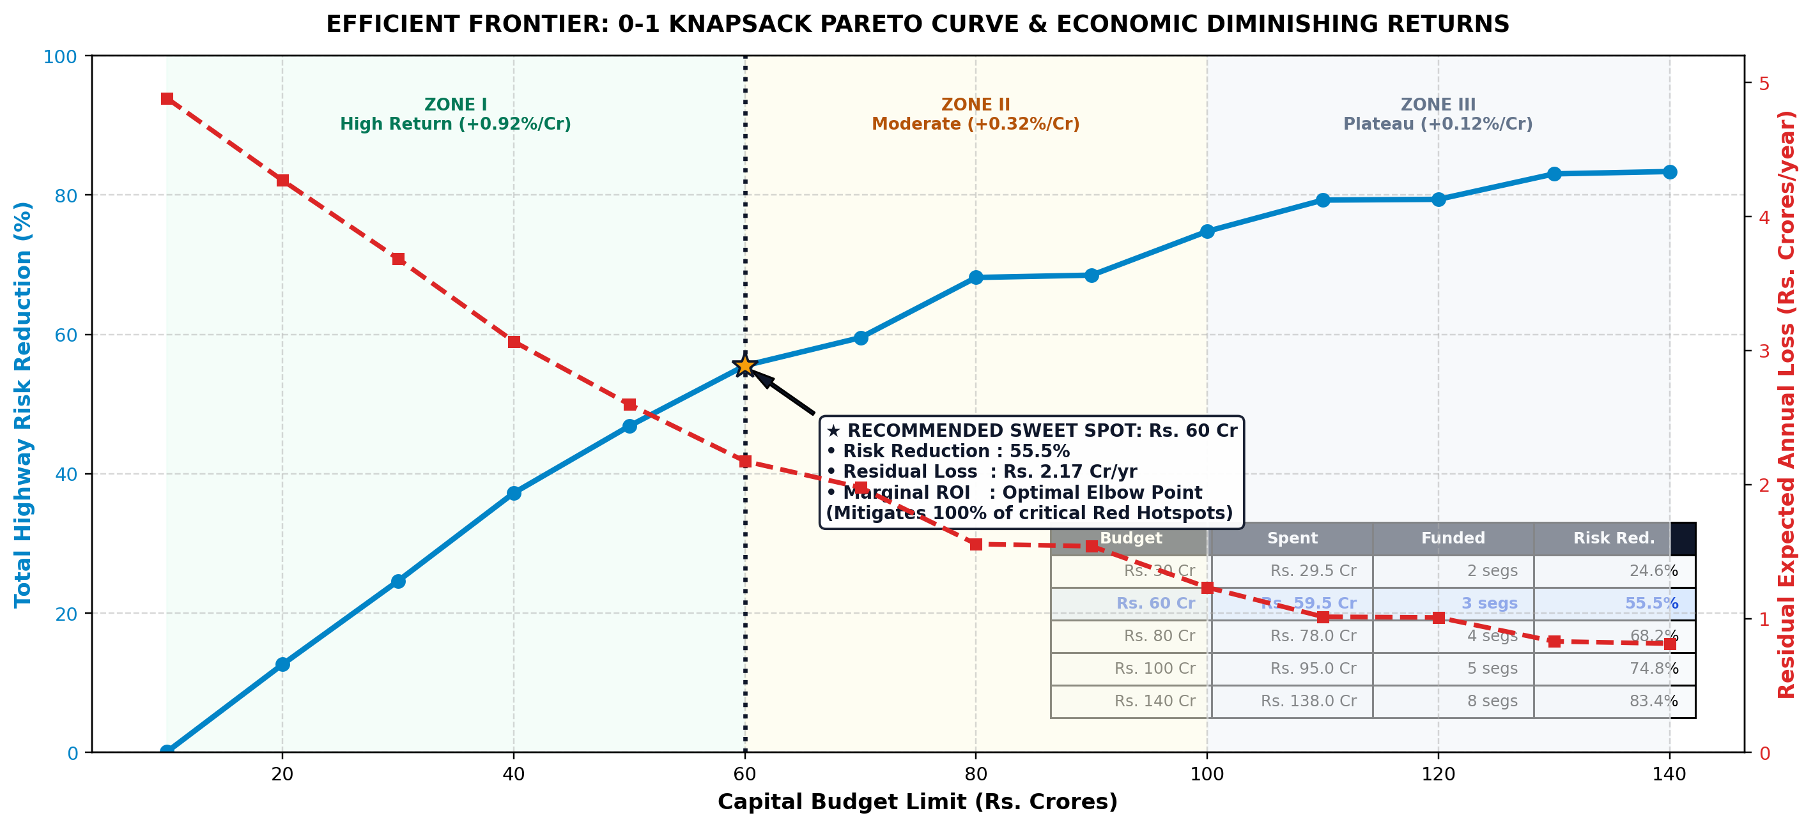
09 | Pareto Frontier & Capital Sensitivity Analysis
Pareto Optimal Curve
Traces maximum possible corridor risk reduction achievable for each capital expenditure limit (solved via 0-1 Knapsack MILP).
Zone I (Rs. 10 - 60 Cr)
Steepest efficiency (+0.92%/Cr). Mitigates 100% of critical red hotspots (Segments 7, 12, 11) for Rs. 59.5 Cr.
Zone II (Rs. 60 - 100 Cr)
Moderate return (+0.32%/Cr). Secondary yellow zones (Segment 6) are funded.
Zone III (> Rs. 100 Cr)
Diminishing marginal returns (+0.12%/Cr). Flat plateau where additional funds yield negligible safety gains.
Elbow Sweet Spot
Mathematically validates Rs. 60 Cr as the optimal budget threshold for highway authorities.

Slide 11
10 | Managerial Implications
High-Risk Zones (Red)
Medium-Risk Zones (Yellow)
Low-Risk Zones (Green)
Segments 6, 7, 12
Immediate structural intervention
Anchored retaining walls, rock-shed galleries
Geo-mesh netting on exposed cut-slopes
Deep reinforced culvert reconstruction
Segments 5, 8, 10, 11
IoT slope displacement sensors
Prepositioned earthmoving machinery
Pre-monsoon culvert clearing drives
Variable message signs for traffic alerts
Segments 1–4, 9, 13–20
Standard periodic maintenance
Annual drainage inspection
No major capital intervention needed
Redirect savings to High/Medium zones

Slide 12
11 | Conclusion & Future Scope
Summary of Contributions
Monte Carlo simulation with 11,000 trials successfully identified 3 critical high-risk zones
AHP-derived weights provided scientifically defensible multi-criteria prioritisation
0-1 Knapsack MILP optimally allocated Rs. 59.5 Cr achieving 55.5% system risk reduction
Value-at-Risk (VaR-95) planning metric identified catastrophic storm thresholds per segment
Model is extensible: pre-construction route comparison or post-construction maintenance planning
Future Scope
Real-time IoT sensor data feed (slope displacement, soil moisture, rainfall radar)
Dynamic vehicle rerouting optimization across alternate arterial networks
Multi-hazard model extension: earthquakes, snowmelt, and traffic load cycles
Machine learning integration for real-time CRI updating during active storm events

Slide 13
Thank You
Operations Research Project | Topic 10
Monte Carlo Simulation for Highway High-Risk Zone Identification
Open for Questions
3 Segments
28,050 / 100,000
55.5% Reduction
Rs. 59.5 Cr
High-Risk (Red Zone)
Failure Trials (Seg 7+12)
System Risk Post-Mitigation
Optimal Budget Allocation

