Slide 1
RISC-V Metamorphic Testing
Vladimir Herdt

Slide 2
Contributions
Propose metamorphic Testing for processor verification
Provide a set of metamorphic rules tailored for the RISC-V ISA
Describe and implement a framework for efficient "on-the-fly" metamorphic-testing
An extensive experimental evaluation that demonstrates the effectiveness of our approach
Discussion on limitations and comparing against reference model based testing???
Provide our implementation as open source???

Slide 3
Current Status
GitLab Repo: gitlab.informatik.uni-bremen.de:riscv/riscv-metamorphic-testing.git
Basic Testing Framework
First set of rules (not yet complete RV32I)
Dynamic mutation injection framework
First ideas on completness/correctness

Slide 4
Overview: Testing Framework
...
Concept: rules act as ISS testbenches and implement the ISS memory interface
=> „on-the-fly“ test generation
Rules:
R1
R2
Rn
select random rule
fetch instr. /
access mem.
ISS
randomize rule
(e.g. sample values)
Example rule: a+b == b+a
Randomize:
- values a and b
- registers for the operations
Rx
run step(s)
check (final) results
process one by one
Alternatively: randomize ISS initial state and run the rules without loading (initial) values
M1
M2
...
Mk
Mutators:

Slide 5
Example Rule Implementation
struct ADD_Comm : public test_rule_if { // a + b == b + a
unsigned rd1, rd2, rs1, rs2;
uint32_t a, b;
void randomize(Random &random) override {
rs1 = random.reg();
rs2 = random.reg();
rd1 = random.unique_reg({rs1, rs2, zero});
rd2 = random.unique_reg({rd1, rs1, rs2, zero});
a = random.reg_val();
b = random.reg_val();
}
void run(Executor &x) override {
x.code.LI(rs1, a);
x.code.LI(rs2, b);
x.code.ADD(rd1, rs1, rs2);
x.code.ADD(rd2, rs2, rs1);
x.run();
x.check(x.get_reg(rd1) == x.get_reg(rd2));
}
std::string to_string() override { … }
};
struct Executor : public MemoryInterface {
// ...
uint32_t load_instr(uint64_t addr) {
return code.next();
}
uint32_t run(unsigned rd=0) {
assert (code.has_next());
while (code.has_next()) {
core.run_step();
}
code.clear();
return core.regs[rd];
}
uint32_t get_reg(unsigned idx) {
return core.regs[idx];
}
}
Only use comparison checks (==, !=, <, >, >=, <=) in the rules, do not pre-compute the results (compute everything on the ISS under test). Otherwise the rules would effectively be „reference implementation models“.

Slide 6
Rule-Set: ADD and XOR
ADD
a+b == b+a
a+b == a+ceil(b/2)+floor(b/2)
if b==0 then a+b==a else a+b!=a
XOR
f(a, b == f(b, a)
f(a, 0) == a
f(a, -1) == ~a
f(a, a) == 0
f(a,b) == f(f(a, b&c), b&~c)
=> f is XOR (proofed for 4 bit operands)
Specific rules for each computational / logic instruction. Rules have dependencies to other instructions.

Slide 7
Rule-Set: Load/Store
@assume R[rs1]+off1 == R[rs2]+off2
lX rd, rs1, off1 == lX rd, rs2, off2
Same load from same address yields same result
Use different address parts
What is stored is also loaded
Use zero extended (unsigned) load
LW can be emulated with two LHU
LHU can be emulated with two LBU
Sign/Zero extension works correctly
Compare signed/unsigned load with same width
Baseline: SW works correctly (otherwise we cannot ensure that address/value is not modified by all load/store instructions in some consistent way, e.g. apply XOR on the value before/after store/load)
@assume R[rs1]+off is properly aligned
sw rs2, rs1, off == lw rd, rs1, off { R[rd] == R[rs2] }
sh rs2, rs1, off == lhu rd, rs1, off { R[rd] == R[rs2] }
sb rs2, rs1, off == lbu rd, rs1, off { R[rd] == R[rs2] }
LW(rs1+off) == LHU(rs1+off) | (LHU(rs1+off+2) << 16)
LHU(rs1+off) == LBU(rs1+off) | (LBU(rs1+off+1) << 8)
lbu rd, rs1, off ==
lb rx, rs1, off
slli ry, rx, 24
srli ry, ry, 24
{ R[rd] *<= R[rx]; R[rd] == R[ry] }

Slide 8
Rule-Set: Jump
x == R[rs1]+y => jal rd, x == jalr rd, rs1, y // both jumps are equal on same effective jump offset
@assume x \in J-Imm // valid jump immediate
@assume x % 8 == 0 // large enough to be split into two parts
j x == j x/2; j x/2;
@assume x \in J-Imm
@assume x != MIN_NEG // not 2**19-1 because it has no positive counterpart
j x; j -x => old_pc == new_pc
j 0 => old_pc == new_pc // self loop does not modify PC
@invariant: rd!=0 => R[rd]==old_pc+4 // link address is correct, [too much like a “reference” rule!?]
// can do the same for JALR, then simply replace the J-Imm value assumption with Reg value

Slide 9
Rule-Set: Branch
// equality should be consistent
beq rs1, rs2, off == beq rs1+x, rs2+x, off
bne rs1, rs2, off == beq rs1+x, rs2+x, off
// opposite operations
beq rs1, rs2 || bne rs1, rs2
blt rs1, rs2 || bge rs1, rs2
bltu rs1, rs2 || bgeu rs1, rs2
beq rs1, rs2 != bne rs1, rs2
blt rs1, rs2 != bge rs1, rs2
bltu rs1, rs2 != bgeu rs1, rs2
// subsumed operations
beq rs1, rs2 => bge rs1, rs2
beq rs1, rs2 => bgeu rs1, rs2
blt rs1, rs2 => bne rs1, rs2
bltu rs1, rs2 => bne rs1, rs
// sign/unsigned comparison relation
R[rs2] >= 0 or R[rs1] < 0:
bge rs1, rs2 => bgeu rs1, rs2
R[rs1] <= 2^31-1 or R[rs2] >= 2^31:
bgeu rs1, rs2 => bge rs1, rs2
// normal PC forward, if branch not taken
not bX rs1, rs2 => next-pc == orig-pc + 4
// compare with jumps (gets the jump properties for „free“)
bX rs1, rs2 => bX rs1, rs2, off == jal rd, off
bX rs1, rs2 => bX rs1, rs2, off :: jal rd, -off
bX rs1, rs2 => bX rs1, rs2, off == jalr rd, zero, off
bX rs1, rs2 => bX rs1, rs2, off :: jalr rd, zero, off

Slide 10
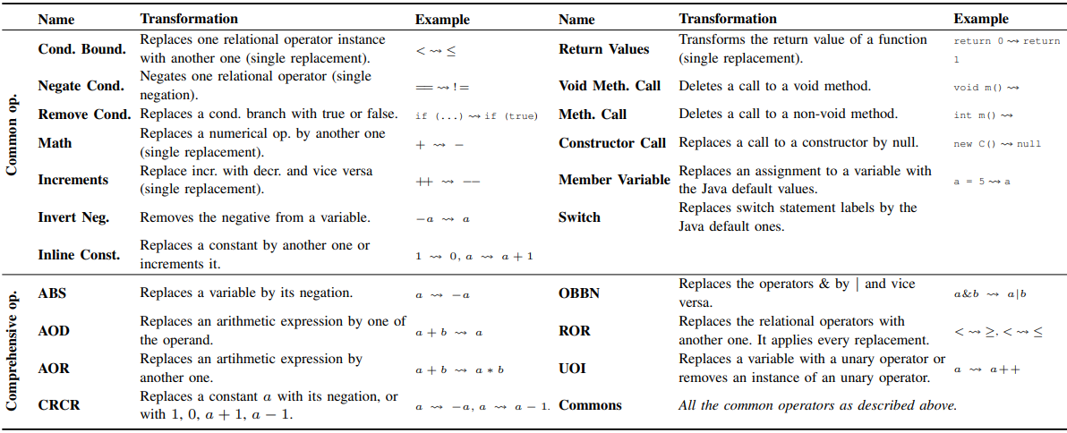
Which Mutators?
=> A lot of effort manually, mutator generation should be automated!
source (screenshot from paper): „Assessing and Improving the Mutation Testing Practice of PIT”
Notes:
Drop a screenshot of the mutation paper here (showing the generic mutation rules)

Slide 11
Mutation Injection: Static vs Dynamic
Dynamic approach:
In the ISS intercept instruction execution and direct control to user-defined mutator (currently implemented)
Idea: use a Python script to generate the mutators (based on an AST representation of the ISS) [still TODO]
All mutators are in a single file that is linked into a single application
Static approach
Mutate the ISS in-place, generate a new ISS for each mutator
Link each mutated ISS with the rules (library) into a seperate application

Slide 12
Discussion: Completness/Correctness?
Can we find any possible error in general?
Random testing with a reference model can (by „just“ guessing the right input)
Probably we won‘t be able to prove this for all instructions
Can prove it for some instructions with small operand sizes (see next slide)
We will need to argue this point to some extent probably
Experiments basically will show that we can find common mutation-based errors

Slide 13
Example Proof
from z3 import *
N = 3
a = BitVec('a', N)
b = BitVec('b', N)
f = Function('f', BitVecSort(N), BitVecSort(N), BitVecSort(N))
exp = And(
Exists([a,b],
f(a,b) != a+b),
ForAll([a,b],
And(
f(a,b) == f(b,a), // a+b == b+a
If(b%2==0, // a+b == a+ceil(b/2)+floor(b/2)
f(a,b) == f(f(a, UDiv(b,2)), UDiv(b,2)),
f(a,b) == f(f(a, UDiv(b,2)+1), UDiv(b,2))),
If(b==0, f(a,b)==a, f(a,b)!=a) // b==0 => a+b==a; b!=0 => a+b!=a
)
)
)
solve(simplify(exp)) // -> no solution (UNSAT)
LI(rs1, a);
LI(rs2, b);
ADD(rd1, rs1, rs2);
SRLI(rx, rs2, 1); // floor(b/2)
ADD(rd2, rs1, rx); // a + floor(b/2)
ANDI(ry, rs2, 1); // b % 2 == 1 ?
ADD(ry, ry, rx); // ceil(b/2)
ADD(rd2, rd2, ry);
run();
check(get_reg(rd1) == get_reg(rd2));
alternative
representation
What about load/store and branch/jump instructions?
Notes:
If b % 2 == 0 then ceil(b / 2) == b / 2 else ceil(b / 2) == b/2 + 1
Floor(b / 2) == b / 2

Slide 14
Next Steps
Devise and implement rules that cover all RV32I instructions
Vladi (implement) & all (ideas)
Provide the test mutators
Static or dynamic framework?
? Static framework setup (Vladi & Hassan) [early & continuous testing]
Hassan (implement) & all (ideas)
Run experiments to see how well the rules work
Think about discussion on completeness/correctness
Which conference do we target?

