Slide 1
Census Income Study
Clustering Analysis
Andrew Graham – Fall 2022

Slide 2
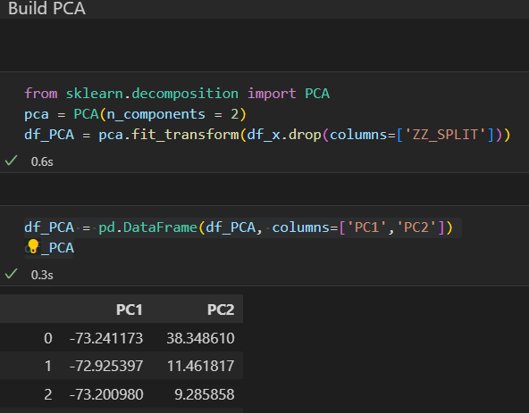
PCA
Clean data from the census dataset used
Target Income removed from dataset
PCA used to determine 2 principal components
The PCA data set will be used for the rest of the analysis

Slide 3
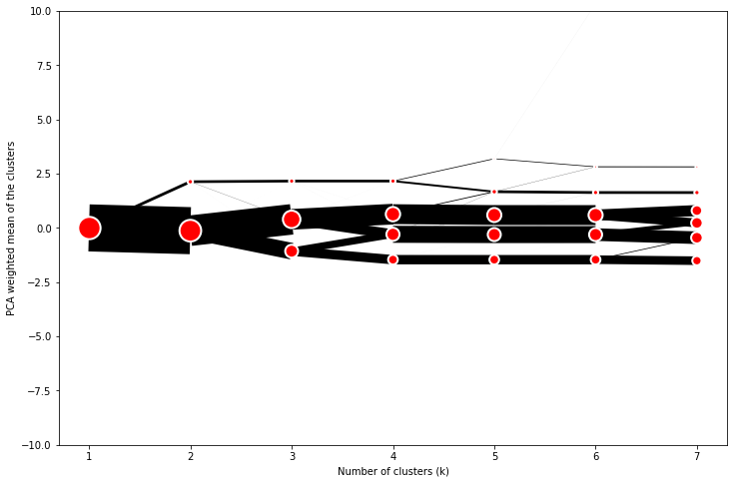
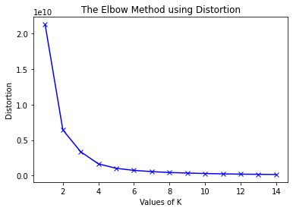
Optimal Clusters
Dendrogram shows optimal clusters at 4
Elbow Diagram shows optimal clusters at 4
4 clusters will be used.

Slide 4
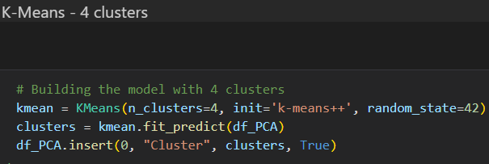
K-Means Clustering
K-means used with number of clusters equal to 4
Cluster results added to PCA data as Target

Slide 5
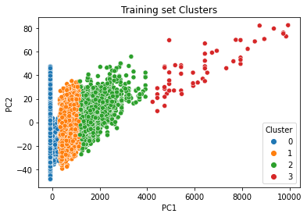
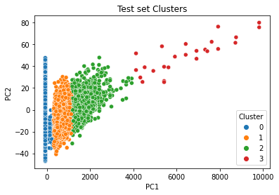
PCA Clustering Plot

Slide 6
What do these Cluster represent?
As seen from prior slide, the 4 clusters do differ and have recognizable groups.
2 clusters in the middle have some merging along the edge so the dividing line could be changed
The clusters represent similar demographics from the study.
A smaller cluster may be Educated white people from the US.
These 4 clusters represent similar groups of these smaller clusters

Slide 7
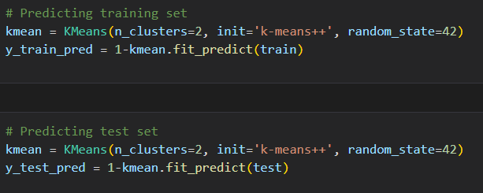

2 Cluster Analysis
2 cluster analysis performed to see if there are 2 clusters similar to the income groups
Accuracy of these clusters is 86%
Indicates a significant difference between demographics of people making >50k and those making <50k
Considering other models achieve >90% this model should not be used.

