Slide 1
Census Income Study
Data Cleaning and Predictive Modeling
Andrew Graham – Fall 2022

Slide 2
Overview
Summary and Goals
Purpose
The purpose of this data is to create a prediction model to determine the income of an individual based on given census data. The goal of this data has been binned into having a salary of > 50k and < 50k. The data is from the US census bureau. Logistic Regression, Random Forest and XGBoost modeling will be Evaluated

Slide 3
Overview
Data Overview - Meta
2 Files were provided containing data split into training and testing data
A meta file was provided containing column information, such as: name, description, and types (nominal/continuous)
This file contained a few tables which were combined using a fuzzy matching algorithm and then the resulting information allowed the data to be labeled
The meta document also contained the unique values from the data which was used to assist in data cleaning efforts
Instructions were given in the document to drop a column (Instance Weight), so those instructions were followed.
Data consist of 41features (40 input and 1 output) with 299,285 records

Slide 4
Overview
Data Overview
40 Input features
7 numerical/continuous
33 nominal
The 7 continuous feature did not have missing data although a majority had 0 values
14 nominal features had complete data
19 features were incomplete
14 features were dropped for having over 30% missing data that could not be imputed
6% of the data was dropped for having missing values
Target(Salary) is unbalance with more than 90% in the <50k category

Slide 5
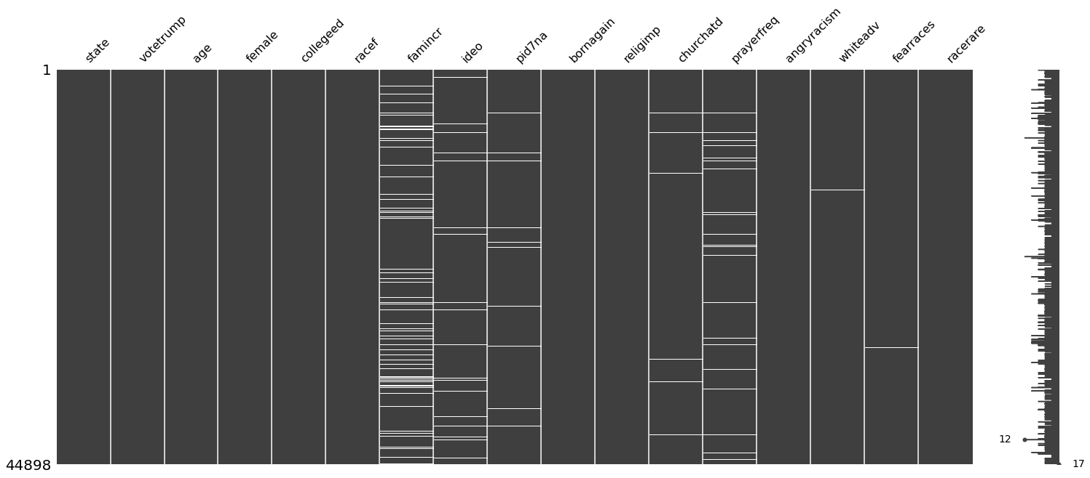
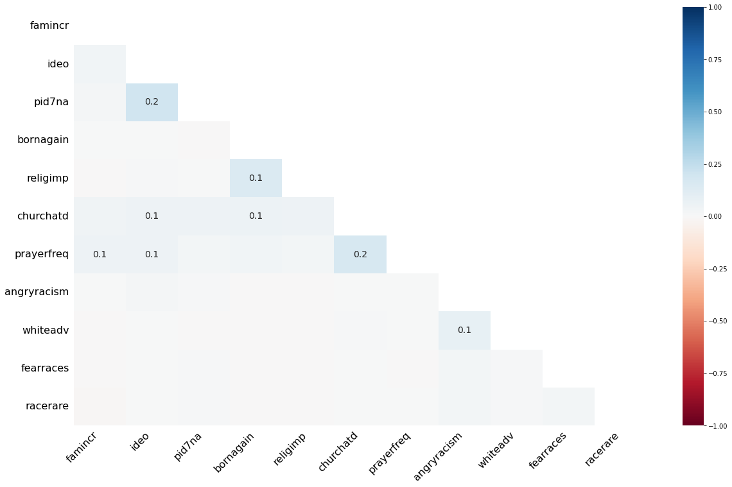
Overview
Data Cleaning
 | number_missing | percent_missing
state | 0 | 0.000000
votetrump | 0 | 0.000000
age | 0 | 0.000000
female | 0 | 0.000000
collegeed | 0 | 0.000000
racef | 0 | 0.000000
famincr | 4717 | 10.506036
ideo | 1501 | 3.343133
pid7na | 611 | 1.360862
bornagain | 22 | 0.049000
religimp | 20 | 0.044545
churchatd | 322 | 0.717181
prayerfreq | 904 | 2.013453
angryracism | 47 | 0.104682
whiteadv | 52 | 0.115818
fearraces | 100 | 0.222727
racerare | 86 | 0.191545
No misspellings or formatting issues
No duplicates
Removed NAs for Target
7337 NA
16% rows with NAs
No dependencies
Randomly Distributed between outputs
NAs Removed
37,561 Data Points Remaining

Slide 6
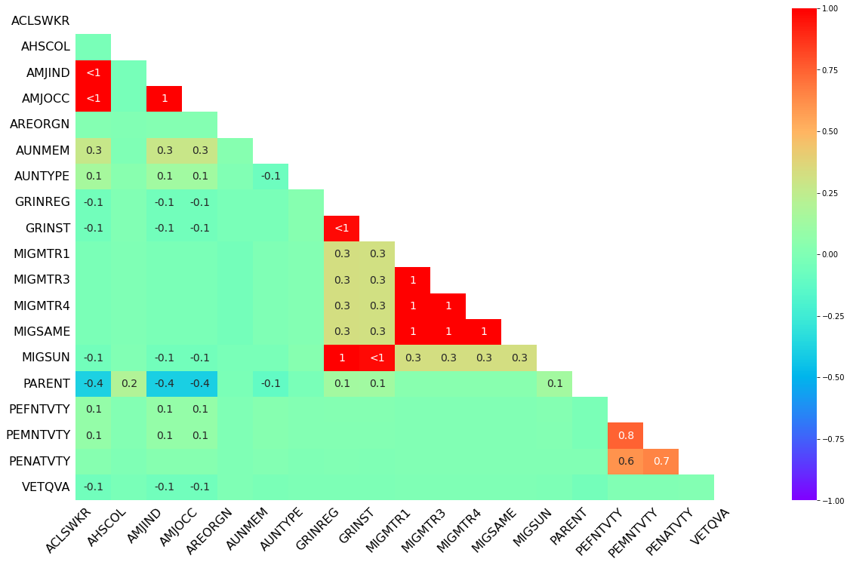
EDA
NA Correlation
From this and the prior chartwe see that most columns look to be MCAR/MAR with the following exceptions...
-AMJOCC and AMJIND (Major Industry Code and Major Occupation Code)
This makes sense as they seem to be referencing the same thing
-GRINREG and GRINST (region and state of previous residence)
This makes sense as one is dependent of the other.
-MIGMTR1,MIGMTR3,MIGMTR4 (Migration code Data)
-PEFNTVTY and PEMNTVTY (Birth pace of Parents)

Slide 7
EDA
NA Feature Dropping
Since the missingness looks to be random and using a threshold of 30%. The following features should be dropped:
- Feature # Missing Missingness
- AMJIND 84080 0.362789
- ACLSWKR 83508 0.360321
- AMJOCC 84080 0.362789
- MIGSAME 114346 0.493381
- MIGMTR4 114346 0.493381
- MIGMTR3 114346 0.493381
- MIGMTR1 114346 0.493381
- AUNMEM 203225 0.876877
- PARENT 203808 0.879392
- GRINREG 208751 0.900721
- MIGSUN 208751 0.900721
- GRINST 209776 0.905143
- AHSCOL 215546 0.930040
- AUNTYPE 222633 0.960619
- VETQVA 228779 0.987138
With the following to be kept:
- Feature # Missing Missingness
- AREORGN 1672 0.007214
- PENATVTY 5057 0.021820
- PEMNTVTY 8779 0.037880
- PEFNTVTY 9690 0.041810

Slide 8
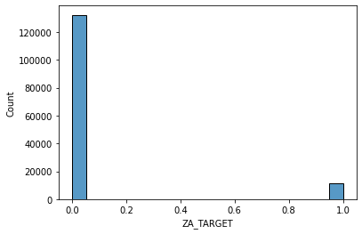
EDA
Target Variable
Target Feature is binned at <50k and >50k
This was converted to 1 for >50 and 0 for <50
Data was clean and had no missing values
The target variable is highly unbalanced, and this will have to be considered for model creation.

Slide 9
EDA
Numerical Features
 | mean | median | min | max | var | std | skew
AAGE | 34.538998 | 33.0 | 0.0 | 90.0 | 4.981140e+02 | 22.318468 | 0.372785
AHRSPAY | 55.105027 | 0.0 | 0.0 | 9999.0 | 7.471515e+04 | 273.340729 | 8.878780
CAPGAIN | 431.742176 | 0.0 | 0.0 | 99999.0 | 2.181608e+07 | 4670.768536 | 19.090569
CAPLOSS | 36.849010 | 0.0 | 0.0 | 4608.0 | 7.278652e+04 | 269.789771 | 7.685924
DIVVAL | 195.851259 | 0.0 | 0.0 | 99999.0 | 3.755251e+06 | 1937.847082 | 27.144287
NOEMP | 1.956172 | 1.0 | 0.0 | 6.0 | 5.592548e+00 | 2.364857 | 0.752317
WKSWORK | 23.178375 | 8.0 | 0.0 | 52.0 | 5.955560e+02 | 24.404016 | 0.210018
7 continuous numerical features.
AHRSPAY (Wage per hour), CAPGAIN, CAPLOSS, and DIVAL are all highly right skewed.
AHRSPAY, CAPGAIN and DIVAL all have ceiling of 9999

Slide 10
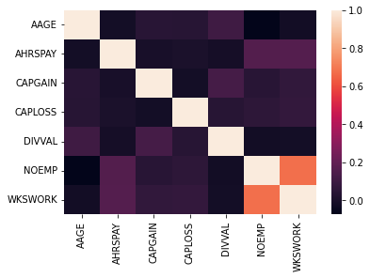
EDA
Numerical Features
Low correlations between most of the variables
NOEMP and WKSWORK have high correlation
This is understandable as someone who has employees likely works a higher amount of weeks

Slide 11
EDA
Nominal Features Summary
Most features can be left as is
The features with larger number of categories can have them consolidated as many categories only show <50k
Country of organ for mother, father, and self may consider changing to USA not USA if performance looks to be ian issue
Year could possibly be deleted
Education should be updated to Ordinal

Slide 12
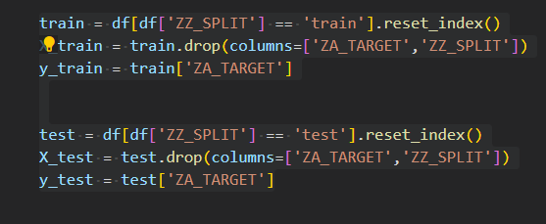
Model Evaluation
Test Train Split
Train Test split 80:20
Split was given by files
Data was converted into ordinal, numerical, and nominal features converted into 1 hot encoding
Data scaled using MinMax Scaler

Slide 13
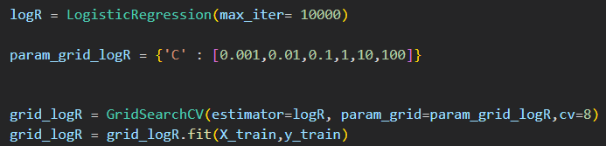
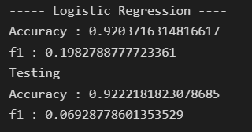
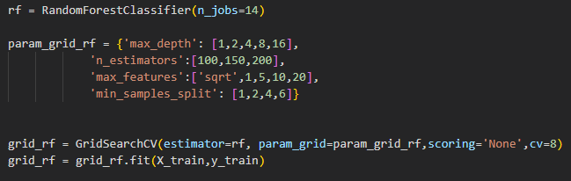
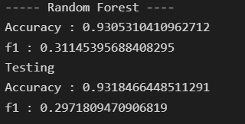
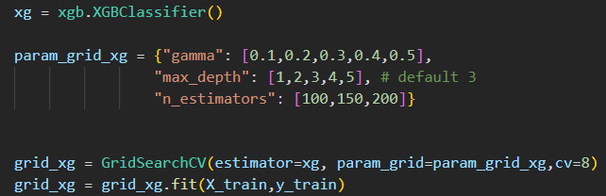
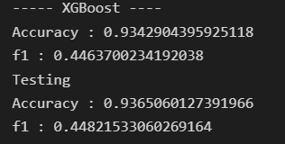
Model Evaluation
Logistic Regression, Random Forest, XGBoost

Slide 14
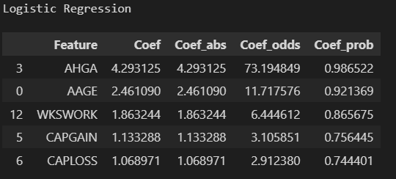
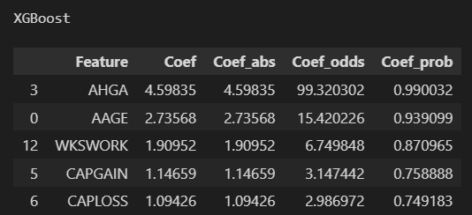
Important Features
Logistic Regression
Most Important Feature for both Models: AHGA (Education)
Logistic Regression
If Education increases by 1 odds of an income >50k increase be 73
XGBoost
If Education increases by 1 odds of an income >50k increase be 99

Slide 15
Conclusion
XGBoost Performed the best on the test set with 93.6% accuracy
Test and Train set Accuracy were dimilar, so did not suffer from Over/Under fitting
F1 score low, so mostly guessed with the majority result (income<50k)
XGBoost best model to move forward

