Slide 1
2016 Trump Voter Survey
Predictive Model Selection
Andrew Graham – Fall 2022

Slide 2
Overview
Summary and Goals
Purpose
To determine the best model to predict, based on survey results from surveys, whether someone voted for Trump or not in 2016. Survey contains demographics and views on ideology, religion and racism.
Significance
To gain an understanding of how certain demographics and views align. Challenge and/or confirm assumptions about the 2016 election. Prediction models can be used in future elections to estimate the likelihood of a candidate getting votes in the future. This can also be used to predict what types of candidates voters would prefer in future elections.

Slide 3
Overview
Summary and Goals
How does the performance of a Naïve Bayes Classifier compare with KNN Classifier, Random Forest Classifier , and Logistic Regression in predicting whether an individual voted for Trump in 2016 given survey answers on demographics, region, ideology, and views on racism?

Slide 4
Overview
Data Description
Data from survey results collected in 2016
64,600 datapoints
44,898 with answer for Trump Vote
1 Continuous
17 Nominal
2 categorical
4 binary
11 ordinal
Output: Voted for Trump
1, 0 (Yes, No)
40% Yes, 60% No
Balanced
Inputs
6 Demographic
Age, Sex, Education, Race, Income, State
2 Ideology Questions
4 Religion Questions
4 Racism Questions

Slide 5
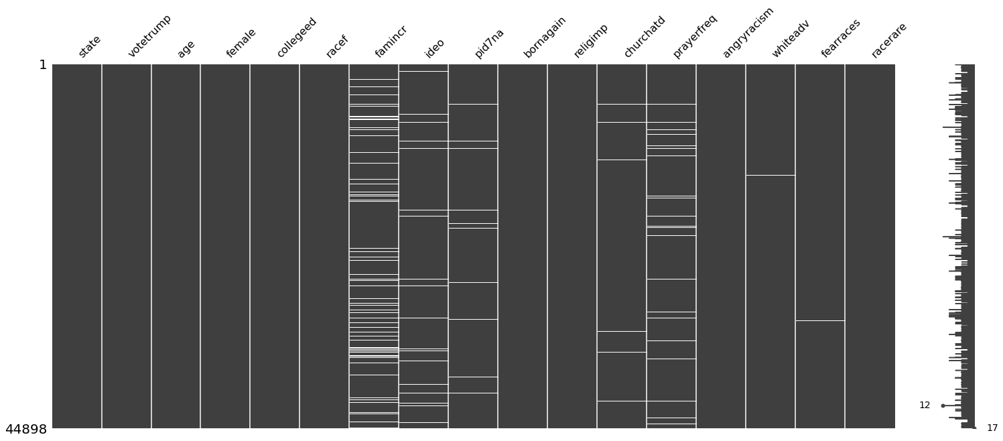
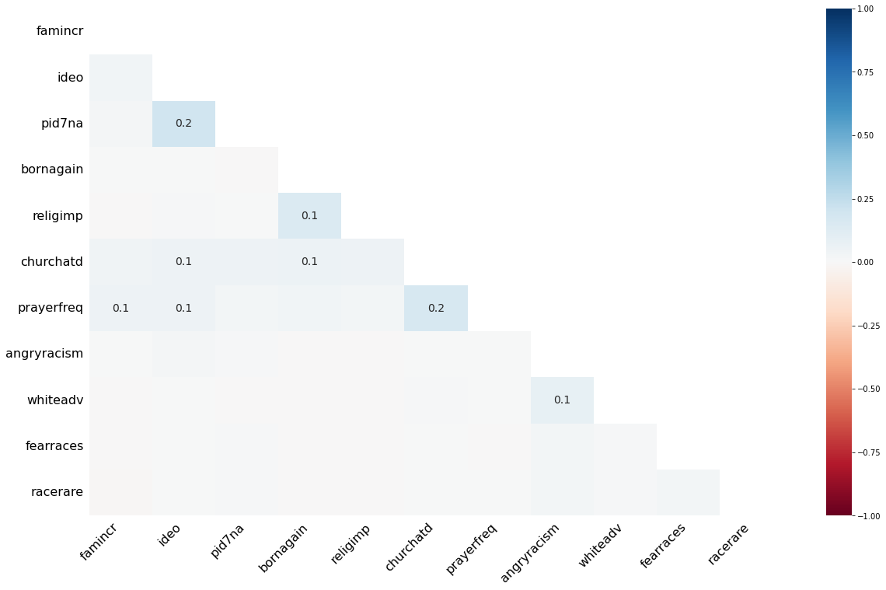
Overview
Data Cleaning
 | number_missing | percent_missing
state | 0 | 0.000000
votetrump | 0 | 0.000000
age | 0 | 0.000000
female | 0 | 0.000000
collegeed | 0 | 0.000000
racef | 0 | 0.000000
famincr | 4717 | 10.506036
ideo | 1501 | 3.343133
pid7na | 611 | 1.360862
bornagain | 22 | 0.049000
religimp | 20 | 0.044545
churchatd | 322 | 0.717181
prayerfreq | 904 | 2.013453
angryracism | 47 | 0.104682
whiteadv | 52 | 0.115818
fearraces | 100 | 0.222727
racerare | 86 | 0.191545
No misspellings or formatting issues
No duplicates
Removed NAs for Target
7337 NA
16% rows with NAs
No dependencies
Randomly Distributed between outputs
NAs Removed
37,561 Data Points Remaining

Slide 6
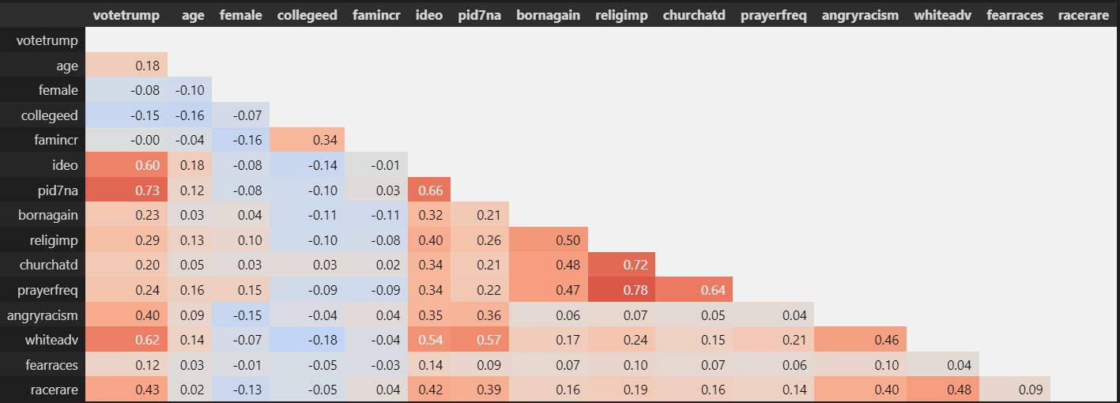
EDA
Dataset
Ideology Features >60% correlation with a vote for Trump
Views on whether whites have an advantage correlates 62%
Views on racism correlates >40%
Religion views correlate ~ 20-30%
Demographics , no significant correlation

Slide 7
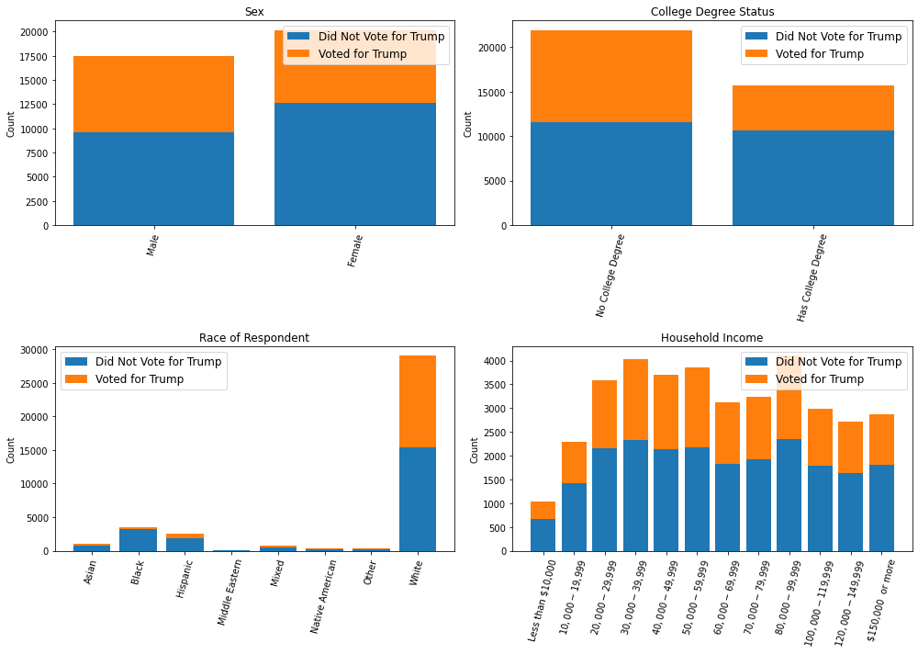
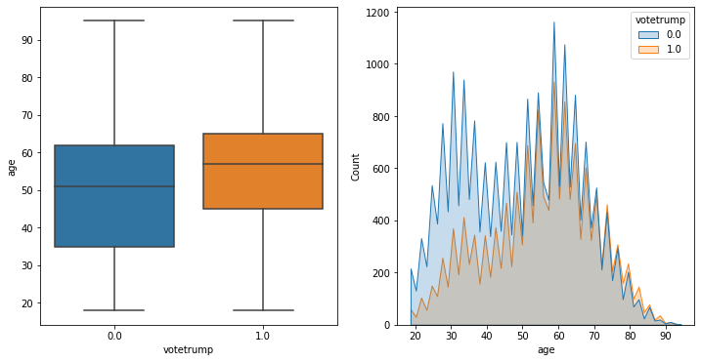
EDA
Demographics
Younger voters less like to vote for Trump
Non-white very unlikely to vote for Trump
Other demographics have minor differences

Slide 8
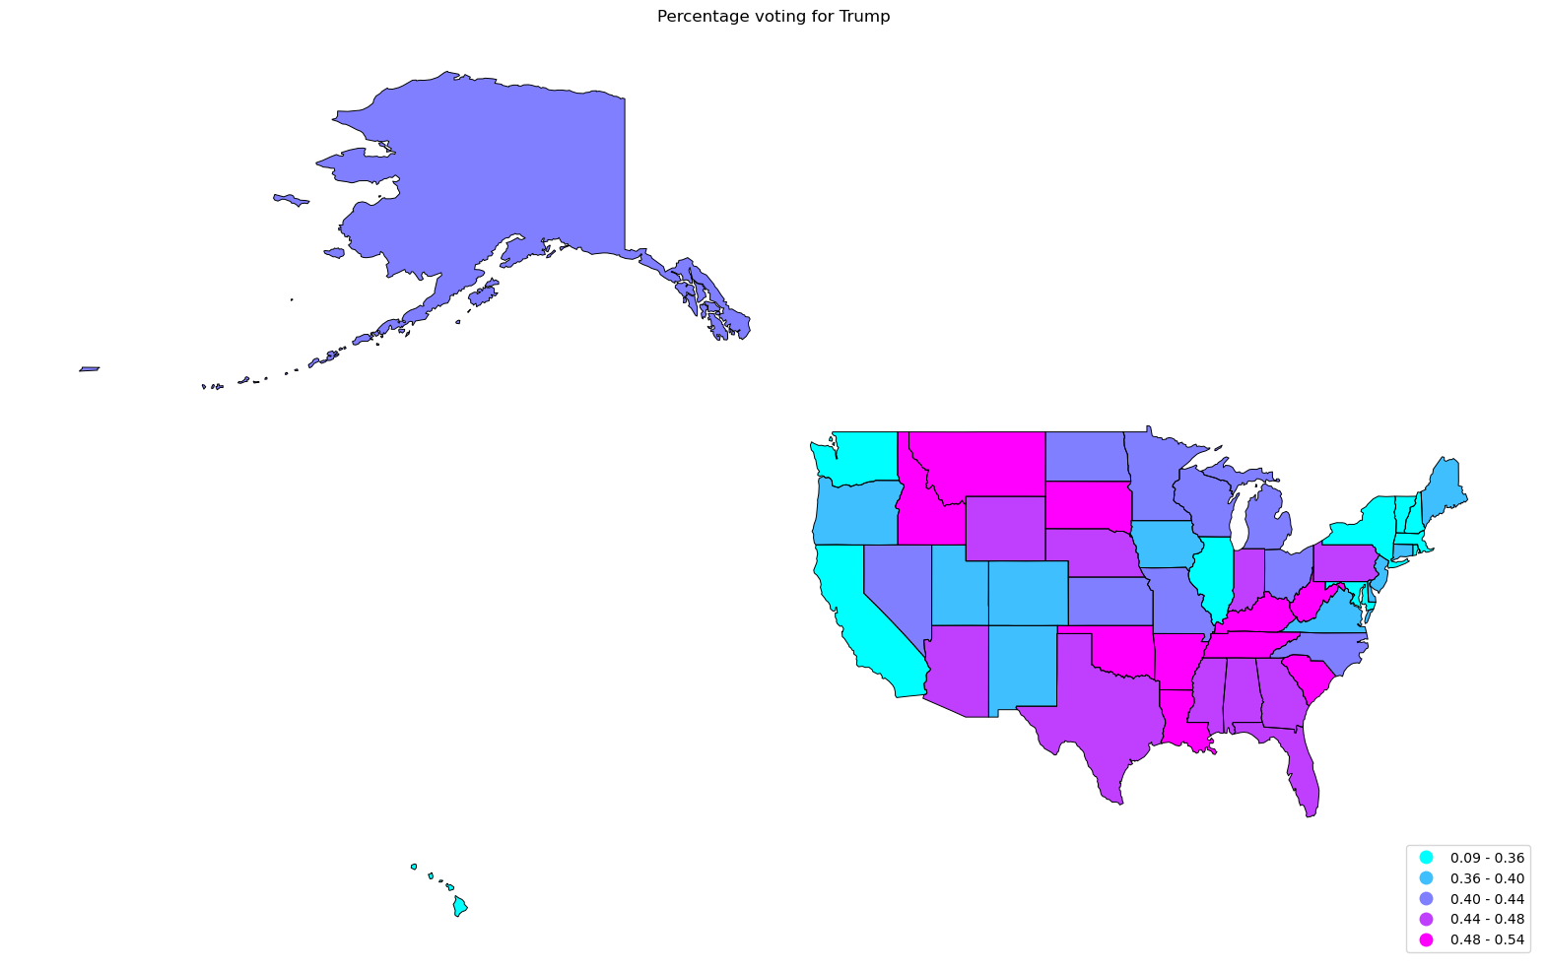
EDA
Location
South and Midwest most likely to vote for Trump
Most states not very predictive
Exception Northeast
California
Oregon
Hawaii

Slide 9
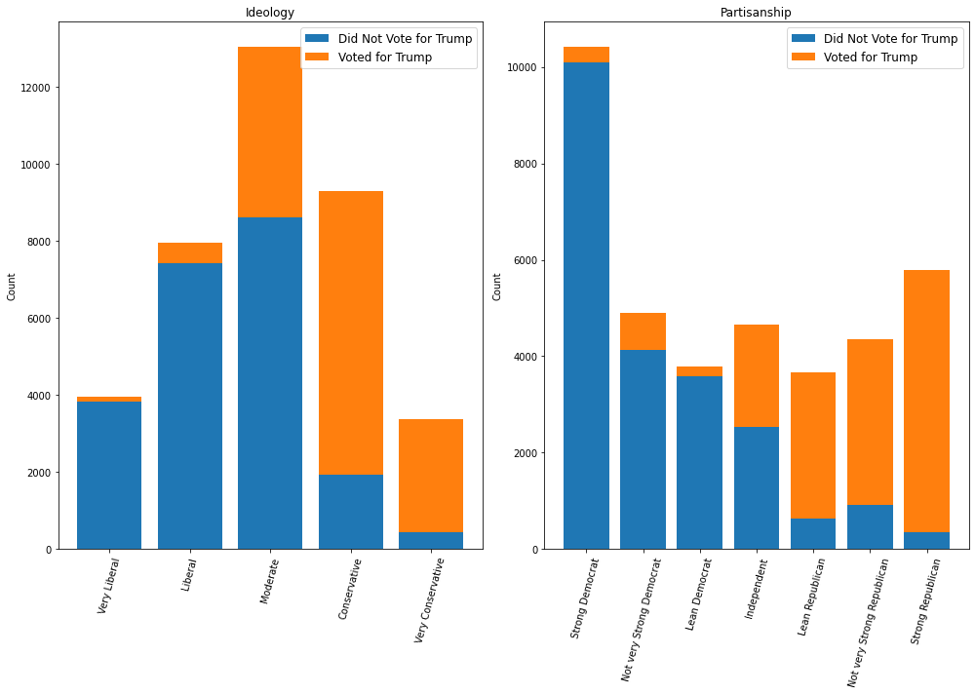
EDA
Ideology
As expected, the left ideology unlikely to vote for Trump, right likely
Independents split
Moderates split by lean to not vote for Trump

Slide 10
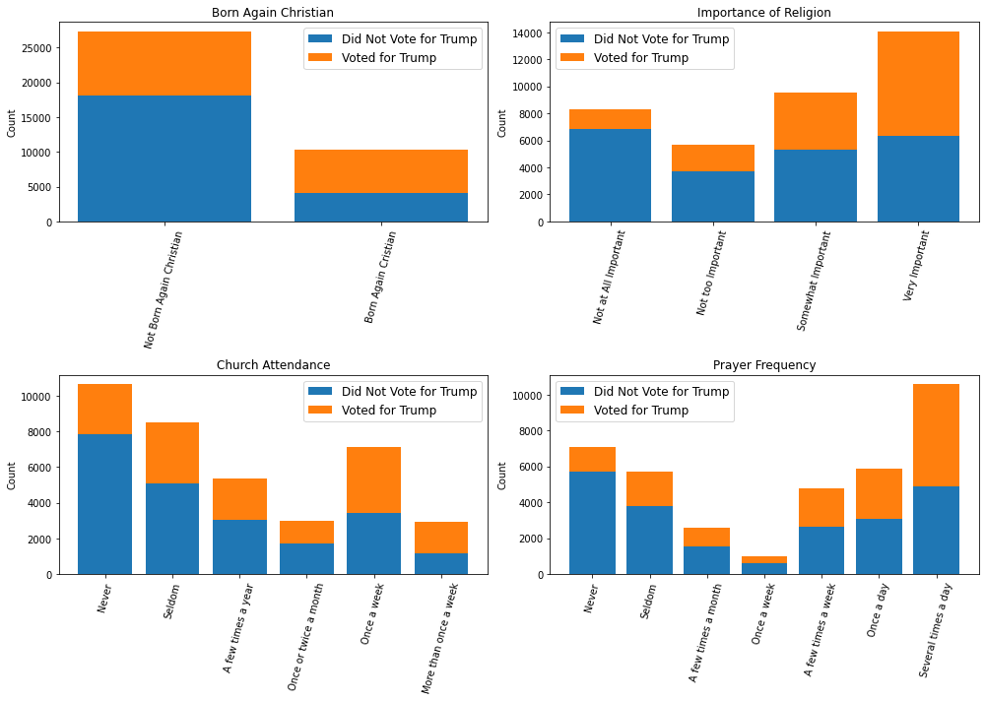
EDA
Views on Religion
The more religious, the more likely to vote for Trump
Church Attendance the affect is a bit less significant
Prayer frequency much more significant

Slide 11
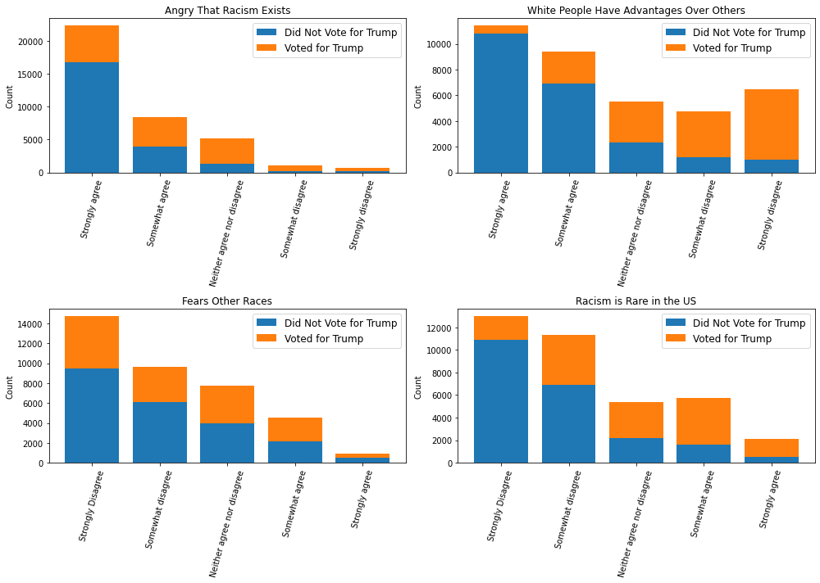
EDA
Views on Racism
Most angry that racism exists, slight correlation.
May indicate different definitions
The rejection of white privilege highly correlated with a vote for Trump
Fearing other races not correlated (Likely people did not admit to this)
Rejecting the commonality of racism correlates with a vote for Trump

Slide 12
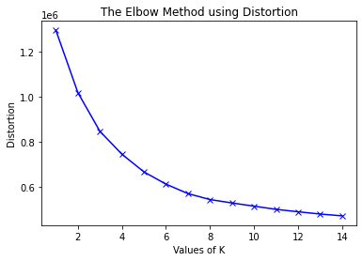
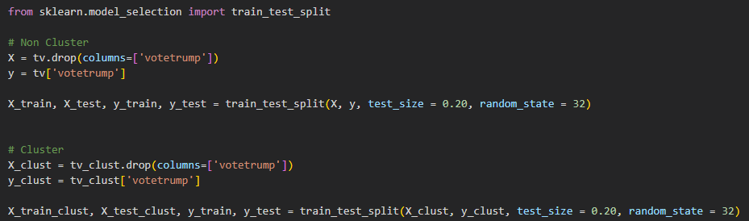
Model Evaluation
Preprocessing
Clustering using KNN used to see if there is an effect on performance
K for KNN chosen to be 6
Train Test split 80:20
Clustering and non-clustered datasets

Slide 13
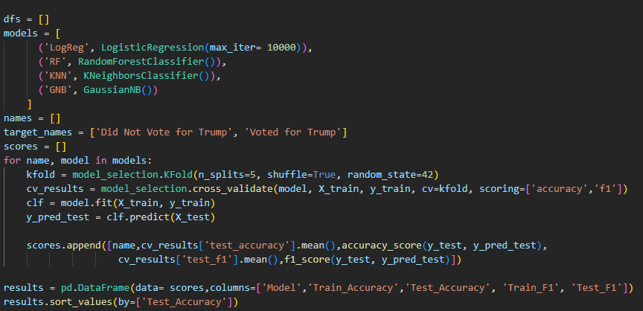
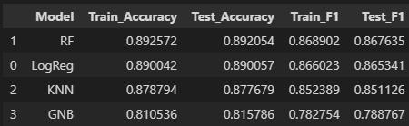
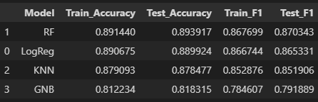
Model Evaluation
Multi-Model Comparison
Without Clustering
With Clustering
4 Models Trained
Random Forest and Logistic Regression Best Performers
Clustering did not improve results
Optimize models without Clustering
No Overfitting

Slide 14
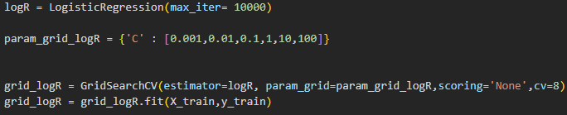
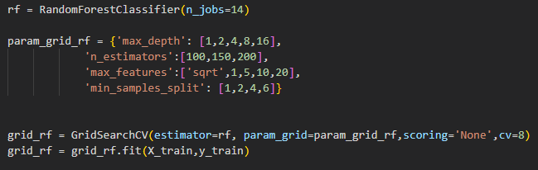

Model Evaluation
Model Optimization/ Selection
Both Models perform equally
Select simplest model
Select Logistic Regression
Parameter C: 0.1

Slide 15
Conclusion
Final thoughts Lessons Learned
Ideology, views on white advantages, and the race of the respondent were the most significant predictors
Income not as significant as initially thought
There seems to be an accuracy ceiling of about 90%
The 10% may not be captured in the questions analyzed
Fuller datasets with full survey answers would be useful
Logistic Model was the simplest and performed the best

