Slide 1
Machine Learning Fundamentals
Capstone Project : Date-a-Scientist
Alexander J Graham
November 25, 2018

Slide 2
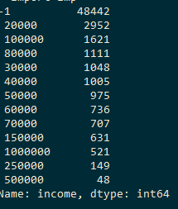
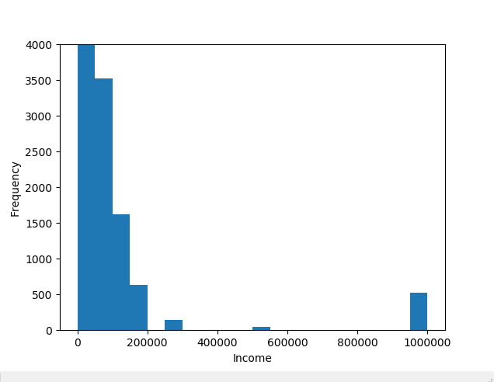
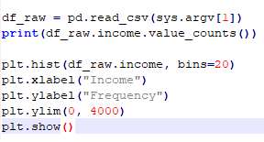
My thoughts from exploring the data…
I first pulled the column names and started to look at the data types for multiple columns (print(df_raw.columns.values, df.head()))
I then noticed there were only two columns containing continuous variables (df[‘age’], df[‘height’]), with the rest mostly being categorical.
I plotted multiple things but income had me slightly interested. First I checked the counts for each income bracket in the dataset, then I made a histogram of the income to better visualize.
The left figure is the result of printing : print(df.income.value_counts()). For the most part, there are a decent amount of samples within each bracket across the entire range. I was uncertain what’-1’ represented (welfare?, other?) so decided if I was to do something with income, to later remove those values from any analysis due to uncertainty.
I then decided to visualize income brackets with a histogram, setting the y-axis to a range that doesn’t consider the “-1” counts. I realized here I may need to remap the data into more contiguous values.

Slide 3
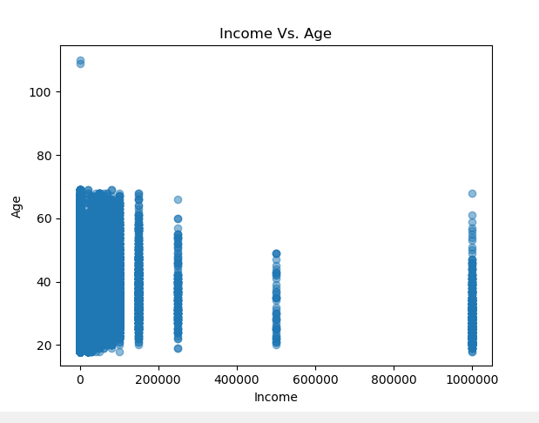
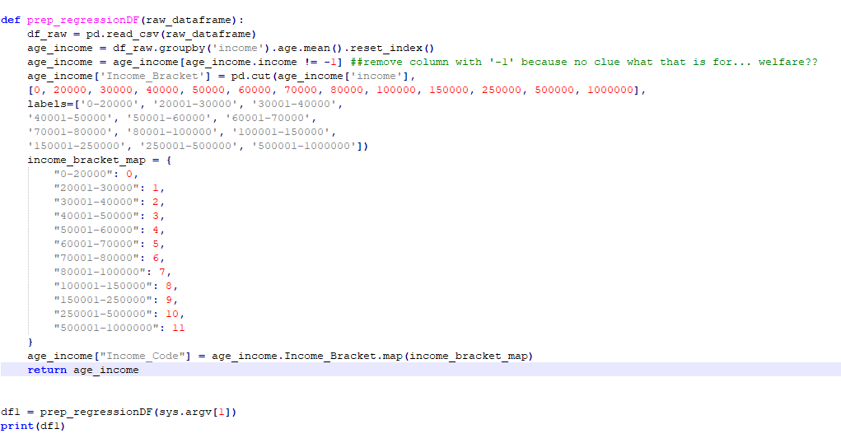
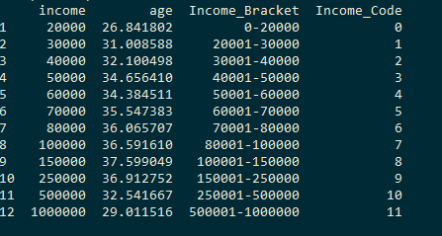
Simple Linear Regression (Question: Can we predict age based on income level?)
The income brackets are categorical, which I feel are not ideal for a regression. I tested this by plotting income against age (far left figure). I wasn’t happy with this which made me wonder what the data would look like if I averaged age across each income bracket.
First I used the ‘groupby’ function to group by income, and get the mean age within each income group.
I put this into a new dataframe just for the regression, with a few new columns (‘Income_Bracket’, and ‘Income_Code’). You will see that I remapped income using ‘pd.cut’

Slide 4
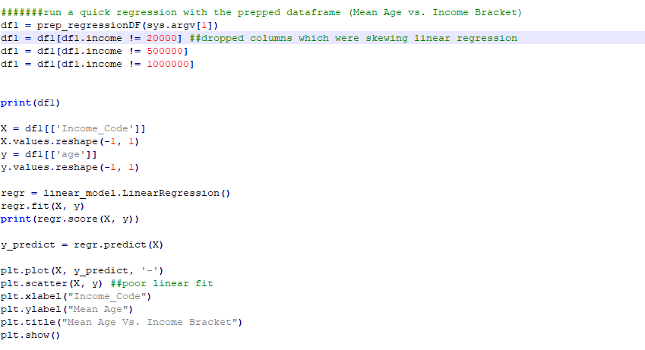
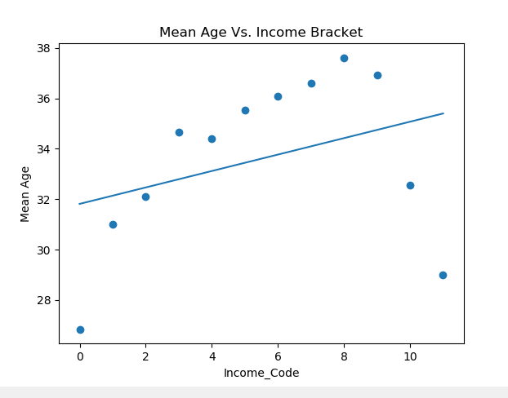
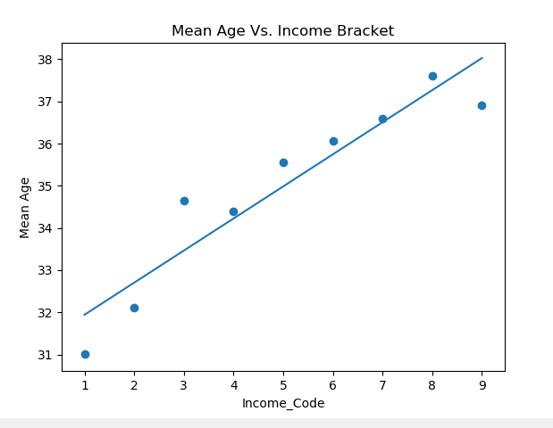
Simple Linear Regression (cont.)
Finally I set up my prepped dataframe and plotted a regression below (Income codes can be seen on previous slide if needed). Code 0(0-20000 income) and codes 10 (250001-500000) and 11 (500001-1000000) are not linear with the majority of the data (R2 = 0.122).
Looking back to slide#2, we still had a decent amount of data points for the brackets that corresponded to codes 0, 10 and 11, which were used to create the means. I could perhaps have assessed more in-depth the standard dev etc. within each bracket. Or, I could have used something such as a polynomial model to fit these data better. So I could move on to the next part of the project, all I did was remove codes 0, 10 and 11 from the data and remade the model.
The bottom-right figure is the regression without codes 0, 10, 11. This pushed the R2 to 0.88. It will be decently accurate for predicting the age of someone based on income levels between 20000 to 250000.

Slide 5
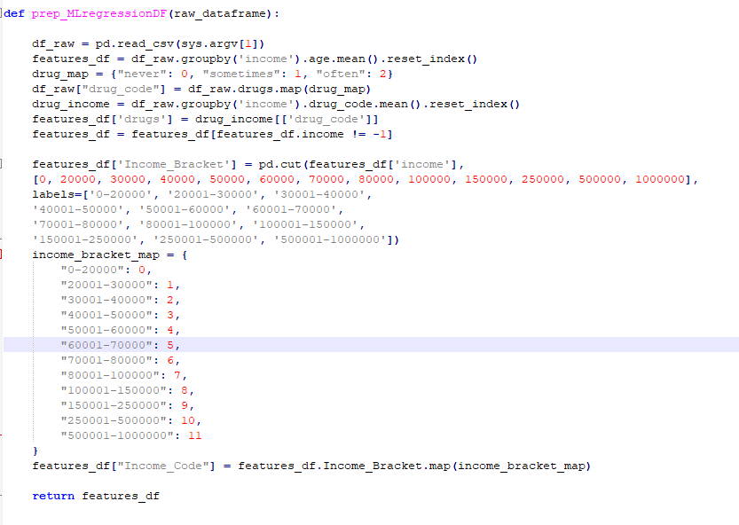
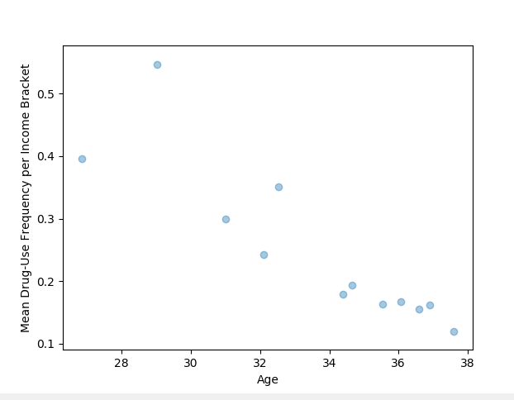
Multi Linear Regression (Question: can we use drug_use with income to predict age?)
I wanted to continue to see if I could improve the current regression model (predicting age with income) by adding another variable for multiple regression.
I decided to add drug_use as a feature in hope that it would introduce better accuracy than the single regression.
I again used the groupby function on the remapped column of drug_use. This gave the mean drug_use of the remapped values (0:never, 1:sometimes, 2:often) within each income bracket.
I go over this more in the last discussion slide, but I do realize I only have 12 rows for each feature (age, income_code, drug_use). This made me hesitant to split this up into training and test samples. I decided to use all the datapoints to train the model , and then to look at other ways to review the accuracy.
Once again I managed to find an interesting relationship using the groupby function. The bottom-right shows a plot of mean drug-use per income bracket vs. age (I had some issues trying to get this plot colorized by income bracket).

Slide 6
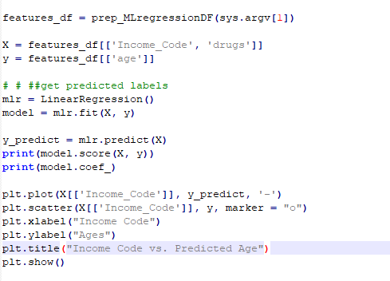
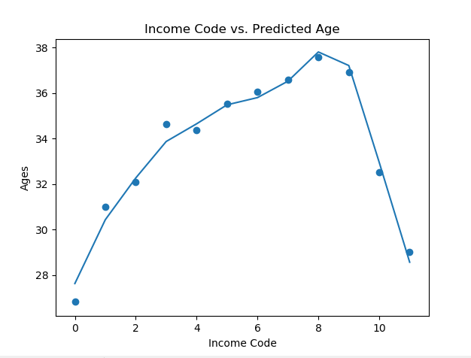
Multi Linear Regression (Question: can we use drug_use with income to predict age?)
I achieved a score of 98.2% (an improvement of ~10% over the single regression after removing outliers).
I do feel the results are overfitted to the data. In this case, I suppose I could have split up the training data, and perhaps done folding to ensure the scores remain consistent across diff. parts of the small dataset. Then used perhaps 50% training and 50% testing splits.

Slide 7
Single v. Multi Linear Regression (Discussion)
Sklearn has made the implementation of both regression types nearly identical, with the only thing change being the X input (single feature for single regression, n features for multi regression).
Assessing the score, and plotting with matplotlib are also identical between regression types.
I found no issues with run-time.
I chose not to split up the data into training/testing because of the low amount of datapoints. This decision in the end was perhaps not a great idea due to overfitting.
I had overfitted my results in the multi-regression but am not sure of the best approach for the situation where you have very few datapoints.
In my case the multi regression outperformed the single regression when introducing another variable that was linear with age (mean drug_use). I also noticed that in the case of the multi-regression, I did not need to remove any outliers to improve results, likely because my data somehow became overfitted.
In closing I do feel regardless of which regression model I used, that I found linear relationships in the data between Mean Age and Income Bracket, and Age and Mean Drug-Use. Within this dataset at least I have found a way to predict age with an acceptable accuracy. If I had to chose between which model I would like to input new data into for predictions, I would chose one of the single linear regressions as I felt neither were overfitted to the data.

Slide 8
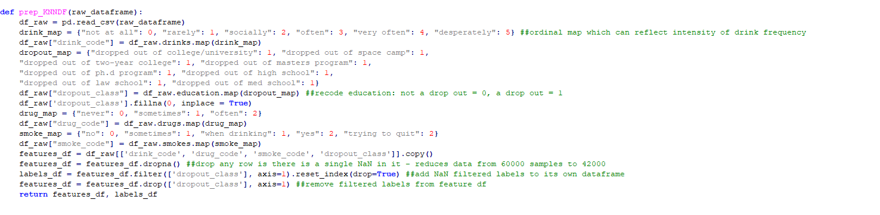
K-NN Classification (Question: Can we predict if someone dropped out based on some lifestyle habits (smoking, drinking, drugs ) ?
I explored and visualized some of the data again much like shown in Slide#2. This time I decided to determine if I could predict whether a person dropped out of school based on lifestyle habits (drinking, drugs, smoking). I remapped education and made any instance of dropping out a ‘1’, and everything else a ‘0’.
I chose those 3 features because I knew they could be mapped with ordinal values, which at least represent intensity/frequency of each habit.
My code for prepping my dataframe is in the figure below. You will see that I decided to clump some categories together for smoking (combined ‘when drinking’ with ‘sometimes’, and combined ‘yes’ with ‘trying to quit’).
I put my mapped features and labels into a new df first, and then removed rows if any single instance of NaN appeared. This reduced the amount of datapoints from ~60000 to 42000.
I then checked the class distribution of my labels after removing the NaNs (print(labels_df.dropout_class.value_counts()) : 40948 non-dropouts, 1547 dropouts)
This class distribution was slightly concerning given I had <4% of the data as dropouts. But I really wanted to see if I could predict dropouts! I decided with my model, I could use cross-folding to ensure I use all parts of my data to determine how well it performs.

Slide 9
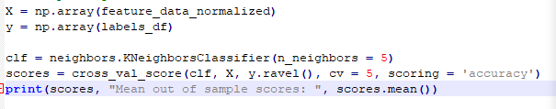
K-NN Classification (Cont.)
I first normalized my data within the features dataframe so that each column was scaled 0-1, as some features originally had ranges of 0 to 5, and others 0 to 2.
I then performed a cross validation check based on my knn classifier set to k=5. In general, the scores remained around 96% across the 5 folds I had set (cv = 5, or 20% training samples per fold).

Slide 10
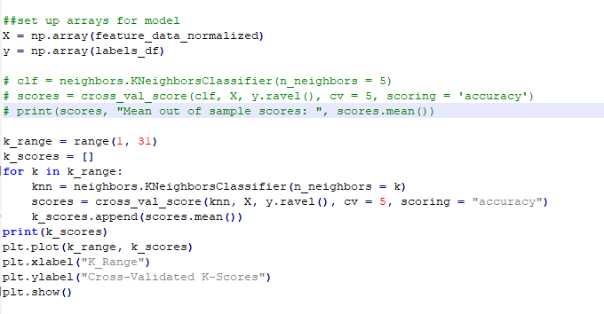
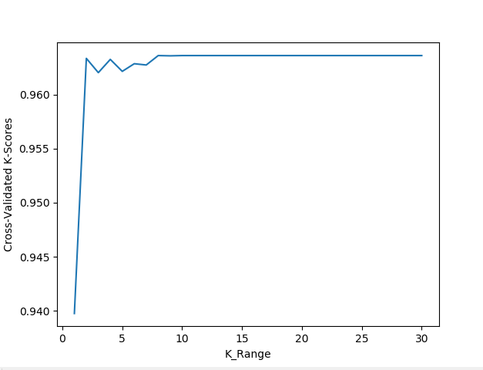
K-NN Classification (Cont.)
I then decided to check for an optimal K value while still using the cross-validation. I did this by creating for loop, so that I could do cross validation at each level of k, and get the mean from those scores appended to a new list (‘k_scores’).
Running this takes around 5 minutes! But it would only have to be run once to figure out the optimal k. I decided on k = 4, which yielded an average score of 0.963 across all folds.

Slide 11
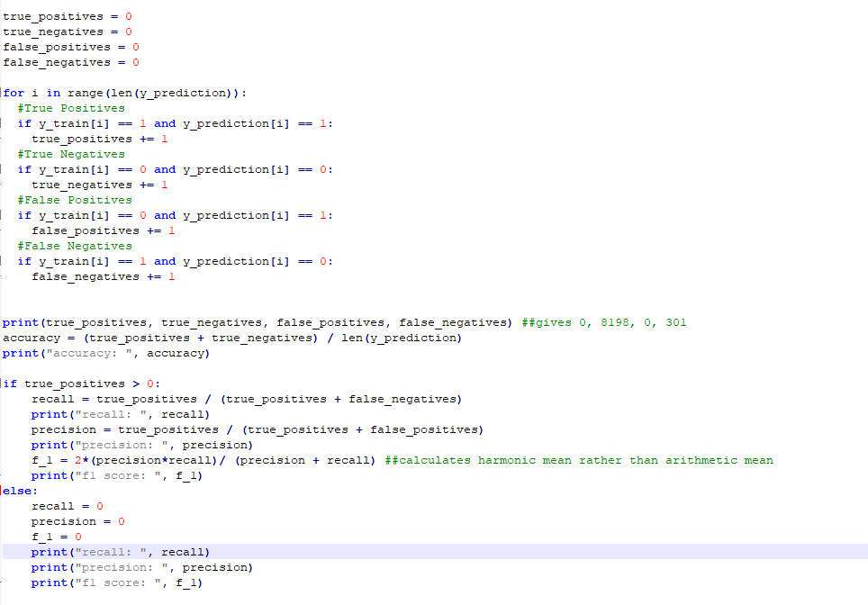
K-NN Classification (Accuracy Verification)
While my model obtained high scores, I needed to check whether the score was being diluted by true negatives. I checked accuracy, precision, recall and f1 on my training labels vs. my predicted labels.
It was rather unfortunate that I found what I had suspected:
True Positives = 0
True Negatives = 8198
False Positives = 0
False Negatives = 301
My accuracy was high because of true negatives, which if you recall reflected 97% of the class label distribution (non-dropouts).
Thus, because of no true positives, my F1, precision and recall were all 0.

Slide 12
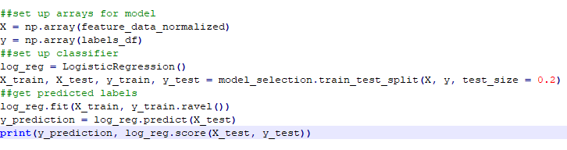
Logistic Regression Classification
I decided to recycle my dataframe from K-NN and quickly try another classifier, since Sklearn makes that process so easy. So I used the exact same data with the same questions I asked for the KNN classification.
I tried a logistic regression, which despite the name I learned is a classification rather than a regression.
Again I achieved a good accuracy, but the logistic regression model was again plagued by the input dataset. I ended up with similar results to the K-NN:
True Positives = 0
True Negatives = 8191
False Positives = 0
False Negatives = 308
The logistic regression performed nearly identical to the K-NN.

Slide 13
K-NN Classification (Discussion)
Neither classification approach was able to handle the dataset I had provided. Perhaps this was due to the uneven class distribution (97% of the data points were from non dropouts, and 3% dropouts). I had a huge amount of true negatives likely since the non-dropout class dominated the dataset.
I also did not explore the relationships in the data in-depth enough before beginning the classification. Perhaps other variables could have been used in place to predict whether someone dropped out or not.
In terms of run-time, both classifications were rapid and identical. Running the cross-validation scores across all folds took the longest, but it would in general only need to be used once while exploring the data for optimal model parameters.
In closing, Next time I would perhaps look at using another variable such as essay length or average word length in essays, as well as an ordinally mapped education level to try and predict dropouts. That would in hopes provide a more even distribution of classes for the models to predict upon.

