Slide 1
Python Project: Life Expectancy (WHO)
Statistical Analysis on factors influencing Life Expectancy
Agraj Agarwal
Jeffery Samuel Chittaranjan
Mankaran Singh Bahri
Tanaya Chittaldurg
Vikas Das

Slide 2
Case Description
Analyze the trends in life expectancy globally, using the data collected for over 190 countries over a period of 16 years (from WHO)
Key variables over which the data was collected are Alcohol Consumption, Level of Schooling, Health Expenditure, GDP, Immunization against certain diseases, etc.
Although a lot of similar studies have been undertaken in the past, the effects of immunization and a country’s expenditure on health were not taken into account
This study will help in suggesting a country which area should be given importance in order to effectively improve the life expectancy of its population

Slide 3
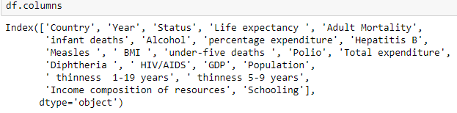
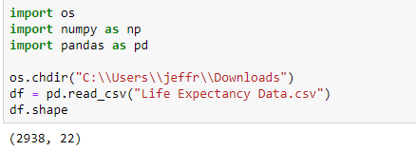
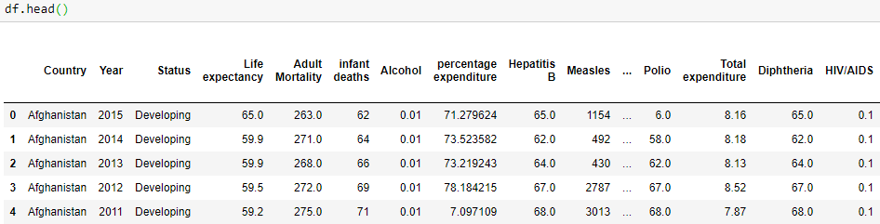
Dataset
The dataset had 2938 rows and 22 columns

Slide 4
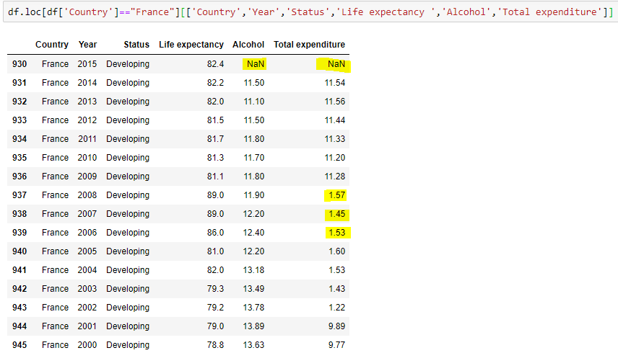
Issues in the Dataset
Null values
One or more null values for a column when aggregated at country level
Entire column values are null when aggregated at country level
Clerical errors
Significant differences in values for subsequent rows in a column when aggregated at country level

Slide 5
Data cleaning steps
Identify columns with Null values
Fill nulls via mean transformation 1. Country level 2. Status level
Interpolation to replace nulls
Detect outliers and set to null

Slide 6
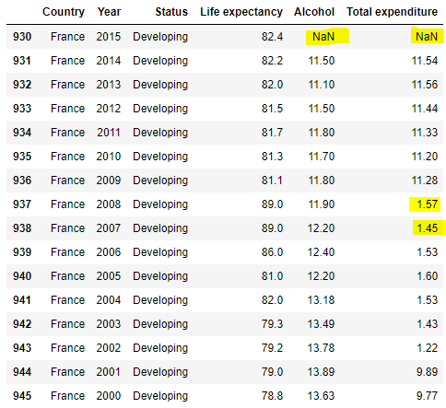
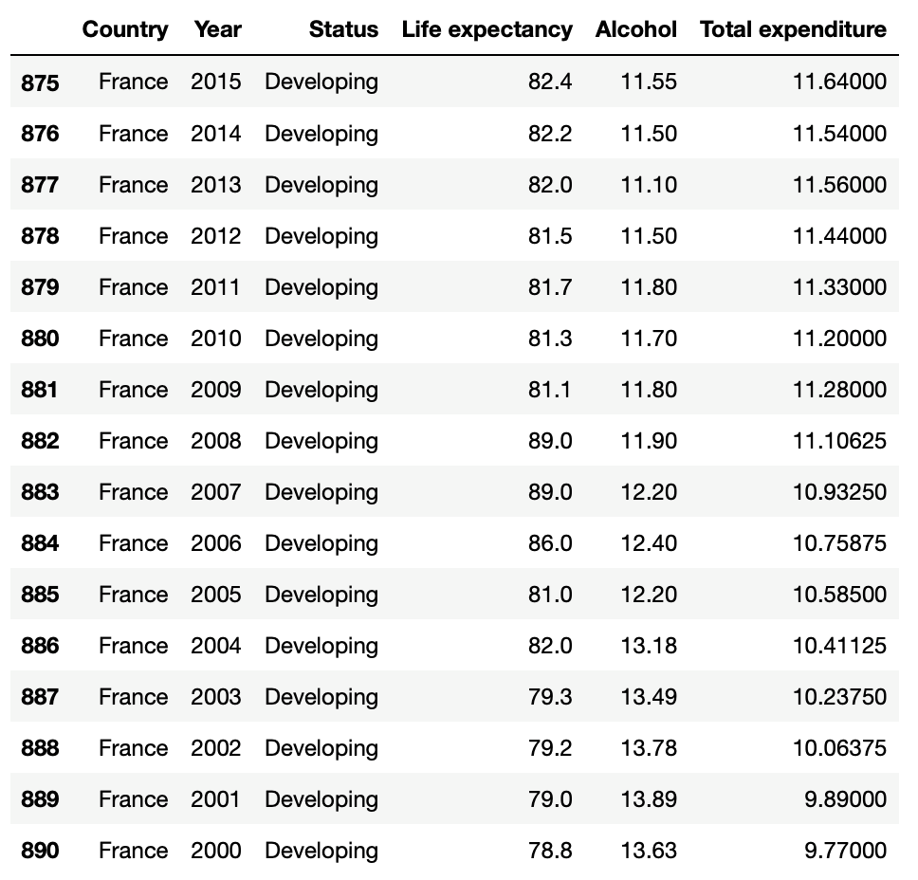
Data Cleaning – Before vs. After

Slide 7
Questions to be answered
Trends of life expectancy over the years across all countries
Does alcohol consumption affect life expectancy?
Does GDP per capita affect life expectancy?
Is there a correlation between the level of schooling and life expectancy?
Does a country's life expectancy depend on its health expenditure?
What is the impact of immunization coverage on life expectancy?
What variables have the highest impact (most significant) on life expectancy?

Slide 8
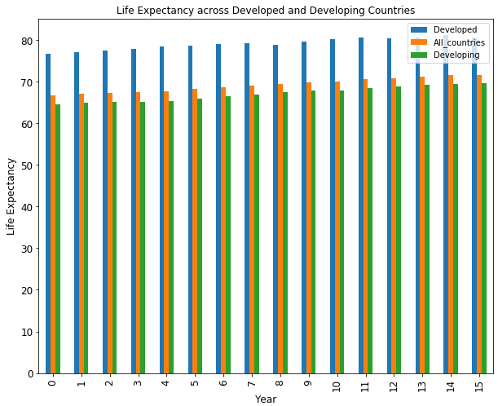
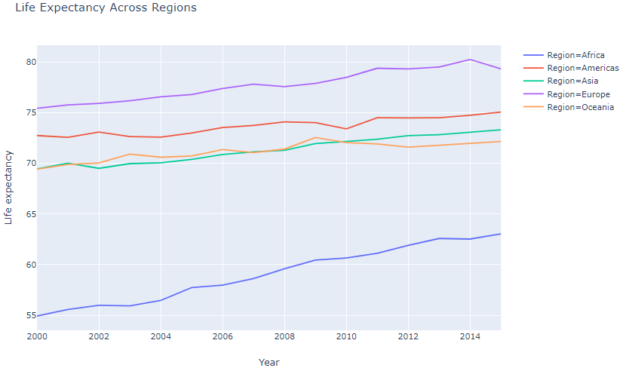
Life Expectancy trends

Slide 9
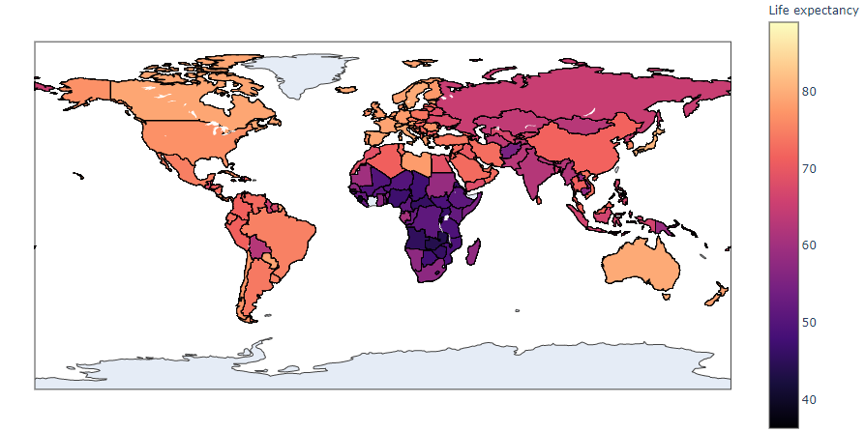
Life Expectancy across Countries in 2015
Developed countries have significantly higher life expectancy
African countries have among the lowest life expectancy

Slide 10
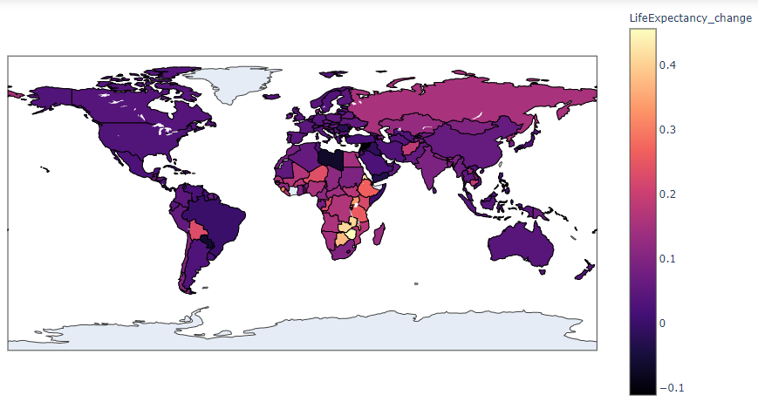
Percentage change in Life Expectancy from 2000-2015
African countries have shown the highest improvement through the years
Developed countries such as USA, Canada, etc. have improved marginally
Life expectancies of Yemen, Syria & Libya have reduced

Slide 11
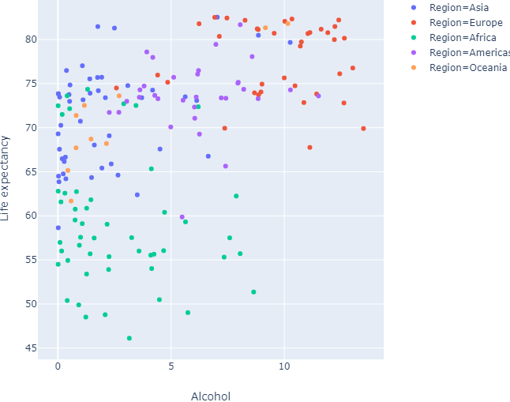
Life Expectancy vs. Alcohol Consumption
European countries have the highest alcohol consumption (per capita in liters) and among the highest life expectancies
Among the countries with life expectancy over 80 years, only Israel and Singapore have considerably lower alcohol consumption
Islamic nations such as Kuwait, Saudi Arabia and Qatar have a high life expectancy (over 73 years) but very low alcohol consumption

Slide 12
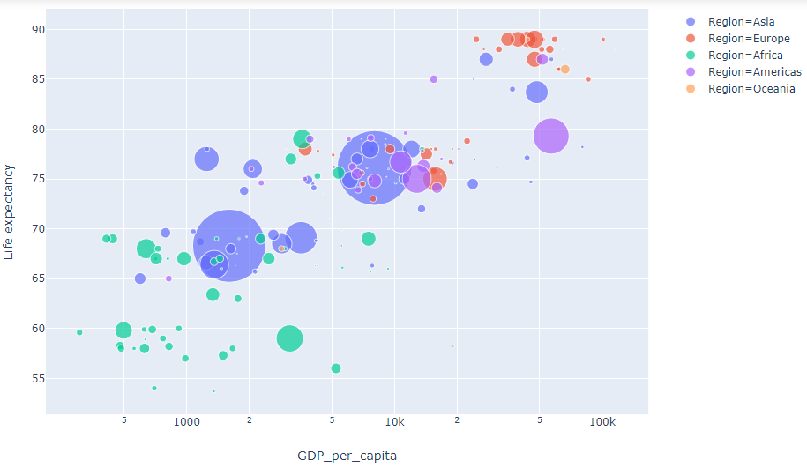
Life Expectancy vs. GDP per capita
European countries have the highest GDP per capita and life expectancies (Only Russia, Belarus and Bulgaria have life expectancy less than 75)
African countries have the least GDP per capita and life expectancies (Only Egypt, Tunisia, Algeria and Morocco have life expectancy over 75)
Among the Asian countries, Singapore and South Korea have the highest GDP per capita and life expectancies

Slide 13
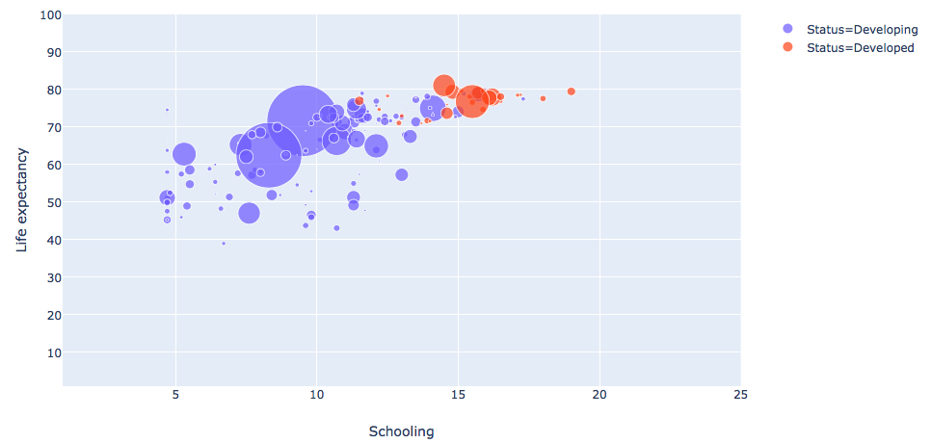
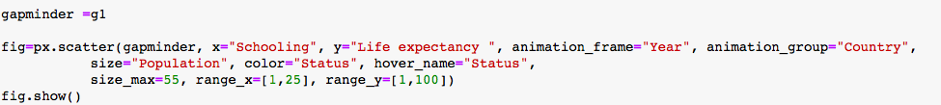
Life Expectancy vs. Schooling
Life expectancy increases as schooling levels increase through the years for Developed and Developing countries

Slide 14
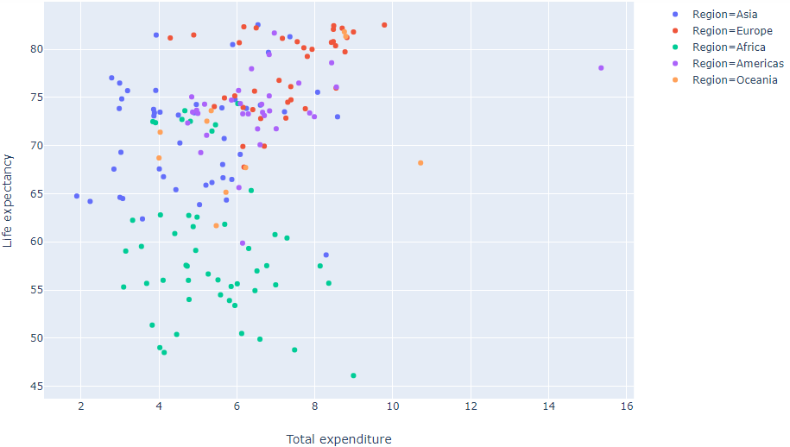
Life Expectancy vs. Health Expenditure %
Life expectancy increases for Europe and Asia as the Health Expenditure increase
For other continents, we do not see any significant linear correlation
Among countries with over 80 years life expectancy, Singapore has the least health expenditure

Slide 15
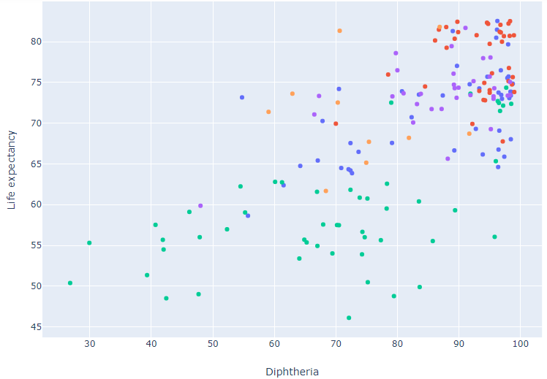
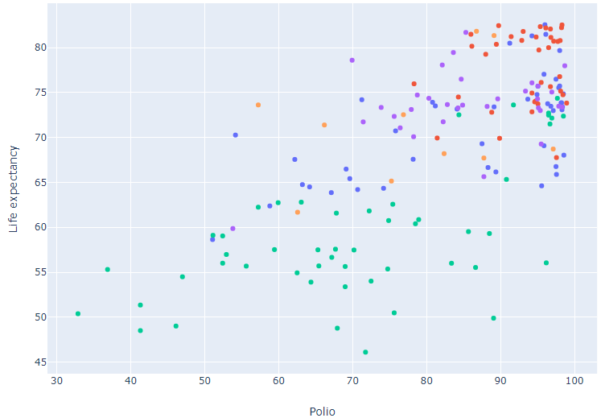
Life Expectancy vs. Immunization factors

Slide 16
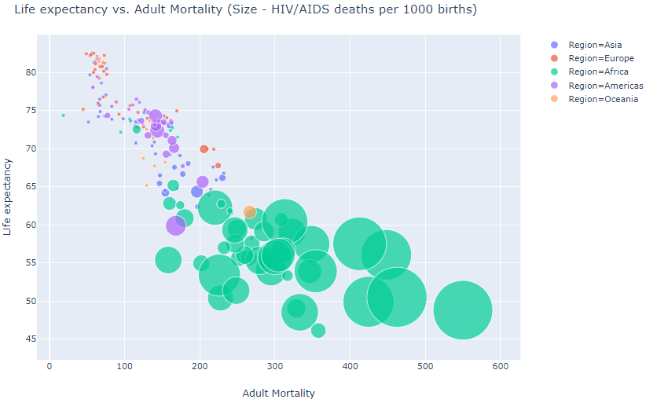
Life Expectancy vs. Mortality factors
Life Expectancy is negatively correlated with Adult mortality and HIV/AIDS (deaths per 1000 births)
African countries have the highest Adult mortality and HIV/AIDS related deaths and the lowest life expectancies (Tunisia, Morocco and Algeria are outliers)
European countries on the other hand have the least Adult mortality and HIV/AIDS related deaths but high life expectancies (Ukraine and Russia are outliers)

Slide 17
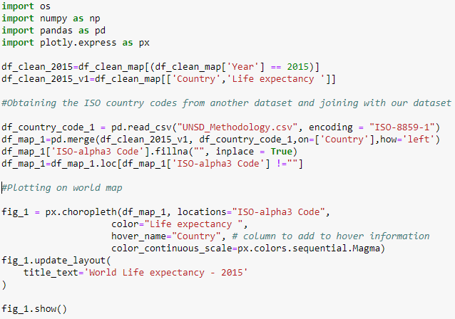
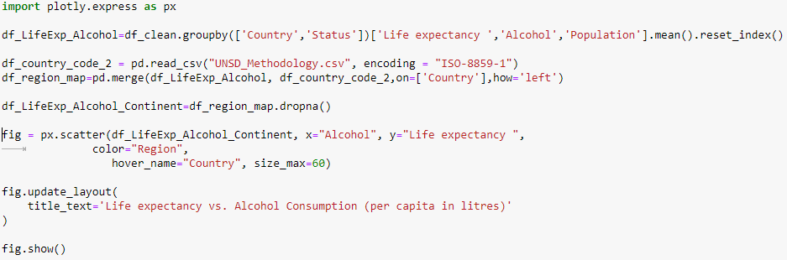
Choropleth maps and Scatter Plots using plotly

Slide 18
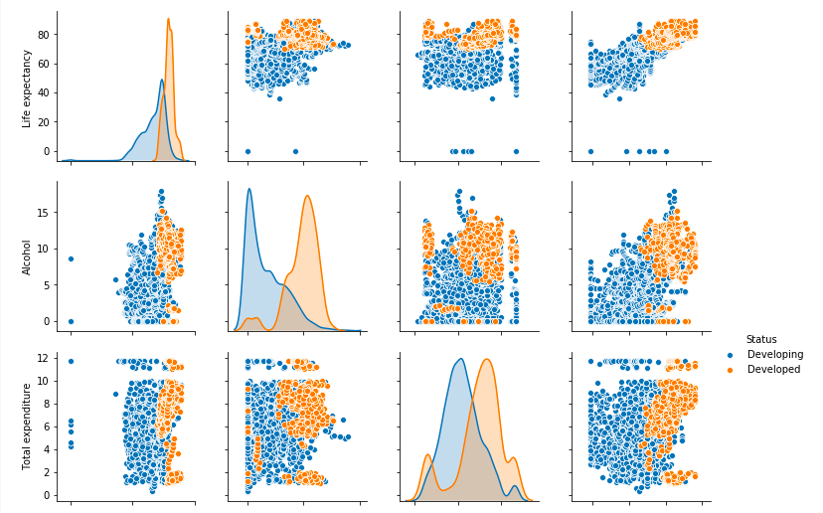
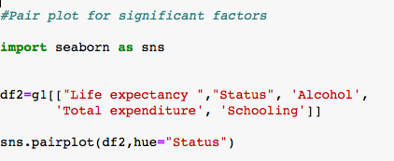
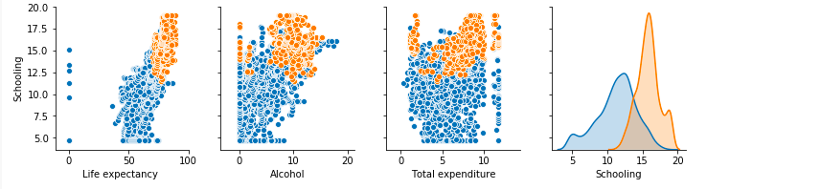
Pair Plot- Significant factors
Life Expectancy for most of the Developed and Developing countries is greater than the mean Life Expectancy.
For majority Developing countries, the alcohol consumption is less that the mean. These are mainly Islamic countries.
Mean value of Total Expenditure and Level of Schooling for Developed countries is greater than the mean value of Developing countries

Slide 19
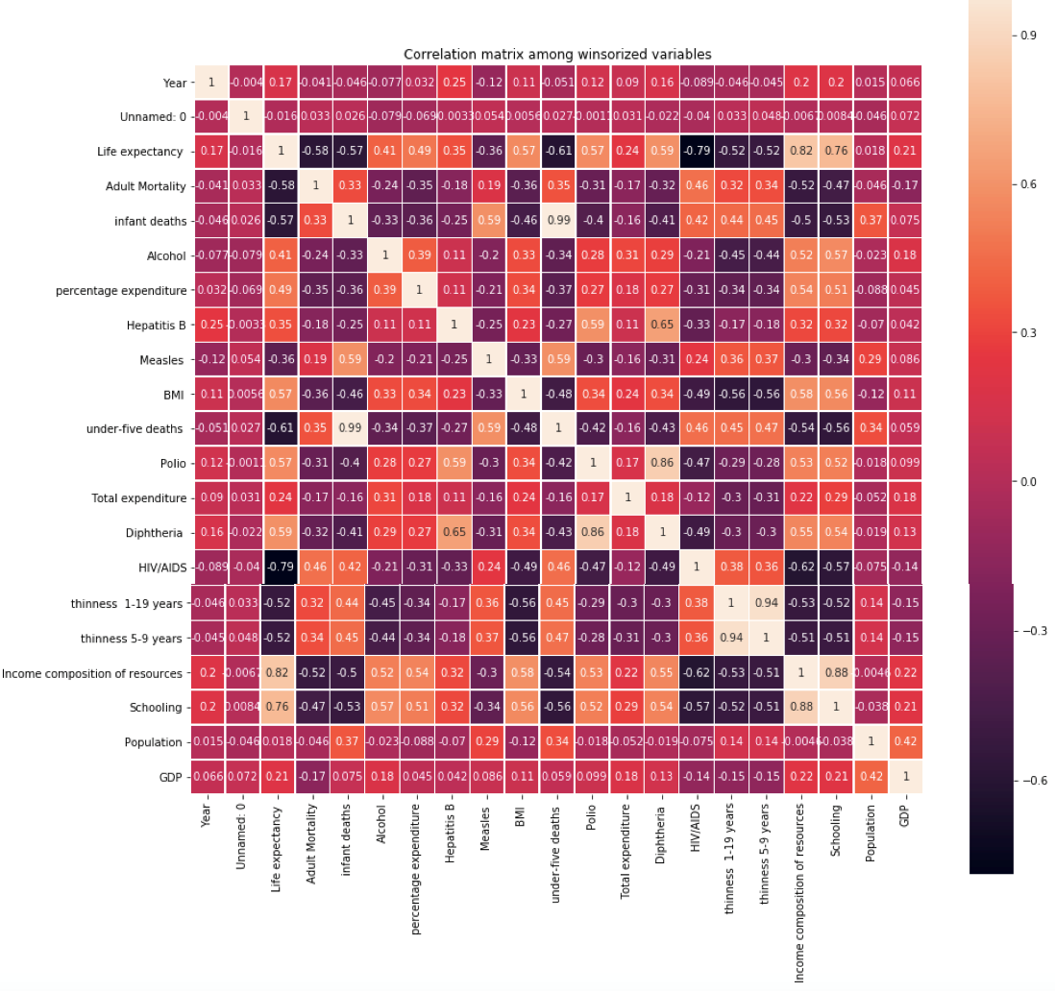
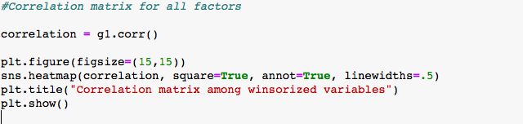
Correlation Matrix

Slide 20
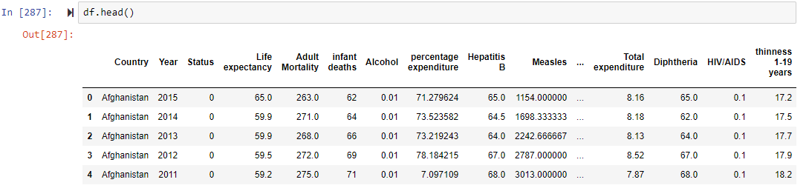
Handling Categorical Data
Multiple regression is performed to understand what variables have significant impact on Life expectancy
Categorical variable needs to be imputed before we run regression
Imputing values for categorical value ‘Status’

Slide 21
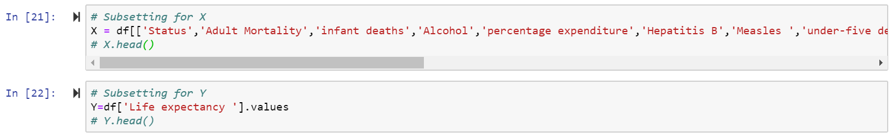
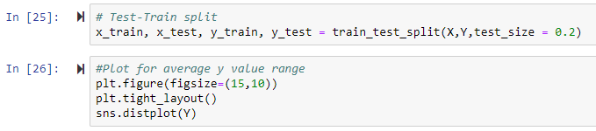
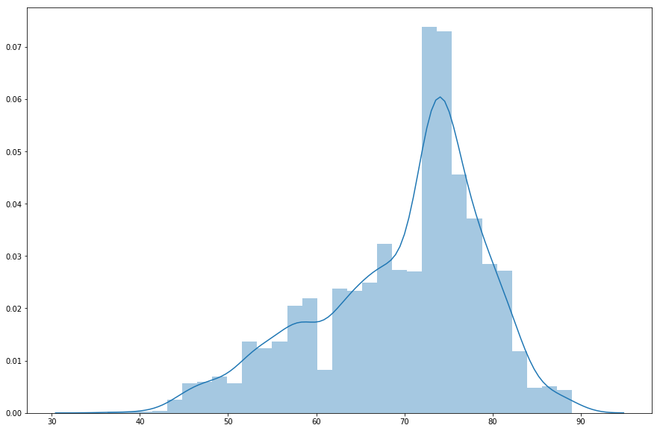
Dataset Preparation for regression
Defining explanatory and response variables
Test-train split of data for model validation

Slide 22
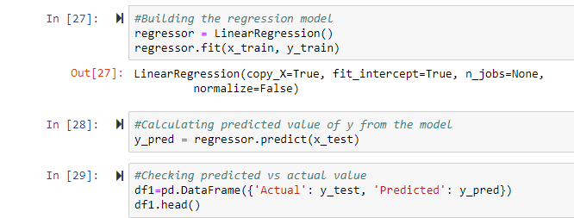
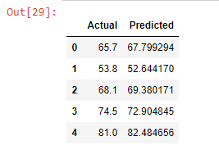
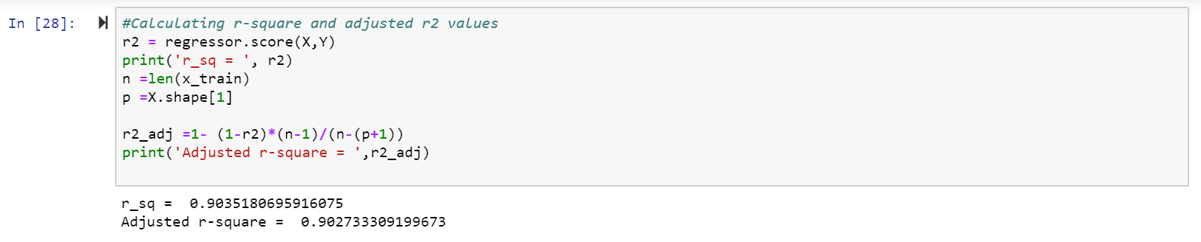
Multiple Linear Regression using Scikit learn
Building regression model – Using Scikit learn
Adj. R squared calculation on the model

Slide 23
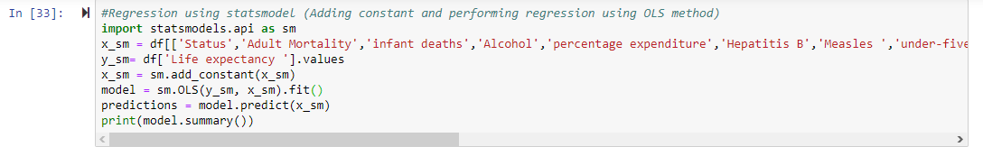
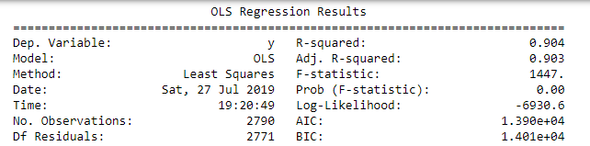
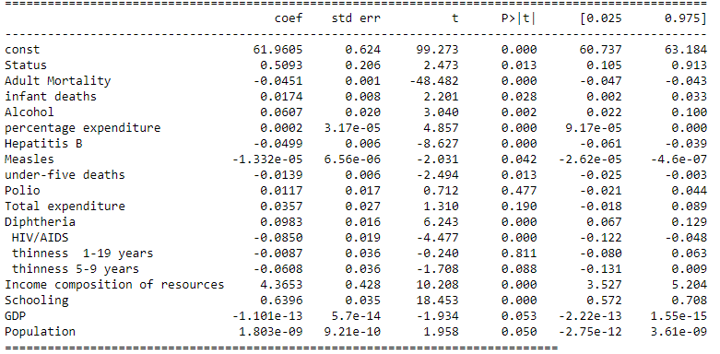
Statsmodel OLS – Regression model
Building regression model – Using Statsmodel

Slide 24
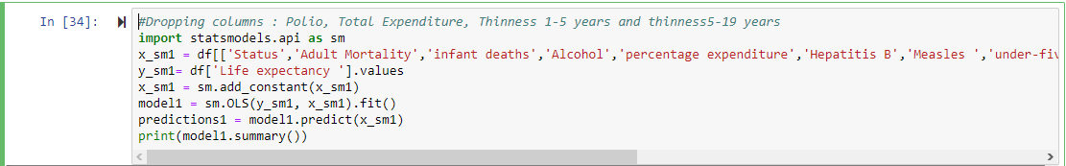
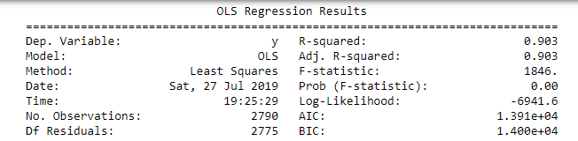
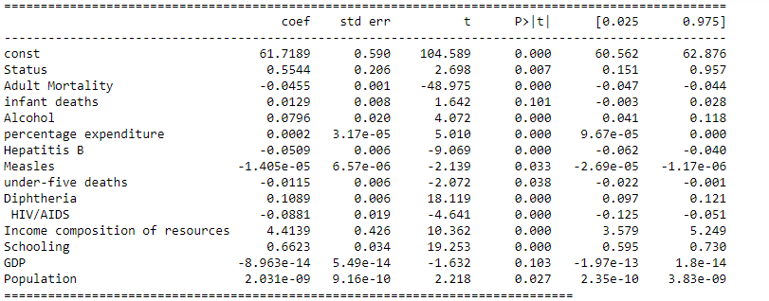
Backward Elimination I
Building regression model – Using Statsmodel

Slide 25
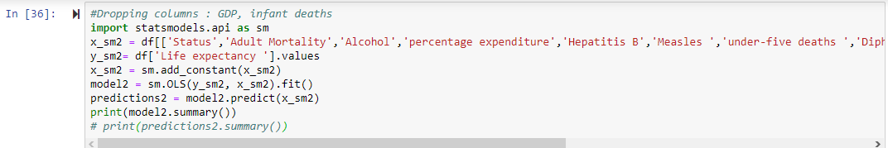
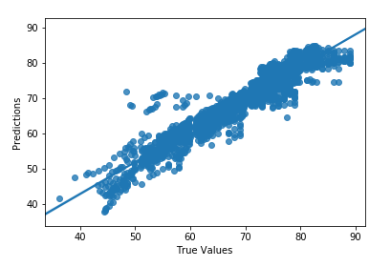
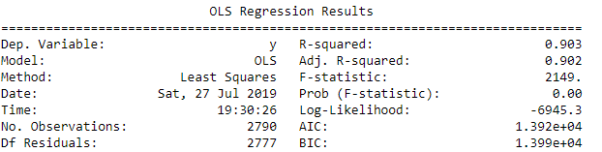
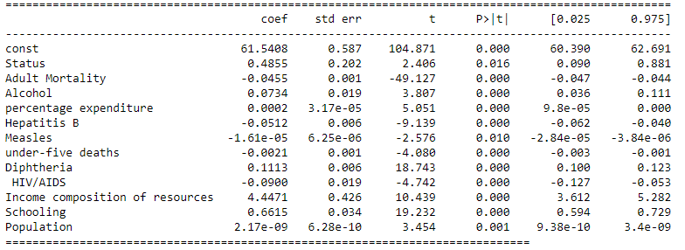
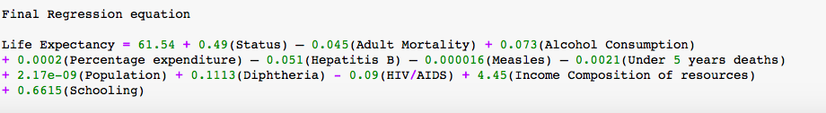
Backward Elimination II
Building regression model – Using Statsmodel

Slide 26
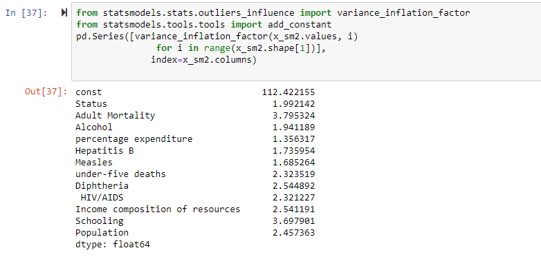
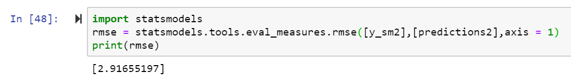
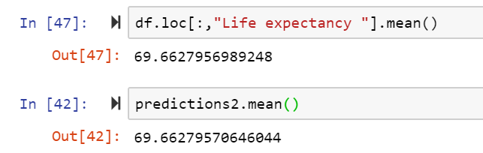
Model Validation
Observing VIF factors for all variables
RMSE of updated model, Comparison of average values

