Slide 1

AURA
Autonomous University Resource Allocator: green cloud resource optimization for smart university data centers
BCSE355L Cloud Architecture Design | Dr. Priya V | 2026-2027
Pranav Hasban (24BIT0537) Frontend | Prakul Jain (24BIT0548) Backend & Database | Agrani Anupam (24BIT0539) AI / ML
Notes:
Introduce AURA: an AI-driven resource allocator that forecasts university demand and switches cloud capacity on and off, scheduling flexible work into low-carbon hours. Introduce the three team members and their roles.

Slide 2
Static infrastructure is sized for a peak it rarely hits
University data centers run LMS, research computing and campus IoT on static, over-provisioned capacity
Demand follows the academic calendar: busy weekdays, quiet nights, weekends and holidays
Idle servers still draw a large share of their peak power, so unused capacity wastes energy and money
Existing green-cloud work targets enterprise and IoT workloads, not academic cycles
28%
average use of capacity sized for peak
CU-BEMS university building, Jul 2018 to Oct 2019: average load 250 kW against a peak of 892 kW (15-minute data).
Notes:
The core problem: capacity is provisioned for the peak and left on. In the real university building data we use, average load is 250 kW while the peak is 892 kW, so anything sized for the peak sits at about 28 percent use on average. Demand is also predictable: weekdays versus nights, weekends and public holidays. That predictability is what AURA exploits.

Slide 3





Objectives
AI-driven allocation
Less energy and carbon
Calendar-aware forecasts
Resource allocation framework for university data-center workloads
Reduce the energy use and carbon footprint of university cloud infrastructure on AWS
Predict academic demand cycles (semester start, exams, breaks) for proactive scaling
Carbon-aware scheduling
Live dashboards
SLA and scalability
Run flexible tasks when grid carbon intensity is low
Real-time monitoring of energy and cost savings
Stay scalable and meet SLAs while optimizing for sustainability
Notes:
The six objectives from our project proposal. The rest of the talk shows how each one maps onto what we built: the forecasting model covers 1 and 3, the scheduling simulation covers 2, 4 and 6, and the dashboard covers 5.

Slide 4
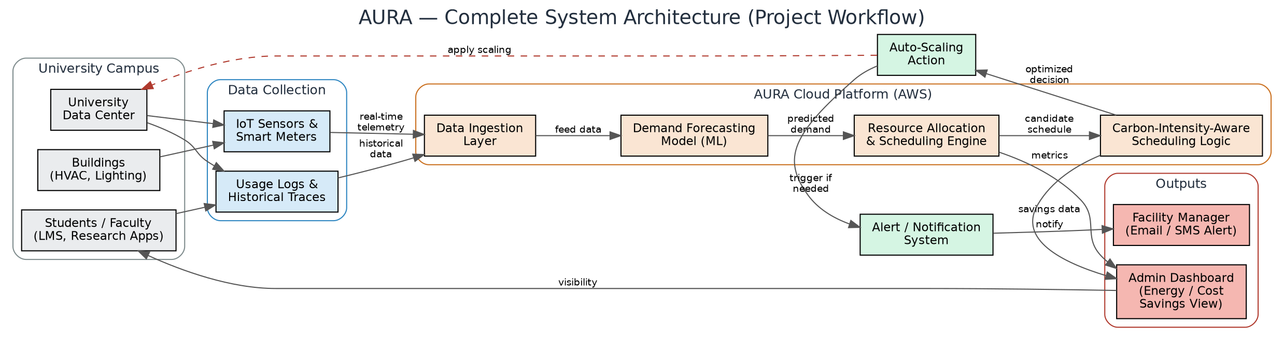
System architecture
Data ingestion
Auth & API
Processing & AI/ML
Storage, monitoring & UI
Sensors, meters and usage logs flow in through API Gateway
Cognito signs users in, IAM limits access, REST APIs connect the layers
LSTM forecast feeds the allocation engine and carbon-aware scheduler
S3 and DynamoDB store data, CloudWatch and SNS alert, React dashboard shows savings
Notes:
Four layers. Data from campus sensors and usage logs is ingested. Cognito and IAM handle identity, and REST APIs connect the pieces. The core is the demand forecasting model feeding a resource allocation engine and carbon-aware scheduling logic, which trigger scaling actions and alerts. Results are stored, monitored and shown on the admin dashboard. The AWS-specific version of this diagram is on the AWS services slide.

Slide 5

Data: a real university building and a real grid
CU-BEMS building energy
Grid carbon intensity
Chulalongkorn University, Bangkok; CC BY 4.0
14 CSVs, 788 MB: 7 floors, 1-minute AC, lighting and plug power plus temperature, humidity, light
After cleaning: 41,766 complete 15-minute steps (about 435 days, 2018-07-01 to 2019-10-22)
Gaps: Floor 6 ends 2019-10-22; Floor 3 is missing about 40 days; steps missing any floor are dropped
UK Carbon Intensity API (carbonintensity.org.uk); CC BY 4.0
3,481 hourly values, 2019-05-31 to 2019-10-23, matched to the building on UTC time
154 of 6,972 half-hours had no actual value and use the API's forecast
Real grid behaviour, but the UK grid, not Thailand's
Notes:
Two open datasets. CU-BEMS is real metered data from a university building in Bangkok, which shows exactly the academic weekday, weekend and holiday cycles we target. After cleaning we keep 41,766 fifteen-minute steps where all seven floors reported, about 435 days. Be upfront about the gaps: Floor 6 stops on 22 October 2019 and Floor 3 has a gap of about 40 days. For carbon we use the UK Carbon Intensity API because it is free and gives real hourly values; the caveat is that it is not Thailand's grid.

Slide 6



Preprocessing and features
1. Aggregate
2. Resample
3. Calendar
4. Weekly memory
Sum every kW meter per floor into total, AC, lighting and plug load
1-minute to 15-minute means; fill gaps up to 1 hour; drop steps where any floor is missing
Hourly series with cyclic hour and weekday, weekend flag, Thai public holiday flag
Load at the same hour last week, and whether that day was a holiday
Holiday flags matter: on the 14 Oct 2019 holiday the model forecast about 136 kW at 8 am (actual 91 kW), where "same hour last week" said 661 kW.
Notes:
Raw one-minute meter readings are summed per floor, averaged to 15 minutes, short gaps up to an hour are interpolated and any step where a floor is missing is dropped so that a dead meter never looks like low demand. For the model we resample to hourly and add cyclic time features, weekend and Thai public holiday flags, and last week's load at the same hour. Holiday flags were the single biggest improvement: on the 14 October holiday, the naive baseline expected a normal Monday peak of 661 kW, while our model forecast about 136 kW.

Slide 7
Forecast model: LSTM, 24 hours ahead
Past 7 days
168 hours x 8 features
LSTM 128
then LSTM 64
Dense 128
24 hourly
kW values
Next 24 hours (known)
24 hours x 8 features
Flatten
Past inputs: load, temperature, hour and weekday (cyclic), weekend, holiday
Future inputs: what is known in advance, including last week's same-hour load
Date-based split 70 / 15 / 15: train Jul 2018 to May 2019, validation Jun to 11 Aug 2019, test 11 Aug to 22 Oct 2019
Model size and lookback chosen on validation error only; test period scored once
Notes:
The model has two inputs. An LSTM encoder reads the last 7 days hour by hour. A second branch takes what is already known about the next 24 hours: time of day, weekday, holidays and last week's load at the same time. Both are combined in a dense layer that outputs 24 hourly values. We split by date so the model is never tested on the past, and we chose the model size and lookback using the validation period only. We tried 32, 64 and 128 units and 3, 7 and 14 day lookbacks; 128 units with 7 days was the best on validation.

Slide 8
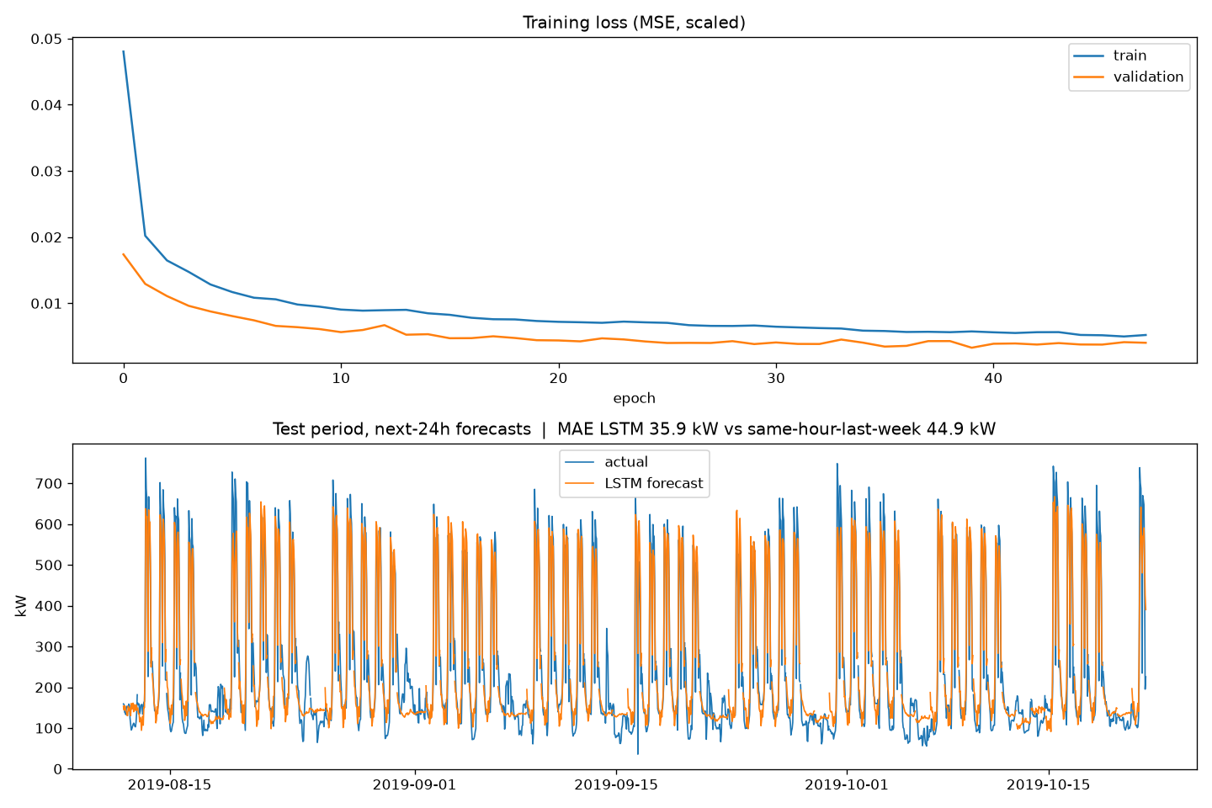
Forecast results: 20% lower error than the baseline
MAPE 20.5% vs 24.0%
A first version without holiday and future inputs scored MAE 46.8 kW, worse than the baseline. Adding those inputs fixed it.
Notes:
On the held-out test period the LSTM's average error is 35.9 kW against 44.9 kW for predicting the same hour last week, 20 percent lower, and its RMSE is 42 percent lower, which means far fewer large misses. Be honest that our first version, without holiday and future inputs, scored 46.8 kW and lost to the baseline; the improvement came from features, not a bigger network. The plot shows the training curve and day-by-day test forecasts against actual load.

Slide 9


Allocation and carbon-aware scheduling
1 Forecast
2 Right-size
Every midnight, forecast the next 24 hours of campus demand
Keep forecast demand + 25% + 4 spare servers on, out of 48
3 Shift
4 React
Move the deferrable 20% of the day's work into the cleanest grid hours with room
Serve interactive work first; if demand beats the forecast, scale up and log an SLA miss
Notes:
This is the AURA policy, simulated hour by hour over the test period. Each midnight the model forecasts the next day. We keep just enough servers on for the forecast plus a safety margin of 25 percent and 4 spare servers. Twenty percent of each day's work, such as backups and research batch jobs, can wait, so it is placed in the hours when the grid is cleanest. At run time interactive users always come first; if real demand beats the forecast we scale up and count that hour as an SLA miss. The baseline keeps all 48 servers on all the time.

Slide 10
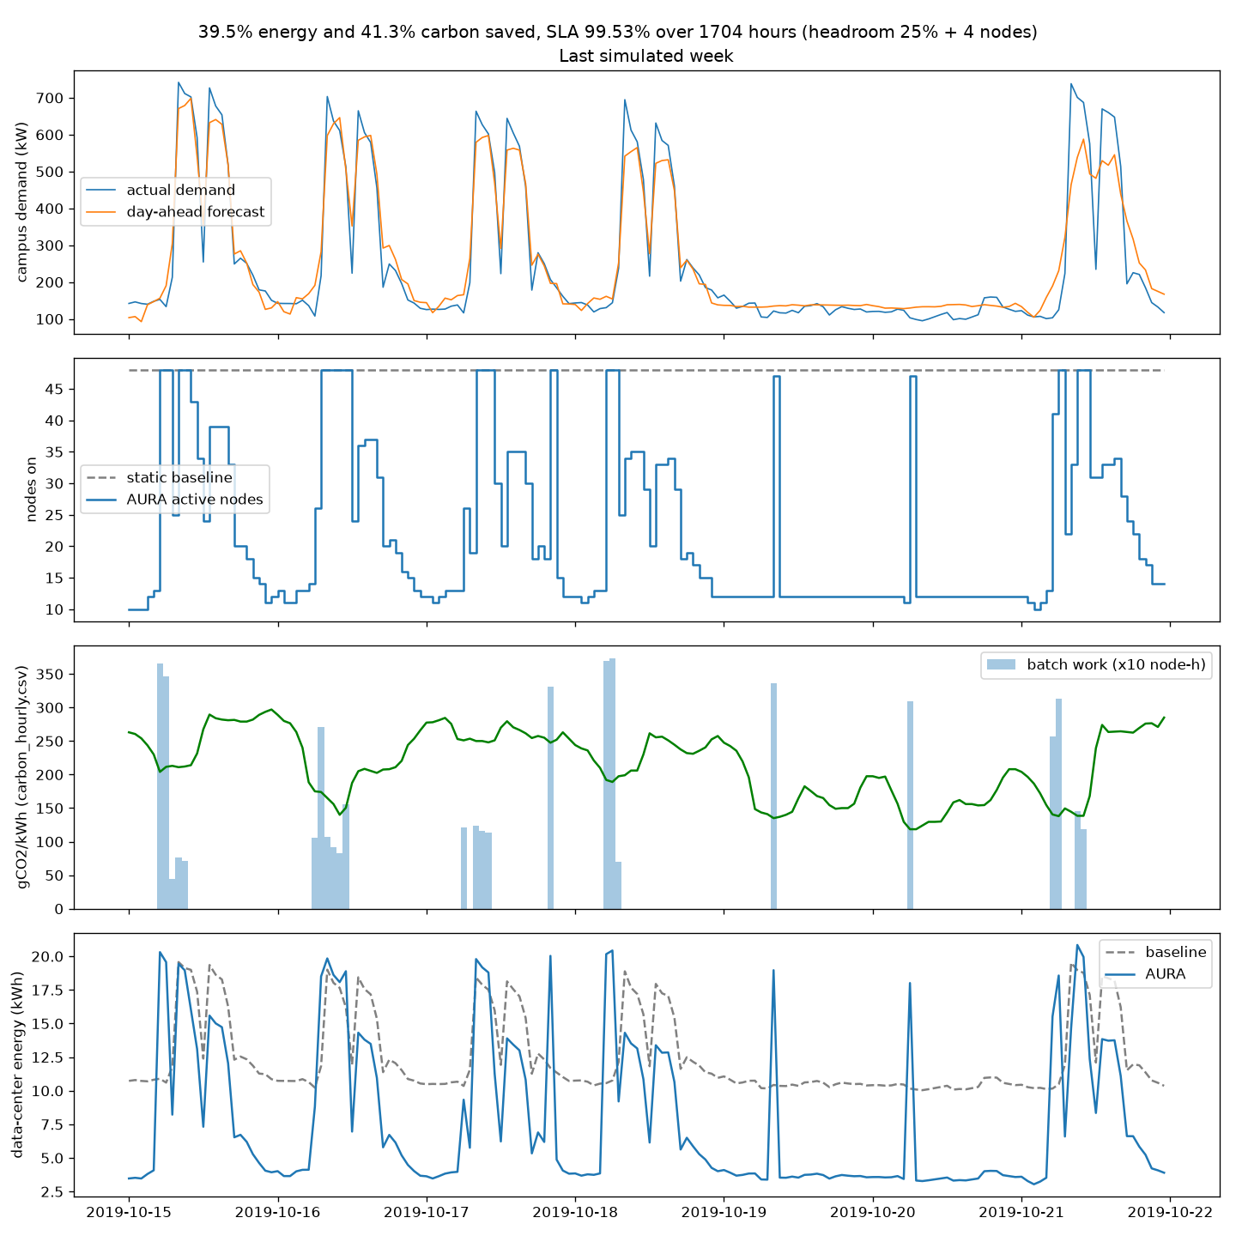
Simulated savings vs always-on servers
39.5%
41.3%
less energy
less CO2
12,674 vs 20,955 kWh
1,589 kg avoided
$993.71
99.53%
cost saved
SLA met
at $0.12 per kWh
hours with enough capacity
Test period: 1,704 hours, 12 Aug to 21 Oct 2019. Carbon-aware shifting adds 2.3 of the 41.3 points (39.0% without it).
Notes:
Over the 1,704 hours of the test period, AURA used 39.5 percent less data-center energy than always-on servers: 12,674 against 20,955 kilowatt-hours. Emissions fall 41.3 percent, or 1,589 kilograms of CO2, and the cost saving is 993 dollars 71 at 12 cents per kilowatt-hour. 99.53 percent of hours had enough capacity. The carbon-aware part contributes 2.3 points: with batch shifting switched off, carbon falls 39.0 percent instead of 41.3. The plot shows the last simulated week: demand against forecast, servers on, batch work landing in low-carbon hours, and energy against the baseline.

Slide 11
Assumptions, and what these numbers are not
This is a simulation, not a measurement on real servers
Building kW stands in for server demand: the 48-server fleet is sized so the training-period peak fills it
Each server: 0.12 kW idle, 0.30 kW at full load (idle is 40% of peak); PUE 1.5 for cooling
20% of each day's work is deferrable; electricity at $0.12 per kWh
Carbon is real UK grid data, while the building is in Bangkok
Headroom chosen on validation (Jun to Aug 2019), then frozen
Headroom + spare | Energy saved | SLA
15% + 2 | 42.5% | 97.24%
15% + 4 | 39.7% | 99.46%
25% + 4 (chosen) | 38.0% | 99.87%
25% + 6 | 35.2% | 99.93%
50% + 8 | 28.4% | 100%
Rule: highest saving with SLA of at least 99.5%. The test period was then run once.
Notes:
Be clear about the limits. This is a simulation: the building's electrical load stands in for server demand, and the fleet size, idle power, PUE and deferrable share are assumptions we chose, not measurements. The carbon data is real but from the UK grid. The safety margin was chosen on the validation period, June to August 2019, with the rule: highest saving that keeps SLA at or above 99.5 percent. That picked 25 percent plus 4 spare servers, which we froze before running the test period once.

Slide 12
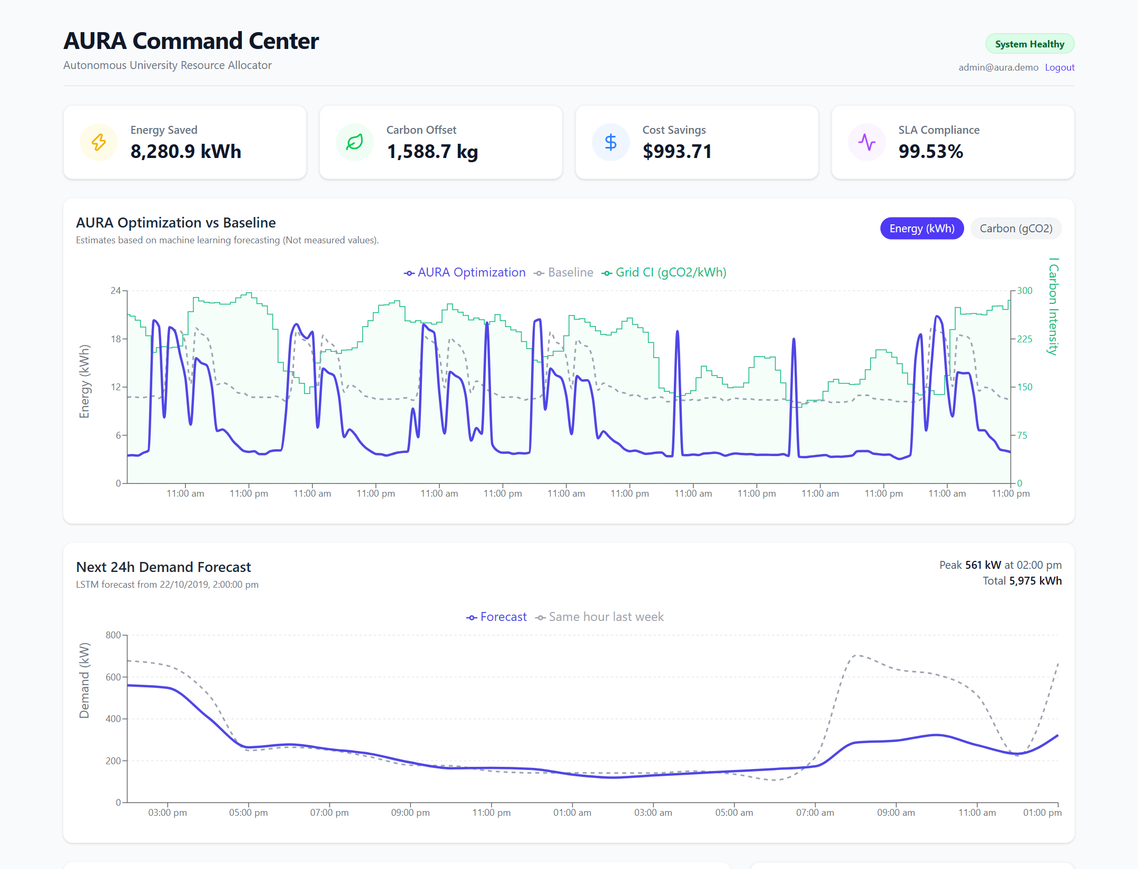
Backend API and live dashboard
Express REST API
GET /api/metrics/energy, /metrics/savings, /allocations, /alerts, /forecast
Cognito ID tokens verified on every /api call
DynamoDB table AURA: partition key type, sort key id
Seed script loads simulation results; 7 automated tests
React dashboard
Savings KPIs, AURA vs baseline, 24-hour forecast, alerts and server table, all from the API
Notes:
The backend is a Node.js Express API with five endpoints. It verifies Cognito tokens and reads from a single DynamoDB table called AURA, keyed by record type and id; locally it reads the simulation's JSON files. The screenshot is the real dashboard running against this API: the savings cards, the AURA versus baseline chart with grid carbon intensity, and the next-24-hour forecast. Note the forecast for 23 October predicts a quiet morning: that is Chulalongkorn Day, a Thai public holiday.

Slide 13
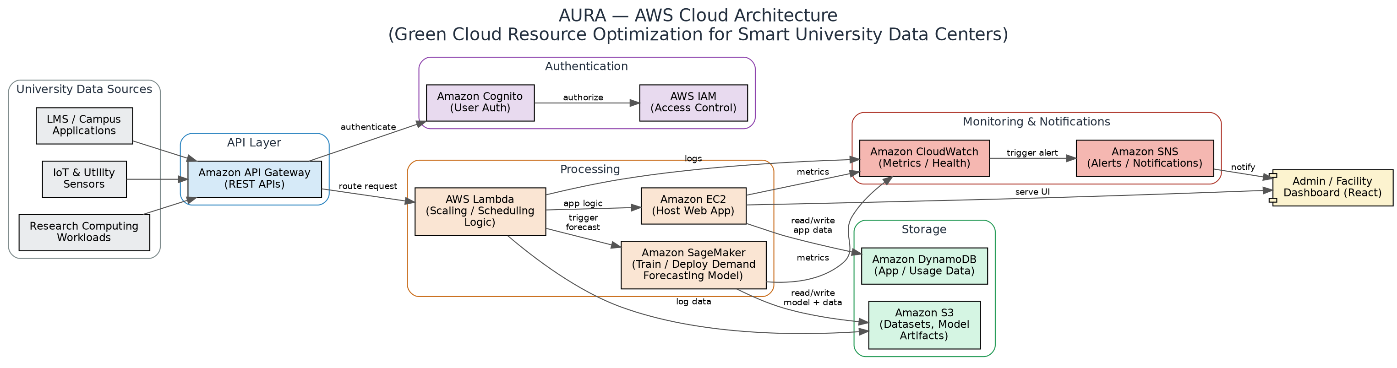





AWS services: one CloudFormation stack
DynamoDB
Cognito
SNS + Lambda
CloudWatch
S3
EC2
AURA table with a stream
User pool and dashboard client
Emails warning and critical alerts
Alarm on alert Lambda errors
Hosts the dashboard website
Runs the API under systemd
Status: the template passes cfn-lint but has NOT been deployed to a real AWS account yet.
Notes:
The planned AWS architecture is on top. What we have written as infrastructure code is the CloudFormation stack: DynamoDB with a stream, a Cognito user pool, SNS with a Lambda that emails warning and critical alerts, a CloudWatch alarm, an S3 website bucket for the dashboard, and an EC2 instance running the API. Be explicit: the template passes cfn-lint but has not been deployed to a real account yet. API Gateway and SageMaker from the diagram are not in the stack yet.

Slide 14



Limitations and future work
Real data-center traces
Local grid data
Replace the building-load proxy with VM or server utilization from a campus data center
Use Thailand's (or India's) hourly grid carbon intensity instead of the UK grid
HTTPS everywhere
SageMaker endpoint
CloudFront for the dashboard; ALB or API Gateway for the API (today both are plain HTTP)
Host the model and run the scheduler on a schedule with EventBridge and Lambda
Live deployment
Academic calendar
Deploy the stack, connect real meters, and measure savings rather than simulate them
Add semester, exam and break dates as features alongside public holidays
Notes:
The main limitation is that savings are simulated on a proxy: building load standing in for server demand, with UK carbon data. Next steps are real data-center traces, local grid carbon data, HTTPS for both the dashboard and the API, hosting the model on SageMaker with a scheduled Lambda, an actual deployment that measures savings, and the academic calendar itself as a feature.

Slide 15
Thank you
Questions welcome
Pranav Hasban
24BIT0537
Frontend: React dashboard, Cognito sign-in, live API integration
Prakul Jain
24BIT0548
Backend & database: REST API, DynamoDB, authentication
Agrani Anupam
24BIT0539
AI / ML: dataset, preprocessing, demand-forecasting model
Data: CU-BEMS (Chulalongkorn University, CC BY 4.0); Carbon Intensity API (National Grid ESO, CC BY 4.0)
Notes:
Close by crediting each team member's area as in our work distribution, and the two open datasets we relied on. Then take questions.

