Slide 1


DISSERTATION
Computational Studies in Identifying Potential Inhibitors of Pantothenate Synthetase including Machine learning and Molecular Docking approaches.
Presented by – Agrani Sinha (14501009)
Mentor – Dr. Imran Siddqi
Supervised by - Dr. Sudha Srivastava

Slide 2
INTRODUCTION

Slide 3
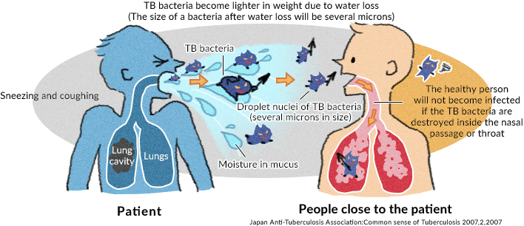
Tuberculosis: An overview
Tuberculosis or TB, as it’s commonly called is a contagious infection that usually attacks your lungs. It can spread to other parts of your body, like your Brain and Spine. A type of bacteria called Mycobacterium tuberculosis causes it.
Types of TB:
Latent TB
Active TB
In terms of resistance to the drugs it is of two types:
MDR (Multidrug Resistance)
XDR (Extensively Drug Resistance)

Slide 4
Scenario in India of Tuberculosis a Disease of concern along with Covid – 19
India has the highest burden of Tuberculosis in the world.
Even as the government was pushing to end TB by 2025, the COVID-19 pandemic has caused a massive disruption in TB services.
TB case notifications across India have dropped by over 50% since March, with an estimated 3,00,000 missed case notifications (until May 30).
Dual Testing:
India has access to existing technologies that permit dual testing for both infections.
Digital chest x-ray (CXR)
Truenat MTB
The Private Provider Interface Agency (PPIA) model has been launched in Mumbai by the Government of India, WHO and PATH and the subsequent large scale, pan-India version of it is called the JEET (Joint Effort for Elimination of Tuberculosis) project.
To detect the missed thousands of TB patients, we need to leverage our best technologies and find ways to integrate testing for both respiratory infections. We need to integrate our public and private health sectors. India needs all hands on the deck, to battle an existing as well as a new killer disease.

Slide 5
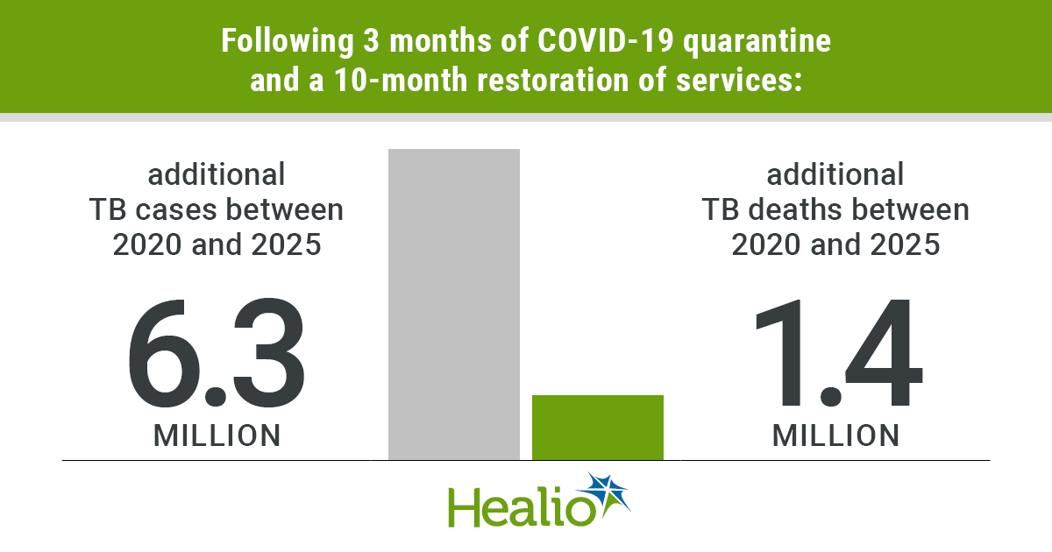
Current Statistical Model of TB around the world
A new analysis from the Stop TB Partnership demonstrates that the global response to COVID-19 could lead to more than 6 million additional cases of tuberculosis and 1.4 million additional deaths from the disease between 2020 and 2025.
The model based on the 3-month lockdown and the 10-month restoration of services could increase the incidence rates of TB, and deaths from the disease, to levels last seen between 2013 and 2016, respectively — representing a setback of at least 5 to 8 years in the fight against TB.
"COVID-19 will set fight against TB back at least 5 years", Healio.com, 2020. [Online]. Available: https://www.healio.com/news/infectious-disease/20200506/covid19-will-set-fight-against-tb-back-at-least-5-years

Slide 6
MATERIALS AND METHODS

Slide 7
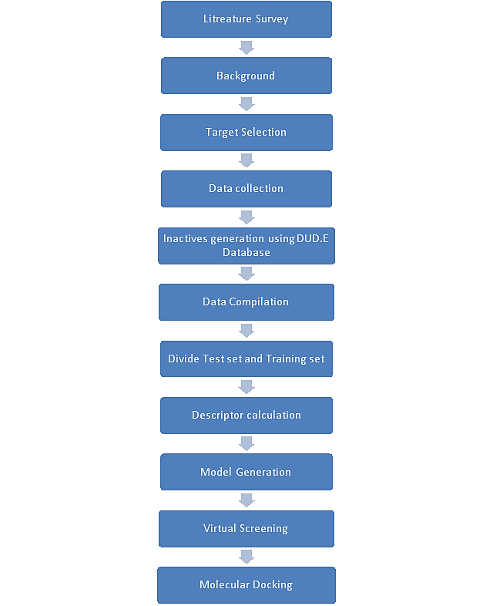
Computational approach in finding the inhibitors

Slide 8
Potential drug target – Pantothenate Synthetase
The lipid rich cell wall of Mtb is an important component for its survival and pathogenicity.
The cell wall contains vast number of genes which encodes enzymes essential in fatty acid metabolism which leads to biosynthesis of lipids providing primary source of energy for the bacteria during infection.
One of the most prior genes is panC gene encoding the enzyme Pantothenate Synthetase which further leads to the production of Pantothenate (Vitamin B5 precursor) in Bacteria.
Pantothenate biosynthesis then further leads to the production of CoA and Acyl carrier protein (ACP) which is an important component of fatty acid synthesis.
It is mainly important for the survival of the bacteria but not to cause disease.
PanC being absent in humans they intake vitamin B5 through supplementary or through their diet.
Pantothenate permease (PanF) is present in most of the bacteria but absent in Mycobacterium tuberculosis which scavenges pantothenate from the host when the bacteria have genetically disrupted PanC gene and becomes auxotroph requiring pantothenate supplementation for their growth.
Therefore, we can say that there is no cross-reaction leading to toxicity in the host and thus makes panC an attractive drug target in Mtb.

Slide 9
Databases and Softwares used in the process
Protein and inhibitor database
Uniprot
ChEMBL
Data Preprocessing
Descriptor Calculation
Model Building
MATLAB
Virtual Screening
Maybridge Library
Molecular Docking
Schrodinger Maestro
DUD.E database
MS-Excel
PaDEL Descriptor

Slide 10
RESULT AND CONCLUSION

Slide 11
Results – Dataset Generation
Database Collection and Refinement
126 inhibitors were collected from the database
Refined the data by -
Inactive generation
Explored DUD.E database
240 inactives generated
Complete dataset
Descriptors – MACCS fingerprint
Dataset -
Inactives > 500,000 nm
79 actives and 3 inactives obtained
Actives – 64
Inactives – 192
20 % Test set -
Actives – 15
Inactives - 47
80% Training set -
Actives < 10,000 nm

Slide 12
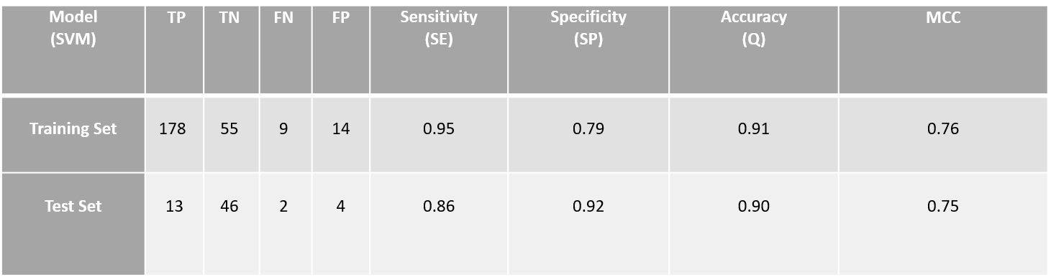

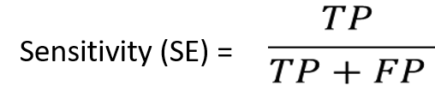
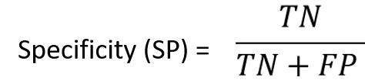
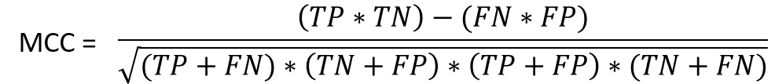
Results – Model Building

Slide 13
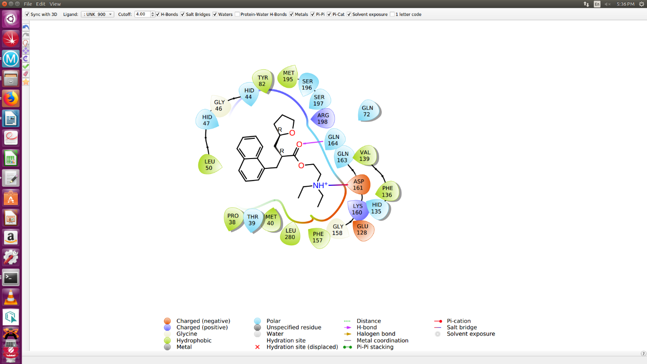
Results – Molecular Docking
Sr.no. | Compounds | Docking Score | Sites of Interaction (H-Bond) | Sites of Interaction (Salt Bridge)
1) | Control (Nafronyl Oxalate) | -6.160 | His44, His47, Asn69, Glu72, Lys160, Glu164 | Asp161
2) | RJC02360 | -10.364 | Gly158, Gln164, Thr39, Gln72, Ser197, Hid44 | -
3) | AW0555 | -9.580 | Ser197, Lys160, Gln72, Gln164 | Asp161
4) | AW00907 | -9.387 | Gln72, Lys160, Ser197 | Asp161
5) | NRB04426 | -9.257 | Val187, Lys160, Arg198, Gln128, Pro38 | -
6) | NRB05197 | -8.772 | Lys160, Hid44, Ser197 | -
7) | BTB12004 | -8.221 | Glu164, Asp161, Gly158, Glu72 | -
8) | NRB04549 | -8.026 | Lys160, Asp161, Hid135, Glu72 | -
9) | BTB13902 | -7.532 | Hid47, Arg198, Glu128 | -
10) | BTB14725 | -7.059 | Ser196, Gly158, Lys160 | -
11) | RJC01776 | -5.443 | Hid44, Gly158, Met40, Arg198, Glu128, Gly74, Asp78 | -
Ligand protein Interaction of the control

Slide 14
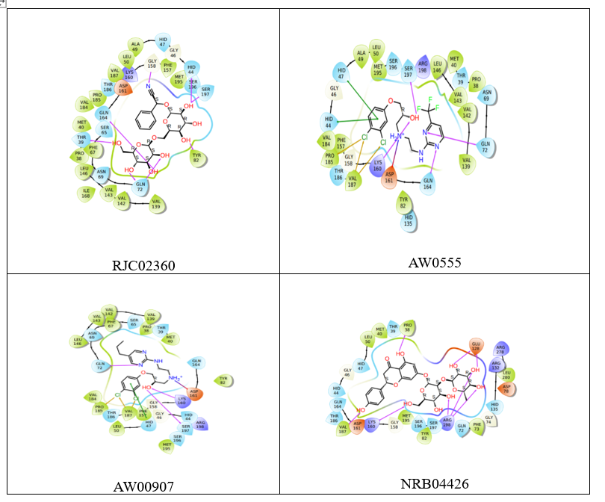
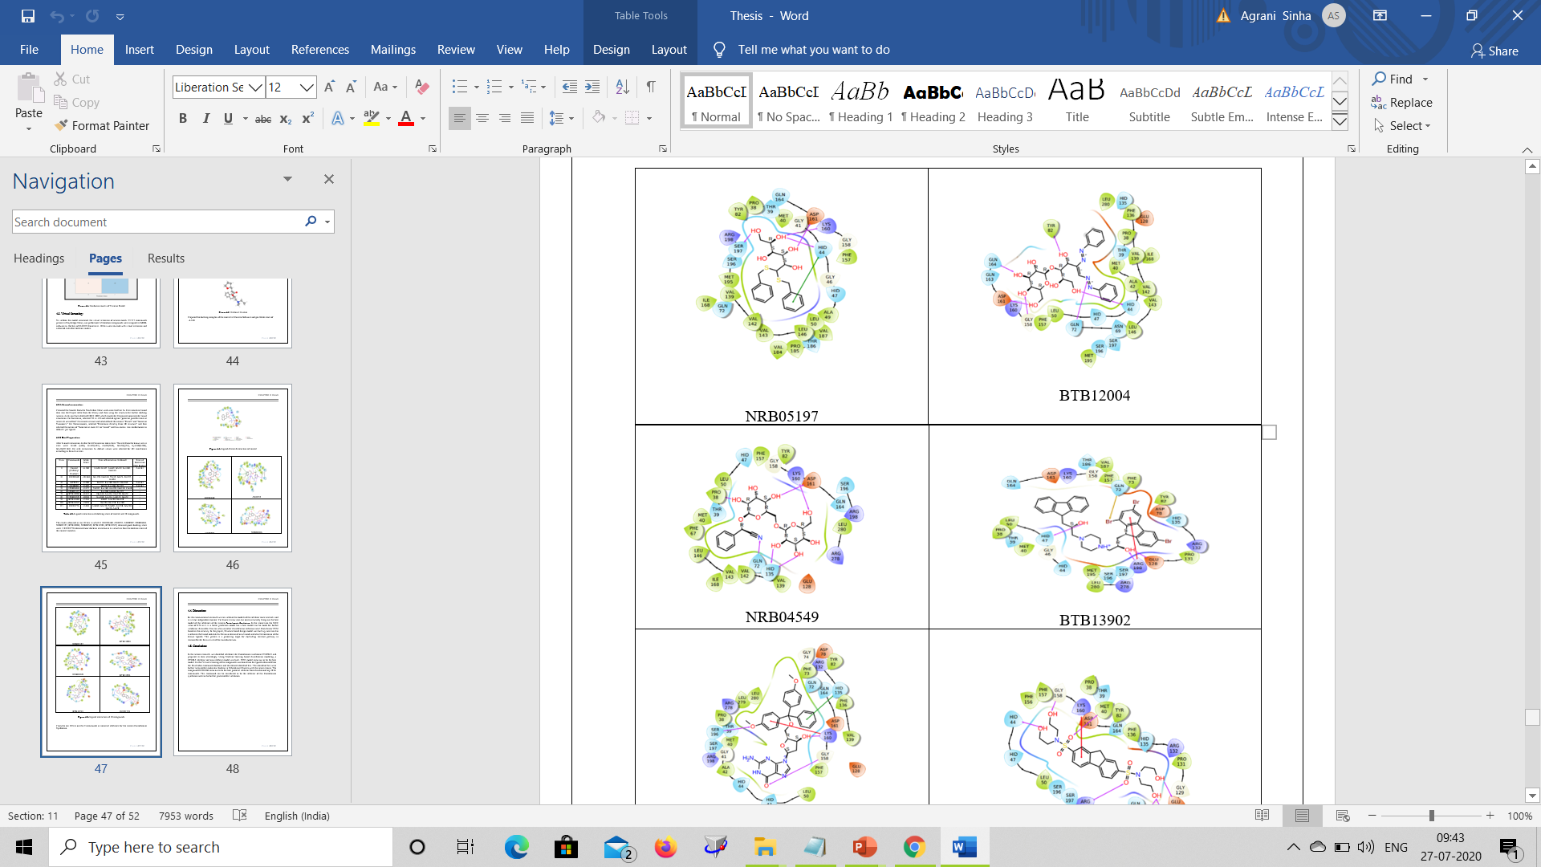
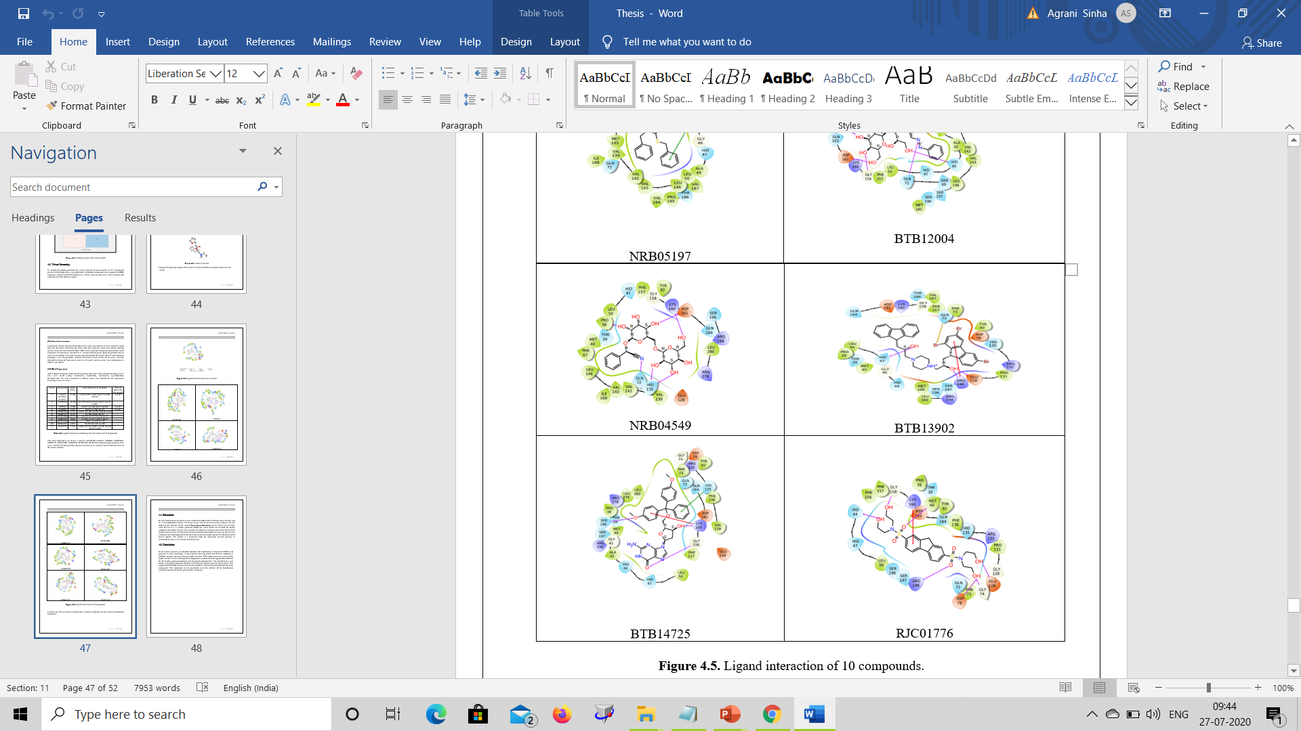
Ligand Interaction of 10 compounds

Slide 15
Conclusion
In the present research, we identified inhibitors for Pantothenate synthetase (P9WIL5) and prepared its data accordingly. Using Machine learning based classification modeling, a P9WIL5 inhibitor and non-inhibitor model was built.
SVM model came out to be the best model.
Further Virtual screening of the compounds was done from the ligands obtained from the Maybridge compound database and developed identified hits.
The identified hits were further prepared for molecular docking in Schrodinger Maestro with the target protein.
The compound RJC02360 came out to be the best potential inhibitor from the obtained top 10 hit compounds.
This compound can be considered to be the inhibitor of the Pantothenate synthetase and can be further processed for validation.

Slide 16
REFERENCES

Slide 17
References
"COVID-19 will set fight against TB back at least 5 years", Healio.com, 2020. [Online]. Available: https://www.healio.com/news/infectious-disease/20200506/covid19-will-set-fight-against-tb-back-at-least-5-years.
"Infectious diseases", World Health Organization, 2020. [Online]. Available: https://www.who.int/topics/infectious diseases/en/.
"Tuberculosis: Department of Health", Health.ri.gov, 2020. [Online]. Available: https://health.ri.gov/diseases/tuberculosis/?parm=102.
"Data & Statistics | TB | CDC", Cdc.gov, 2020. [Online]. Available: https://www.cdc.gov/tb/statistics/default.htm.
"Signs & Symptoms | Basic TB Facts | TB | CDC", Cdc.gov, 2020. [Online]. Available: https://www.cdc.gov/tb/topic/basics/signsandsymptoms.htm.
"Global Tuberculosis Report 2019", Who.int, 2020. [Online]. Available: https://www.who.int/tb/global-report-2019.

Slide 18
JoAnne L. Flynn, "New Way to Deliver Old Tuberculosis Vaccine Provides 'Incredible Protection' in Monkeys", ScienceAlert, 2020. [Online]. Available: https://www.sciencealert.com/a-new-tuberculosis-vaccine-delivery-method-just-proved-more-powerful-in-monkeys.
"History | World TB Day | TB | CDC", Cdc.gov, 2020. [Online]. Available: https://www.cdc.gov/tb/worldtbday/history.htm.
R. Ellis et al., "Innovative clinical trial designs to rationalize TB vaccine development", Tuberculosis, vol. 95, no. 3, pp. 352-357, 2015. Available: 10.1016/j.tube.2015.02.036.
Treatment for TB Disease | Treatment | TB | CDC", Cdc.gov, 2020. [Online]. Available: https://www.cdc.gov/tb/topic/treatment/tbdisease.htm
"Tuberculosis Drugs and Mechanisms of Action", Niaid.nih.gov, 2020. [Online]. Available: https://www.niaid.nih.gov/diseases-conditions/tbdrugs.
"Life Cycle of Organism - Study of Tuberculosis", Sites.google.com, 2020. [Online]. Available: https://sites.google.com/site/mycobacteriumtbstudy/home/life-cycle-of-organism.
G. Schneider and U. Fechner, "Computer-based de novo design of drug-like molecules", Nature Reviews Drug Discovery, vol. 4, no. 8, pp. 649-663, 2005. Available: 10.1038/nrd1799.

