Slide 1
'Mapping of shipment info from shipment documents​

Slide 2
Team
Paypal Mentor Manikkam Pandian
Faculty Coordinator Karthik.R
Students-
Shantanu Singh
Agryanya Pratap Singh
Tejpala
M.Siva Tharasen

Slide 3

Introduction
Our Module Basically extracts the Barcode details from an Input image check if is valid and returns the barcode

Slide 4
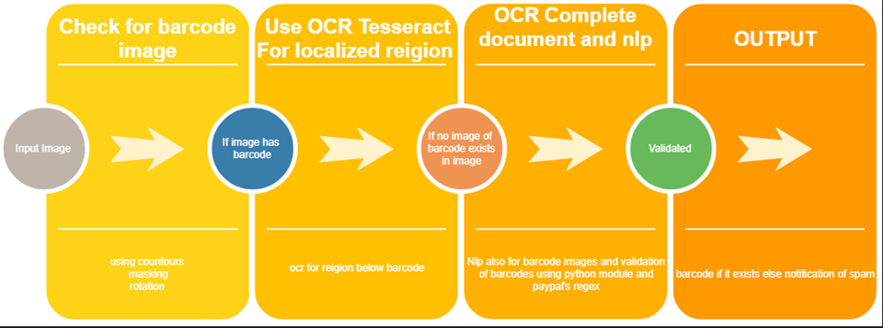
Process Step by Step

Slide 5
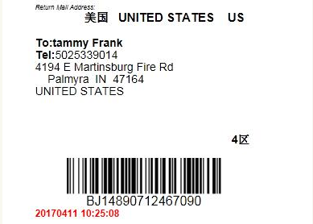
Resizing of Image
Input Image

Slide 6


Slide 7
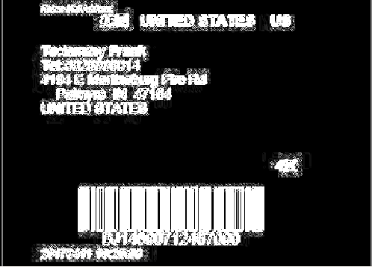
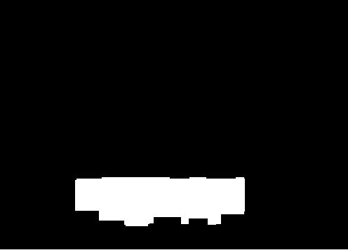
Thresholding and Masking of Images with Barcode
Post thresholding, erosion and dilation operations
Gradient representation

Slide 8
Cropping Approach:
Boxes of dimensions-
i. Covering only barcode
ii. Region surrounding barcode
drawn on masks
Bitwise AND operation to merge masks with image
NumPy functions where(), min(), max() to find non masked region
NumPy array slicing to crop

Slide 9
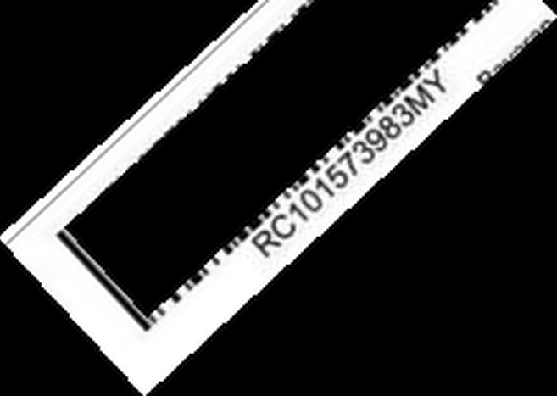
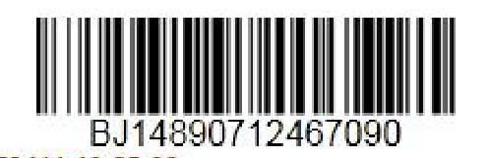
Extracted Barcode And Mask
Barcode with surrounding region cropped
Barcode masked

Slide 10

Final Output of image with Barcode
Input
Output

Slide 11
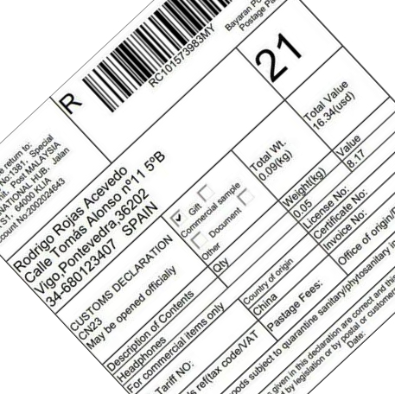

Rotated image
Input
Output

Slide 12
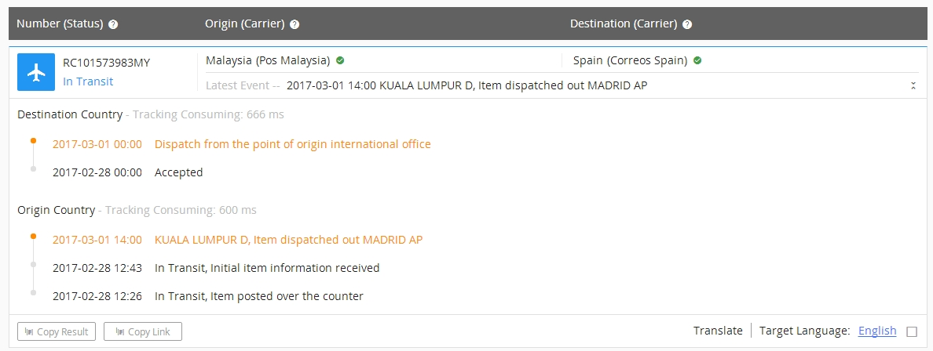
Images Without Barcode

Slide 13
Images Without Barcode
We Resize the Image in same manner as we did in images with barcodes.then we do OCR of resized image and Apply Basic Natural Language Processing
Extract all probable words and validate using the Regular Expressions and python module tracking_url

Slide 14
Stages in NLP and Validation
Post NLP
Post Validation

Slide 15
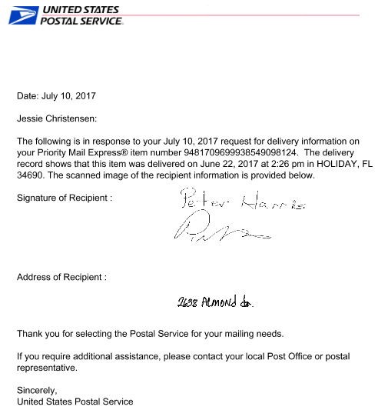
Final Output of Sample Images
Input
Output

Slide 16
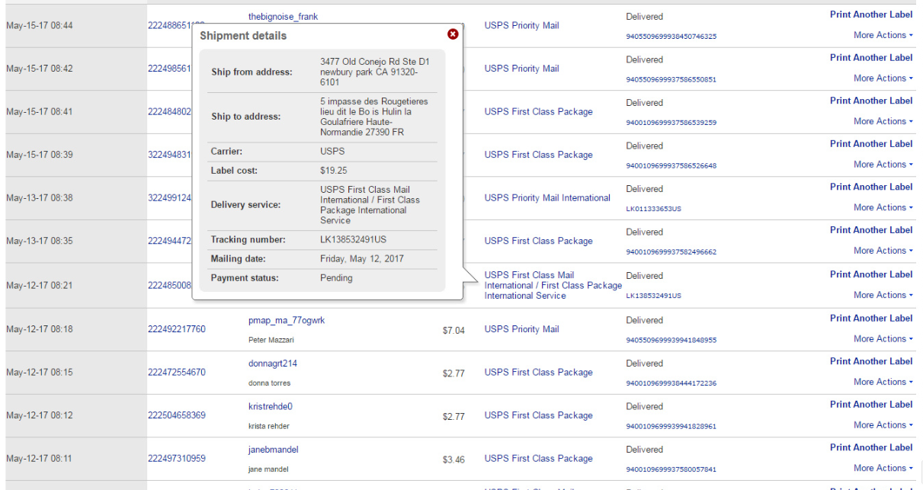
Multiple Tracking IDs

Slide 17
Output

Slide 18
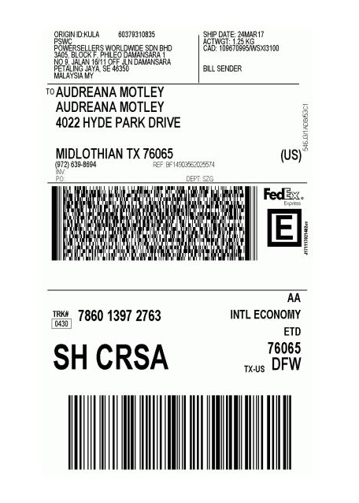
Critical Analysis

Slide 19

Critical Analysis
Output
It gives an output of this kind though there is no
Such tracking id in the image this happens because of the very small text at the top of the image which has been wrongly read by ocr as it got confused due small text of tracking id form present at the top and also because the barcode has spaces in between

Slide 20
Conclusion
Our module works for almost all types of images with or without barcode and extracts tracking id from it
Except for cases where there is spaces in barcode or the image has too many texts which are all valid tracking id in our validation system but in actual are not the tracking id for that document

