Slide 1
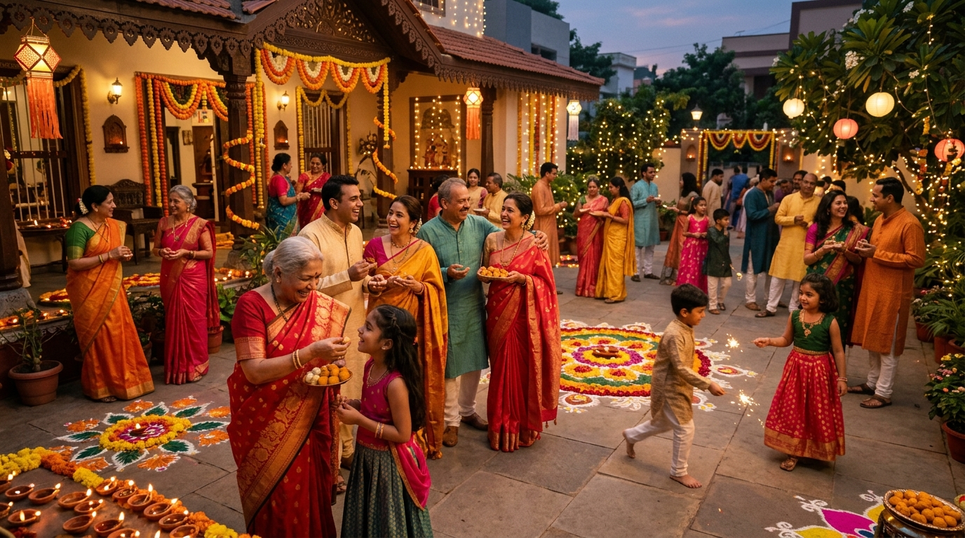
AI PRESENTATION TOOLS • TOPIC 3
The Heartbeat of Togetherness
How Indian Festivals Unite Families & Communities
Festivals in India transcend simple calendar holidays. They serve as a powerful cultural catalyst—bridging generational gaps, reviving ancestral ties, and turning diverse neighborhoods into tightly-knit families through shared feasts, rituals, and collective joy.
Curated AI Multimedia Deck | 10-Second Introductory Showcase
Notes:
Slide 1 Speaker Notes:
Welcome everyone. Today we are presenting an AI-generated multimedia exploration into why festivals in India are central to building social cohesion and family unity. Using generative AI tools, we explore the visual, acoustic, and cultural dimensions of these vibrant celebrations.

Slide 2
AI Video & Audio Generation Showcase
Topic 2 Deliverable: 10-Second Introductory Multimedia Clip & Neural Voiceovers
10-SECOND INTRODUCTORY SCRIPT
“Across India, festivals bring families together across generations, uniting neighborhoods and communities in shared love, light, and celebration.”
Narration Specs:
• Exact Runtime: 10.27 Seconds (18 words at 1.8 wps)
• Voice Model 1: Azure Neural Neerja (Expressive Indian English)
• Voice Model 2: Azure Neural Prabhat (Dignified Narrative)
• Resolution: 1080p Full HD • 30 FPS • H.264/AAC
Generated Media Links & Access:
▶ Interactive Video Player: festival_video_preview.html (Browser player with live subtitles)
🎬 10-Second Video Clip: indian_festivals_intro_10s.mp4 (Full HD MP4)
🎙 AI Voiceover (Female): indian_festivals_voiceover_female.mp3
🎙 AI Voiceover (Male): indian_festivals_voiceover_male.mp3
Notes:
Slide 2 Speaker Notes:
Here we showcase the exact multimedia generated for Topic 2. The 10-second clip was created by combining photorealistic AI visual generation with Azure Neural Text-to-Speech tuned to an expressive Indian English dialect. The script is concisely crafted at 18 words to deliver high impact within the 10-second window.

Slide 3
Why Indian Festivals Unify Families & Society
Three Core Cultural Pillars of Collective Belonging and Harmony
1. Intergenerational Gathering
Reconnecting Across Distances
In modern India, career and education scatter families across cities. Festivals like Diwali, Eid, and Pongal act as an unbreakable calendar anchor, drawing children, parents, and grandparents back to ancestral homes for shared rituals.
2. Shared Feasting & Preparation
Kitchens Without Boundaries
The multi-day preparation of sweets (mithai, sewaiyan, modaks) and community langars turns cooking into a collaborative act. Sharing food across doorsteps dissolves socio-economic divides into neighborly warmth.
3. Collective Street Solidarity
Public Spaces as One Family
From vibrant Garba circles to street carnivals and illuminated alleys, private celebrations spill into shared public spaces. It offers a cultural reset button—renewing trust, forgiveness, and mutual harmony.
Notes:
Slide 3 Speaker Notes:
In our final slide, we analyze the sociological importance of these festivals. First, intergenerational bonding: reuniting families dispersed by urbanization. Second, communal kitchens and shared feasting, which dismantle barriers. And third, public street solidarity, which transforms individual neighborhoods into a unified collective.

