Slide 1
AGGIE HACK 2026 · FAIRLIGHT ADVISORS
Nonprofit Financial
Resilience Analytics
By: Aditya Agrawal, Rishabh Bhat, Viraj Gandhi
A data-driven platform for Fairlight Advisors to assess, benchmark,
and stress-test 130K+ U.S. nonprofits using IRS Form 990 data.
RAV · 2026

Slide 2
The Problem
?
~
!
Where to donate?
Am I healthy?
Who needs help?
Funders guess where to allocate
philanthropic capital without data.
Nonprofit leaders can't benchmark
themselves against true peers.
Capacity builders like Fairlight
advise clients without data.
400K+ Form 990s filed. The data is public. The decisions to invest remain guesswork.

Slide 3
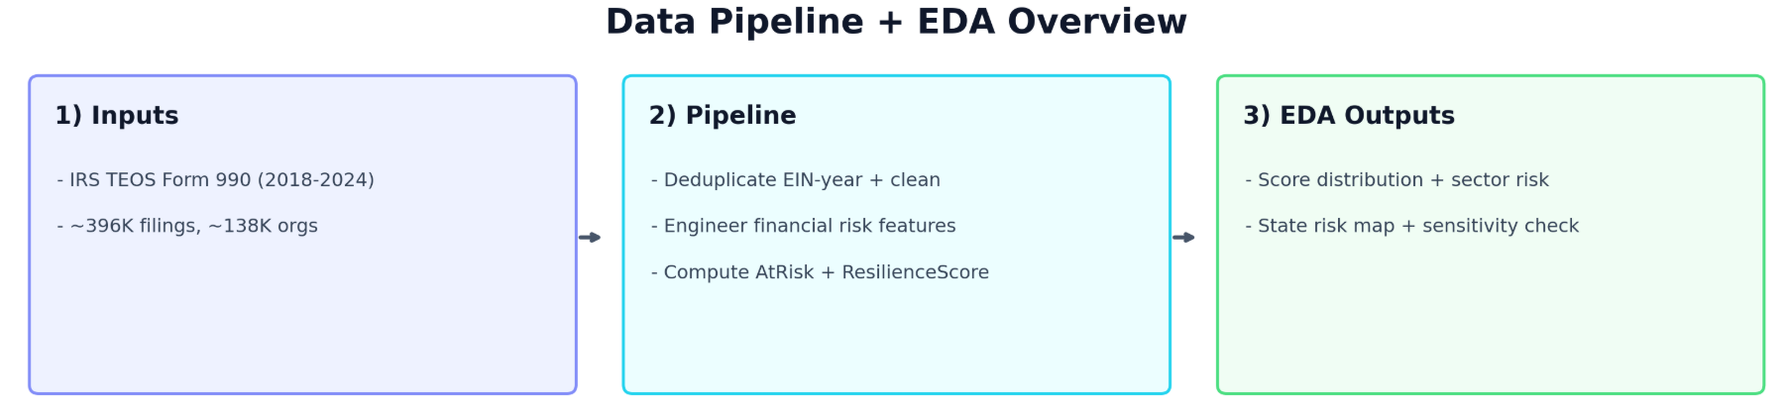
The Data We Started With
Not a sample — the whole sector.
396,910
137,938
7
59
Total filings
Unique organizations
Tax years (2018–2024)
States & territories
Why data quality mattered:
IRS batch deduplication · Negative expense correction · NTEE fallback via mission text
[ Insert: data pipeline / EDA overview screenshot ]

Slide 4
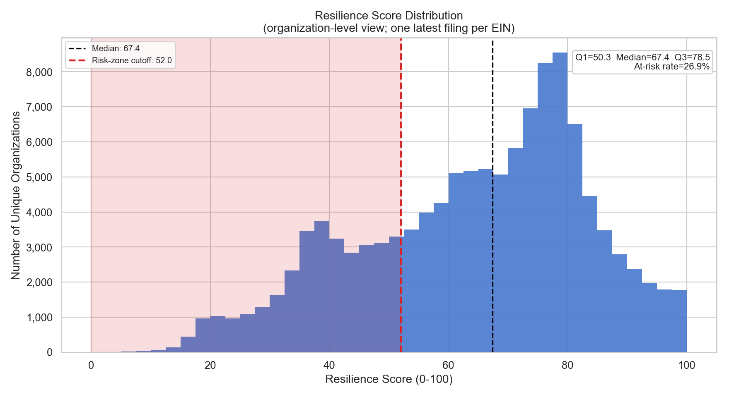
EDA Finding #1
The Sector Is More Fragile Than It Looks
26.9%
[ Insert: Resilience Score distribution histogram ]
At-risk rate across the
130,000 organizations
The shape of the curve was the first signal this problem was worth solving at scale.

Slide 5
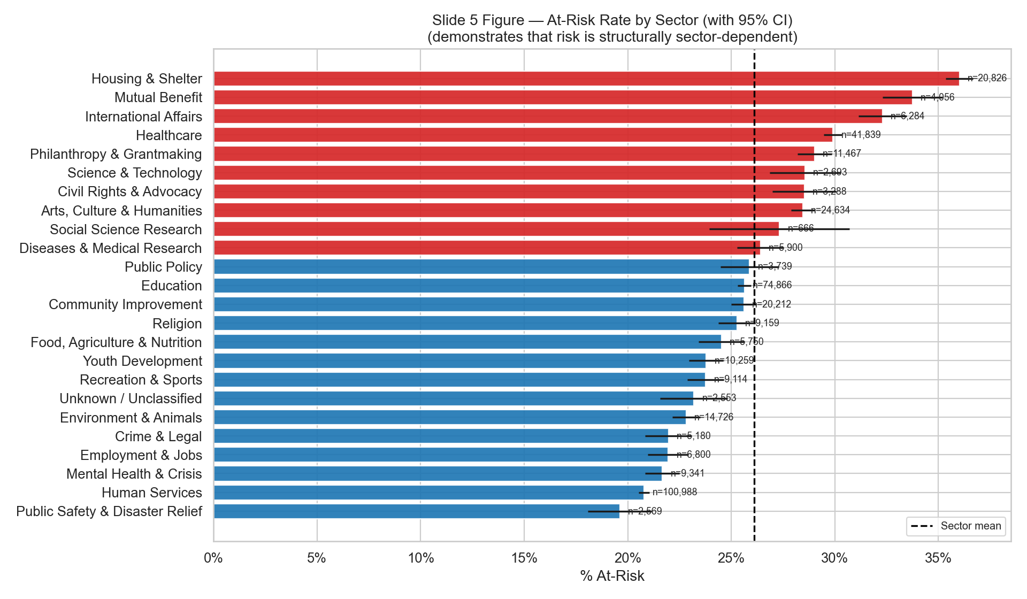
EDA Finding #2
Risk Isn't Random
Housing & Shelter, Mutual Benefit, and International Affairs, consistently score lowest
[ Insert: State choropleth map ]

Slide 6
EDA Finding #3
The Wrong Intuition About Failure
Intuition said low program spending = at risk. The model disagreed.
Debt Ratio
17.6%
Contribution Growth
13.3%
Log Assets
11.8%
Log Revenue
10.2%
Reserve Months
9.4%
Debt load and fundraising momentum predict failure more than mission efficiency. Size matters too.

Slide 7
What We Built From These Findings
The Resilience Score
Component | Weight | Why — grounded in EDA findings
Operating Reserves | 30 pts | Top stability signal — directly counters low-reserve at-risk definition
Revenue Diversification | 20 pts | Counters grant dependency — contribution growth was predictor #2
Program Efficiency | 20 pts | Core mission metric — lower weight than expected from EDA
Surplus Margin | 15 pts | Deficit is an at-risk trigger — baked into score formula
Low Debt | 15 pts | Debt Ratio was the #1 predictor — explicitly in the formula
Strong ≥ 70
Moderate 40–69
At Risk < 40

Slide 8
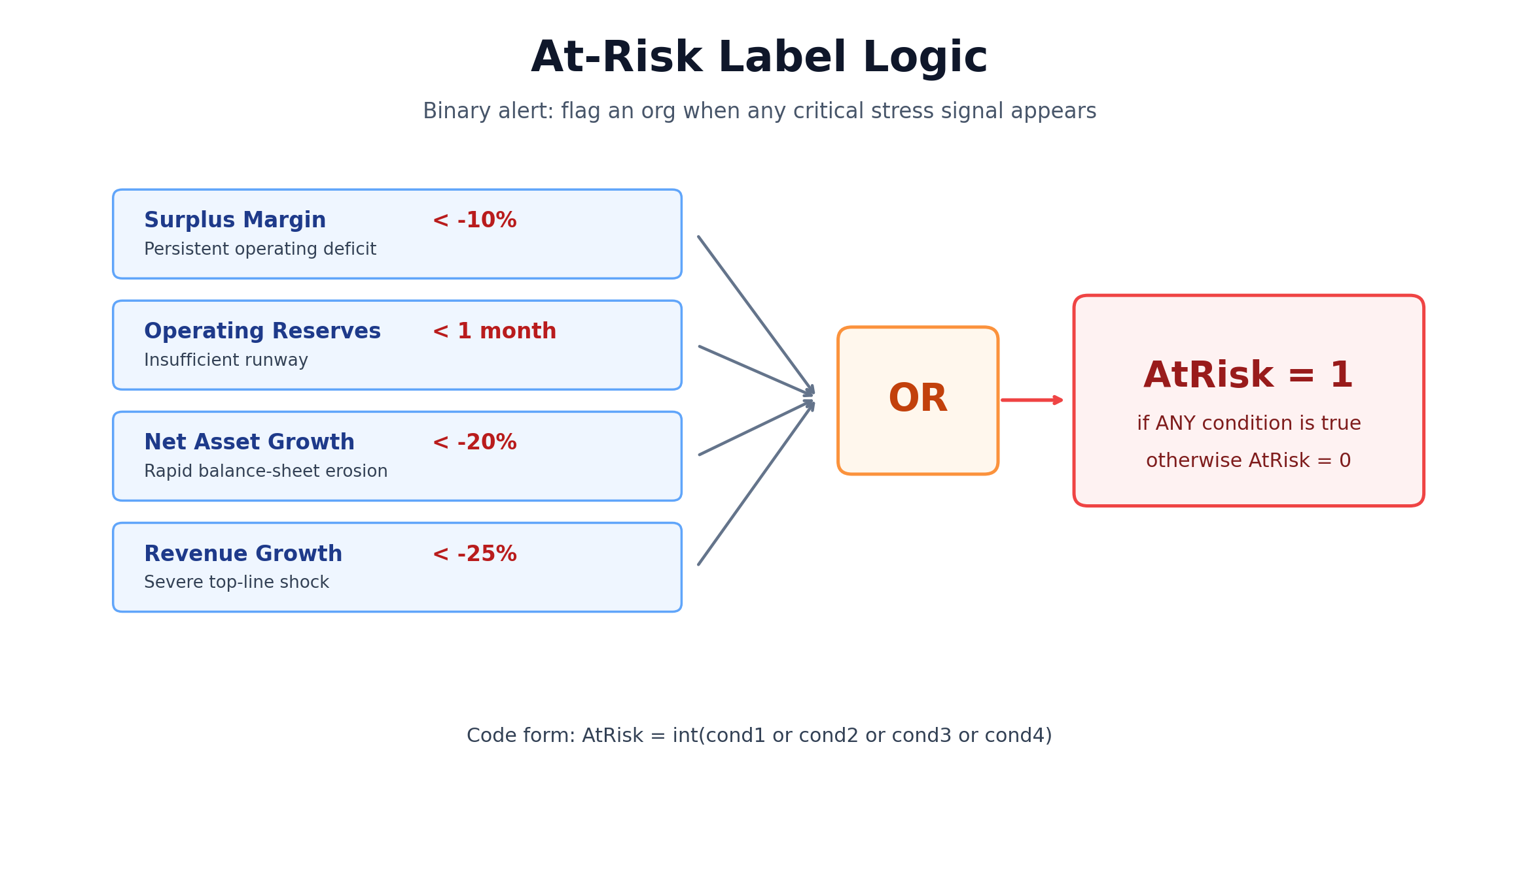
At-Risk Score
Component Definitions
SurplusMargin: Measures whether the nonprofit is consistently earning more than it spends, with negative values signaling operating deficits.
OperatingReserveMonths: Measures cash runway as months of expenses covered by net assets, with low values meaning weak short-term resilience.
NetAssetGrowthPct: Measures year-over-year change in net assets, where large declines indicate structural financial deterioration.
RevenueGrowthPct: Measures year-over-year revenue momentum, where sharp drops indicate funding instability and elevated risk.
Values: set for transparent early-warning thresholds
Why this works
Covers 4 different stress pathways
Transparent and easy to explain
Useful as an early warning alert
One-liner: An organization is at-risk if it shows a major warning sign in profitability, liquidity, balance-sheet health, or revenue trend.

Slide 9
01 Executive Overview
We turned these findings into six
decision-making tools.
02 Peer Benchmarking
03 Resilience Explorer
04 Stress Test Simulator
05 Hidden Gems Finder
06 Brand Map

Slide 10
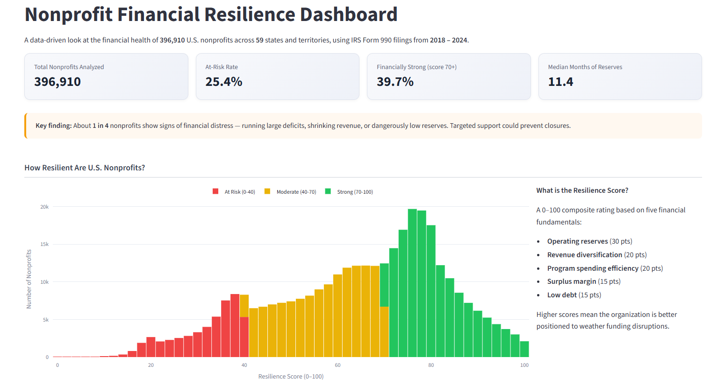
Executive Overview
Why we built it
[ Insert: Executive Overview tab screenshot ]
Funders need a sector-wide scan before zooming in. EDA showed risk is unevenly distributed — you need the full picture first.
What it shows
KPI cards (at-risk rate, median reserves), resilience distribution, state choropleth, sector ranking bar chart. Orange alert fires when >20% at risk.

Slide 11
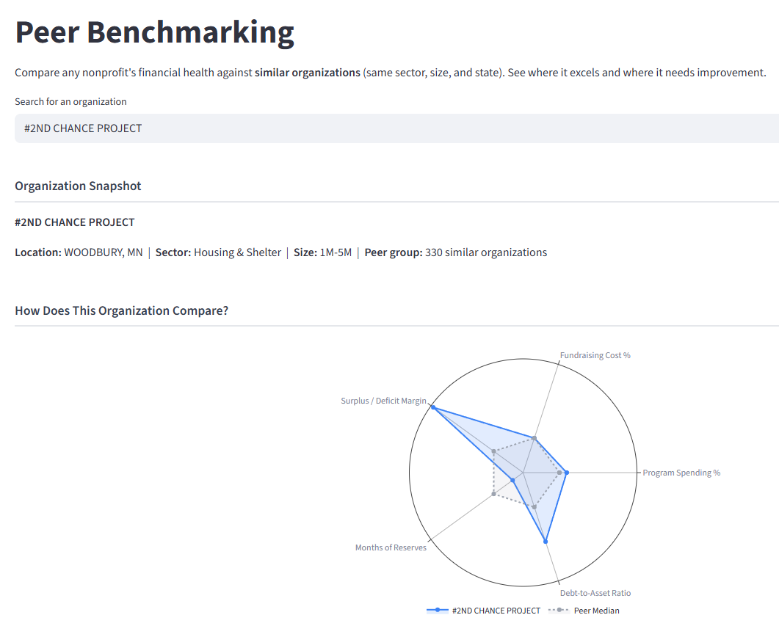
Peer Benchmarking
Why we built it
[ Insert: Peer Benchmarking tab screenshot ]
EDA finding #2 — sector and geography matter enormously. A raw score means nothing without knowing what 'normal' looks like for true peers.
What it shows
Radar chart of org vs. peer median across 5 axes. Green/red metric breakdown. Full peer group table with Z-score context.

Slide 12
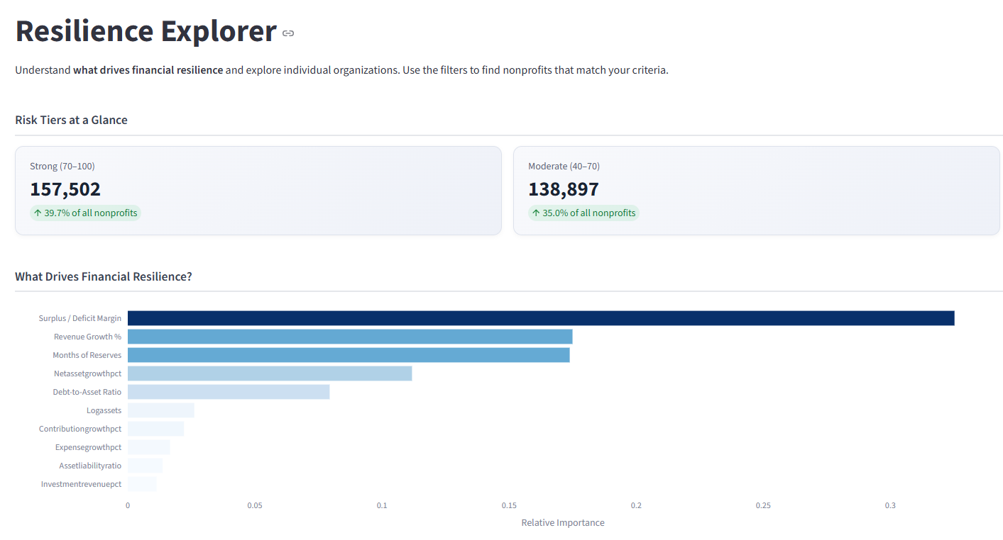
Resilience Explorer
Why we built it
What it shows
Feature importance bar chart from trained model, revenue vs. resilience scatter, filterable browse table with at-risk probability per org.
Feature importance findings needed interactive surfacing — funders managing portfolios need ML risk probability and resilience score together.

Slide 13
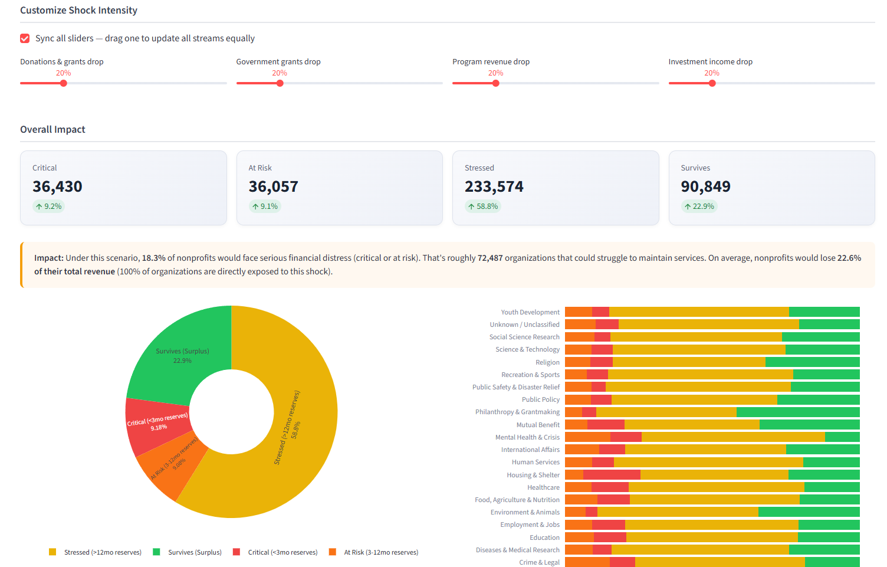
Stress Test Simulator
Why we built it
Knowing an org is 'at risk' today isn't enough — funders need to know what happens when a specific shock hits, especially given federal budget debates.
What it shows
5 pre-modeled scenarios, post-shock status breakdown (Critical / At Risk / Stressed / Survives), sector stacked bar, recovery timeline histogram.

Slide 14
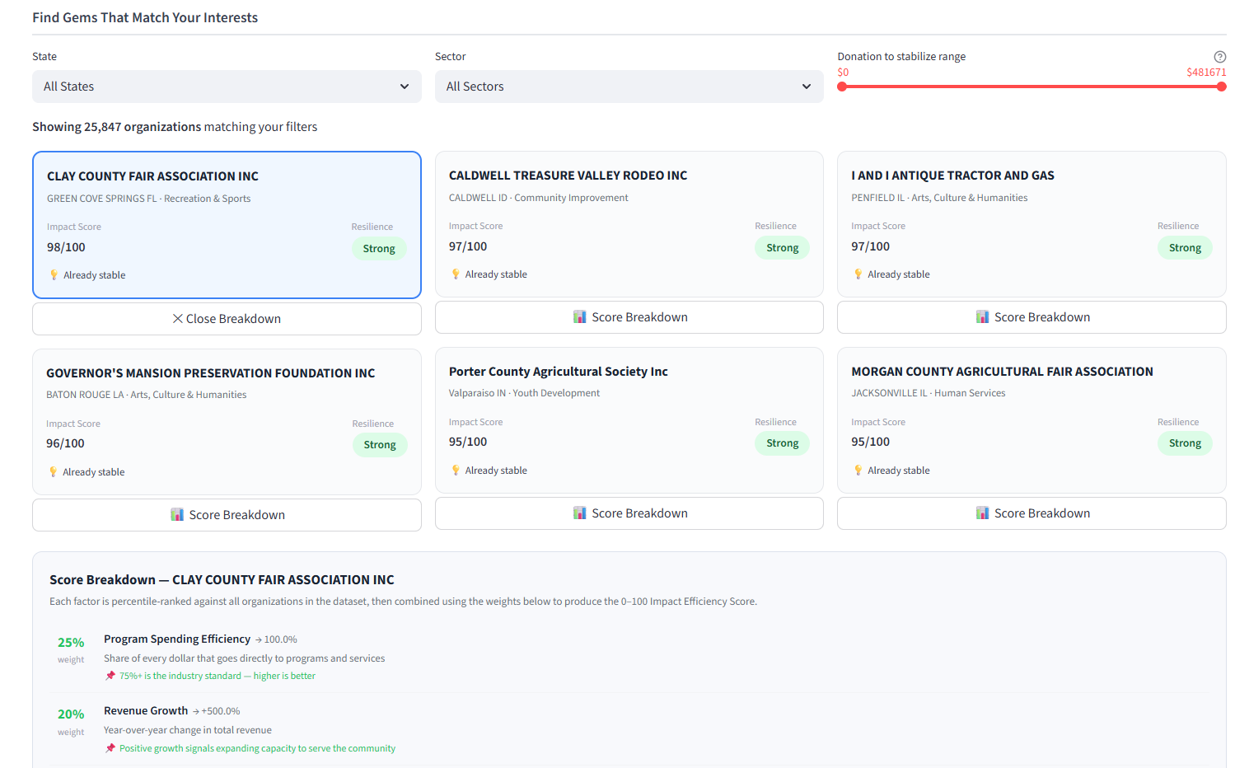
Hidden Gems Finder
Why we built it
[ Insert: Hidden Gems Finder tab screenshot ]
Risk is only half the picture. EDA surfaced orgs punching above their weight — high impact efficiency, below-median budget, financially sustainable.
What it shows
27,208 qualifying orgs. DonationToStabilize metric — exact dollars to reach 6-month reserve. Top 6 gem cards. Budget vs. impact scatter.

Slide 15
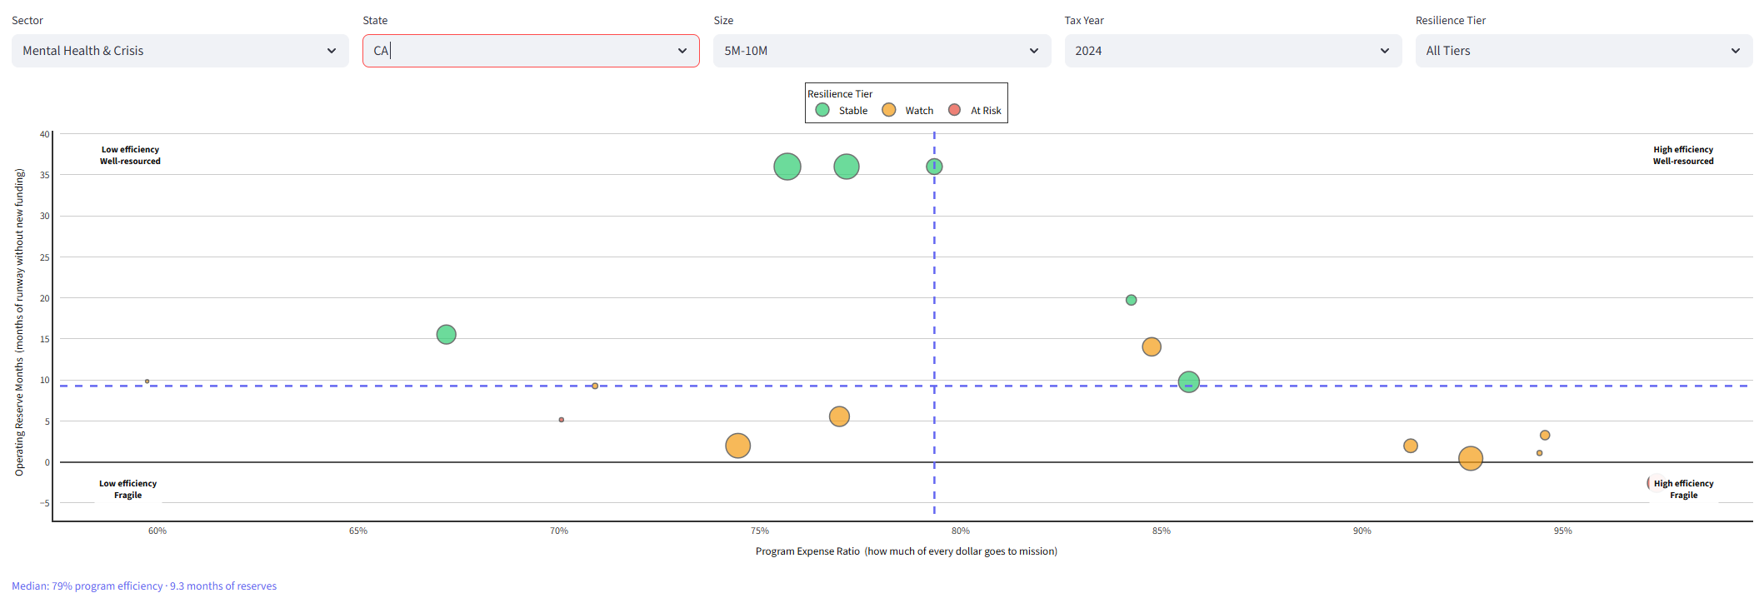
Brand Map
Why we built it
What it shows
Program Expense Ratio (X) vs. Reserve Months (Y).
Dot color = resilience tier. Dot size = revenue.
Filterable by sector, state, size, year, tier.
Hover shows org name, revenue, surplus margin, grant dependency.
The other tabs answer specific questions.
This one shows the entire sector at once — mission efficiency vs. financial survival.
Quadrants
Low efficiency
Well-resourced
High efficiency
Well-resourced
High efficiency
Fragile (hidden gems)
Low efficiency
Fragile (highest risk)

