Slide 1
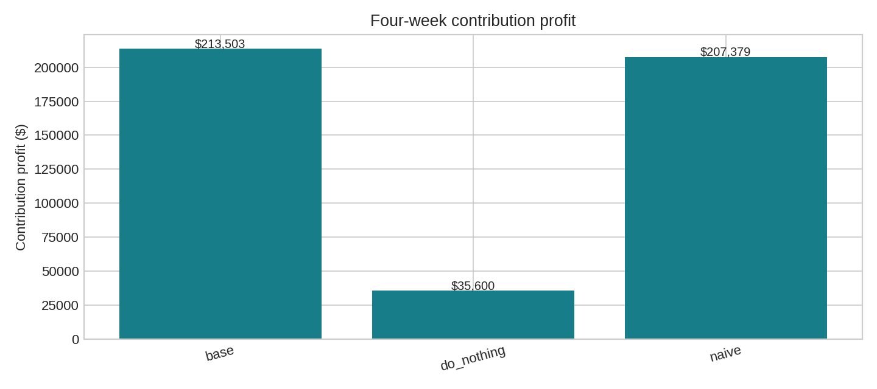
0:00 | Approve targeted replenishment
512 cases · 27 visits · $213,503.10 profit
+$177,903.35 versus no deliveries
+$6,123.90 versus a feasible forecast rule

Slide 2
0:30 | Parkas are the best supply opportunity
100 extra J200 parkas in week 1: +$10,169.20
Next: H600 beanies +$1,019.80
These are total gains after replanning, not per-unit shadow prices.

Slide 3
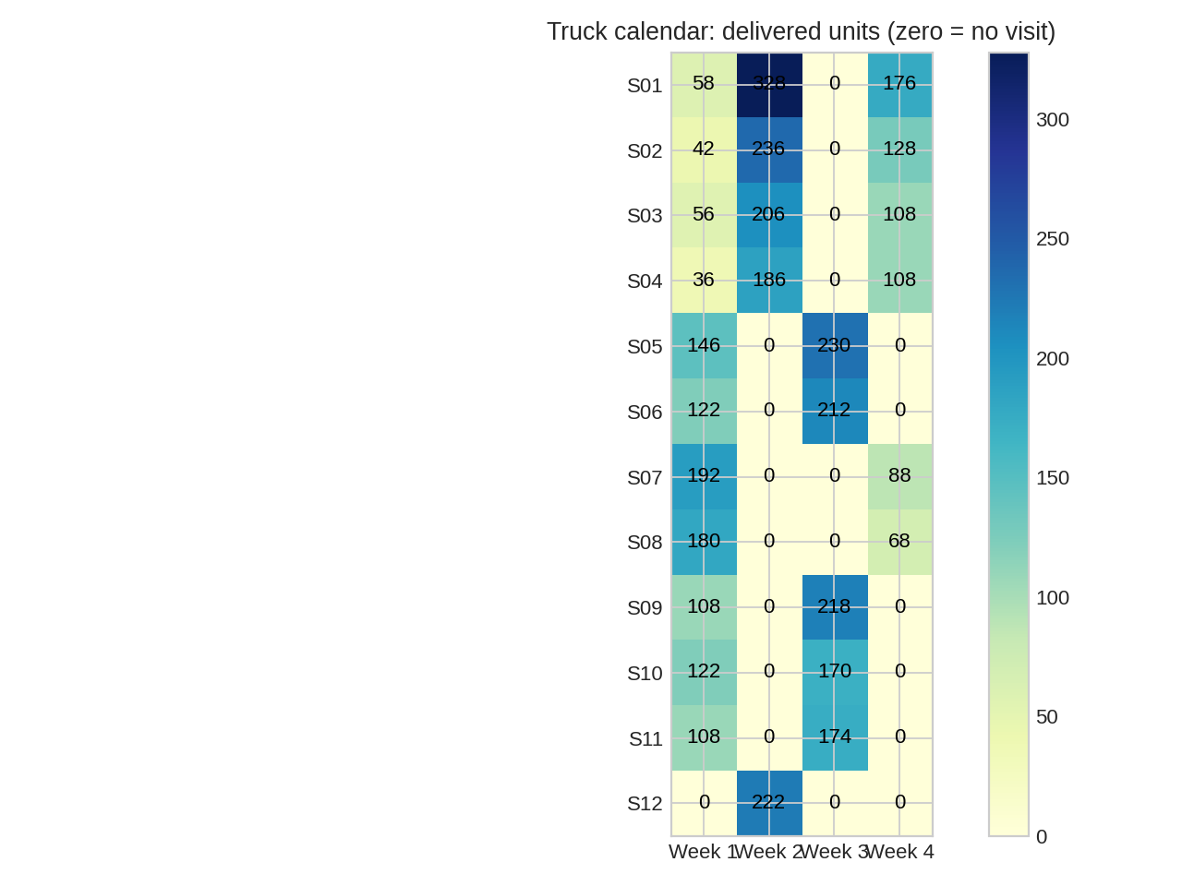
1:30 | Give each store its own delivery calendar
4,028 units on 27 visits
Blanket alternate-week policy costs $3,124.00
Numbers in the calendar are delivered units; zero means no truck.

Slide 4
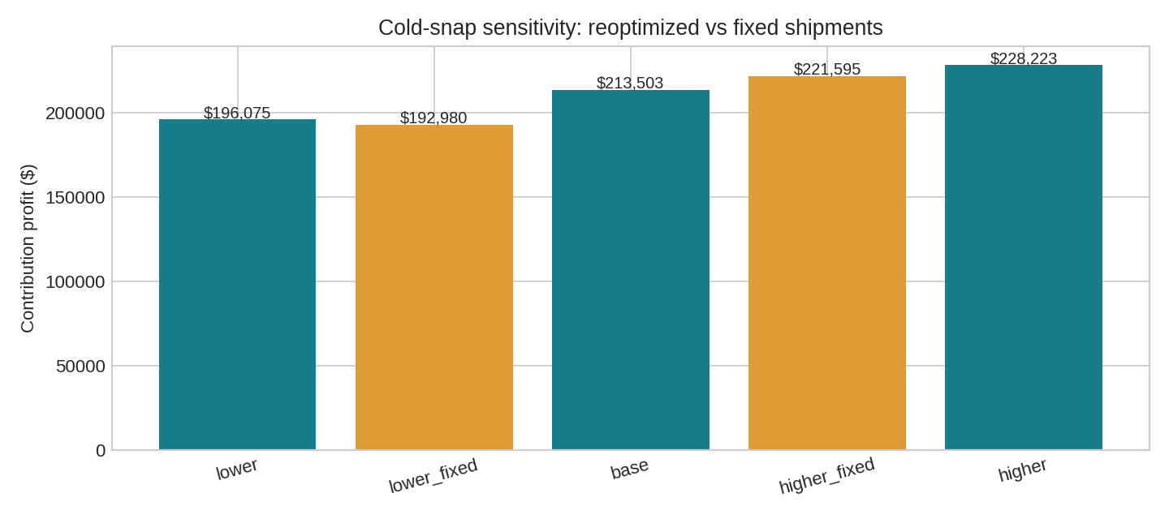
3:00 | Refresh the plan when forecasts move
Lower demand: $196,074.61 replanned
Higher demand: $228,223.15 replanned
Weeks 3–4 only; all SKUs ±20%. Fixed-policy results shown in notebook.

Slide 5
4:15 | VP action requested
Approve the case-level shipments and store-specific truck calendar.
Secure 100 parkas if the premium is below $10,169.20.
Replan when forecasts or supply change; retain the base plan only as a fallback.
Anshuman · Inka · Juan Diego | ISOM 839 | Academic case

