Slide 1
CONTRIBUTORS: Anshuman · Inka · Juan Diego
Retail replenishment as a decision-science problem
12 stores · 8 SKUs · 4 weeks
Choose whole-case shipments and delivery visits under real capacity limits.
Benchmark analysis: modeled outcomes, not realized company savings.

Slide 2
CONTRIBUTORS: Anshuman · Inka · Juan Diego
Validated data → constrained decisions
Five immutable CSVs with schema and identifier checks.
MILP: stock flow, demand, shared shelf, trucks and cumulative supply.
Independent Gurobi / CP-SAT comparison, objective bounds and accounting checks.

Slide 3
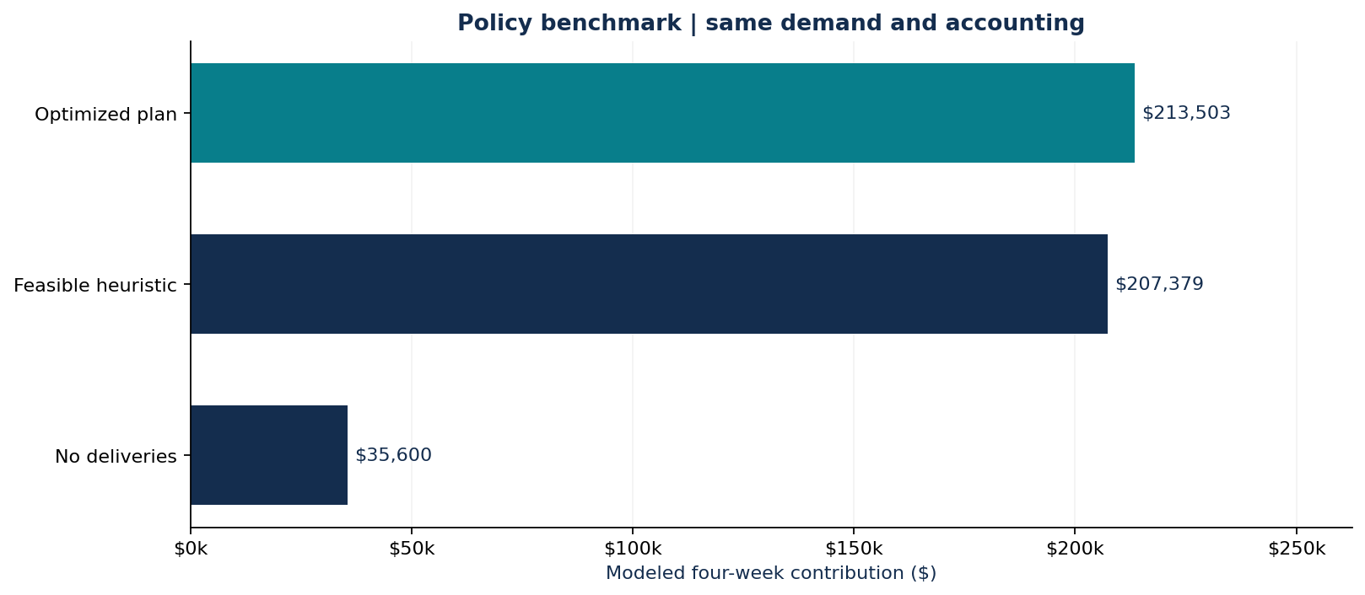
CONTRIBUTORS: Anshuman · Inka · Juan Diego
Optimized benchmark: $213,503.10
$6,123.90 / 2.95% above a feasible heuristic
96.13% demand filled
512 cases · 27 visits

Slide 4
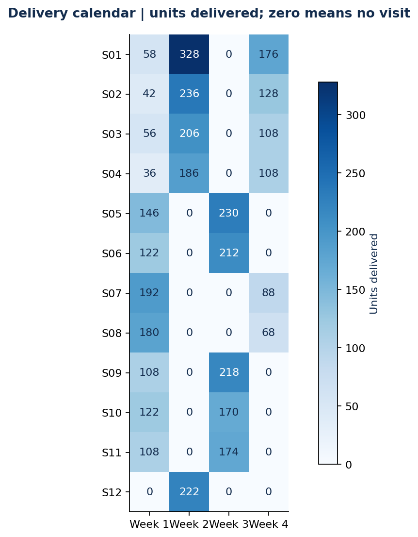
CONTRIBUTORS: Anshuman · Inka · Juan Diego
Allocate supply and consolidate deliberately
100 extra J200 parkas: +$10,169.20 gross contribution
Blanket alternate-week deliveries cost $3,124.00.
Approve the detailed store/week calendar.

Slide 5
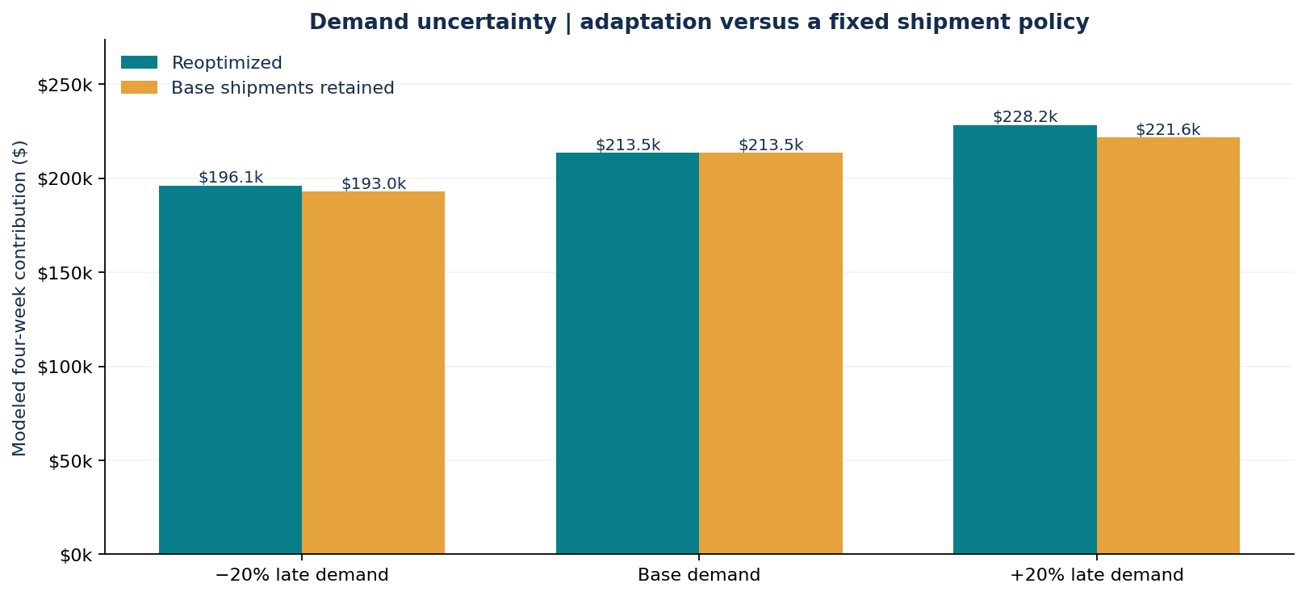
CONTRIBUTORS: Anshuman · Inka · Juan Diego
Separate adaptation from fixed-policy robustness
Lower demand: $196,074.61 reoptimized
Higher demand: $228,223.15 reoptimized
Weeks 3–4 change ±20%; original deliveries evaluated separately.

Slide 6
CONTRIBUTORS: Anshuman · Inka · Juan Diego
Reproduce, inspect and extend
Standalone Colab notebook; installable Python CLI; tested input and constraint checks.
Use forecasts as inputs; validate rolling decisions before deployment.
ChatGPT: debugging and explanations. Codex: implementation, testing and documentation.
Source credit and complete reproducibility evidence are in the repository.

