Slide 1
CARS COMPARISON PROJECT AND FUTURE APPLICATIONS
ANUBHAV BANERJEE(TECH LEAD)
CHAITANY AGRAWAL(CO LEAD)
RISHABH JOSHI (DESIGN LEAD)

Slide 2
BASIC INFORMATION
This is a pet project which has potential to be a real game changer in technical industries
For now it may showcase as a normal car comparison program
But….
What if we modify this program to compare stocks with a stock price prediction app
Or…
Use it to compare crypto currency with the same function of predicting the prices as a added function
This project may have infinite possibilities with the increase in technology

Slide 3
The libraries used are as follows:- 1.streamlit- Streamlit is a free and open-source framework to rapidly build and share beautiful machine learning and data science web apps. It is a Python-based library specifically designed for machine learning engineers. 2.panda-panda stands for python data analysis library

Slide 4
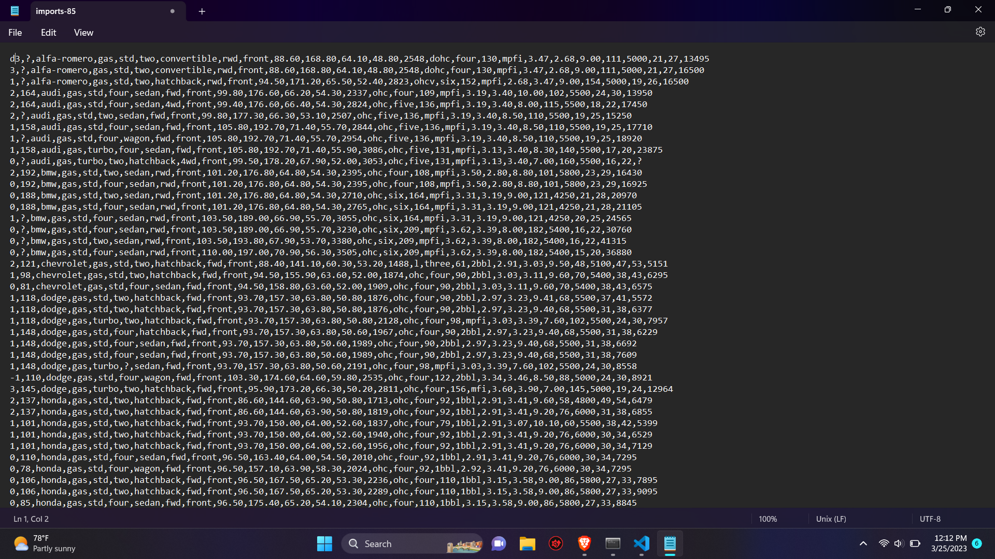
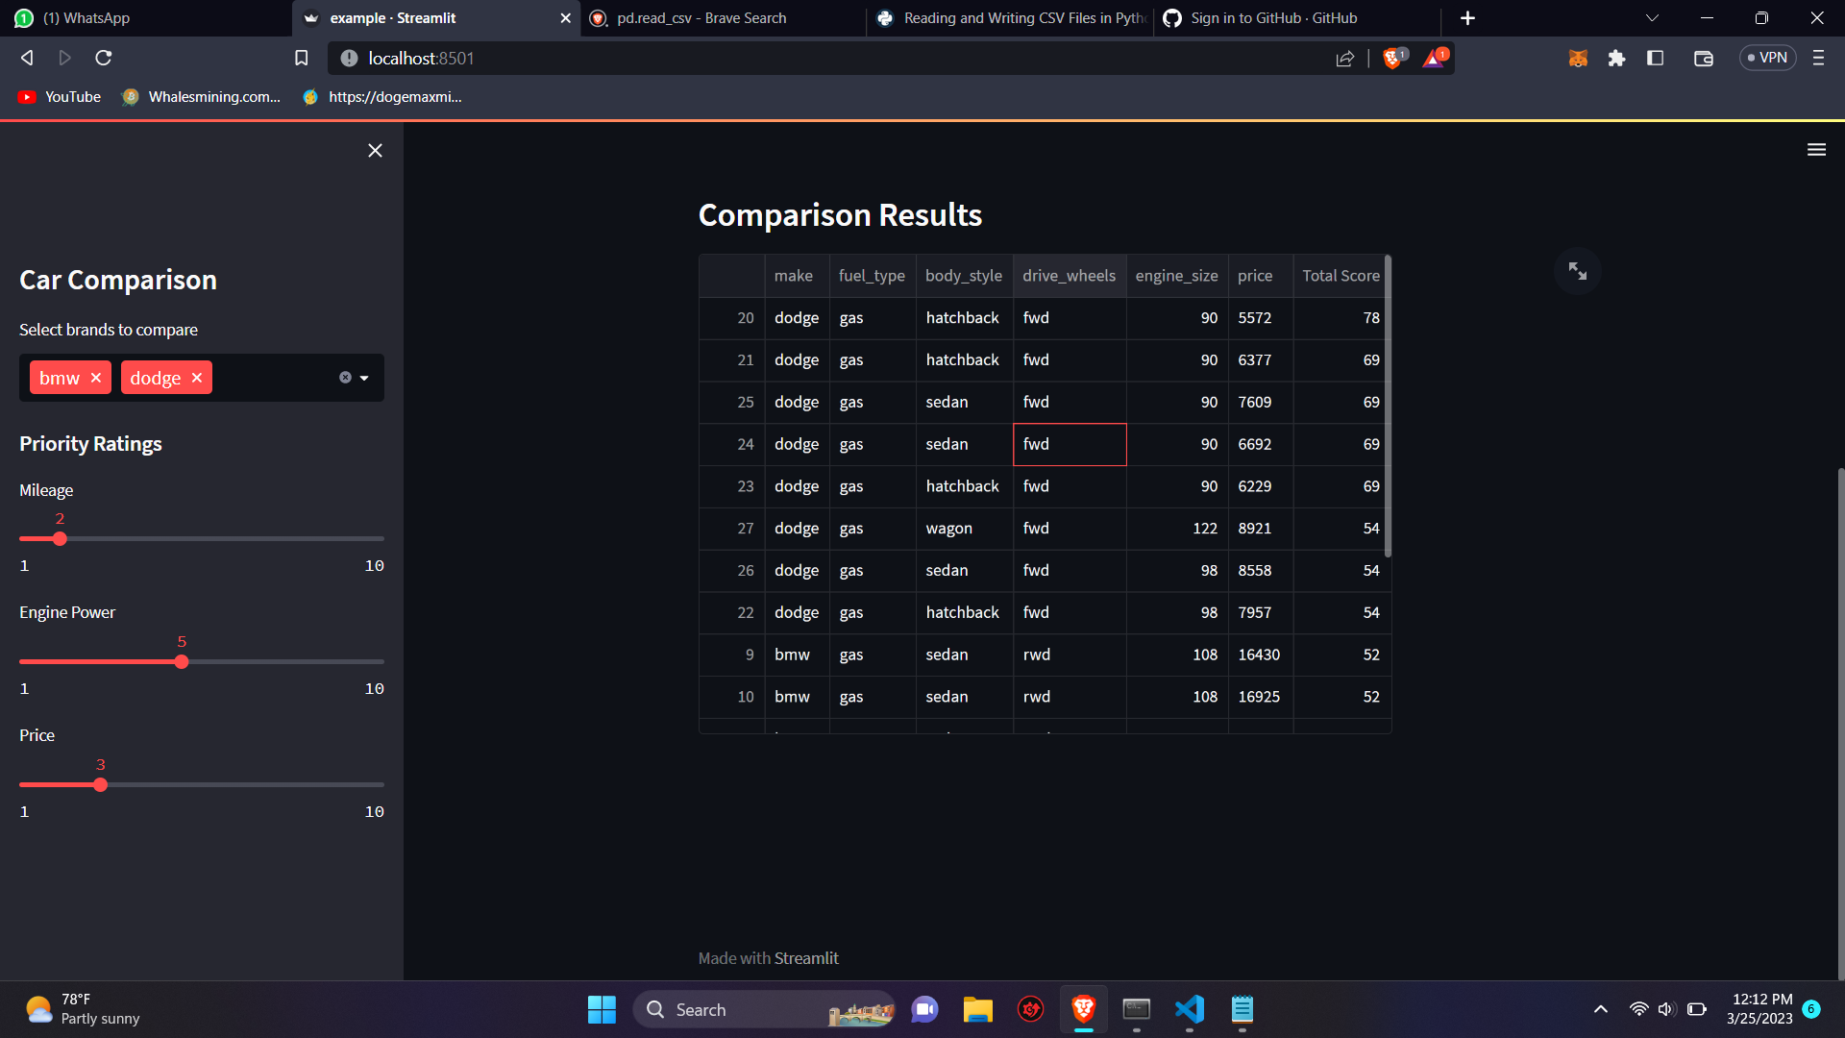
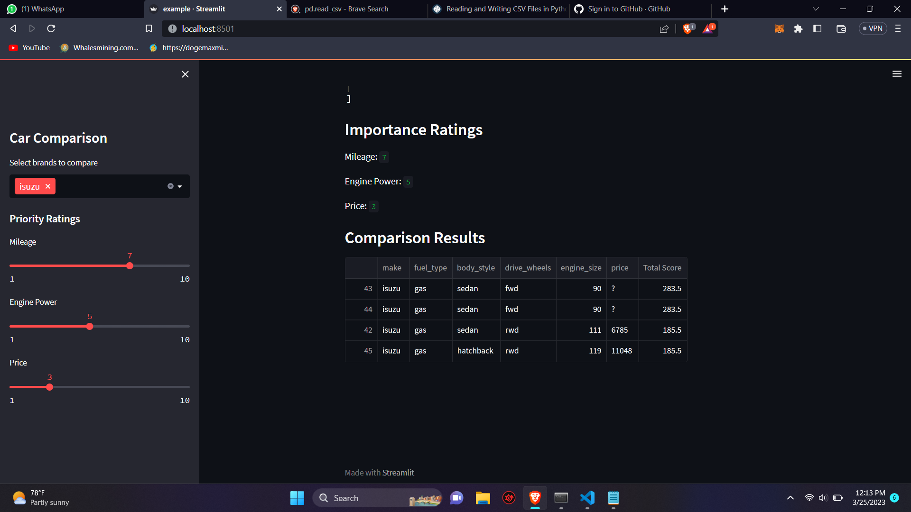
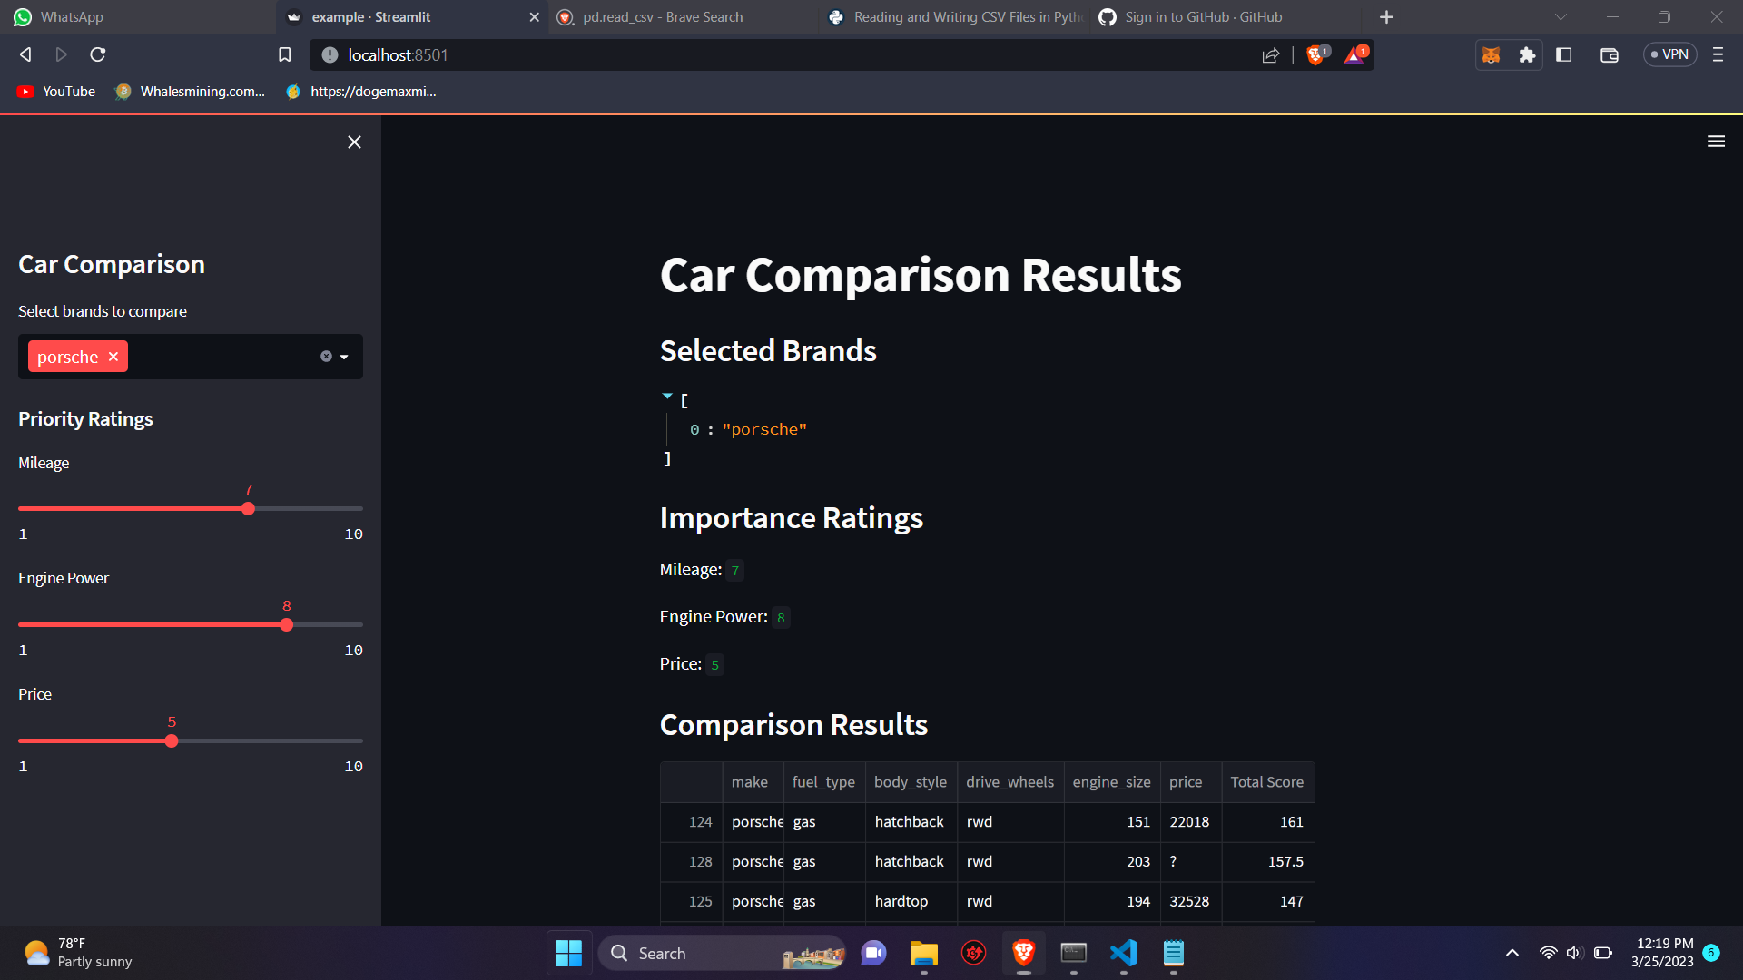
Screenshots of our projects

Slide 5

this is the end of our presentation

