Slide 1

Bank Management System Using Database Management System (BMICSE0452)
Department of Computer Science and Engineering
M.Tech Int.
(Under the Supervision: Dr. Mohd. Nazim )
NAME | ROLL NO | DEPARTMENT
Deepak Agrawal | 2301330100516 | M.Tech(int)-IV

Slide 2

Index
Introduction
Literature Survey/Existing System
Problem Statement
Proposed Methodology
Flowcharts and Use Case/ER Diagrams
Feasibility Study
Hardware /Software Requirement
Results and Conclusion
Refrences
Live Demonstration of Project with screenshots in ppt
DBMS Project PPT 2024-25 Even Sem

Slide 3
Introduction
Banking is a secure and efficient banking database management system designed to handle banking operations such as account management, transactions, and customer data management. This system ensures smooth banking operations, secure transactions, and effective management of financial records

Slide 4
Existing Systems
Existing System
Lack of security measures, making them vulnerable to fraud.
Difficulty in data retrieval and reporting due to unstructured data storage.
Comparison with Our System
This Banking Database System improves upon these limitations by implementing:
Fully automated database operations using My Sql and JDBC.
Secure transactions with encryption and role-based access control.
Efficient data retrieval and real-time transaction updates through a user-friendly GUI.

Slide 5
Problem Statement
The banking industry requires a reliable, fast, and secure database system to manage accounts, customers, and transactions. Banking aims to:
Eliminate manual data handling errors.
Secure customer information using encryption and authentication.
Provide real-time updates for transactions and balance inquiries.
Enable seamless fund transfers and account management.

Slide 6
Proposed Methodology
This Banking System follows a structured database management approach, ensuring data integrity and security. Key methodologies include:
Database Design – Tables for customer details, accounts, transactions, employees, and loans.
JDBC Connectivity – Java-based GUI for real-time banking operations.
Role-Based Access Control – Different user roles (Admin, Employee, Customer).
Data Encryption – Storing sensitive information (like passwords) securely.
Transaction Management – Implementing Deposit, Withdrawal, and Fund Transfers.
Reporting Module – Viewing transaction history and account statements in JTable.

Slide 7
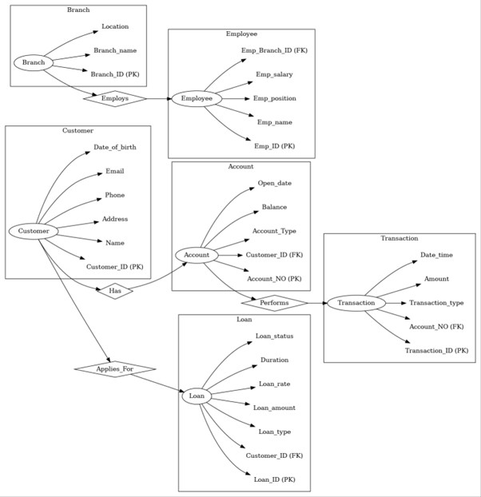
Flowcharts and Use Case/ER Diagrams

Slide 8
Feasibility Study
A. Technical Feasibility
✅ Uses modern web technologies (Java Spring Boot, Mysql DB). ✅ Scalable and responsive system accessible on all devices. ✅ Encryption & security mechanisms ensure safe transactions.
B. Economic Feasibility
✅ Reduces operational costs by minimizing paperwork and manual intervention. ✅ Saves time for both customers and employees through automation.
C. Operational Feasibility
✅ User-friendly web interface for all users. ✅ Easy to maintain and update functionalities.

Slide 9
Hardware /Software Requirement
Hardware
💻 Server: Cloud-Based Hosting or Local Server 💾 Storage: Oracle Database for transaction and user data
Software
Frontend: HTML, CSS, JavaScript
Backend: Java (Spring Boot), REST APIs
Database: Oracle 11g DBMS, My SQL
Security: JWT Authentication, Password Hashing
Development Tools: VS Code, IntelliJ IDEA. Eclipse

Slide 10
Results and Conclusion
After implementing the Banking Database System, we achieved:
Faster transaction processing with optimized database queries.
Secure banking operations with encryption and authentication.
User-friendly banking GUI for simplified account management.
Scalability to add future enhancements like loan management and mobile banking.
Conclusion:
This Banking System successfully streamlines banking processes, providing an efficient, secure, and scalable solution for modern banking needs.

Slide 11
References
📚 Books
JDBC, Servlets, and JSP by Santhosh Kumar K Covers database connectivity in Java and backend handling with examples. ISBN: 978-9388176224
Beginning Java with Data Structures by Will Briggs Good for understanding Java fundamentals with practical applications. ISBN: 978-1284089200
📄 Research Papers
Design and Implementation of Online Banking System Published in International Journal of Engineering Research & Technology (IJERT), Vol. 3 Issue 12, 2014. https://www.ijert.org/design-and-implementation-of-online-banking-system
A Review on Banking Management System – IJRASET International Journal for Research in Applied Science & Engineering Technology https://www.ijraset.com/fileserve.php?FID=38938
💻 GitHub Repositories
Bank Management System in Java GitHub Repo: https://github.com/RohitM302/bank-management-system-java
Simple ATM Interface using Java Swing GitHub Repo: https://github.com/DeepakShrma/ATM-Interface
🌐 Online Resources (Tutorials & Documentation)
GeeksforGeeks – Java Swing Applications https://www.geeksforgeeks.org/java-swing-create-a-simple-application/
GeeksforGeeks – JDBC in Java https://www.geeksforgeeks.org/introduction-to-jdbc/

Slide 12
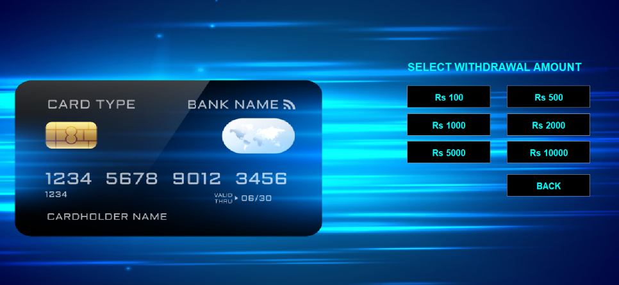
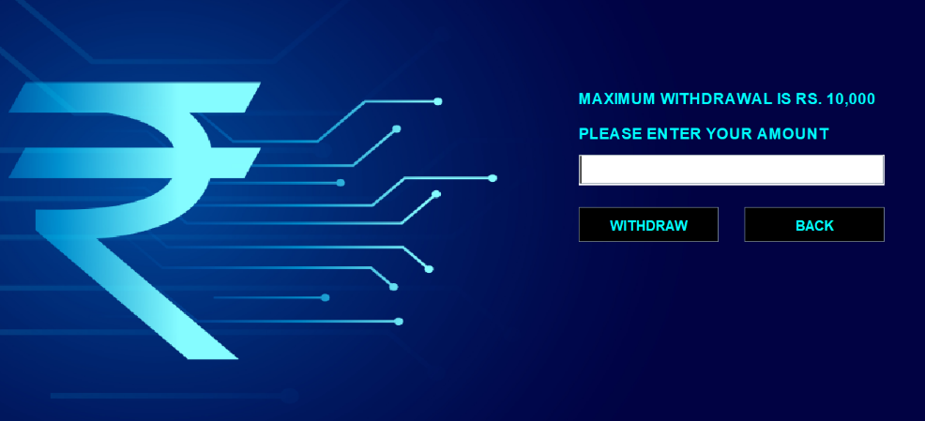
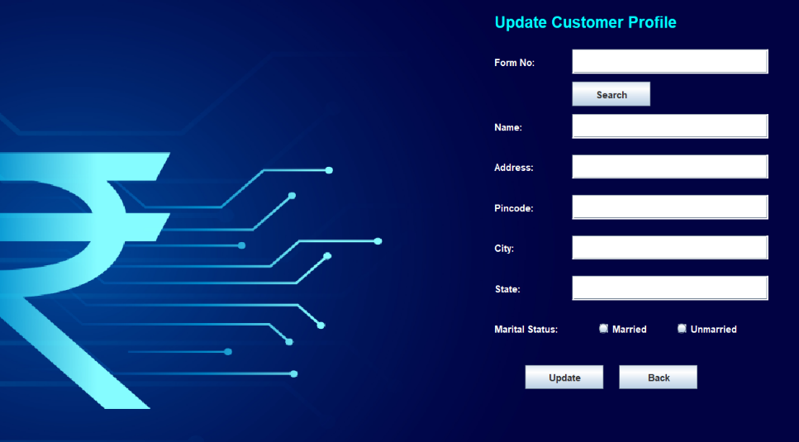
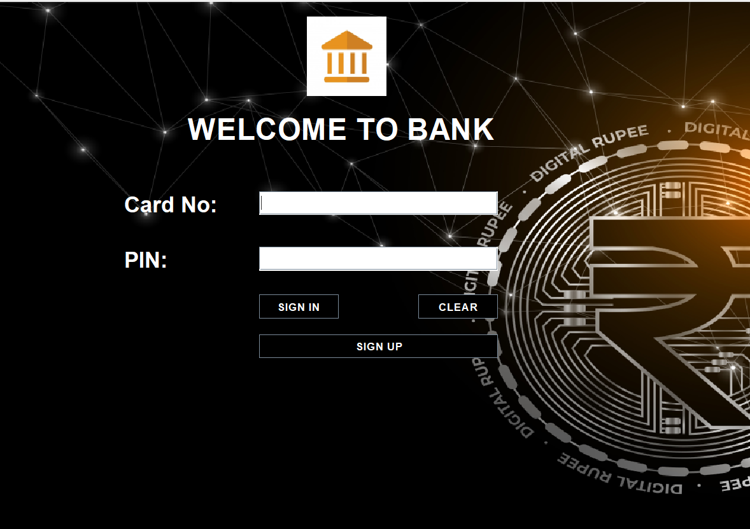
Live Demonstration of Project with screenshots

Slide 13
Thank You

