Slide 1
Major Project
(Hand gesture recognition using ML,DL)

Slide 2
Steps Need to be followed :-
1. Scope : -Alphabets, Digits , Symbols(palm,ok,I,index,thumb,fist….)
Digits: - DataSet gathering available is SVHN available on Kaggle
Symbols : - Available dataset are Kaggle,MINST,ASL….
2. Select dataset : -create custom or use available datasets
3. Preprocessing :- Apply augmentation techniques to improve the quality of dataset
4. Model Selection: - Best used are ANN or CNN

Slide 3
5. Model Development : - Use accuracy and precision, F1 Scores to access models performance
6. Deployment: - Develop user friendly interface
7. Testing
8. Validation
9.Documantation
10.Presentation

Slide 4
TOOLS USED: -
Jupyter Notebooks Or IDE, Python Libraries
Dataset (Kaggle)
Version Control
Deployment Platform
Workstation

Slide 5
HOW TO BUILD A MODEL ?
1. In Python it can be done using tensorflow and keras you can use tf.keras.Sequential , API to build a sequential model
2. Functional API of PYTORCH
3.MXNet
4. Caffe

Slide 6
How to create a dataset : -
Generate Synthetic data using random
Collection of data from external sources using pandas
Data Annotation
Data Simulation
Structured data creation using DataFrames

Slide 7
American Sign Language
Detector and classifier – Detector –Position/location , classification-Representation
2 Scripts data collection , test the hand
Detect,crop, image ,training
Rock paper scissor or asl
Now a,b,c –
Problem –rectangle ,square cropping is an issue to send data to classifier for b the information is lost use 300*300 add this to thecenter of the image – data collection consistency
Maths is correct -
Make datacollection , test and folders for a,b,c it will contain data images to train the model

Slide 8
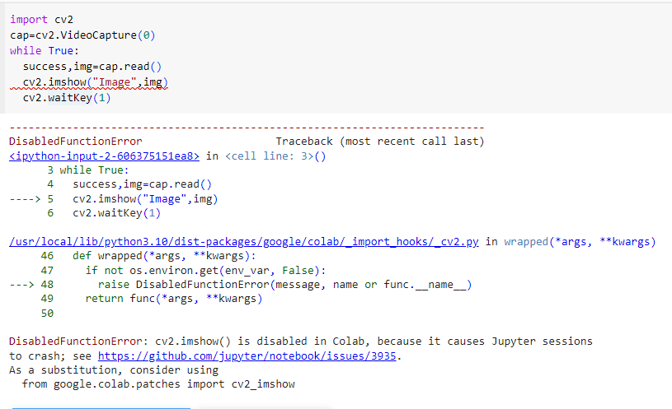
Cvzone , mediapipe

