Slide 1
HAND SIGN RECOGNITION
Submitted By –
Disha Agrawal(201500225)

Slide 2
Steps Followed:
Scope :- Sign Detection (ASL)
ASL- American Sign Language since a common trend to be followed

Slide 3
Steps
Webcam
Detect hands
Make Coordinates
Crop the image
Store the data
Train the model

Slide 4
Documentation
Libraries used – Cvzone , mediapipe
Cvzone- for

Slide 5
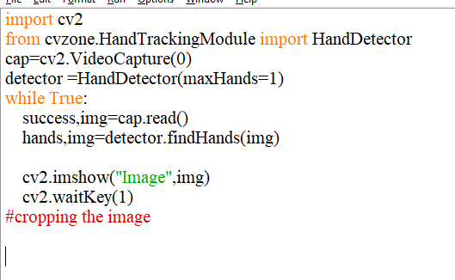
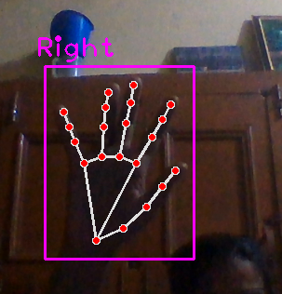
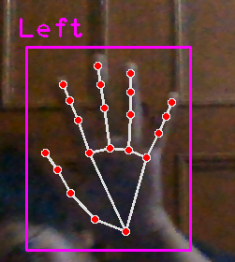
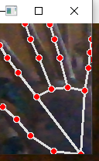
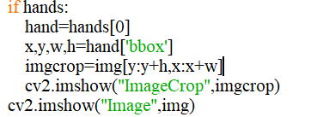

Slide 6
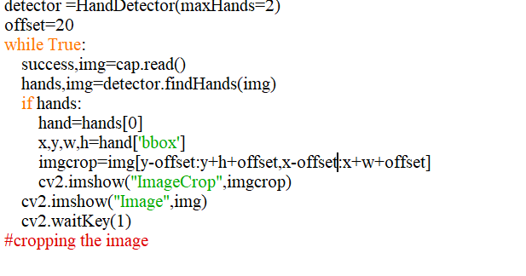
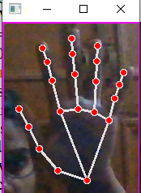
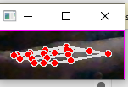
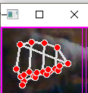


Slide 7
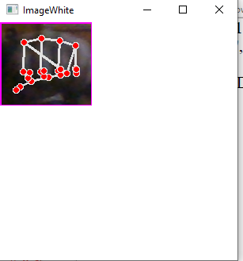
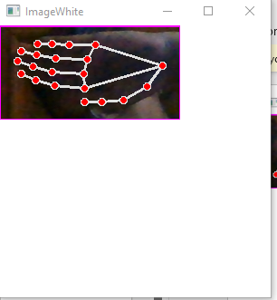
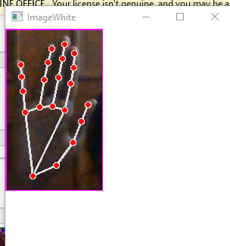
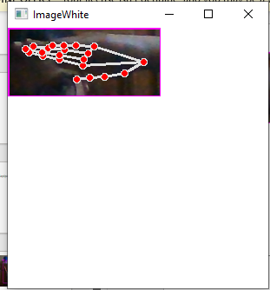

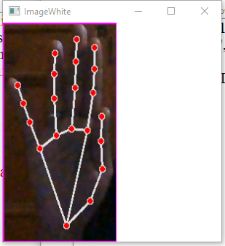
Not Efficient since lot of space is wasted also the image size cannot go beyond 300
and still difficult for classifier since images have different scenec and scenerios make it center on the logic that if height is greater than width make height 300 if width is bigger streach height to 300 and then calculate the other perspective acd to calculated image put it in the center of white image

