Slide 1
Smart Waste
Classifier with Analytics
Rashmi Suryavanshi
SMART WASTE CLASSIFIER WITH ANALYTICS
1 / 10

Slide 2
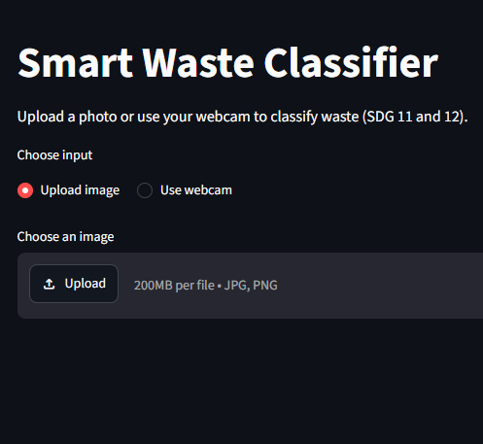
Introduction
Waste segregation is the first step of recycling, and mistakes in sorting reduce recycling efficiency.
This project uses deep learning to classify waste into 6 classes: cardboard, glass, metal, paper, plastic, trash.
An analytics layer (SQL + Power BI) shows where the model succeeds and where it fails.
Aligned with UN SDG 11 (Sustainable Cities) and SDG 12 (Responsible Consumption).

Slide 3
Problem Statement
02
Manual waste sorting is slow, costly and error-prone.
Automated classifiers are often reported with a single accuracy number.
Need: a low-cost classifier whose reliability is measured and understood, not just reported.
Speed
Manual sorting is slow.
Reliability
A single accuracy number is not enough.
Need
Measure and understand model errors.
SMART WASTE CLASSIFIER WITH ANALYTICS
2 / 10

Slide 4
Project Objective
03
Build a 6-class waste image classifier and compare it with a baseline CNN.
Handle class imbalance and evaluate with per-class metrics.
Store predictions in a portable SQL database and analyse errors and confidence.
Deliver a Streamlit app and a Power BI dashboard.
01 CLASSIFY
6 waste classes
02 EVALUATE
Per-class metrics
03 ANALYSE
SQL + Power BI
04 DEPLOY
Streamlit app
SMART WASTE CLASSIFIER WITH ANALYTICS
3 / 10

Slide 5
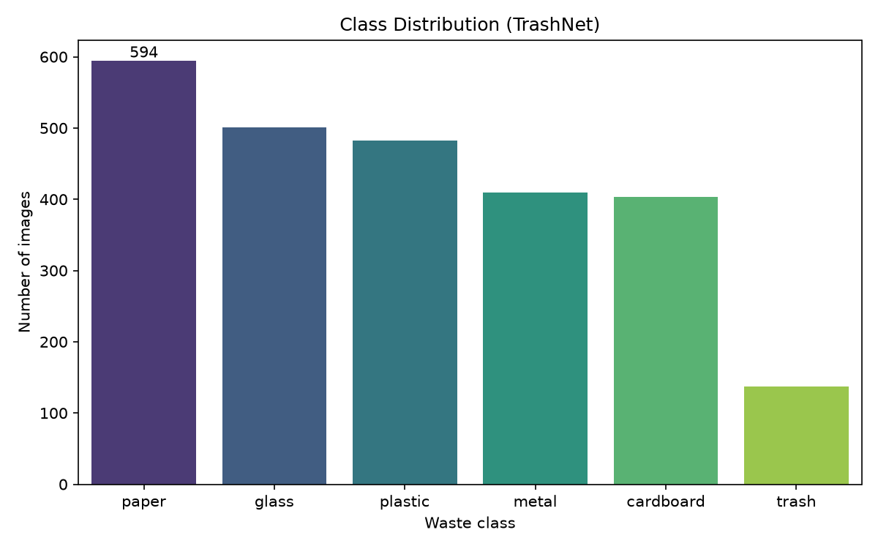
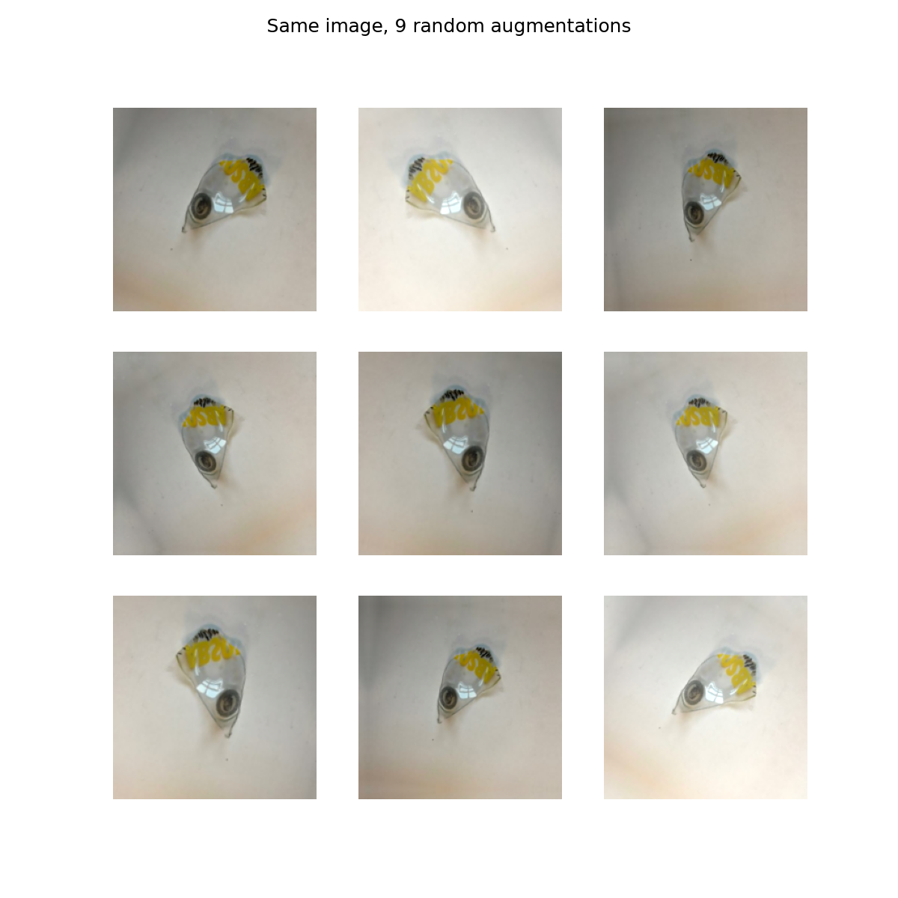
Dataset and Preprocessing
04
Class distribution
Dataset: TrashNet, 2,527 images (512x384), 6 classes.
Imbalance: trash has 137 images vs paper 594 (about 4.3x).
Stratified split 70/15/15: 1,768 train, 379 validation, 380 test.
Augmentation on the training set only: flip, rotation, zoom, brightness, contrast.
Class weights: trash gets about 3.07x weight, paper about 0.71x.
Augmentation examples
SMART WASTE CLASSIFIER WITH ANALYTICS
4 / 10

Slide 6
Model Development
05
Baseline CNN: small network trained from scratch (reference).
MobileNetV2: ImageNet-pretrained, transfer learning in two stages:
1. Train the new classification head with the base frozen.
2. Fine-tune the top 60 layers at a low learning rate.
Early stopping and learning-rate reduction to limit overfitting.
Preprocessing is built inside the model, so the app cannot mismatch it.
MODEL PIPELINE
Image
Augmentation
MobileNetV2
Dense
Input
Train only
Transfer learning
6 classes
Dense (6 classes)
Preprocessing is embedded in the model
SMART WASTE CLASSIFIER WITH ANALYTICS
5 / 10

Slide 7
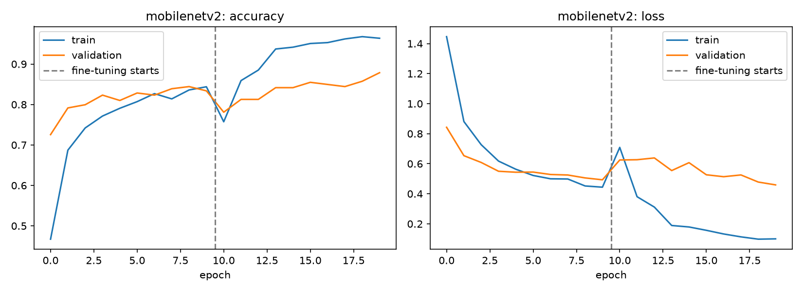
Model Evaluation and Results
06
Model | Split | Accuracy | Macro F1
Baseline CNN | Validation | 53.8% | 0.51
MobileNetV2 | Validation | 87.9% | 0.86
MobileNetV2 | Test | 85.3% | 0.85
Training curves
Transfer learning improved validation accuracy by about 34 points.
The model was chosen on validation data, and the test set was used once.
SMART WASTE CLASSIFIER WITH ANALYTICS
6 / 10

Slide 8
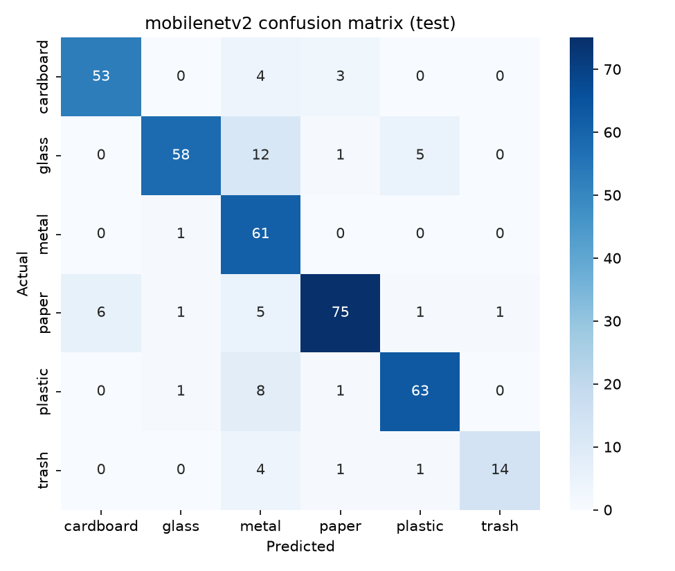
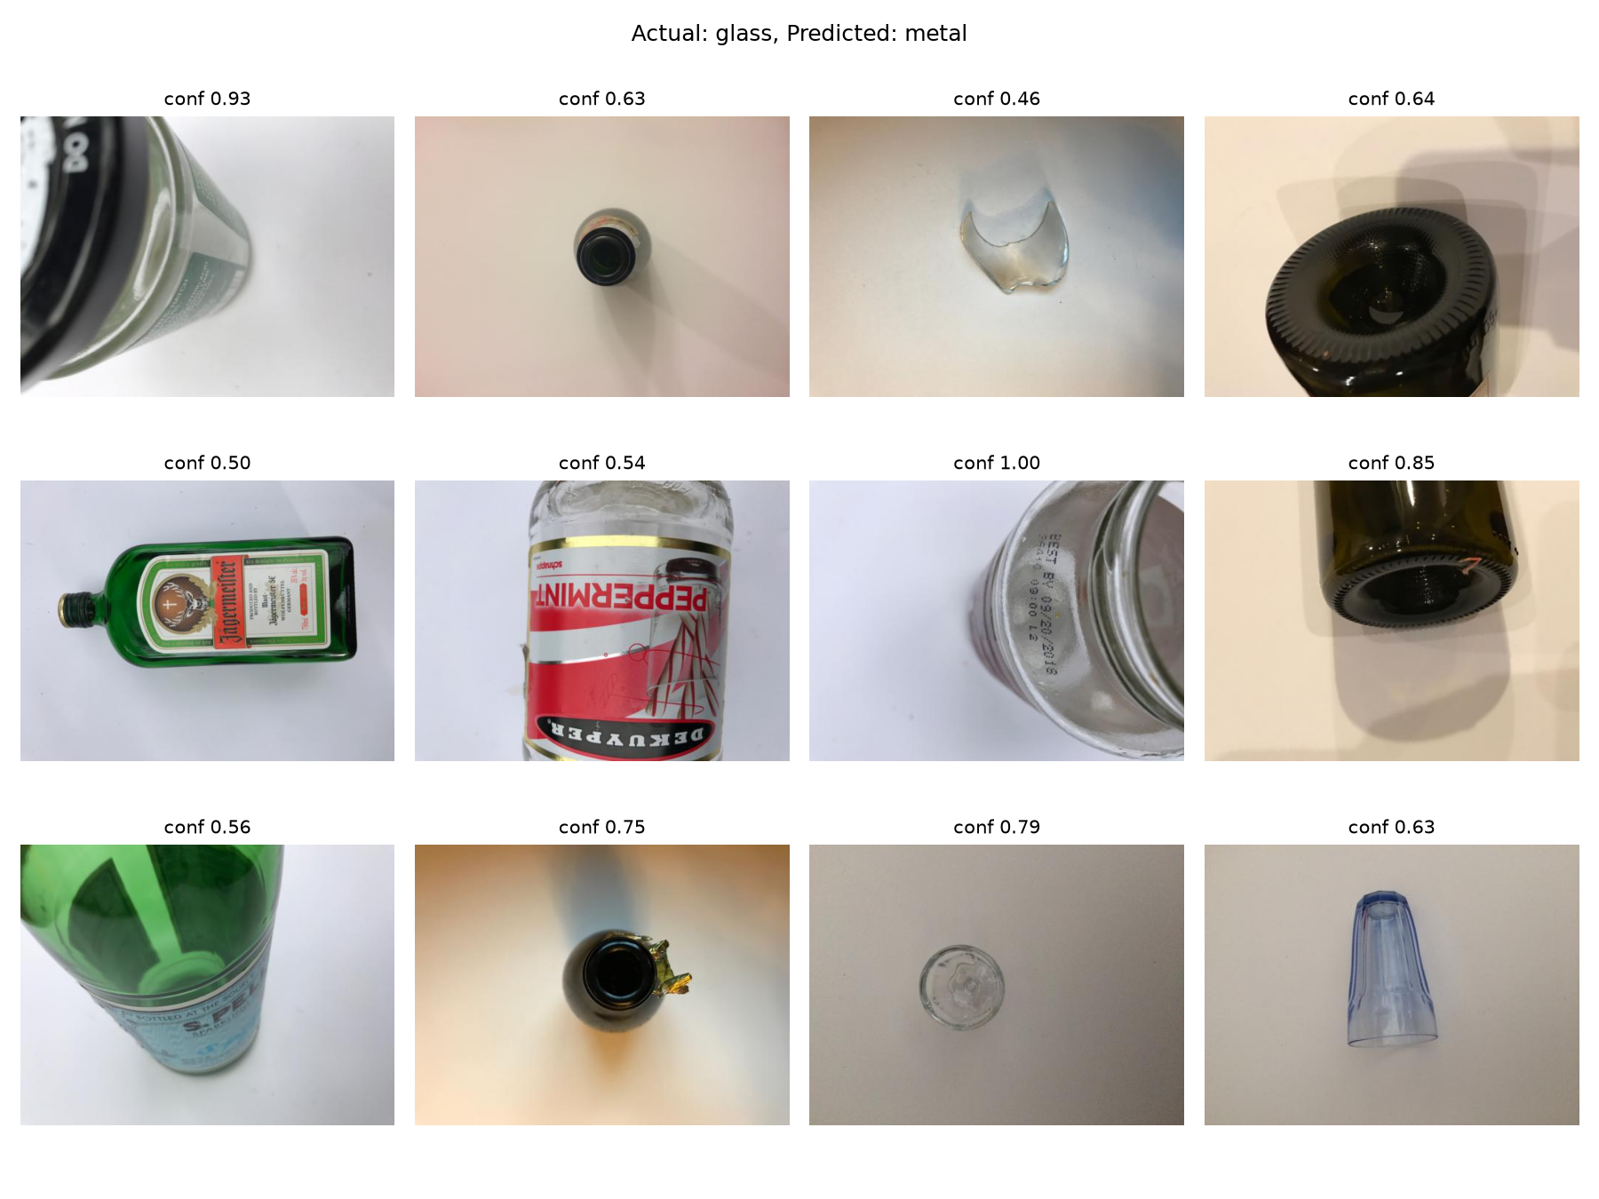
Error Analysis
07
Test confusion matrix
56 of 380 test images were misclassified.
Top confusions: glass → metal (12), plastic → metal (8), paper → cardboard (6).
Reviewing the glass errors showed the labels were correct. The model struggles with bottle bases and caps and with transparent or reflective objects.
Some errors had very high confidence (up to 1.00).
Glass predicted as metal
SMART WASTE CLASSIFIER WITH ANALYTICS
7 / 10

Slide 9
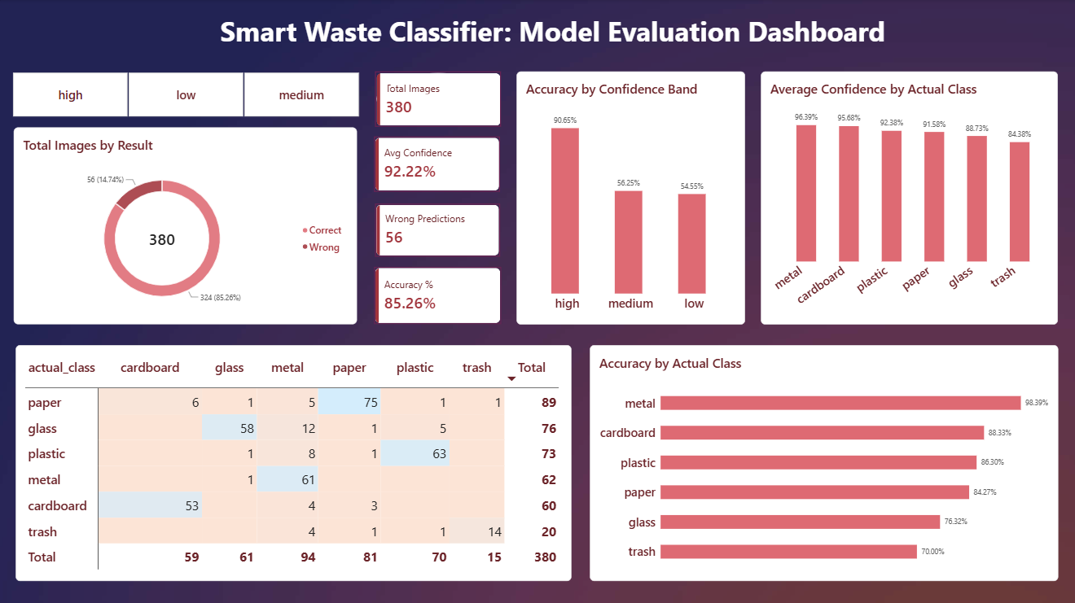
SQL Analytics and Dashboard
08
SQLite database with 3 tables: waste_classes, images, predictions (portable to MySQL/PostgreSQL).
Queries use JOIN, GROUP BY and CASE WHEN.
Class-wise accuracy: metal 98.4%, trash 70.0%, glass 76.3%.
Predictions with confidence ≥ 0.8 are 90.7% correct, against about 56% below 0.8.
Result: the app shows an “unsure” warning below 0.8 confidence.
Power BI dashboard with DAX measures, a confusion matrix, confidence bands and a class slicer.
Power BI dashboard
SMART WASTE CLASSIFIER WITH ANALYTICS
8 / 10

Slide 10
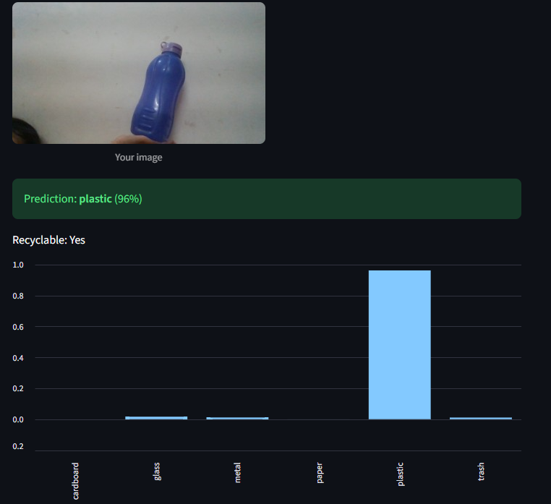
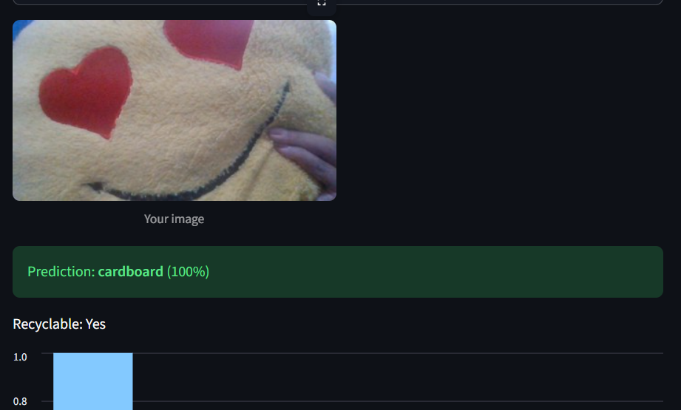
Streamlit Web Application
09
Correct prediction
Wrong prediction
Image upload and webcam input.
Shows the predicted class, confidence, a recyclable yes/no and a probability chart.
“Unsure, please check manually” warning when confidence is below 0.8.
App preprocessing verified on the full test set: 85.0% vs 85.3% in evaluation.
SMART WASTE CLASSIFIER WITH ANALYTICS
9 / 10

Slide 11
Limitations and Future Scope
10
Limitations
Future Scope
TrashNet has plain backgrounds, so accuracy drops on cluttered real-world photos (domain shift).
No “not waste” class: a landscape was predicted as “metal” (90%) and a cushion as “cardboard” (100%).
Near-duplicate photos may make the test score slightly optimistic.
Only 20 trash images in the test set, so its scores are unstable.
Add realistic datasets (RealWaste, TACO) and your own cluttered-background photos.
Add a “not waste / other” class or an out-of-distribution detector.
Compare ResNet50V2 and deploy online.
“A high test score does not guarantee real-world performance.”
SMART WASTE CLASSIFIER WITH ANALYTICS
10 / 10

