Slide 1

VLAN 10 Students
VLAN 20 Faculty
VLAN 40 Servers
COLLEGE CAMPUS NETWORK DESIGN AND SECURITY
VLAN-Based Segmentation, Network Services and Access Control Using Cisco Packet Tracer
Mini-project presentation
Computer Networks Laboratory (CSE20110)
Department of Computer Engineering and Technology
Simulation tool: Cisco Packet Tracer 9.0.1
Raghav Singh– 1262241452 Mitali Agrawal– 1262241467
Hrushikesh Kapre–1262241493 Aarushi Tyagi– 1262241597
Panel-A Batch A-2
Faculty: Mr. Susheel Kumar
Academic Year: 2026–2027
Presentation date: 22/10/2026
Computer Networks Laboratory CSE20110
15 seconds

Slide 2
Problem and Objectives
Problem
VLAN 10 STUDENTS
A college needs separate, manageable networks for students, faculty and shared servers, yet must still allow the traffic each group needs (addressing, name lookup, web access).
Without segmentation and access control, all devices share one broadcast domain and students could reach server resources freely.
VLAN 20 FACULTY
VLAN 40 SERVERS
Objectives
1. Segment users and servers using VLANs
2. Enable inter-VLAN routing (router-on-a-stick)
3. Configure DHCP (with relay), DNS and HTTP services
4. Restrict student access to the server subnet using an ACL
5. Enable SSH remote management of the router
6. Configure port security and shut down unused switch ports
7. Verify network functionality through testing
Scope: simulated campus LAN in Cisco Packet Tracer – no external WAN or public Internet connection.
Computer Networks Laboratory CSE20110
40 seconds

Slide 3
Proposed Design and Tools
R1 · Cisco 2911
Inter-VLAN routing · ACL · SSH v2
Trunk
Trunk
Switch2 · Cisco 2960
Switch0 · Cisco 2960
Switch1 · Cisco 2960
Trunk
VLAN 10/20/40
PC3
Student · VLAN 10
PC4
Student · VLAN 10
PC0
Student · VLAN 10
PC1
Student · VLAN 10
Server0
DHCP / DNS
192.168.40.2/24
Server1
HTTP website
192.168.40.3/24
PC5
Faculty · VLAN 20
PC6
Faculty · VLAN 20
PC2
Faculty · VLAN 20
VLAN 10 Students
VLAN 20 Faculty
VLAN 40 Servers
Trunk (802.1Q)
Schematic redrawn from the expanded topology – replace with the actual Packet Tracer topology screenshot.
Tools: Cisco Packet Tracer 9.0.1 · 1 router (2911) · 3 switches (2960) · 7 PCs · 2 servers
Protocols: VLANs, IEEE 802.1Q trunking [1], DHCP, DNS, HTTP, ACL, SSH v2
Addressing:
VLAN 10 STUDENTS 192.168.10.0/24 gateway 192.168.10.1
VLAN 20 FACULTY 192.168.30.0/24 gateway 192.168.30.1
VLAN 40 SERVERS 192.168.40.0/24 gateway 192.168.40.1
Computer Networks Laboratory CSE20110
45 seconds

Slide 4
Implementation and Working
PC0
Student, VLAN 10
DHCP
IP via relay from Server0
DNS lookup
name → 192.168.40.3
R1 + ACL
routes; ACL permits DNS, HTTP
Server1
HTTP response
Student DHCP pool
starts 192.168.10.10 · gateway 192.168.10.1
Faculty DHCP pool
starts 192.168.30.11 · gateway 192.168.30.1
DNS server (Server0)
192.168.40.2
Website (Server1)
www.collegenetwork.com → 192.168.40.3
Implementation:
1. VLANs 10/20/40 created; access ports assigned [2]
2. 802.1Q trunks to R1; router subinterfaces act as gateways
3. DHCP pools, relay (ip helper-address 192.168.40.2) [6], DNS, HTTP
4. Student ACL STUDENT-RESTRICTIONS [3], SSH v2 [4], port security [5], unused ports shut
Expansion: Switch2 and four PCs (PC3–PC6) added, trunked to Switch0 (VLANs 10, 20, 40). Existing VLANs and IP subnets reused – no extra router or new subnet needed.
Working: Relay forwards client DHCP requests to Server0; DNS resolves the domain to Server1’s IP; R1 routes between VLANs and the ACL filters student traffic.
Troubleshooting: faculty DHCP gateway corrected to 192.168.30.1
Computer Networks Laboratory CSE20110
55 seconds

Slide 5
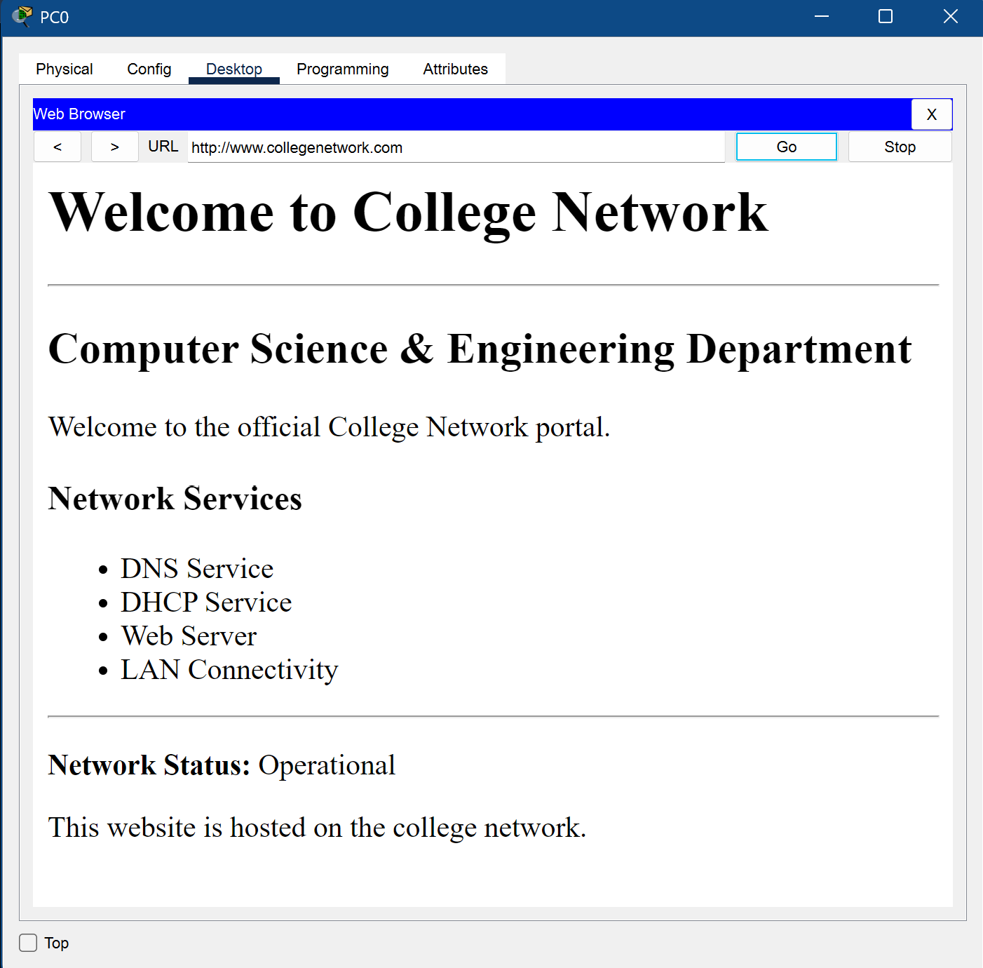
Testing and Results
Test | Result
Student / faculty DHCP | Reported successful
Faculty gateway / server reachability | Reported successful
Website by domain name | Reported successful
SSH login from PC0 to R1 | Reported successful
Sticky MAC port security | SecureSticky entries observed
Student ping to Server0 | Blocked as expected by the ACL (ICMP not explicitly permitted)
DHCP on new PCs (PC3–PC6) | Addresses assigned
Website from PC3 and PC5 | Loaded by domain name
Switch2 VLANs and trunk | Verified
Switch2 port security | 1 sticky MAC/port; 0 violations
Simulation Mode (website) | DNS/HTTP events observed
Test: ping from a student PC to Server0 (192.168.40.2)
Expected: blocked – the ACL permits specified DNS and web traffic but does not explicitly permit ICMP to the server subnet.
Observed: ping fails. This reflects ACL policy, not a network fault; web access by domain name still works (reported).
Objectives achieved: 1–2 (faculty reachability), 3 (DHCP, DNS, HTTP), 4 (ACL), 5 (SSH), 6 (port security) – per the reported results; attach screenshots as evidence.
Computer Networks Laboratory CSE20110
50 seconds

Slide 6
Working Demonstration
Function to demonstrate
Accessing the campus website from PC3 or PC5: http://www.collegenetwork.com
1. Open PC3 (or PC5) → Desktop → Web Browser
2. Visit http://www.collegenetwork.com
3. Show the loaded webpage; explain DNS resolution, routing and (for PC3) the student ACL’s HTTP permit
PC3 or PC5
VLAN 10 / VLAN 20 · opens the URL
Server0 · DNS
192.168.40.2
Short Simulation Mode demo
1. Enable the DHCP, DNS and HTTP event filters.
2. Request http://www.collegenetwork.com from PC3 or PC5.
3. Use Capture/Forward to step through the packet events.
4. DNS resolves the name; HTTP carries the request and response.
DHCP events appear only when a DHCP request is generated. Simulation Mode visualizes network events; it does not configure the network.
R1 + student ACL
routes; HTTP permitted
Server1 · HTTP
192.168.40.3
Secondary demo (time permitting): SSH v2 login from PC0 to R1 – credentials not shown.
Success criterion: The domain resolves to 192.168.40.3 and the HTTP website loads from PC3 (student VLAN) and PC5 (faculty VLAN).
Computer Networks Laboratory CSE20110
65 seconds

Slide 7
Conclusion and Contributions
Outcome and Application
Outcome
Segmented campus network expanded to three switches and four extra PCs, reusing the student and faculty VLANs; inter-VLAN routing; DHCP, DNS and HTTP services; student ACL and switch/router security
Application
A simulated college or departmental LAN
Limitations
No external Internet/WAN connectivity
ACL applies to students only
HTTP tested; HTTPS service not confirmed
Legacy 192.168.20.1 noted on physical R1 GigabitEthernet0/1 – review if obsolete
Future scope
Configure and test HTTPS
Add a management VLAN
Add logging and monitoring
Improve credential management and access policies
Add redundancy or WAN connectivity if required
Team contributions:
Raghav Singh – Network topology, VLANs, and inter-VLAN routing.
Mitali Agrawal – DHCP, DNS, and website configuration.
Hrushikesh Kapre – Network security, ACLs, SSH, and port security.
Aarushi Tyagi – Connectivity testing, documentation, report, and PPT preparation.
AI use: ChatGPT assisted with explanations and documentation; Claude assisted in preparing these slides. Project facts should be checked against the actual Packet Tracer configuration and test evidence.
Computer Networks Laboratory CSE20110
30 seconds

Slide 8
References
[1] IEEE Standard for Local and Metropolitan Area Networks—Bridges and Bridged Networks, IEEE Std 802.1Q-2022, Dec. 2022. [Online]. Available: https://standards.ieee.org/ieee/802.1q/10323/
[2] Cisco Systems, “VLAN Configuration Guide, Cisco IOS Release 15.2(2)E (Catalyst 2960-X Switch),” in Catalyst 2960-X Series configuration guides. [Online]. Available: https://www.cisco.com/c/en/us/support/switches/catalyst-2960-x-series-switches/products-installation-and-configuration-guides-list.html
[3] Cisco Systems, “Security Configuration Guide: Access Control Lists, Cisco IOS Release 15SY.” [Online]. Available: https://www.cisco.com/en/US/docs/ios-xml/ios/sec_data_acl/configuration/15-sy/sec-data-acl-15-sy-book.html
[4] Cisco Systems, “Configure SSH on Routers and Switches,” Doc. ID 4145. [Online]. Available: https://www.cisco.com/c/en/us/support/docs/security-vpn/secure-shell-ssh/4145-ssh.html
[5] Cisco Systems, “Configuring Port-Based Traffic Control,” Consolidated Platform Configuration Guide, Cisco IOS Release 15.2(6)E (Catalyst 2960-X Switch). [Online]. Available: https://www.cisco.com/c/en/us/td/docs/switches/lan/catalyst2960x/software/15_2_6_e/configuration_guide/b_1526e_consolidated_2960x_cg/b_1526e_consolidated_2960x_cg_chapter_0111001.html
[6] Cisco Systems, “Configuring the Cisco IOS DHCP Relay Agent.” [Online]. Available: https://cisco.com/en/US/docs/ios-xml/ios/ipaddr_dhcp/configuration/15-sy/dhcp-relay-agent.html
Computer Networks Laboratory CSE20110
Backup slide

