Slide 1

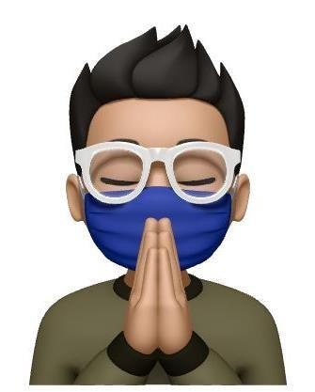
DIGITAL MARKETING PORTFOLIO
Crown
Google-Certified Digital & Performance Marketing Agency

Slide 2
ABOUT US
Who We Are
A Google-certified digital marketing agency working with companies around the world.
Based in Dubai, UAE, we bring a marketing-first approach across strategy, campaigns, and analytics.
For about four years we have worked as a Digital & Performance Marketing partner to a variety of well-reputed businesses — building strategy, running campaigns, and turning data into growth.
Crown
DIGITAL MARKETING AGENCY
Full-funnel growth partner
Dubai, UAE
4+ yrs
Global
Google
EXPERIENCE
CLIENTELE
CERTIFIED
Crown · Digital Marketing Agency
01

Slide 3
WHAT WE DO
Our Expertise
Full-funnel digital marketing across organic, paid, and creative.
01
Social Media Marketing
02
Content Planning & Strategy
03
Social Media Advertising
04
WordPress Website Design
05
Landing Page Development
06
Performance Marketing
07
Graphic Design
08
Email Marketing & Automation
09
Keyword & Competitor Research
10
Search Engine Optimization
11
Data Analysis & Reporting
12
Conversion Rate Optimization
Crown · Digital Marketing Agency
02

Slide 4
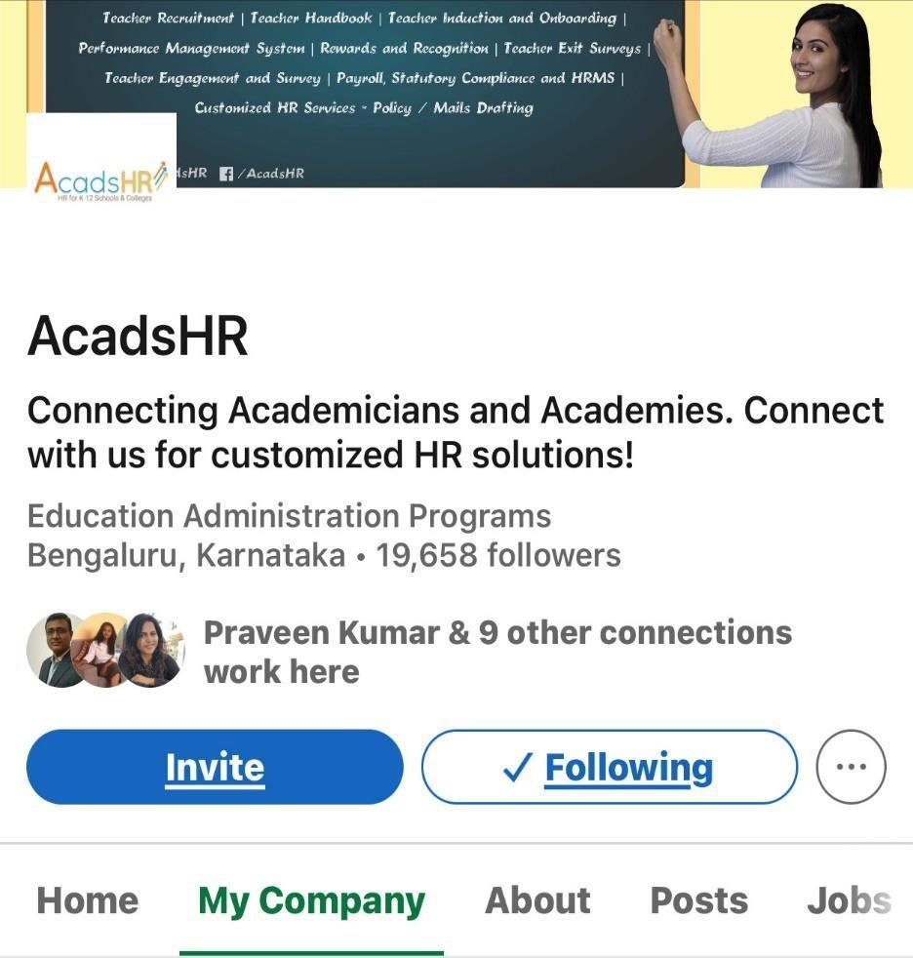
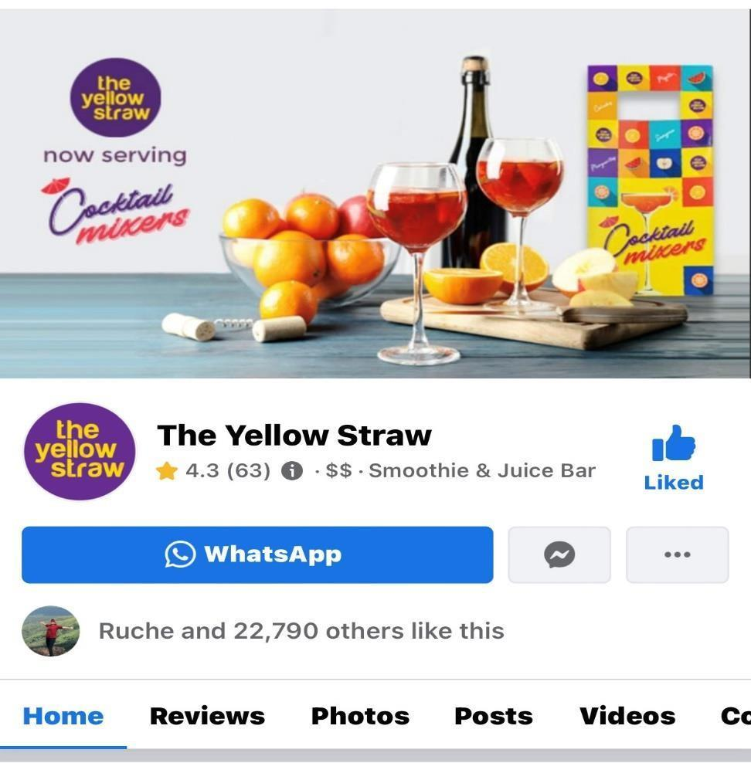
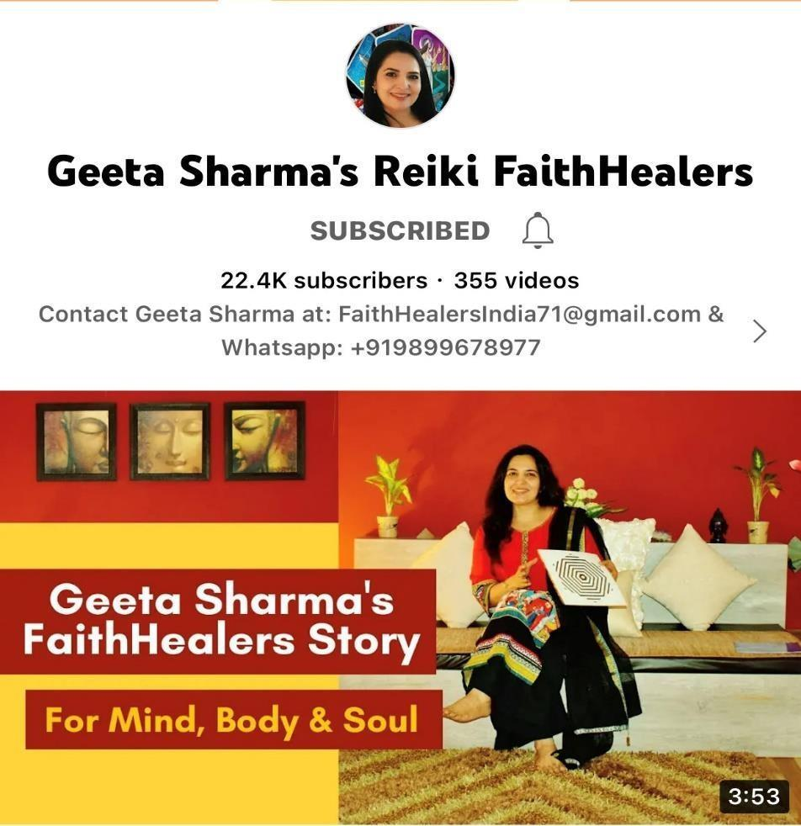
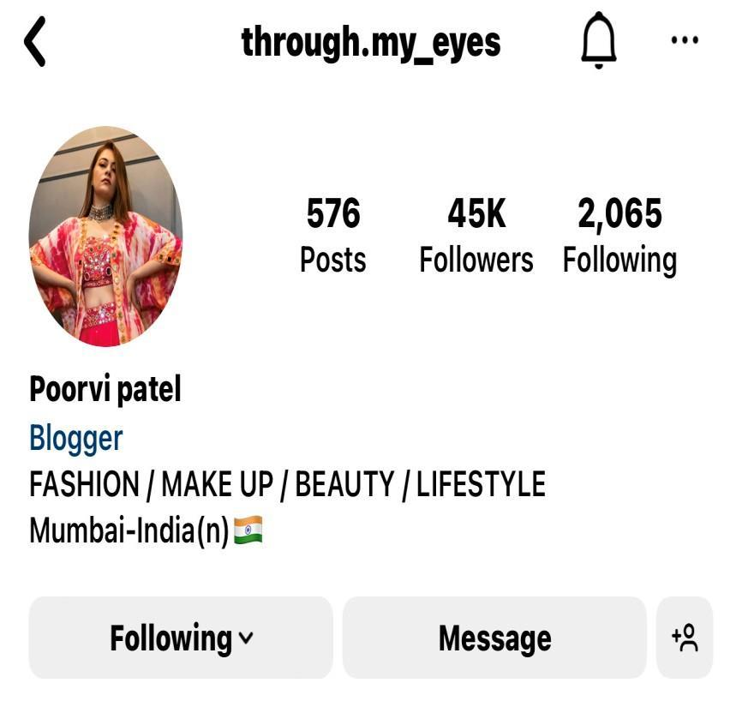
TRACK RECORD
Overview of Our Experience
We've managed communities and social accounts and helped clients enrich their social presence — from full profile audits to advertising strategy and data-driven recommendations.
45K
20K+
INSTAGRAM COMMUNITY
FACEBOOK FOLLOWERS
19K
22.5K
LINKEDIN AUDIENCE
YOUTUBE SUBSCRIBERS
Crown · Digital Marketing Agency
03

Slide 5
CREDENTIALS
Certifications
GOOGLE
GOOGLE
G
The Fundamentals of Digital Marketing
G
Google Ads Search & Display
Google Digital Garage · ID: JKJG3UZDB
Google · ID: 113015369, 108288402
GOOGLE
LINKEDIN
G
Advanced Google Analytics
in
Content & Social Media Marketing
Google Analytics · Issued Dec 2021
LinkedIn Certification
Crown · Digital Marketing Agency
04

Slide 6

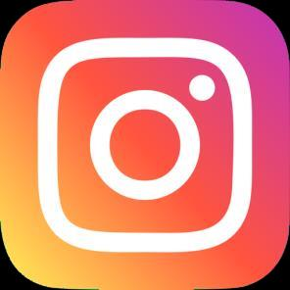

CAPABILITIES
Core Skills
01
Social Media Management
PLATFORMS I MANAGE
Instagram, Facebook & LinkedIn — content, community and reputation management.
Facebook
02
Promotions / Advertising
Instagram
Instagram, Facebook, LinkedIn, Google, YouTube, Microsoft & Snapchat Ads.
LinkedIn
03
LinkedIn Certification
Content Marketing, Social Media & Digital Marketing tools.
Crown · Digital Marketing Agency
05

Slide 7
01
SECTION ONE
Social Media
Marketing
Growing brand communities and driving engagement through organic content and strategy.
CROWN

Slide 8
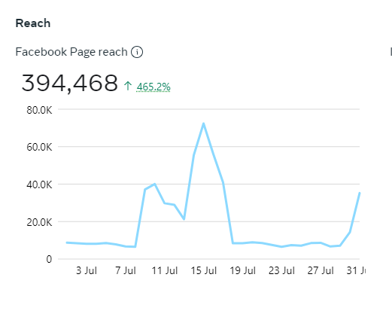
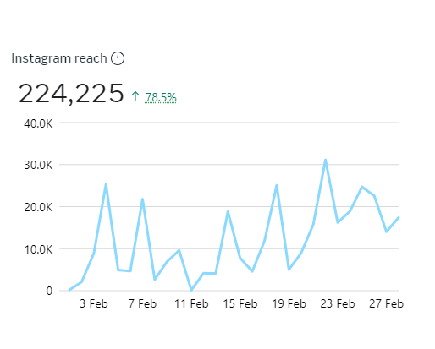
ORGANIC GROWTH
Building Social Presence
By leveraging the full potential of social media marketing, we have increased brand visibility while facilitating meaningful interactions and customer engagement. Carefully crafted content and strategic ad placement have driven soaring reach, amplified conversions, and increased website traffic.
Highlights
Full profile audits and content strategy
Community growth and engagement
Copywriting and reputation management
Crown · Digital Marketing Agency
06

Slide 9
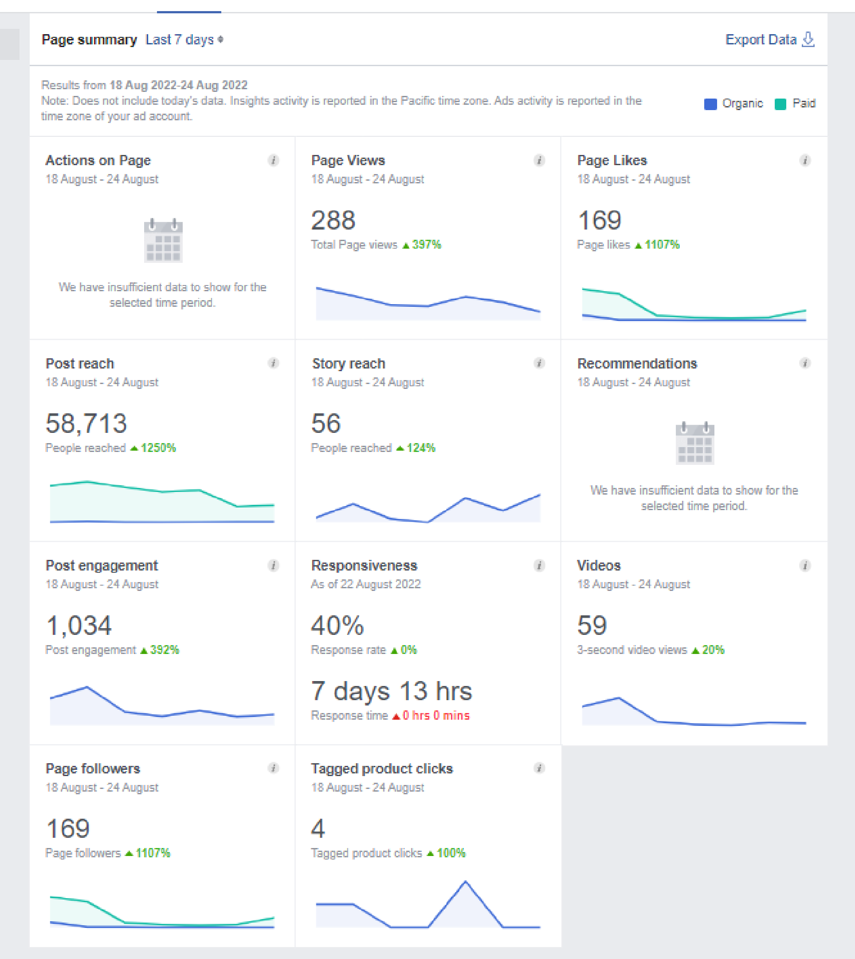
CASE STUDY · FACEBOOK
7-Day Page Growth
By managing a client's Facebook page we drove dramatic organic growth in a single week.
+1,107%
+1,250%
PAGE LIKES
POST REACH
+397%
+392%
PAGE VIEWS
POST ENGAGEMENT
169 new page likes & followers gained in just 7 days
Crown · Digital Marketing Agency
07

Slide 10
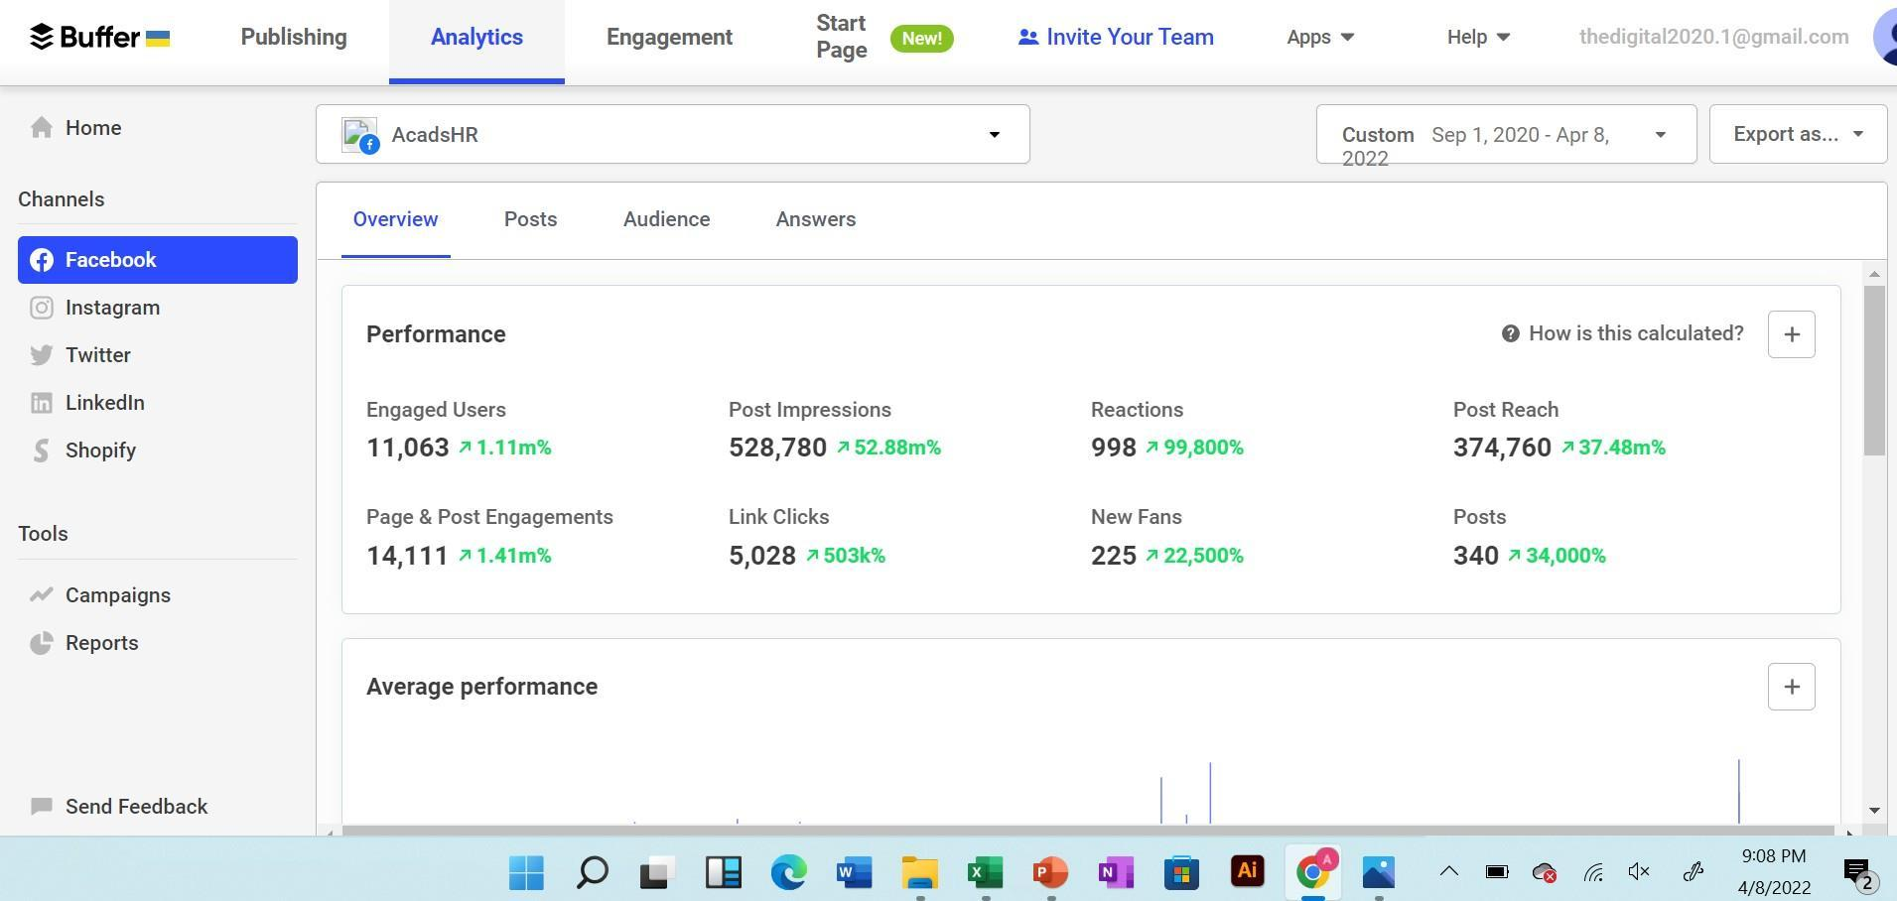
ANALYTICS · FACEBOOK
Facebook Page Insights
Page performance from 1 Sep 2020 – 8 April 2022.
Crown · Digital Marketing Agency
08

Slide 11
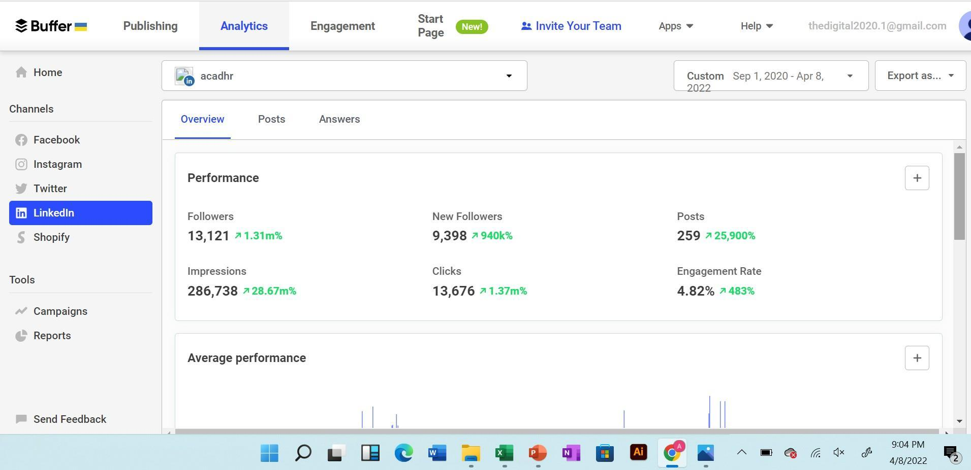
ANALYTICS · LINKEDIN
LinkedIn Organic Growth
Purely organic marketing traffic from 1 Sep 2020 – 8 April 2022.
Crown · Digital Marketing Agency
09

Slide 12
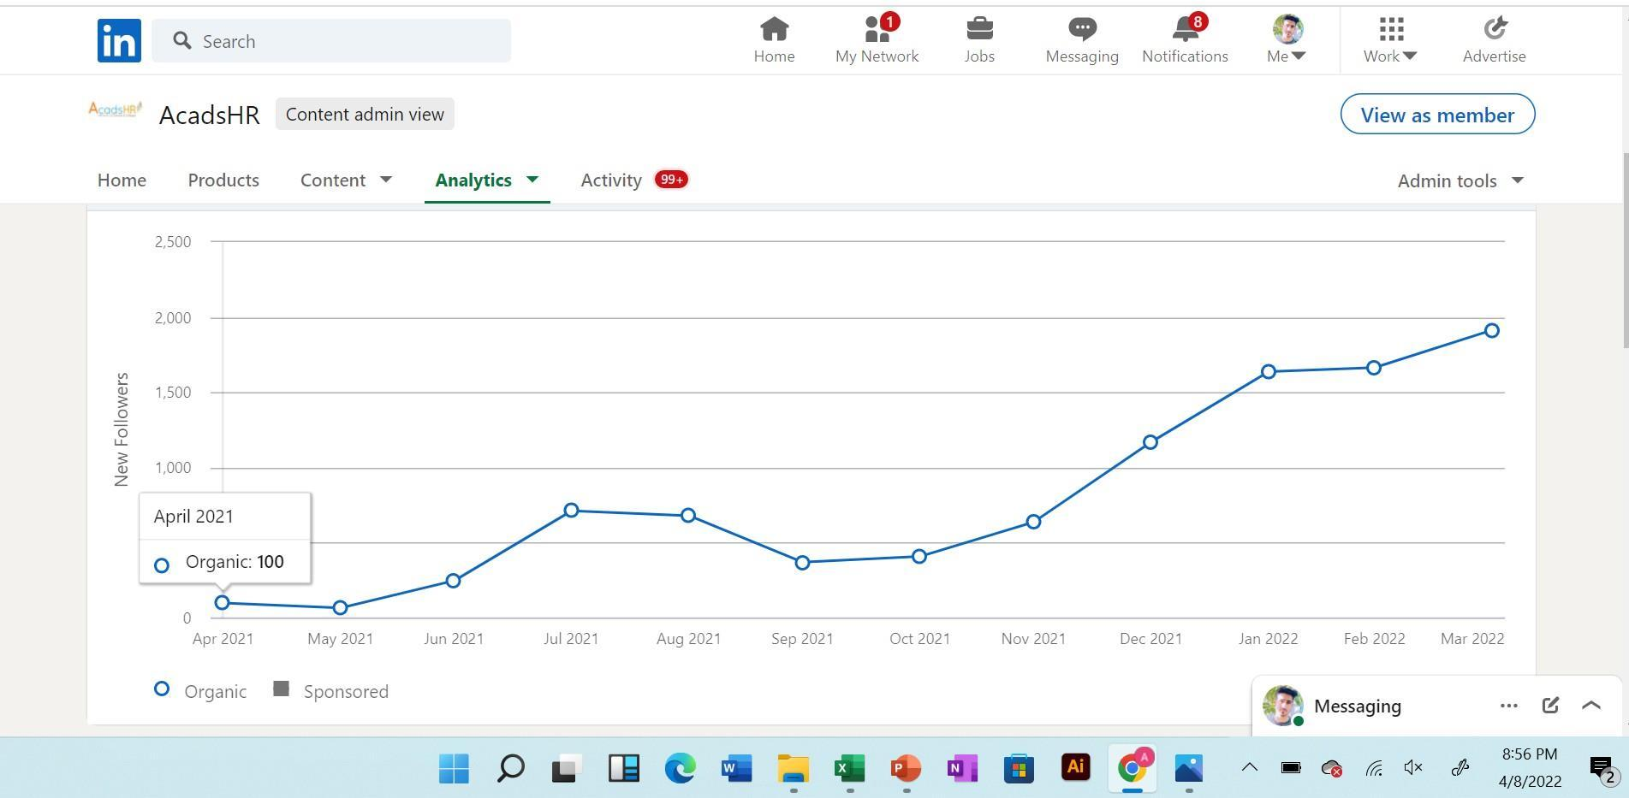
ANALYTICS · LINKEDIN
Organic Insight — April 2021
+100 organic followers gained on the LinkedIn page in April 2021.
Crown · Digital Marketing Agency
10

Slide 13
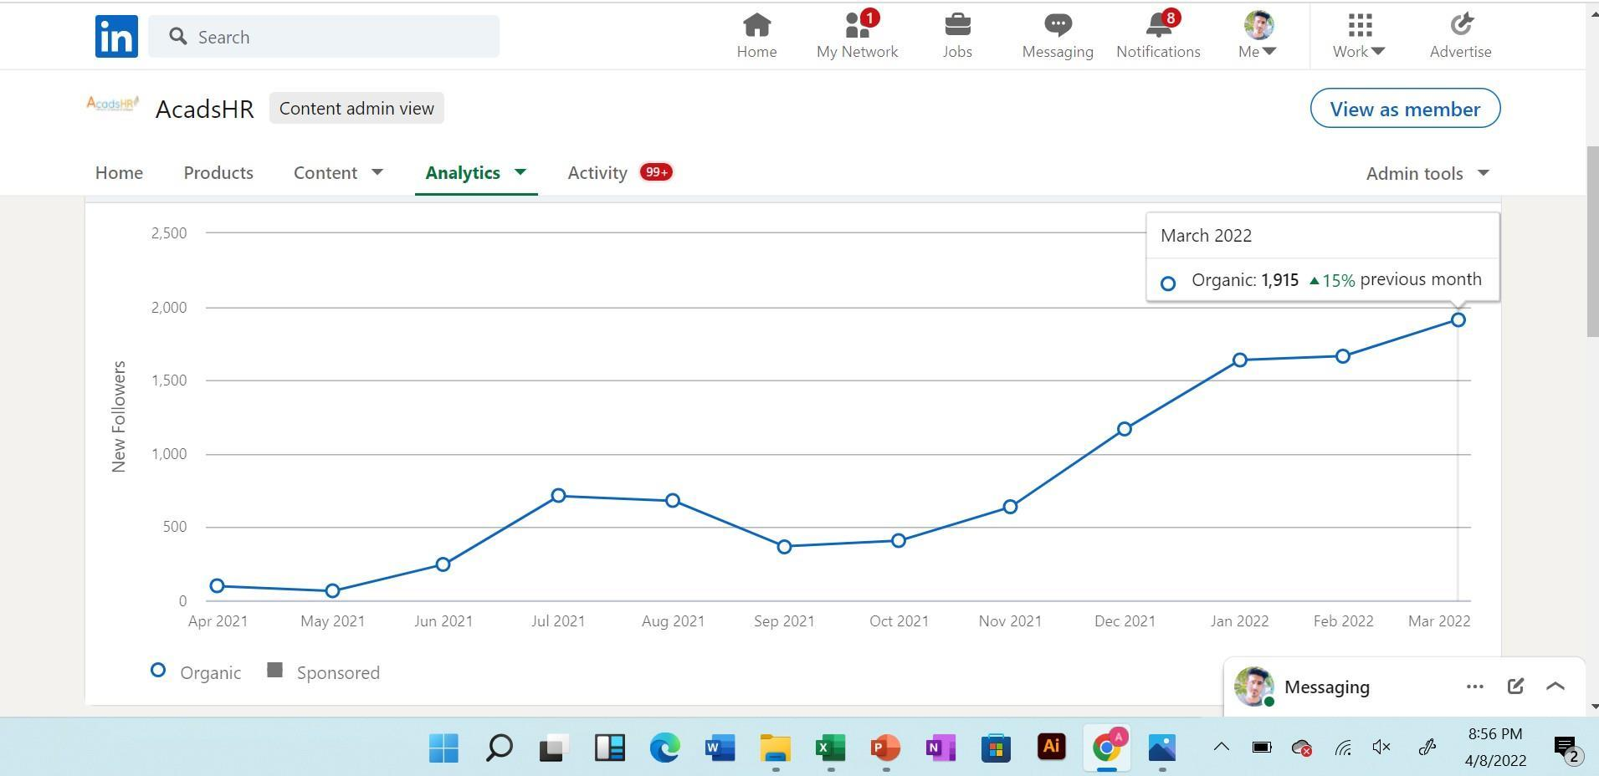
ANALYTICS · LINKEDIN
Organic Insight — March 2022
+1,915 organic followers in March 2022 — 15% higher than the previous month.
Crown · Digital Marketing Agency
11

Slide 14
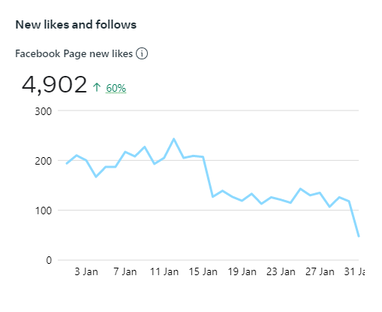
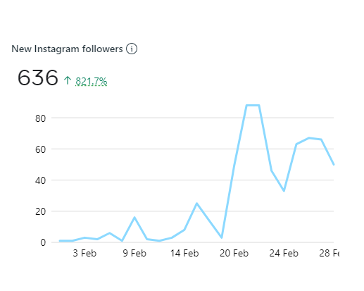
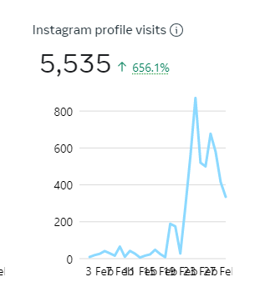
RESULTS
Turning Pages into Communities
Through strategic and consistent social media marketing, page likes and followers have grown remarkably — transforming each brand's online presence into a thriving community of loyal supporters.
Crown · Digital Marketing Agency
12

Slide 15
02
SECTION TWO
Paid Social
Media Ads
Performance campaigns across Facebook, Instagram, LinkedIn & YouTube — engineered for ROI.
CROWN

Slide 16
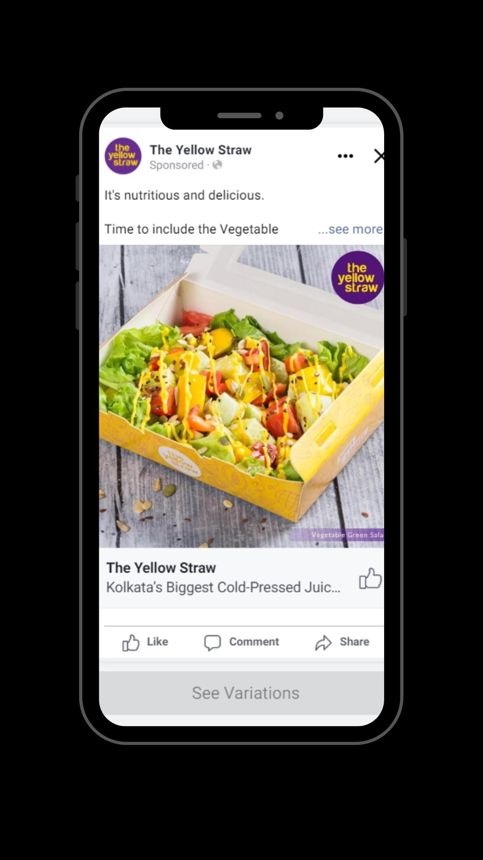
CASE STUDY · FACEBOOK ADS
Page-Like Campaign
Strategic optimization slashed the cost per page like — dramatically improving the efficiency of acquiring new followers.
BEFORE
AFTER
Rs 10.89
Rs 1.25
cost per page like
cost per page like
88% lower cost per acquisition
Objective — Facebook Page Likes
Refined audience & creative testing
Continuous bid and placement optimization
Crown · Digital Marketing Agency
13

Slide 17
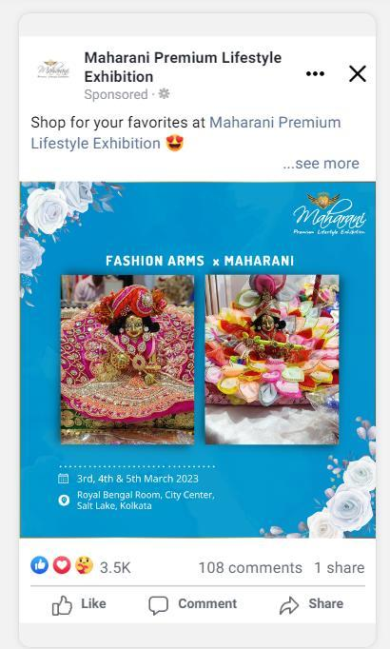
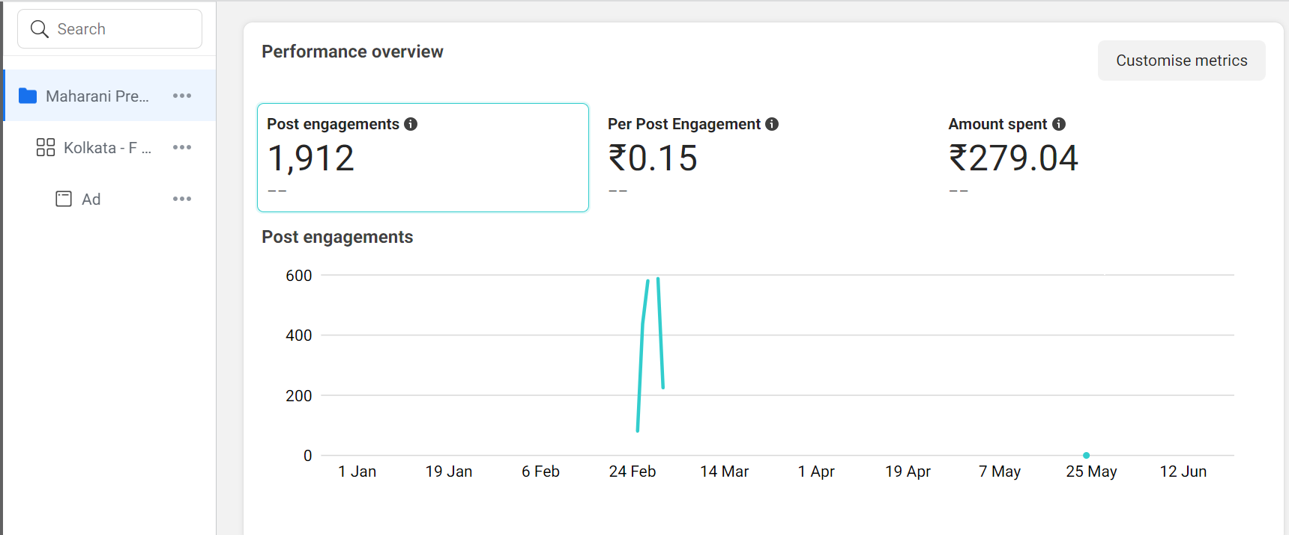
FACEBOOK ADS
Engagement Campaign
Single-image ad designed to maximise post engagement and interaction.
CAMPAIGN
Objective — Post Engagement
Format — Single Image Ad
Placements — Facebook & Instagram
Focus — reach and interactions
Crown · Digital Marketing Agency
14

Slide 18
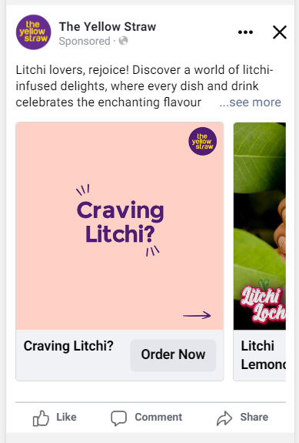
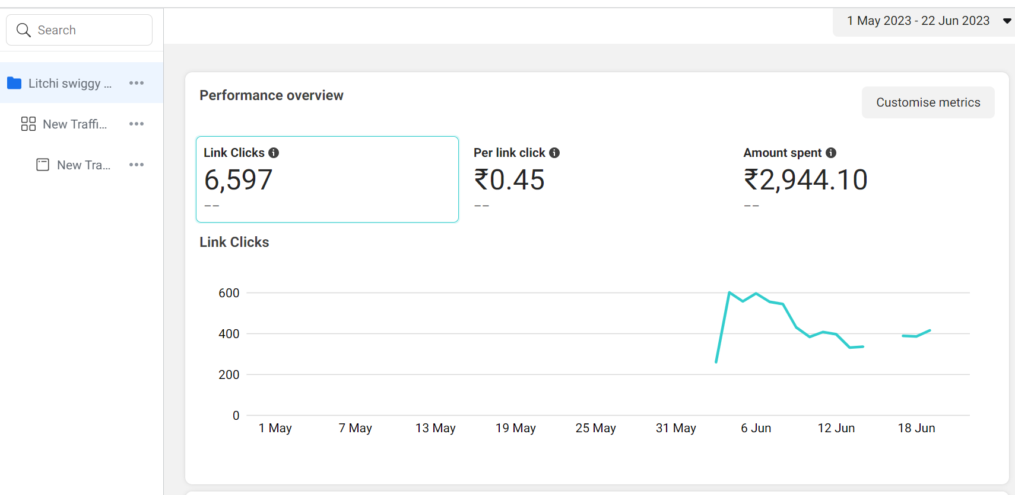
FACEBOOK ADS
Traffic Campaign — Carousel
CAMPAIGN DETAILS
OBJECTIVE
Traffic
CONVERSION
Website
PLACEMENT
Facebook, Instagram
AGE
25 – 46
GENDER
Male & Female
LOCATION
Kolkata
Crown · Digital Marketing Agency
15

Slide 19
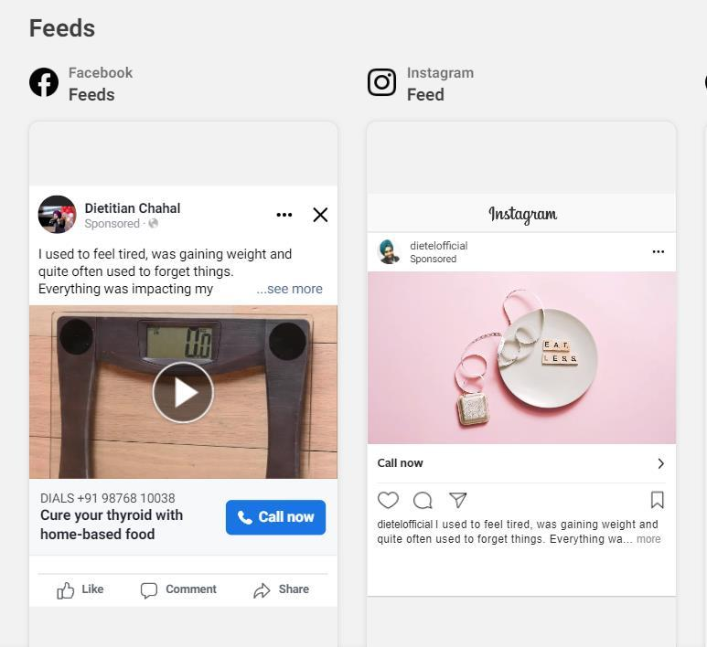
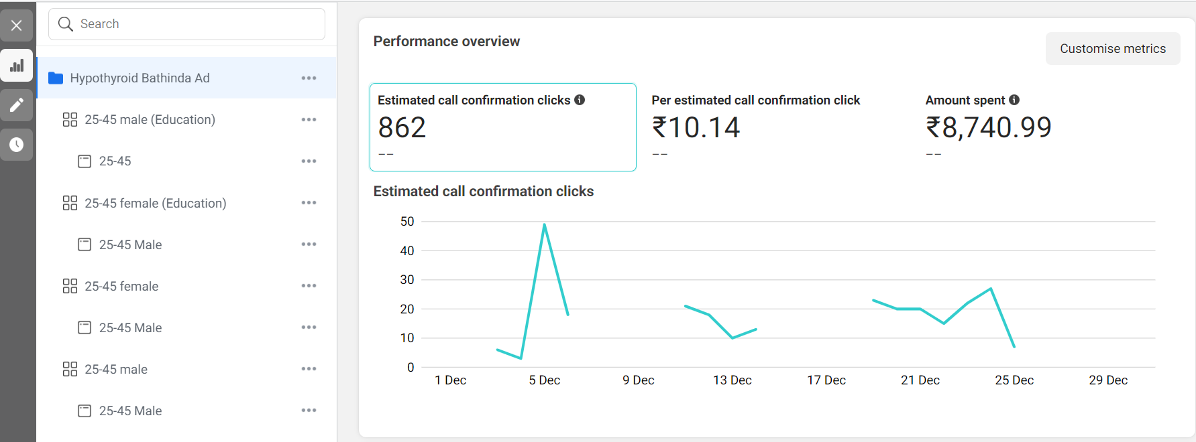
FACEBOOK ADS
Lead Generation — Video Ad
CAMPAIGN DETAILS
OBJECTIVE
Leads
CONVERSION
Call
PLACEMENT
Facebook, Instagram
AGE
25 – 45
GENDER
Male & Female
LOCATION
Punjab
Crown · Digital Marketing Agency
16

Slide 20
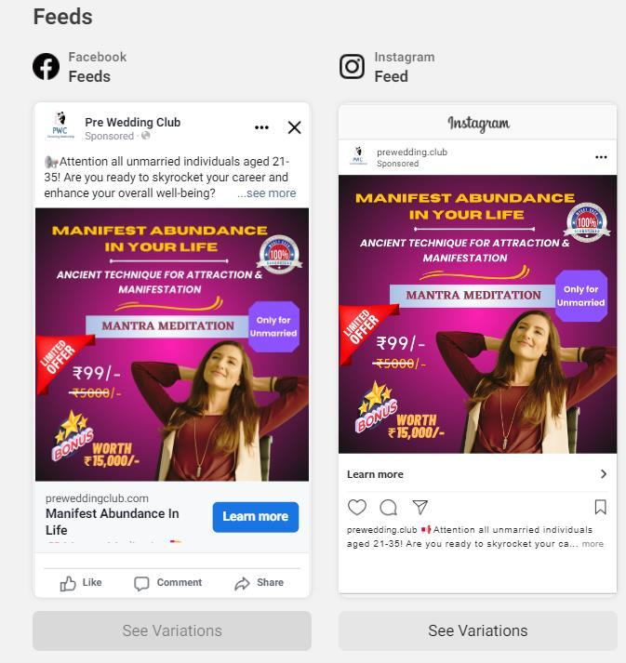
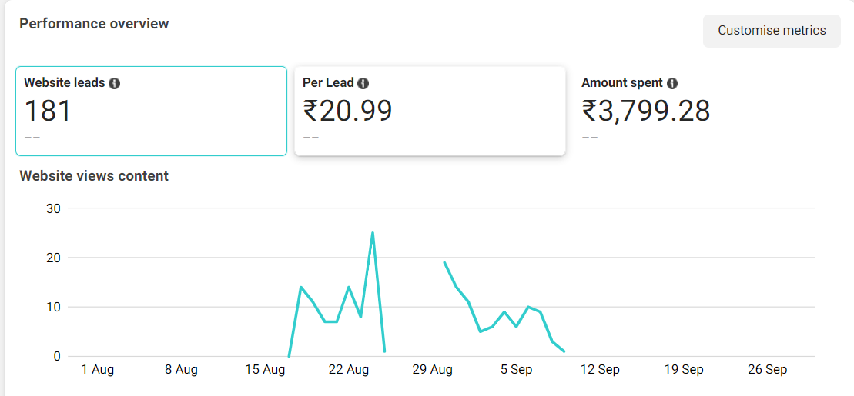
FACEBOOK ADS
Lead Generation — Single Image
CAMPAIGN DETAILS
OBJECTIVE
Leads
CONVERSION
Website
PLACEMENT
Facebook, Instagram
AGE
21 – 35
GENDER
Male & Female
LOCATION
Tier 1 & Tier 2 India
Crown · Digital Marketing Agency
17

Slide 21
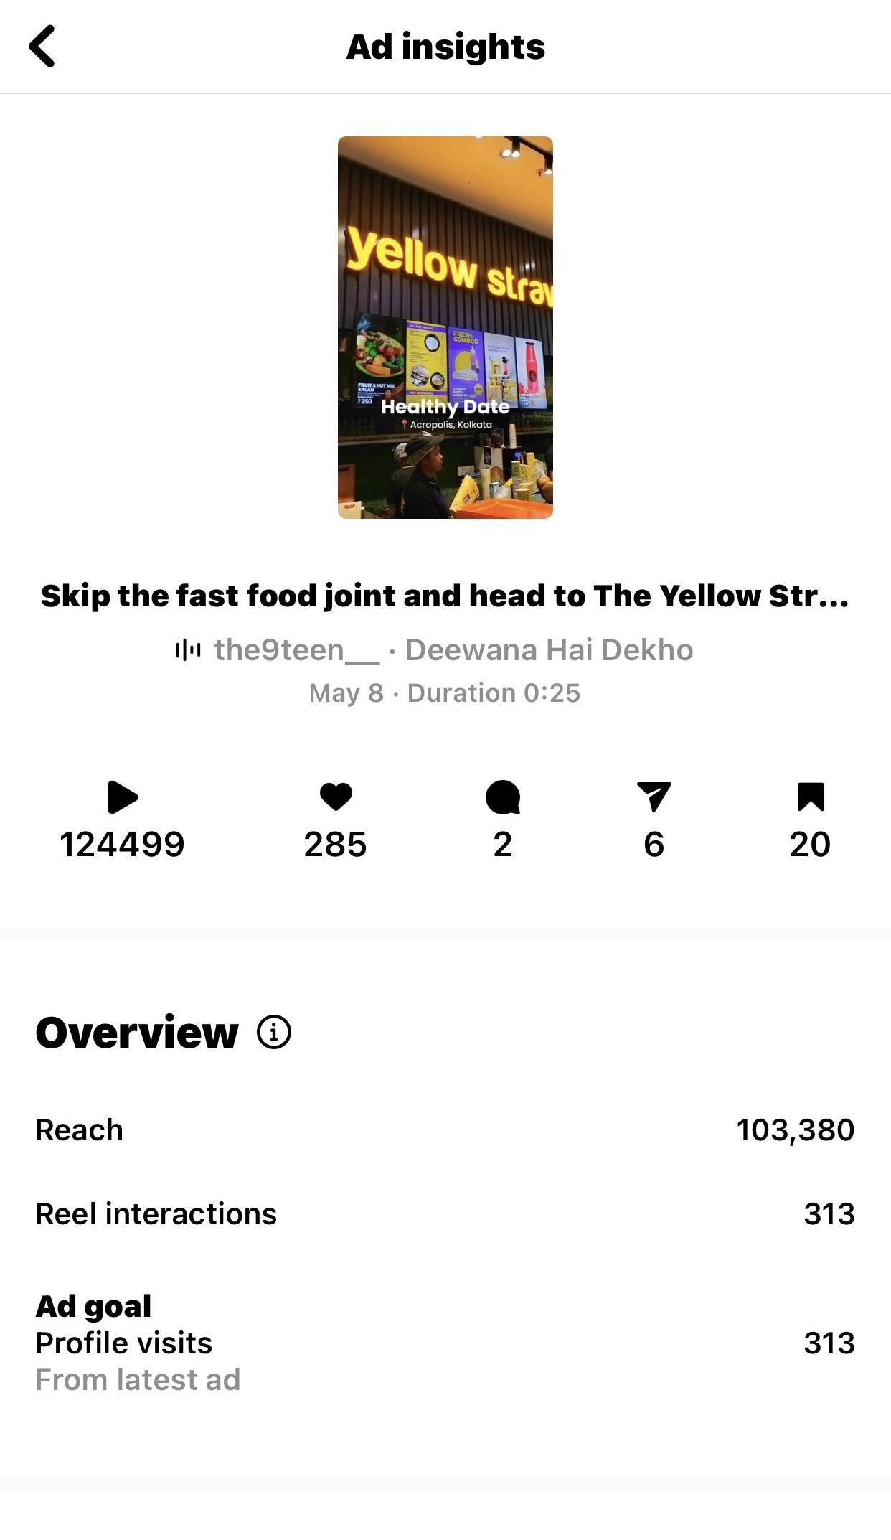
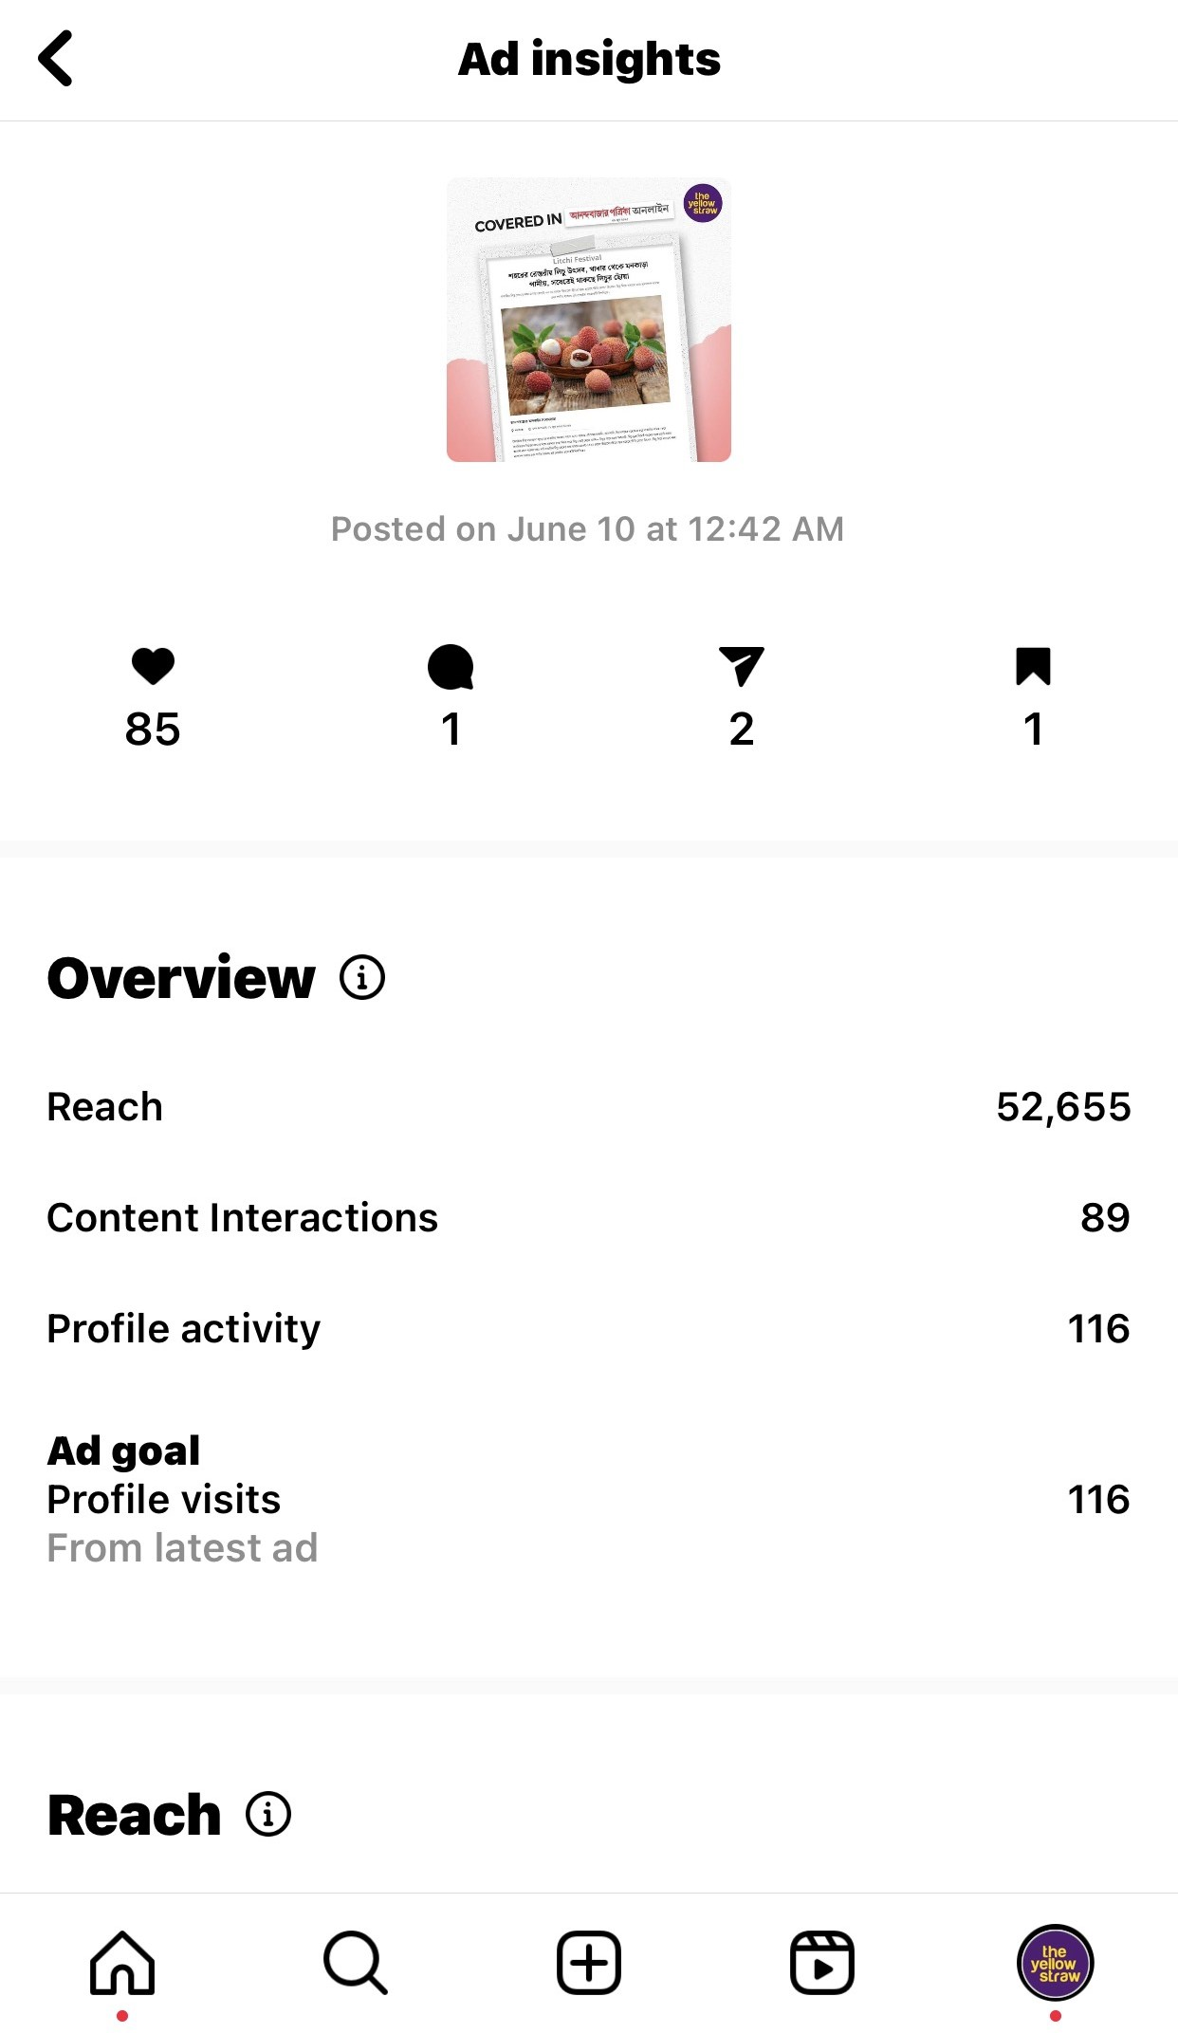
INSTAGRAM ADS
Profile-Visit Reel Campaign
CAMPAIGN DETAILS
OBJECTIVE
Profile Visits
PLACEMENT
Instagram
AGE
22 – 44
GENDER
Male & Female
LOCATION
Kolkata
1,03,380
456
313
Reel views
Link clicks
Profile visits
Crown · Digital Marketing Agency
18

Slide 22
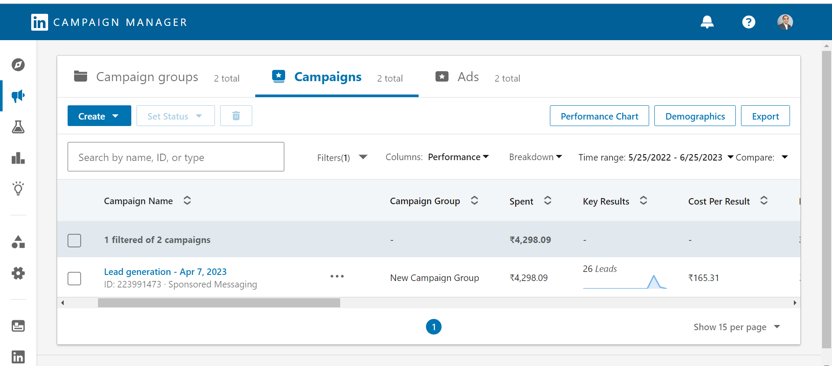
LINKEDIN ADS
LinkedIn Advertising
OUTREACH — SALES
LEAD GENERATION
Rs 900
26
daily budget
total leads
Goal Website Visits
Daily budget Rs 500 Total spent Rs 4,289
Crown · Digital Marketing Agency
19

Slide 23
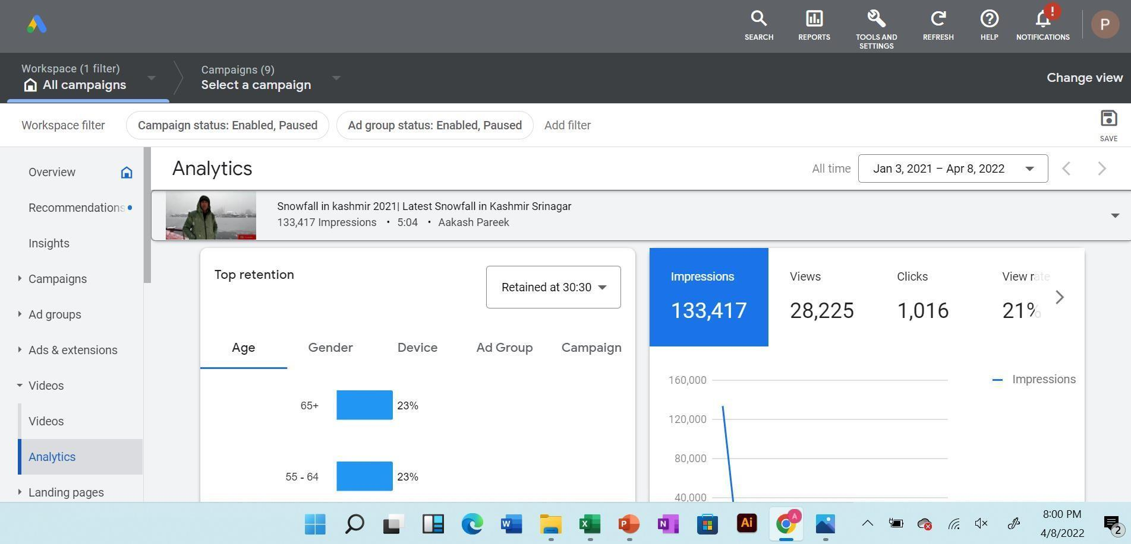
VIDEO ADVERTISING
YouTube Ads
Video campaigns built for reach, views, and qualified traffic.
Crown · Digital Marketing Agency
20

Slide 24
03
SECTION THREE
Search Engine
Marketing
Capturing high-intent demand with Google Search & Display advertising.
CROWN

Slide 25
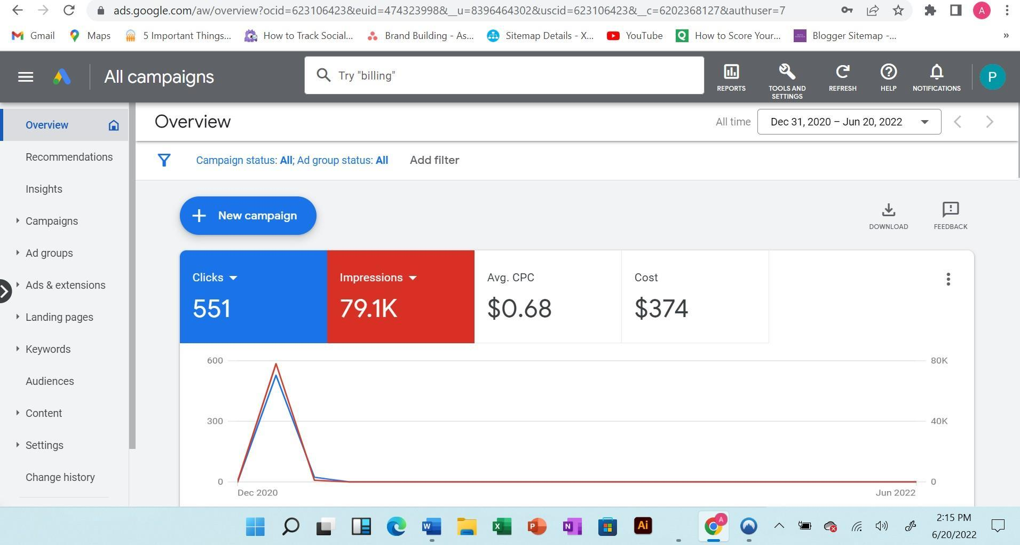
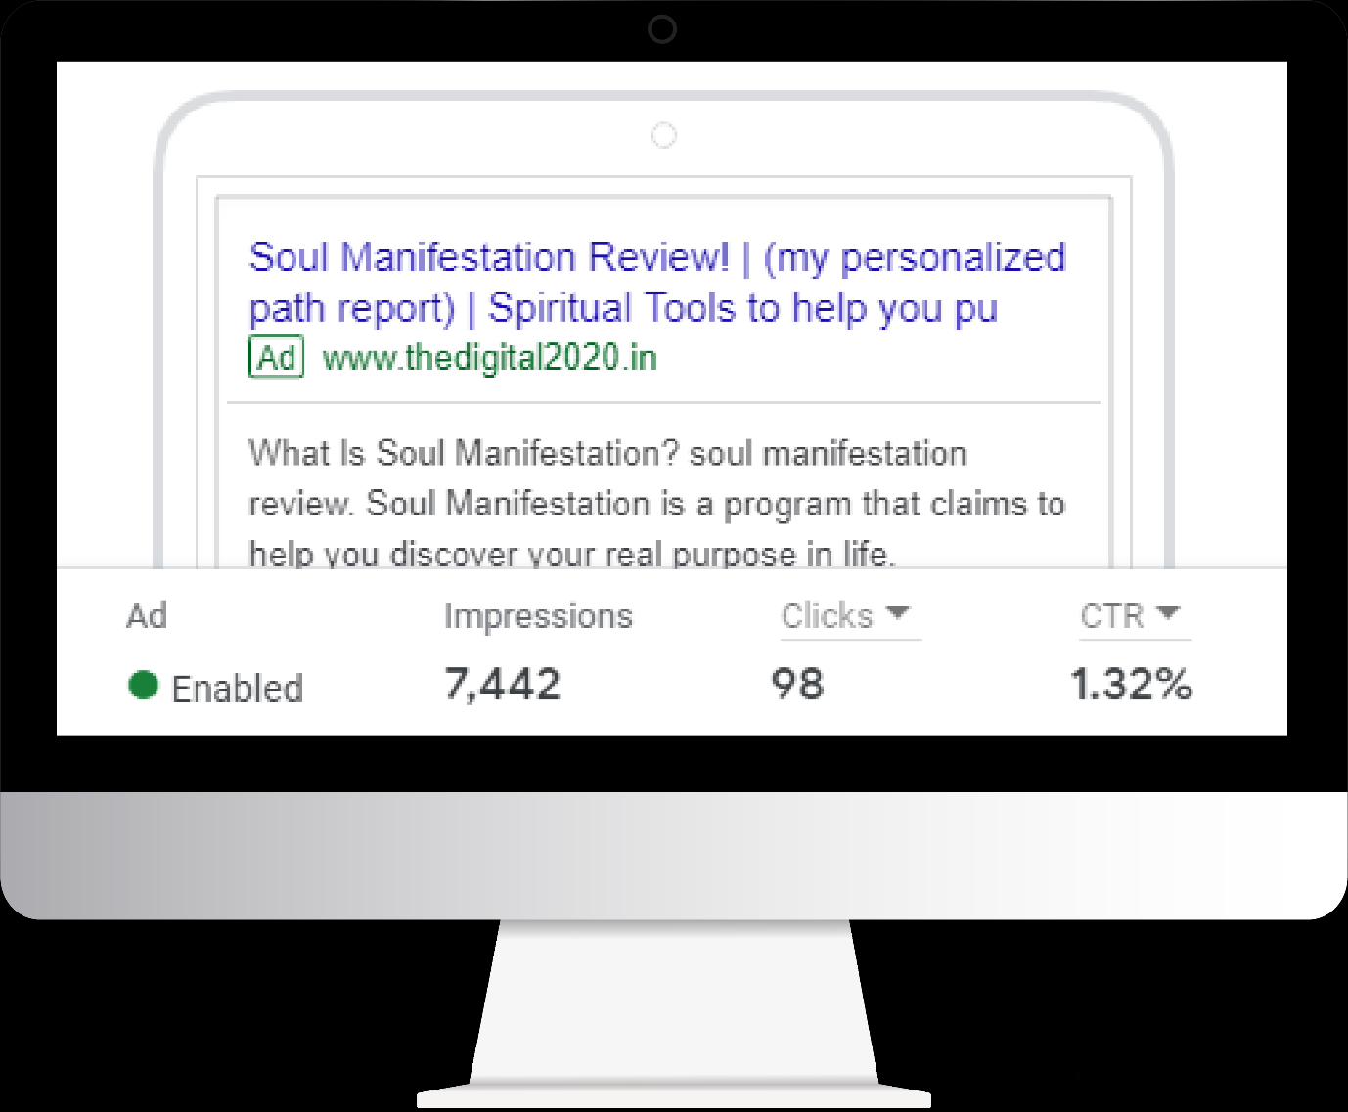
SEM · GOOGLE ADS
Google Search Ads
Keyword-targeted search campaigns that put the brand in front of ready-to-buy audiences.
Crown · Digital Marketing Agency
21

Slide 26
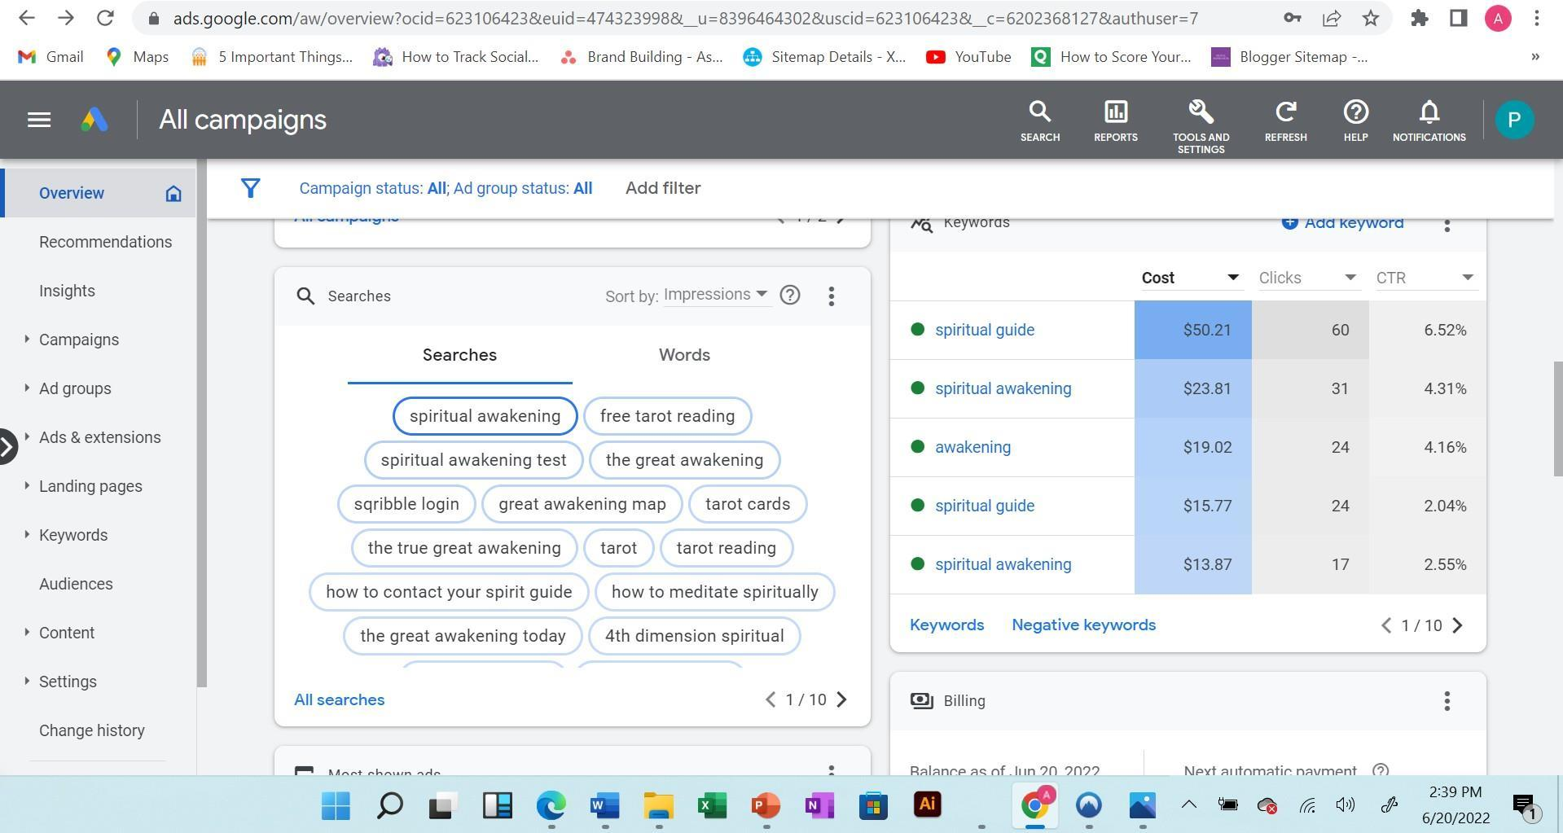
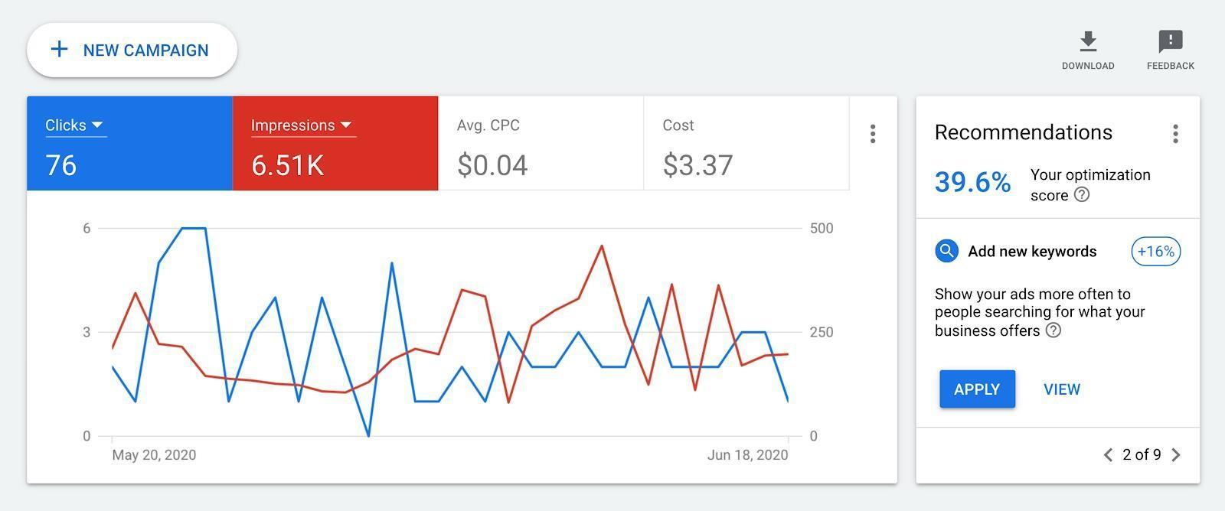
SEM · GOOGLE ADS
Search Campaign Performance
Live campaign dashboards showing spend, clicks, impressions and optimization scores.
Crown · Digital Marketing Agency
22

Slide 27
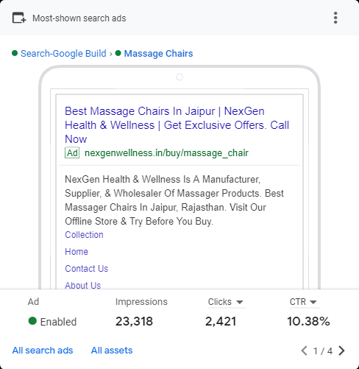
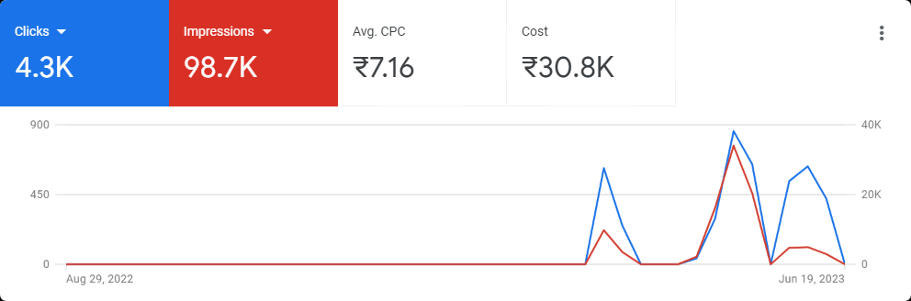
SEM · GOOGLE ADS
Campaign Setup & Structure
Well-structured ad groups, keywords, and extensions built for quality score and efficiency.
Crown · Digital Marketing Agency
23

Slide 28
ORGANIC SEARCH
Search Engine Optimization
End-to-end on-page and off-page optimization to grow organic visibility and rankings.
01
On-Page
02
Technical
03
Off-Page
Keyword research & analysis
Meta titles & descriptions
Internal & external linking
Content & image optimization
Tags & page speed
Robots.txt & sitemap.xml
Google Search Console
Google Analytics
Google integration
Core Web Vitals
Backlink building
Social media linking
Brand mentions
Directory & citations
Reputation signals
Crown · Digital Marketing Agency
24

Slide 29
04
SECTION FOUR
More Marketing
Channels
SMS, email automation and influencer marketing that extend every campaign's reach.
CROWN

Slide 30
DIRECT MARKETING
SMS & WhatsApp Campaigns
01
WhatsApp Marketing
02
SMS Marketing
A time- and cost-effective way to share new products, services, offers and app marketing using tools like Mbasket — building awareness and brand presence online and offline.
Textlocal business SMS to promote services and stay connected with candidates and clients — job updates, interview confirmations, and follow-ups — boosting productivity and cutting cold calls.
Crown · Digital Marketing Agency
25

Slide 31
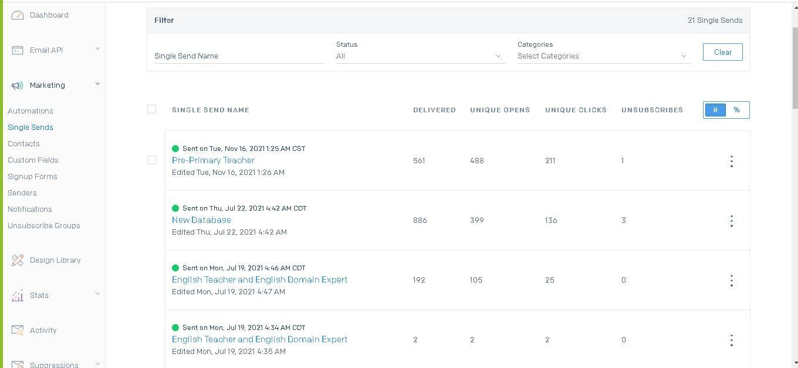
LIFECYCLE MARKETING
Email Marketing & Automation
PLATFORMS
SendGrid
Mailchimp
Mailgun
CAPABILITIES
Email automation
Signup forms & testing
Creative templates & design
Delivery & open-rate analytics
Crown · Digital Marketing Agency
26

Slide 32
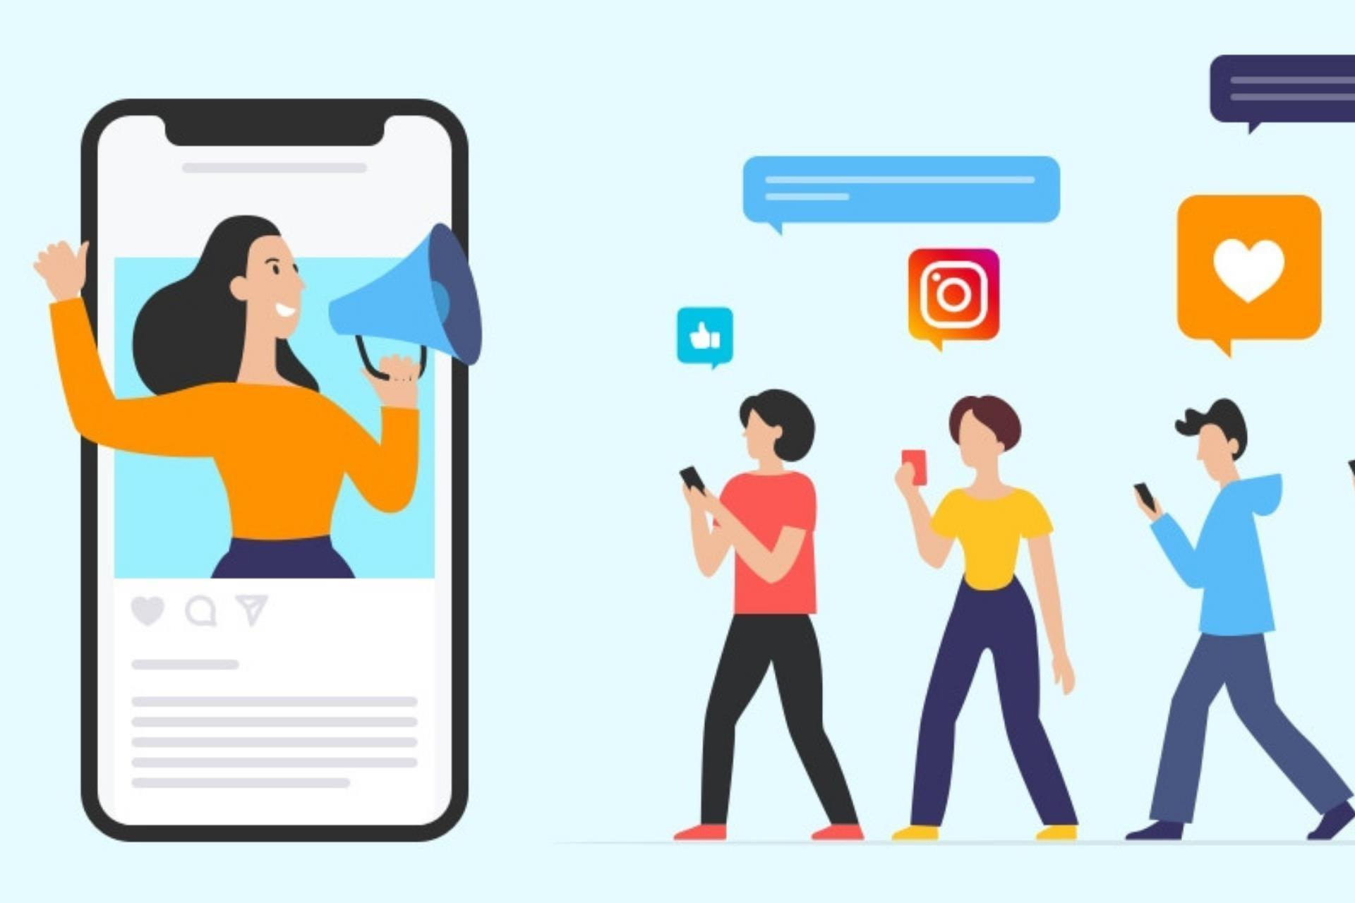
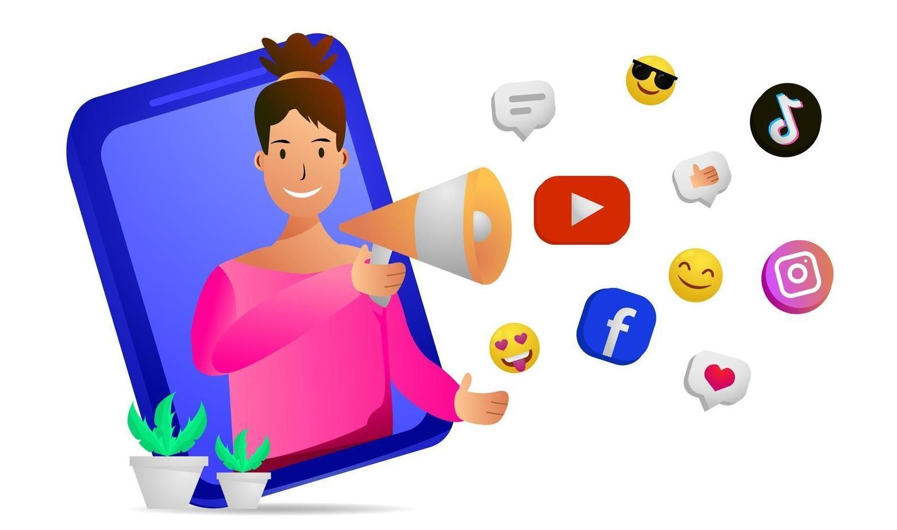
INFLUENCER MARKETING
Influencer Discovery & Management
Sourcing and managing influencers for a digital marketing agency — identifying creators on Instagram who meet set criteria to help brands grow their audience organically.
Crown · Digital Marketing Agency
27

Slide 33
TOOLKIT
Marketing Tools & Platforms
GRAPHICS & VIDEO
CONTENT PLANNING
EMAIL MARKETING
Canva · VN Video Editor · Pictory · Capcut
Buffer · Hootsuite · Asana
SendGrid · Mailchimp · Mailgun
ADS & SOCIAL
SEO
ANALYTICS
Meta Business Suite · Facebook & Instagram Ads · LinkedIn Campaign Mgr · Google Ad Manager
SEMrush · Moz · Yoast SEO · Ahrefs
Google Analytics · Search Console · Data reporting
Crown · Digital Marketing Agency
28

Slide 34
05
SECTION FIVE
Creative
Showcase
Digital and print design that gives every campaign a consistent, on-brand look.
CROWN

Slide 35
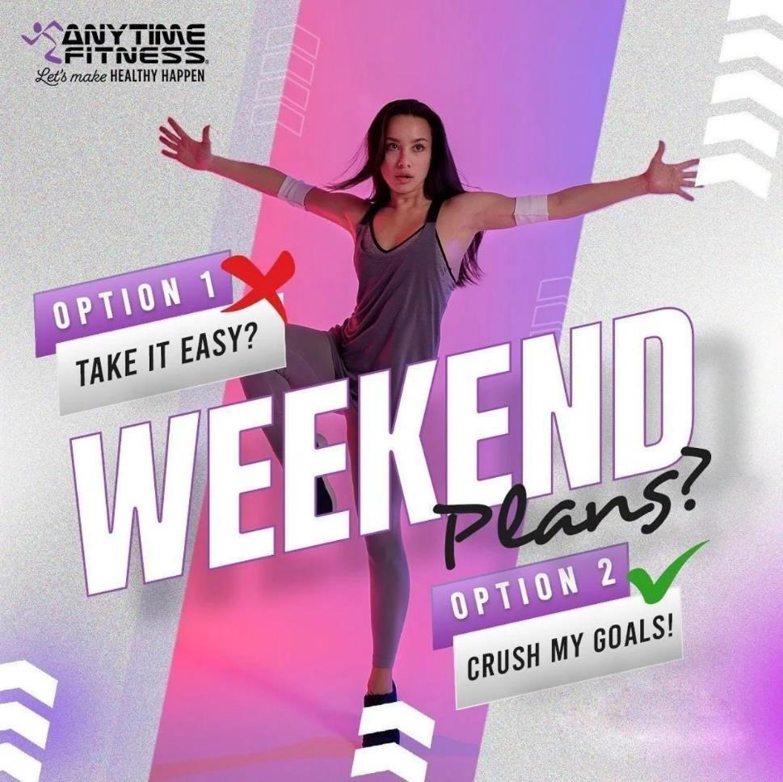
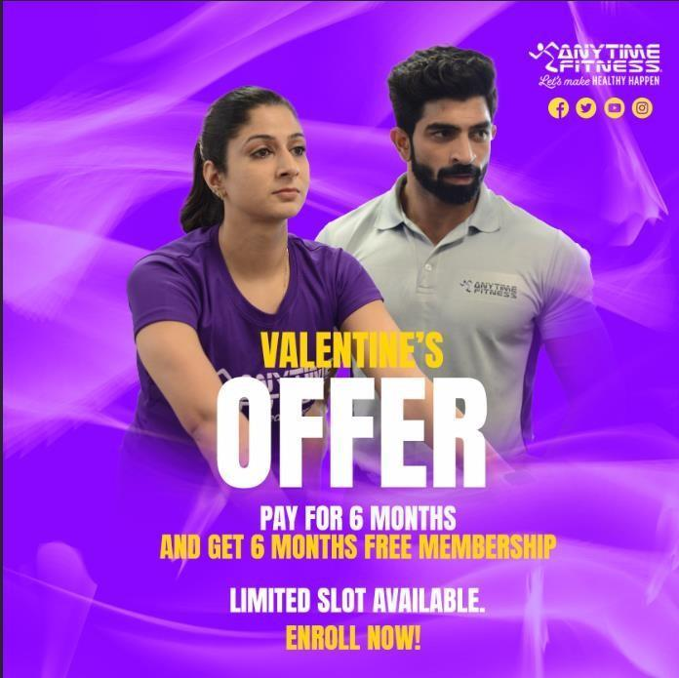
DESIGN
Creative Capabilities
DIGITAL
Websites, blogs, social media and digital devices.
PRINT
Business stationery, advertising, packaging, brochures, flyers, roll-ups and more.
Crown · Digital Marketing Agency
29

Slide 36
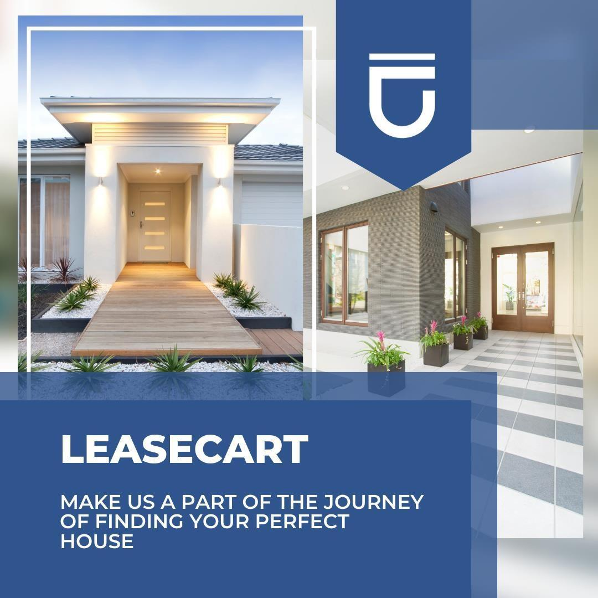
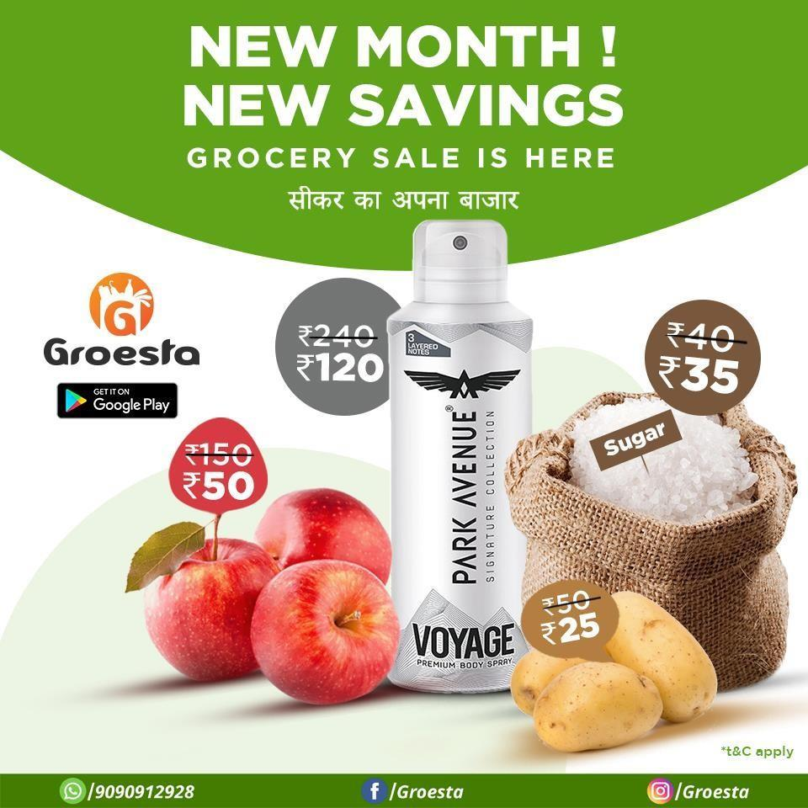
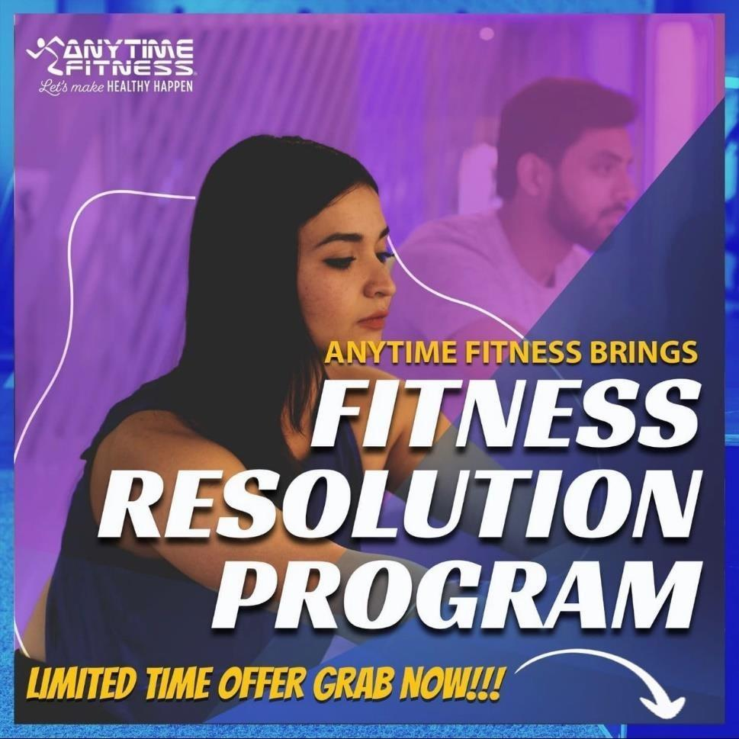
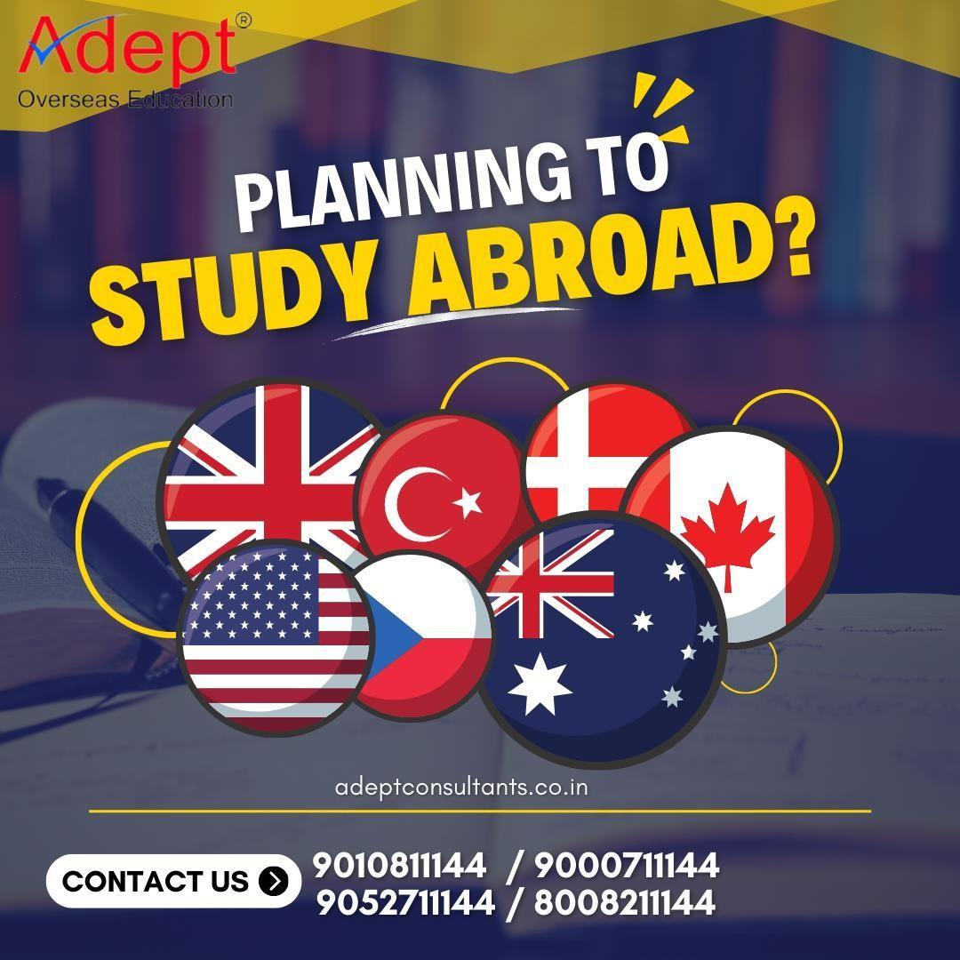
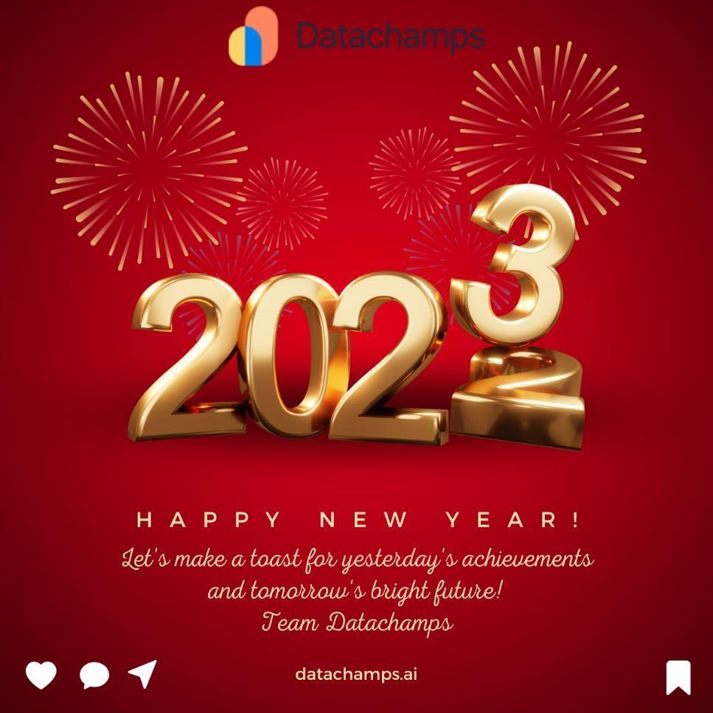


PORTFOLIO
Selected Creative Work
Crown · Digital Marketing Agency
30

Slide 37
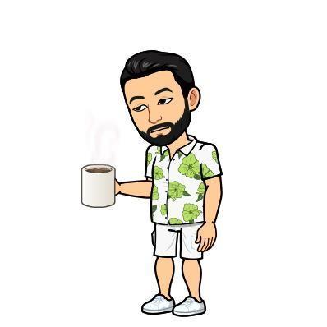
LET'S WORK TOGETHER
Get in Touch
Ready to grow your brand with data-driven digital marketing?
Let's build something remarkable together.
CROWN · DIGITAL MARKETING AGENCY

