Slide 1
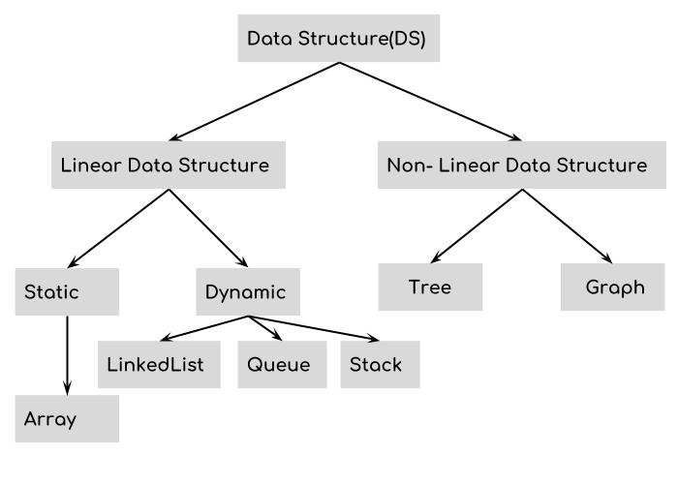
Data structures + Algorithms
APS Hack Day 2019

Slide 2
Repo
https://github.com/averyschiff/apsHackDay
  presentation.odp
  data_structures
    stacks_and_queues.ipynb
    linked_list.ipynb
    trees.ipynb
  Algorithms
    Euclid’s algorithm
    Sieve of Aritosthenes
    Sorting algorithms
      Insertion sort
      Merge sort
      Quick sort

Slide 3
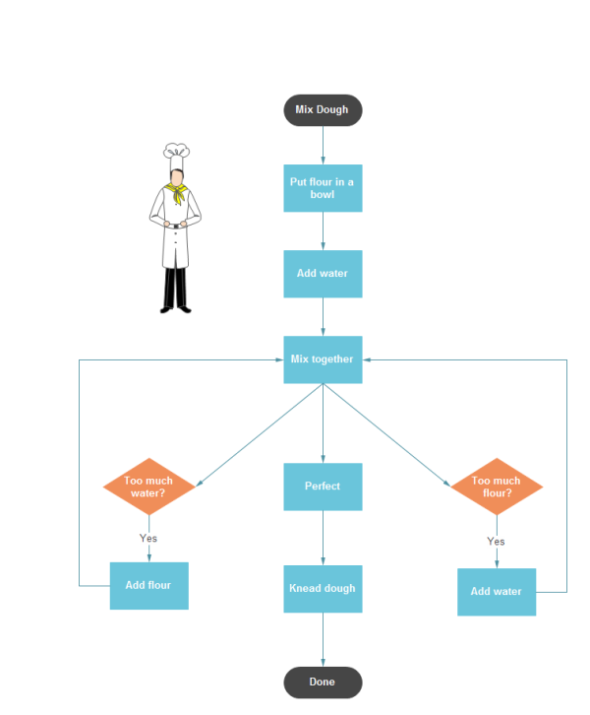
Basic definitions
Data structures
  Primitive data types: X = 2
  Nonprimitive data structure:
  X = [“Boulder”, “Denver”, “Colorado Springs”, “Pueblo”]
Algorithm
  “a process or set of rules to be followed in calculations or other problem-solving operations, especially by a computer”

Slide 4
Big O notation
If n = the length of our data set
# number of operations ~ f(n)
We say the algorithm runs in O(f(n)) (said as “O of f(n)”) time.
e.g. “This sorting algorithm runs in O(n!),” “This method takes O(n), but we can improve it to run in O(1).”
We always consider the worst case and we write the fastest growing function without
This means O(2*n^2 + n + 5) = O(n^2), but O(0.001 * n^2 + 100000 * n) = O(n^2) as well.

Slide 5
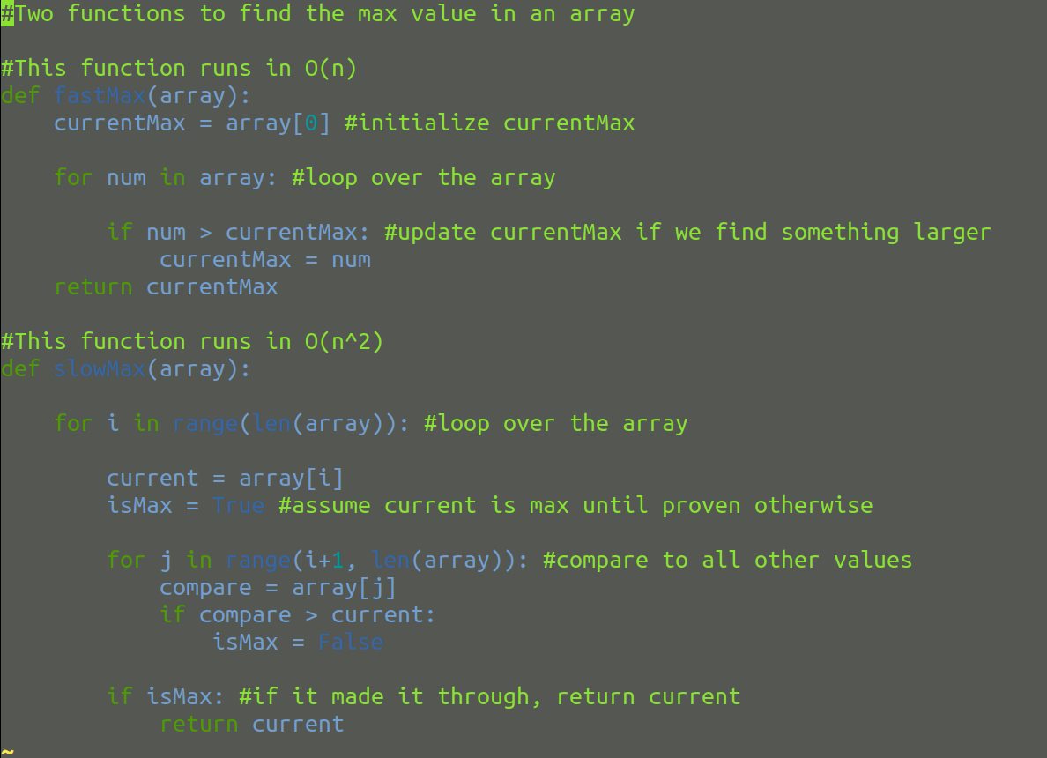
Big O notation
Consider two different approaches to finding the maximum value in
X = [1, 2, 3, 4, 5].
In the worst case, the second takes
(n - 1) + (n – 2) + … + 1 = n * (n-1)/2
Operations, so it runs in O(n^2).

Slide 6
Data structures
Stacks, Queues, and Trees Oh My!

Slide 7
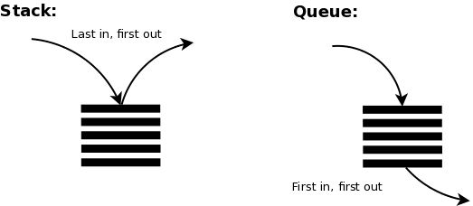
Stacks and Queues
Stacks and queues each have two functions: push and pop. Push adds a single element, pop removes (and returns a single element).
Pros: Super fast to get the first/last element
Cons: Super slow to get something in the middle or on the opposite end

Slide 8
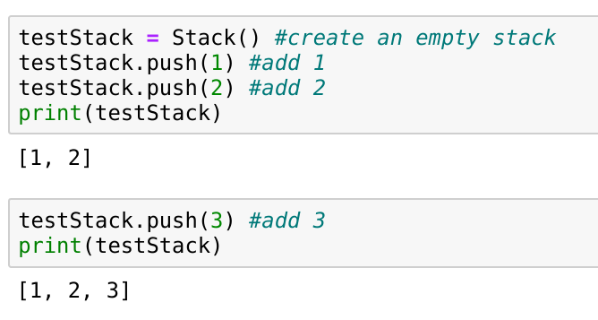
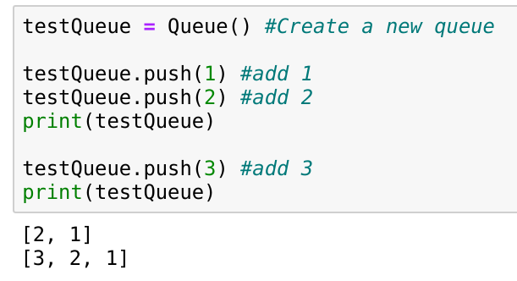
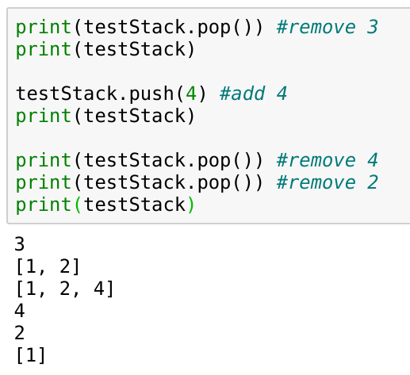
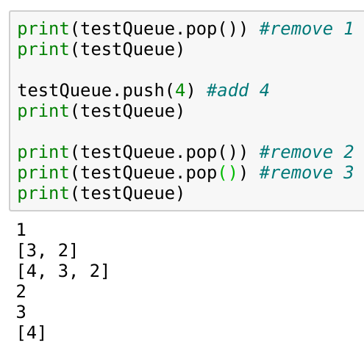
Stacks
Queues

Slide 9
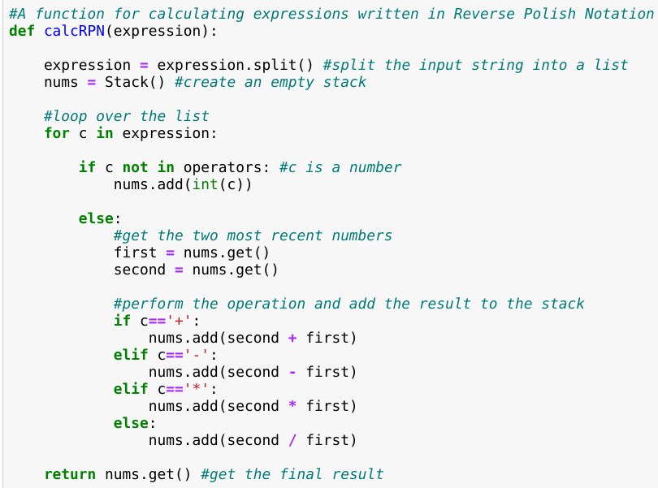
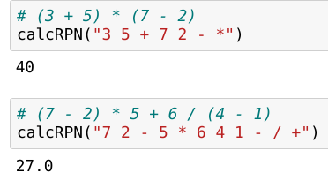
Stacks: Reverse Polish Notation
3 + 5 * 7 – 2 = 36? 54?
Normal: (3 + 5) * (7 – 2)
RPN: 3 5 + 7 2 - *
Normal: 3 + (5 * 7) – 2
RPN: 3 5 7 * + 2 -

Slide 10
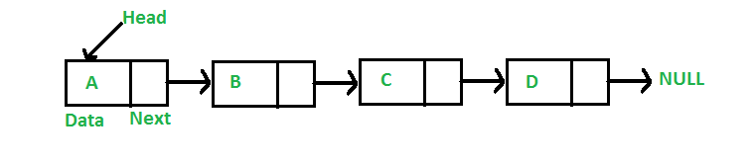
Linked List
A linked list is a series of nodes. Any given node has two parts: its data and the location of the next node in the chain.
Pros: Very easy to add/delete elements, dynamic size
Cons: Takes up more memory, harder to quickly navigate, easy to destroy

Slide 11
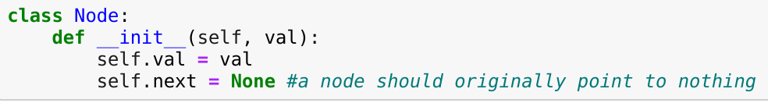
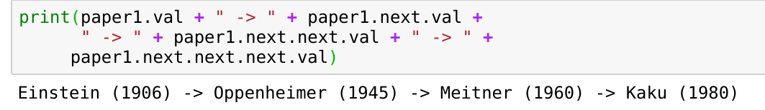
Linked List

Slide 12
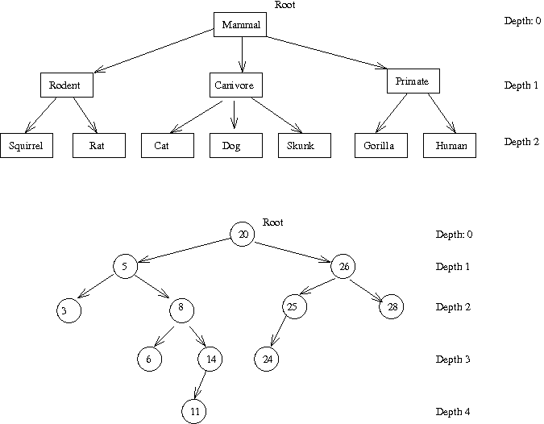
Trees
Trees are like linked lists, but nodes can now point to multiple “children.”
Trees are an excellent representation of hierarchical data. They organize our data in a sensible fashion and it’s relatively quick/easy to add or delete nodes.

Slide 13
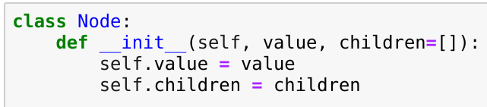
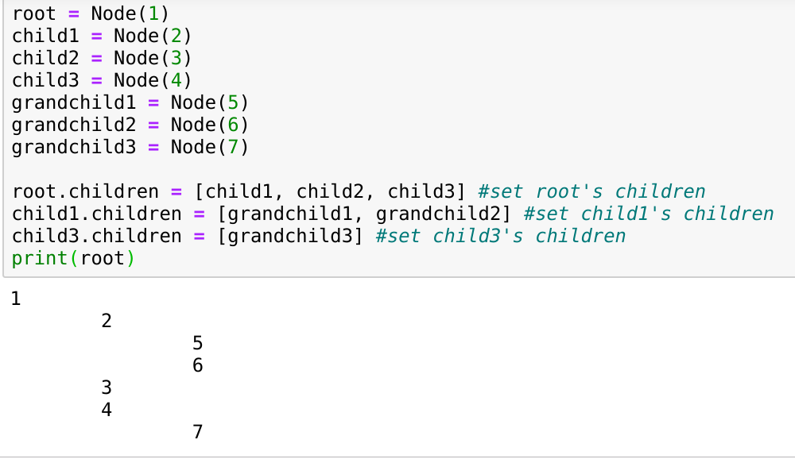
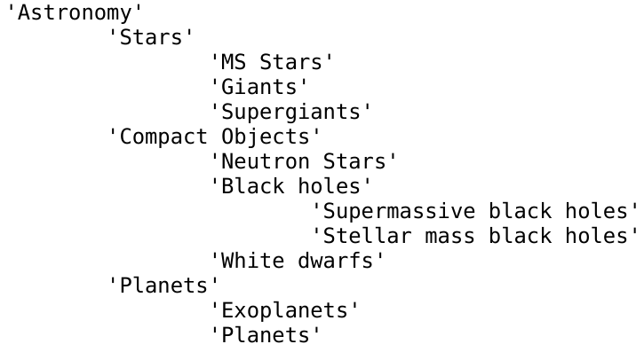
Trees

Slide 14
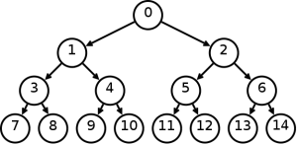
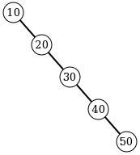
Trees
A binary tree is a tree where every node has at most two children. We typically try and make these trees “balanced.”

Slide 15
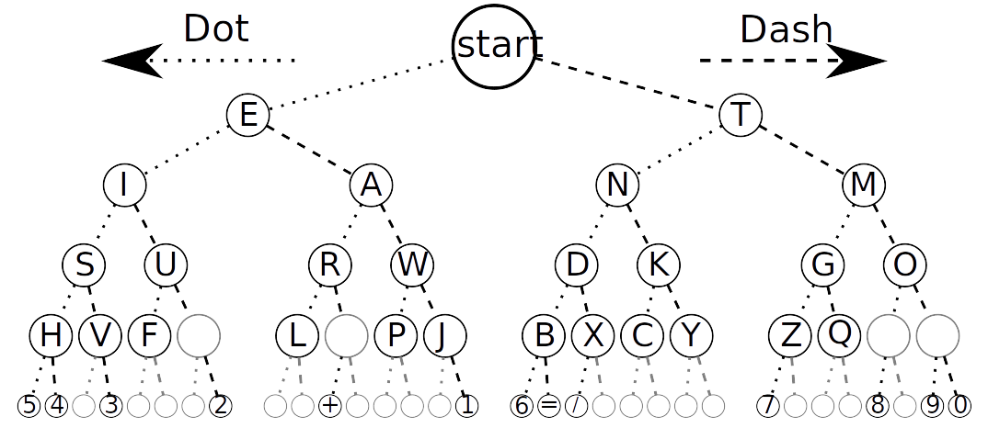
Encoding

Slide 16
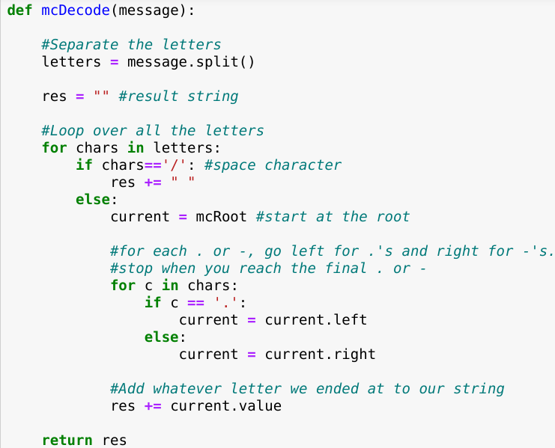
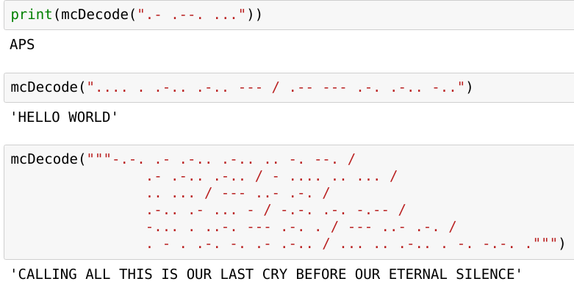
Trees

Slide 17
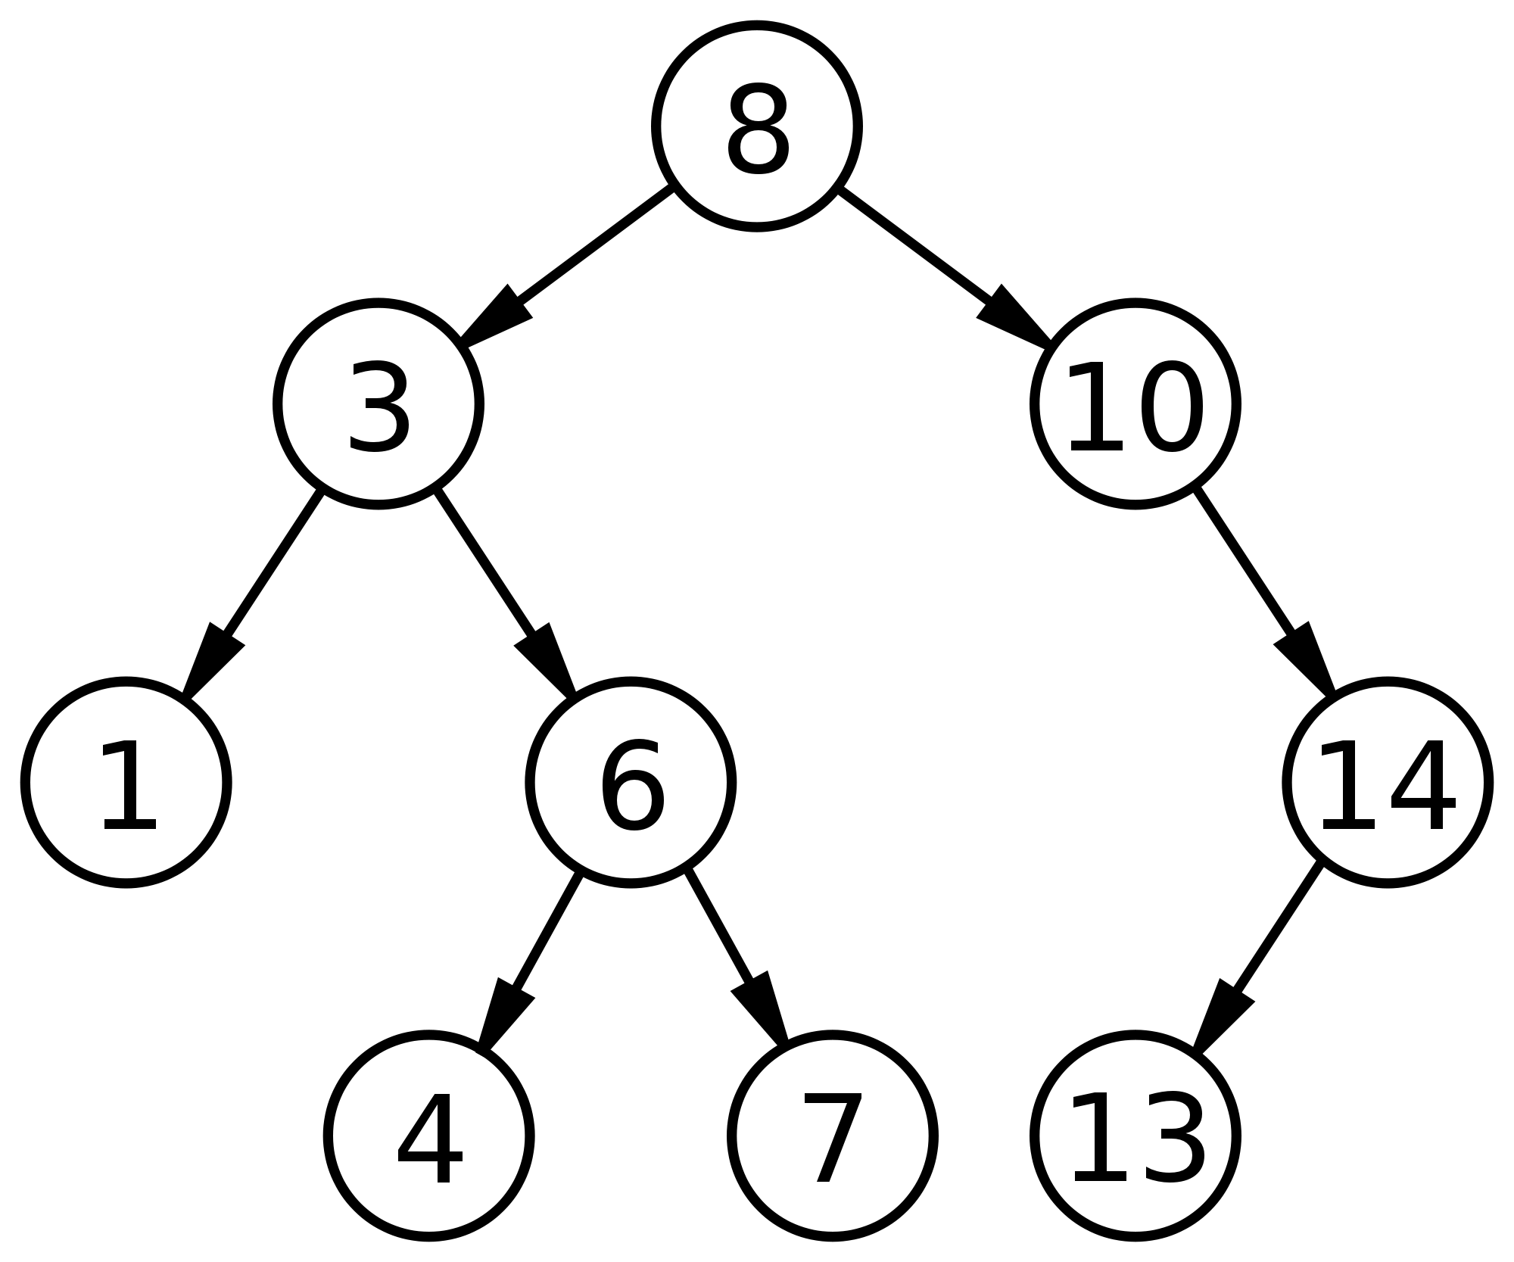
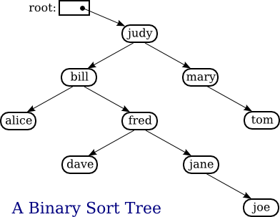
Binary search trees
Binary search trees are binary trees with a simple but significant feature. For any given node, everything to the left is “smaller” and everything to the right is “larger.”

Slide 18
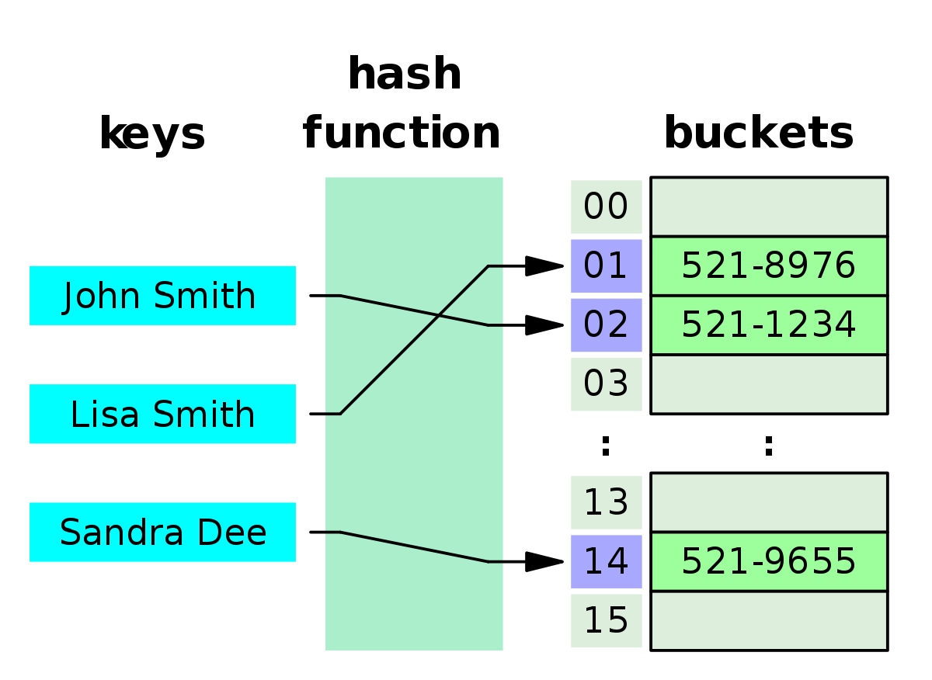
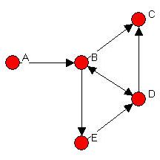
Other data structures
Graphs
Hash table

Slide 19
Euclid’s algorithm (find the GCD)
Many programming languages, including Python, have functionality for “modular arithmetic.”
a mod b = the remainder of a/b. In Python, this is written as a%b.
10%3 = 1, 15%5 = 0, 14%27 = 14
We can use this to find the greatest common divisor (GCD) of two numbers (i.e. if x = GCD(a,b), then x is the largest number for which a%x = b%x = 0).
GCD(20, 15) = 5
GCD(10, 3) = 1
GCD(163231, 152057) = 151
GCD(23, 0) = 23

Slide 20
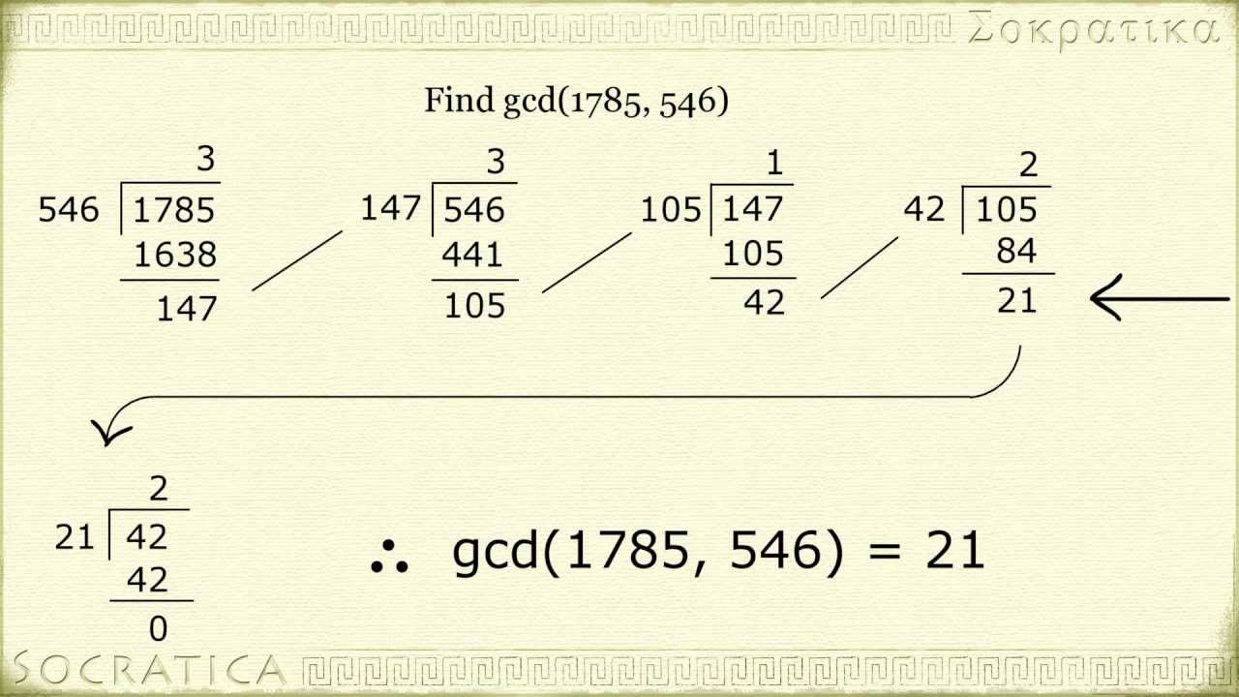
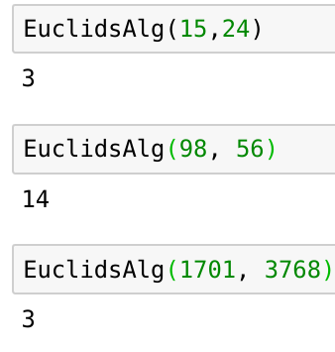
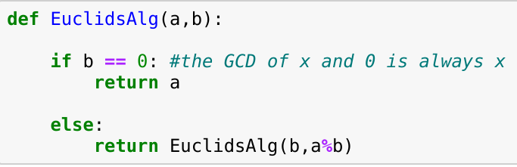
Euclid’s algorithm (find the GCD)

Slide 21
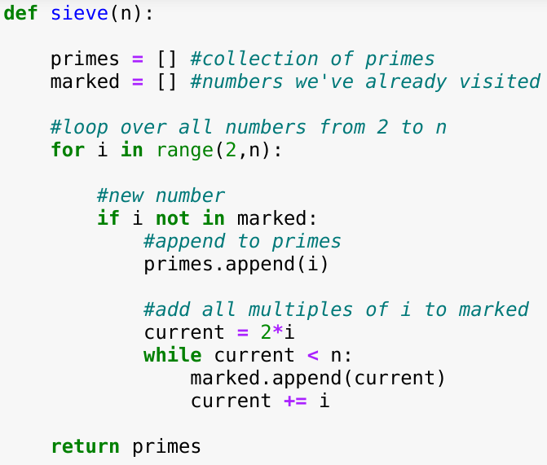
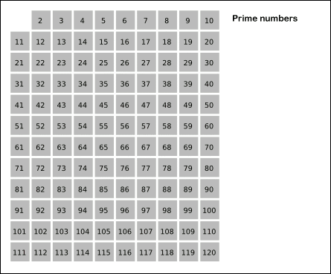
Sieve of Eratosthenes (find primes)
How do we find all the prime numbers less than n?
1. Write down all numbers from 2 to n. All numbers begin as “unmarked.”
2. Move to your first “unmarked” number, i, and add it to your list of primes.
3. Mark every multiple of i less than n.
4. Repeat steps 2-3 until all numbers are marked.

Slide 22
Sorting algorithms
Goal: [13, 1, 4, 9, 5, 4, 3] → [1, 3, 4, 4, 5, 9, 13]
The problem is simple to understand but surprisingly difficult to do well!
Wikipedia currently lists 42 unique sorting algorithms.

Slide 23
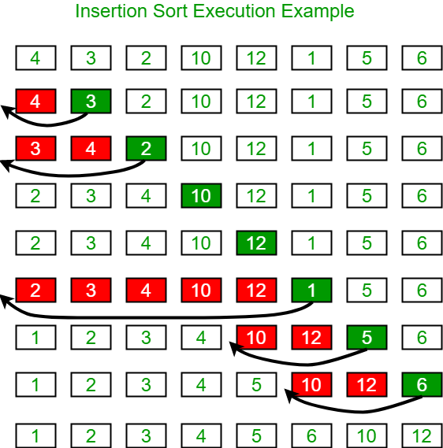
Insertion sort
1. Start with the second element of your array.
2. If the element is smaller than its left neighbor, swap the two.
3. Continue swapping until the element is larger than its left neighbor.
4. Select the next element in the array.
5. Repeat steps 2-4 until you reach the end of your array.
Best case: [1, 2, 3, 4, 5] - O(n
Worst case: [5, 4, 3, 2, 1] - O(n^2)

Slide 24
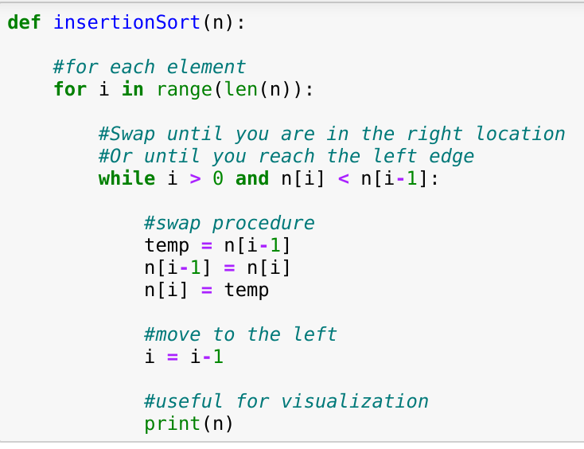
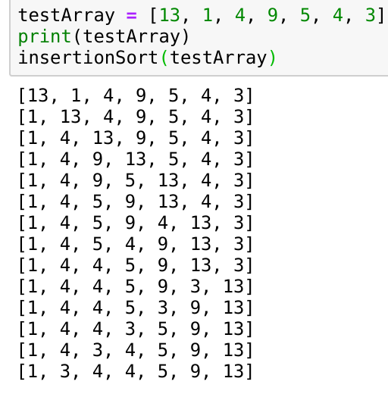
Insertion sort

Slide 25
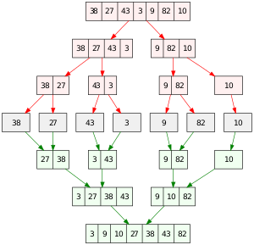
Merge sort
1. If the list has a single element, return that element.
2. Otherwise, cut the list in half.
3. Run Merge Sort on the left half.
4. Run Merge Sort on the right half.
5. Merge the two sorted lists.
Merging two sorted lists requires iterating through them a single time. Merging therefore takes O(n) time. We will have to merge for each time we were able to split the list in two, log_2(n).
We say that merge sort runs in O(n log(n)) time.

Slide 26
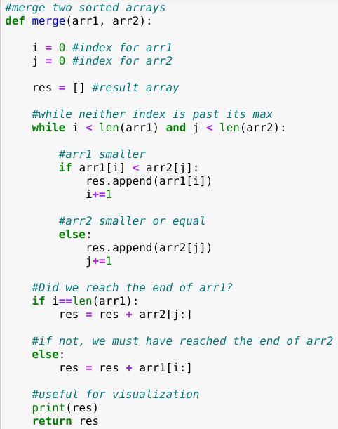
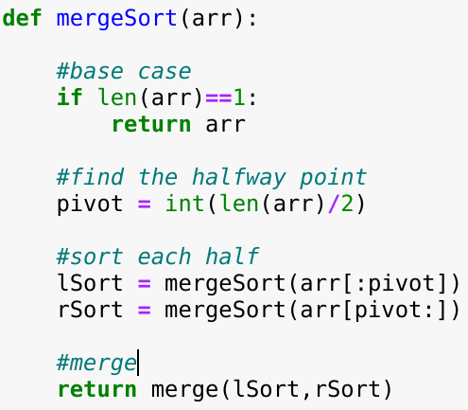
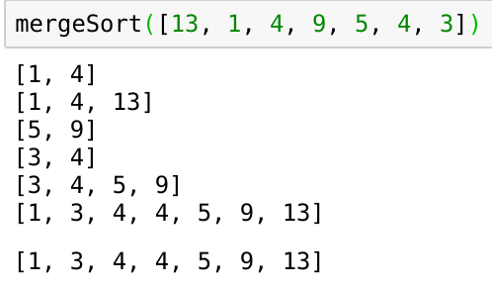
Merge sort

Slide 27
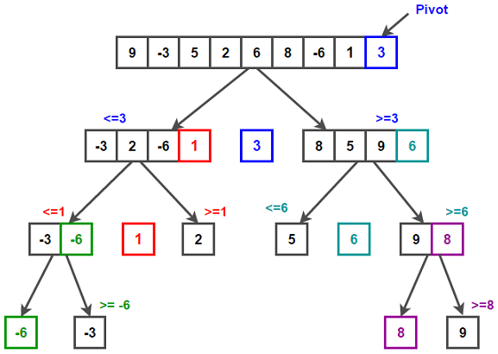
Quick sort
1. Choose a “pivot value.”
2. “Partition” the array: rearrange the array so that all values <= the pivot are to the left of the pivot, all values > the pivot are to the right.
3. Run quick sort on the subarray to the left of the pivot.
4. Run quick sort on the subarray to the right of the pivot.
Each partition takes n steps. At worst, we will require n partitions, giving O(n^2).
However, on average we will only need log n partitions, giving O(n log(n)).

Slide 28
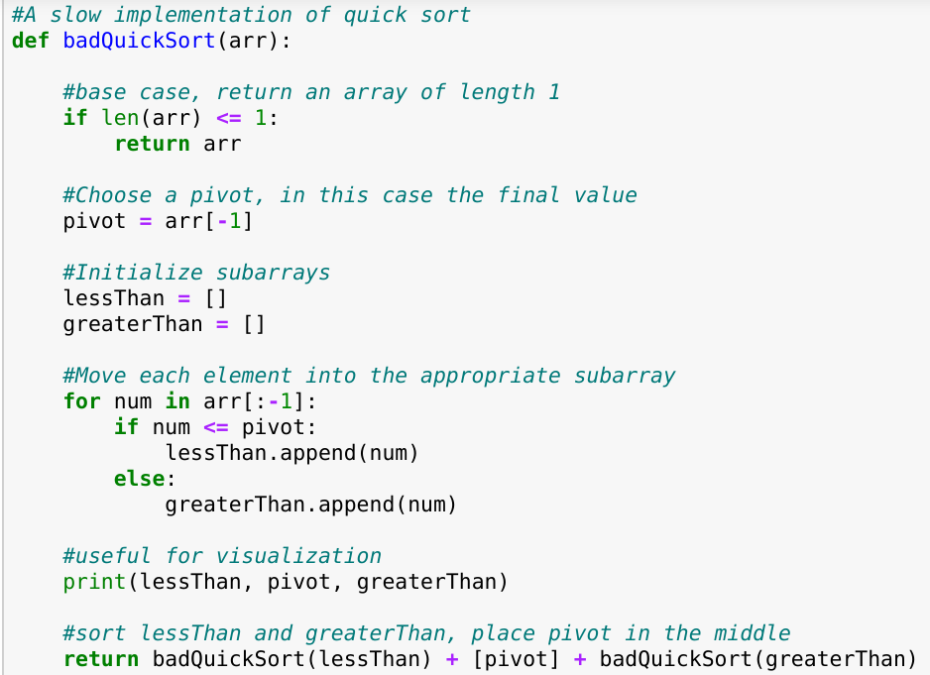
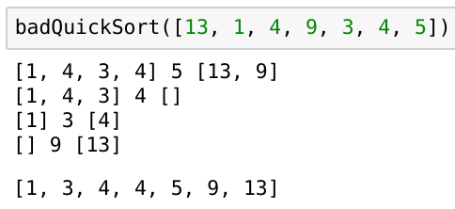
Quick sort

Slide 29
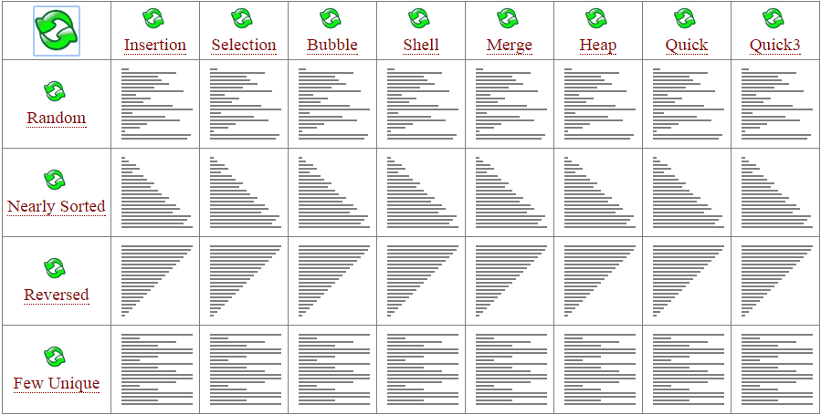
When asked how to sort 1,000,000 random integers:
“I think the bubble sort would be the wrong way to go.” - Barack Obama

