Slide 1

[Samsung PRISM]
AI/ML: Age,Gender and emotion detection from speech
Team
College Professor(s):
1) Dr J Selvin Paul Peter, Associate Professor, Department of Computing Technologies, selvinpj@srmist.edu.in
2)Dr P Murali, Associate Professor, Department of Computing Technologies, muralip@srmist.edu.in
Students:
Rishabh Agrawal / ra7546@srmist
Raghav Khanna / ri9320@srmist.edu.in
Aaryaman bajaj / an1143@srmist.edu.in
Nilanjana Bhattacharya / nb2168@srmist.edu.in
Department: Cse Core (Computing Technologies)
Date: 15 Dec 2023

Slide 2
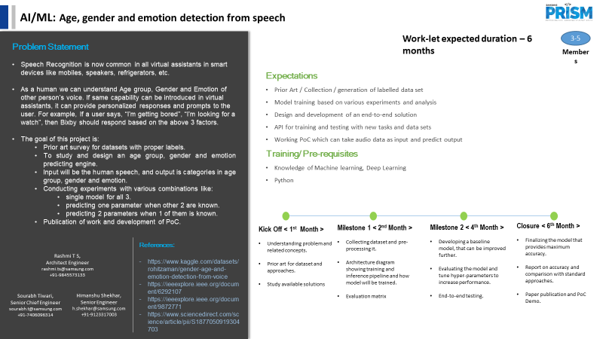

Information Retrieval | SQL to Lucene Query Parser
Notes:
-

Slide 3
KPIs Achieved Till Now
Compared the performance of the combined model with the individual models for age, gender, and emotion detection.
Measured the time taken to train each model.
Measured the inference time: Time taken by model to make predictions.
Explored the dependencies between the target variables.

Slide 4
Challenges Faced
Emotions are subjective, and individuals may express them differently, making it challenging to create a one-size-fits-all model.
Instances where age, gender, and emotion cues provide conflicting information poses difficulty in making accurate predictions.
Insufficient or biased training data.
Identifying relevant features for age prediction that are both informative and resistant to noise can be difficult.
Achieving real-time processing for voice-based models posed challenges due to computational constraints.
Cultural and social norms related to gender expression introduces bias, affecting the model's generalization.

Slide 5
Key Achievements/Outcome Till Now
Drafted a research paper for our project with plagiarism percentage of 15% which we plan to decrease further .
The three proposed solutions which are individual models , sequential models and an all in one model which we have described in our research paper

Slide 6
Thank you

