Slide 1
STAT 542 - Final Project
Group 1
Rishabh Agrawal, Marcus Kornmann, Jie Ni, Heqi Yin

Slide 2
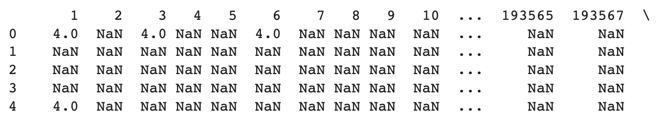
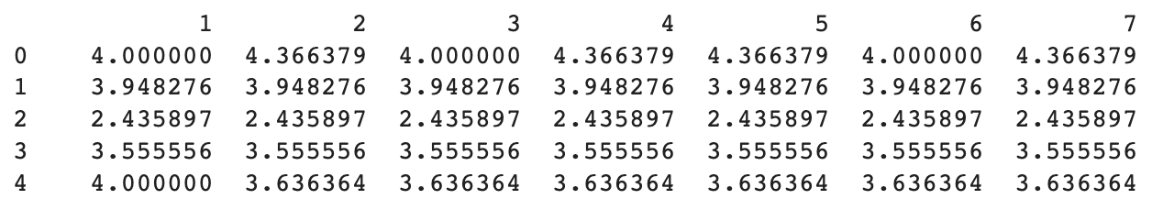
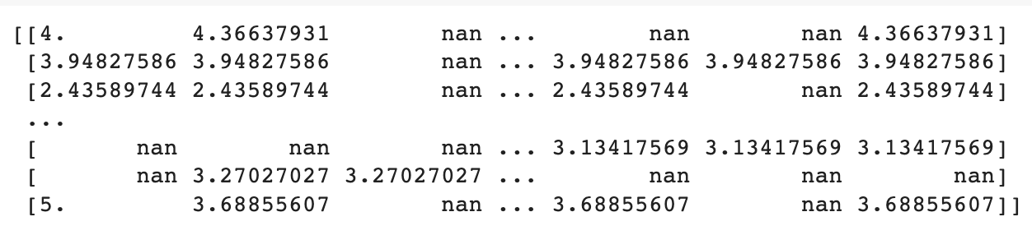
Datasets
MovieLens (600 x 9000)
Contains ratings for movies (scale 1 - 5)
Replace missing values with column mean
Randomly replace 50% of data with NaN

Slide 3
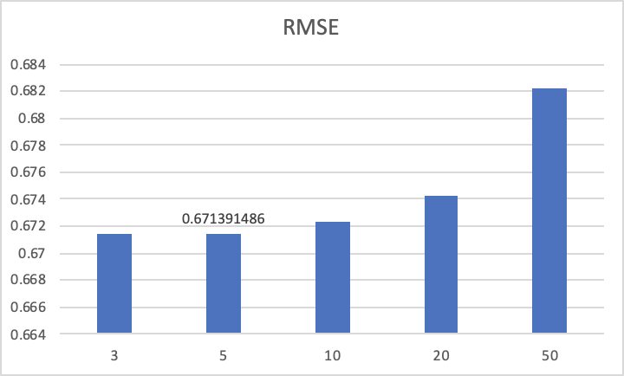
KNN

Slide 4
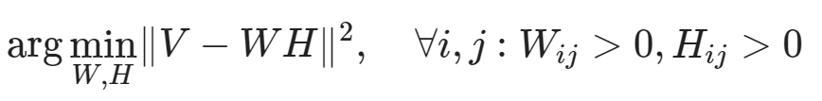
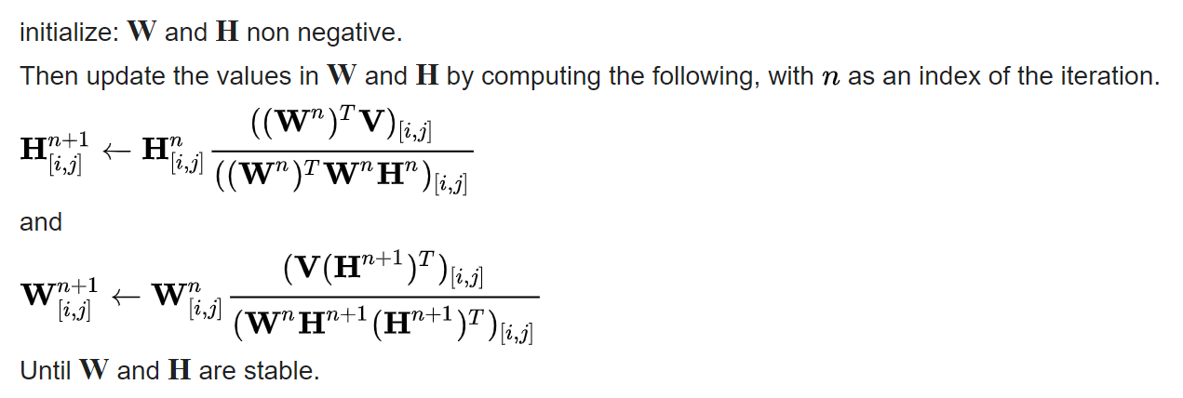
Non-negative matrix factorization (NMF)
Nonneg. V
(n x m)
W
(n x k)
H
(k x m)
Solve with multiplicative update:

Slide 5
Non-negative matrix factorization (NMF)- Results
Fill in missing values using different methods: mean, median, zeros, min
Run NMF from sklearn.decomposition
Tuning the hyperparameter n_components(k) by cv = 10. Optimal = 4
Results for MovieLens (RMSE):
mean | median | zeros | min
1.32 | 1.40 | 2.38 | 2.11

Slide 6
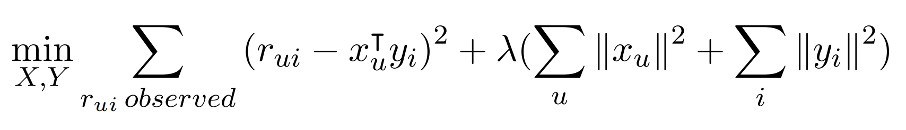

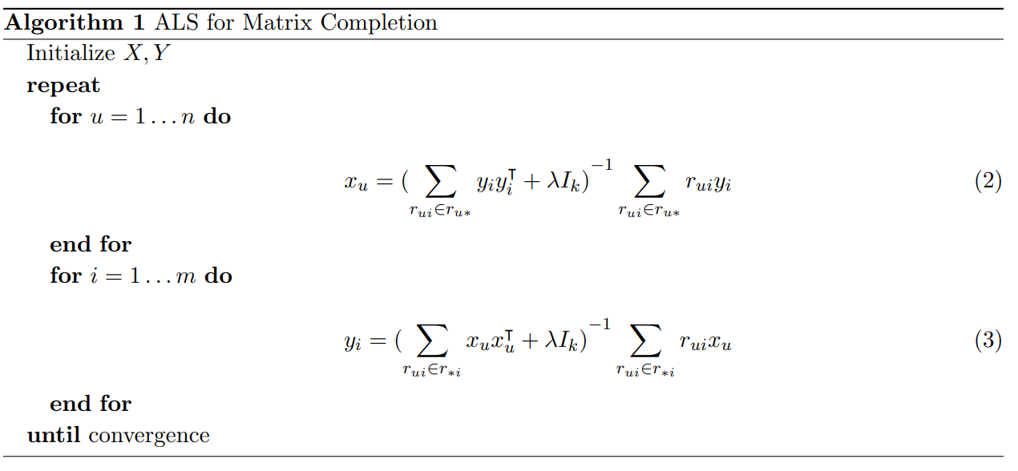
Alternating Least Squares (ALS)
RMSE = 0.53, different values for regularization and number of factors have similar results
https://stanford.edu/~rezab/classes/cme323/S15/notes/lec14.pdf
Notes:
Split data into user matrix X and item matrix Y
Calculate Matrix R ≈ X^T * R
Minimize the least squares error for the observed ratings
We fix Y first and optimize X and then fix X and optimize Y

Slide 7
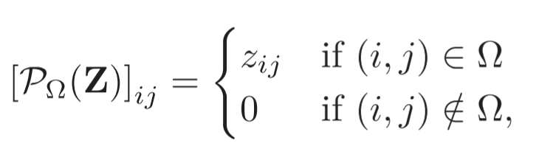

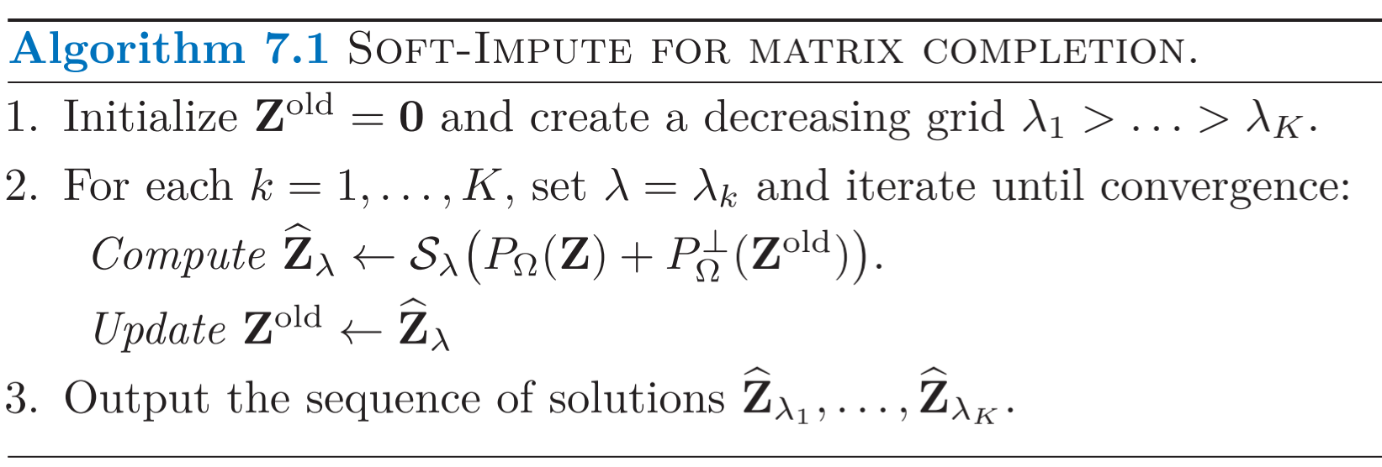
Soft-Impute

Slide 8
Soft-Impute - Results
Fill in missing values using different methods: mean, median, zeros, min
Run Soft-Impute of library fanyimpute with respective fill method
Results for MovieLens (RMSE):
mean | median | zeros | min
0.47 | 0.48 | 1.25 | 1.23

Slide 9
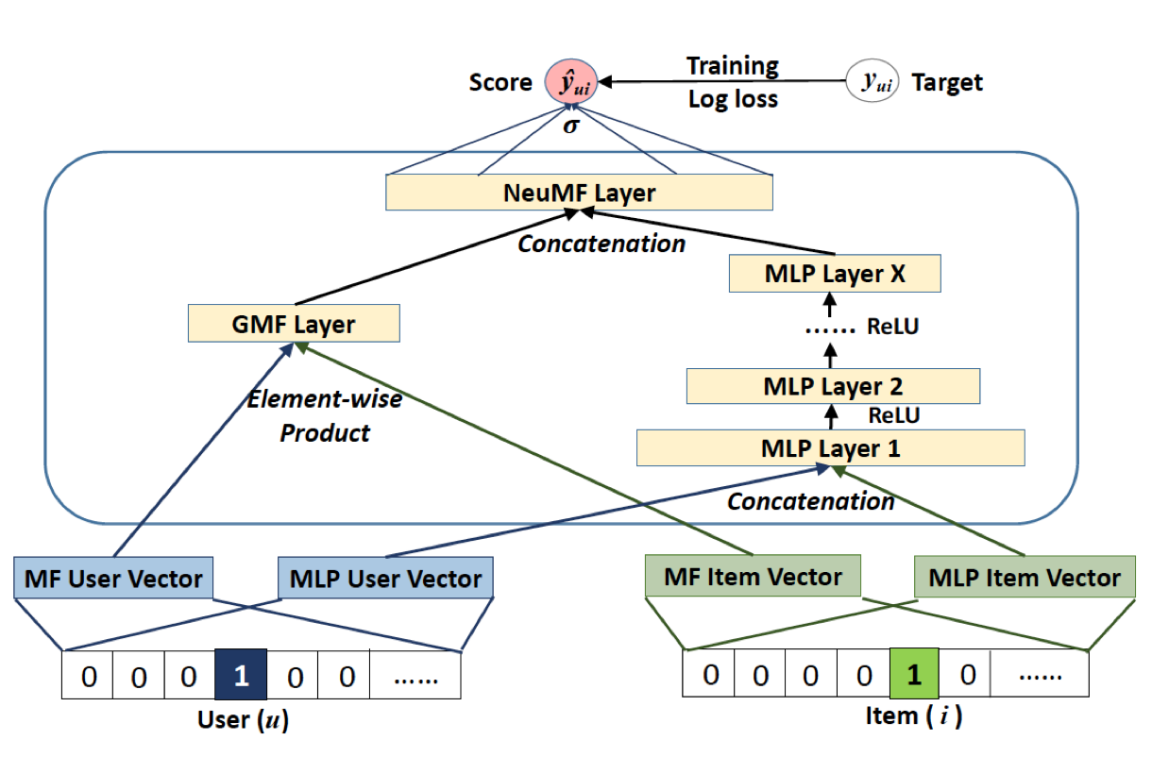
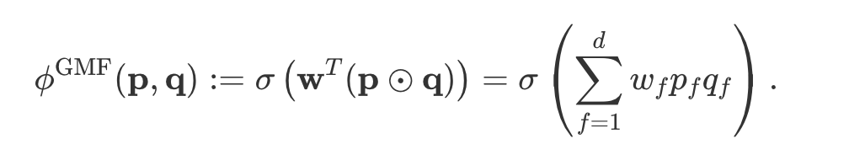
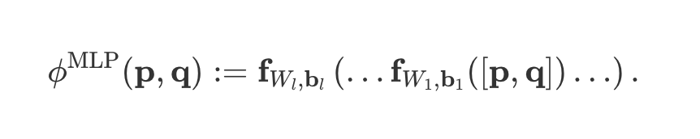
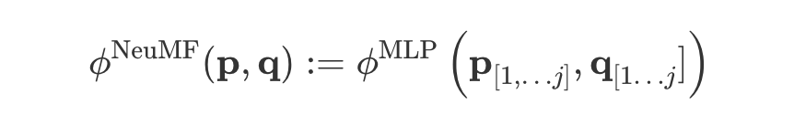
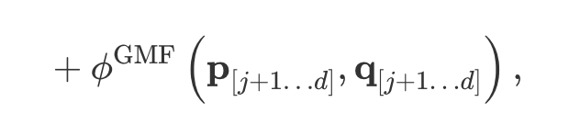
Neural Matrix Factorization (NeuMF)

Slide 10
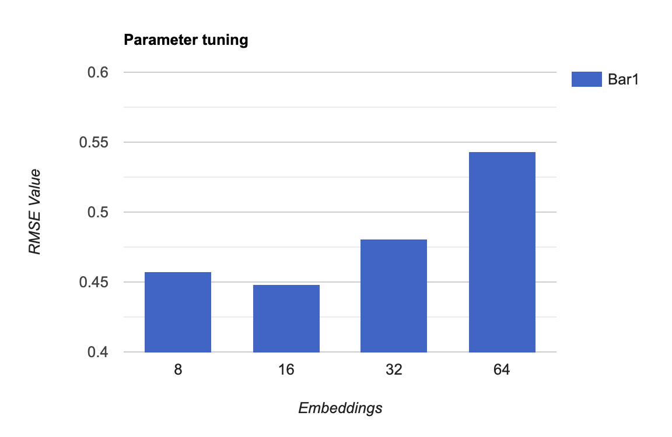
In the NeuMF implementation, we utilized a 3-layer Multi-Layer Perceptron (MLP) architecture.
To mitigate overfitting, we applied a 50% dropout rate to the MLP layers.
The algorithm achieved its best performance when the embedding dimension was set to 16.

Slide 11
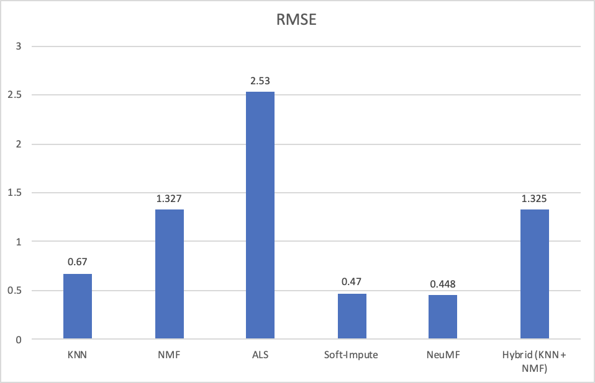
Comparison

Slide 12
Difficulties
Finding hyperparameters like NeuMF, NMF.
NeuMF takes more resources to run as it make use of neural component.
In NMF, while using the higher “r” value, it requires more compute resources.
Algorithms MSE was changing dramatically on changing the parameters or missing percentage.
Ex: NMF was performing well when the missing ratio was 10-20% but its performance decreased a lot when the missing ratio was set to 50%. Other algorithm outperformed NMF. So it was difficult to choose best algorithm.

