Slide 1
Federated Learning
Amrita Aash ( MT22011 ) Shubham Agrawal ( MT22124 ) Group Number: 49

Slide 2
Topics for discussion
1
4
7
2
5
8
3
6
9
How does FL work?
Privacy and Security in FL
Introduction
What is Federated Learning ?
Challenges
Types of FL
Distributed vs Federated Learning
Conclusion & Future Work
FL Algorithms

Slide 3
Introduction
Machine learning and deep learning models are data hungry, but data sources exist in chunks.
We can benefit more if we train our models on a union of these datasets; however, data is sensitive and bound to various policies.
In such scenarios, Federated Learning comes to the rescue!

Slide 4
First introduced in the paper “Communication-Efficient Learning of Deep Networks from Decentralized Data”[1], Federated Learning is a distributed machine learning framework wherein various clients collaborate to construct a global model without exposing their private data to the server.
But what is Federated Learning?

Slide 5
Federated Learning vs Distributed Learning
 | Distributed Learning | Federated Learning
Unbalanced Data | Data slices in the compute nodes are roughly of equal sizes. | Data slices in the computed nodes varies across devices.
Non-IID Data | Data in compute node is non correlated. | Data in a client’s device highly self-correlated.
Device Availability | Every device available all the time. | Only a few devices are available at a time.

Slide 6
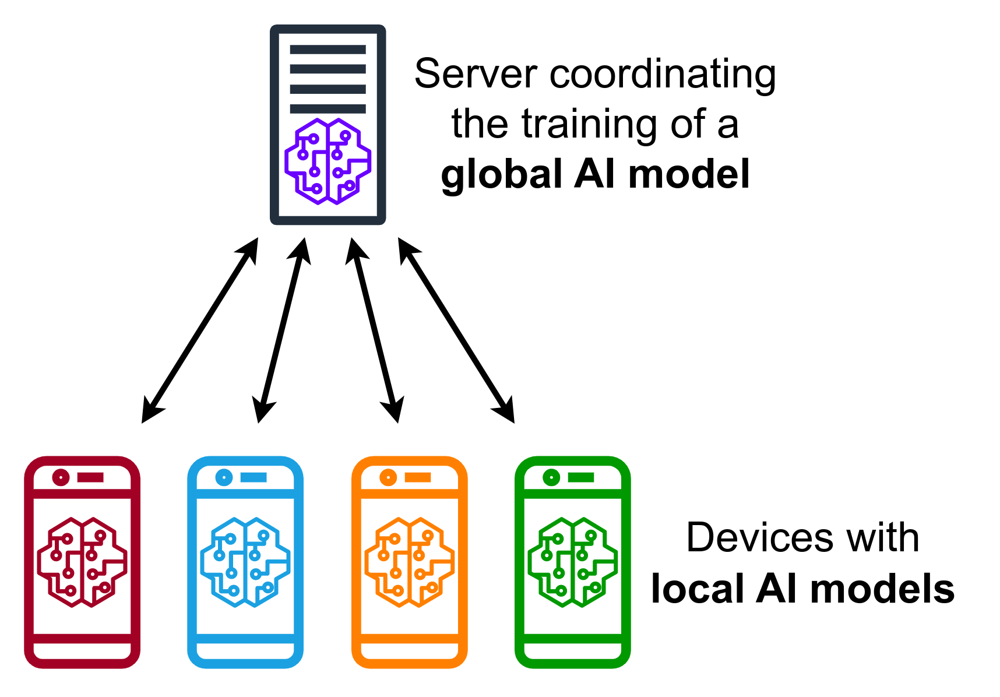
How does Federated Learning Work?
The global model is obtained by aggregating local models from the participating clients.
The aggregated model is passed to each client.
The clients use this obtained model to train on their local data.
The locally tuned models are sent to the server for aggregation.
The process continues until the global model converges.

Slide 7
Types of Federated Learning
On the basis of data partitioning
Horizontal FL
Vertical FL
Federated Transfer Learning
Data in every client has the same feature space but the number of samples is different.
Data in every client has the same samples but the feature space is different
Data in every client has a different feature set and different samples.

Slide 8
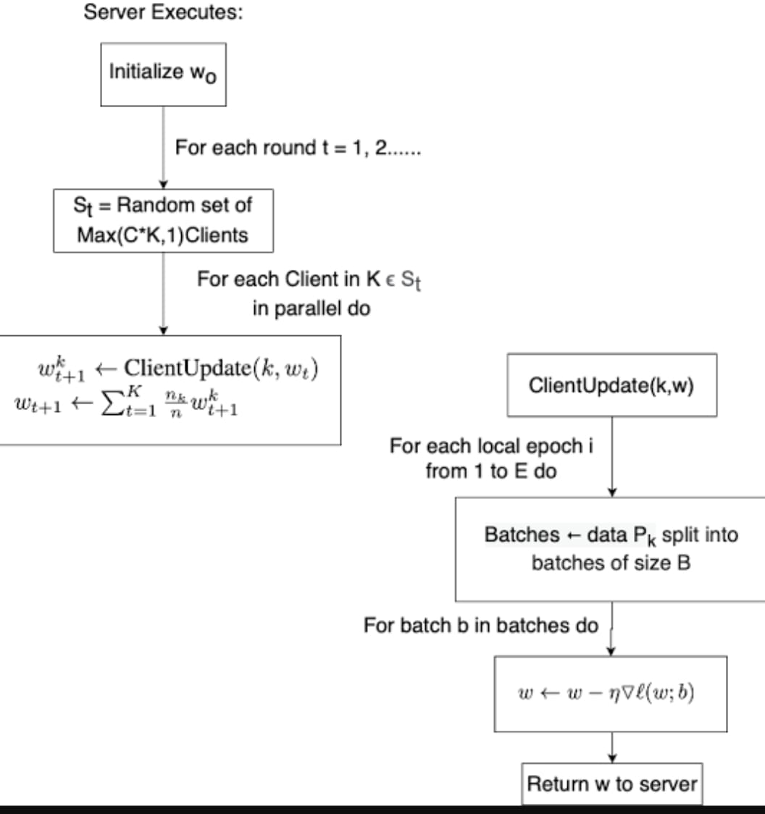
FL Algorithms
FederatedAveraging algorithm: FedAvg [1]

Slide 9
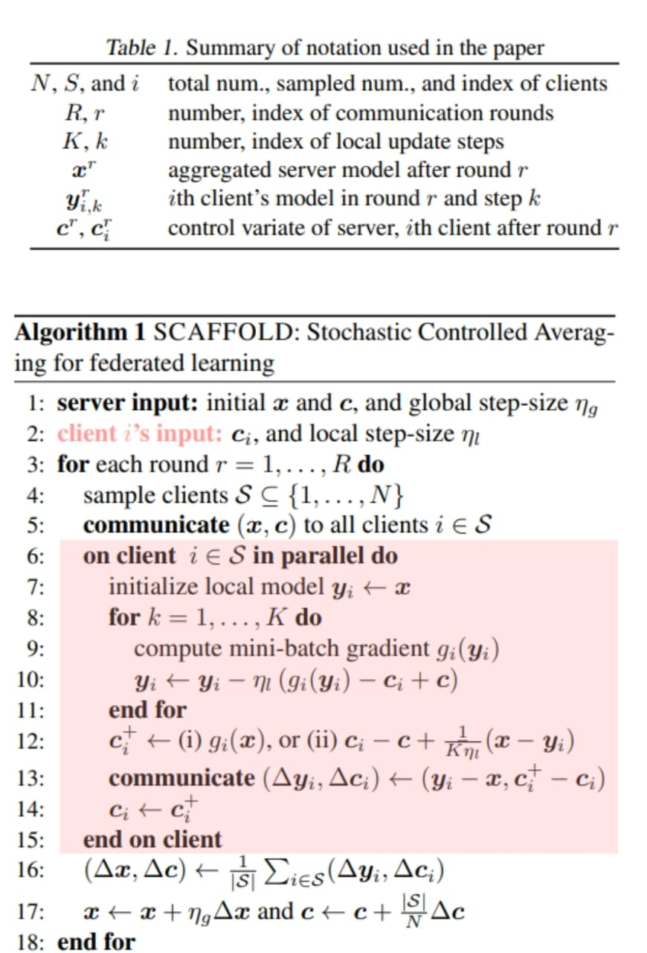
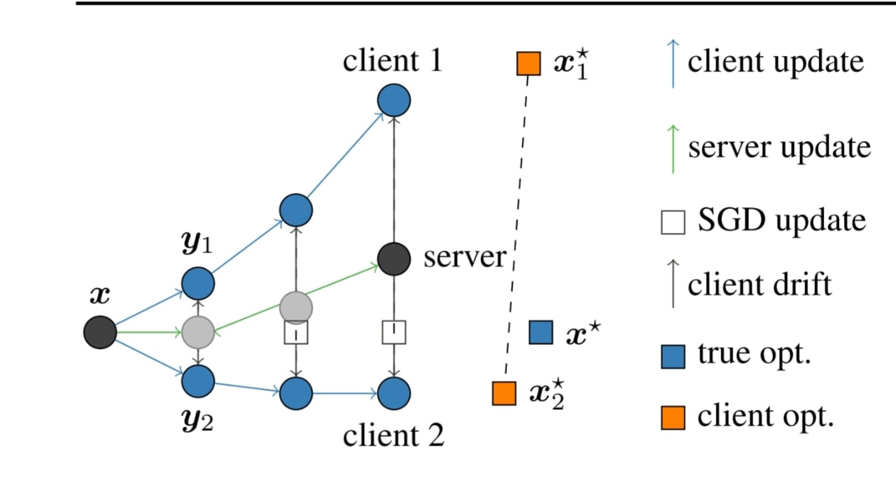
FL Algorithms
Stochastic Controlled Averaging for federated learning: Scaffold [2]

Slide 10
Privacy and Security in FL
Although the data does not leave the client, it does not mean that federated learning is completely immune to privacy and security issues. Various researches have revealed new privacy and security threats and have proved that even the model update information can uncover private information about the clients or inject security threats. Malicious servers, clients and even eavesdroppers in the channels may contribute to loss in privacy.
Various works have been done to counter such data leaks by hostile actors. Two of the major ones are Cryptographic Methods and Differential Privacy.

Slide 11
Privacy and Security in FL
Cryptographic Methods
Here, the clients and server need to encrypt their messages before transmission, perform computations over encrypted messages, and decrypt the encrypted output to get the final result.
Two of the popular cryptographic methods are Homomorphic Encryption [3,4,5,6] and Secure Multiparty Computation (SMC) [7, 8, 9,10].

Slide 12
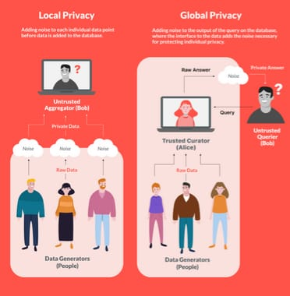
Privacy and Security in FL
Differential Privacy
To protect the privacy of clients, differential privacy adds a small amount of random noise to obscure the contribution of individual clients in the overall aggregated model[11], all while ensuring that the model still draws patterns from the overall population. Through a concept called privacy ‘budget’, it is even possible to calculate the degree of privacy loss.

Slide 13
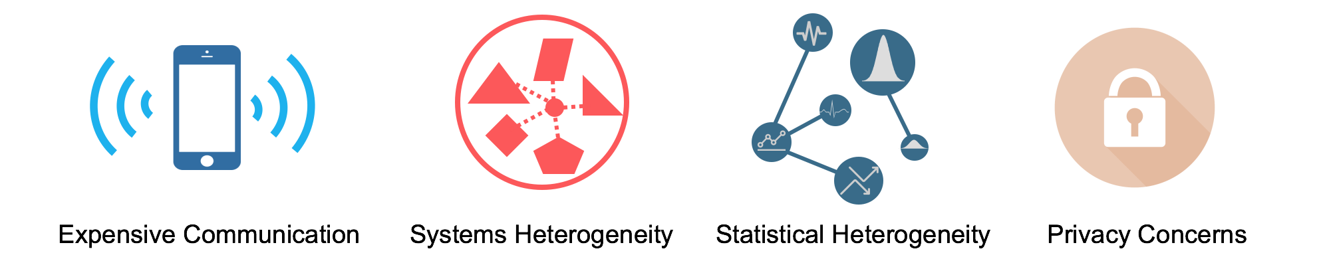
Challenges
Potentially comprises of millions of edge devices, making the communication slow and expensive. Thus requiring transmission of smaller model updates instead of the entire dataset.
Every edge device has different capabilities and specification. Moreover the device participation and network connectivity is unreliable.
Edge devices generate and collect data in a non identical and non independent fashion adding another layer of complexity.
Communicating model updates may still reveal sensitive information. While methods to counter data leaks exist, but they often come at the cost of speed & model performance

Slide 14
Conclusion & Future Work
FL has emerged as an innovative learning paradigm which taps the growing computational power and the humongous data of edge devices while ensuring privacy and security.
Many areas for future exploration are still open , such as:
dealing with dynamic and asynchronous client participation
ensuring fairness and accountability
incorporating domain knowledge and transfer learning in federated settings
evaluating and benchmarking federated learning systems
Despite these open questions, Federated Learning is a rapidly advancing field with great potential to transform machine learning and enable new AI applications.

Slide 15
Thanks !
Do you have any questions?

Slide 16
[1] McMahan, B., Moore, E., Ramage, D., Hampson, S., and y Arcas, B. A. Communication-efficient learning of deep networks from decentralized data. In Proceedings of AISTATS, pp. 1273–1282, 2017.
[2] 82. S. P. Karimireddy, S. Kale, M. Mohri, S. Reddi, S. Stich and A. T. Suresh, "SCAFFOLD: Stochastic controlled averaging for federated learning", Proc. 37th Int. Conf. Mach. Learn., pp. 5132-5143, 2020.
[3] Yoshinori Aono, Takuya Hayashi, Lihua Wang, Shiho Moriai, et al. Privacy-preserving deep learning via additively homomorphic encryption. IEEE Transactions on Information Forensics
[4] Stephen Hardy, Wilko Henecka, Hamish Ivey-Law, Richard Nock, Giorgio Patrini, Guillaume Smith, and Brian Thorne. Private federated learning on vertically partitioned data via entity resolution and additively homomorphic encryption. arXiv preprint arXiv:1711.10677, 2017.
[5] Herve Chabanne, Amaury de Wargny, Jonathan Milgram, Constance Morel, and Emmanuel Prouff. ´ Privacy-preserving classification on deep neural network. IACR Cryptology ePrint Archive, 2017: 35, 2017.
[6] M Sadegh Riazi, Christian Weinert, Oleksandr Tkachenko, Ebrahim M Songhori, Thomas Schneider, and Farinaz Koushanfar. Chameleon: A hybrid secure computation framework for machine learning applications. In Proceedings of the 2018 on Asia Conference on Computer and Communications Security, pages 707–721. ACM, 2018.
[7] Adi Shamir. How to share a secret. Communications of the ACM, 22(11):612–613, 1979
[8] David Chaum. The dining cryptographers problem: Unconditional sender and recipient untraceability. Journal of cryptology, 1(1):65–75, 1988.
[9] Keith Bonawitz, Vladimir Ivanov, Ben Kreuter, Antonio Marcedone, H Brendan McMahan, Sarvar Patel, Daniel Ramage, Aaron Segal, and Karn Seth. Practical secure aggregation for federated learning on user-held data. arXiv preprint arXiv:1611.04482, 2016.
[10] Keith Bonawitz, Vladimir Ivanov, Ben Kreuter, Antonio Marcedone, H Brendan McMahan, Sarvar Patel, Daniel Ramage, Aaron Segal, and Karn Seth. Practical secure aggregation for privacypreserving machine learning. In Proceedings of the 2017 ACM SIGSAC Conference on Computer and Communications Security, pages 1175–1191. ACM, 2017.
[11] A. Bhowmick, J. Duchi, J. Freudiger, G. Kapoor, and R. Rogers, “Protection against reconstruction and its applications in private federated
learning,” arXiv preprint arXiv:1812.00984, 2018.
References

