Slide 1
Team Project - Fun Martial Arts Video
Group 2:Team ABJK :Arjay Nguyen, Boya Zhou, Joseph Hu, Kevin Tran
CS174-Section 1/Fall, 2014

Slide 2
Overview
We worked on domain fun_video2.sql which contained different martial arts and tai chi styles
Our group has implemented features A-D
We are hosting our website under Kevin Tran’s folder on the instructor’s server:
http://www.sjsu-cs.org/classes/cs174/sec1/tran/projectmilestone1/index.php

Slide 3
Data correction and preparation
Removed 2 Duplicates
Removal using SQL statements such as viewcount < 50000 and if there was the same title and length of video. (Risky but worked)
53 Total Videos were left after an initial
DISC: Resolution was mistaken, wrong picture URL.
Non-English, English, Description not accurate
TAG: Similar Master, Uploaded Username, Weapon used...
How the user searches:
Searching Keywords with search box
Edit function
Double checked every single video for verification

Slide 4
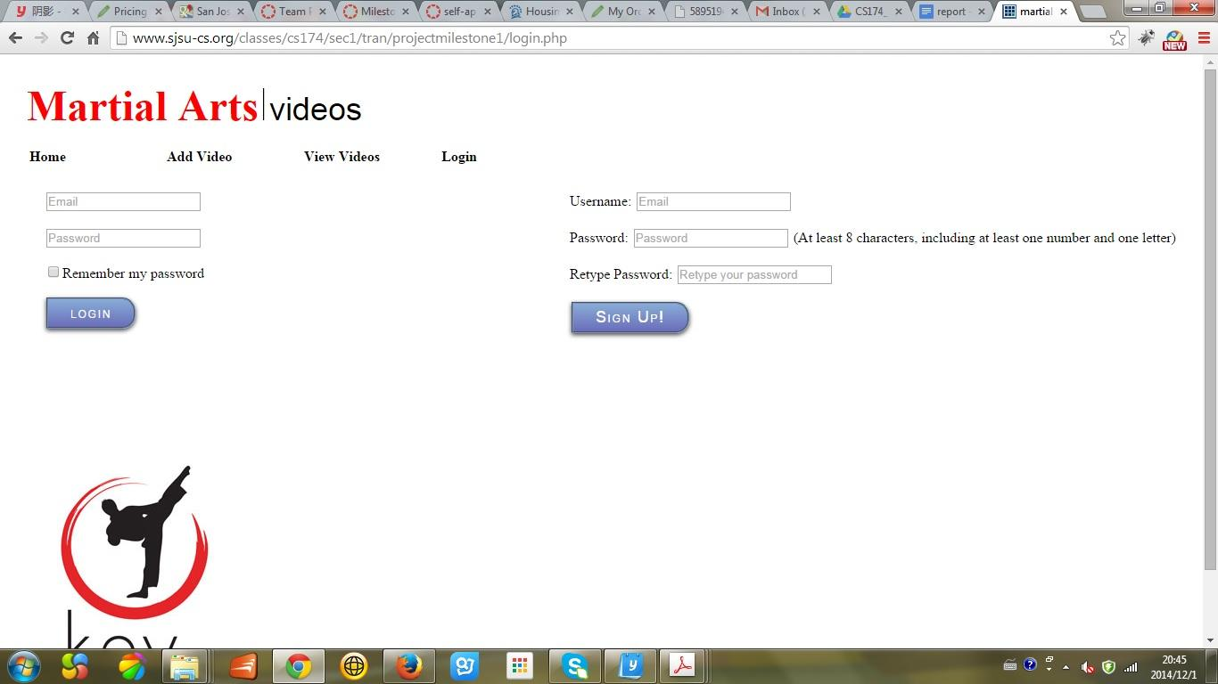
Login/Registration

Slide 5
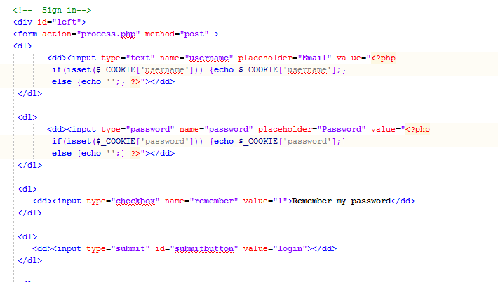
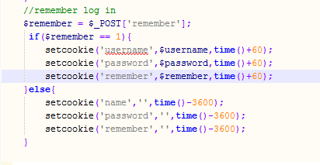
Cookies for login info

Slide 6
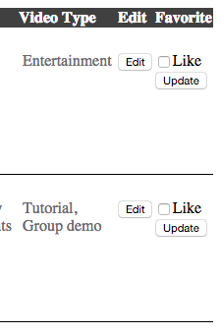
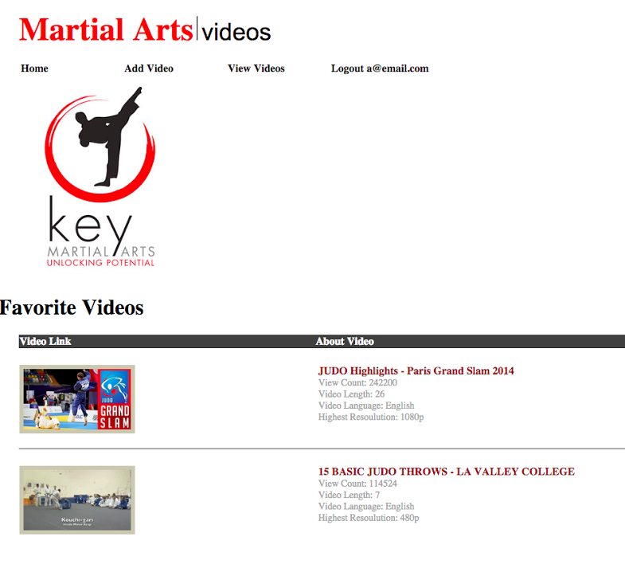
Favorite videos
Checkboxes to indicate favorite videos
Starts session at login
Stored user favorite videos in user database
Upon login, load favorite videos
When new favorite is added, session is updated and list uploaded to database
Technical Difficulties
Stored favorite video inside an array
Workaround to store array in database
When user has favorited videos they show up on their homepage, 4 max

Slide 7
Demo
Provide a short demo illustrating your work

