Slide 1
Network-aware traffic speed forecasting
Phase 1: the machine-learning component
METR-LA, 207 Los Angeles highway sensors
Team T005
Notes:
Introduce the question: does knowing the road network help predict traffic speed? This talk covers Phase 1 only, the machine-learning part. The graph neural network and the signal simulation are Phase 2.

Slide 2
Congestion travels along the road
A slowdown spreads to upstream sensors within minutes
A model that sees only one sensor's history cannot anticipate it
Question: does road-graph information improve multi-step forecasts?
upstream
sensor
down-
stream
traffic direction
What Phase 1 delivers
Independent model
sees only its own sensor
Network-aware model
also sees neighbours
The strongest defensible baseline, how it was validated, and how much of the network benefit a tree model captures when it is only handed neighbour speeds.
Notes:
Motivation. A slowdown at one detector reaches the detectors upstream within minutes. A model that forecasts each sensor from its own history cannot see it coming. The research question is whether giving a model the neighbours' readings, or the whole road graph, improves forecasts. Phase 1 builds the strongest conventional baseline and measures how much of the benefit of network structure a tree model already captures.

Slide 3
Scope: Phase 1 versus Phase 2
Phase 1 (this talk)
Phase 2 (next)
Data audit and exploration
Leakage-free feature engineering
Naive, boosted-tree and random-forest models
Chronological validation, peak vs off-peak
Graph attention network and diffusion model
Same split, same metrics
SUMO signal control, simulation only
Data audit
Features
Models
Evaluation
Notes:
Phase 1 is graded on the machine-learning component: literature, data quality, features, theory, models and validation. The graph attention network, the diffusion model and the signal-control simulation belong to Phase 2. Signal control is simulation only; nothing here touches live traffic.

Slide 4
METR-LA at a glance
207
34,272
119
8.1%
loop detectors, LA highways
five-minute time steps
days, March to June 2012
readings missing
Chronological split (whole days, time order)
Train: 83 days
Val
Test: 24 days
1 Mar to 22 May
Validation: 12 days, 23 May to 3 Jun
4 to 27 Jun
Speed only. Flow and occupancy, mentioned in the brief, are not in this dataset and are not invented.
Notes:
METR-LA: average speed from 207 loop detectors on Los Angeles highways, every five minutes, 1 March to 27 June 2012. Speed only: no flow or occupancy, although the project brief mentions them. The split is by whole days in time order: 83 training, 12 validation and 24 test days.

Slide 5
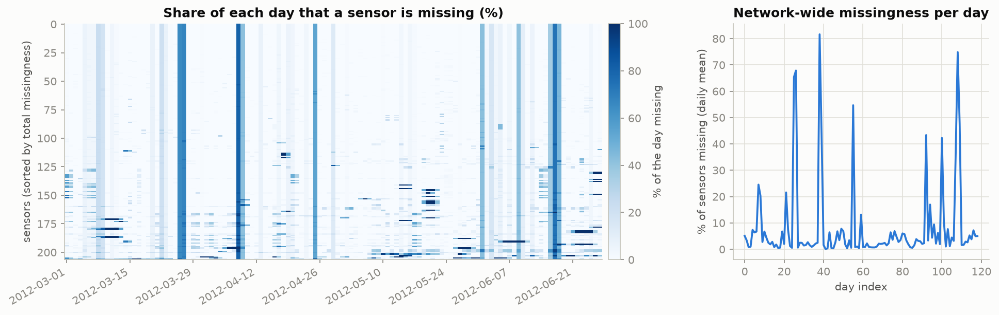
A reading of zero means missing
8.11%
2,148
0.33 mph
of readings are exactly 0.0
steps with all 207 sensors at 0
smallest positive reading
Notes:
Evidence that zero is a missing-value code: 8.11 percent of readings equal exactly zero while the smallest positive reading is 0.33 mph. In 2,148 time steps, all 207 sensors read zero at the same moment, which cannot be real traffic. So zeros become missing values with an observation mask and no model treats an outage as zero speed. The test period has more missing data than training: 12.0 versus 7.2 percent.

Slide 6
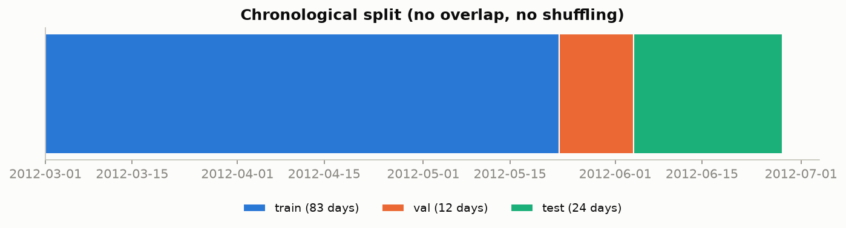
Leak-free by construction
Five rules
Split by whole days, in time order
Scaler and sensor means: training data only
Inputs up to the origin, targets after it (asserted)
Outages masked, never zero-filled
Test period scored once, at the end
Why not shuffle?
Windows ending at 08:00 and 08:05 share 11 of 12 inputs. A random split would put one in training and one in validation and reward memorising.
Notes:
How leakage is prevented. Whole days, in time order. The scaler and per-sensor means are fitted on training timestamps only. For every sample the inputs are at or before the origin and the targets strictly after it, asserted in code. Outages are masked, never zero-filled. The test set is scored once, at the end.

Slide 7
Feature engineering
Group | What it captures | Columns
Lags and anchor | 12 lagged speeds, last observed value and its age | 14
Rolling statistics | means, spreads, trend, number observed | 7
Calendar of the target | sin/cos of time of day and weekday, weekend flag | 5
Sensor identity | training mean speed, latitude, longitude, id | 4
Road-graph neighbours | upstream and downstream neighbour speeds | 8
Missing lags stay missing: tree models route them natively, nothing is imputed. Cyclic encoding makes 23:55 and 00:00 neighbours.
Notes:
Every feature uses data at or before the forecast origin; calendar information about the target time is allowed because it is known in advance. One row is one origin and sensor pair, 38 columns in the spatial model. We deliberately did not use a seasonal-average feature: a mean fitted on the training rows contains the training target, which gives an in-sample advantage the model does not have at test time.

Slide 8
Boosting versus bagging
XGBoost (boosting)
Random forest (bagging)
Trees fitted one after another to the remaining error
Absolute-error loss: targets the median, matches MAE
One model per horizon (direct strategy)
Missing inputs routed natively
Independent trees on bootstrap samples, averaged
Squared-error splits: targets the mean, favours RMSE
One forest, four outputs, shared structure
Variance falls with more trees; bias does not
Different objectives, so different metrics can crown different models.
Notes:
XGBoost builds trees one after another, each fitted to the error left by the previous ones, and here minimises absolute error, whose minimiser is the conditional median, the right target for MAE. The random forest averages independent trees grown on bootstrap samples; scikit-learn splits on squared error, a conditional-mean target, which favours RMSE. The forest predicts all four horizons with one tree structure. The different objectives are the reason to expect different winners on different metrics.

Slide 9
Boosted trees beat persistence by 18 to 32%
18% to 32%
XGBoost MAE reduction vs persistence, 5 to 60 min
2.22 mph
best 5-min MAE: XGBoost + neighbours
Spatial XGBoost has the lowest MAE, RMSE and MAPE at every horizon.
Notes:
Test-period MAE by horizon, 24 held-out days. Persistence rises from 2.82 to 5.35 mph. XGBoost lowers it to 2.30 to 3.66. Adding neighbour speeds gives the best model at every horizon: 2.22, 2.74, 3.16 and 3.60. The seasonal average is flat at 4.18 because it ignores the current state. All differences between XGBoost and persistence have bootstrap intervals far from zero.

Slide 10
The forest loses on MAE, ties on RMSE
-4.5 to -13%
MAE vs XGBoost, intervals exclude zero
-0.2 to +1.9%
RMSE vs XGBoost: a tie, forest slightly ahead from 15 min
Notes:
The random forest has a 4.5 to 13 percent higher MAE than XGBoost, with intervals that exclude zero. Its RMSE is equal or slightly lower from 15 minutes on. This fits the training objectives: squared-error splits target the mean, absolute-error targets the median. We did not test that explanation by swapping the objectives, so it is a consistent reading, not a proof. The practical lesson is that one metric can hide the picture.

Slide 11
Neighbour speeds help, most at the peaks
3.6% to 1.8%
overall MAE reduction, 5 to 60 min
95% intervals: [3.3, 4] at 5 min and [1.4, 2.2] at 60 min.
The bar for Phase 2
2.22 / 2.74 / 3.16 / 3.60 mph test MAE
Notes:
Giving the tree model upstream and downstream neighbour speeds lowers its MAE by 3.6 percent at 5 minutes down to 1.8 percent at 60 minutes, all with intervals above zero. The gain is larger in peak hours, when congestion forms and propagates. This is the reference a graph neural network has to beat in Phase 2: gains over plain XGBoost alone would not show that the graph model learns anything beyond neighbour speeds.

Slide 12
Which features carry the skill
~0%
from rolling statistics, inside seed noise
19%
from calendar + sensor identity at 60 min
1.7%
from neighbours at 60 min (2.7% at 15)
Notes:
Feature groups added cumulatively, scored on validation. Lags and the last value already beat persistence by 12.7 percent at 15 minutes and 9.3 percent at 60 minutes. Rolling statistics add nothing measurable, inside the seed-to-seed noise of 0.001 and 0.004 mph. At 60 minutes, calendar features and sensor identity are worth 9.1 and 10.3 percent, far more than the 1.7 percent from neighbours: knowing when and where matters more than the neighbours' speeds. The stages are cumulative, so the order matters.

Slide 13
Tuning barely matters; what we cannot claim
Hyper-parameter study
Limits
12 random candidates + default, 30-min horizon
3 rolling-origin folds inside training, with a gap
Adopt only if CV MAE improves by more than 0.5%
Winner: +0.54%, all 3 folds; test gain 0.1 to 1.3%
One city, 119 days in 2012, speed only
Test has more missing data (12.0% vs 7.2%)
Tree models fitted once; intervals cover test days only
Forest's best setting sits at the grid edge
One global model, not 207 per-segment models
The surface is flat: the default was within ~0.4% of the best.
Notes:
Twelve random configurations and the default were compared with a rolling-origin cross-validation inside the training period; the adoption rule was fixed before running. The best challenger improved the cross-validation MAE by 0.54 percent, just over the 0.5 percent threshold, and won all three folds. Its test gain is 0.1 to 1.3 percent. The default was already within about 0.4 percent of the best searched value. On the right, the honest limits of this study.

Slide 14
Takeaways and Phase 2
Phase 2
1
Boosted trees cut persistence MAE by 18 to 32%, validated chronologically
Graph attention network and diffusion model, same split. Reference to beat: 2.22 / 2.74 / 3.16 / 3.60 mph.
2
Neighbour speeds add a further 1.8 to 3.6%, mostly at peak hours
3
Long-horizon skill comes mostly from knowing when and where
Notes:
Three takeaways: boosted trees give a strong, validated baseline; the neighbour features give a consistent extra gain, concentrated in the peaks; the lesson from the ablation is that long-horizon skill comes mostly from knowing when and where. Phase 2 then asks whether a graph attention network beats the spatially informed tree model, with an ablation that removes the edges.

