Slide 1
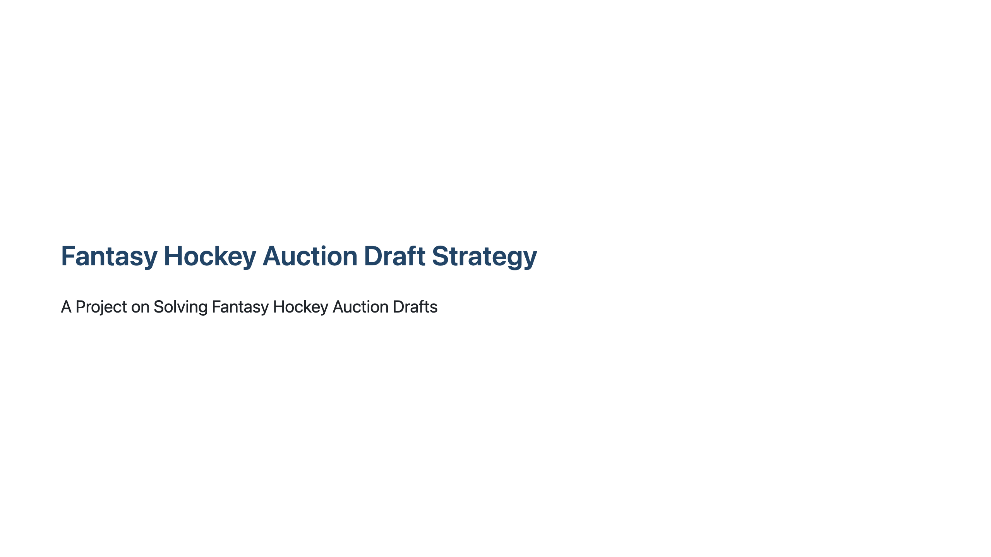
Notes:
Slide 1: Title Slide

Slide 2
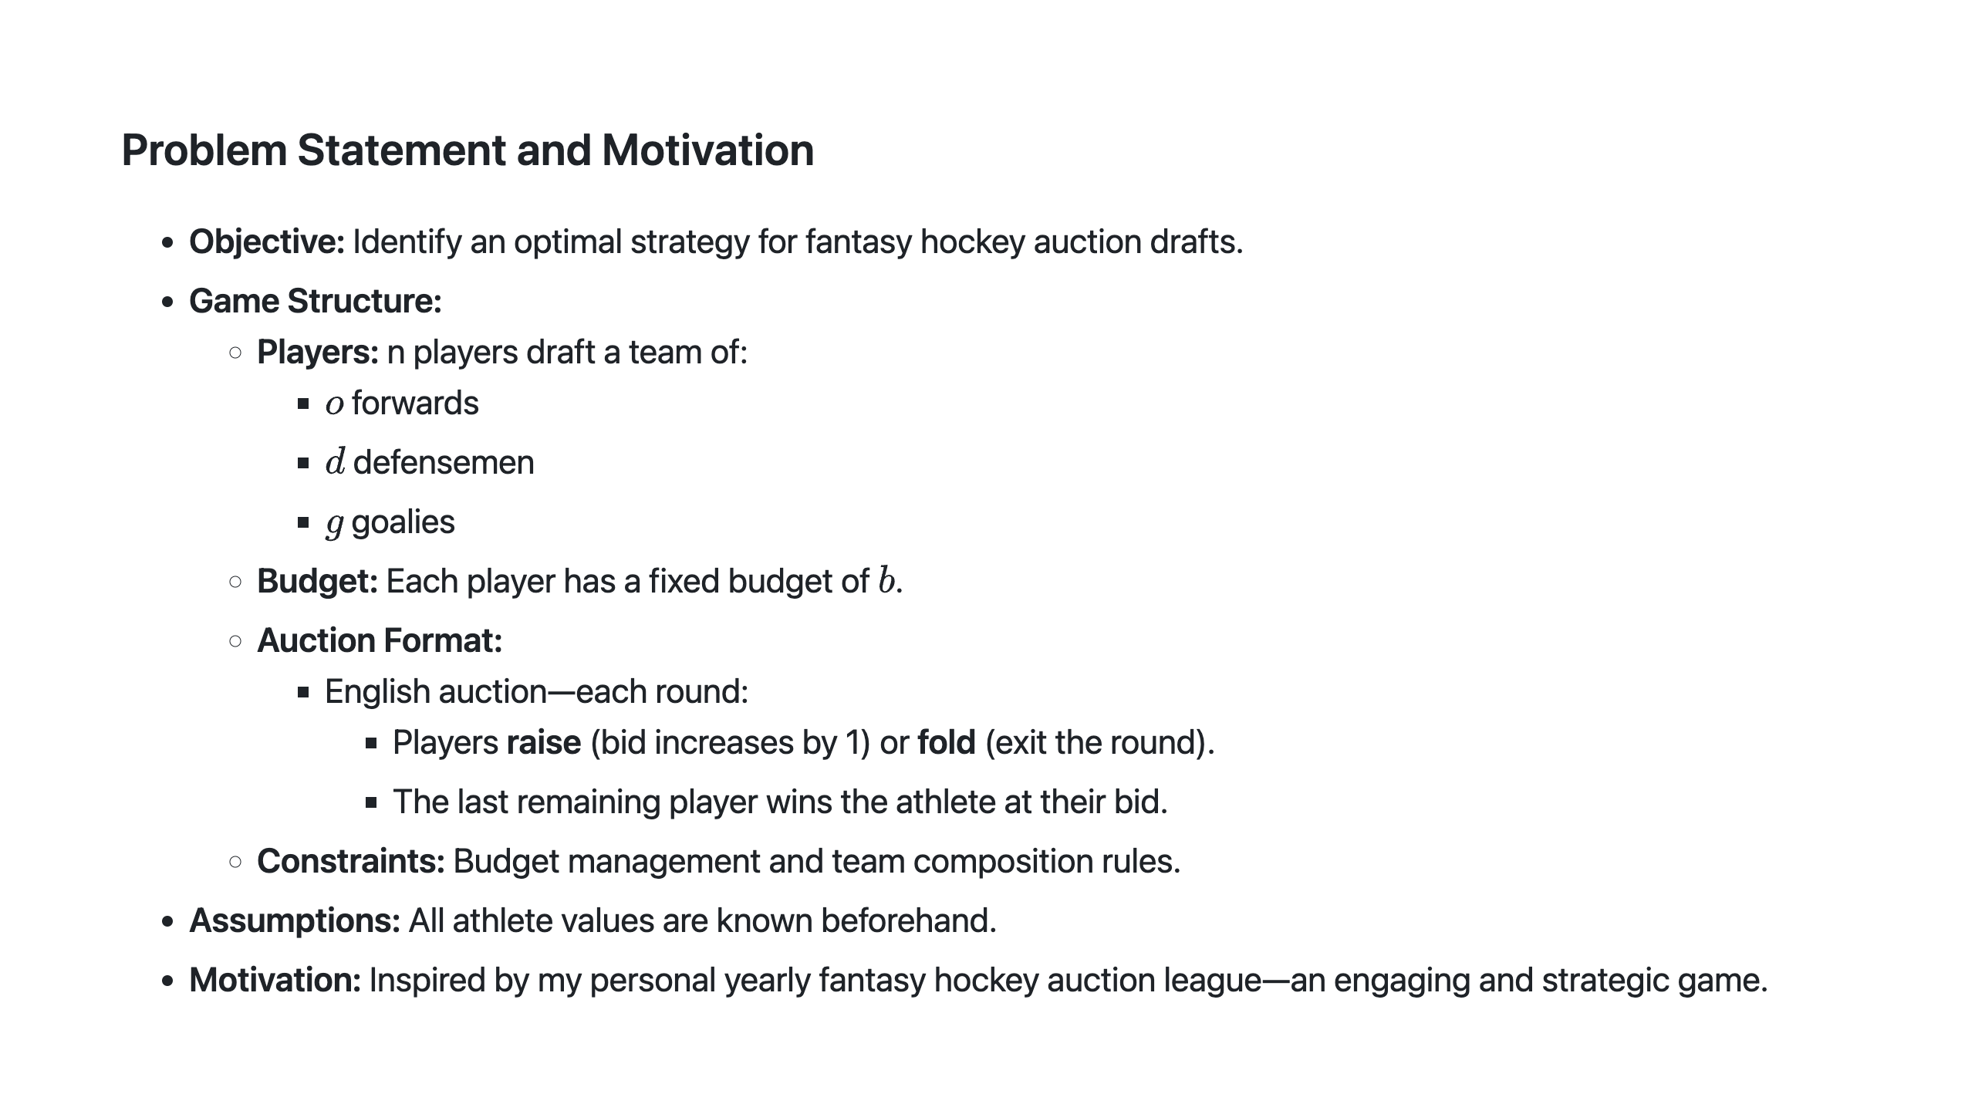
Notes:
Slide 2: Problem Statement and Motivation

Slide 3
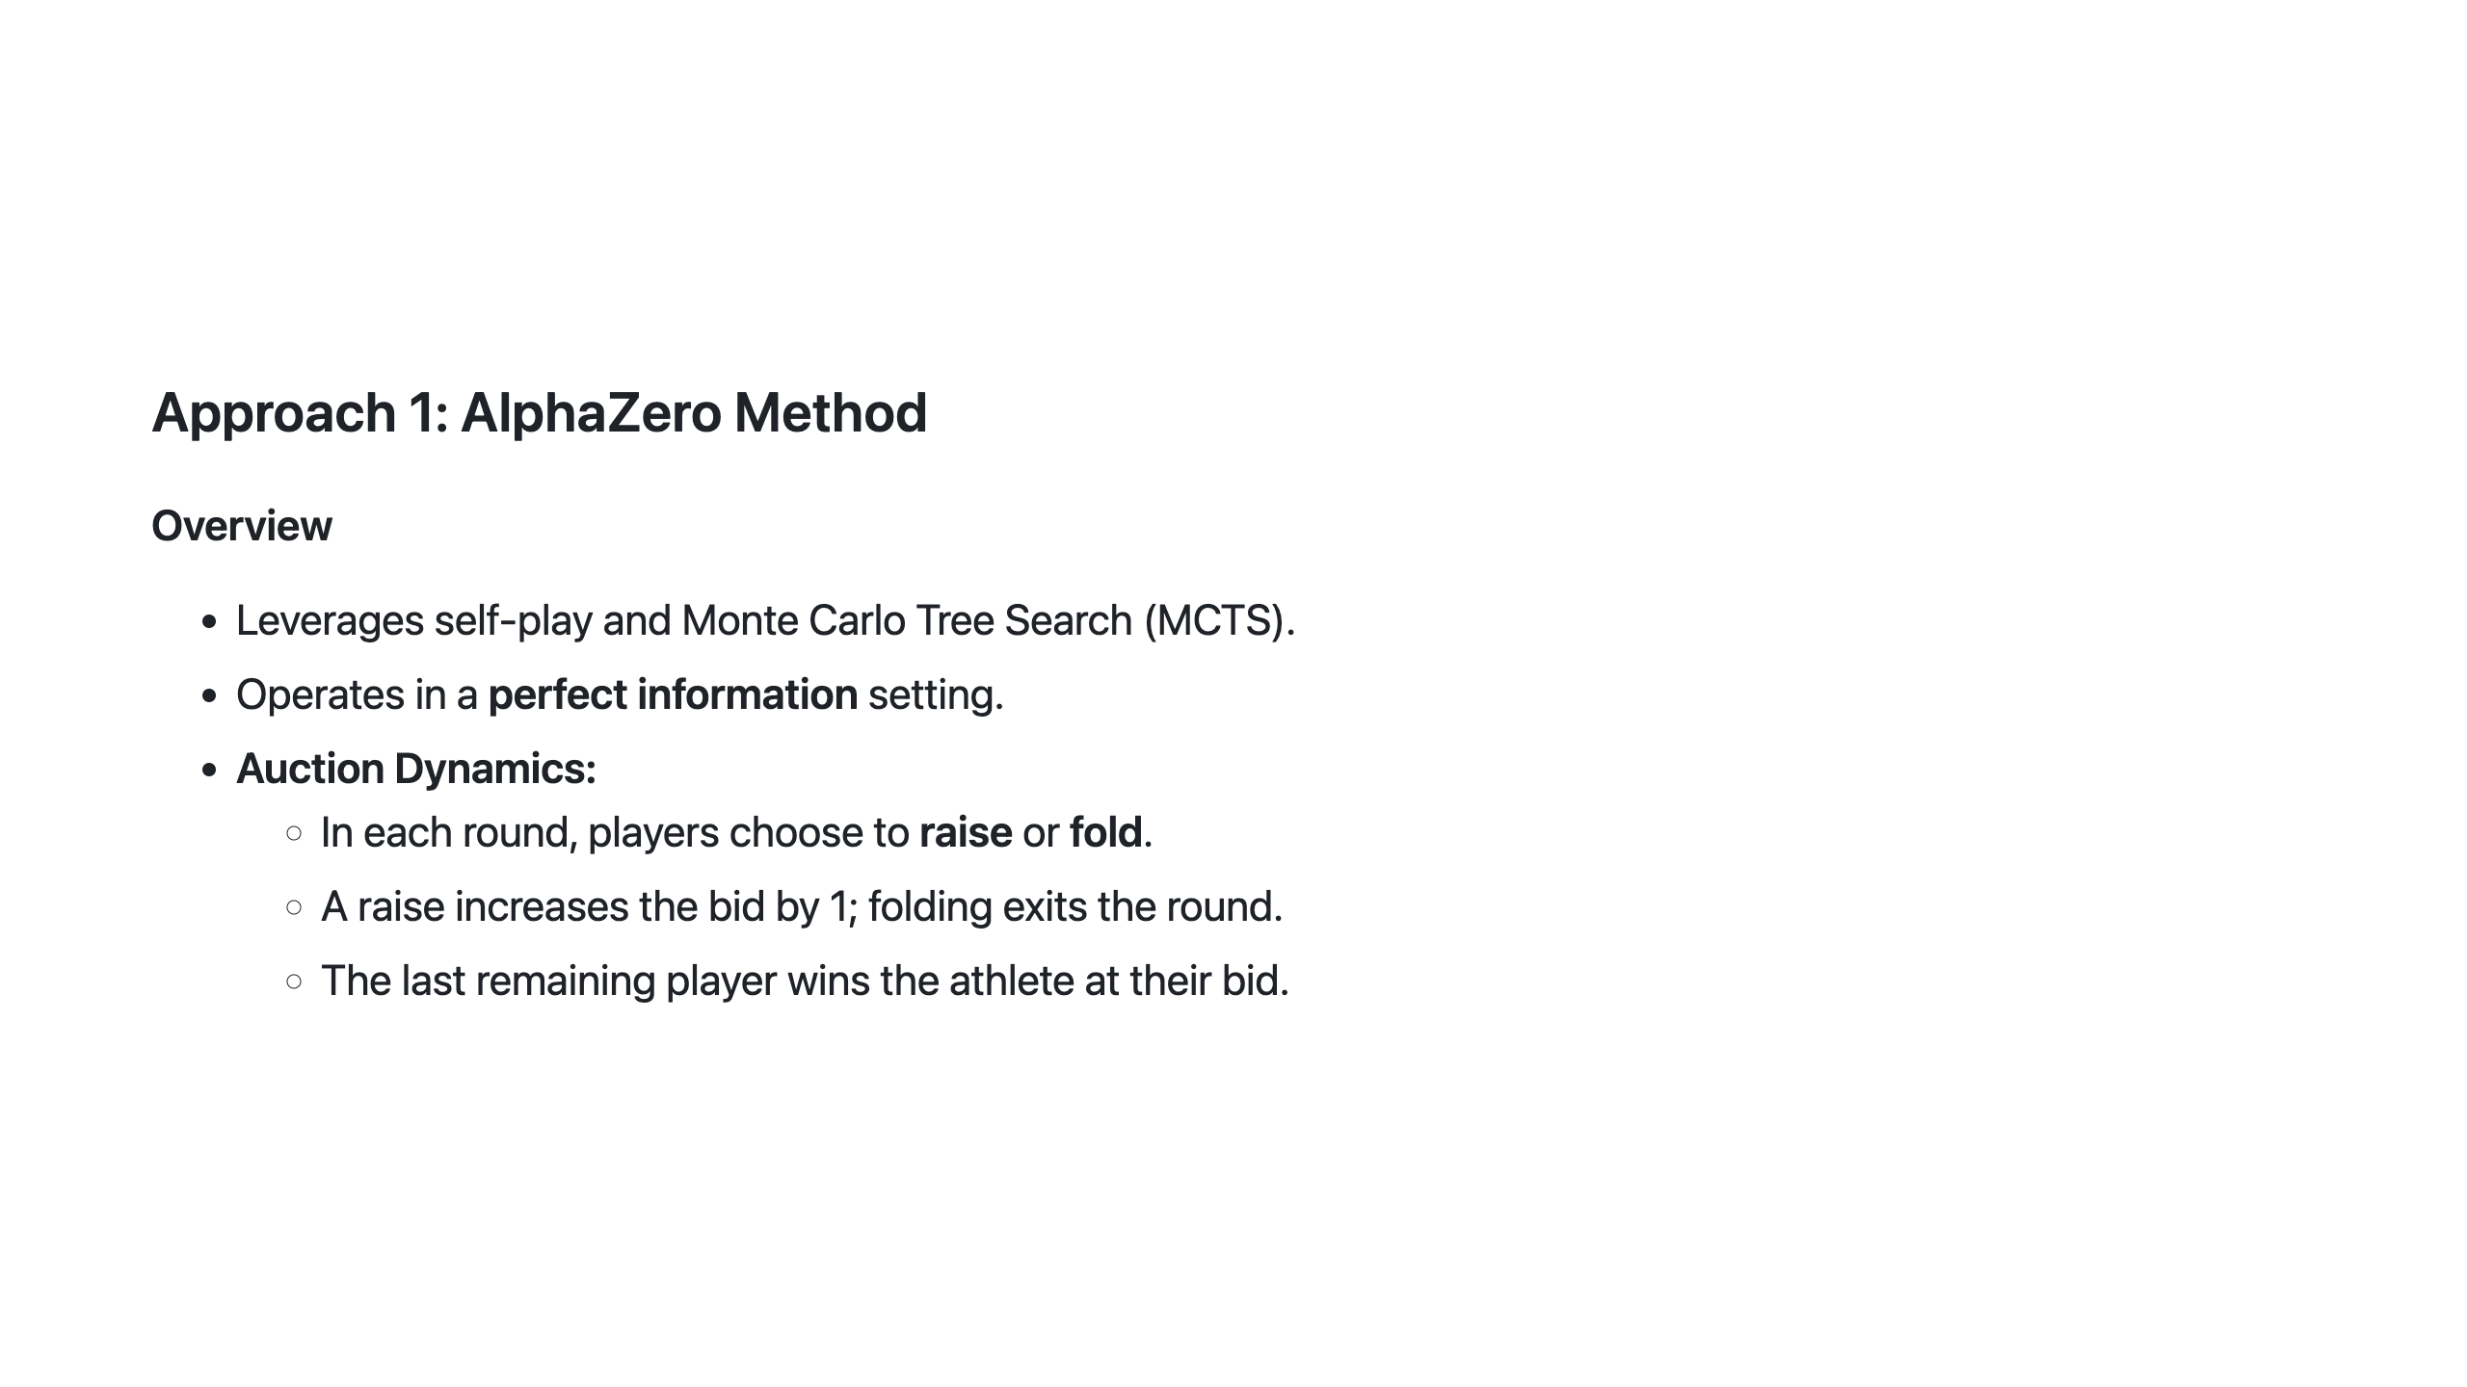
Notes:
Slide 3: Approach 1 - AlphaZero Overview

Slide 4
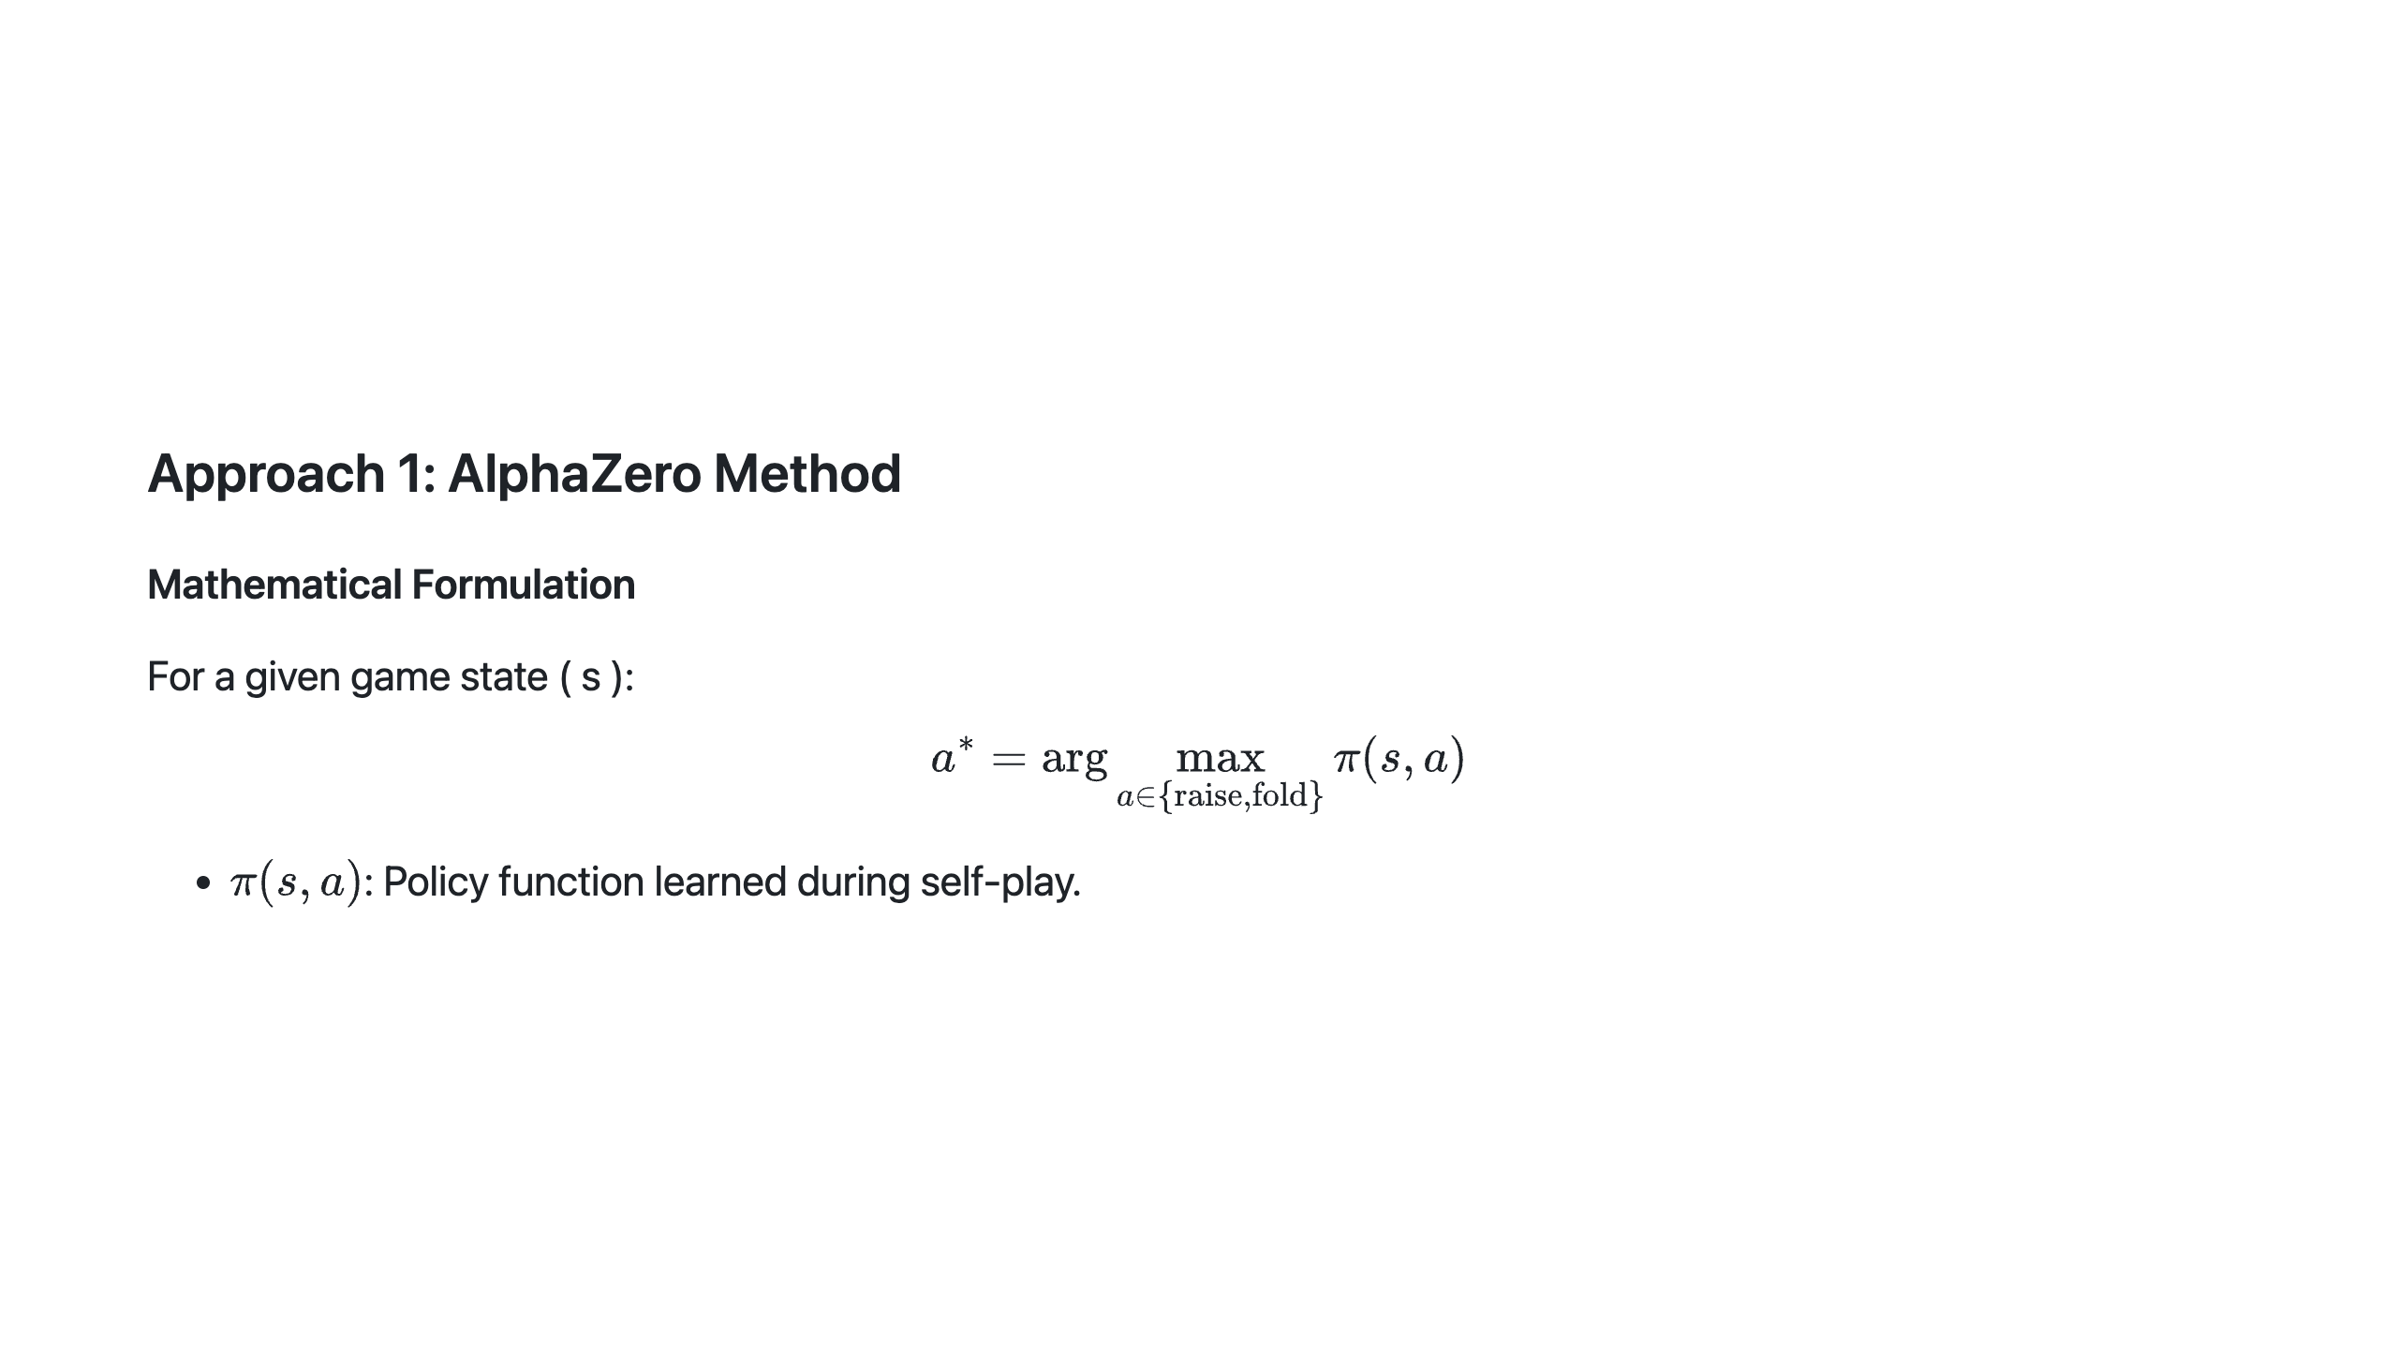
Notes:
Slide 4: Approach 1 - Mathematical Formulation

Slide 5
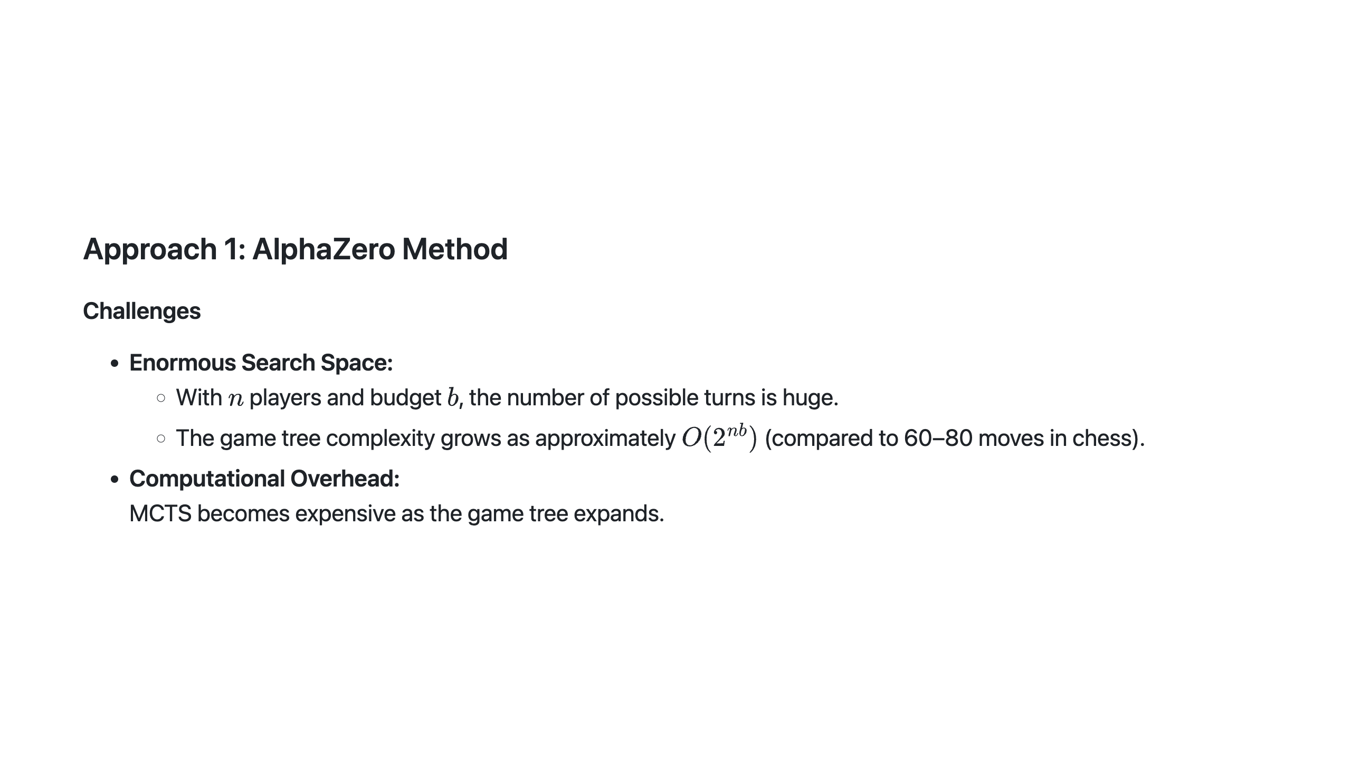
Notes:
Slide 5: Approach 1 - Challenges

Slide 6
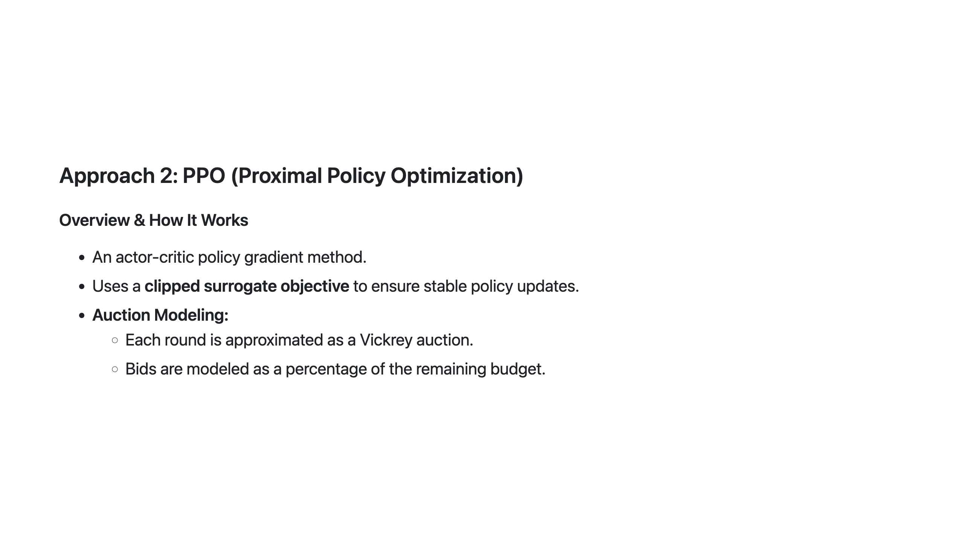
Notes:
Slide 6: Approach 2 - PPO Overview

Slide 7
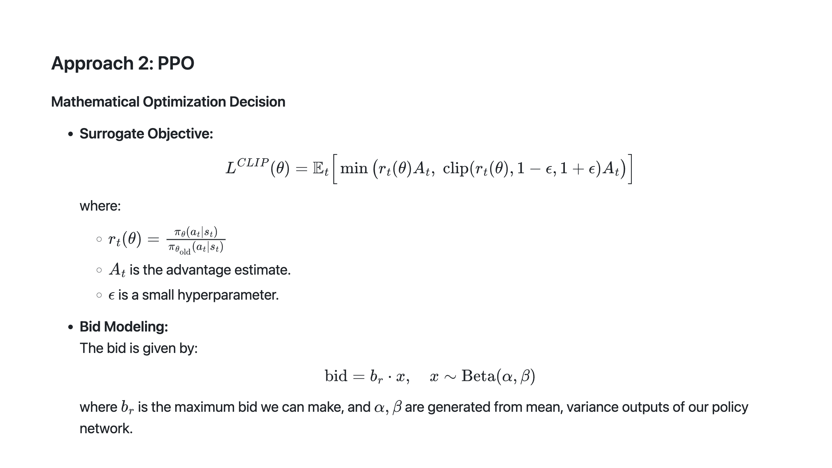
Notes:
Slide 7: Approach 2 - Mathematical Optimization

Slide 8
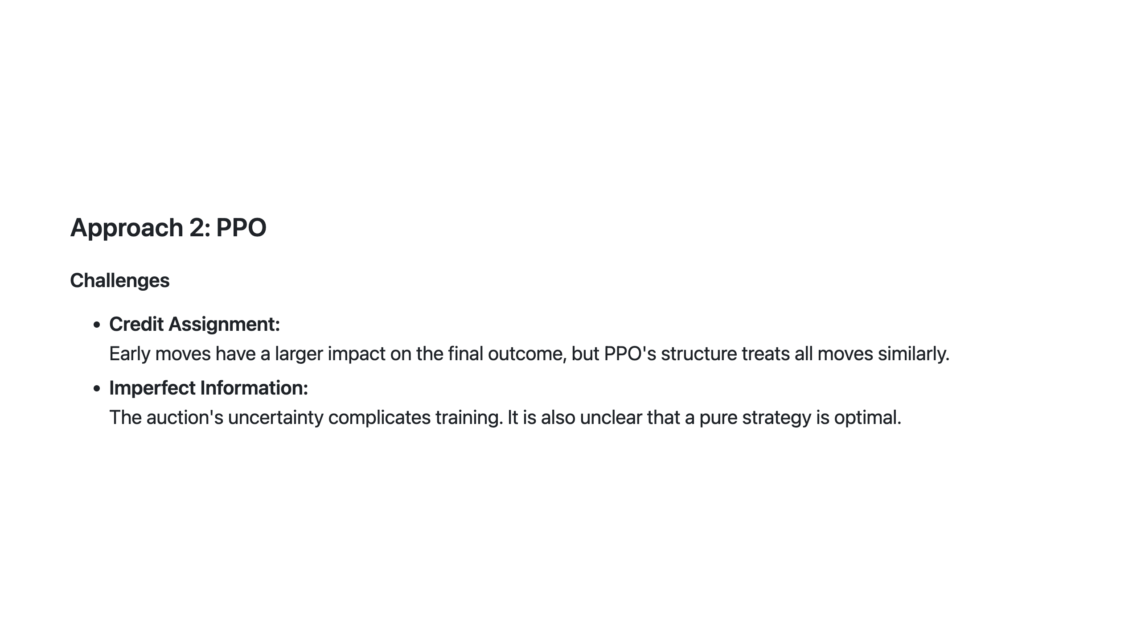
Notes:
Slide 8: Approach 2 - Challenges

Slide 9
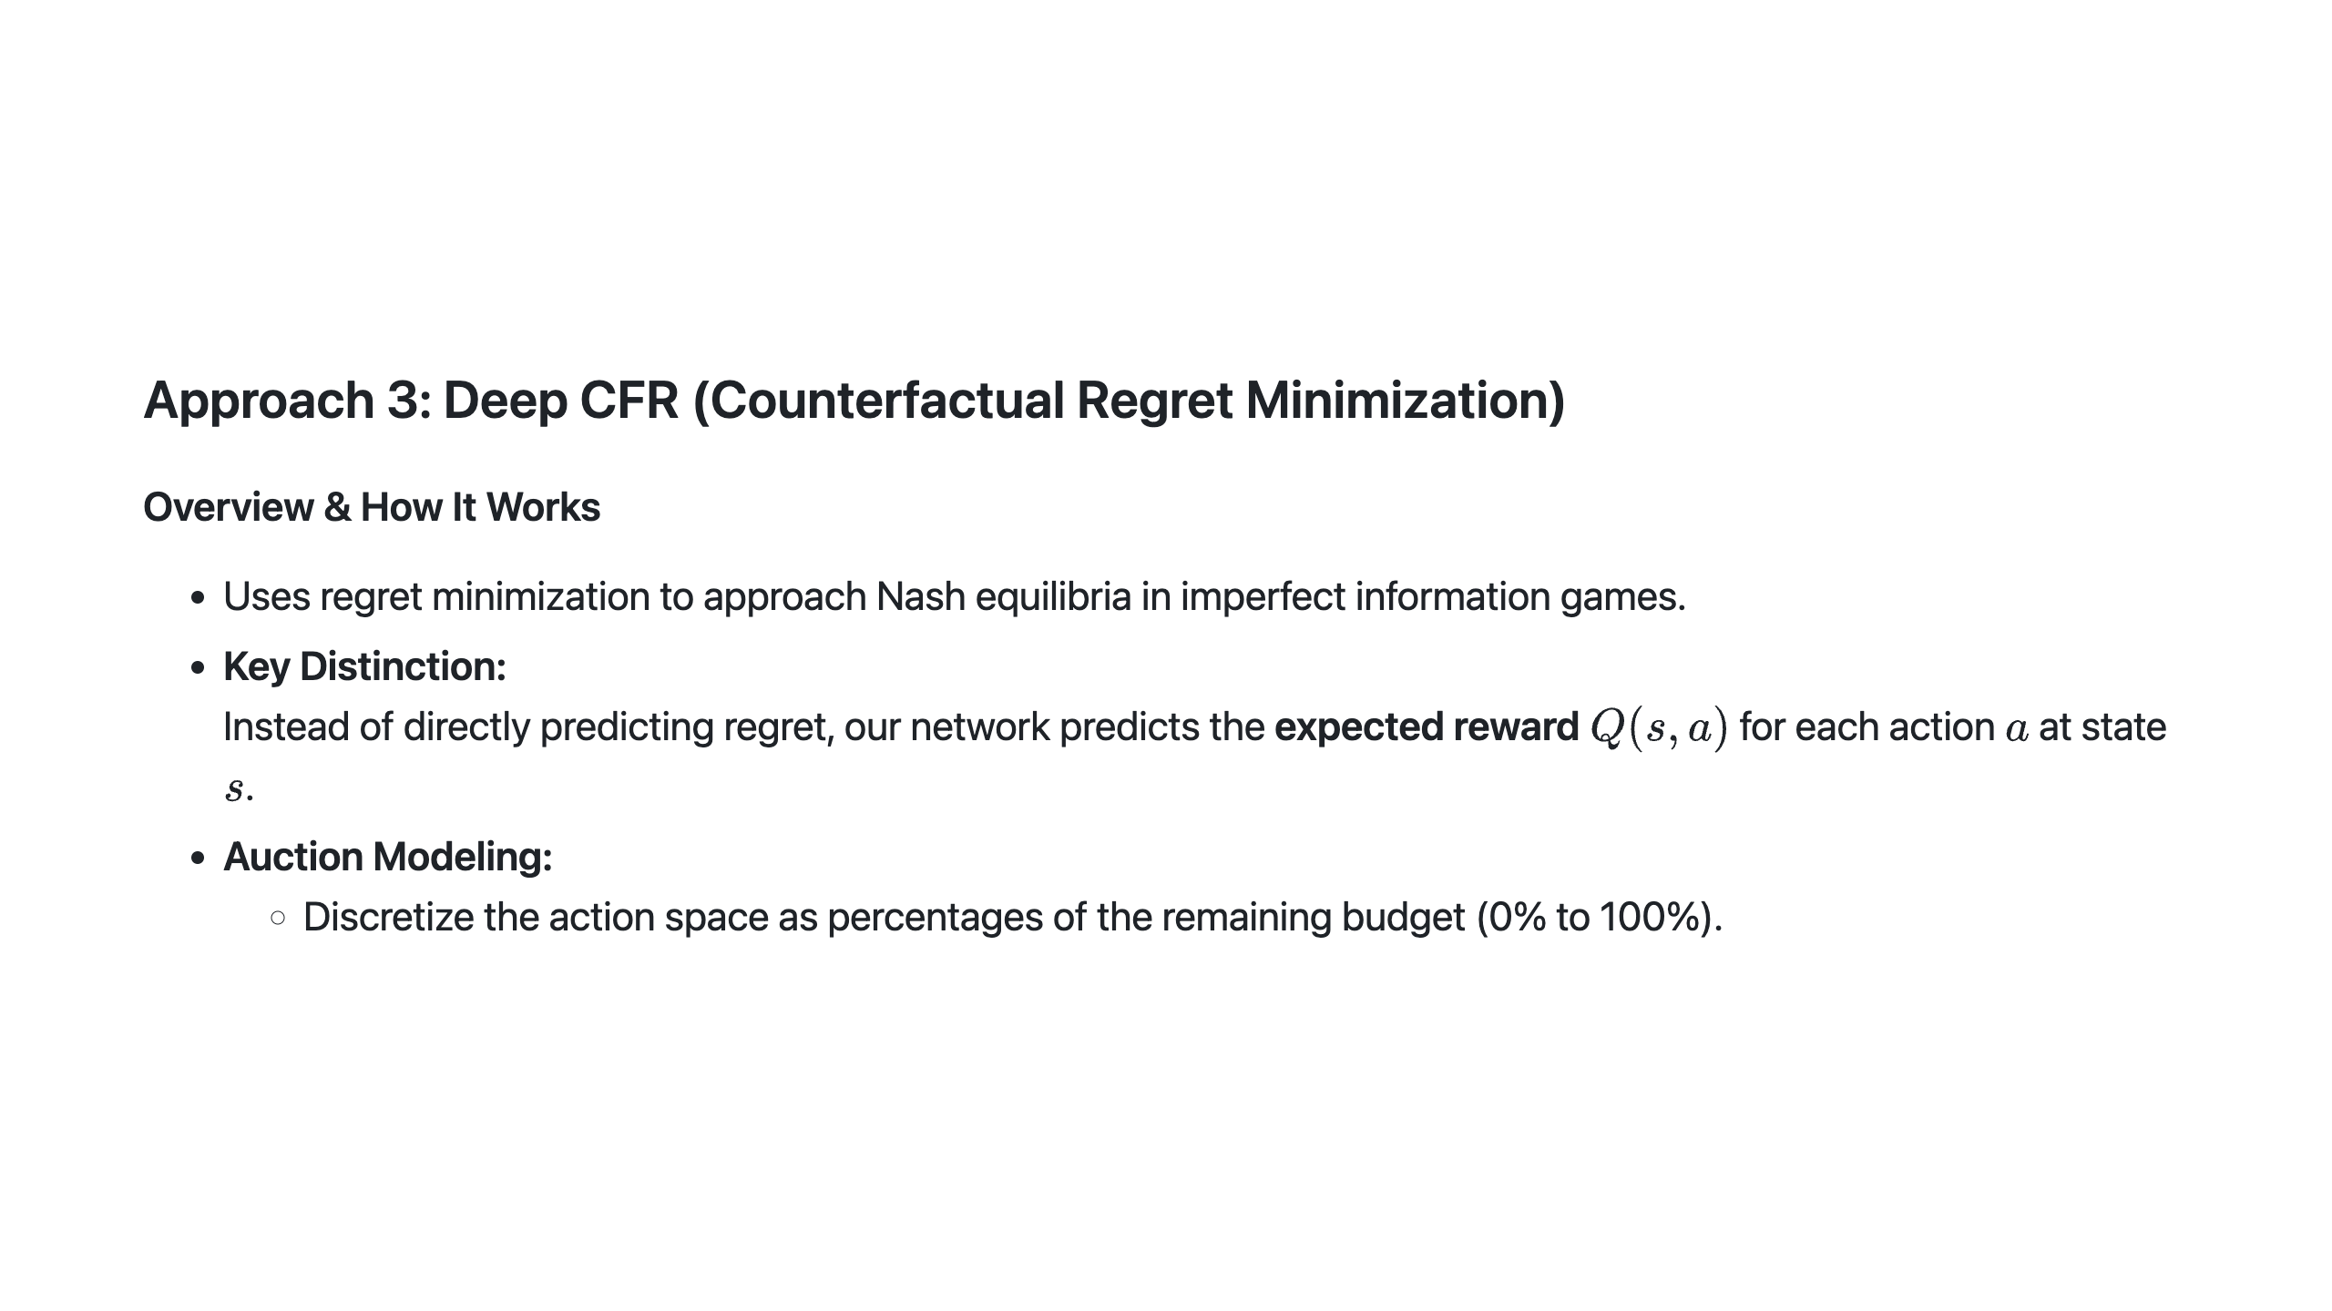
Notes:
Slide 9: Approach 3 - Deep CFR Overview

Slide 10
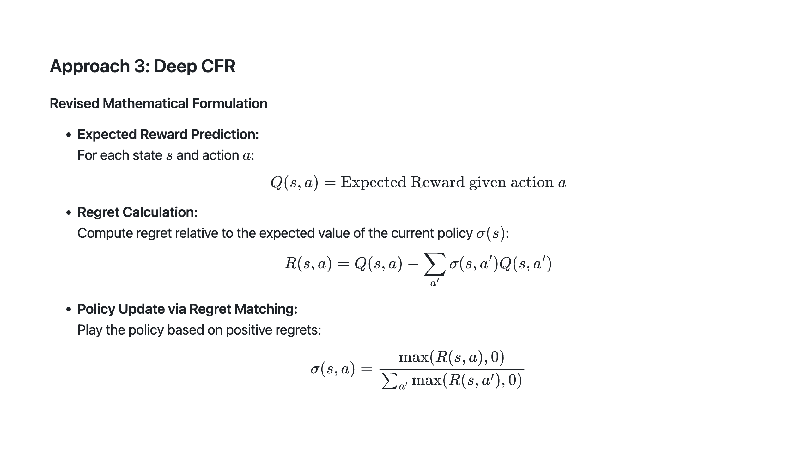
Notes:
Slide 10: Approach 3 - Revised Mathematical Formulation

Slide 11
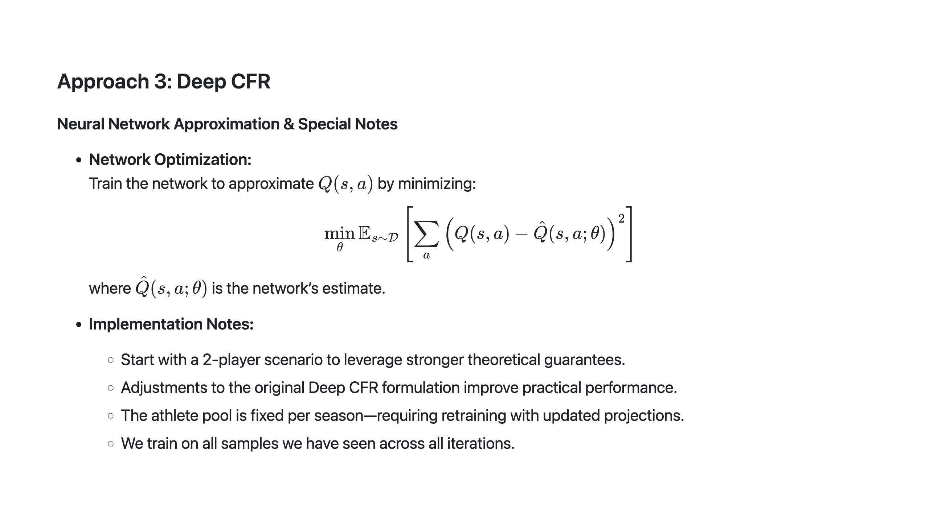
Notes:
Slide 11: Approach 3 - Neural Network Optimization & Special Notes

Slide 12
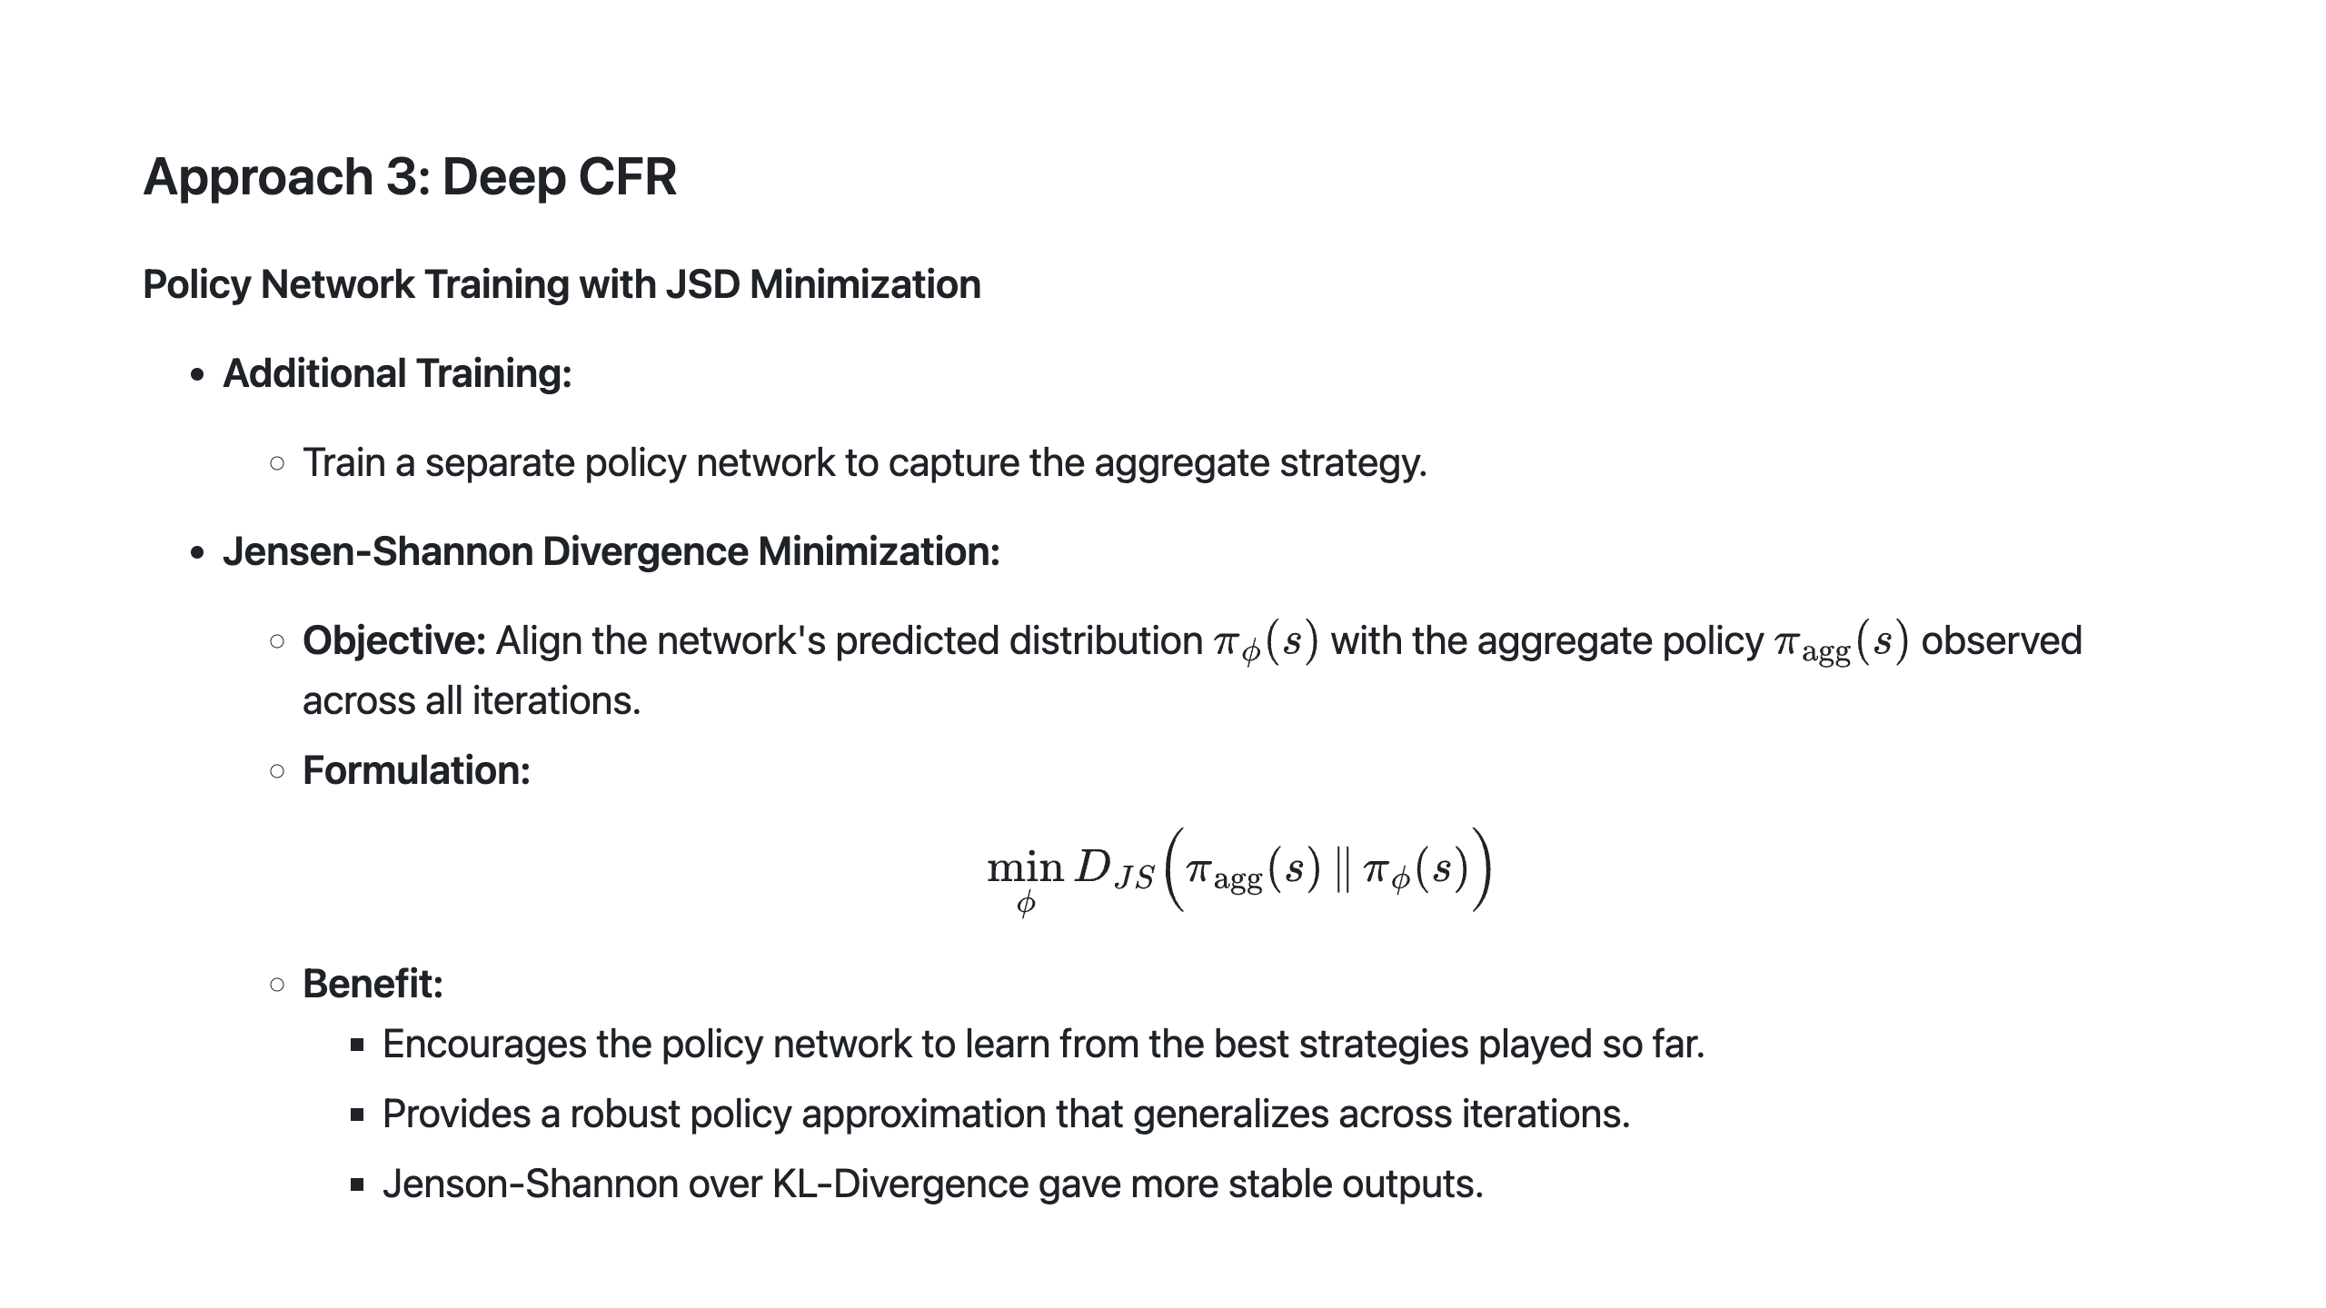
Notes:
Slide 12: Approach 3 - Policy Network Training

Slide 13
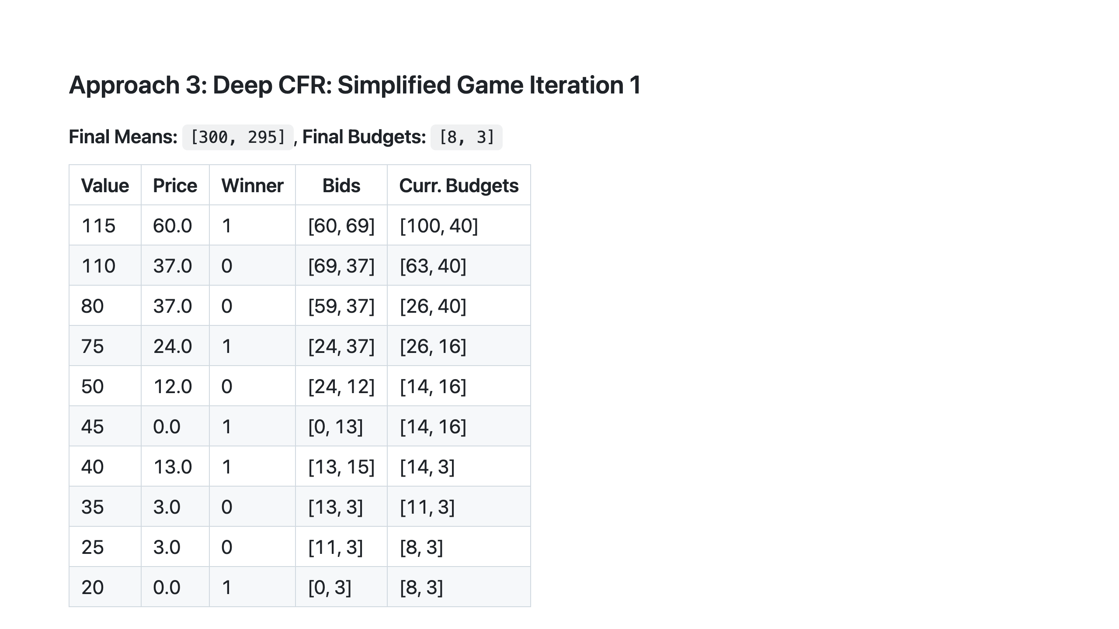

Slide 14
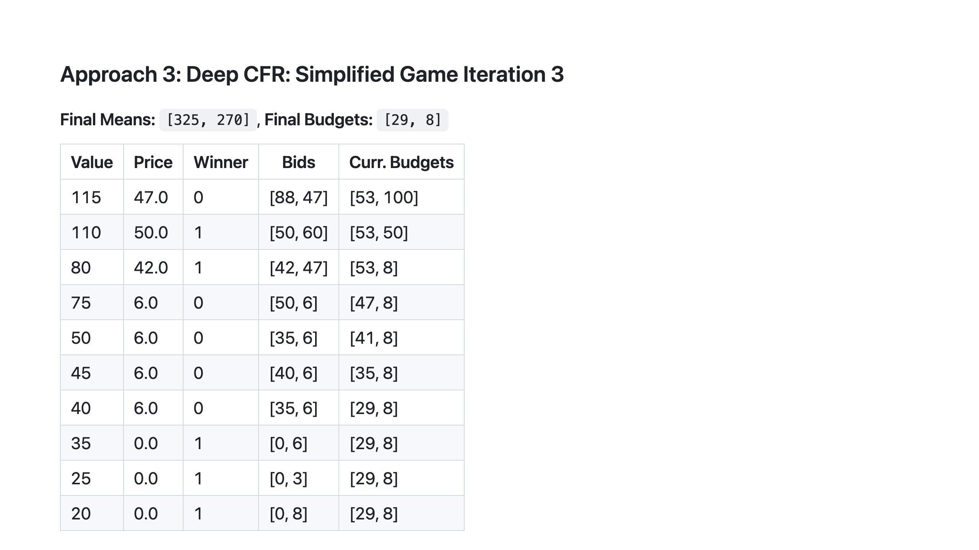

Slide 15
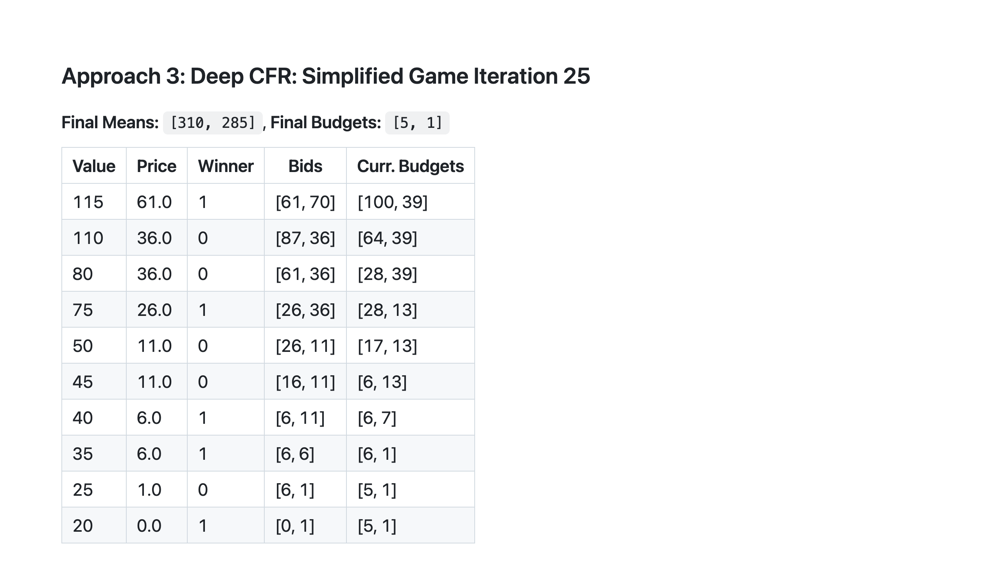

Slide 16
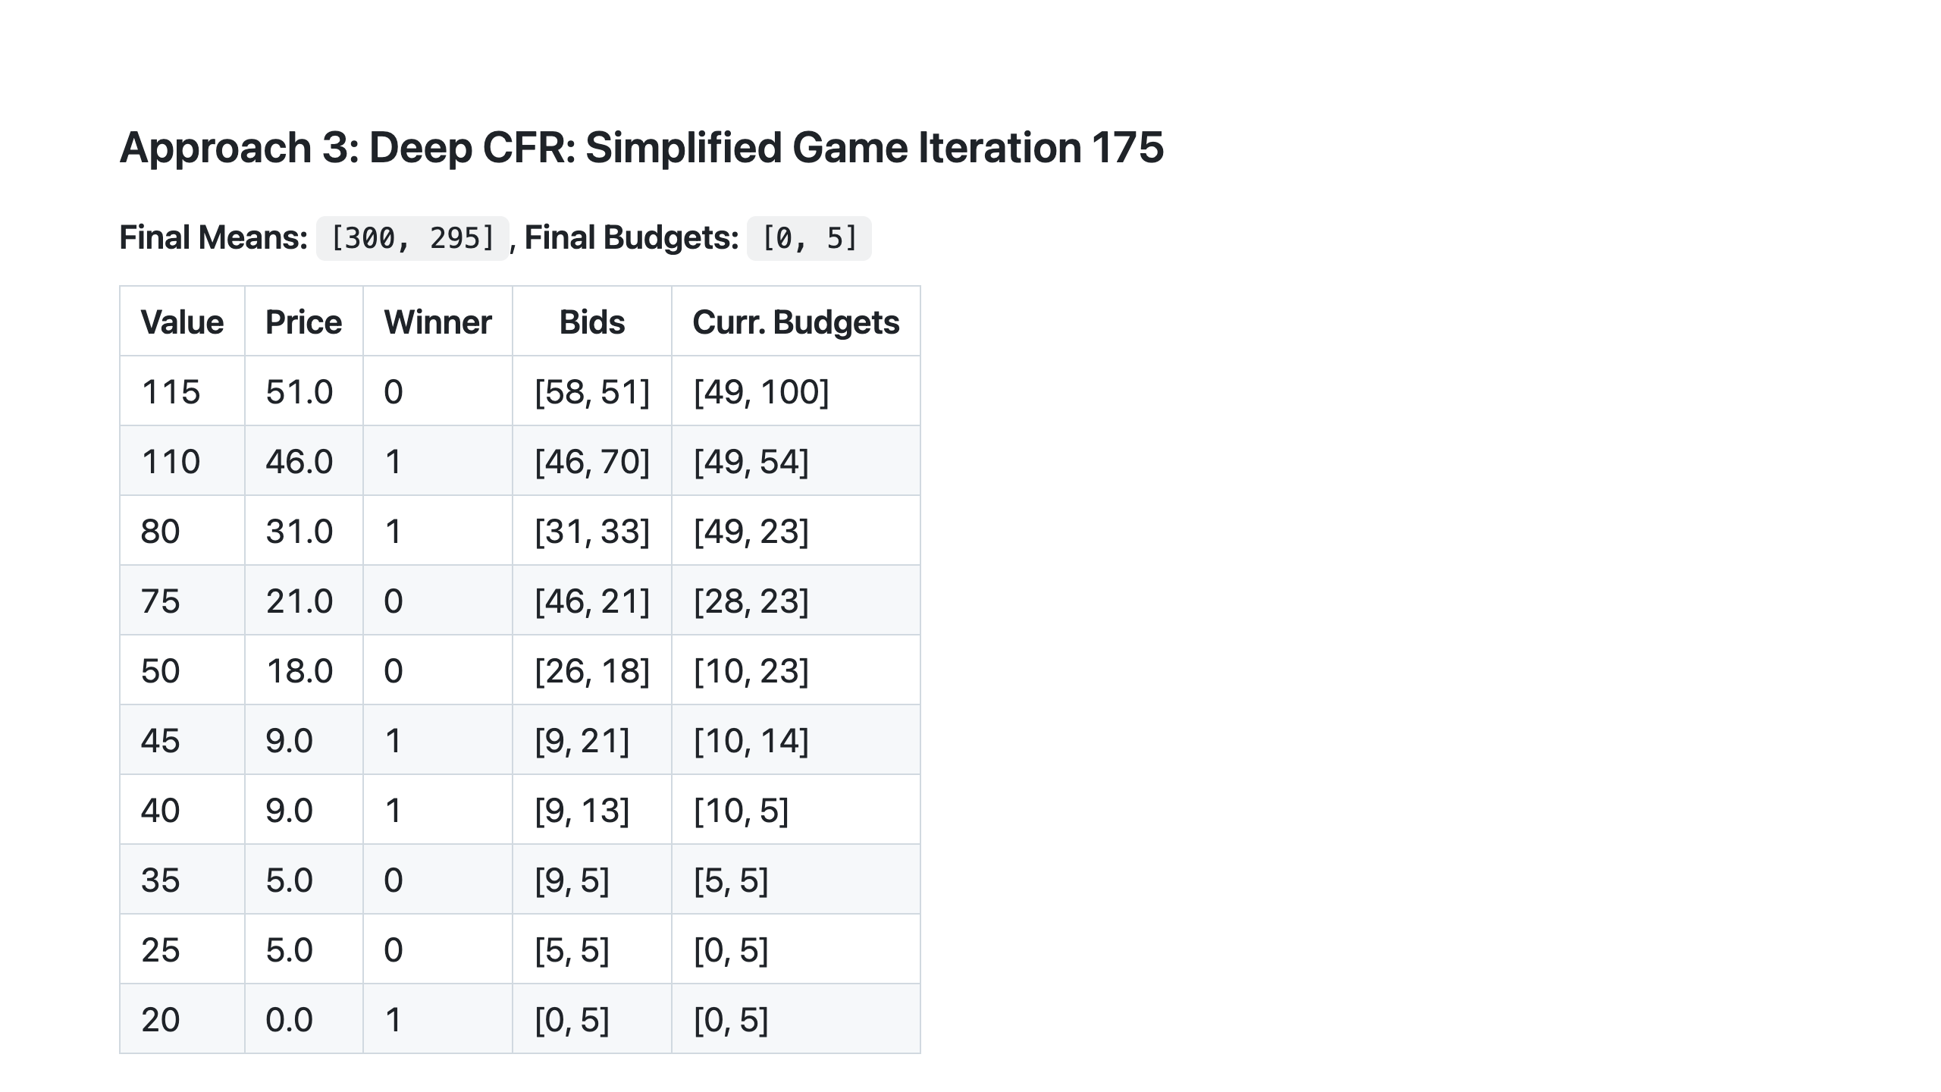
Notes:
Slide 13: Next Steps

Slide 17
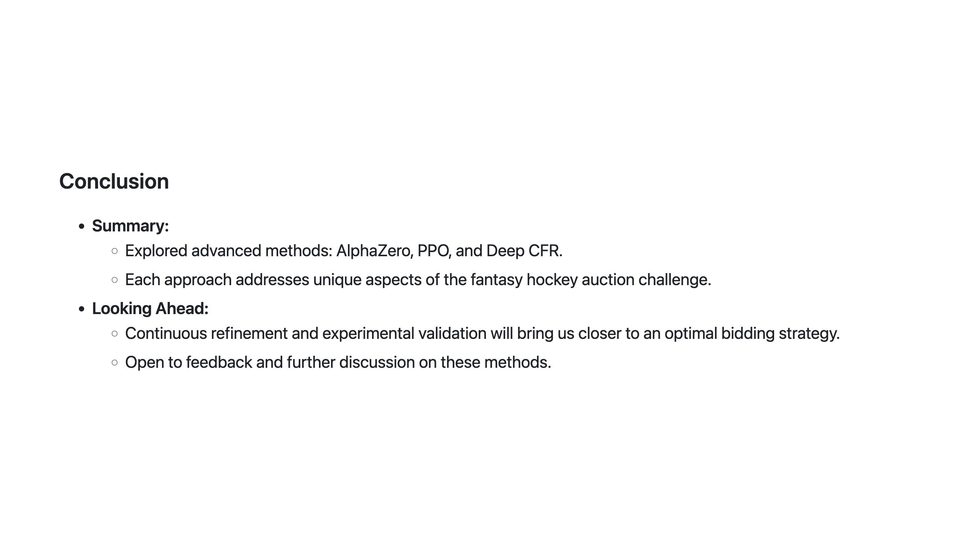
Notes:
Slide 14: Conclusion

